Slide 1


Hakodate Japan Presented by Fellow Cruiser Marc Silver

Slide 2
What I Will Cover
My Port Philosophy
Don’t Miss the Ship
Japanese Money
About Hakodate
Area Map of Hakodate
Map of Hakodate
Hakodate Transportation
Places to see or at least consider
A few restaurant recommendations
Conclusion

Slide 3
My Port Philosophy
I have been cruising for over 45 years and have taken over 100 cruises. So, I consider myself an experienced cruiser.
The information I will present is based on those many years of
experience.
When I am on a cruise where the city, I want to visit is not the port city,
I always recommend taking a ship’s tour.
But when I am in a port with multiple attractions nearby and easy to see
on my own - I will do it on my own.
This presentation is not like that.

Slide 4

Don’t Miss the Ship
How to Avoid Missing Your Ship
Pay attention to the time. - Ship time and local time are often different.
Put a return-to-ship reminder on your phone.
Choose excursions wisely.
If a ship-sponsored excursion is late returning to port, the ship will wait for you. If you are on your own???
Be Prepared
Have your Passport, Credit Card, and phone numbers for your ship port agent.
What to Do If You Miss the Ship Most cruise lines have port agents stationed in the port area to assist if your ship has left without you. If your are lucky, when cruisers are late returning to the vessel, the ship’s crew will often remove the passengers’ essential items – passports, cell phones, and medication -- from the ship to leave with the port agents.
The Port Officials can help you with contacting your ship and making necessary travel arrangements.

Slide 5
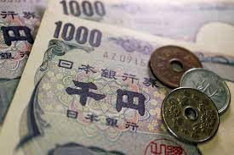
Money
The Yen is the official currency of Japan
Official Exchange is 100 Yen is 72 cents US
Or 142.15 Yen to the US Dollar

Slide 6
About Hakodate
Hakodate (函館) is Hokkaido's third largest city, located at the island's southern tip. Hakodate is best known for its spectacular views from Mount Hakodate and its delicious, fresh seafood.
Hakodate was among the first Japanese port cities that were opened to international trade after the country's era of isolation. As a result, the city has experienced notable influence from overseas, and the foreign population's former residential district and a Western-style fort are among its main tourist attractions.
Onuma Park, a quasi-national park with beautiful, island-dotted lakes, is located only half an hour north of Hakodate and makes a nice side trip or a stop along the journey between Hakodate and Sapporo.

Slide 7
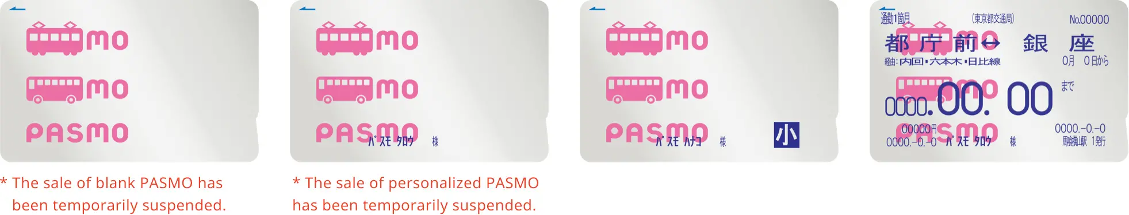


PASMO, Suica & ICOCA Cards
The PASMO, Suica, and ICOCA Cards are e-money IC cards that can be used for travel and shopping across Japan.
Cashless fare payment
Use it for shopping
No waiting for change
Get special privileges
Apple phone users can also link with all three cards.
PASMO refunds - If you no longer need your PASMO, it can be refunded. Suica and ICOA cards do not offer refunds.

Slide 8
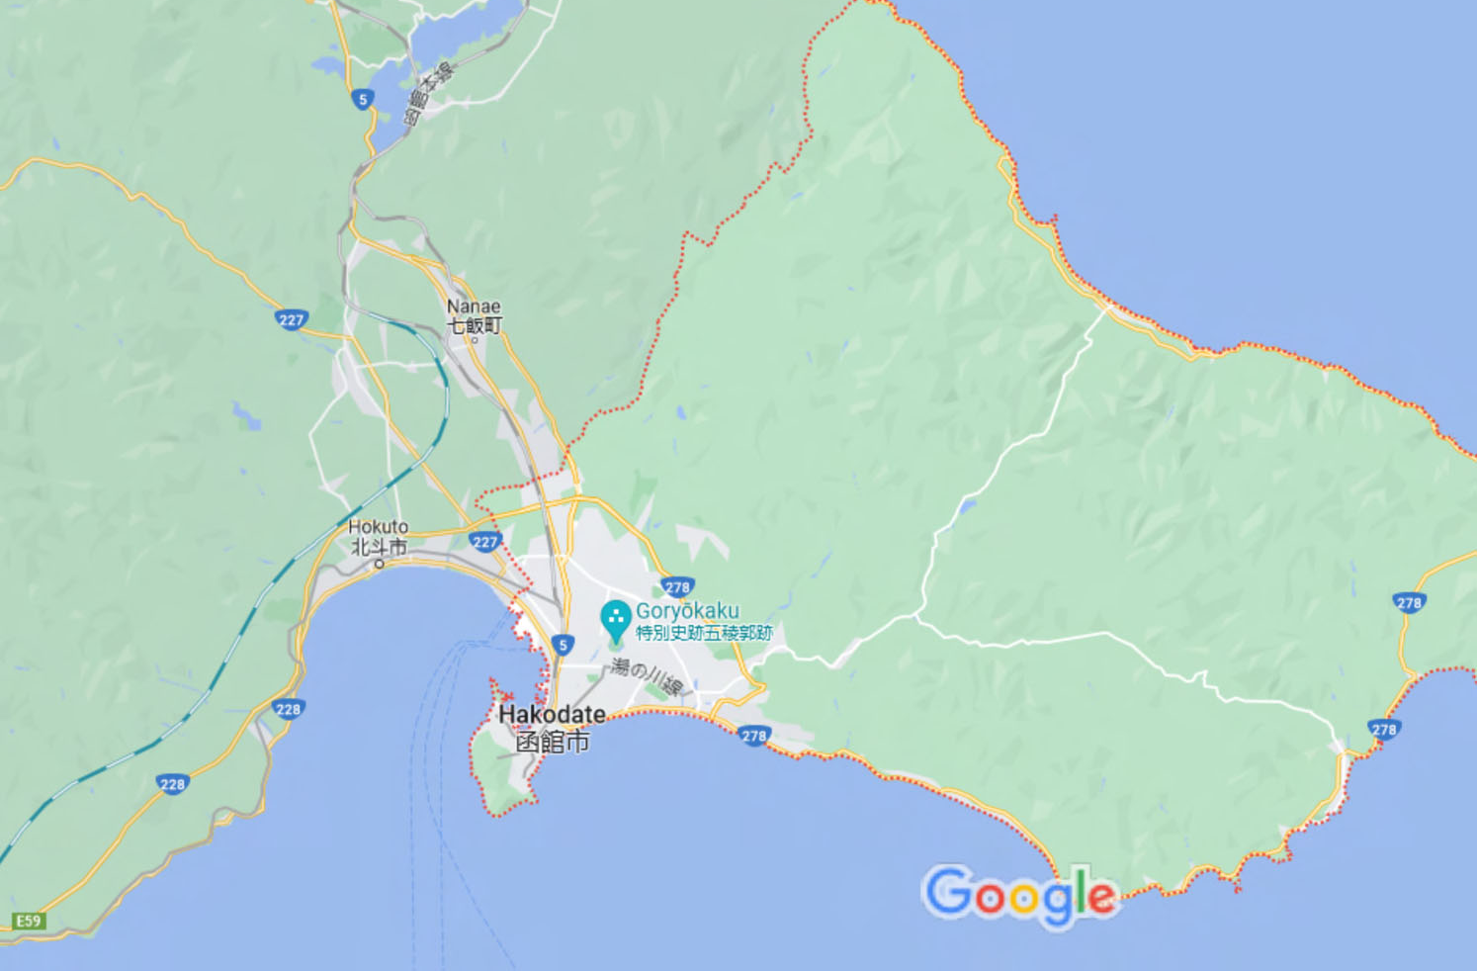
Area Map of Hakodate

Slide 9
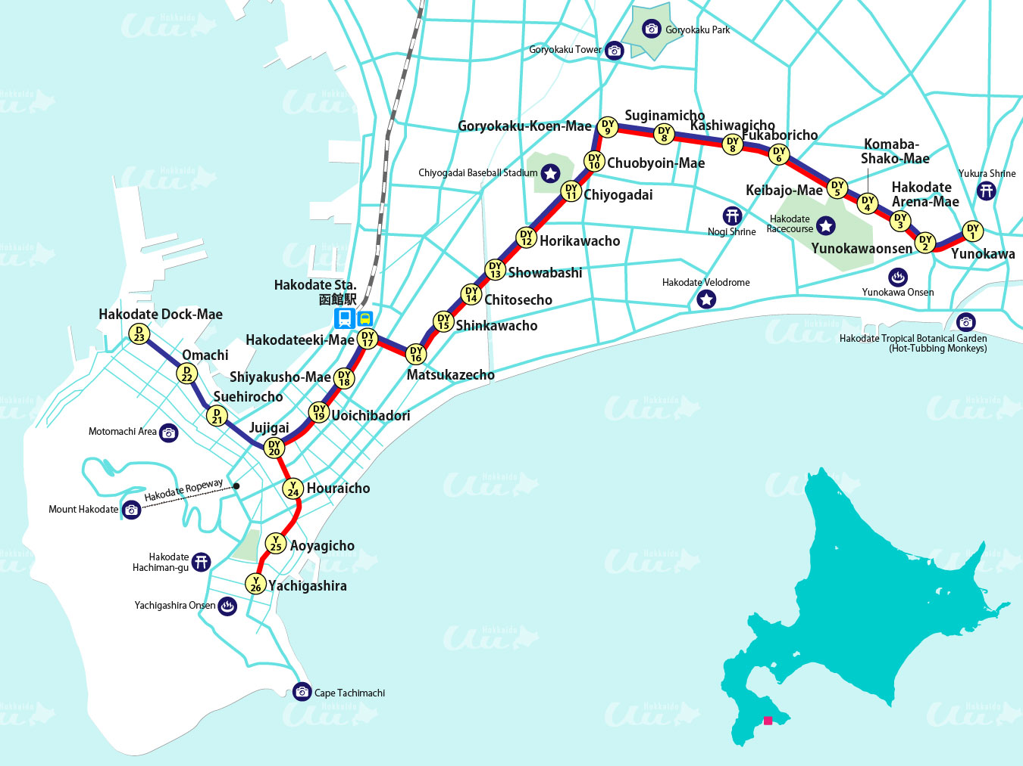
Map of Hakodate

Slide 10
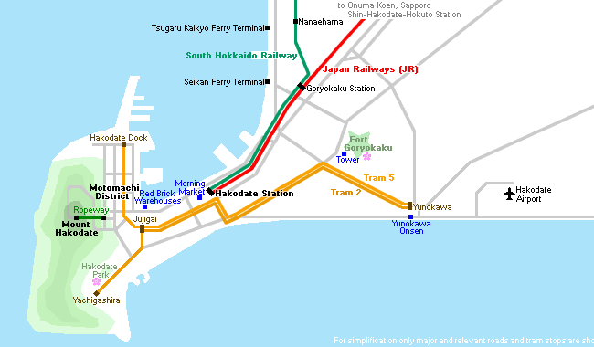
Hakodate Transportation
Central Hakodate with Hakodate Station, the old Motomachi district and
Mount Hakodate are located
on the distinctively shaped
peninsula. The city is served
by two tram lines and a bus
network. A ropeway leads to
the top of Mount Hakodate,
which is also accessible by
bus. The fare is between 210 and 260 yen, depending on the distance traveled.

Slide 11
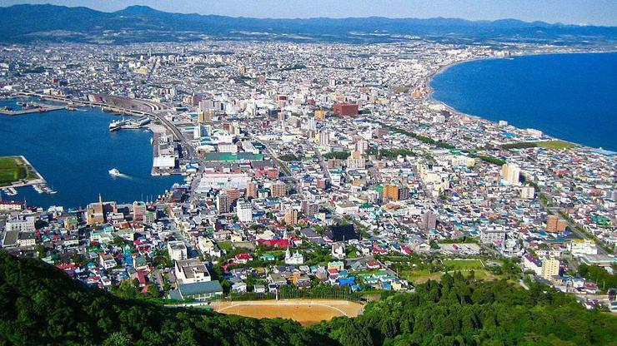
Mount Hakodate
Mount Hakodate (Hakodateyama) is a 334-meter-high, wooded mountain at the southern end of the peninsula on which much of central Hakodate is located. On clear days and nights, in particular, the views from the mountain are spectacular and included among Japan's three best night views alongside the views from Nagasaki's Mount Inasa and Kobe's Mount Rokko.
Facilities at the summit, which is accessible by ropeway, bus or car, include free observation platforms, souvenir shops, a café, and a restaurant.

Slide 12
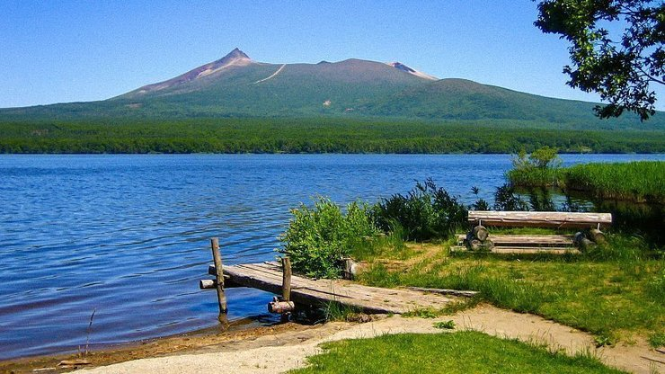
Onuma Quasi-National Park
Designated as a "quasi national park" and located only 20 kilometers north of Hakodate, Onuma Park is known for its picturesque, island dotted lakes and majestic volcano, Mount Komagatake.
Onuma Park can be easily visited in either a day trip from Hakodate or
on a stop over on a journey between Hakodate and Sapporo, since most limited express trains between the two cities stop at Onuma Koen Station, the park's centrally located railway station, along the way.

Slide 13
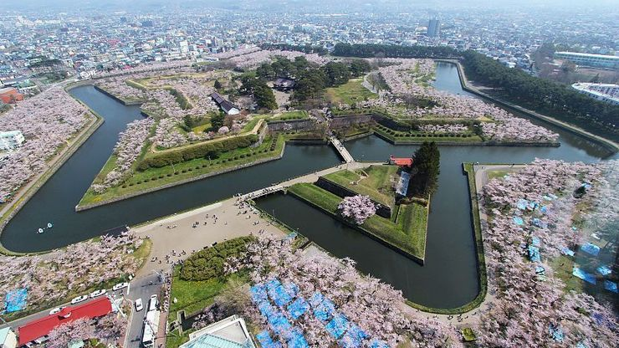
Fort Goryokaku
Fort Goryokaku (五稜郭, Goryōkaku) is a massive, star-shaped, Western-style citadel, which was built in the last years of the Edo Period (1603-1868) for the defense of Hakodate against the imperialist threat posed by the Western powers. A few years later, the fort became the site of a civil war between an army of the shogunate and the superior troops of the newly established Meiji government.
After the fort had lost its military importance, it was eventually turned into a public park in the 1910s. Over one thousand cherry trees were planted along its moats, making it one of Hokkaido's best cherry blossom spots. The peak of the blooming season usually takes place around early May.
From Hakodate Station, take the tram to "Goryokaku Koen-mae" (五稜郭公園前, 15 minutes, 230-yen one way), from where the fortress is another ten minutes on foot.
Admission 900 yen

Slide 14
Motomachi
The harbor of Hakodate was one of the first to be opened to foreign trade in 1854 when Japan's era of isolation was coming to an end. As a result, many traders from Russia, China, and Western countries moved to Hakodate. Motomachi, at the foot of Mount Hakodate, became a district favored among the new foreign residents.
Many foreign-looking buildings remain in the area today. Among the most famous is the Russian Orthodox Church, the Old British Consulate, the Chinese Memorial Hall, the prefectural government’s former branch office building, and the old Hakodate Public Hall.
The Motomachi district is situated at the foot of Mount Hakodate and is easily accessed from Hakodate Station in a 5-minute tram ride or 20-30 minute walk.

Slide 15
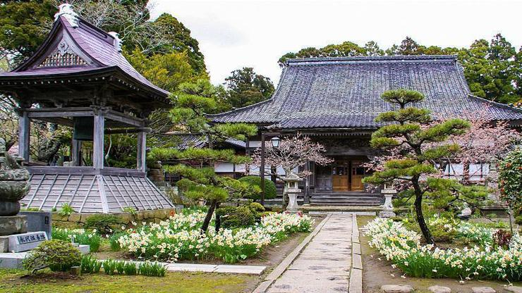
Matsumae
Matsumae (松前) is a former castle
town just west of Cape Shirakami,
the southernmost point of Hokkaido
Only 20 kilometers across the
Tsugaru Strait from Aomori,
Matsumae was the northern limit of
Japan during the Edo Period and
the sole feudal fief on the otherwise
wild, untamed frontier of Hokkaido. The prosperous town attracted merchants engaged in the shipping trade and was protected by a garrison at Matsumae Castle, the only Japanese-style castle to have been built on Hokkaido.

Slide 16
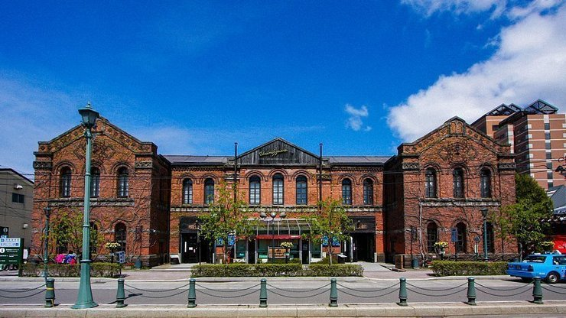
Red Brick Warehouses
Hakodate Port was among the first Japanese ports to be opened to international trade towards the end of the feudal era. Several red brick warehouses from past trading days survive along the waterfront in the bay area of Hakodate and have been redeveloped into an atmospheric shopping, dining, and entertainment complex.
Besides a typical range of trendy souvenirs, fashion, interior and sweets shops, the complex also features a restaurant, a beer hall, a chapel for weddings, and sightseeing cruises of the bay.
The red brick warehouses are a 15-20 minute walk from Hakodate Station or a five minute walk from the Jujigai tram stop (5 minutes, 210 yen from Hakodate Station).

Slide 17
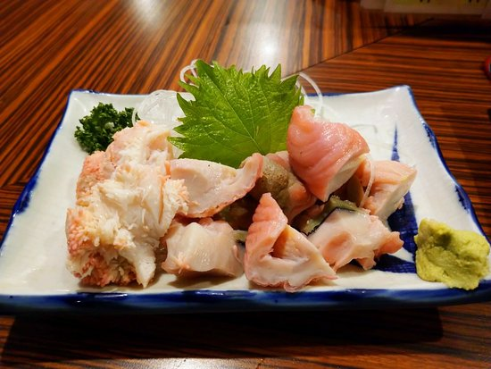
Hokkaido Restaurants
There are a lot of excellent restaurants in Hokkaido. Especially for seafood.
Here are some recommendations: Restaurants in Hakodate:
Sakuradori Umeno Zush $$$$ Japanese Sushi.
1-19 Kashiwagicho, Hakodate 042-0942 Hokkaido
Hasegawa Store Bay Area $ Japanese, Fast Food
23-5 Suehirocho, Hakodate 040-0053 Hokkaido
Gyosanko $$ - $$$ Japanese Seafood
19-3 Wakamatsucho, Hakodate 040-0063 Hokkaido
Shigechan Sushi $ Sushi
14-10 Nakajimacho, Hakodate 040-0014 Hokkaido
Asaichi Dining Store No. 2 $ Japanese Seafood
9-19 Wakamatsu-cho Hakodate Asaichiekini Ichiba 2F, Hakodate 040-0063 Hokkaido

Slide 18
Conclusion
Hakodate is a beautiful City with a rich history and numerous attractions. Regardless of what you're looking for, Hakodate has something for everyone.
I hope this presentation will help when we visit Hakodate!

Slide 19
Thanks For Coming
If you have any more questions, please ask.
I will do my best to answer them for you.
Have a great visit in Hakodate !

