Slide 1
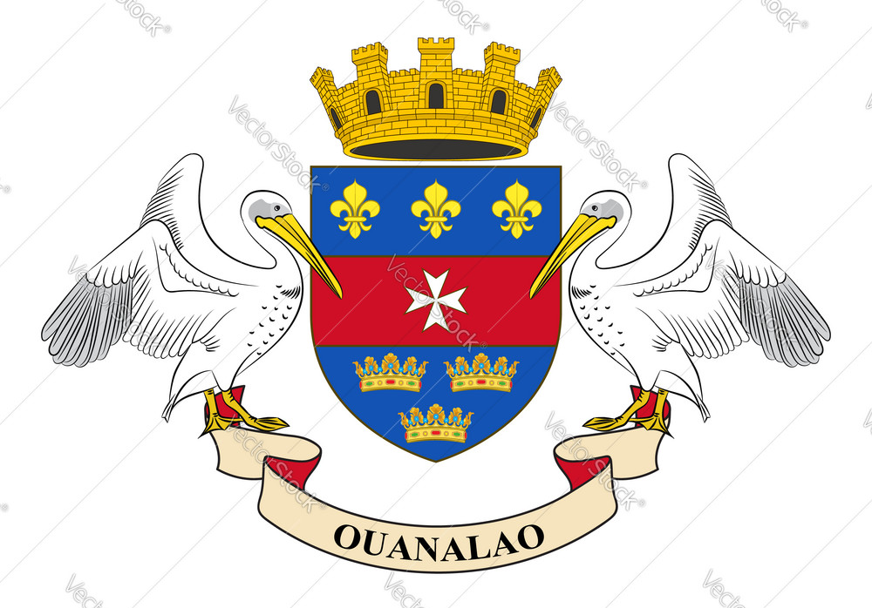
Gustavia, St. Barts Presented by Marc Silver

Slide 2
What I Will Cover
My Port Philosophy
Don’t Miss the Ship
Money
About Gustavia, St. Barts
Area Map of Gustavia, St. Barts
Map of Gustavia, St. Barts Transportation
Places to see or at least consider
A few restaurant recommendations
Conclusion

Slide 3
My Port Philosophy
I have been cruising for over 45 years and have taken over 100 cruises. So, I consider myself an experienced cruiser.
The information I will present is based on those many years of
experience.
When I am on a cruise where the city, I want to visit is not the port city,
I always recommend taking a ship’s tour.
But when I am in a port with multiple attractions nearby and easy to see
on my own - I will do it on my own.
This presentation is for that type of port.

Slide 4

Don’t Miss the Ship
How to Avoid Missing Your Ship
Pay attention to the time. - Ship time and local time are often different.
Put a return-to-ship reminder on your phone.
Choose excursions wisely.
If a ship-sponsored excursion is late returning to port, the ship will wait for you. If you are on your own???
Be Prepared
Have your Passport, Credit Card, and phone numbers for your ship port agent.
What to Do If You Miss the Ship Most cruise lines have port agents stationed in the port area to assist if your ship has left without you. If your are lucky, when cruisers are late returning to the vessel, the ship’s crew will often remove the passengers’ essential items – passports, cell phones, and medication -- from the ship to leave with the port agents.
The Port Officials can help you with contacting your ship and making necessary travel arrangements.

Slide 5
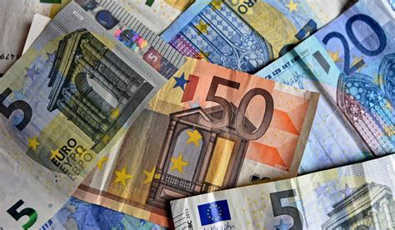
Money
The Euro is the local currency of St. Barth.
Many restaurants will also show what the amount would be in U.S. dollars. Almost every restaurant takes credit cards. If you pay by credit card, you will get the true rate of exchange. VISA is the most widely accepted. AMEX is the least.
Currently 1.00 Euro =
$1.07 US Dollars

Slide 6
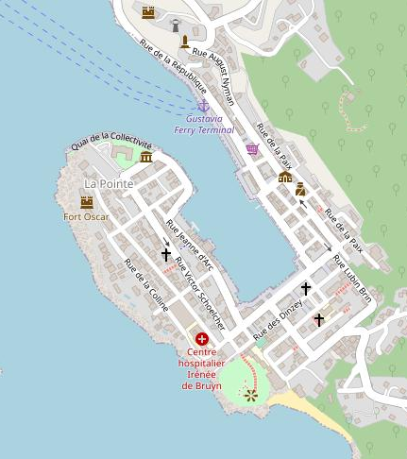
About Gustavia, St. Barts
Gustavia is the capital and main town of St. Barts (Saint-Barthélemy)! The island is renowned for its opulence and exclusivity, making it a must-visit destination for those seeking a luxurious getaway.
Gustavia, has charming streets, lined with upscale boutiques, gourmet restaurants, and chic cafes.
The town’s picturesque harbor is a hub of activity, with luxurious yachts dotting the crystal-clear waters.
Get ready to immerse yourself in the heart of this thriving town! Gustavia is a charming and vibrant destination that offers a plethora of things to see and places to explore.

Slide 7
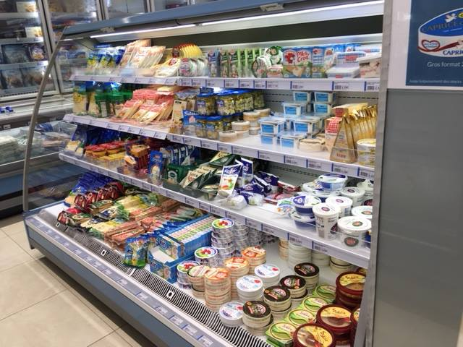
About St. Barts
As beautiful an island as St. Barts is, everything there is extremely French and very-very expensive.
Some examples in US dollars are:
A whole chicken is about $42.00
A Dozen eggs is $13.50
A pint of beer is $8 and up
A pack of cigarettes is $27
2 lbs. of apples $8.00
A bottle of Wine is $53 and up
A can of beans $8.64
A litter of milk $9.18
A car rental starts at about $350 for the day.

Slide 8
History of St. Barts
St. Barth was originally inhabited by Arawak Indians, followed by the Caribs. Christopher Columbus arrived in 1493. He named the island for his brother Bartoloméo.
The French made initial unsuccessful attempts to settle it until some determined Huguenots from Normandy persevered and prospered. Later, French buccaneers made it a way station as they plundered Spanish galleons, which adds to St. Barth's lore.
In 1784, France traded the island to Sweden, and the capital was named Gustavia, in honor of its king, Gustavia III. He declared it a free port which has continued to today.
In 1878, it was sold back to France.
Tourism took hold when Rémy de Haenen, an eccentric Dutch aviator, landed his plane at what is now the airport. He later became the first hotelier and the island's mayor. Rémy hosted the era's luminaries. He was a friend of Howard Hughes which was the start of the island becoming a destination for the rich and famous like the Rockefellers and Rothschilds. Thus, the mystique was created. The '70s brought spectacular yachts like Onassis's Christina into the Lilliputian Harbor in Gustavia.

Slide 9
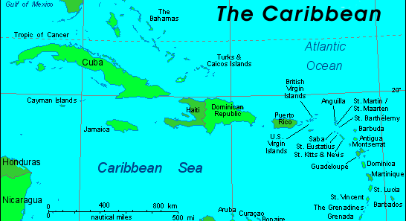
St. Barts Area Map

Slide 10
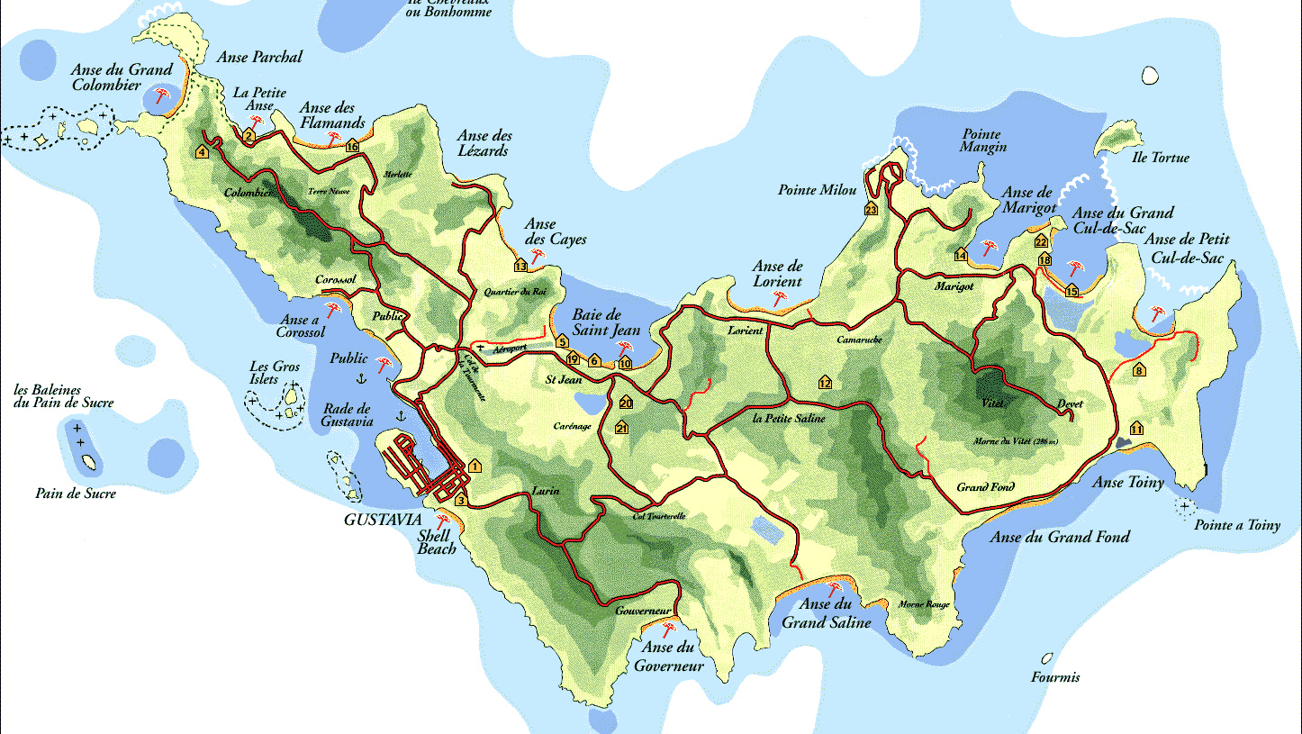
Map of St. Barts
St. Barts

Slide 11
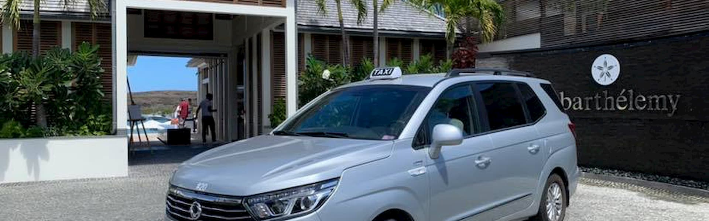
Taxis in St. Barts
There are many taxis on the island of St. Barth.
All the Taxis are modern and air-conditioned vehicles. 10-passenger Vans for larger groups are available.
Even though it only takes 20 minutes to cover the island, Taxis are good for short jaunts around town, but longer journeys and island tours will put a considerable dent in your wallet.
It's best to agree on a fare before you enter the cab.
Some taxis offer private island tours, so that’s also a way of getting around St. Barts!
Please note that the taxi fee covers a ride for a maximum of five passengers, so if you have a larger group, you’ll need to arrange it accordingly.

Slide 12
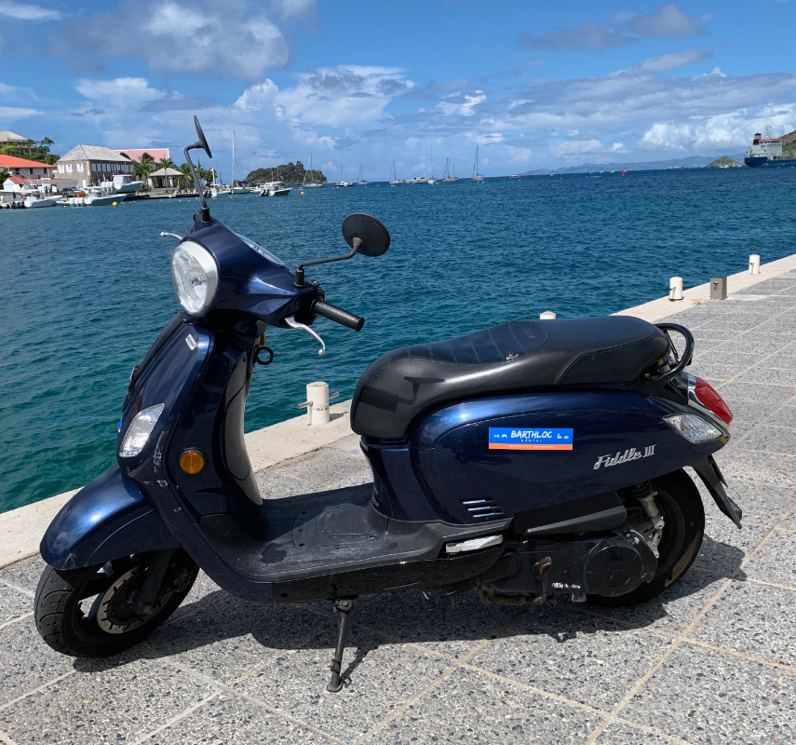
Scooter, Motorcycle Rental
Gustavia, St. Barts has few options when it comes to scooter and motorcycle rentals.
But for the more adventurous it is a good option to consider.
You can rent a 125cc scooter runs about 40.00€/day.

Slide 13
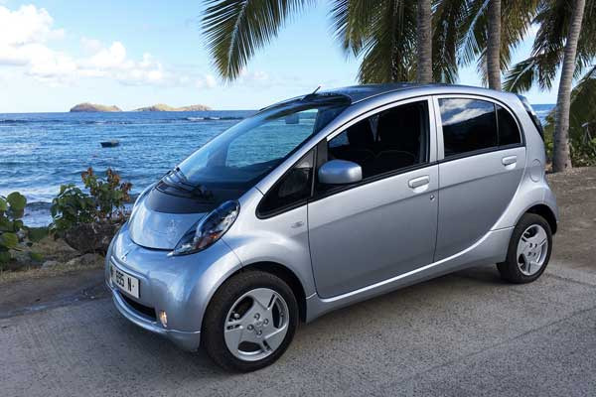
Car Rental
When we dock in St. Barts it’s a short walk to one of the local car rental locations.
Convenance will cost you, however.
If you rent a Mieve Electrique ultra city car, 100% electric, is a true 4-seater. It includes all the equipment of a classic car with a range of 160 km. It recharges very quickly from a conventional electrical outlet.
Car Rental starts from about 70.00€/day

Slide 14
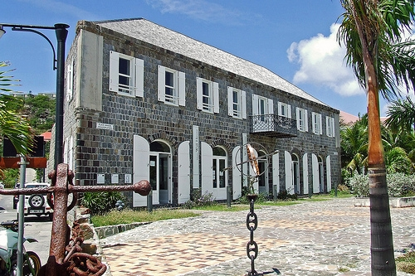
Wall House Museum
The history and culture of St. Barts are presented in documents, photographs, and an exhibition on the plant and animal life on the island.
An imposing stone building from the Swedish period at the tip of the peninsula houses a modest collection of oil lamps, period furniture, farming tools, fishing boats, and other relics of yesteryear that sadly reveal little of importance about St-Barth's history.
Upstairs is the historical library, and, in the courtyard, you'll find the remains of a brick-made bread oven.
Entrance to the museum is free

Slide 15
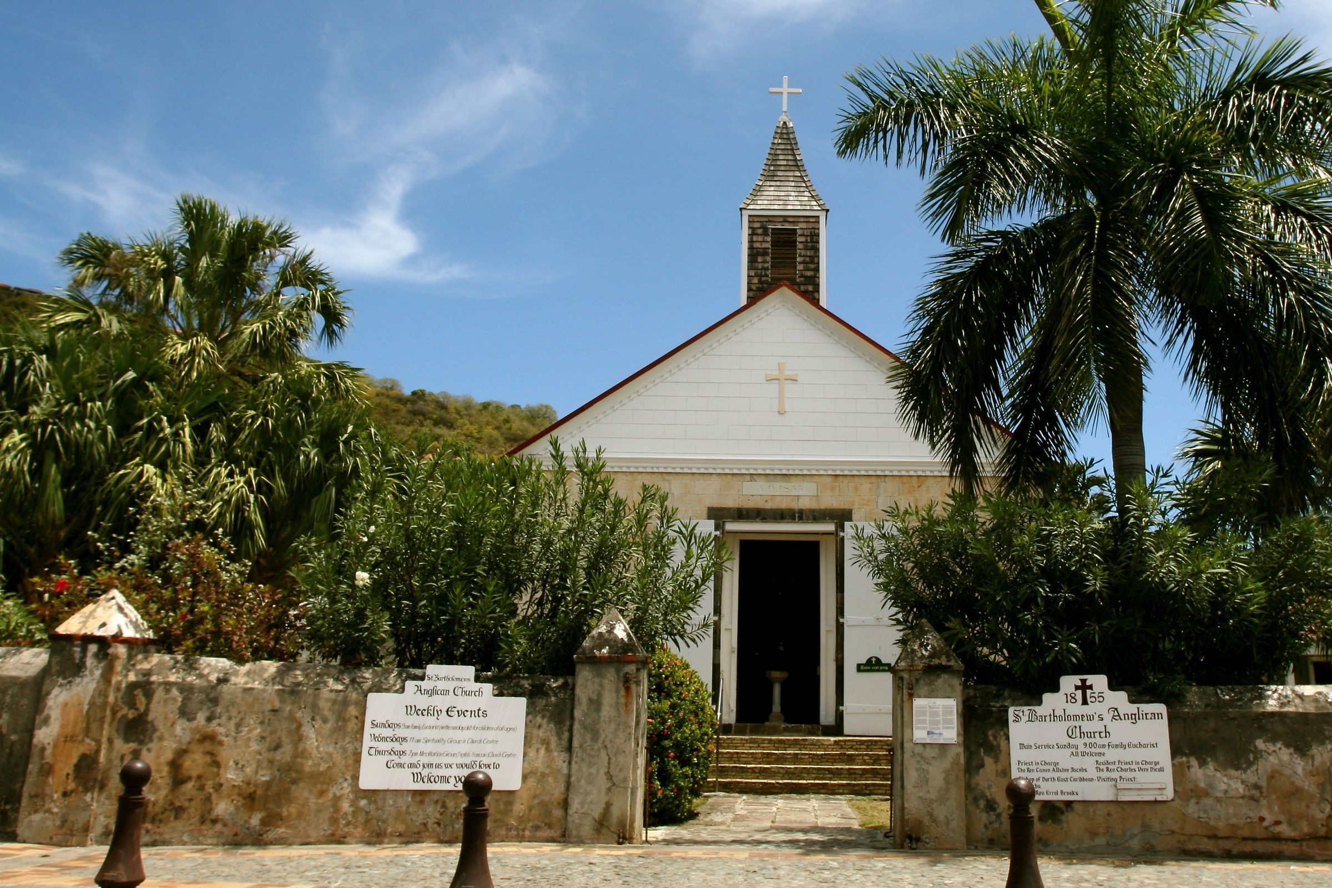
St. Bartholomew's Anglican Church
While you’re visiting Gustavia, make a stop at this Anglican Church. A peaceful sight, it is named St. Bartholomew’s, and it’s perched quaintly on the harbor.
Saint Barthélemy was first claimed by France in 1648. The island was given to Sweden in exchange for trade rights in Gothenburg in 1784 and Sweden founded the Swedish West India Company. Prospering during the Napoleonic Wars, assets were low thereafter, and the island was sold back to France in 1878.
The eventual site of Gustavia was first called Le Carénage (The Careening) after the shelter it provided to damaged ships. According to the archives, the name Gustavia appeared between December 28, 1786, and February 9, 1787.
Gustavia remains as a reflection of the Swedish period, during which a minority of the population of approximately 4% were of Swedish origin.

Slide 16
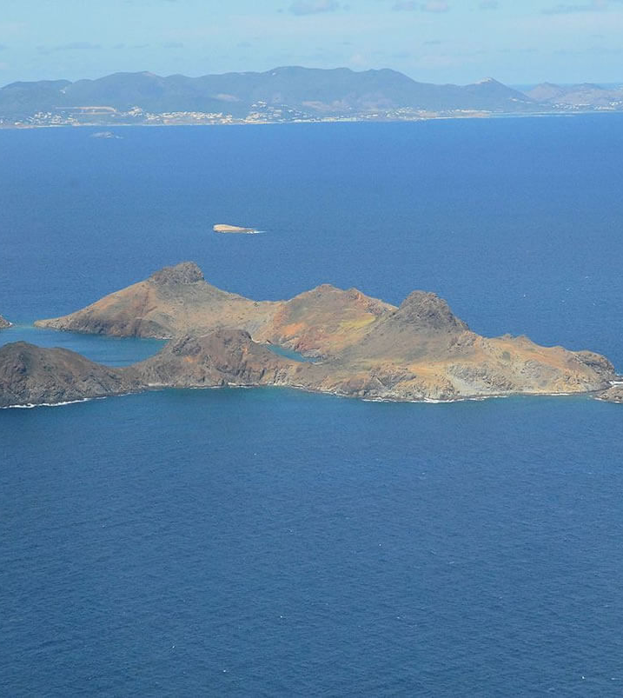
Nature Reserve of Saint-Barthélemy
Nature Reserve of Saint-Barthélemy is a marine reserve divided into five separate zones around the island to preserve the fragile marine ecosystems.
Many of the island's best dive sites lie within the reserve's boundaries, marked by white buoys. Divers and snorkelers may see turtles, spotted eagle rays, and reef sharks, as well as many colorful varieties of coral.
Kayali is a superb 30-meter-deep wreck dive, where lobster, conch, and vast schools of tropical fish can be spotted. In the reserve’s high-protection areas, diving and all forms of fishing are prohibited.

Slide 17
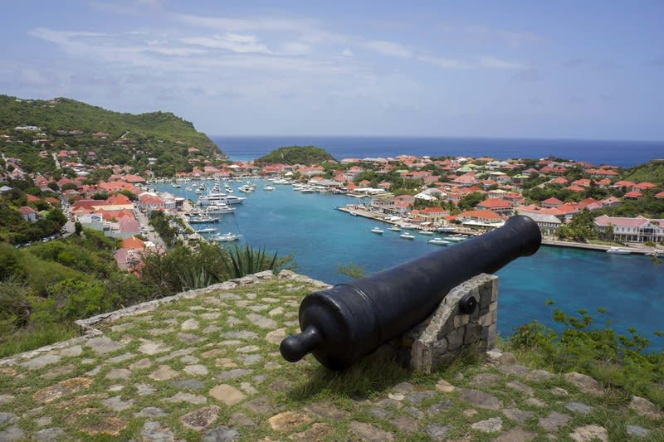
Fort Gustave
Recognizable by the red and white lighthouse that was built on the site in 1961, Fort Gustave is one of the best vantage points for viewing the harbor. This is one of the top places to visit if you're on a sightseeing tour of Gustavia.
The remains of this 18th-century fort includes the ruins of the stone ramparts, a sentry box, part of the old brick-floored bakery, cannons, and a powder house.

Slide 18
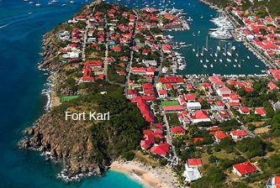
Fort Karl
Along with Fort Gustave, Fort Karl is one of three forts that stood watch over Gustavia back when it was under Swedish rule (the late 18th century). The other two forts were Fort Gustave (mentioned above) and Fort Octav.
The sparse ruins of Fort Karl stand high above the harbor, near Shell Beach, and this historic spot remains one of the most visited points of interest due to its panoramic views. Here, you'll find cannons that were added later, and an observation platform primed for photo-taking.
To get to the fort, expect a bit of a hike upwards. Stone steps lead from the town below. It will only take about five minutes to reach the top.

Slide 19
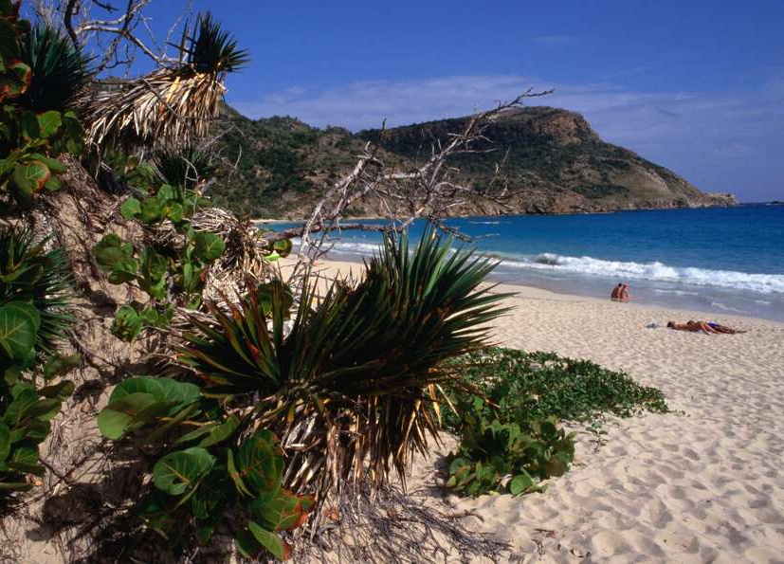
The Beaches of St. Barts
There are 22 beaches in St. Barts. St. Barts’ beaches are considered some of the best in the Caribbean.
Not only do they offer up warm turquoise water and long coves of white sand. The scenery is also a visual treat, most of the beaches are surrounded by dramatic landscapes of lush jungles and hills.
St. Jean Bay is the most popular beach, lined with beach clubs, restaurants, and the iconic Eden Rock Hotel.
Being a French island, it has “au natural” beaches.
Try Anse de Grande Saline.
It’s perfectly okay to go topless at any other beach on the island.

Slide 20
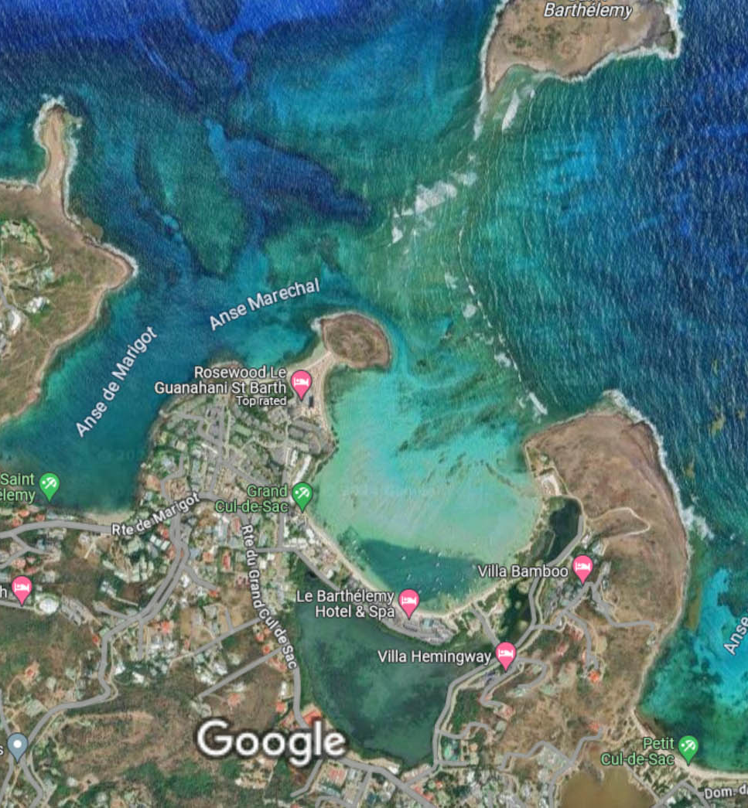
Grand Cul-de-Sac St Barts
Nestled along the northeastern coast of the island lies Grand Cul-de-Sac St Barts. This area is renowned for its serene lagoon, thrilling water sports, and awe-inspiring natural beauty.
This charming coastal village, nestled on the stunning island of St. Barts, offers a plethora of exciting experiences that will leave you enchanted.
The magnificent lagoon at Grand Cul-de-Sac St Barts is a stunning body of water and boasts a unique combination of size and shallowness, making it a true natural wonder.
The waters are calm, inviting you to dive in and explore the wonders that lie beneath the surface. The coral reef not only adds to the breathtaking beauty of the scene but also serves as a protective barrier, ensuring that the lagoon remains a tranquil oasis, shielded from the powerful forces of the open ocean.
There is also a collection of exquisite restaurants and resorts nearby.

Slide 21
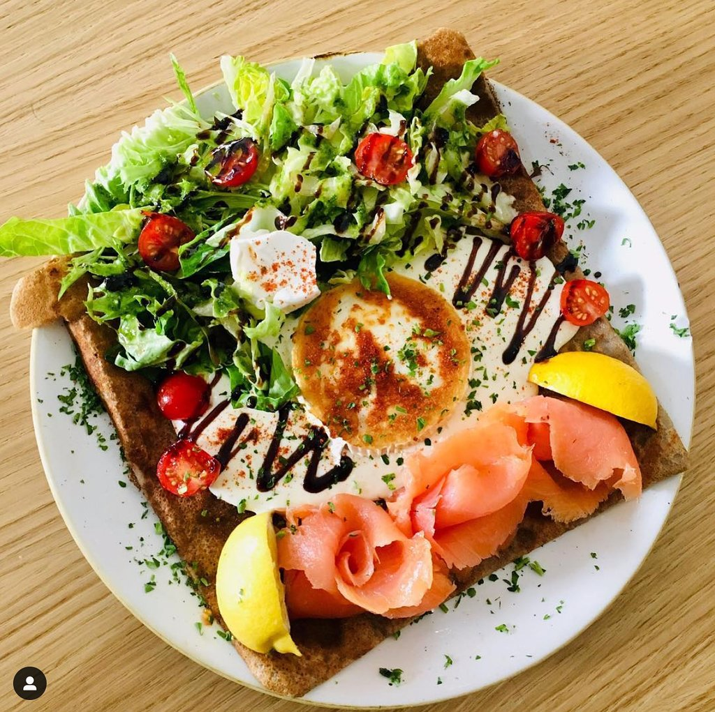
Restaurants
There are a lot of excellent restaurants in Gustavia. It is a culinary adventure with a delightful array of restaurants and cafes. You can choose from cozy cafes to upscale dining establishments Ocean Club St Barths $$$$ French, Contemporary, Vegan
19 Rue De La République Au Dessus De Prada et Dolce & Gabbana, Gustavia
Eddy’s $$ - $$$ French, Caribbean, International
12 Rue Samuel Fahlberg, Gustavia
Crêperie St Barth $$ - $$$ French, International, Vegetarian
Rue du roi Oscard II, Gustavia
Fish Corner Food and Market $$ - $$$ Caribbean, Seafood, Mediterranean 41 Rue de La Republique, Gustavia
For those of you who just like good food, you can’t go wrong just about anywhere you go in St Gustavia, St. Barts.
GOOD EATING

Slide 22
Conclusion
St. Barts is a beautiful resort island with incredible beaches. Regardless of what you're looking for, St. Barts has something for everyone.
I hope this presentation will help when we visit St. Thomas!

Slide 23
Thanks For Coming
If you have any more questions, please ask.
I will do my best to answer them for you.
Have a great visit to St. Barts!

