Slide 1
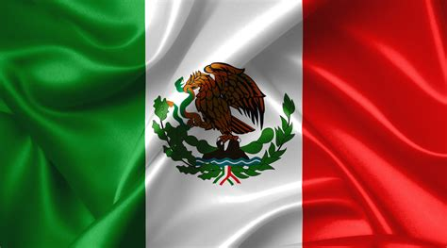
Guaymas, Mexico Presented by Marc Silver

Slide 2
What I Will Cover
My Port Philosophy
Don’t Miss the Ship
Money
About Guaymas, Mexico
History of Guaymas, Mexico
Maps
Transportation
Points of Interest
Places to see or at least consider
A few restaurant recommendations
Conclusion

Slide 3
My Port Philosophy
I have been cruising for over 45 years and have taken over 100 cruises. So, I consider myself an experienced cruiser.
The information I will present is based on those many years of
experience.
When I am on a cruise where the city, I want to visit is not the port city,
I always recommend taking a ship’s tour.
But when I am in a port with multiple attractions nearby and easy to see
on my own - I will do it on my own.
This presentation is for that type of port.

Slide 4
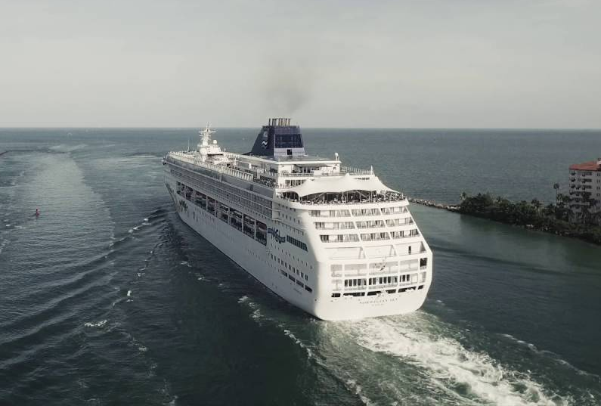
Don’t Miss the Ship
How to Avoid Missing Your Ship
Pay attention to the time. - Ship time and local time are often different.
Put a return-to-ship reminder on your phone.
Choose excursions wisely.
If a ship-sponsored excursion is late returning to port for, the ship will wait for you. If you are on your own???
Be Prepared
Have your Passport, Credit Card and phone numbers for your ship port agent.
What to Do If You Miss the Ship Most cruise lines have port agents stationed in the port area to assist if your ship has left without you. If you’re lucky, when cruisers are late returning to the vessel, the ship's crew will often remove the passengers' essential items -- passports, cell phones and medication -- from the ship to leave with the port agents.
The Port Officials can help you with contacting your ship and making necessary travel arrangements.

Slide 5
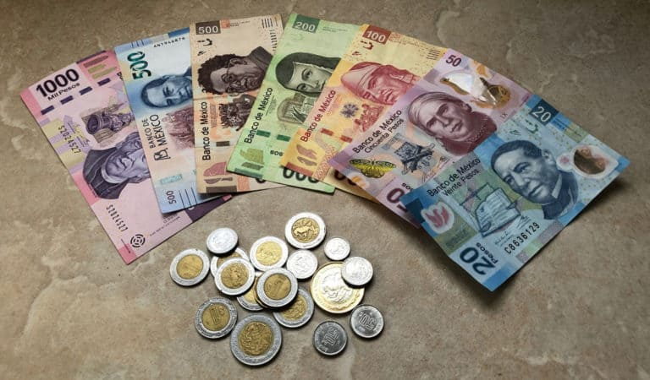
Money
The Peso is the official currency of Mexico
Official Exchange is 100 Pesos is $5.80 US
Or 17.35 Pesos to the US Dollar

Slide 6
About Guaymas
Guaymas is a city and port in southwestern Sonora, Mexico. Located on a bay of the Gulf of California. The city was established in 1769, San Carlos is now a lively beach town populated by Mexicans, Canadians, and people from the United States.
It is a getaway of beach, good restaurants, hiking, fishing, watersports, and boating. There are two world-class Marinas, Marina San Carlos and Marina Real, with over 700 jetties. On any given day, glancing out at the water, sailboats, yachts, and kayaks can be seen.
Windsurfing is popular off one of the beaches. Off San Francisco Beach, on any morning, the paddleboarders ride serenely on calm seas. In addition to the ocean's options, there is excellent hiking in Canyon Nacapule, which contains an interesting variety of desert plants and palm trees.
For the skilled climbers, Cerro Tetakawi is an exciting climb, with a vista that is one of the best in the world. There is no shortage of recreational activities in the area.
Guaymas remains a center for shipping, commerce, manufacturing, and tourism. Among its chief exports are copper, sulfuric acid, wheat, and various other crops grown in the hinterland (notably cotton, fruits, and vegetables). Seafood-processing plants are located in Guaymas but overfishing and a lack of fresh water from the Colorado River have caused a decline in its fisheries, especially for shrimp. The city is still known for its sportfishing (sailfish, marlin, yellowtail, and others), however. Resort developments along the Gulf of California north of the city, especially at San Carlos, are transforming Guaymas into a major tourist destination.

Slide 7

Historical Guaymas
Before the arrival of the Europeans, the Bay of Guaymas was dominated by the Guaymas, Seri, and Yaqui tribes. Some small Jesuit missions were founded in the 1610s and 1620s when Jesuits founded eight mission villages with the Yaqui. The Seri strongly opposed the European settlements and resisted fiercely until 1769.
The Spanish established the Loreto mission somewhat inland of Guaymas Bay. To receive supplies by ship and evangelize the Guaymas Indians, the Jesuits founded another small mission on the bay, called San José de Guaymas. The Seri repeatedly attacked the San José mission, forcing it to be rebuilt several times. This mission was abandoned permanently in 1759.
In 1767 there was a military offensive to subdue the Seri and Pima tribes. After doing so, the Spanish colonials built an adobe fort in Guaymas, however no traces of the fort remain today.

Slide 8
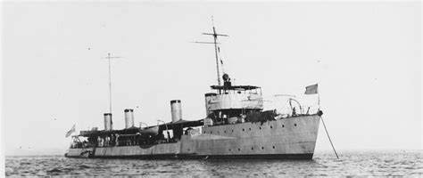
Historical Guaymas Cont.
Guaymas was declared a city in 1769 but no colonists settled there until the early 19th century.
In the late 18th and early 19th century, there was reportedly a single inhabitant of Guaymas, "Tio Pepe" (Uncle Pepe), said to be a drunk and a thief. At the beginning of the 19th century, the village was settled by farmers and ranchers holding large properties but having no market for their products. Farming was on a subsistence level.
The port became a municipality in 1825. During the Mexican–American War, American warships fired on and captured the town, keeping it in U.S. hands from 1847 to 1848.
The French moved north into Sonora, intending to take the state for its goldfields, the men and women of Guaymas dressed in military uniforms and stood on the hills surrounding Guaymas, appearing to be a formidable, defending force. The town at that time (1854) was comprised of 2,000 residents, made up of Europeans, South Americans, and local tribes.
In 1865, French ships arrived to attack Republican forces, which were forced to retreat. The French occupied the city until 1866.

Slide 9
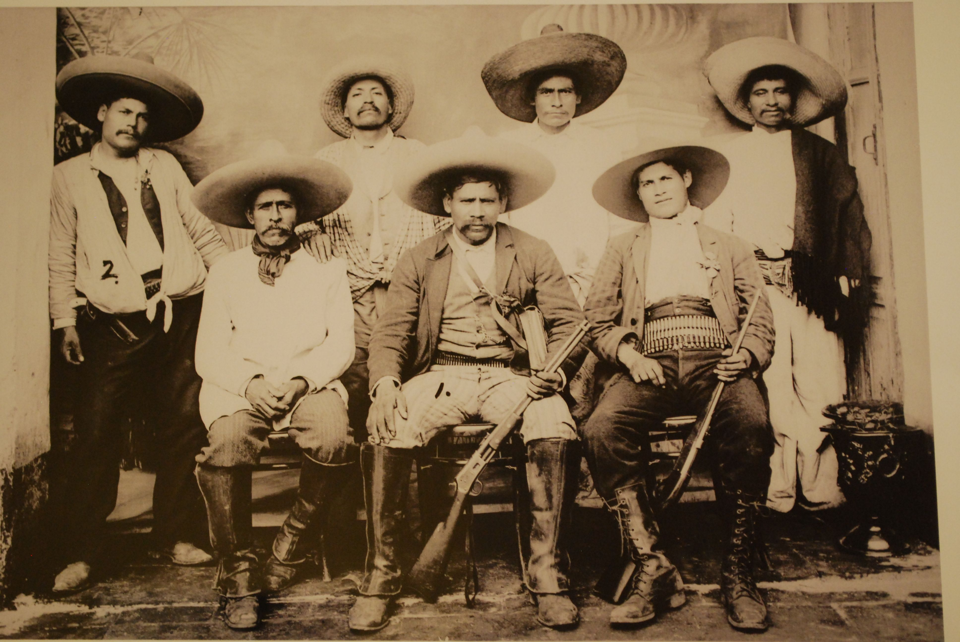
Historical Guaymas Cont.
On October 4–5, 1911, Guaymas was struck by a major hurricane and accompanying storm surge which killed some 500 people in the city and environs.
During the Mexican Revolution, the first aerial bombardment of a naval target occurred just off the coast of Guaymas. In 1913, five military ships belonging to Federal forces appeared in the bay, and the rebel army ordered the bombing of these ships using the aircraft Sonora.
Modern port facilities were built in 1925 for the Mexican Navy. In 1942 a commercial pier and warehouse were built at La Ardilla. Guaymas' importance as a port grew in the 1950s, and in 1961, a pier was built by PEMEX. A naval ship repair station called the Varadero Nacional, and silos for the export of grain, called the Almacenes Nacional de Depósito, were built in 1964.
A Ferry connection with the city of Santa Rosalía, Baja California Sur was established in 1972.

Slide 10
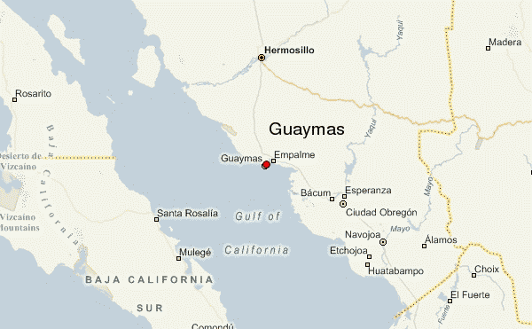
Area map of Guaymas Mexico

Slide 11
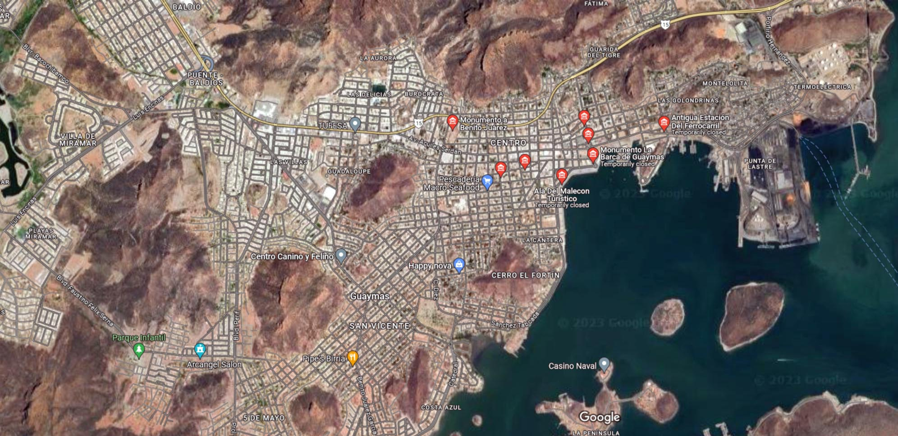
City Map of Guaymas

Slide 12

Guaymas City Bus
Guaymas has a very simple bus system.
Traveling by bus is totally safe and is an interesting experience if you like to mingle with the locals.
The fare is 12 pesos, and the drivers can make change.

Slide 13
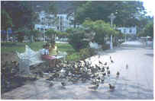

Guaymas Taxis
Taxis in Guaymas are plentiful. Taxis can be very reasonable; Be sure you ask the price BEFORE you get in.
Be aware that Hotel taxis charge a premium rate because they've paid a higher union fee to sit in front of the hotel.
Make sure you have small change. Taxis will not carry change so they can keep yours.
You do not tip taxi drivers. The tip is included in the price.
Uber is also available if you have phone service and the app.

Slide 14
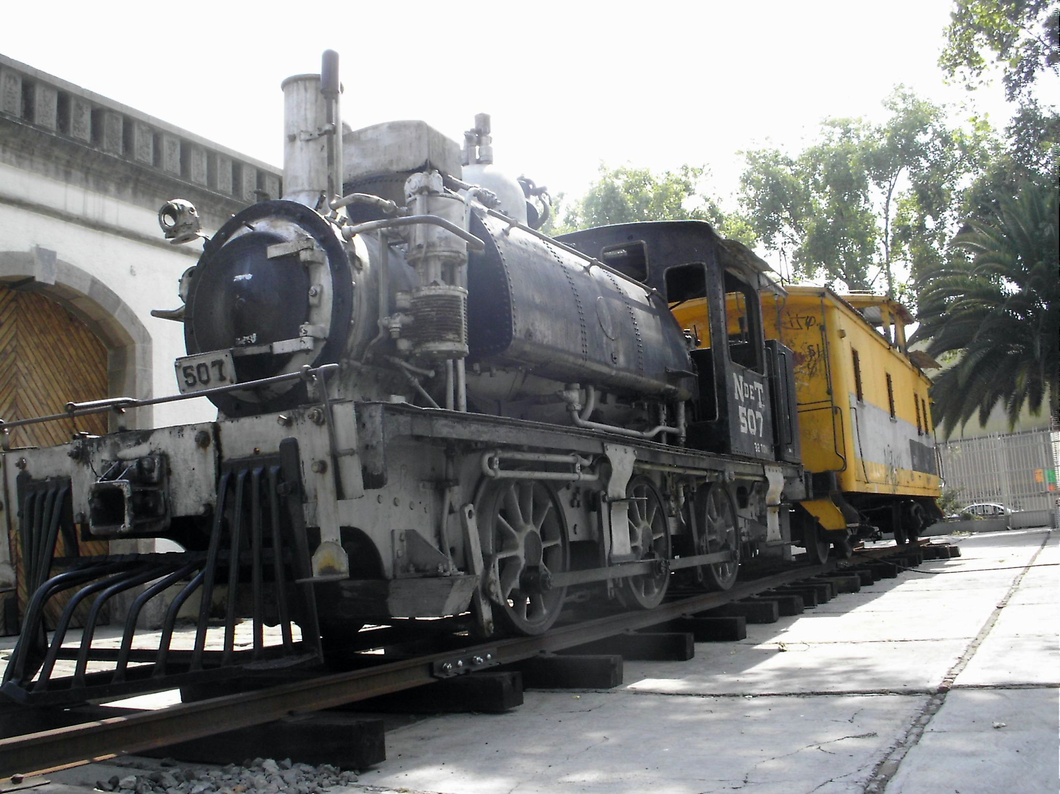
Museo Ferrocarrilero
The Museo Ferrocarrilero is a Railway Museum dedicated to the rescue, conservation, and classification of railway heritage. It rescues the history of the Empalme station of the Guaymas-Empalme branch. It has a replica of the 650 locomotive machine made in the workshops of the same railway.
The construction of the South-Pacific Railway continued the laying of tracks linking Nogales and Guadalajara. On the anniversary of its foundation, commemorative ceremonies and cultural, artistic, and civic festivals are usually held.

Slide 15
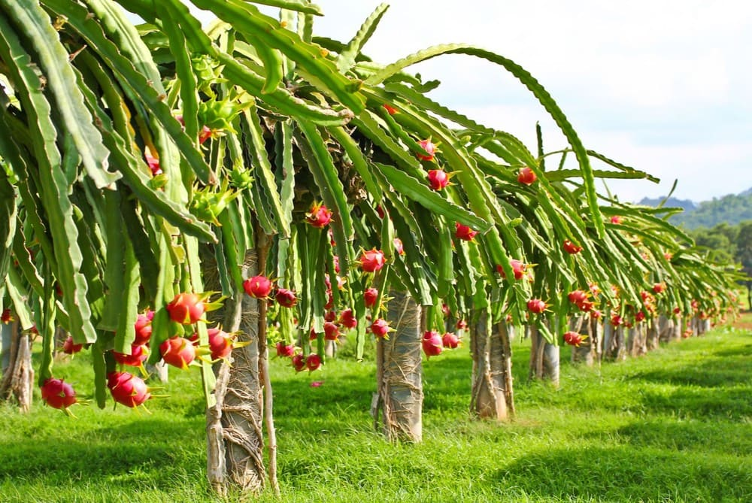
Dragon Fruit Farm Rancho Pitahaya
Rancho Pitahaya is Sonora's First and Only Organic Dragon fruit Farm. They offer tours by appointment.
The tour of the farm at Rancho Pitaya is both informative and fun. If you haven't tasted dragon fruit, I recommend you do. Like kiwi fruit, the taste is hard to describe. Fresh and sweet, they are delicious. The afternoon at the farm begins with drinks and getting to know the group attending that day. The guests are usually a mix of locals, Mexicans, and American tourists. There are 1,000 plants yielding thousands of fruits a year. You can also take a walk into the desert to see the massive cardon cacti. You may also see the Sea of Cortez from there.

Slide 16



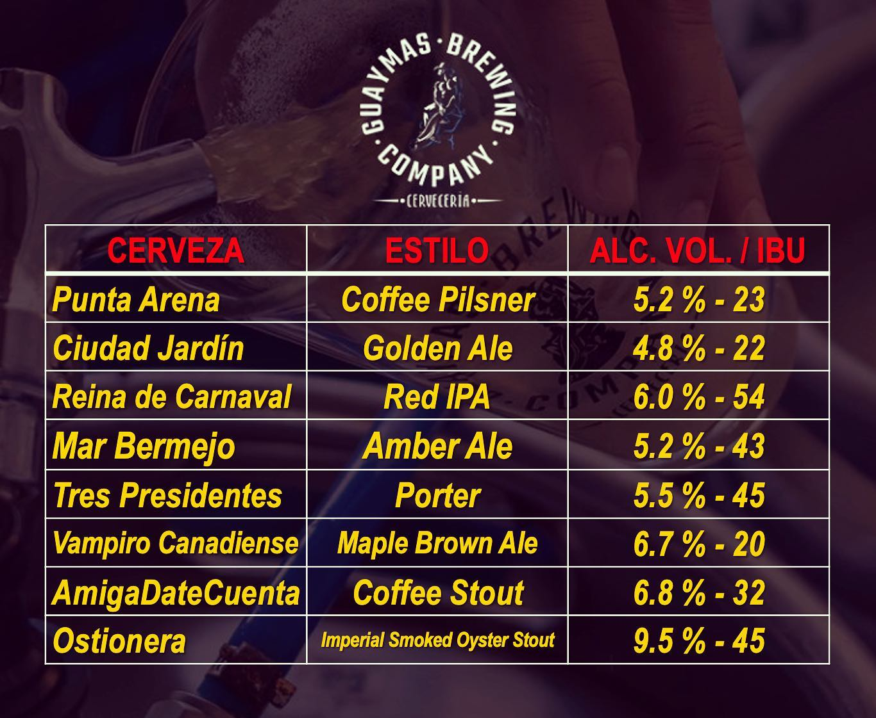
Guaymas Brewing Company
For the craft beer fans a visit to Guaymas Brewing Company, can be a great outing. All their beer is brewed in the heroic port of Guaymas, Sonora.
They produce a variety of different types of beer.
4 5-ounce samples for only 100 pesos

Slide 17
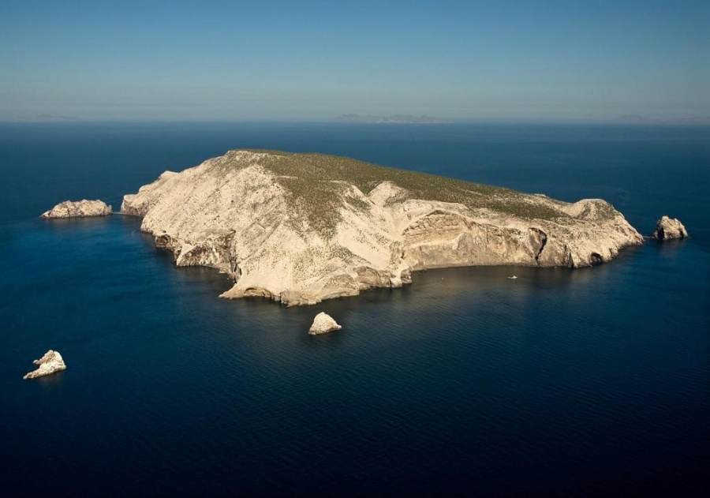
Explore San Pedro Mártir Island
San Pedro Island is about an hour and a half off the coast of San Carlos. This is the place to go to play with the dolphins. They are playful and are great fun. The island and its marine life are, since 2002, part of the San Pedro Martir Biosphere Reserve, and is regarded as a natural laboratory of adaptive evolution, similar to that of the Galápagos Islands. It is home to 292 species of fauna and flora (both land-based and aquatic), with 42 species protected by Mexican law, and 30 listed on the List of Threatened Species.
The large bird population deposits enormous quantities of guano on the island, resulting in the white appearance of the island contrasted with sparse vegetation. While the island has 24 species of vascular plants, the flora of the island is dominated by the Mexican giant cardon or elephant cactus that can grow to 60 feet and is especially suited to the lack of rainfall.

Slide 18
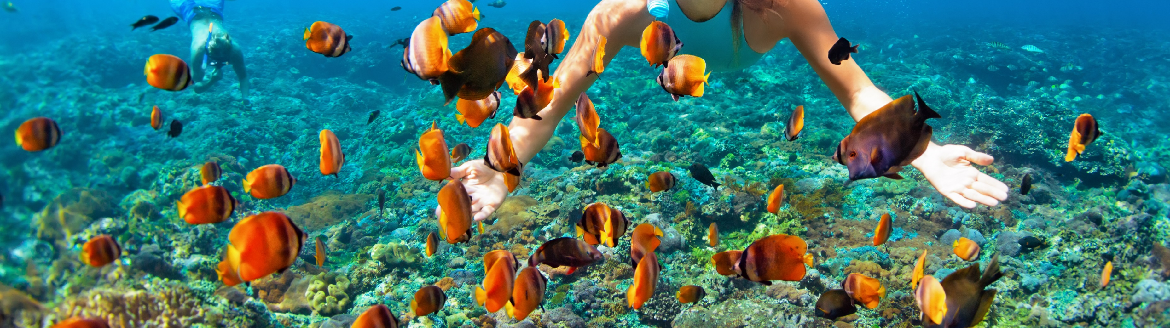
Go Snorkeling
The snorkeling in this area is excellent, with many coves, arches, and rocky outcrops to keep you busy. You will see a ton of starfish, eels, octopus, and different colored fish (including Sergeant Majors and angel fish).
Contact one of the many local dive shops for information on renting snorkeling equipment (fins, mask, snorkel, life jacket).

Slide 19
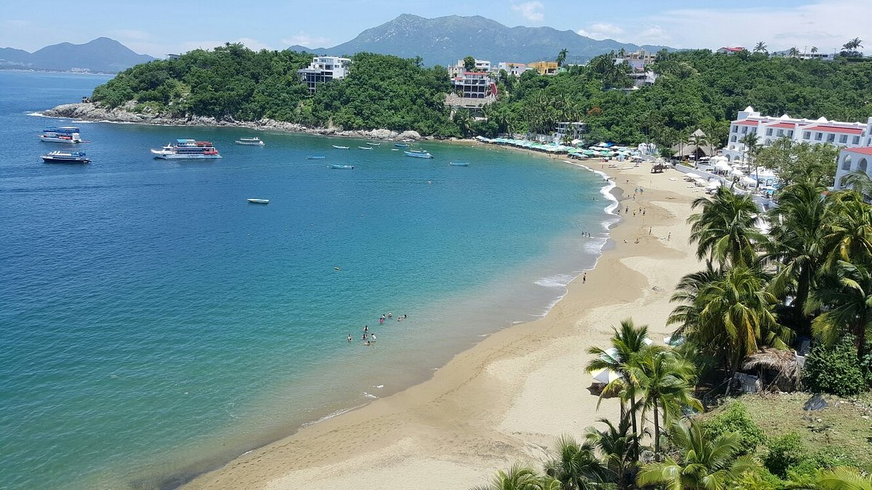
Miramar Beach Bahia de Bacochibampo
In the Yaqui language, Bacochibampo means bay of vipers. Dry and hot, the bay is in the municipality of Guaymas, Sonora, right in the heart of the Gulf of California. It is just 3 miles from the international.
Guaymas layout is characterized by the bay and the city’s wealthy residential neighborhood. The center of this district is Port Nautical, an environmental project encompassing the largest marine on the Gulf of California. Here you can find beach hotels and a marina, a convention center, a mall, parks, a sailing and beach club, as well as fishing, scuba diving, and tennis.

Slide 20
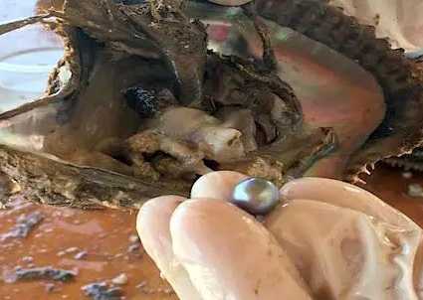
Perlas del Mar de Cortez
Perlas del Mar de Cortez is the first commercial saltwater cultured pearl farm in the Americas, and as the only pearl oyster farm in the world which cultivates its pearls using a unique pearl oyster: the "Rainbow Lipped Pearl Oyster" or Pteria sterna.
Cortez Pearls® are some of the finest cultured pearls in the world, thanks to their thick nacre and unusual natural colors: opalescent silver, grays, gold/bronze, blue/cyan, emerald/olive green, purple/violet, and black, but always with various Overtones: pink, violet, blue and green.
Cortez Pearls® are the most exotic cultured pearls in the world due in no small part to 1) their limited annual production (4 thousand pearls) and 2) of their Quality standards. There are really few who can boast of having one of these rare gems with 100% Fair Trade backing and All-Natural beauty.

Slide 21
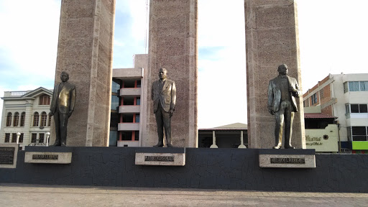
Walk the Malecon
One enjoyable activity is to take a walk along the seafront of Malecon. Guaymas has made a significant effort to beatify the entire area.
The Guaymas Malecon is the boardwalk that runs along the harbor, a stop for cruise ships with a marina with more than 750 boat slips. The main architectural sights in Guaymas are in the vicinity of Plaza de los Tres Presidentes. The plaza honors Adolfo de la Huerta, Plutarco Abelardo Rodriguez, and Elias Calles, three native sons who became presidents of Mexico. Two neoclassical buildings are near the square.
San Fernando Church, the oldest in the city, was built in 1850, and the Banco de Sonora. Thirteen of July Square commemorates a battle against the French in 1854.
The park features a Moorish-inspired bandstand. Gustave Eiffel, the designer of Paris' Eiffel Tower, designed the square.

Slide 22
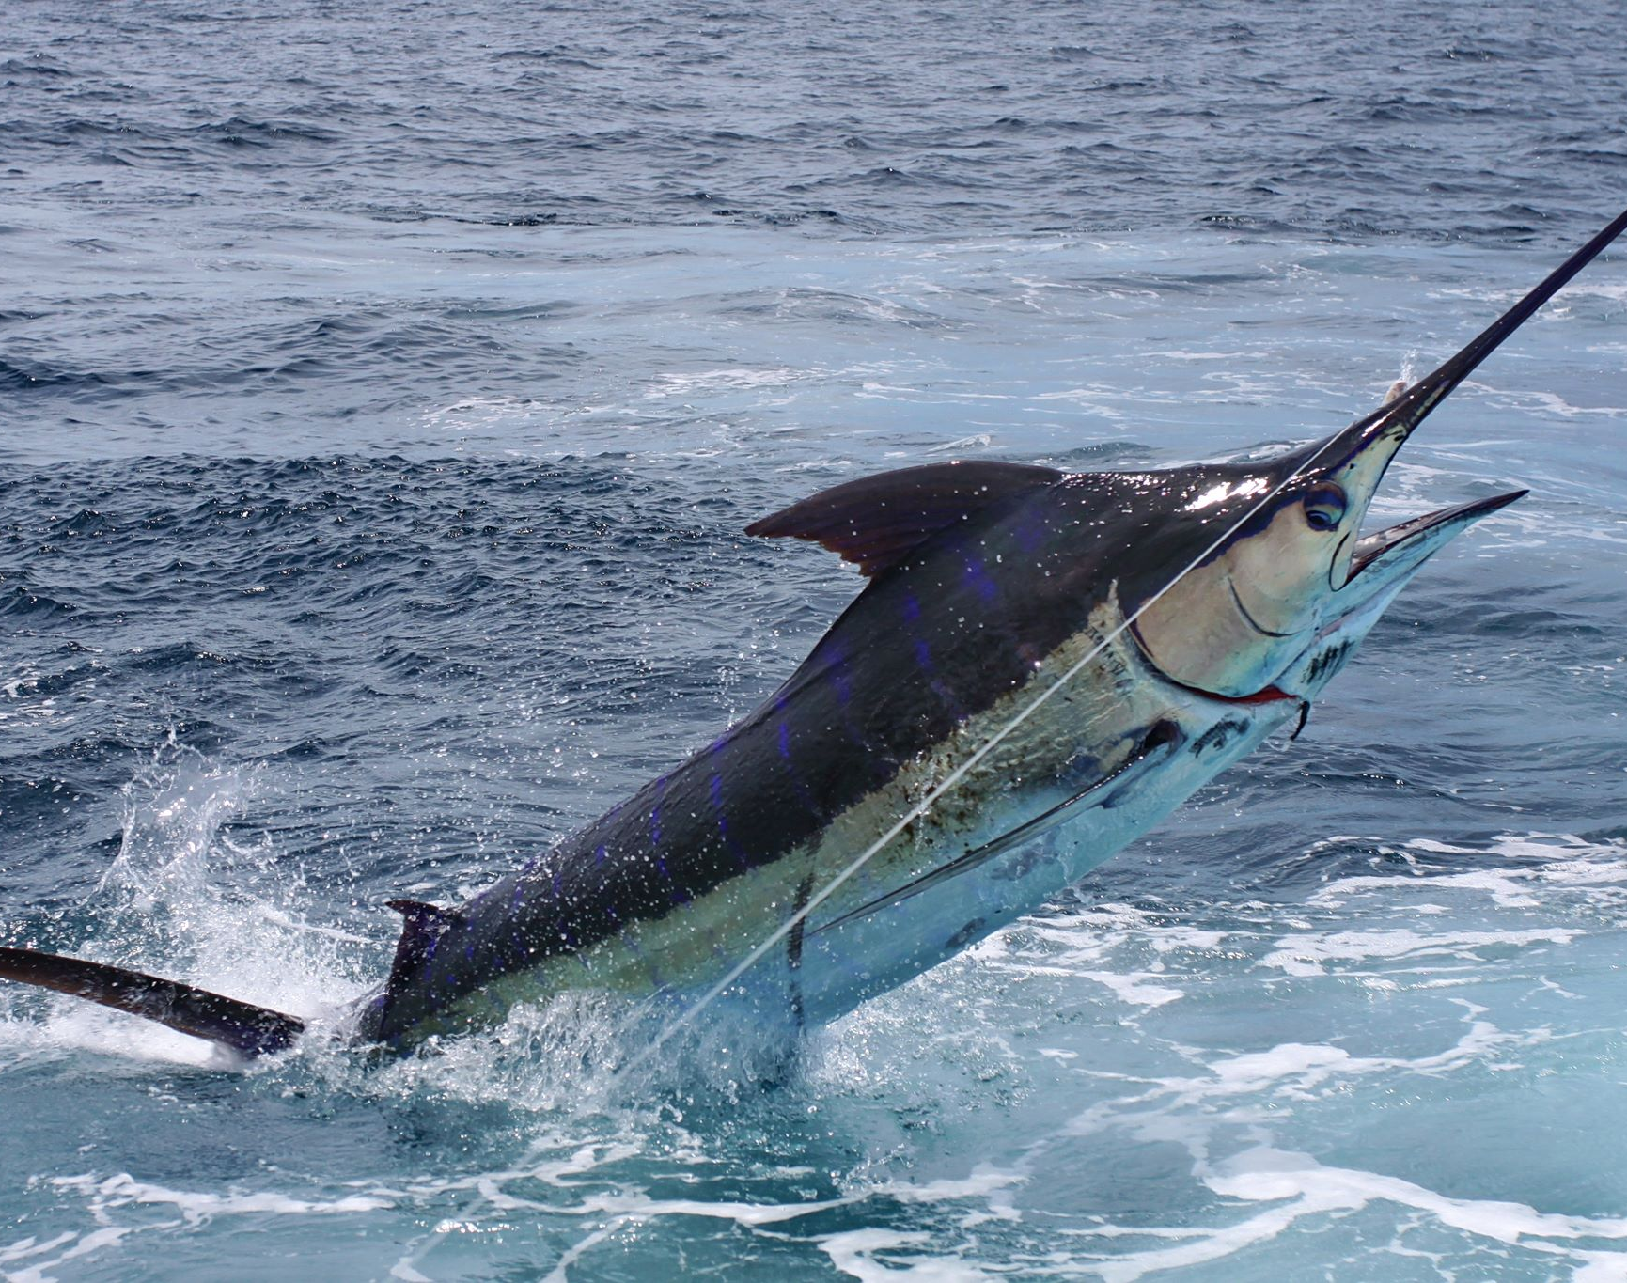
Sport Fishing
Fish for game fish with lines set for trolling offshore. Fishing species include marlin, sailfish, snook, and red snapper.
Marlin fishing is done in the Sea of Cortez, with boats from Guaymas Bay, and includes sports yachts and all fishing equipped with a professional team.
Snook and snapper are caught around the inlets of the bay formed at the mouth of the river El Fuerte.

Slide 23
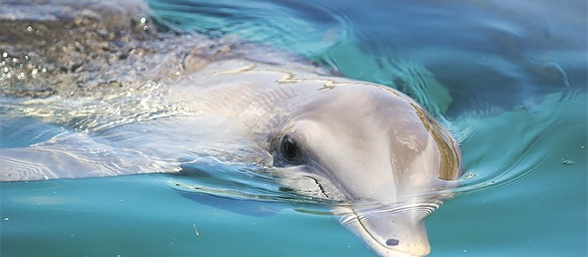
The Sonora Dolphinarium
The dolphin is considered one of the most intelligent animals in the world, in this dolphinarium you can admire this beautiful animal closely.
The place offers a dolphin and sea lion show, an acrylic observatory, a dolphin swim, and even Dolphin Assisted Therapy (TAD). Not only can
you enjoy a unique experience in life, but you will also learn a lot about these wonderful mammals.
Dolphinarium entrance fee: Adults 180 pesos / Children 90 pesos
Swimming with dolphins: Saturdays and Sundays 9 am to 10 am Dolphin Experiences $ 40 usd / Dolphin Encounter $ 63 usd Dolphin Interaction $ 80 usd

Slide 24
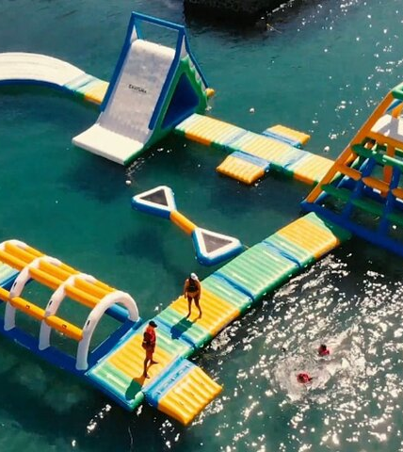
Parque Acuático Ekotura
Located only 8 Km from the ship, is pure fun in the water park, test your skills in the different challenges, and enjoy a unique experience with friends and family.
Founded in 2007, Parque Acuático Ekotura Is a fun water park and tourist destination with an emphasis on ecology and adventure. You can Explore Miramar Bay by kayaks, and enjoy the landscapes and marine fauna and flora that only Guaymas can offer you. You can do your experience in a Single ($200.00 MXN per hour) or Double Kayak ($300.00 MXN per hour).

Slide 25
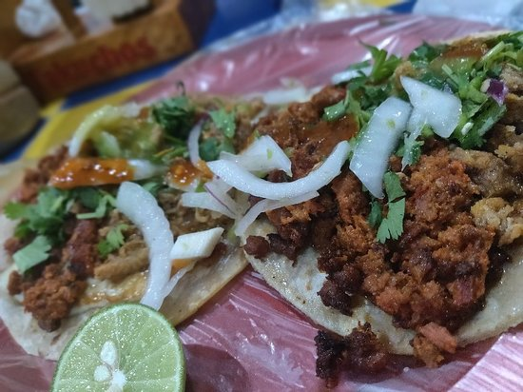
Guaymas Restaurants
Guaymas has many excellent restaurants. Many of us on the ship are foodies, so naturally, we’re always on the hunt to eat at the most exclusive spots anytime we travel.
Here are a few of the best restaurants to consider in downtown.
Mariscos El Mazateno - $$$ Mexican Seafood, Petrolera, Guaymas
Mariscos EL Rey $$ - $$$ Seafood, Carretera Internacional Junto Al Puente de Miramar, Guaymas
La Cobacha Granpatio $$ - $$$ Mexican Seafood, Carretera Internacional km. 1982, Guaymas
El Oeste Steak House $$ - $$$ Mexican Steakhouse Bar, Carretera Internacional. Delicias, Guaymas
Los Arbolitos $$ - $$$ Mexican Seafood, Carretera Internacional Km 1982, Guaymas
Los Takuchos $ Mexican, Enseguida Oxxo Loma Dorada, Guaymas
For those of you who just like good food, you can’t go wrong just about anywhere you go in Guaymas.
GOOD EATING

Slide 26
Conclusion
Guaymas is a beautiful City with a rich history and numerous attractions. Whether you're looking for stunning beaches, historic sites, or unique attractions, Guaymas has something for everyone.
I hope this presentation will help when we visit Guaymas!

Slide 27
Thanks For Coming
If you have any more questions, please ask.
I will do my best to answer them for you.
Have a great visit in Guaymas!

