Slide 1
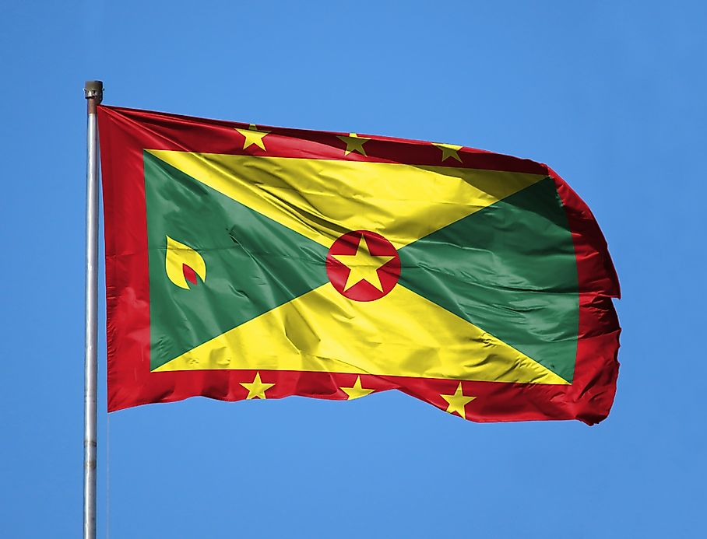
Grenada
Presented by
Marc Silver

Slide 2
What I Will Cover
My Port Philosophy
Don’t Miss the Ship
Money
About Grenada
Area Map of Grenada
Map of Grenada
Grenada Transportation
Places to see or at least consider
A few restaurant recommendations
Conclusion

Slide 3
My Port Philosophy
I have been cruising for over 45 years and have taken over 100 cruises.
So, I consider myself an experienced cruiser.
The information I will present is based on those many years of
experience.
When I am on a cruise where the city, I want to visit is not the port city,
I always recommend taking a ship’s tour.
But when I am in a port with multiple attractions nearby and easy to see
on my own - I will do it on my own.
This presentation is for that type of port.

Slide 4

Don’t Miss the Ship
How to Avoid Missing Your Ship
Pay attention to the time. - Ship time and local time are often
different.
Put a return-to-ship reminder on your phone.
Choose excursions wisely.
If a ship-sponsored excursion is late returning to port, the ship will
wait for you. If you are on your own???
Be Prepared
Have your Passport, Credit Card, and phone numbers for your ship
port agent.
What to Do If You Miss the Ship
Most cruise lines have port agents stationed in the port area to assist if your ship has left without you. If your are lucky, when cruisers are late returning to the vessel, the ship’s crew will often remove the passengers’ essential items – passports, cell phones, and medication -- from the ship to leave with the port agents.
The Port Officials can help you with contacting your ship
and making necessary travel arrangements.

Slide 5
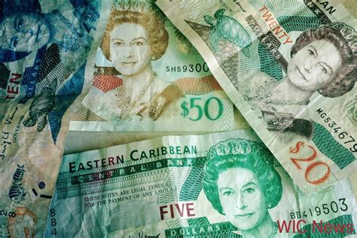
Grenadian Money
The official currency of Grenada is the East Caribbean dollar,
with the symbol EC$ and currency code XCD.
The official Exchange is 1EC$ = $0.36 USD
2.7 XCD to $1 USD

Slide 6
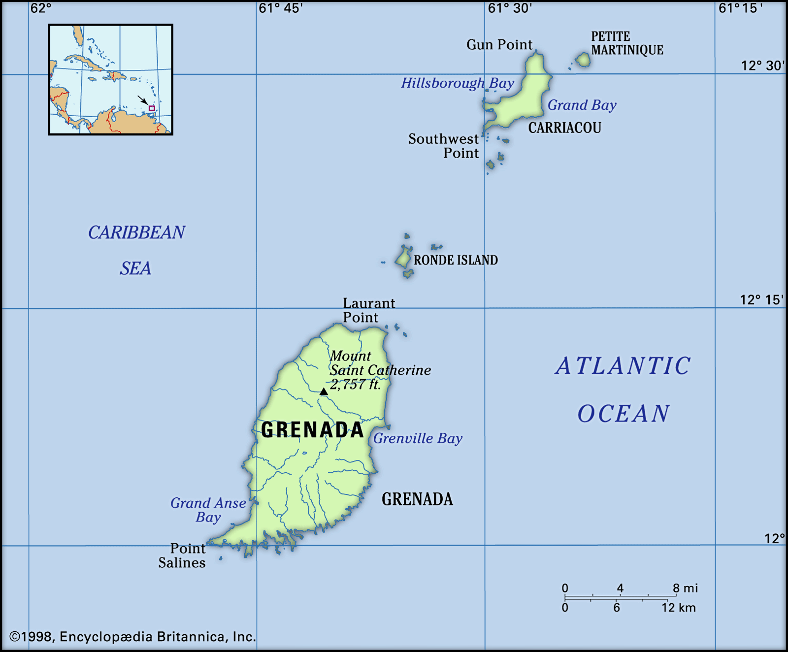
About Grenada
Grenada, often referred to as the Isle of Spice, island country in the West Indies. It is the southernmost island of the north-south arc of the Lesser Antilles, lying in the eastern Caribbean Sea about 100 miles north of the coast of Venezuela. Oval in shape, the island is approximately 21 miles long and 12 miles wide. The southern Grenadines, the largest of which is Carriacou, about 20 miles north-northeast,
with an area of 13 squares. The capital, St. George’s,
on the southwest coast, is also the main port.
In 1974 Grenada attained independence within the
Commonwealth and membership in the United
Nations. It was the first of the six West Indies
Associated States to do so.

Slide 7

People of Grenada
Most of the population is black, having descended from African slaves, and there is a large minority of mulattoes and other mixtures. There are also small minorities of East Indians, descendants of indentured laborers brought to replace the freed slaves; descendants of the old French and British settlers; and more recent immigrants from North America and Europe. Although English by older people in the villages. is the accepted language, a form of patois is still spoken.
Nearly one-half of the population is Protestant. More than one-third is Roman Catholic, and small but significant portions of the population adhere to the Rastafarian and Jehovah’s Witnesses’ faiths. Although Grenada is densely populated, its population grew slowly during the 20th century

Slide 8
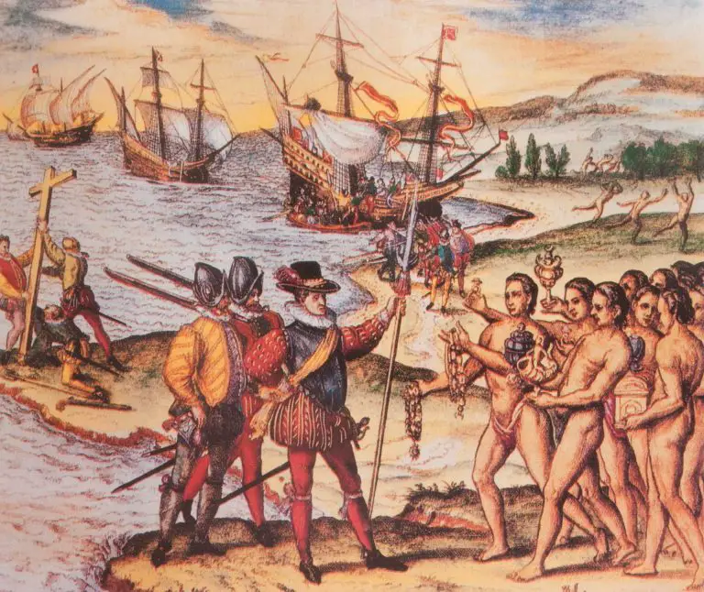
Historical Grenada
The history of Grenada in the Caribbean covers a period from the earliest human settlements to the establishment of the contemporary nation-state of Grenada. First settled by indigenous peoples, Grenada by the time of European contact was inhabited by the Caribs.
French colonists killed most of the Caribs on the island and established plantations on the island, eventually importing African slaves to work on the sugar plantations. Control of the island was disputed by Great Britain and France in the
18th century, with the British ultimately prevailing.
In 1795, Fédon's Rebellion, inspired by the Haitian Revolution, very nearly succeeded, taking significant military intervention to quell. Slavery was abolished in 1833, and in 1885, the island's capital, St. George's, became the capital of the British Windward Islands. Grenada achieved independence from Britain in 1974.

Slide 9
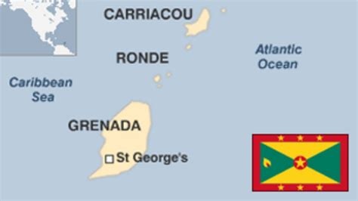
Area Map of Grenada

Slide 10
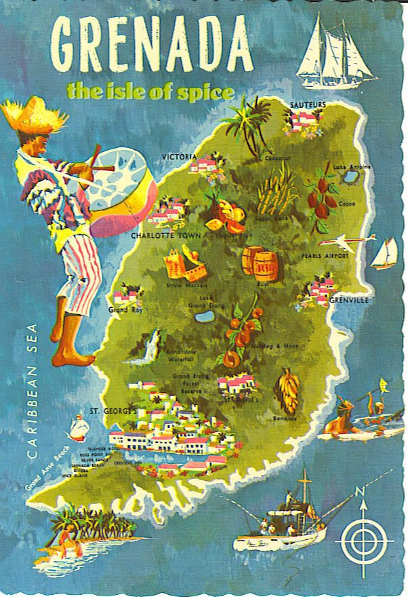
Map of Grenada

Slide 11
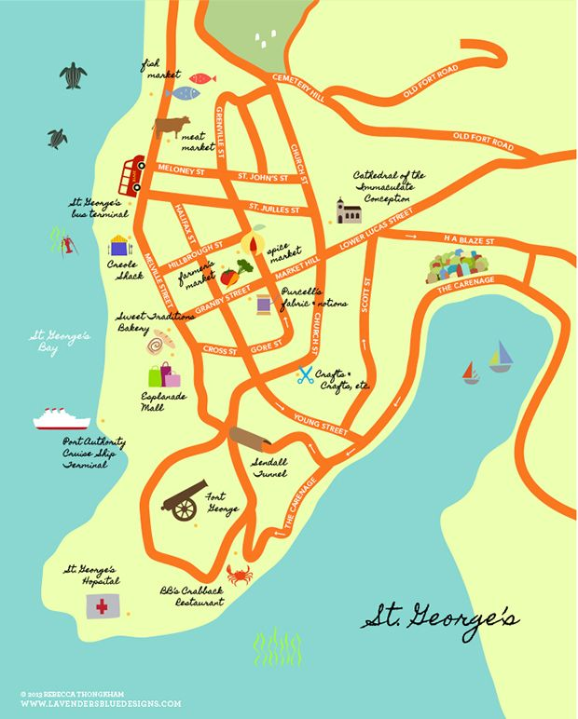
Map of St. George

Slide 12
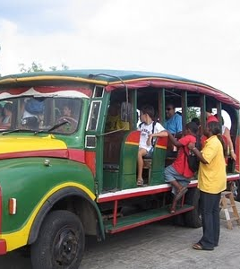
Grenada Buses
The buses in Grenada are probably nothing like you have ever experienced. Buses in Grenada are privately owned vans that seat up to 20 people. It’s a tight fit, with lots of shifting around to let passengers in and out. The owners of the buses – who are usually also the drivers – are accompanied by a conductor who sits beside the sliding side door, often with their head hanging out the window.
As they drive, the conductor scouts the roadside for passengers, and with a word or snap of the fingers they signal the driver to stop.
As the bus is nearing your destination, just knock on the side of the bus (or press the doorbell beside you if there is one), and the driver will pull over at the nearest safe spot to let you off.
For this (almost) door-to-door service, you’ll pay the equivalent of about $1 US dollar.

Slide 13
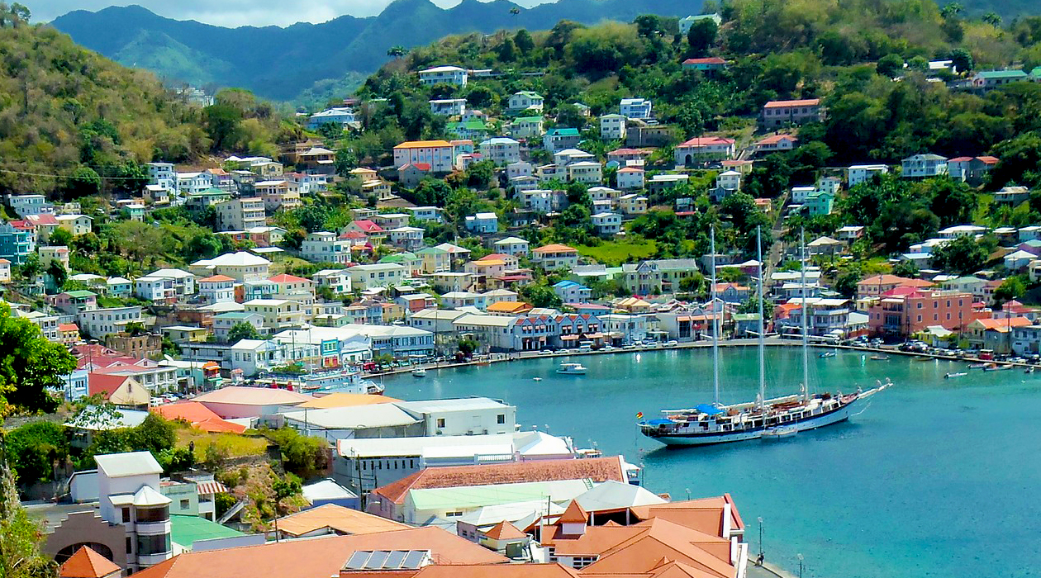
City of St. George's
St. George's, Grenada's capital, is one of the prettiest cities in the Caribbean, its busy harbor of Carenage bristling with sailboats. You can even island hop in Grenada. The quieter islands of Carriacou and Petite Martinique lie off the island's northeast coast and are easy to get to.
This colorful capital of Grenada is popular with boaters, who dock in the busy harbor, called the Carenage. Brick and stone buildings with red-tiled roofs line the streets, where locals sell spices and crafts.
Two of the main historical attractions in the city are Fort George, built by the French in the early 18th century, and Fort Frederick. Both offer beautiful views over the town and the sea.
Another one of the top things to do in St. George is visit the House of Chocolate. Here, you can browse exhibits on the local cocoa industry and sample decadent sweet treats. This is a must for chocoholics!

Slide 14
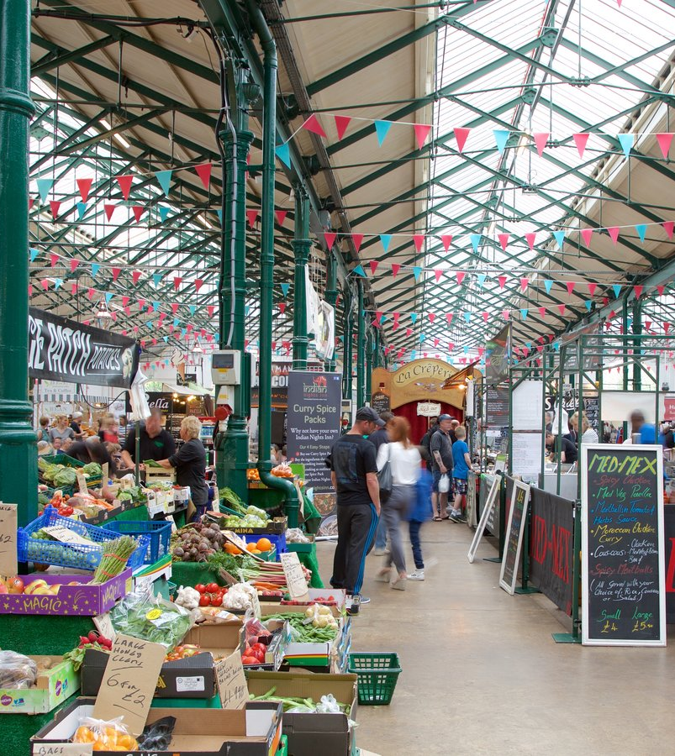
St. George’s
Market Square
The best time to visit St. George's Market Square is on a Saturday morning, when the market really bustles. Set in the heart of downtown, a mere block from the Cruise Ship Terminal, Market Square is home to the region's best spice market and is considered one of the city's top attractions.
This is where you'll find heaps of fresh fruits and veggies overflowing their baskets in a kaleidoscope of colors. Bring your appetite, not to mention a camera, as you'll want to enjoy these local goods in every way possible.

Slide 15
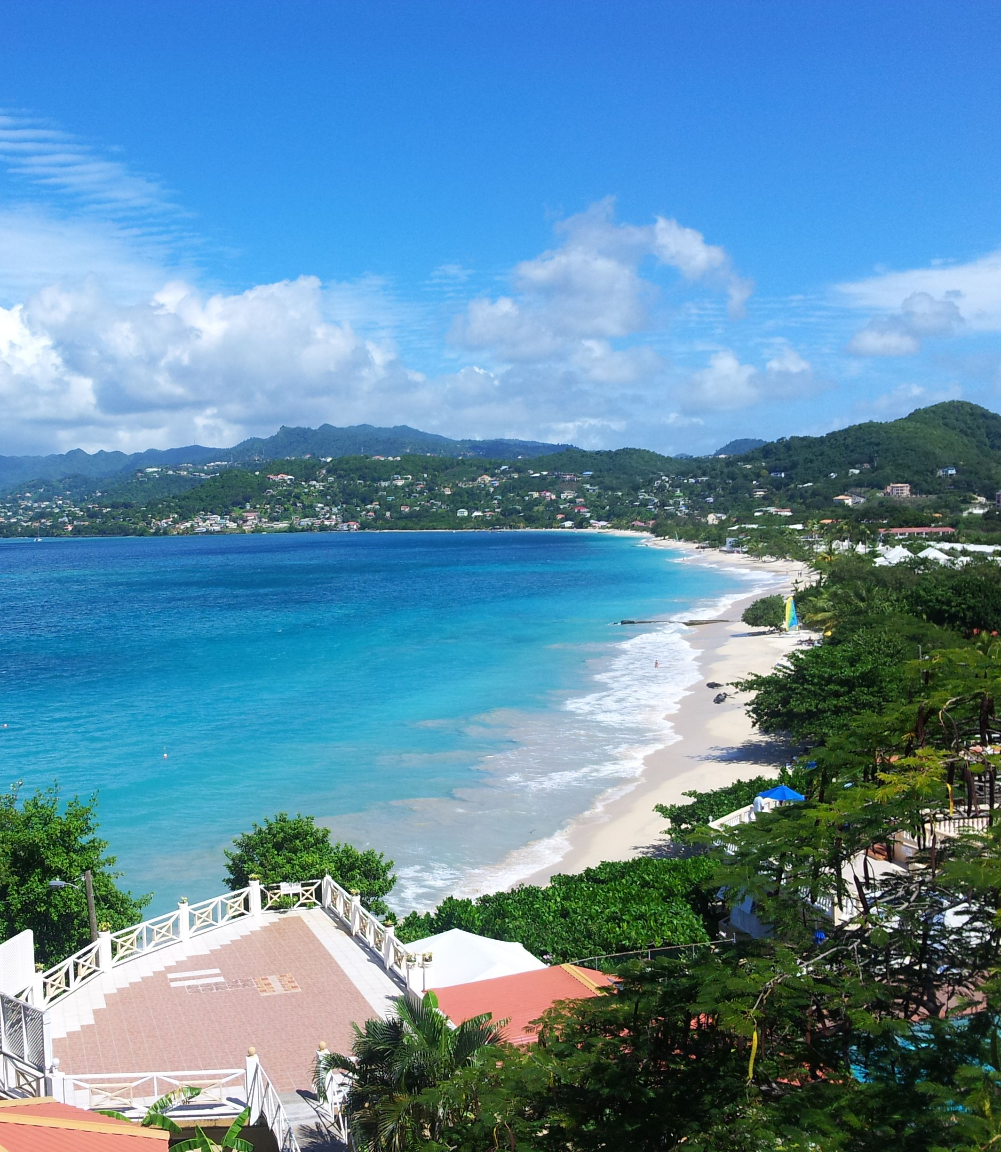
Grand Anse Beach
Fringed by sea grapes, almond trees, and coconut palms, Grand Anse is Grenada's most famous beach. Cruise ship visitors flock to this three-kilometer arc of golden sand and gentle surf, as do families looking for a fun day at the shore.
Water hues range from clear turquoise in the shallows to deep cobalt blue, and the calm waters are perfect for swimming. Many hawkers patrol the sands, but a polite "No, thank you" will keep them at bay.
If you feel like indulging in a little shopping, midway along the beach is the Grande Anse Craft and Spice Market, another popular stop for cruise ship visitors who are searching for something special to take home.

Slide 16
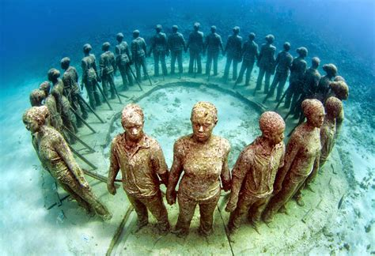
Grenada Underwater Sculpture Park
Grenada Underwater Sculpture Park is a unique submerged gallery that also serves as an artificial reef in a marine protected area. It lies on the west coast of Grenada, a short drive north of St. George's at Moliniere Bay.
Created by artist Jason deCaires Taylor, the sculptures range from Amerindian petroglyphs to life-size figures cast from local children.
Divers, snorkelers, and glass-bottom boat passengers can admire this underwater exhibition,
although coming face-to-face with these sculptures below sea level is the best way to appreciate their artistry. Visiting this one-of-a-kind attraction is one of the most memorable things to do in Grenada. Be sure to pack a waterproof camera to get shots of the unique finds and colorful fish you'll see during your adventure.

Slide 17
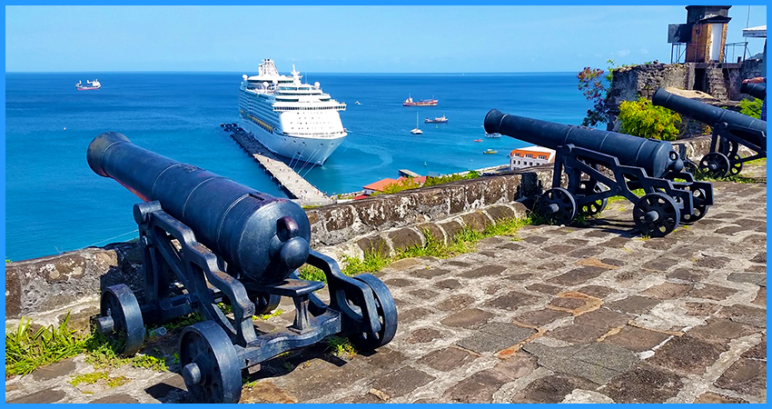
Fort George
Built in 1705 by the French, Fort George lies on the promontory to the west of the harbor and is Grenada's oldest fort. It was built to protect the harbor but stands mostly derelict today.
The main draw here is the spectacular 360-degree view across the town's red-tiled roofs and church spires to
the harbor and sea beyond.
You'll also spot a few of the
original cannons, which are still
fired on special occasions. The
police headquarters currently
sit on a section of the property.

Slide 18
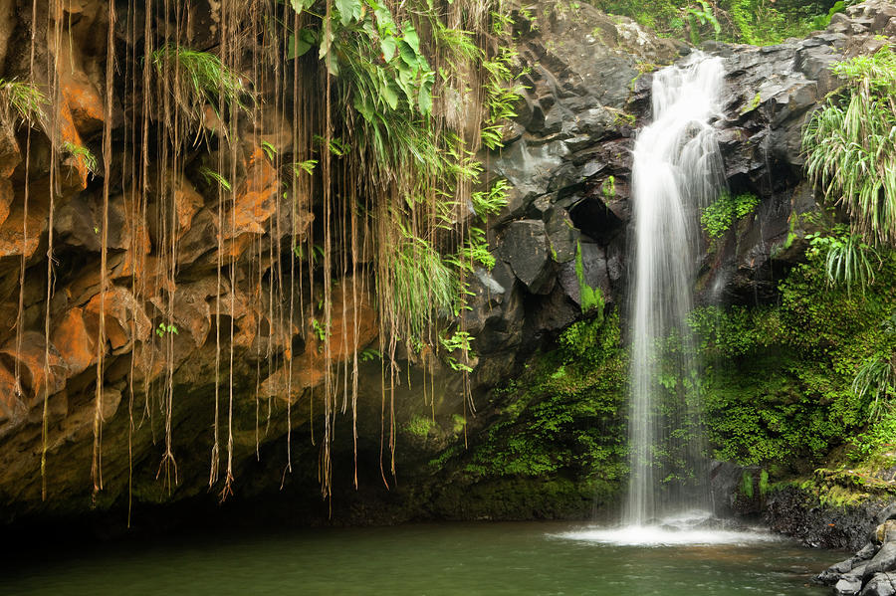
Annandale Falls
Annandale Falls plunges 10 meters into a pool tucked amid tropical foliage. It's located in the mountains north of St. George's.
The short trail to the waterfall begins at the Annandale Falls Centre. Along the way, you'll see beautiful tropical flowers and foliage, like ferns and wild ginger.
One of the highlights of a visit is watching fearless local divers leap into the water from the top — but be prepared that they may ask for a donation. You can also swim at the base of the cascades, and change rooms are available.

Slide 19
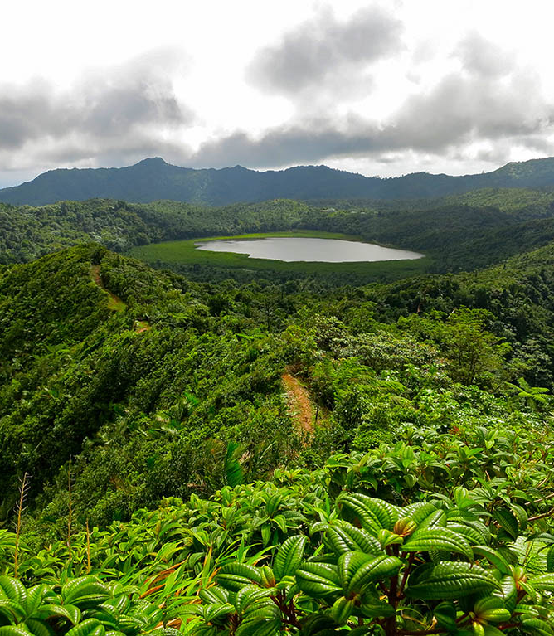
Grand Etang National Park & Forest Reserve
Grand Etang National Park offers some beautiful rainforest scenery and rewarding hikes. Travelers of all ages, from families toting young children to honeymooning couples can hike these trails, and the park hosts a rich diversity of plants and animals.
One of the focal points of the park is the beautiful crater-formed Grand Etang Lake. From the Grand Etang visitor center, several trails lead through the park, ranging from the 30-minute self-guided Morne LaBaye Trail, with many specimens of native plants, to the more challenging Concord Falls Trail, which passes a trio of cascades with swimming areas.

Slide 20
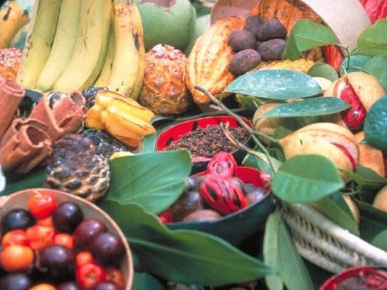
Spice Tours & Tastings
About an hour's drive from St. George's, the Belmont Estate offers a variety of tours that explore the organic farm and its tropical fruits and spices. At this 17th-century plantation, you can also learn about the cultivation of cocoa and how the fruit is made into chocolate (with tastings along the way). Serious chocoholics can sign up for a tour, which includes a scrumptious three-course lunch spotlighting chocolate in every course.
Laura Herb & Spice Garden offers a more intimate experience. Your visit begins with a guided tour through the beautiful spice gardens, with tastings and tips on health benefits.

Slide 21
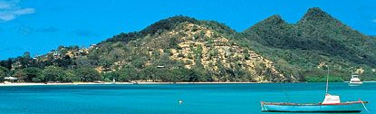
Island of Carriacou
While not technically on Grenada, the island of Carriacou is a beautiful day trip destination. This pretty isle lies just northeast of Grenada, an easy, 90-minute boat trip away.
Both white- and black-sand beaches fringe the coast, and coral reefs lie offshore with great opportunities for diving and snorkeling.
Carriacou has a number of small villages, but the main population center is Hillsborough. The Carriacou Museum here displays Carib, European, and African artifacts, and the island offers several hiking trails.

Slide 22
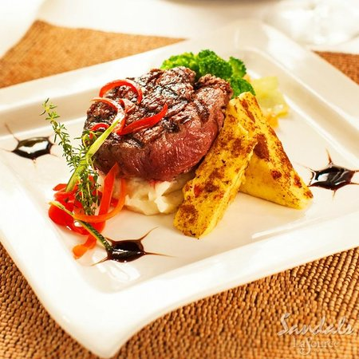
St. George Restaurants
There are a lot of excellent restaurants in St. George. Especially for seafood.
Here are some recommendations:
BB's Crab Shack $$ - $$$ Caribbean Seafood, Dessert
Grand Etang Road, Marina Villa Road The Carenage, St. George
Butch's Chophouse $$$$ American Steakhouse, International
Pink Gin Beach, St. George
The Aquarium Restaurant $$ - $$$ Caribbean, Seafood
Point Salines Beach Magazine Beach, St. George
The Fish Pot $ Caribbean Seafood
Grand Anse Beach, St. George
Fish and Chick Restaurant $ Caribbean Seafood
Airport Road between Mont Tout and the Limes, St. George
For those of you who just like good food, you can’t go wrong anywhere you go in Grenada.
GOOD EATING

Slide 23
Conclusion
Grenada is a beautiful City with a rich history and numerous attractions. Regardless of what you're looking for, Grenada has something for everyone.
I hope this presentation will help when we visit Grenada!

Slide 24
Thanks For Coming
If you have any more questions, please ask.
I will do my best to answer them for you.
Have a great visit in Grenada !

