Slide 1
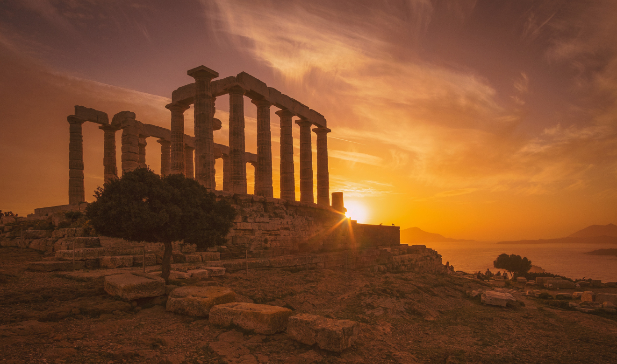
The Wines of Greece
It’s Regions, Terroir, and Varietals
Presented by
Marc Silver

Slide 2

Wine in Mythology
According to Greek mythology, wine was invented by Dionysus (to the Romans Bacchus).
The god generously gave Ikarios, a noble citizen of Ikaria in Attica, the vine tree. From this, Ikarios made wine, which he shared with a group of passing shepherds.
However, unaware of the stupefying effects of wine, the shepherds thought they had been poisoned and so swiftly took revenge and killed the unfortunate Ikarios.
Notwithstanding such an inauspicious start to the wine industry, this gift from the gods would become the most popular drink in antiquity.

Slide 3

Greek Wine History
Greece, with its rich history of viticulture, has long been a cradle of wine production dating back over 4,000 years.
The recorded history of wine in Ancient Greece begins around the 15th century BC, while viticulture appears to have existed as early as the Neolithic era, 6,500 years ago.
Ancient Greece is also the place
modern wine culture began, as wine
consumption stopped being solely a
sacred act, as it had been when priests
and rulers controlled the vineyards.
By the early Bronze Age, vineyard
cultivation of grapes was widespread in
ancient Greece, and by the time of the
rise of the Minoan and Mycenaean
civilizations, wine was part of everyday
life, for consumption and/or production.

Slide 4
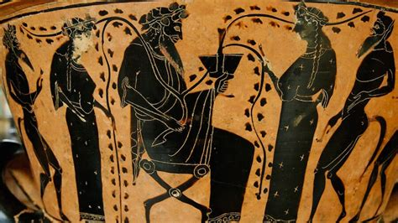
Greek Wine History
The Greek city-states established colonies throughout the Mediterranean.
The settlers, already experienced in vine cultivation, brought grapevines with them and were able to better cultivate already-existing vineyards.
Moving west to Sicily and southern Italy the first colonies were established by ancient Greeks calling the southern part of the Italian Peninsula Oenotria (“the land of vines”).
Today, Greek wines are experiencing a renaissance, gaining recognition globally for their unique flavors, ancient varietals, and terroir-driven expressions.
In this talk I will explore Greece’s diverse wine regions, the distinctive terroir of each, the prominent grape varieties cultivated, and some of the most famous wineries in the country.

Slide 5
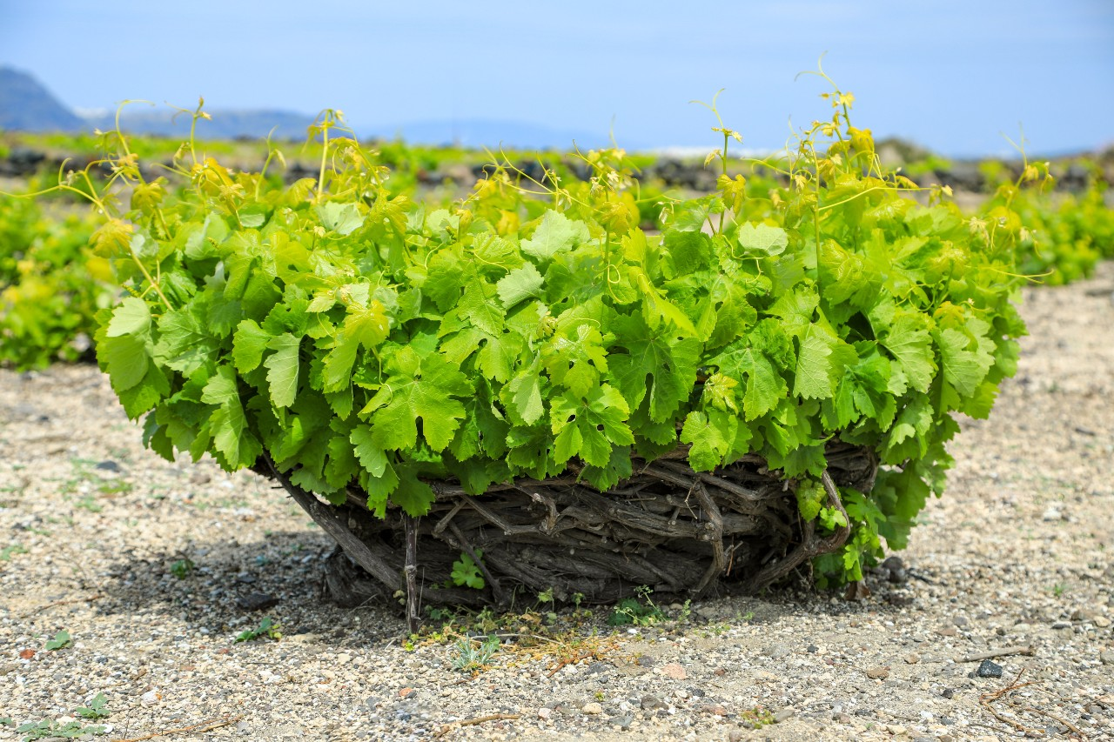
Growing Vines
The Greeks, in particular, became passionate wine-drinkers, and so demand was always high.
They knew that the three essentials of good soil, climate, and type of vine combine to create differing varieties of grape and taste.
While we know of many cultural
practices and the mythology involving
wine in the Greek world, it was the
Romans who have left us the best
descriptions of the process of making it.
On the island of Santorini, they train
their vines into basket shapes.
This training system reduces waste of
water and ensures greater exposure of
the leaves to the sun and lesser need for
chemical treatments.

Slide 6
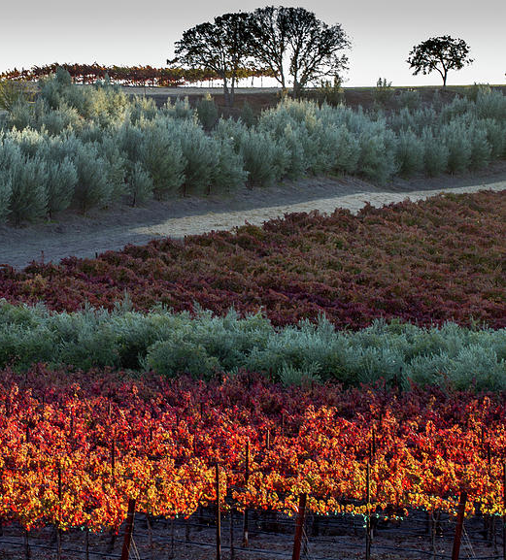
Growing Vines Cont.
Training vines to grow at the optimum height from the ground (which depends on local temperatures and wind), along a trellis, if necessary, the optimum distance from each other, and regular pruning to strengthen the vine were all practices well-known to the Greeks.
Vines could be left free-standing, supported with timber props, or even trained to grow up trees (especially olive trees).
This last method was prevalent in Roman vineyards with the best reputation for quality.

Slide 7
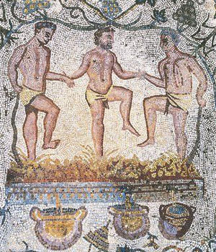
Early Wine Making
The ancients knew full well the value of fine wines and distinguished their production between new young wines for the masses or armies in the field and more mature wines for the connoisseur.
Certain places quickly gained prestige as good winemakers, notably the Greek islands of Chios, Kos, Lesbos, Rhodes, and Thasos.
The industry became highly lucrative and regulations were imposed, as indicated in surviving inscriptions, concerning the sale of wine, its export, and guaranteed quality.
Aside from large-scale producers, most estates would have had their own vineyards for private consumption. In Rhodes, for example, two-thirds of the villas had vineyards.

Slide 8
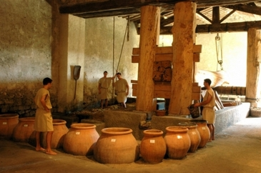
Early Wine Making Cont.
Grapes were harvested and then pressed underfoot in large pottery vessels, baskets, stone vats, or on a simple tiled floor which sloped to a collecting channel.
The process became more sophisticated with the invention of beam and weight presses which increased the crushing efficiency, and which later evolved into even better screw presses from the 1st century CE.
Many vineyards from the Greek islands added sea water to the pressed must to make the wine smoother and increase acidity.
Wines were both white and red, the latter gaining its color from leaving the mash (must) longer before fully pressing out the juice.
A redder color was also achieved by ageing the wine over a few years and even exposing the wine to heat by storing it in lofts built above hearths.

Slide 9
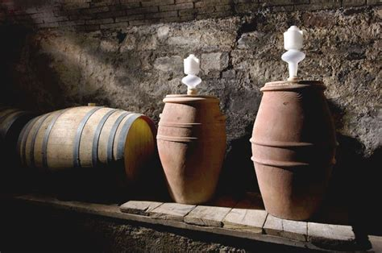
Early Wine Making Cont.
Wine was fermented in large storage terracotta jars, typically set partially into the ground in open-roofed buildings which had walls with apertures to allow a cool movement of air.
When ready, wine was then drained off and stored in clay amphora for transportation, usually sealed with a clay stopper or resin.
Those amphora destined for export were usually stamped to indicate their origin
Wine was sold in markets and, in the Roman world, dedicated wine shops.

Slide 10
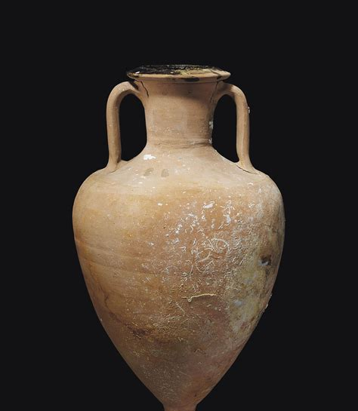
Early Wine Making Cont.
The Romans most valued sweet white wines (which would have been much cloudier than today's wines due to the more primitive production process).
The Carthaginians had a similar taste, producing a famous sweet white wine made from sun-dried grapes.
Wine was considered best as a pure drink without additives, but sometimes more unscrupulous producers and sellers did add substances (anything from spices to honey) in order to disguise the taste of poor wine or wine which had passed its best.

Slide 11
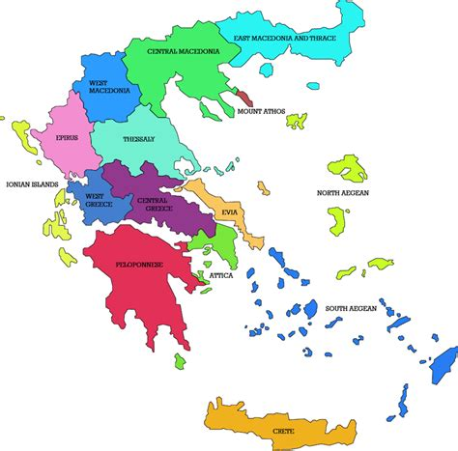
Wine Regions of Greece
Greece’s wine regions are as diverse as the country’s rich and varied geography, stretching from the rugged, mountainous terrain of the north to the sun-soaked islands of the Aegean Sea.
This unique geographic diversity has fostered a wide array of microclimates, each imparting distinct characteristics to the wines produced in its region.
The interplay of climate, elevation, and soil types across Greece allows winemakers to cultivate a broad spectrum of grape varietals, each thriving under different conditions and yielding wines with remarkable complexity and individuality.

Slide 12
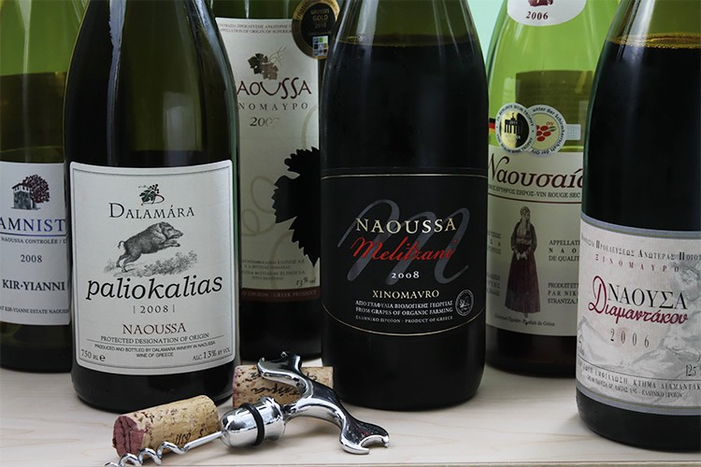
Wine Regions of Greece Cont.
In the mountainous regions of northern Greece, such as Naoussa and Amyntaio, cooler temperatures and higher elevations create ideal conditions for producing elegant, structured reds like Xinomavro, known for its deep tannins and aging potential.
The dramatic altitude shifts in these areas allow for slow, even ripening, leading to wines with bright acidity and vibrant aromas.
Naoussa Xinomavro dry red wines, aged for two years

Slide 13
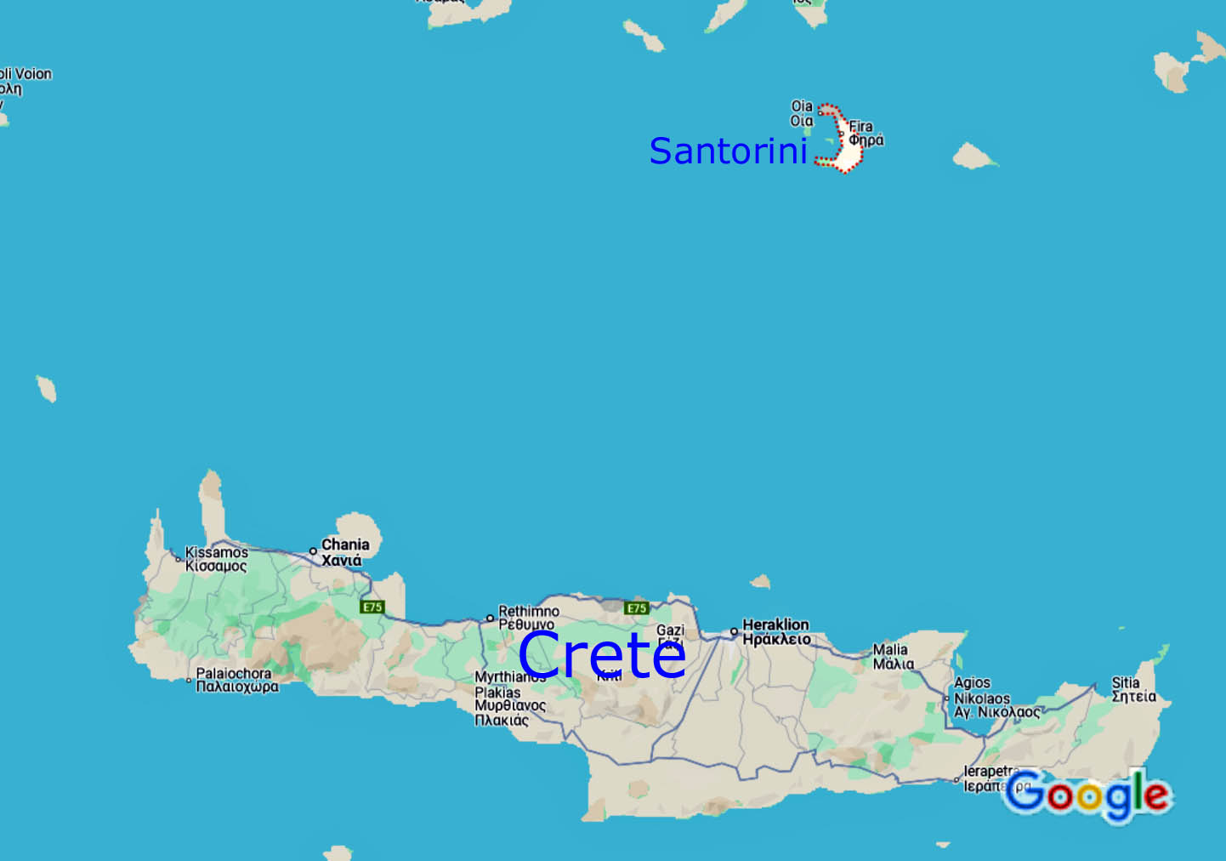
Wine Regions of Greece Cont.
In contrast, the sun-drenched islands of the Aegean, like Santorini and Crete, offer a completely different viticultural landscape.
The volcanic soils of Santorini, shaped by ancient eruptions, are responsible for some of the world’s most distinctive white wines.
Here, the Assyrtiko grape thrives, producing mineral-rich, zesty wines that capture the island’s windswept, arid environment.
Meanwhile, Crete’s warmer, Mediterranean climate gives rise to full-bodied reds and fresh whites, with indigenous varietals such as Liatiko and Vidiano expressing the island’s robust character.

Slide 14
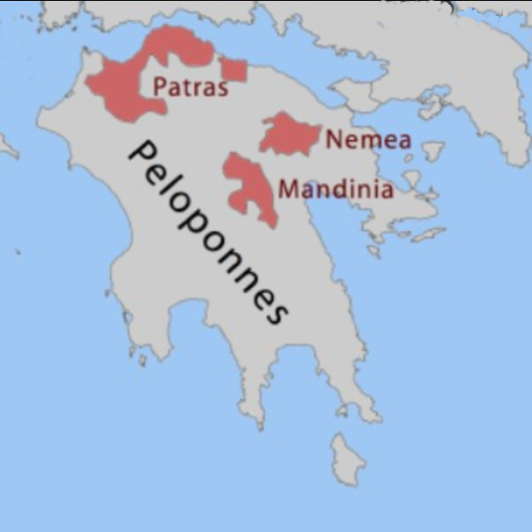
Wine Regions of Greece Cont.
Each wine region in Greece is a reflection of its local microclimate, soil composition, and centuries-old winemaking traditions.
In the Peloponnese regions like Nemea and Mantinia benefit from a mix of warm days and cool nights, perfect for producing the soft, fruit-forward Agiorgitiko red and the aromatic Moschofilero white.
These wines exhibit a balance of ripeness and freshness, a direct result of the region’s temperate climate.
The diversity of Greece’s wine regions is not only influenced by geography but also by the winemakers’ deep connection to the land.

Slide 15
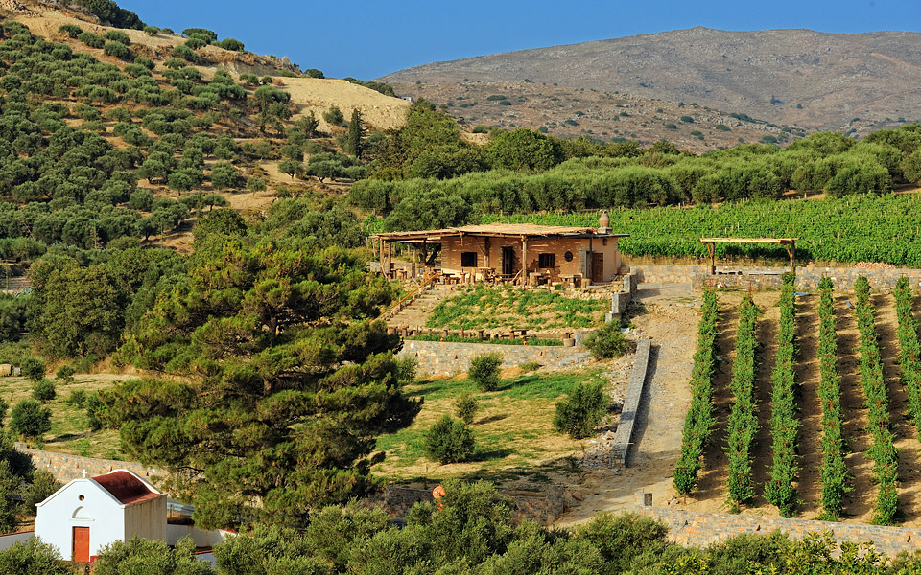
Wine Regions of Greece Cont.
Many Greek vineyards are small, family-owned estates, passed down through generations, with each family adapting their methods to the unique environmental factors of their region.
This combination of tradition and terroir allows Greek wines to express a sense of place unlike anywhere else in the world.
As Greece’s wine industry continues to gain global recognition, it is the country’s geographic diversity and unique microclimates that stand at the heart of its winemaking success.
From the cool, mountainous vineyards of the north to the sun-drenched coastal regions and volcanic islands, Greece’s wine regions offer an unparalleled range of styles and flavors.

Slide 16
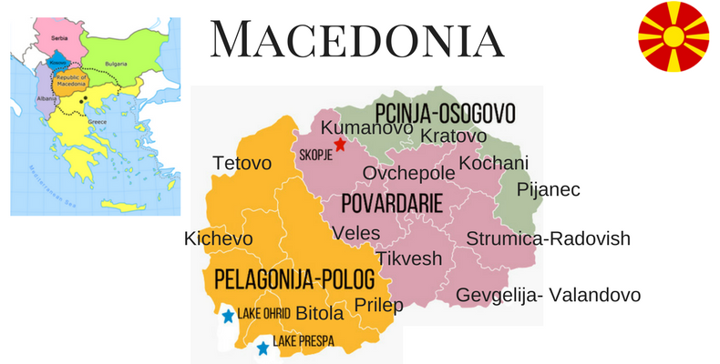
Macedonia
Macedonia, in northern Greece, is one of the country’s most significant wine-producing regions, known for its fertile valleys and cool climate, especially around the foothills of Mount Olympus and Mount Vermio.
The region's flagship grape is Xinomavro, often compared to Nebbiolo due to its tannic structure, high acidity, and aging potential.
Terroir: The terroir of Macedonia is diverse, with clay and limestone soils, abundant rainfall, and cooler temperatures. These conditions contribute to Xinomavro's intense flavor profile of red fruit, tomato leaf, and
earthy aromas.
Prominent Wineries: Ktima Kir-Yianni,
Alpha Estate, and Domaine Tatsis are
among the most well-regarded producers
from this region, with a focus on
producing high-quality, age-worthy wines.

Slide 17
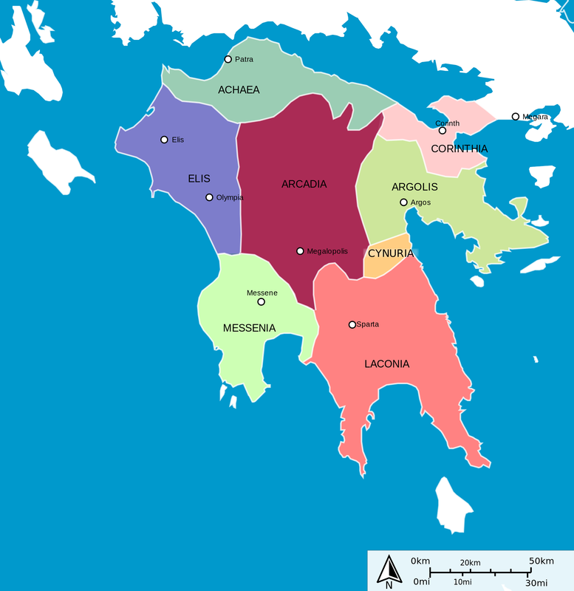
Peloponnese
The Peloponnese peninsula, located in southern Greece, is another vital wine region known for both red and white wines.
It’s home to Agiorgitiko, one of Greece’s most versatile red grapes, and Moschofilero, a floral and aromatic white variety.
Terroir: The region's terroir varies from the high-altitude vineyards of Nemea (where Agiorgitiko thrives) to the cooler, mountainous regions where Moschofilero is grown. The soils here are mostly limestone and clay, with a Mediterranean climate that brings warm days and cool nights.
Prominent Wineries: Gaia Wines, Skouras, and Tselepos Winery are renowned for their modern takes on traditional Greek varietals, bringing them to the international stage.

Slide 18
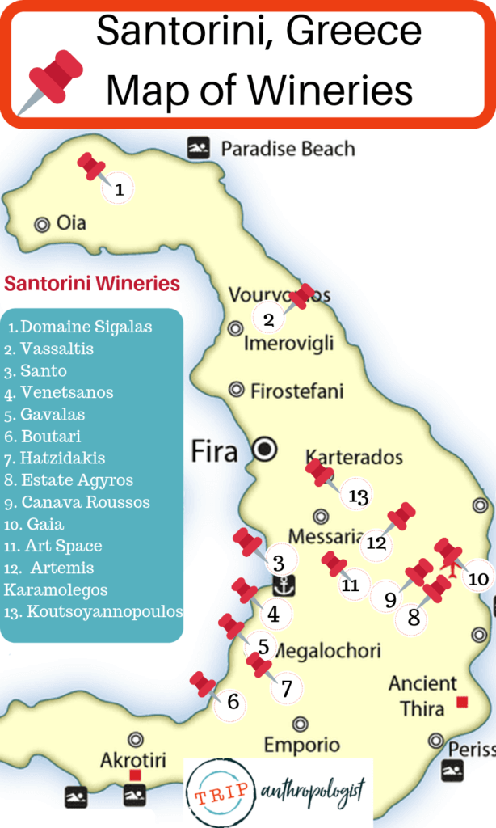
Santorini
Santorini is arguably Greece's most famous wine region, located on the volcanic island of the same name in the Aegean Sea.
The island’s iconic grape is Assyrtiko, a white variety that thrives in the volcanic soil and harsh, windy conditions.
Terroir: The volcanic soil of Santorini is rich in minerals and extremely porous, which, combined with the lack of water and strong winds, forces the vines to grow deep roots and develop intense flavors. The unique basket-shaped vine training system, kouloura, protects the grapes from the island’s strong winds and sun.
Prominent Wineries: Domaine Sigalas, Hatzidakis Winery, and Gavalas Winery produce some of the finest examples of Assyrtiko, known for its high acidity, citrus notes, and minerality.

Slide 19
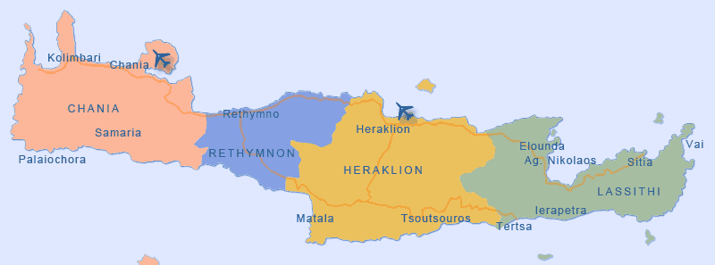
Crete
Crete, Greece's largest island, has a long history of winemaking, with a focus on indigenous varieties such as Vidiano and Liatiko.
The island’s warm Mediterranean climate and varying altitudes create a dynamic environment for viticulture.
Terroir: Crete’s mountainous terrain offers a range of microclimates, with vineyards planted at both high and low elevations. The combination of sandy, limestone soils and the island's abundant sunshine creates ripe, flavorful wines with a good balance of acidity.
Prominent Wineries: Douloufakis Winery, Lyrarakis Wines, and Manousakis Winery are leading the way in promoting Crete’s indigenous varieties and modern winemaking techniques.

Slide 20
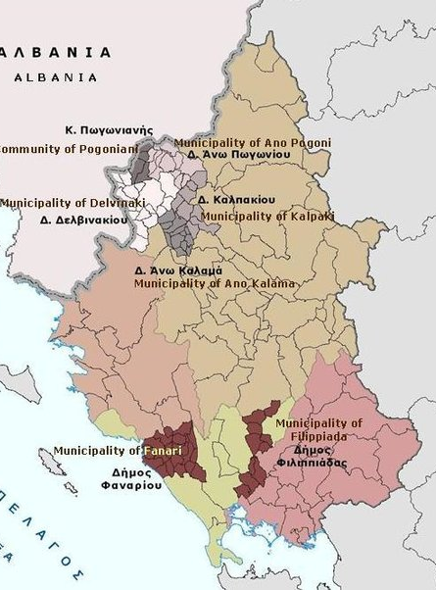
Epirus
Located in the rugged mountains of northwestern Greece, Epirus is known for its cool climate and the production of Debina, a high-acid white grape used to make sparkling and still wines.
The region’s steep vineyards are some of the most challenging to cultivate in Greece.
Terroir: Epirus is characterized by its mountainous terrain and limestone-rich soils, with a cooler climate that preserves acidity in the grapes. The result is wines with bright acidity and crisp, green apple and citrus flavors.
Prominent Wineries: Zitsa Cooperative Winery and Domaine Glinavos are notable producers in this region, focusing on sparkling wines and fresh, vibrant whites.

Slide 21
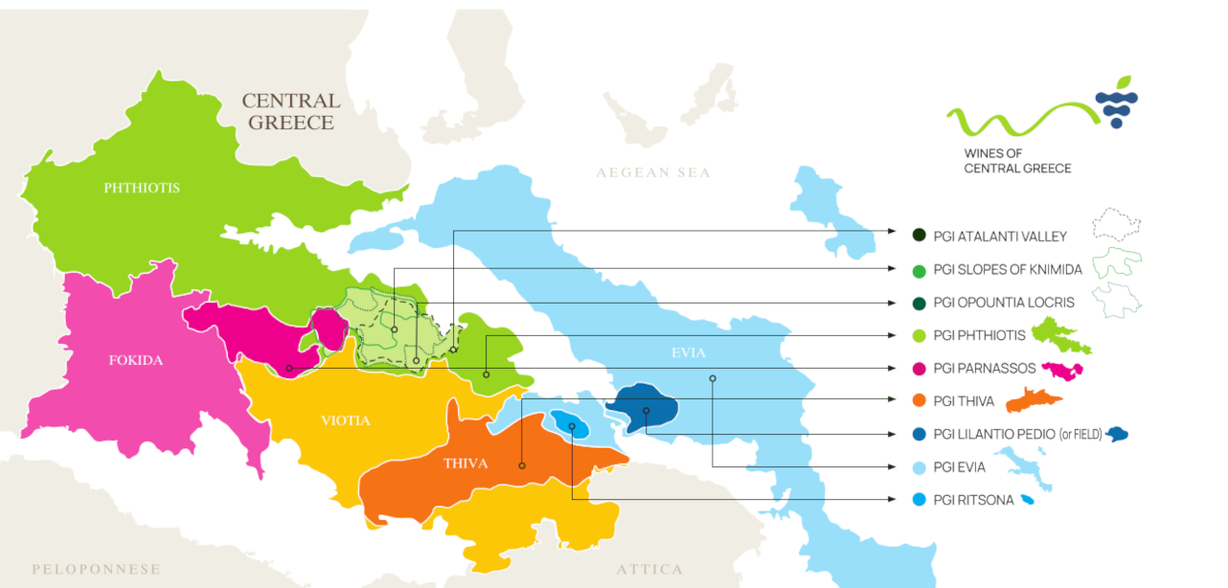
Central Greece (Sterea Ellada)
Central Greece is home to Savatiano, a white grape that has historically been associated with the production of Retsina, the famous resin-flavored wine of Greece.
However, in recent years, winemakers have been producing high-quality dry wines from this variety.
Terroir: The region is characterized by its varied topography, with vineyards located on both flatlands and mountainous areas. The climate is generally warm, but cooling breezes from the Aegean Sea help retain freshness in the grapes.
Prominent Wineries: Papagiannakos Winery and Mylonas Winery are at the forefront of the Savatiano revival, showcasing the grape’s potential for producing elegant, mineral-driven wines.

Slide 22
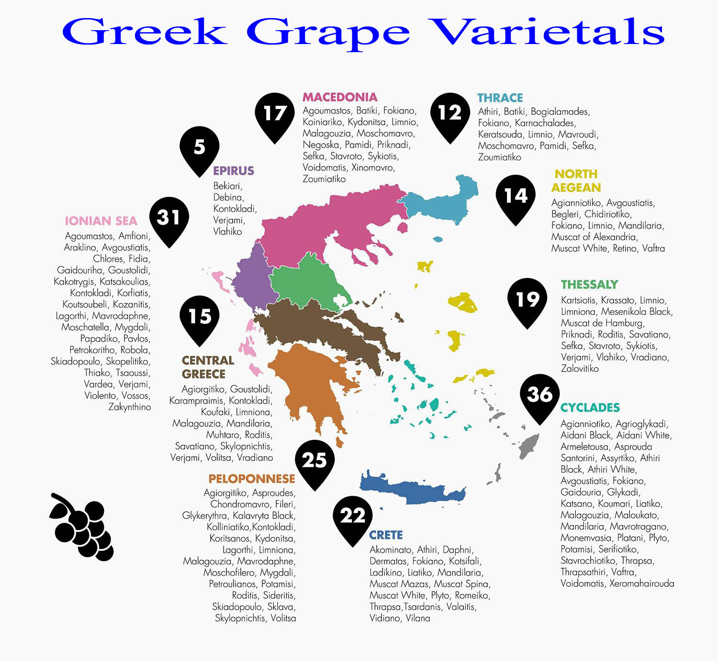
Prominent Grape Varieties of Greece
Greece is home to more than 300 indigenous grape varieties, many of which are unique to specific regions and perfectly adapted to their local terroirs.
The following are some of the most important Greek varietals:
Xinomavro (Macedonia): Known for its aging potential, this red grape produces wines with high tannins, bright acidity, and complex aromas of red fruit, olives, and spice.

Slide 23
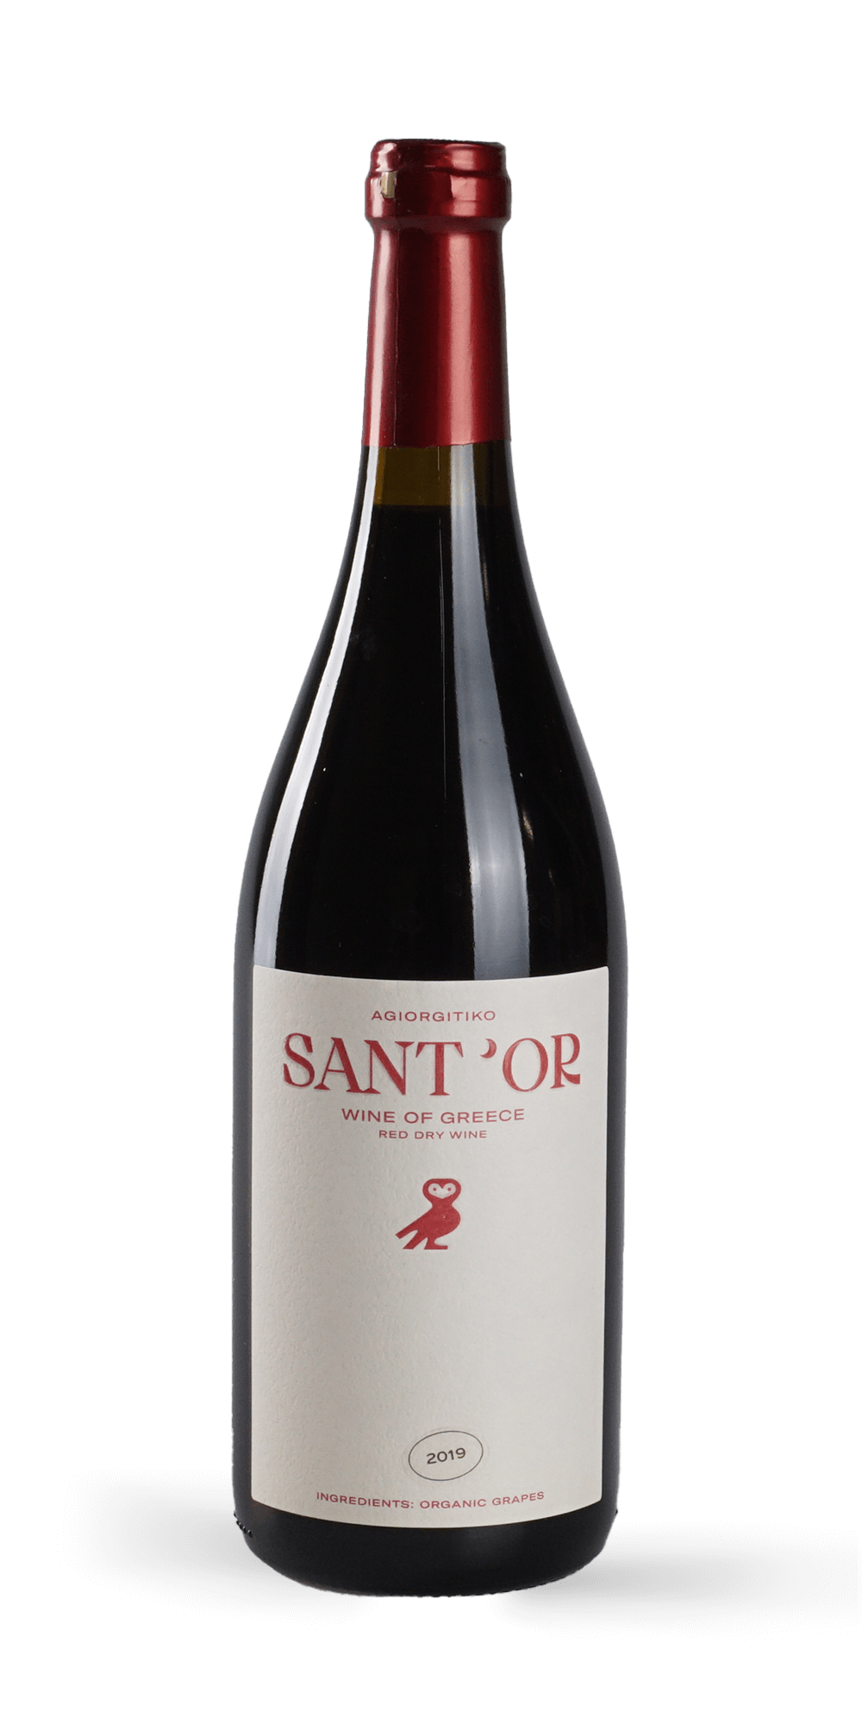
Prominent Grape Varieties of Greece
Agiorgitiko (Peloponnese): Arguably Greece's flagship red wine grape, Agiorgitiko wines can be as varied as the regions they are grown in.
It is frequently referred to as “Mult dynamic”, since it is capable of producing a large range of styles, from refreshing rosés, delicious dry reds to concentrated sweet wines.
A versatile red variety that can produce everything from fruity, easy-drinking reds to structured, age-worthy wines.
It is known for its soft tannins and flavors of dark berries and plums.
Agiorgitiko is a captivating grape variety that caresses the senses with elegance, freshness and intensity of aromas and flavors.

Slide 24
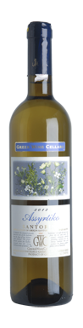
Prominent Grape Varieties of Greece
Assyrtiko (Santorini): A highly regarded white grape with intense acidity, minerality, and citrus flavors, Assyrtiko is often compared to Riesling and Chardonnay for its ability to age and express terroir.
It is possibly some of the greatest varieties found in the Mediterranean basin.
It originated from Santorini (Assyrtiko-Santorini) but it spread all over Greece, becoming, in terms of quality, one of the most important native varietals.
It produces mainly dry white wines, some of which are being aged in oak. However, a number of sweet wines are made, from late harvests or sun dried grapes.

Slide 25
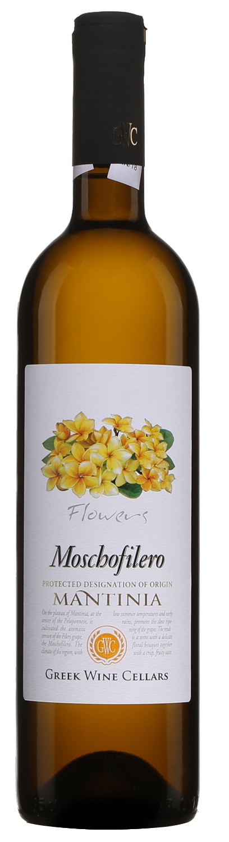
Prominent Grape Varieties of Greece
Moschofilero (Peloponnese): Moschofilero is a Greek grape that hails from Peloponnese. It is an aromatic and late-ripening variety that delivers high yields, but it is sometimes sensitive and finicky to grow.
Varietal Moschofilero wines can be incredibly versatile. They will usually have bright and crisp acidity, which highlights their clean and fresh character. The wines from lower altitudes will usually have more freshness, and those from higher vineyards tend to have a more prominent floral character.
Typical aromas are reminiscent of peaches, jasmine, orange blossom, roses, and citrus fruit.
Moschofilero is usually enjoyed young, but the best examples sometimes show aging potential.
These wines would pair nicely with fish and seafood, poultry, light snacks, spicy dishes, Asian fare, and salads.

Slide 26
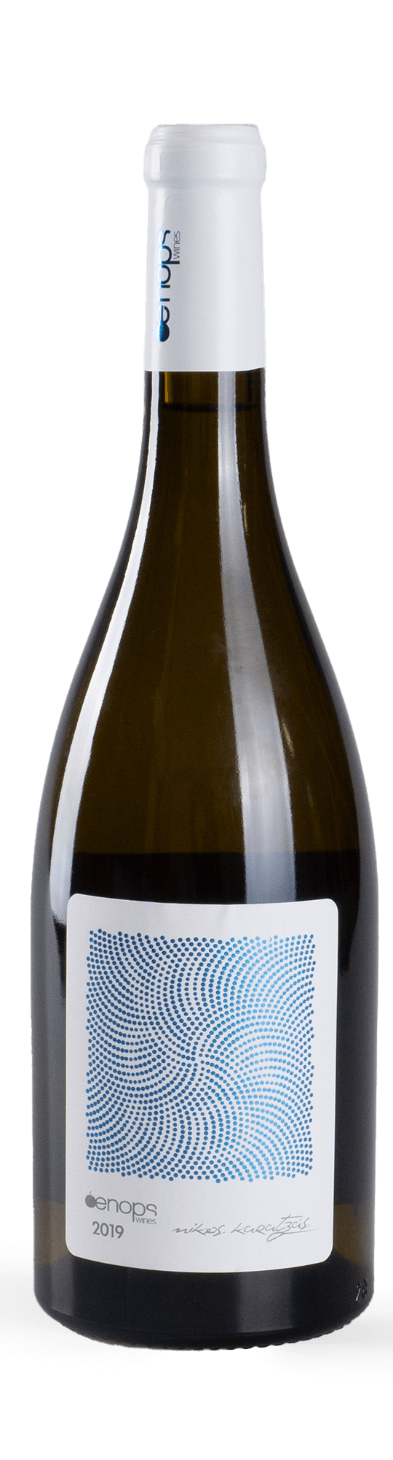
Prominent Grape Varieties of Greece
Vidiano (Crete): It is a white grape variety coming from Crete, used to produce white dry whites, sometimes aged in oak.
Vidiano has been introduced to commercial production over the last decade. Producers agree on a tremendous quality potential, so essentially this is history in the making.
Tastine notes: This rising star of Cretan light-bodied white grapes produces wines with melon, peach, apricot, citrus and floral notes, along with a rich texture and balancing acidity plus a long, lemon-driven finish.
Vidiano wines are best paired with fish or vegetable dishes. It can be served with simple, grilled fish dishes, but it has enough character to work well with fattier fish or creamy sauces.

Slide 27
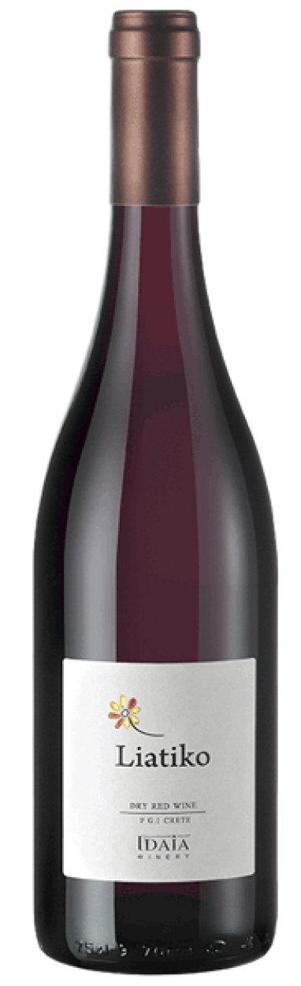
Prominent Grape Varieties of Greece
Liatiko (Crete): Liatiko is an black-skinned grape variety grown on Crete.
In the 21st Century, only a handful of producers make wine from Liatiko, but the variety was once of great importance to Crete's winemakers, particularly during the Middle Ages, when the island was under Venetian rule.
An ancient red variety that produces wines with a light color but intense aromas of dried fruits, herbs, and spices.
Liatiko must is typically quite pale, and loses much of its tint during maturation, whether in tank, barrel or bottle. "Bricking" (the process whereby a red wine takes on orange-brown, brick-like colors) sets in early for all but the most robust examples.
Food matches for Liatiko wines include: Grilled lamb skewers (dry variety), Deep-dish pizza (dry variety), Raisin cake (sweet variety)

Slide 28
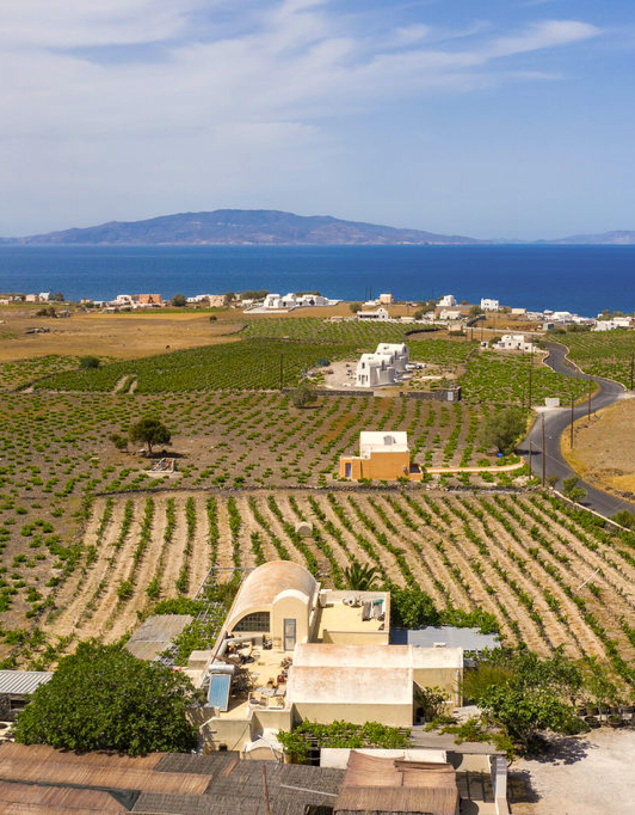
Notable Wineries of Greece
Greek winemakers are increasingly gaining international acclaim for their ability to combine tradition with modernity. Some of the most renowned wineries include:
Domaine Sigalas (Santorini): is a small, scenic winery in Baxedes near Oia, offering award-winning wines and good views of the sunset year-round.
As with most of Santorini wineries, the most commonly used variety of white grape here is Assyrtiko, used alone or blended with Athiri, Aidani, Mandilaria, and Mavrotragano grapes. Sigalas’ renowned and award-winning wines are available across Greece and exported worldwide.
Known for producing some of the best Assyrtiko wines in the world.
Website: sigalas-wine.com

Slide 29
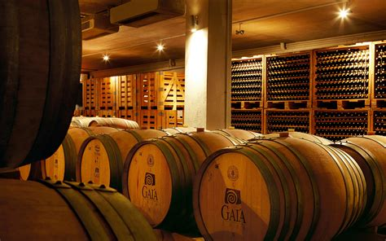
Notable Wineries of Greece
Gaia Wines (Peloponnese & Santorini): A leader in modern Greek winemaking, Gaia produces both Agiorgitiko and Assyrtiko with international acclaim.
Gaia is a Greek wine producer with wineries in Nemea and on the island of Santorini.
It is particularly known for its mineral, crisp Thalassitis Santorini wine made from the Assyrtico grape, and its flagship wine from Nemea, made from Agiorgitiko. The latter is a powerful, smoothly textured red wine with soft tannins which reaches its peak after 5-10 years of age.
The company began production in 1994 with 10,000 bottles of Thalassitis.
Since then, production of this wine has increased ten-fold, and Gaia now produces five wines on Santorini, including a vinsanto.
These are made in a converted tomato factory on the waterfront.

Slide 30
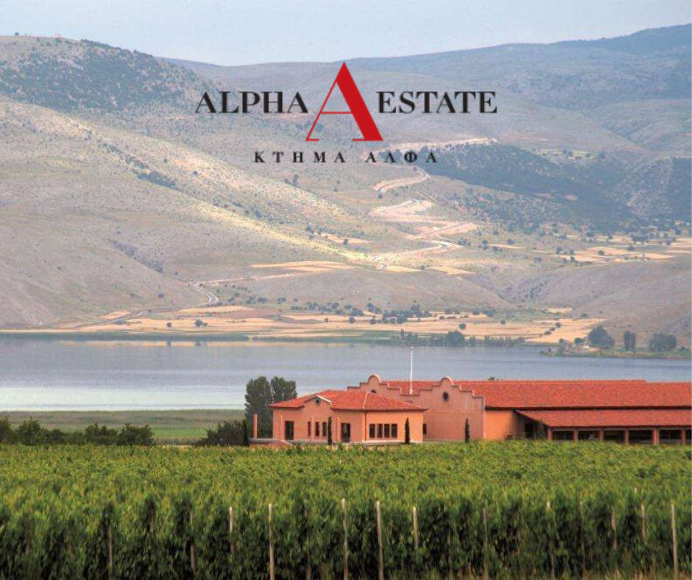
Notable Wineries of Greece
Alpha Estate (Macedonia): This winery focuses on producing top-quality Xinomavro and other international varieties.
Alpha winery vineyard is situated in the "AMPELIA" location (meaning vines) of Vegora place, in the heart of the Amyndeon region, at an altitude of 620-710 meters.
The varieties cultivated are: Sauvignon Blanc, Gewürztraminer, Malagouzia, PinotTannat, Barbera, Mavrodaphne, Merlot, Syrah Noir, Negro Amaro, Montepulciano, and Xinomavro.
Their wines consistently score between 88 and 93 points.

Slide 31
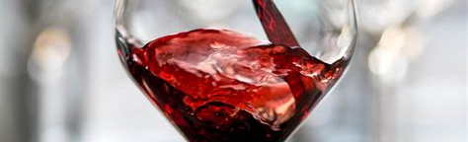
A Tapestry of Terroirs
Greece’s wine regions offer a diverse array of terroirs, each contributing to the country’s rich and varied wine production.
From the bold reds of Nemea to the crisp whites of Santorini and the innovative blends of Crete, Greek wine is a testament to the country’s dynamic and evolving wine industry.
Each region, with its unique combination of climate, soil, and grape varietals, adds a distinct thread to the vibrant tapestry of Greece’s wine, making it one of the most exciting wine destinations in the world.

Slide 32
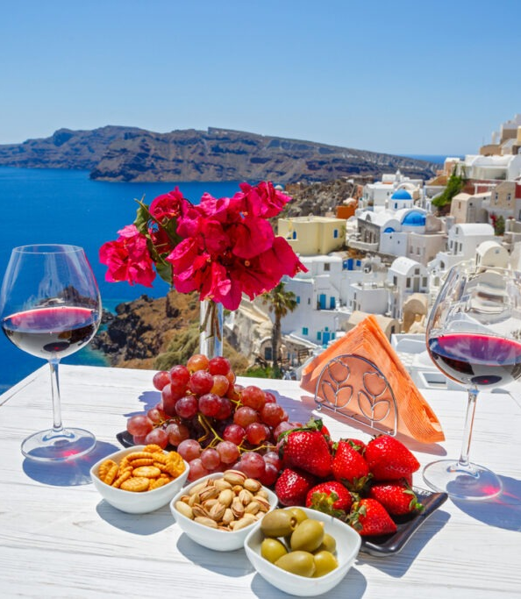
Conclusion
Greek wines are a testament to the country's rich history and diverse terroir, blending ancient traditions with modern innovations.
Each wine region in Greece reflects the country's varied landscapes and climates, producing unique styles and flavors.
The full-bodied reds of Macedonia, made from the Xinomavro grape, and the crisp, mineral whites of Santorini, crafted from Assyrtiko, are just two examples of how these wines capture the essence of their regions, and offer a true taste of Greece’s viticultural heritage.

Slide 33
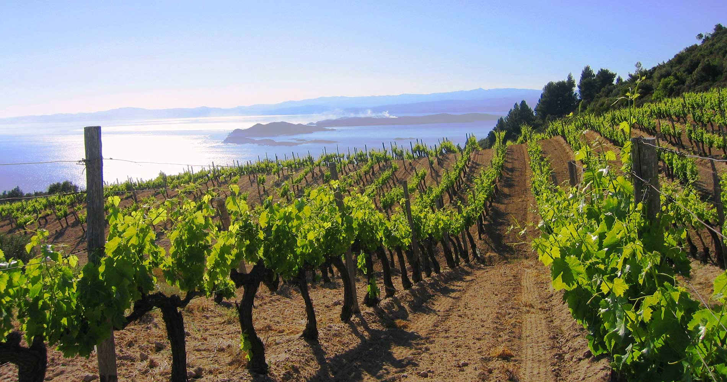
Greece’s wine scene blends centuries of tradition with modern winemaking techniques, showcasing both ancient varietals like Agiorgitiko and Mavrotragano and innovative approaches to blending and vineyard management.
Once hidden gems, Greek wines are now gaining international recognition for their balance of heritage and contemporary tastes.
Winemakers are reviving ancient methods, such as aging in amphora and traditional pruning, to craft wines that honor the past while embracing the future.
Each bottle offers a unique journey of flavor, embodying Greece’s rich winemaking heritage and its evolving, dynamic industry.

Slide 34
Wine of Greece
I hope you found these facts about Greek Wine
interesting and informative.
Hopefully, you all get the opportunity to visit the beautiful and historic country for yourselves.
Thank you for coming!

Slide 35
Acknowledgement
My seminars are the result of many years of travel experience
combined with many hours of research over the internet.
The article was crafted based on a broad understanding of the Greecian wine industry, drawing on general knowledge about the history, wine regions, and varietals of Greece.
Specific resources or citations were not directly referenced in creating this content.
I would like to acknowledge the many sources I have accessed.

Slide 36
Resources: Books and Guides
Bibliography
Wine Enthusiast. "Greek Wine: A Complete Guide to Greece's Grapes, Regions and Styles." Wine Enthusiast, https://www.winemag.com. Accessed September 2023.
Decanter. "Guide to Greek Wines: Exploring Greece’s Top Regions and Grapes." Decanter, https://www.decanter.com. Accessed September 2023.
Greek Wine Federation. "Wine Regions and Indigenous Grapes of Greece." Greek Wine Federation, https://www.greekwinefederation.gr. Accessed September 2023.

Slide 37
Resources: Books and Guides
Ktima Kir-Yianni. "Xinomavro: The Jewel of Macedonia." Kir-Yianni Winery, https://www.kiryianni.gr. Accessed September 2023.
Domaine Sigalas. "Assyrtiko and the Volcanic Terroir of Santorini." Domaine Sigalas, https://www.sigalas-wine.com. Accessed September 2023.
Gaia Wines. "Agiorgitiko and the Wines of Nemea." Gaia Wines, https://www.gaia-wines.gr. Accessed September 2023.
Alpha Estate. "Xinomavro: The Essence of Northern Greece." Alpha Estate, https://www.alpha-estate.com. Accessed September 2023.
Hatzidakis Winery. "Organic Viticulture in Santorini." Hatzidakis Winery, https://www.hatzidakis.gr. Accessed September 2023.

