Slide 1


Grand Cayman
Presented by
Fellow Cruiser
Marc Silver

Slide 2
What I Will Cover
My Port Philosophy
Don’t Miss the Ship
Money
About Grand Cayman
Area Map of Grand Cayman
Map of Grand Cayman
Grand Cayman Transportation
Places to see or at least consider
A few restaurant recommendations
Conclusion

Slide 3
My Port Philosophy
I have been cruising for over 45 years and have taken over 100 cruises.
So, I consider myself an experienced cruiser.
The information I will present is based on those many years of
experience.
When I am on a cruise where the city, I want to visit is not the port city,
I always recommend taking a ship’s tour.
But when I am in a port with multiple attractions nearby and easy to
see on my own - I will do it on my own.
This presentation is for that type of port.

Slide 4

Don’t Miss the Ship
How to Avoid Missing Your Ship
Pay attention to the time. - Ship time and local time are often
different.
Put a return-to-ship reminder on your phone.
Choose excursions wisely.
If a ship-sponsored excursion is late returning to port, the ship will
wait for you. If you are on your own???
Be Prepared
Have your Passport, Credit Card, and phone numbers for your ship
port agent.
What to Do If You Miss the Ship
Most cruise lines have port agents stationed in the port area to assist if your ship has left without you. If your are lucky, when cruisers are late returning to the vessel, the ship’s crew will often remove the passengers’ essential items – passports, cell phones, and medication -- from the ship to leave with the port agents.
The Port Officials can help you with contacting your ship
and making necessary travel arrangements.

Slide 5
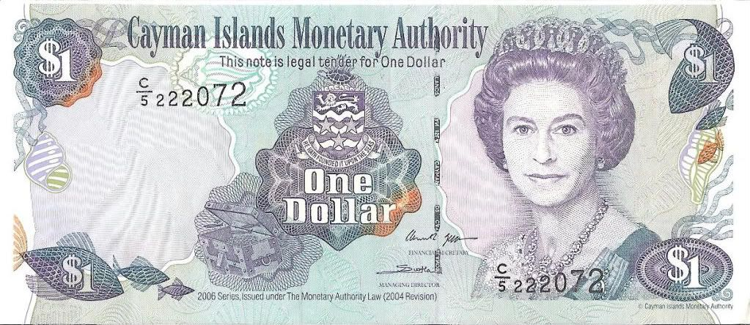
Money
The Cayman Islands Dollar (KYD) is the currency of the Cayman Islands.
Abbreviated with the dollar sign $, or alternatively, CI$ or $KYD to distinguish it from other dollar-denominated currencies. It is subdivided into 100 cents
The Official Exchange is $1.00 KYD = $1.20 USD
CI $1 = US $1.25 as the ‘street’ conversion
Or $.83 KYD to the US Dollar

Slide 6
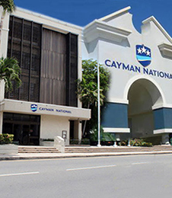
About Grand Cayman
Grand Cayman is the largest of the three Cayman Islands and the location of the territory's capital, George Town. In relation to the other two Cayman Islands, it is approximately 75 miles southwest of Little Cayman and 90 miles southwest of Cayman Brac.
Offshore banking is huge here.
There are just under 600 banks and trust companies in Grand Cayman, including 43 of the 50 largest banks in the world. Because of this large financial presence on the island, banking, investments, and insurance drive the economy in Grand Cayman

Slide 7
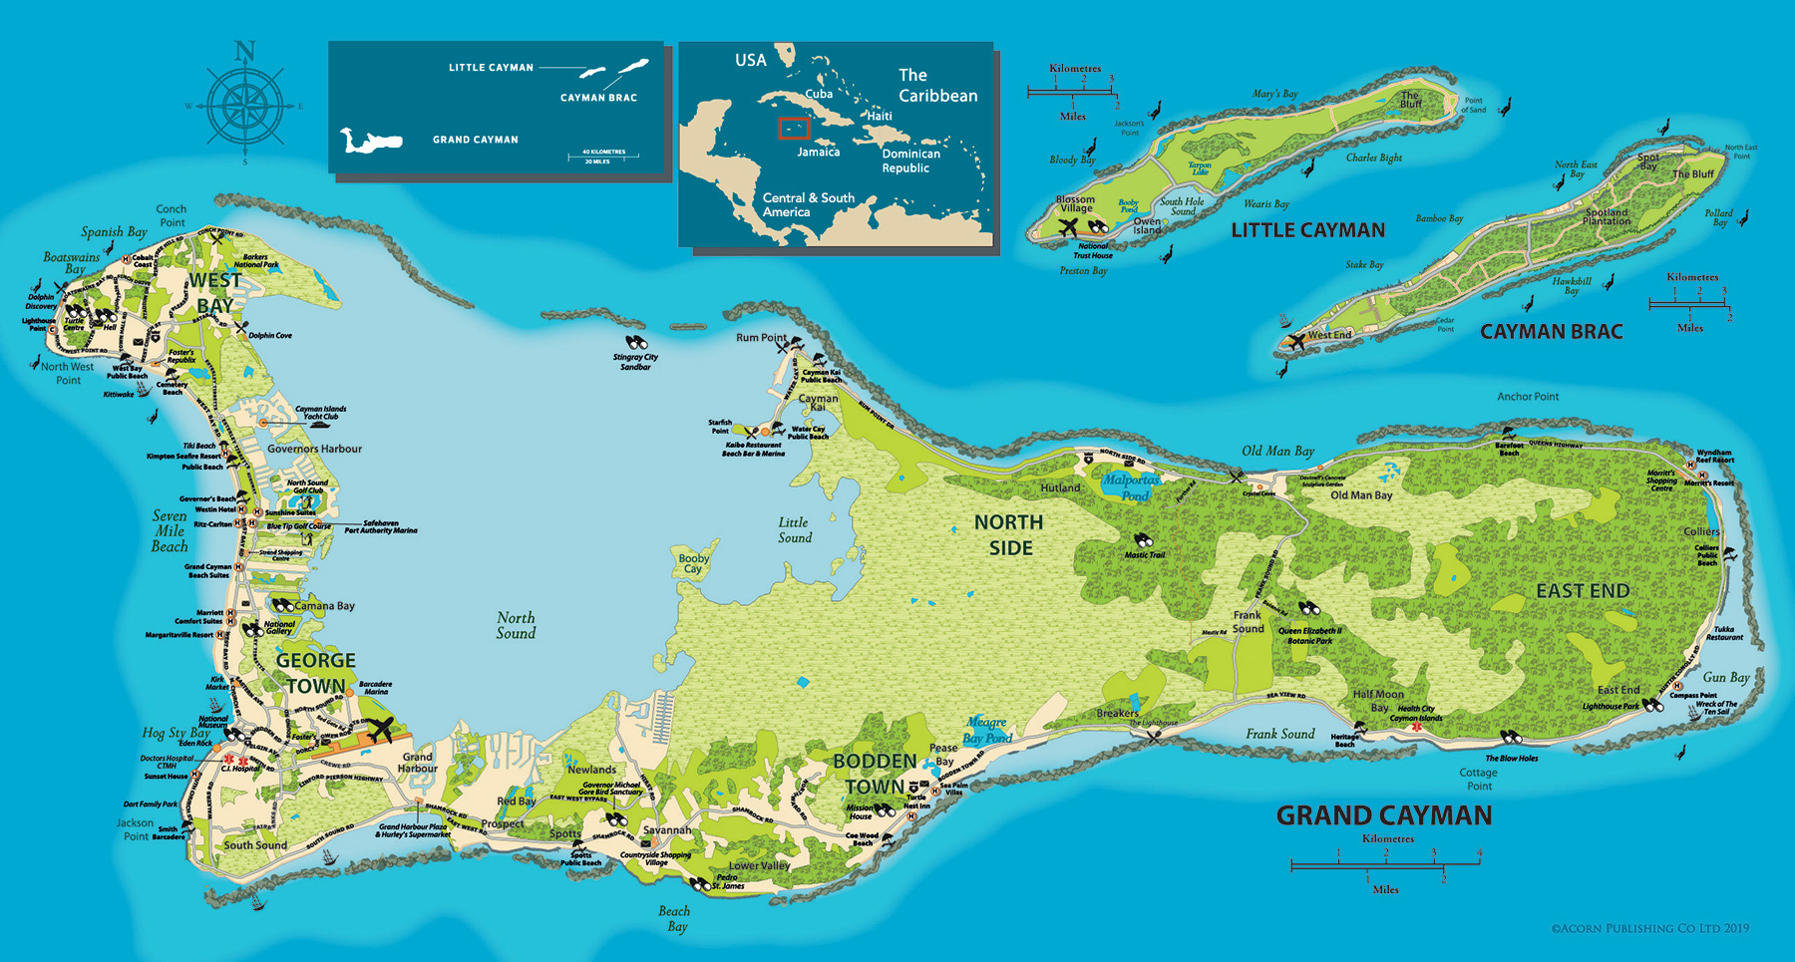
Map of Grand Cayman

Slide 8
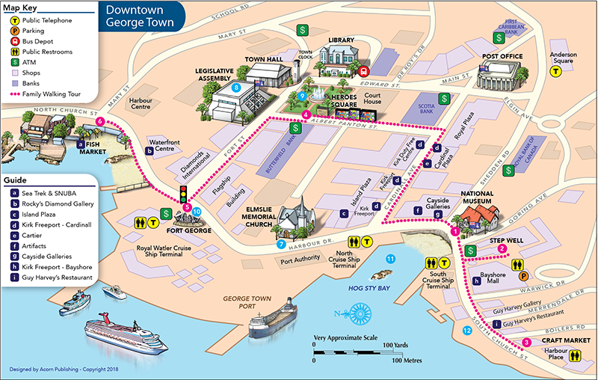
Map of George Town

Slide 9
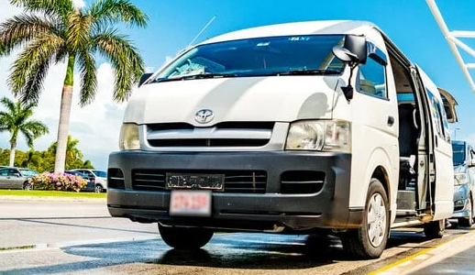
Grand Cayman Taxis
The Cayman Islands Government-owned digital fare calculator ensures consistent and transparent pricing for taxi fares by setting standard prices for routes.
Their app allows passengers to plug in their route, the number of passengers and see what the fare should cost in both US and Caymanian dollars. It also allows users to input the number of passengers and how many pieces of luggage a visitor has. There is also a
sliding scale for five passengers or more.
The CI:GO app is available for free in the Google Play Store and the Apple App Store.
You can also negotiate island tours with your taxi driver, prior to departure.

Slide 10
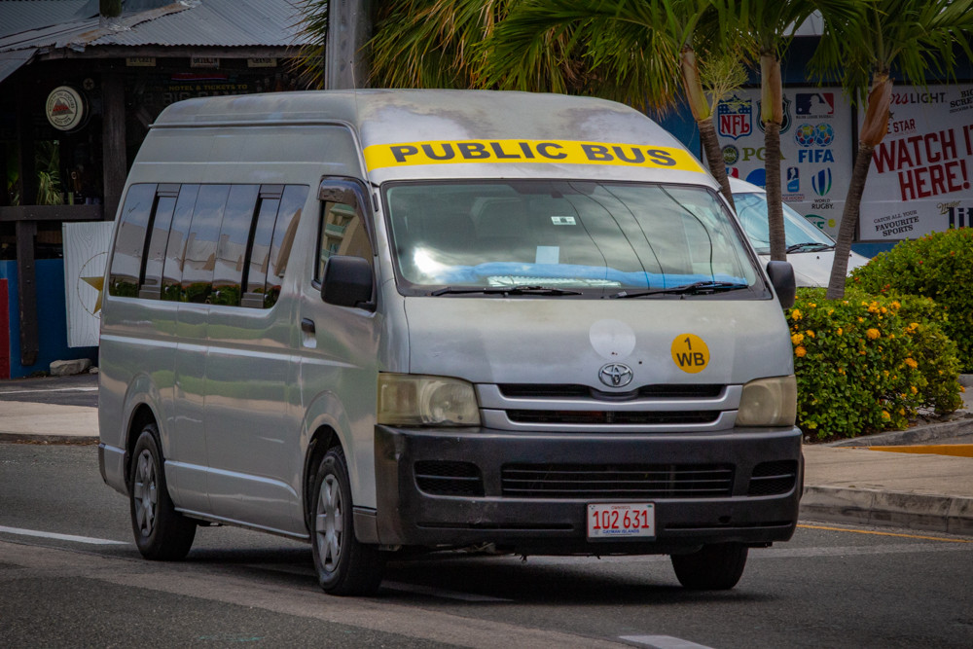
Grand Cayman Buses
Bus Fares
The average fare is CI$2 per journey or CI$3.50 if you take a long trip like George Town to East End or North Side. Any journey that crosses the Frank Sound junction costs CI$3.50. Any journey that stops before the Frank Sound junction costs CI$2. Any journey that goes beyond Hutland Road, such as Rum Point and Cayman Kai, will cost CI$8.
Route | KYD | USD
George Town - West Bay | $2 | $2.50
George Town - Bodden Town | $2 | $2.50
George Town - East End | $3.50 | $4.37
George Town - North Side | $3.50 | $4.37
George Town - Cayman Kai | $8 | $10
George Town - Walkers Road and Olympic Way | $2 | $2.50

Slide 11
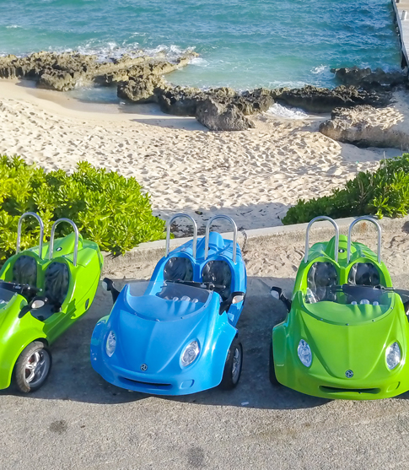
Vehicle Rental
600 Meters north of the dock is Scoot N Tour Cayman. They offer Tiny 3-wheel car rental for up to 9 Hours for US $149
On Grand Cayman, there are electric scooters that can also be rented.
You must have a driver’s license to be able to rent a vehicle in the Cayman Islands.
You can also rent a car at Caman Car Rental next door to Scoot N Tour Caman.

Slide 12
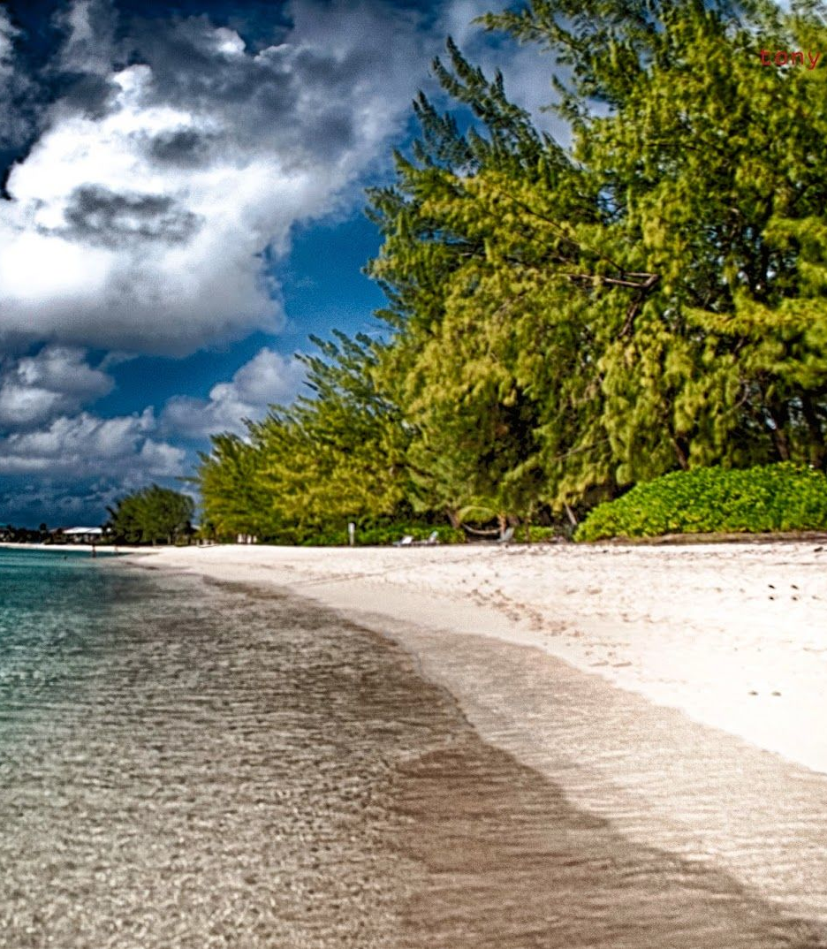
Seven Mile Beach
Seven Mile Beach has been lauded as one of the Caribbean's best beaches. Take one glance at this crescent-shaped shore and one sniff of the soft, coral sand and you'll easily understand why.
Many of Grand Cayman's best resorts are situated on Seven Mile, and there are a number of casual beach bars and restaurants, a playground, restrooms, and showers to boot.
What's more, it's also a great spot to try snorkeling for the first time – the clear water allows snorkelers to see the vibrant fish and beautiful coral.

Slide 13
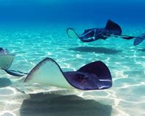
Stingray City
Located in the North Sound area of Grand Cayman, Stingray City is the most popular attraction on any of the three Cayman Islands. Travelers insist it's a tourist trap – but perhaps a tourist trap that's worth it.
The "city" is actually a shallow sandbar where you can interact with and feed the wild Atlantic stingrays that live freely in those waters (there are no penned enclosures). Previous visitors reveled in the opportunity to get so close to the creatures and insist that it's not dangerous, as long as you follow the guidelines of the instructors.

Slide 14
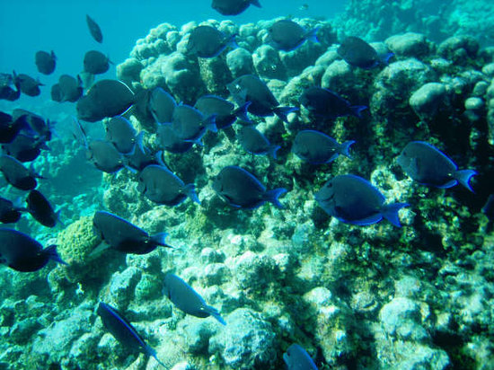
Eden Rock & Devil's Grotto
Just south of Seven Mile Beach and approximately 46 feet below the surface are Eden Rock and Devil's Grotto, two of the most popular diving spots on Grand Cayman.
Both are wonderful underwater mazes filled with tarpon, silversides, parrotfish and barracuda, and they should be enjoyable swims for both beginner and intermediate snorkelers.

Slide 15
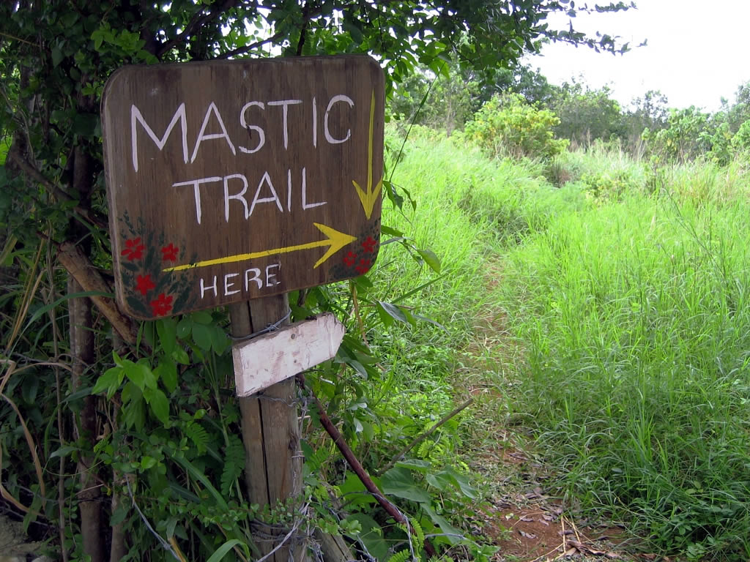
Mastic Trail
Mastic Trail to your list of Grand Cayman must-dos. The trail is a 200-year-old gravel path that winds through a native mangrove swamp and a 2-million-year-old woodland area, surrounded by some of the island's most colorful and rare plant life. The 2.3-mile trail (one-way) is preserved as a flat, beginners' hike by the Cayman Islands National Trust, though some recent travelers said there is a section where scrambling is required and as such, you'll want to wear the appropriate
footwear. Remember to take bug repellant as the
mosquitoes can be relentless.
Because it's sheltered from the sea breeze, the trail
can get quite hot and humid. If you’re planning a
trip, you'll have a more pleasant experience if you
visit in the morning.

Slide 16
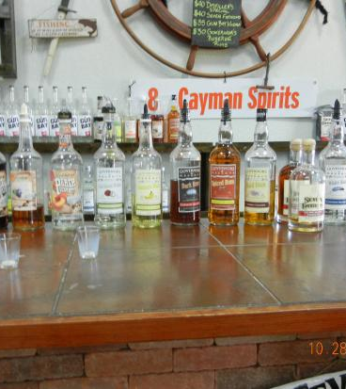
Cayman Spirits Co. Distillery
What started in 2008 as a small distillery producing ocean-aged rum has become the 5,000-square-foot Cayman Spirits Co. Distillery. What's unique about this distillery is the way they age their rum: on the ocean floor. In fact, it was the first distillery to do so. These days, in addition to producing rum, the distillery also produces flavored rums, vodka and liqueurs. A tour of the George Town distillery, which usually takes about 30 to 40 minutes and includes tastings of Seven Fathoms Rum, Gun Bay Vodka, and Governor's Reserve Rum, along with the seasonal Distiller's Special spirit.
Tours cost $15 per person

Slide 17
Restaurants
There are a lot of excellent restaurants in Grand Cayman. Especially for seafood.
Here are some recommendations in Grand Cayman:
Ms. Piper’s Kitchen + Garden
Blue by Eric Ripert
Library by the Sea
Saint June

Slide 18
Conclusion
Grand Cayman is a beautiful City with a rich history and numerous attractions.
Regardless of what you're looking for, Grand Cayman has something for everyone.
I hope this presentation will help when we visit Grand Cayman!

Slide 19
Thanks For Coming
If you have any more questions, please ask.
I will do my best to answer them for you.
Have a great visit in Grand Cayman !

