Slide 1
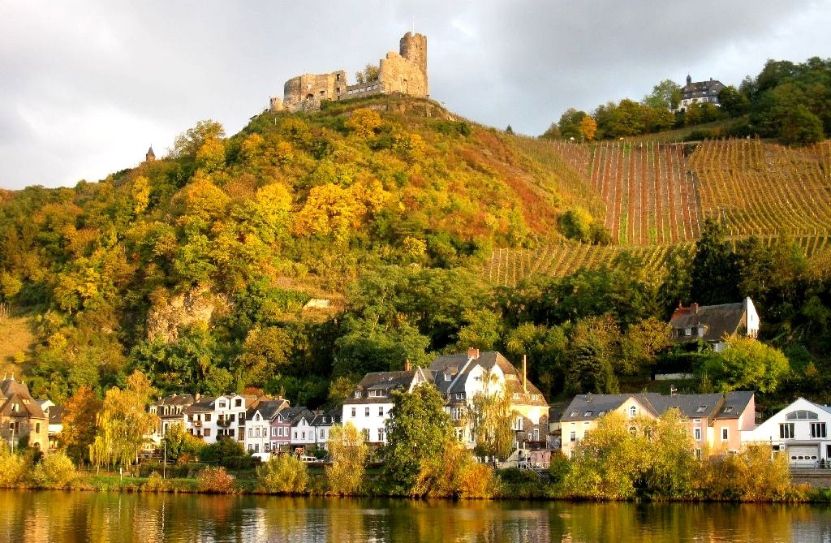
The Wines of Germany Presented by: Marc Silver

Slide 2
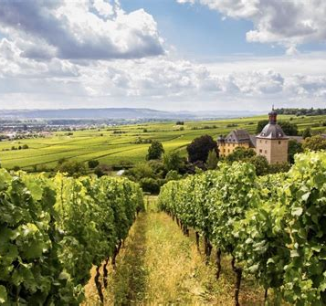
The Wine of Germany
Germany has earned a distinguished reputation as one of the world’s finest wine producers, known for its unique expression of varietals, particularly Riesling.
Though the country's wines were historically overshadowed by neighboring France and Italy, a renaissance in recent decades has brought German wines back to global prominence.
The diversity in terroir, the distinct wine regions, and the meticulous craftsmanship of German winemakers all contribute to this success.

Slide 3
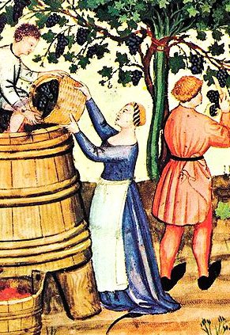
A Brief History of German Winemaking
Winemaking in Germany dates back to Roman times. Vineyards were first planted along the rivers Rhine and Moselle, where the climate and soil conditions proved ideal for viticulture.
Over the centuries, Germany's wine industry has evolved through periods of expansion and decline, often influenced by political and economic factors.
In the late 19th century, Germany's wines, particularly Rieslings, were considered among the most sought-after and expensive in the world.
However, the two World Wars and the advent of mass-produced, lower-quality wines in the mid-20th century diminished Germany’s wine reputation.
In recent decades, a focus on quality, along with sustainable and biodynamic practices, has revived the industry, positioning German wines back at the forefront of the global wine market.

Slide 4
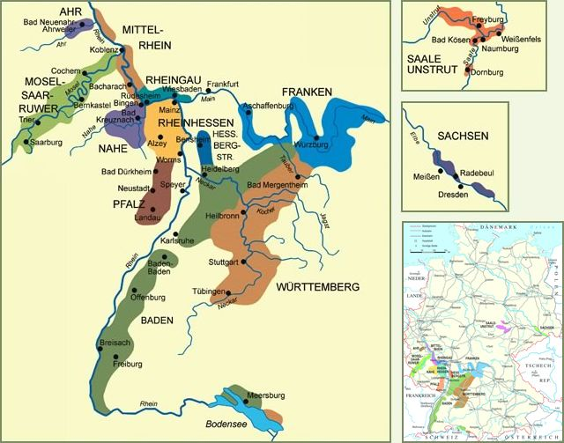
Major Wine Regions of Germany
Germany’s 13 official wine regions—called "Anbaugebiete“, each offer distinct flavors and characteristics influenced by terroir, climate, and traditional winemaking practices.
Let’s explore the most significant wine regions and their contributions to German wine culture.

Slide 5
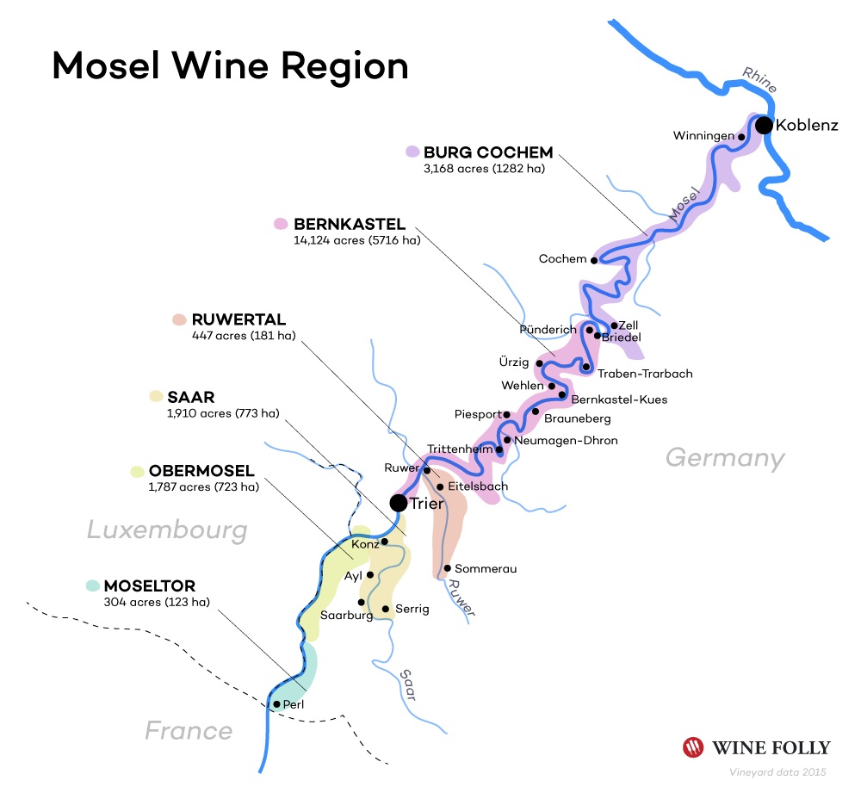
Mosel
Varietals: Riesling, Elbling, Pinot Blanc (Weißburgunder), Pinot Noir (Spätburgunder)
Terroir: Steep, south-facing slate soils; proximity to the Moselle River moderates temperatures
Notable Wineries: Weingut Egon Müller, Weingut Dr. Loosen, Weingut J.J. Prüm
The Mosel region, with its winding river valleys and dramatic slopes, is perhaps the most iconic wine region in Germany.
The steep slate-covered vineyards provide an ideal environment for growing Riesling, which thrives in cooler climates and reflects the terroir with remarkable clarity.
Rieslings from the Mosel are known for their floral aromas, bright acidity, and minerality.
Wineries like Egon Müller and Dr. Loosen have built international reputations, producing Rieslings that range from dry to lusciously sweet, often with great aging potential.
Weingut J.J. Prüm, in particular, is known for its extraordinary Eisweins (ice wines), made from grapes harvested after the first frost.

Slide 6
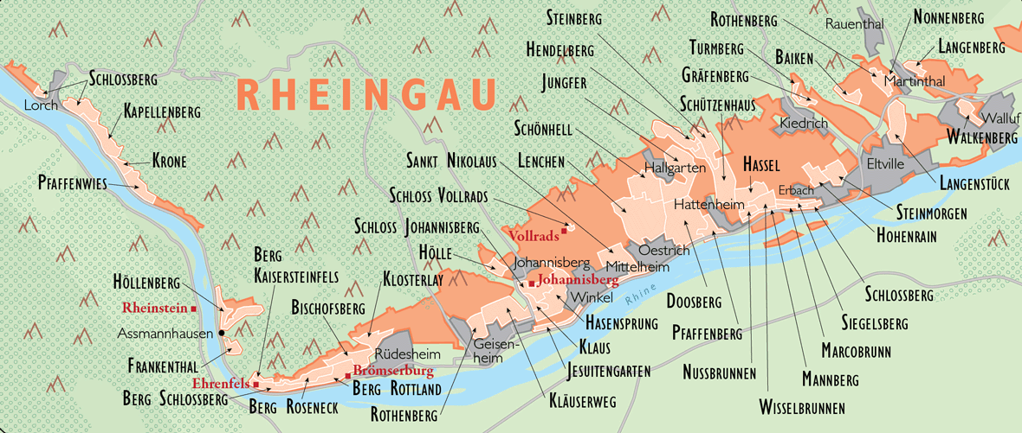
Rheingau
Varietals: Riesling, Spätburgunder (Pinot Noir)
Terroir: Loess, loam, and slate; Rhine River influence helps moderate temperatures
Notable Wineries: Schloss Johannisberg, Weingut Robert Weil, Weingut Georg Breuer
The Rheingau is synonymous with world-class Riesling, but it also produces some of Germany’s finest Pinot Noir. With a climate influenced by the Rhine River, Rheingau wines tend to be fuller-bodied than those from the Mosel. Rieslings here often exhibit richer fruit flavors alongside high acidity, which balances out the wine's structure.
Schloss Johannisberg, one of the oldest Riesling estates, has been a significant producer for centuries.
Weingut Robert Weil is celebrated for its top-tier dry and sweet Rieslings, while Weingut Georg Breuer produces a modern take on the region’s classic varietals, focusing on sustainability and minimal intervention.

Slide 7
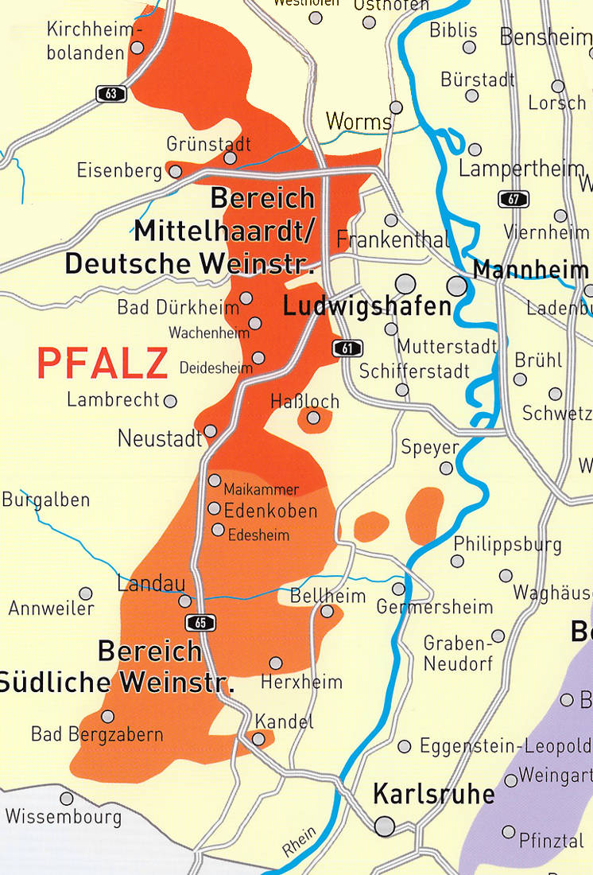
Pfalz
Varietals: Riesling, Müller-Thurgau, Pinot Gris (Grauburgunder), Dornfelder
Terroir: Varied soils—sandstone, limestone, and loess; a warm, sunny climate
Notable Wineries: Weingut Dr. Bürklin-Wolf, Weingut Reichsrat von Buhl, Weingut Bassermann-Jordan
The Pfalz region benefits from one of the warmest climates in Germany, creating wines with fuller bodies and riper fruit characteristics.
Riesling remains king, but Pfalz is known for its diversity in varietals, including Pinot varieties (Blanc, Gris, and Noir) and the red grape Dornfelder. The wines from Pfalz are often approachable in their youth, with expressive fruit flavors and good structure.
Weingut Dr. Bürklin-Wolf is one of the region’s premier producers, known for its commitment to biodynamic farming.
Weingut Reichsrat von Buhl produces some of the best sparkling wines (Sekt) in Germany, while Weingut Bassermann-Jordan is a historic estate known for its wide range of exceptional whites.

Slide 8
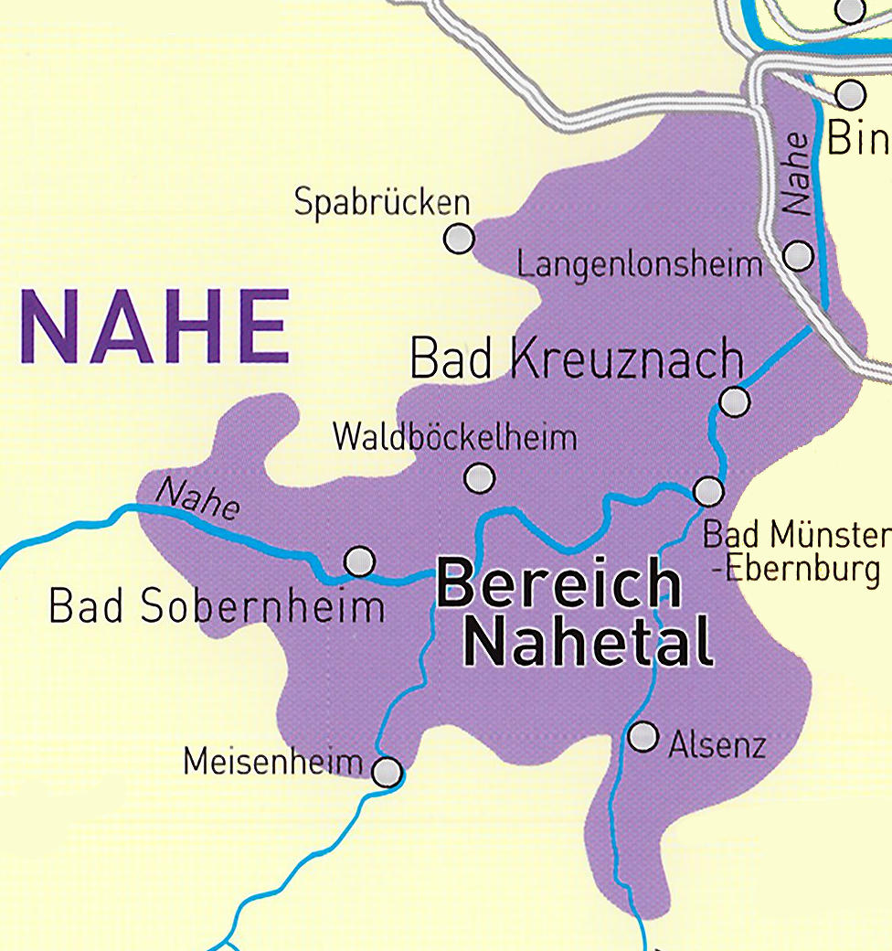
Nahe
Varietals: Riesling, Silvaner, Grauburgunder, Spätburgunder
Terroir: Complex soils including volcanic rock, slate, and sandstone
Notable Wineries: Dönnhoff, Schäfer-Fröhlich, Emrich-Schönleber
The Nahe region, located between the Mosel and Rheinhessen, is one of Germany’s most varied in terms of soil and microclimates.
This diversity allows for a wide range of wine styles, with Riesling as the standout varietal. Nahe Rieslings are known for their balance of fruit, acidity, and minerality, often exhibiting a subtle elegance compared to the more intense Mosel or Rheingau wines.
Weingut Dönnhoff is arguably the star of the Nahe, producing highly acclaimed Rieslings from various vineyards. Schäfer-Fröhlich and Emrich-Schönleber are also top estates that have helped establish Nahe’s reputation for premium wines.

Slide 9
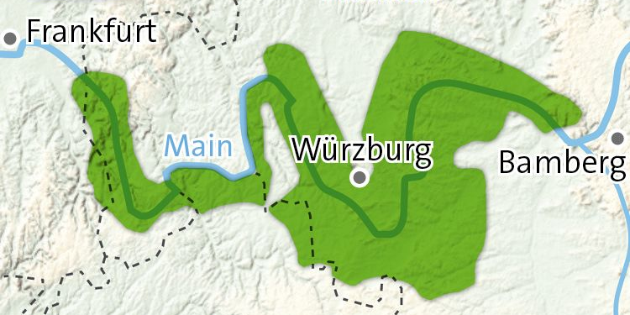
Franken
Varietals: Silvaner, Müller-Thurgau, Riesling, Bacchus
Terroir: Limestone and clay; continental climate
Notable Wineries: Weingut Rudolf Fürst, Weingut Hans Wirsching, Weingut Juliusspital
Franken is distinguished by its Silvaner wines, a varietal that thrives in the region’s limestone-rich soils.
Silvaner from Franken is often more robust than elsewhere in Germany, showing an earthier, more mineral-driven profile. Riesling and Müller-Thurgau are also important in the region, with Riesling benefiting from the cool, continental climate.
Weingut Rudolf Fürst is famous for both its Silvaner and Spätburgunder (Pinot Noir), while Weingut Hans Wirsching is a key producer of traditional dry Silvaner.
Weingut Juliusspital is one of the oldest wineries in Germany and is noted for its wide portfolio of both whites and reds.

Slide 10
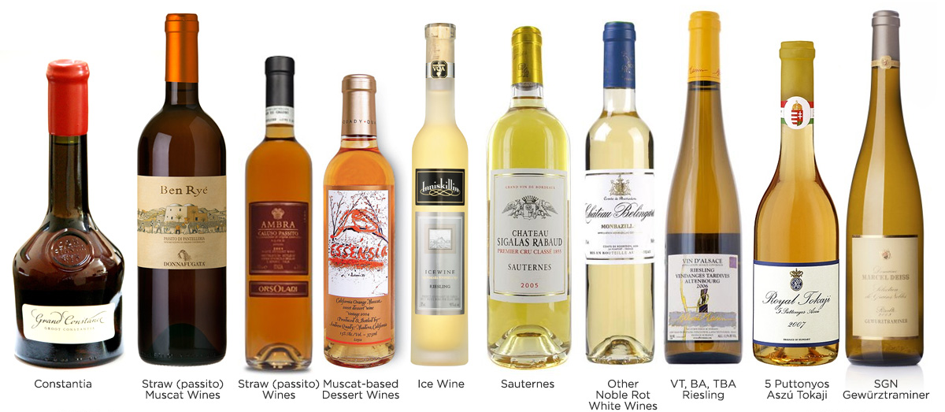
Key German Wine Varietals
While Riesling is undoubtedly the flagship grape of Germany, there are several other varietals that play essential roles in the country’s winemaking tradition.

Slide 11
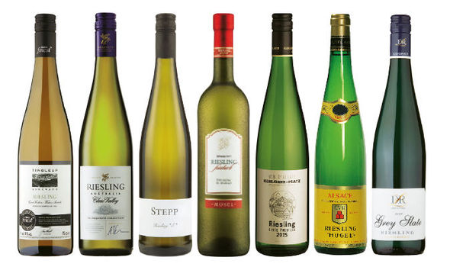
Key German Wine Varietals: Riesling
Riesling, one of the most versatile and expressive grape varieties, is celebrated for its unique ability to reflect the characteristics of the land where it’s grown, known as terroir.
Unlike many other white wines, Riesling ages exceptionally well, evolving in complexity over time. This adaptability also means it can be crafted in a broad spectrum of styles, from refreshingly crisp and bone-dry (Trocken) to lusciously sweet.
At the drier end of the scale, Trocken Riesling exhibits bright acidity, citrus, green apple, and minerality, making it an excellent pairing for seafood, salads, and lighter fare.
As you move toward off-dry or medium-sweet styles, Riesling develops more fruit-forward flavors like peach, apricot, and honey, while still maintaining its vibrant acidity.

Slide 12
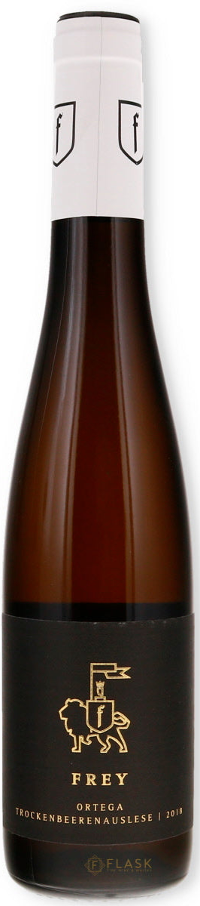
Key German Wine Varietals: Riesling
For those with a preference for sweet wines, Riesling truly shines in late-harvest varieties.
Auslese, made from select ripe grapes, offers a rich, honeyed sweetness balanced by acidity, ideal for pairing with spicy foods or enjoyed on its own.
At the pinnacle of sweetness is Trockenbeerenauslese (TBA), an ultra-rich dessert wine made from individually selected, overripe grapes that have been dried on the vine.
TBA Rieslings are rare, luxurious, and known for their incredible depth of flavor, often with notes of caramel, dried fruits, and exotic spices.
Riesling’s remarkable range ensures that there’s a style to suit almost every palate, from dry to intensely sweet, making it a favorite among both casual wine drinkers and connoisseurs alike.

Slide 13
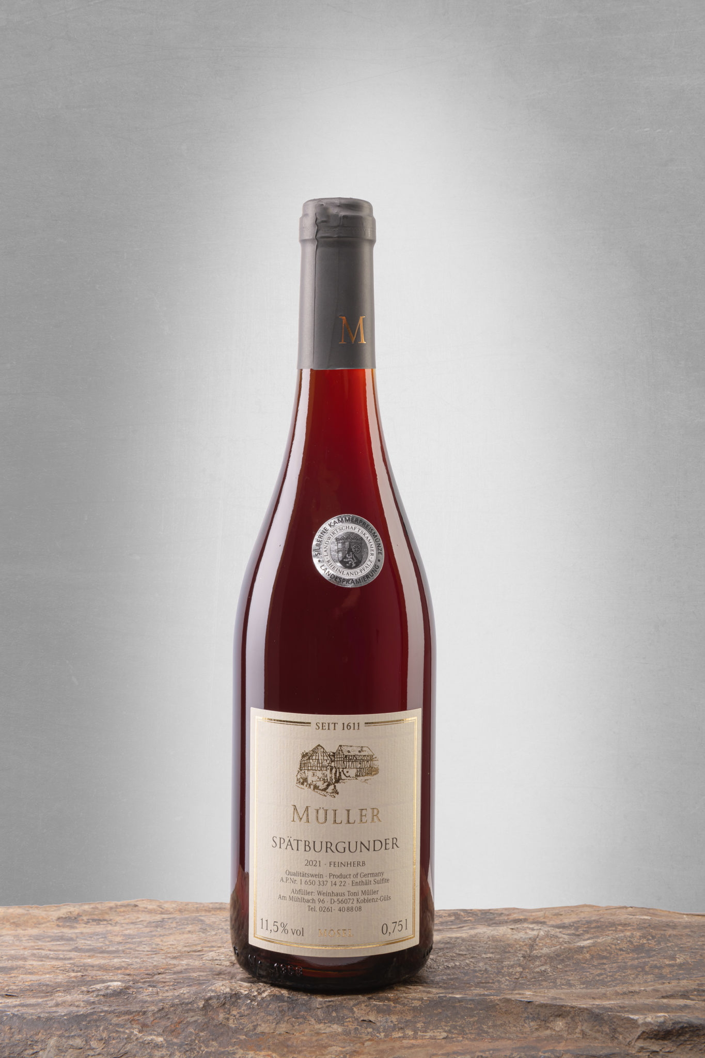
Key German Wine Varietals: Spätburgunder (Pinot Noir)
In recent years, German Pinot Noir, or Spätburgunder, has earned widespread recognition for its high quality, particularly from renowned regions such as Ahr and Baden.
These areas are known for crafting elegant, yet layered wines that showcase bright cherry flavors, complemented by earthy undertones and subtle spice.
With its delicate structure and balanced acidity, German Spätburgunder is gaining increasing respect on the global wine stage, offering a unique expression of Pinot Noir that rivals some of the best from France and beyond.

Slide 14
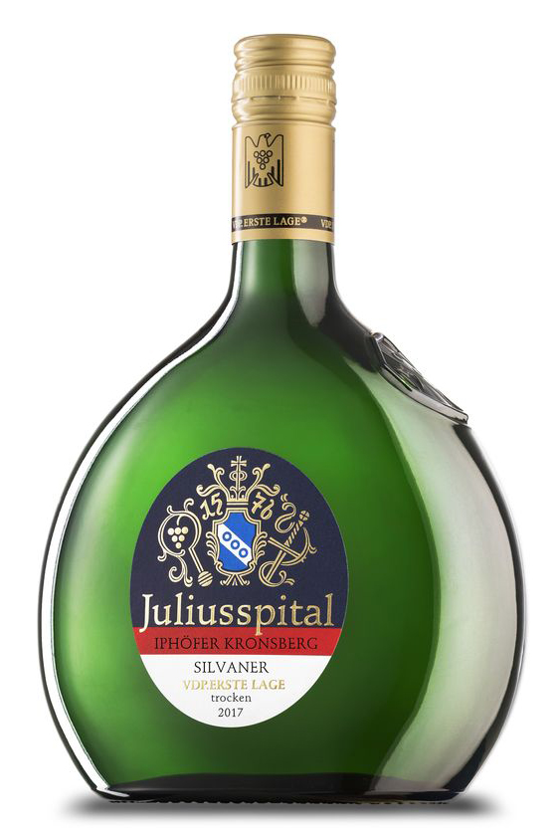
Key German Wine Varietals: Silvaner
Especially prominent in the Franken region, Silvaner is known for its more subdued, mineral-driven character compared to the more aromatic Riesling.
Silvaner often showcases subtle herbal and savory notes, with hints of green apple, pear, and a distinct earthiness.
Its restrained flavor profile and crisp acidity make it a versatile wine, pairing well with a variety of dishes, including seafood, salads, and light vegetarian fare.
While less internationally known, Silvaner is cherished for its ability to reflect terroir and its food-friendly nature.

Slide 15
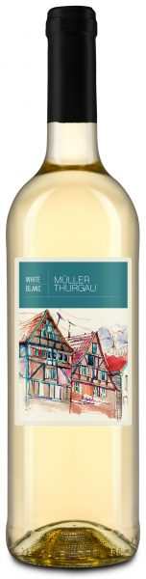
Key German Wine Varietals: Müller-Thurgau
A hybrid of Riesling and Madeleine Royale, Müller-Thurgau is a light, approachable white wine known for its easy-drinking appeal.
It features delicate floral aromas alongside fresh, fruity notes of peach, apple, and sometimes a hint of citrus.
Though it lacks the complexity of Riesling, Müller-Thurgau offers a pleasant, refreshing profile, making it a popular choice for casual sipping or pairing with light dishes such as salads, seafood, and mild cheeses.
This varietal is especially valued for its early ripening and versatility in various wine-growing regions.

Slide 16
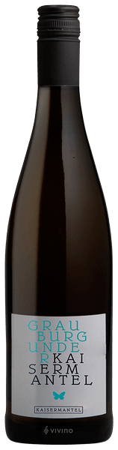
Key German Wine Varietals
Grauburgunder and Weißburgunder: German Pinot Gris (Grauburgunder) and Pinot Blanc (Weißburgunder) are highly versatile wines, each offering a broad spectrum of styles.
Grauburgunder can range from crisp and refreshing, with zesty citrus and green apple notes, to richer, more full-bodied expressions that feature ripe pear, almond, and a touch of spice.
Similarly, Weißburgunder offers styles from light and delicate, with fresh acidity and subtle floral hints, to fuller-bodied wines with creamy textures and flavors of melon and stone fruits.
Both varietals are incredibly food-friendly, pairing well with everything from seafood to poultry and lighter vegetarian dishes.

Slide 17
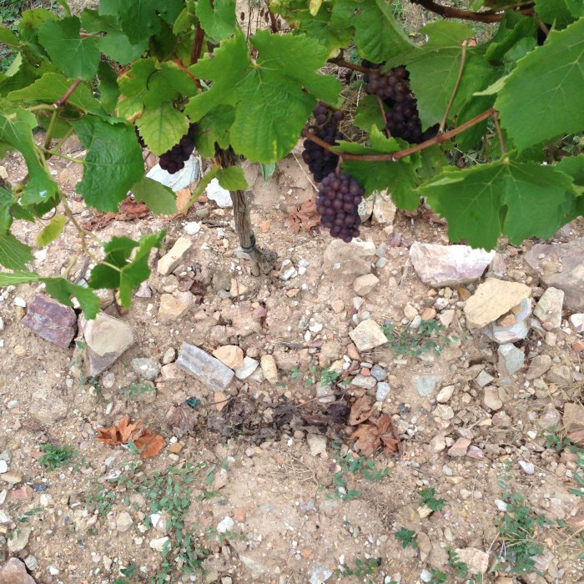
Germany’s Terroir
The Secret Behind German Wine Quality
Germany’s varied terroirs—comprising soil, climate, and geography—create ideal conditions for wine production.
The steep river valleys of Mosel, Rheingau, and Nahe benefit from south-facing slopes that capture sunlight, allowing grapes to ripen fully while retaining their acidity due to cooler nighttime temperatures.
The soils in these regions are often slate or volcanic in nature, adding a distinct minerality to the wines.
In contrast, regions like Pfalz and Baden, with their warmer climates and loess soils, produce wines with more fruit-forward characteristics.

Slide 18
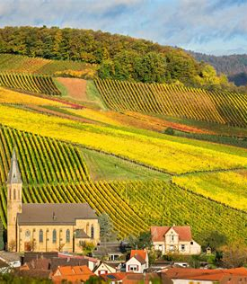
Conclusion
Germany’s wine regions have undergone a renaissance, with a renewed focus on quality and innovation.
From the steep vineyards of the Mosel to the sun-drenched slopes of Pfalz, German wines today offer diversity, precision, and exceptional value.
Riesling continues to be the crown jewel, but emerging varietals like Pinot Noir and Silvaner are also making their mark on the global stage.
As Germany’s winemakers continue to push boundaries, the country’s wines are increasingly appreciated by a new generation of wine lovers.

Slide 19
Acknowledgement
My seminars are the result of many years of experience combined with many hours of research over the internet.
I would like to acknowledge the many source I have accessed.
These include Wine Spectator, Wine Enthusiast, BKWine Magazine, Wine & Spirits Magazine, American Vineyard Magazine, The Grapevine Magazine, Wikipedia.com, Britannica.com, and the various Government websites.

Slide 20
Referances
Jancis Robinson, The Oxford Companion to Wine (4th ed.), Oxford University Press, 2015.
Stuart Pigott, Best White Wine on Earth: The Riesling Story, Stewart, Tabori & Chang, 2014.
German Wine Institute, Germanwine.de

