Slide 1
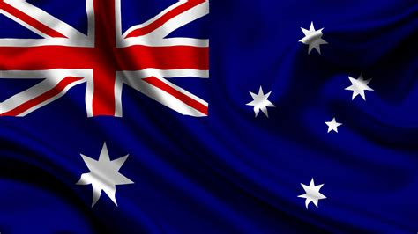
Geraldton Australia Presented by Marc Silver

Slide 2
What I Will Cover
My Port Philosophy
Don’t Miss the Ship
Money
About Geraldton
Maps
Geraldton Transportation
Places to see or at least consider
A few restaurant recommendations
Conclusion

Slide 3
My Port Philosophy
I have been cruising for over 45 years and have taken over 200 cruises. So, I consider myself an experienced cruiser.
The information I will present is based on those many years of
experience.
When I am on a cruise where the city, I want to visit is not the port city,
I always recommend taking a ship’s tour.
But when I am in a port with multiple attractions nearby and easy to see
on my own - I will do it on my own.
This presentation is for that type of port.

Slide 4

Don’t Miss the Ship
How to Avoid Missing Your Ship
Pay attention to the time. - Ship time and local time are often different.
Put a return-to-ship reminder on your phone.
Choose excursions wisely.
If a ship-sponsored excursion is late returning to port, the ship will wait for you. If you are on your own???
Be Prepared
Have your Passport, Credit Card, and phone numbers for your ship port agent.
What to Do If You Miss the Ship Most cruise lines have port agents stationed in the port area to assist if your ship has left without you. If your are lucky, when cruisers are late returning to the vessel, the ship’s crew will often remove the passengers’ essential items – passports, cell phones, and medication -- from the ship to leave with the port agents.
The Port Officials can help you with contacting your ship and making necessary travel arrangements.

Slide 5
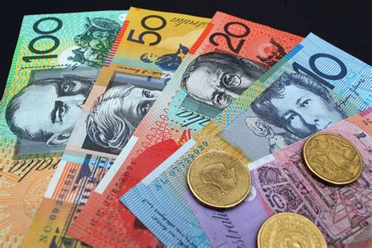
Money
The currency for Geraldton is the Australian Dollar.
The conversion at the rate is $1.48 AUD to $1.00 U.S.
Or $1 AUD $.67 U.S.

Slide 6
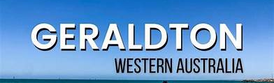
About Geraldton
Geraldton Western Australia is a great destination for those looking to enjoy the outdoors. This vibrant coastal city has a laid-back vibe that draws people to visit.
The city’s rich past is an ideal place to visit while exploring Western Australia’s Coral Coast and Wildflower Country.
The Port of Geraldton is a major west coast seaport. Geraldton is an important service and logistics center for regional mining, fishing, wheat, sheep and tourism industries.

Slide 7
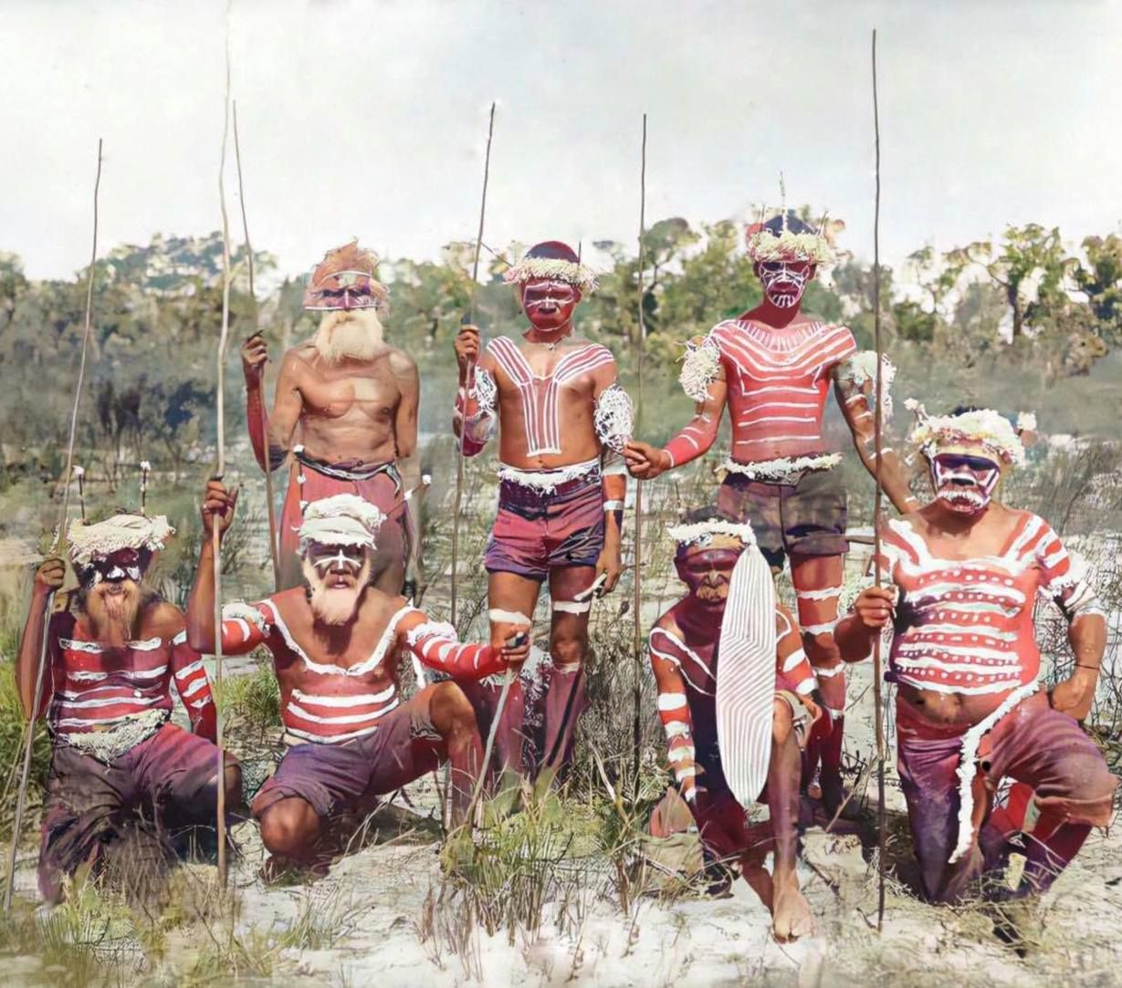
About Geraldton
Clear evidence has established Aboriginal people living on the west coast of Australia for at least 40,000 years, though at present it is unclear when the first Aboriginal people reached the area around Geraldton.
The original local Aboriginal people of Geraldton are the Amangu people, with the Nanda immediately to the north and Badimaya immediately to the east.
Today the Aboriginal people of the region generally identify as Yamatji or Wajarri people. Wajarri country is inland from Geraldton and extends as far south and west.

Slide 8
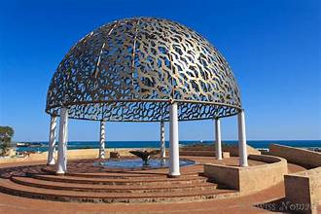
About Geraldton
Geraldton is brimming with history, just walk around the CBD and you can see it for yourself.
The HMAS Sydney II Memorial, Saint Francis Xavier Cathedral, Victoria District Hospital and Old Geraldton Goal Craft Centre, Birdwood House Military Museum and the Point Moore Lighthouse all have their own stories, which you can learn about at the Museum of Geraldton.
HMAS Sydney II Memorial

Slide 9
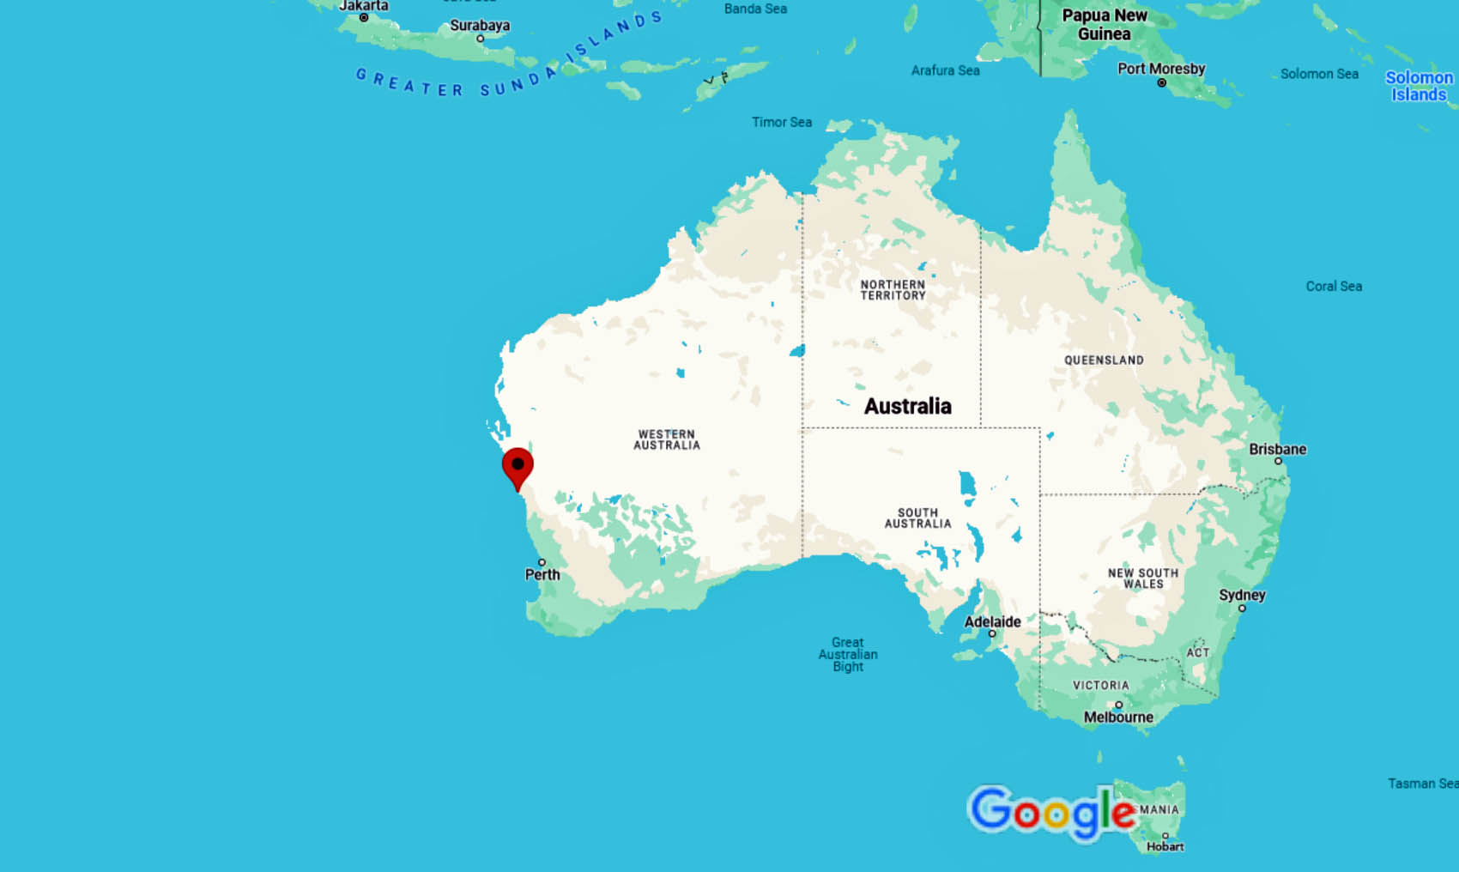
Australia
Geraldton

Slide 10
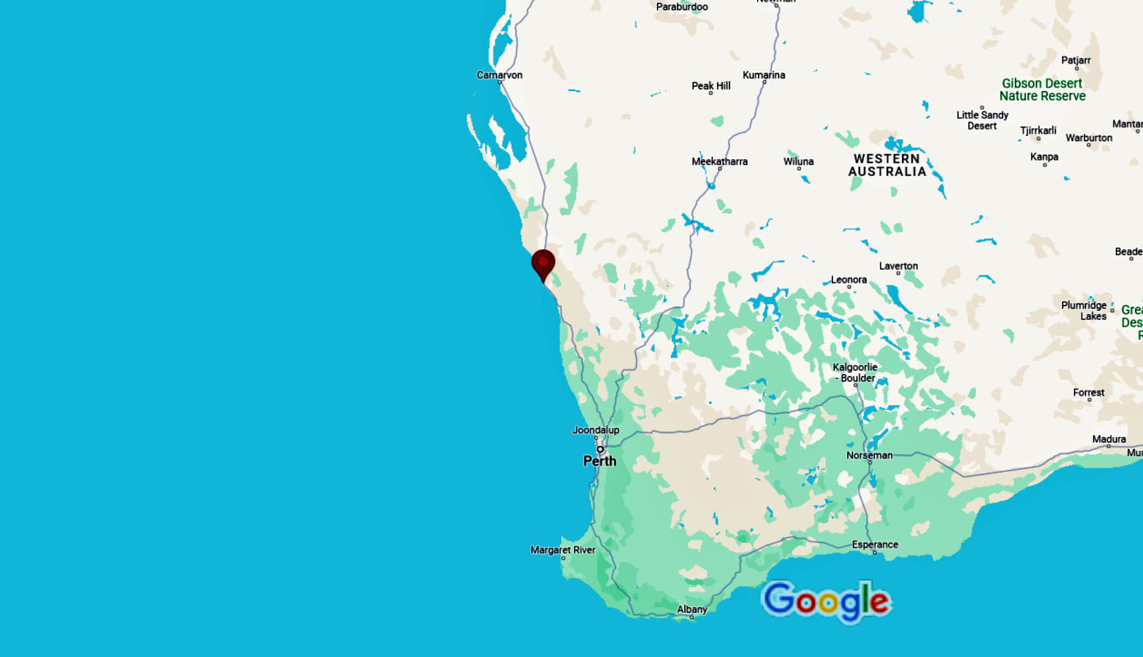
Geraldton Area Map
Geraldton

Slide 11
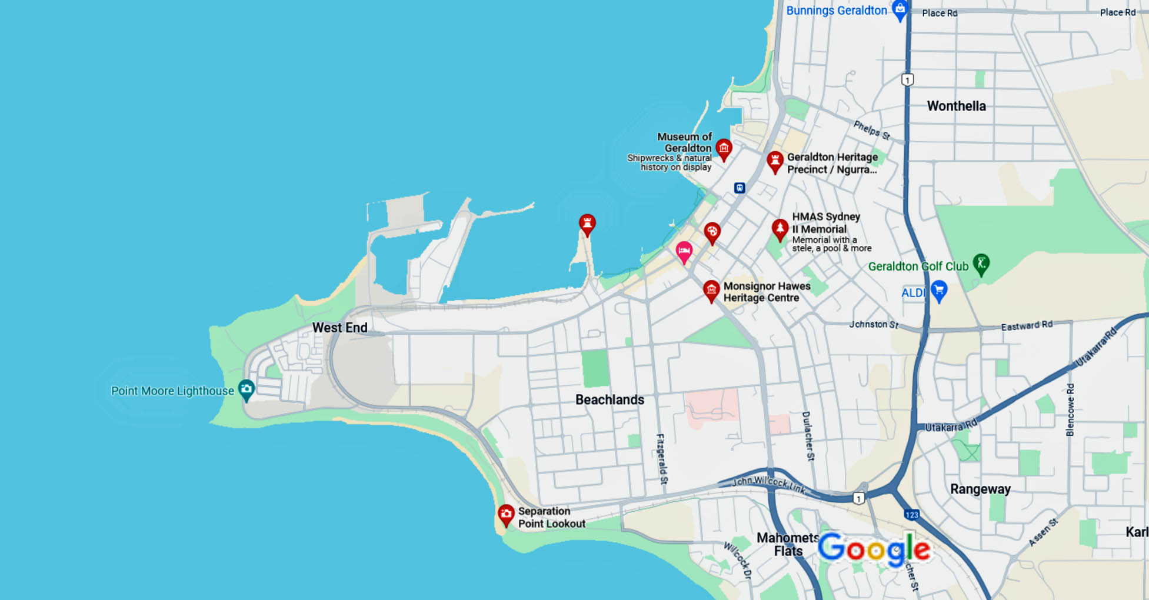
Map of Geraldton

Slide 12
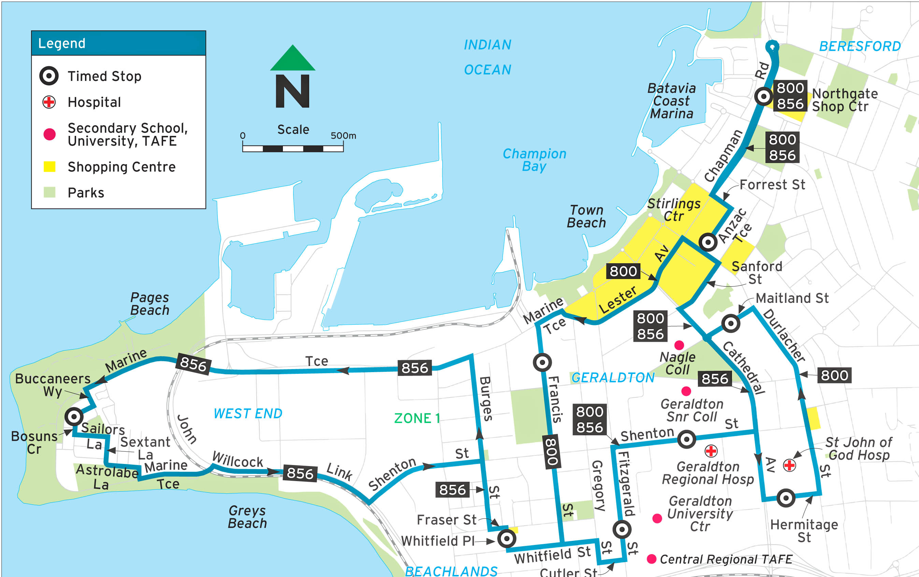
Geraldton Buses
Public transport can often provide an ideal solution since it offers access to many areas without having to make too much of a physical.
You have many transportation options available to you, including bus routes and ridesharing services.
Geraldton’s bus network runs on a system of 11 lines that cover a range of local areas. This allows travelers to visit some of the main attractions in Geraldton easily, such as its stunning Western Australian beaches and Historical Museum.
A ticket entitles passengers to two hours of travel on any line for just $4.00.

Slide 13
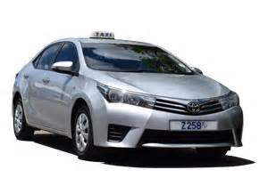
Geraldton Taxis
Standard taxis provide a safe and reliable way to explore the city or for transport between the cruise port and various attractions.
Like taxis in most locations the cost is significantly more expensive than other modes of transport.
The local Rideshare company is TaTa
You can call them directly at 08 6266 8372

Slide 14
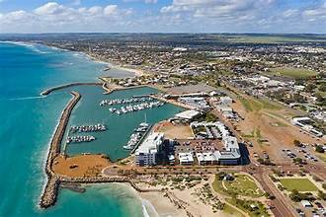
Getting Around Geraldton by Foot
Exploring on foot can be a great way to take in the sites of any city. In Geraldton, people often opt to get around by foot, especially when it comes to visiting beachside areas.
Exploring on foot also has some unique benefits, such as the ability to go at your own pace, stop whenever you please and get a more intimate feel for local areas.
However, there are also some drawbacks that come with traveling by foot. It could be argued that those with physical conditions, elderly individuals or young children may not find this an ideal mode of transportation.
Although Geraldton is quite an easy city to maneuver around on foot, certain areas such as the WA Museum may prove quite a challenge due to its distance .

Slide 15
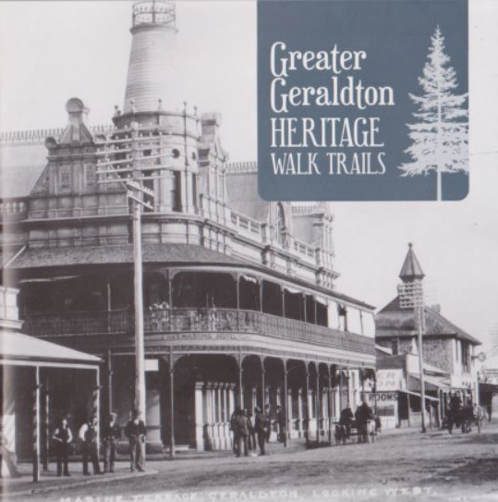
Geraldton Heritage Walk
"The City of Geraldton Heritage Walk Trails features six easy routes located in the CBD of Geraldton.
Waterfront Walk Trail
Marine Terrace Walk Trail
Rocks Laneway Walk Trail
West End Walk Trail
Victoria Hospital Walk Trail
Bluff Point Walk Trail
All trails suit the majority of fitness and experience levels, with footpaths and wheelchair access along all trails."
Information is Available from Geraldton Regional Library for $2.00

Slide 16
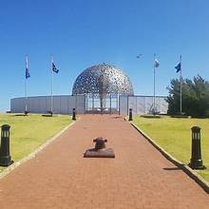
HMAS Sydney II Memorial
The sinking of the HMAS Sydney II on 19 November 1941 was a painful blow to Australia and the Allied effort in World War II.
This was the largest Allied warship to be lost with all hands (645) in the war.
The exact location of the wreck was unknown until it was discovered close to the Kormoran some 100 nautical miles off Dirk Hartog Island in Shark Bay in 2008. Geraldton has a fitting memorial to the sailors who lost their lives in the event, which has taken on extra significance after the wreck was located.
There’s a wall of remembrance with the names of the 645 sailors on board.

Slide 17
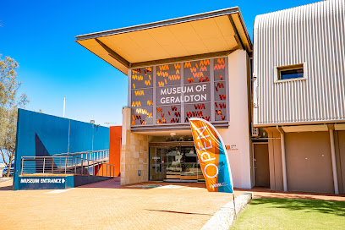
Museum of Geraldton
There are lots of enthralling stories to uncover at the town’s museum by the marina.
You can get a handle on the amazing biodiversity and natural scenery of the region and the Abrolhos Islands.
Space is also given to aboriginal Yamaji history and culture, while there’s a ton of early European at the Shipwrecks Gallery showing off finds dating back four centuries.
Free Entry. Suggested donation $5
The story of the Batavia, wrecked off the Abrolhos Islands in 1628, is as exciting as it is bloody, and accompanying coins, cannons and an entire Baroque stone arch help paint a vivid picture.
Also devoted to underwater discoveries is From Great Depths, where an exhibit and 3D film present the wrecks of the light cruiser HMAS Sydney (II) and German auxiliary cruiser HSK Kormoran, resting at a depth of 2,500 after their battle in 1941.

Slide 18
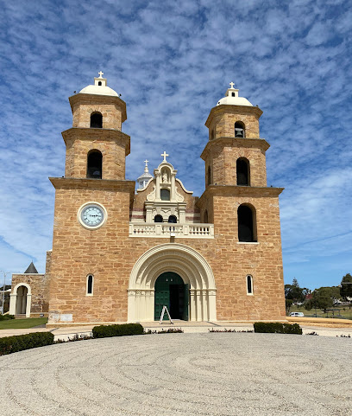
St Francis Xavier Cathedral
Just a 15-to-20-minute walk from the port is The St Francis Xavier Cathedral.
It blends Romanesque and Byzantine Revival architecture and was the work of architect and priest, Monsignor John Cyril Hawes (1876-1956).
The cathedral, serving Geraldton’s Roman Catholic community stands out for its twin towers flanking the entrance and the substantial dome between the nave and apse.
The interior is decorated in the Byzantine style with round arches and bands of alternating stone.

Slide 19
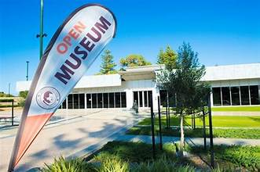
Monsignor Hawes Heritage Museum
Facing off against the cathedral’s imposing portal is a modern interpretive centre about the unusual life of John Hawes.
Born in England and qualified as an architect in the 1890s, he arrived in Geraldton after being ordained in 1915, and would remain for the next 25 years.
During this time he had a huge impact on Geraldton, designing 44 buildings for the city, 29 of which were built.
What you’ll get is a rich and intimate portrayal of the man, complemented by his architectural plans, diary entries, vestments and personal documents.
Admission Fee: Adults $5 can be purchased at the Heritage Centre

Slide 20
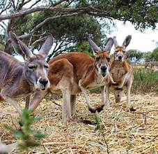
Greenough Wildlife Park
Run by donations, this privately-owned animal park about 20 minutes south of Geraldton has been rescuing and rehabilitating Western Australian wildlife since the 1980s.
If you’re tentative about visiting zoos, you can be assured that all profits go towards the park’s inhabitants and conservation efforts.
The staff are friendly and knowledgeable and allow plenty of interaction with dingoes, joeys, camels, emus, farm animals and a variety of reptiles.
Check the website before coming to make sure you catch the park’s crocodile being fed, normally taking place around midday.

Slide 21
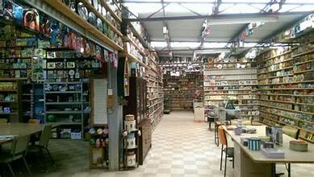
The Tin Heads
Those with a taste for the quirky and obscure will strike gold, or tin, at this private museum belonging to Geraldton couple Margaret and Robert Gaston.
They have assembled what is believed to be Australia’s largest collection of tin containers, which as of 2020 numbered in the mid-1100s, although the count is rising all the time.
Made for anything from shoe polish to tea, syrup, cakes or biscuits, these are stacked neatly in glass display cases and on shelves from floor to ceiling.
The oldest tin dates back to 1834, and Margaret and Robert have a story to tell about almost every exhibit.

Slide 22
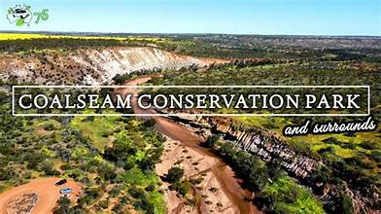
Coalseam Conservation Park
Coalseam Conservation Park showcases spectacular bushland.
A stunning collection of flowers will ensure an explosion of color to delight your senses.
Keep the camera handy to capture the diversity of wildlife that lives in the park including Kangaroos, Emus, Echidnas, Eagles and Cockatoos. For the nature lover, this is truly paradise.
While at the Park, you can explore the site of Western Australia's first coal mine, view fossilized marine life in the riverbanks and take a walk along one of many walking trails through the park.
Entry cost: Free

Slide 23
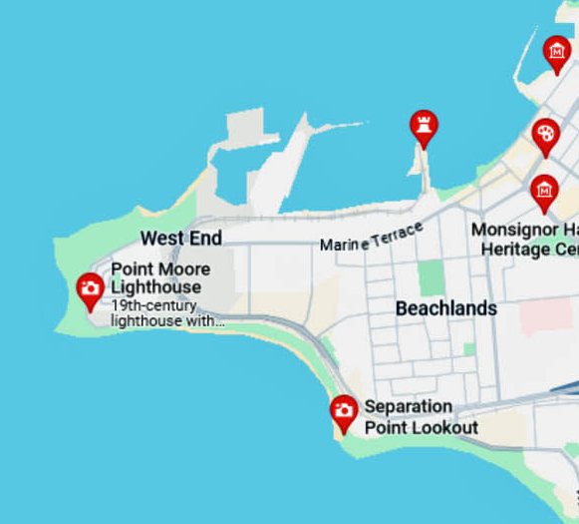
Geraldton’s Beaches
Roughly 200 meters long, Pages Beach is Geraldton’s main beach located directly west of the city’s marina, continuing as far as a long seawall on the east side of the port, known as the Esplanade.
The seawalls at each end of the beach help keep the ocean currents away, and the surf is rarely more than knee height.
Pages Beach is located in the beautiful West End, and protected from the southerly winds and is a popular swimming and fishing location. This family friendly beach also offers and a playground.
Greys Beach is a Km south of Pages Beach located on the south side of the peninsula. Is is protected from northerly winds, and is a pristine swimming beach.
Back Beach is a great beach for both beginners and the more experienced depending on the swell size. ‘Backers’ as it is fondly known, is the place to go for beach-break surf, a boogie board or kite board.
Pages Beach
Greys Beach
Back Beach

Slide 24
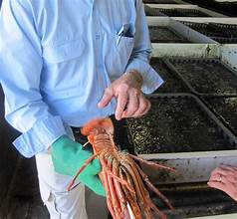
Geraldton Fishermen’s Co-operative
One of the things that puts Geraldton on the map is its multimillion-dollar fishing industry, centered on the western rock lobster.
Since 1950 Geraldton Fishermen’s Co‑operative (GFC) has supplied premium-quality Western Rock Lobster, commonly known as crayfish here in Western Australia, to customers across the globe.
If you’re interested in seeing this industry in action you can call in at the state-of-the-art , Brolos processing plant on Fishermen’s Wharf.
Tours take place at 10:00 on Monday, Wednesday and Friday, during which you’ll find out all you need to know about the incredible scale of the industry and its commitment to sustainability.
There’s plenty of insight about the western rock lobster as a species, and why it does so well in the Indian Ocean off Geraldton.
If you’re feeling adventuresome. you’ll be able to try holding one of the larger lobsters at the plant.

Slide 25
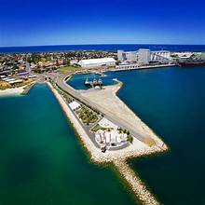
Geraldton Esplanade
One of the things that will strike you about Geraldton is how fresh everything looks along the waterfront.
This is the result of a long-term renovation, laying down grassy spaces, planting trees and putting up shelters.
If you’re close to the visitor center you’ll be able to use the free Wi-Fi, while at the southern end by the port, and watch the cargo ships coming and going.
A colony of sea lions has also made its home by the entrance to the port. Thees is a 18-metre viewing tower for a panorama of the city, port and Bay.
The name “Esplanade” has unexpected origins, referring to the former Esplanade Jetty, built in 1858 and servicing sailing ships for the next 90 or so years.

Slide 26
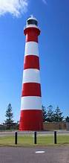
Point Moore Lighthouse
The Point Moore Lighthouse with its red and white candy-stripes has become a popular attraction and a icon for the city.
Geraldton’s 34-meter-tall lighthouse actively guides ocean traffic around Geraldton Point.
When it went up in 1878 this was the first all-steel tower on mainland of Australia, and is easily recognized.
The 1000W tungsten halogen beacon has an impressive range of 23 nautical miles.
Interestingly, the structure was built in Birmingham, England in 1876 and shipped here in one piece, arriving the next year.
You can get to the lighthouse in five minutes on foot from the CBD, and although the lighthouse is a working facility there are interpretive signs outside with some facts and figures about the building.

Slide 27
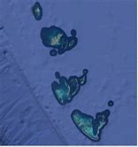
Houtman Abrolhos
37 Miles off the coast at Geraldton is an archipelago chain of 122 islands with extraordinary biodiversity, often described as Galapagos Islands of the Indian Ocean.
It is the southernmost true coral reef in the Indian Ocean, and one of the highest latitude reef systems in the world.
Some two million birds from 35 species breed here. The abundant marine life includes coral, a variety of shark species and the vulnerable Australian sea lion.
Clustered into three rough groups and now protected as a national park, there are more than 122 Abrolhos Islands.
This is the main site for the vastly productive western rock lobster fishery, as well as scores of shipwrecks.
including the Batavia followed by a bloody mutiny in 1628. There’s a big choice of packages available from Geraldton, and one of the best if you’re intrigued by the archipelago’s maritime past is the 4.5-hour Shipwreck Special Nature Tour/Half Day Tour.

Slide 28
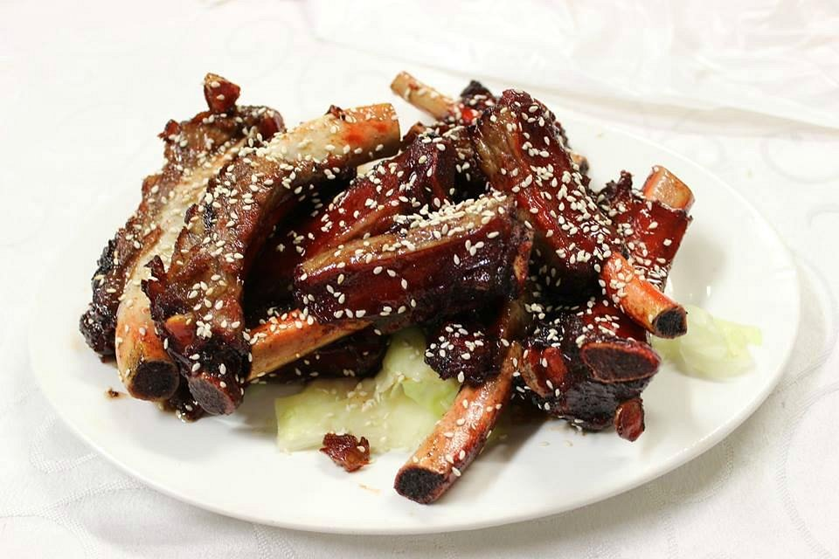
Restaurants in Geraldton
There are a lot of excellent restaurants in Geraldton. Here are some recommendations:
Salt Dish $$ - $$$, Cafe, Contemporary, Australian
Cutler& Smith $$ - $$$, Bar, Barbecue, Pub
Laian Restaurant $$$$, Australian, Middle Eastern
Cafe Fleur $$ - $$$, Cafe, Australian, Vegetarian
The Emerald Room $$ - $$$, Australian, Vegetarian
Delicious on Green/ Green Street Deli $, Asian, Vegetarian
Gone Fishing for Fish and Chips $$ - $$$, Seafood, Fast food
Jade House Chinese $$ - $$$, Chinese, Asian, Vegetarian
L'Italiano Restaurant $$ - $$$, Italian, Pizza, Mediterranean
Skeetas Restaurant and Café $$ - $$$, Seafood, Spanish, Contemporary
Hogs Breath Café $$ - $$$, Steakhouse, Vegetarian Friendly, Gluten Free

Slide 29
Conclusion
Geraldton is a beautiful City with a rich history and numerous attractions. Regardless of what you're looking for, Geraldton has something for everyone.
I hope this presentation will help when we visit Geraldton!

Slide 30
Thanks For Coming
If you have any more questions, please ask.
I will do my best to answer them for you.
Have a great visit to Geraldton!

Slide 31
Acknowledgement
My seminars are the result of many years of travel experience combined with many hours of research over the internet.
I would like to acknowledge the many source I have accessed.
These include: Wikipedia.com, Britannica.com, and the various Museum, Park and Government websites.

