Slide 1
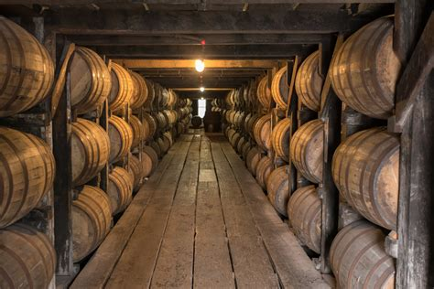
A Journey Through Georgian Wines Presented by Marc Silver

Slide 2
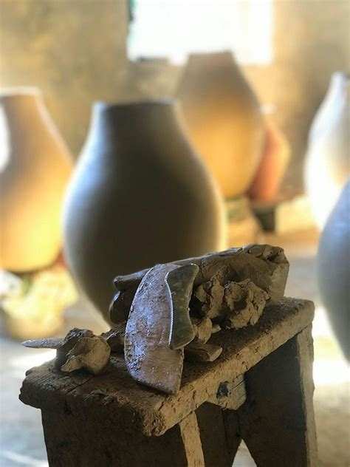
8,000 Years of Winemaking
Welcome to the world of Georgian wine! If you’re passionate about wine or just curious about unique wine traditions, you’ve come to the right place. As a wine enthusiast, I’ve had the privilege visiting some of the most exciting wine regions, and Georgia, the country—often referred to as the “cradle of wine”—is truly something special.
It’s not just the 8,000 years of winemaking history that’s impressive, but also the diversity of the wines and the unique grape varieties that are found only in this part of the world.
Let me take you on a journey through Georgia’s wine regions, introduce you to the fascinating varietals, and explain why Georgian wine deserves a spot in your cellar.

Slide 3
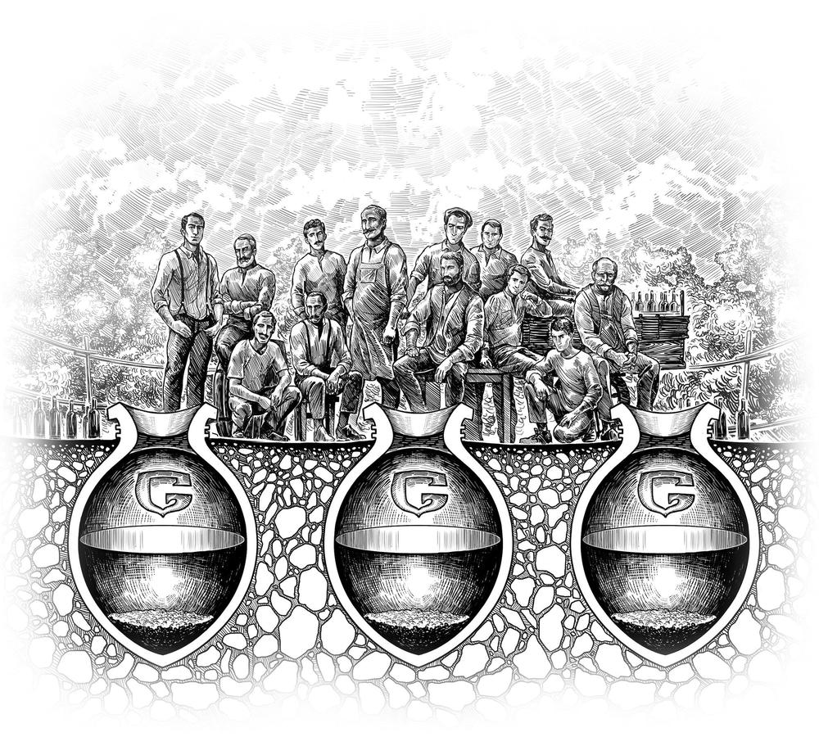
A Brief Overview
Why Georgian Wine?
Georgia is one of the oldest wine regions in the world. Archaeological evidence shows that winemaking in Georgia dates back to 6,000 BC. The ancient tradition of fermenting wine in large clay vessels called qvevri is still used today, giving Georgian wines a unique character that’s hard to find anywhere else.
But what makes Georgian wine even more exciting are its indigenous grape varieties.
Unlike many other wine-producing countries that rely heavily on a few popular international varieties (think Cabernet Sauvignon, Merlot, or Chardonnay), Georgia boasts over 500 native grape varieties. It’s a wine lover’s paradise!

Slide 4
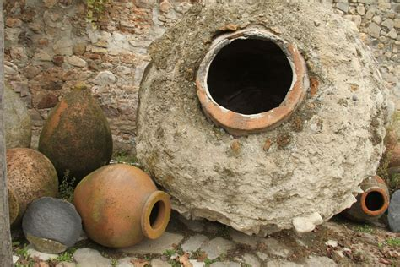
The Qvevri: The Soul of Georgian Winemaking
Let’s dive into the fascinating world of qvevri, the heart of Georgian winemaking.
A qvevri, also known as churi in western Georgia, is a large, egg-shaped clay vessel with a narrow bottom and a wide mouth. These vessels are a hallmark of Georgia’s ancient wine culture, with a history stretching back thousands of years.
While early qvevri were likely stored above ground, winemakers have long adopted the practice of burying them in the earth, leaving only the rim visible.
This tradition is rooted in the Georgian word "kveuri," meaning "deeply buried in the ground."

Slide 5
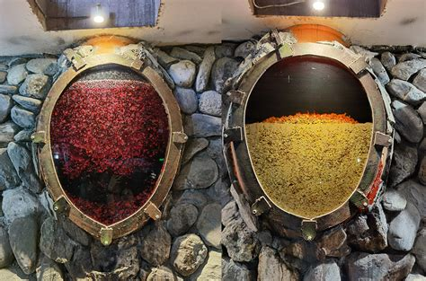
The Qvevri: A Comparison
The Qvevri Tradition
What sets qvevri apart from the clay amphorae used elsewhere is their unique role in winemaking. They are used not only for fermentation but also for maturing and storing wine, making them one of the oldest known winemaking tools.
Modern qvevri can range from 100 to 3,500 liters (26 to 925 gallons), with some large enough for a person to climb inside for cleaning.
Recognizing their cultural and historical importance, UNESCO inscribed qvevri winemaking on its list of intangible cultural heritage in 2013.
Further elevating its status, qvevri gained Protected Geographical Indication (PGI) status in 2021, cementing Georgia as the home of this ancient tradition.

Slide 6
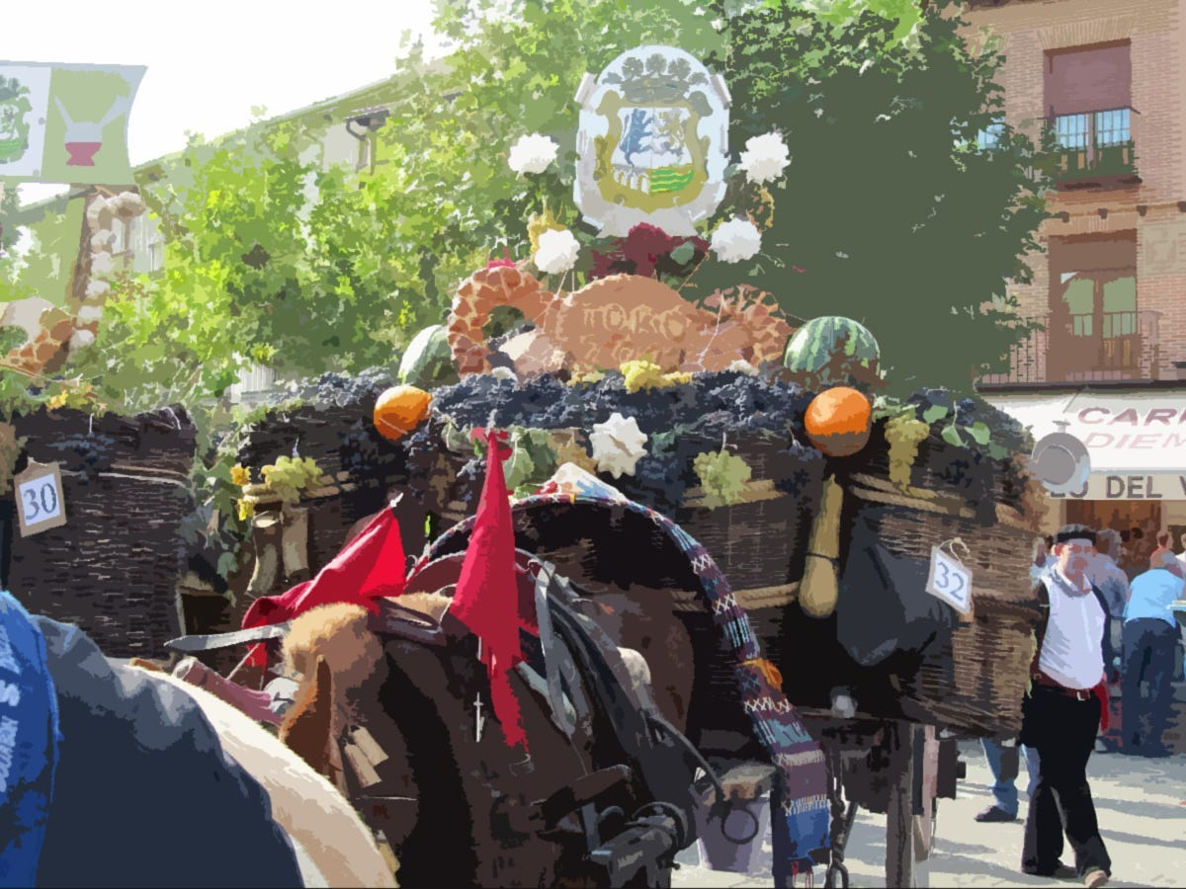
The Grape Harvest Festival
Rtveli: The Grape Harvest Festival
Each autumn, Georgia celebrates Rtveli, the annual grape harvest festival. This time-honored tradition brings together families and communities to pick grapes, stomp them by foot, and enjoy feasts of traditional Georgian food and wine.
Rtveli is not just a celebration of the harvest but also a way to honor Georgia’s long-standing wine culture.

Slide 7
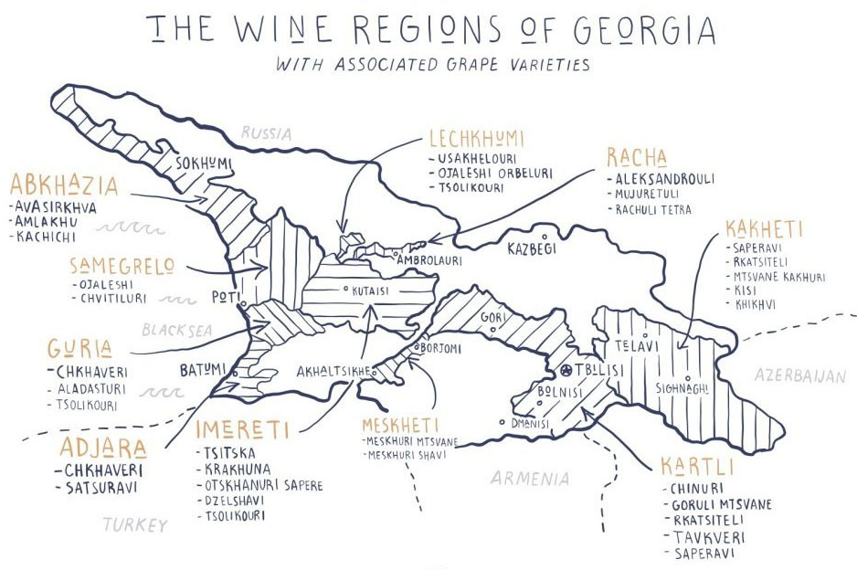
Georgian Wine Regions
Although Georgia is a small country, its varied climate and landscapes give rise to a wide range of wine styles. There are five primary wine regions, each with its own distinct characteristics.
Despite its small size, Georgia's varied climate and landscapes produce a remarkable diversity of wine styles. The country has five main wine regions, each offering distinct characteristics:
Kakheti – Famous for traditional qvevri wines and both white and red varieties.
Kartli –Known for lighter wines, including sparkling varieties.
Imereti – Produces balanced wines, blending traditional and modern technique.
Racha-Lechkhumi – Celebrated for semi-sweet red wines like Khvanchkara.
Adjara – Known for fresh, aromatic wines due to its subtropical climate.
These diverse regions showcase Georgia’s deep winemaking heritage and contribute to its wide range of wine styles.

Slide 8
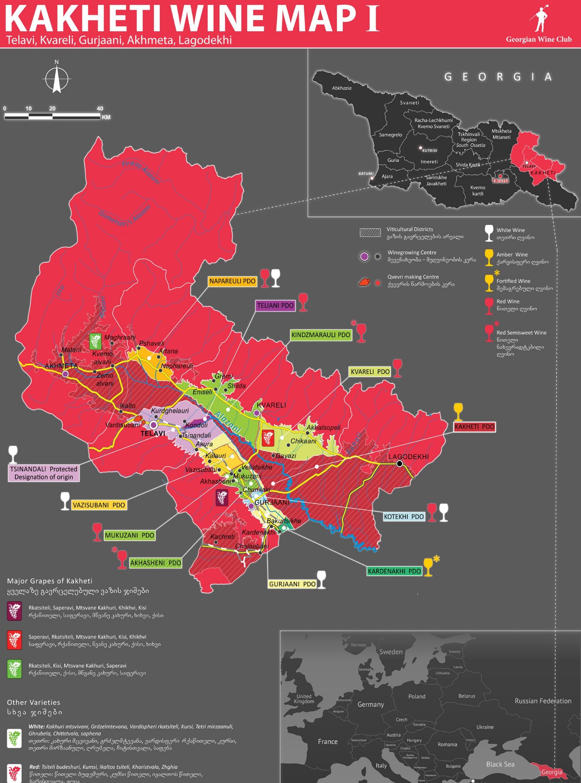
Georgian Wine Regions
Kakheti: The Heart of Georgian Winemaking
When people talk about Georgian wine, they’re often referring to Kakheti. Located in the eastern part of the country, Kakheti is the largest and most important wine region, producing around 70% of Georgia’s wine.
Kakheti’s hot summers and dry autumns make it perfect for cultivating the region’s signature grape, Saperavi, a robust red that offers dark fruit flavors with bold tannins. You’ll also find white wines like Rkatsiteli, which are often aged in qvevri for a rich, amber color and complex taste.
Notable Wines: Kindzmarauli, a semi-sweet red made from Saperavi, and Tsinandali, a dry white blend of Rkatsiteli and Mtsvane.

Slide 9
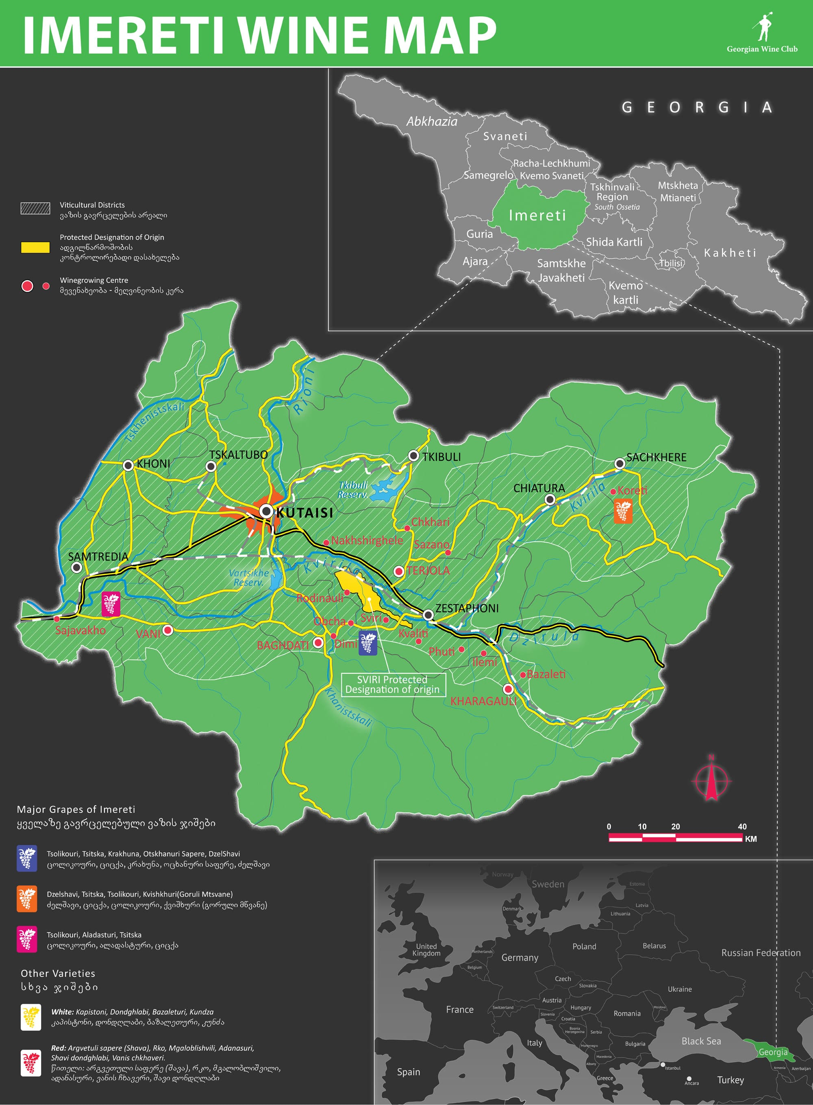
Georgian Wine Regions
Imereti: The West’s Hidden Gem
Moving west, Imereti offers a cooler, more humid climate. While it’s not as well-known as Kakheti, Imereti produces some exceptional wines, particularly whites.
The grapes here are often fermented in smaller, shallower qvevri compared to those in Kakheti, resulting in lighter, fresher wines.
Signature Grapes: Tsitska and Tsolikouri are the standout white varietals, offering fresh acidity and citrusy notes. If you’re a fan of crisp, mineral-driven whites, you’ll find Imereti wines quite intriguing.

Slide 10
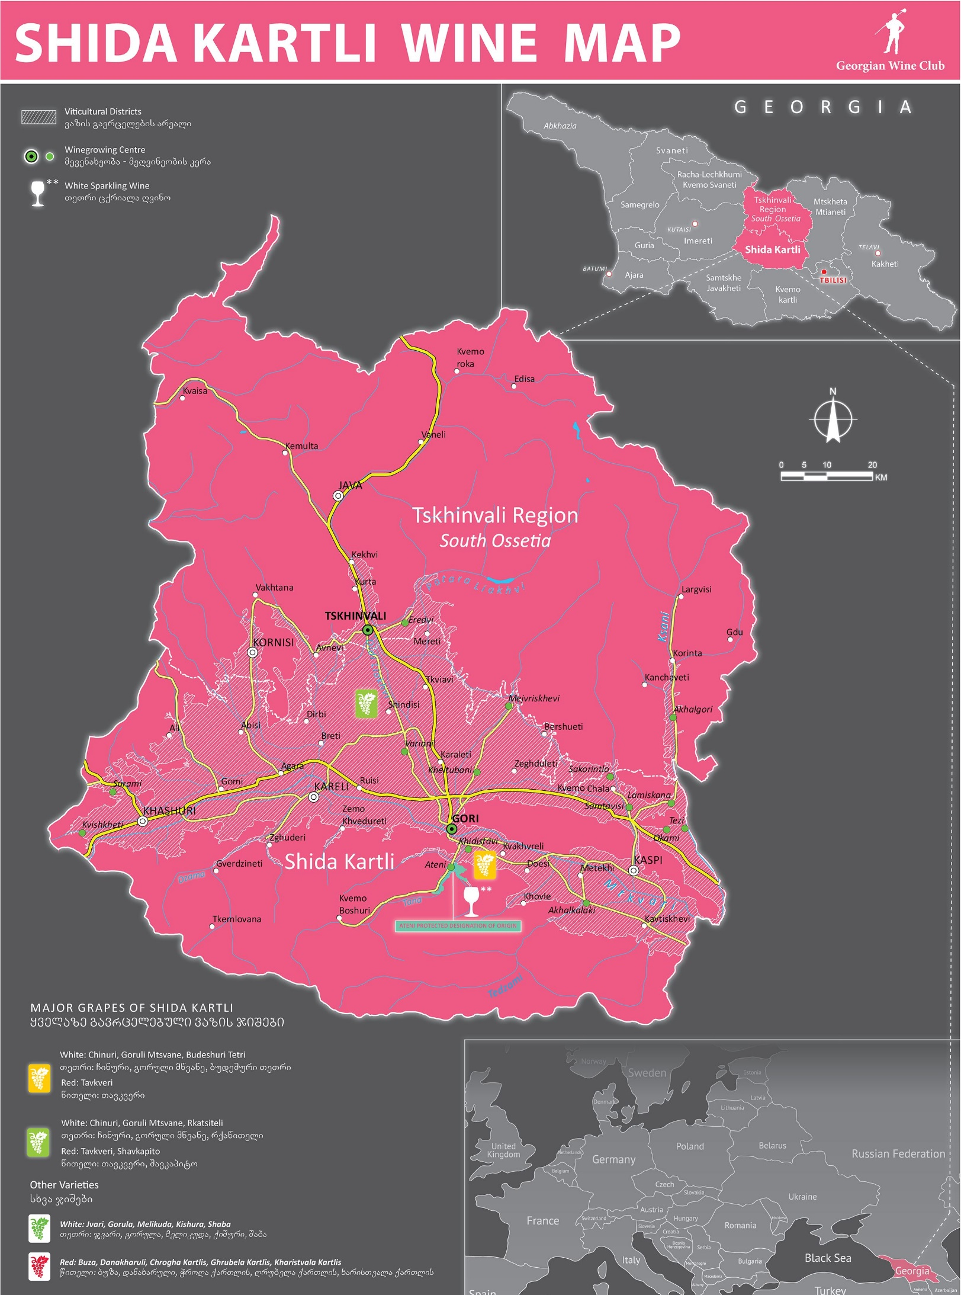
Georgian Wine Regions
Kartli: The Historic Center
Situated in central Georgia, Kartli may not have the volume of production that Kakheti boasts, but it makes up for it with historical significance. Wines from Kartli often have a refined, old-world elegance.
The region’s cooler climate makes it ideal for growing grapes like Chinuri (a white grape) and Tavkveri (a light red). Kartli is also home to some of Georgia’s best sparkling wines, often made in the traditional method.
Notable Wine: Goruli Mtsvane, a fresh, floral white with high acidity.

Slide 11
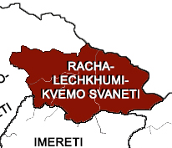
Georgian Wine Regions
Racha-Lechkhumi: Sweet Wine Paradise
Heading up into the mountains, you’ll find Racha-Lechkhumi. This remote region is known for its semi-sweet reds, particularly Khvanchkara, a wine that gained fame thanks to Stalin’s admiration of it.
Racha-Lechkhumi is perfect for dessert wine lovers. The cooler temperatures and higher altitudes result in grapes that maintain their sweetness and acidity, creating wines that balance sugar with freshness.
Notable Wine: Khvanchkara, a naturally semi-sweet red made from the Aleksandrouli and Mujuretuli grapes.

Slide 12
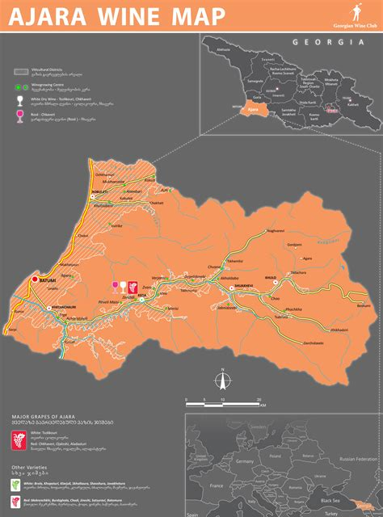
Georgian Wine Regions
Adjara: Coastal Cool
This small wine region hugs the Black Sea, offering a maritime influence that sets it apart from the rest of the country.
The region experiences a subtropical climate with high humidity, especially along the coast and mountainous areas. Adjara is one of the wettest parts of the Caucasus, receiving the most rainfall in Georgia.
While it’s not as prolific as other regions, Adjara’s humid climate and fertile soils produce light, aromatic wines with vibrant acidity.

Slide 13
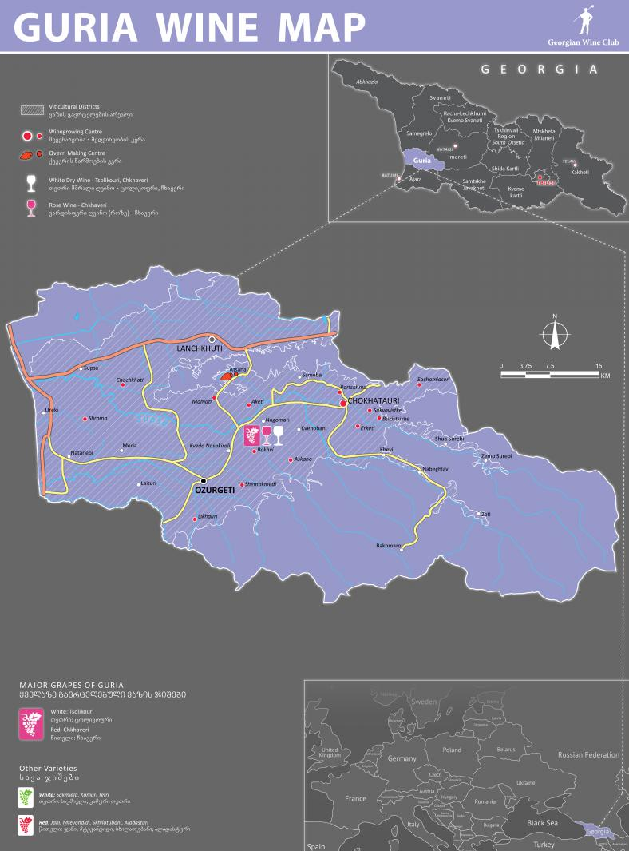
Georgian Wine Regions
Guria: A Revival of Ancient Grapes
Guria is located in the Colchian Lowlands of the western part of Georgia, where it has a 22-kilometre shoreline on the Black Sea.
Guria is known for the indigenous Chkhaveri grape, a rare pink-skinned variety that creates delicate rosés and light reds. Gurian wines were once nearly extinct, but thanks to a growing interest in preserving ancient varieties, they are making a comeback.
These wines are crisp, refreshing, and often feature floral and herbal notes.

Slide 14
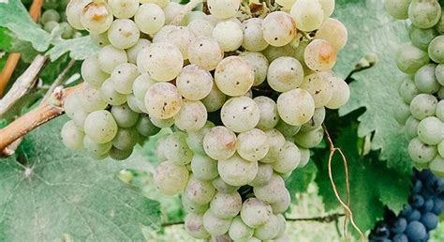
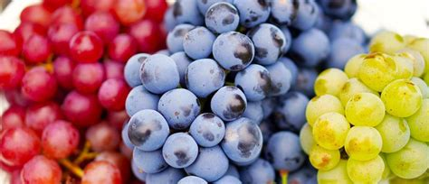
The Grapes of Georgia
A Deep Dive into Indigenous Varieties and Their Significance
Georgia, often referred to as the "cradle of wine," boasts a rich viticultural history dating back over 8,000 years.
At the heart of its winemaking tradition are indigenous grape varieties that are key to the country’s unique wine profile. Let’s explore these remarkable grapes and what makes them essential to Georgia’s winemaking legacy.

Slide 15
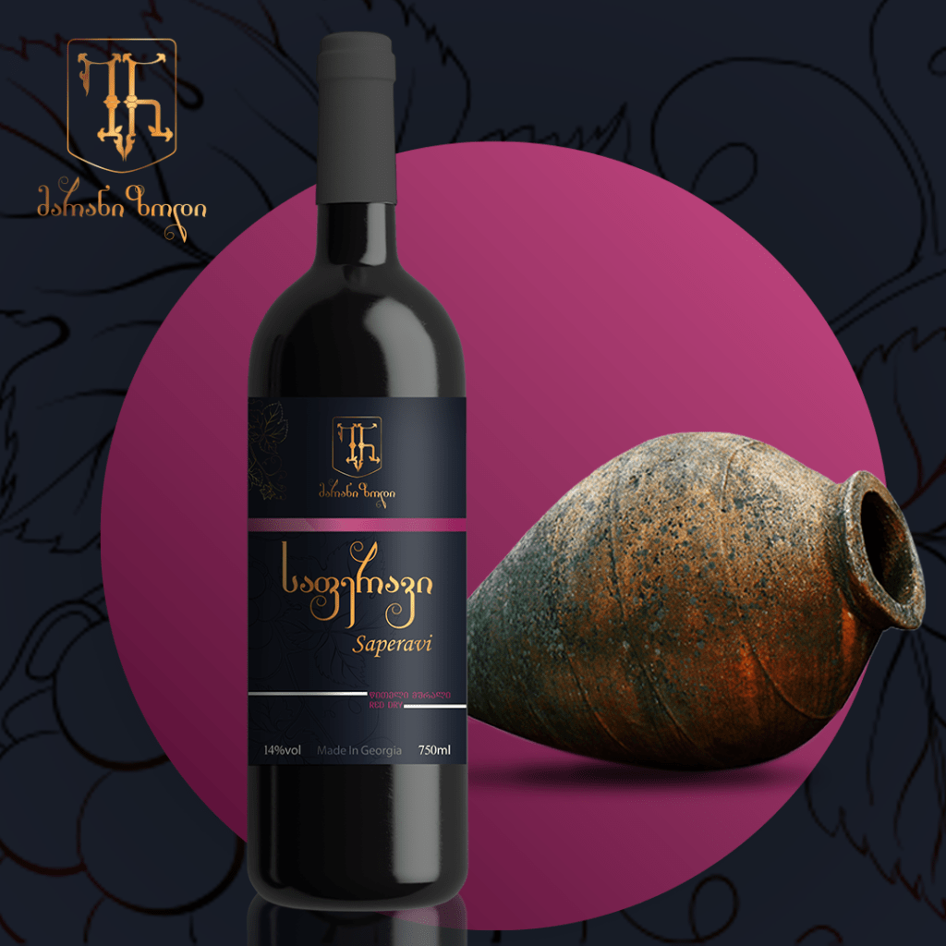
The Grapes of Georgia
Saperavi: The Backbone of Georgian Reds
Saperavi is Georgia’s most famous red grape and a cornerstone of the country's winemaking. As a teinturier grape, it possesses both dark skin and dark flesh, which results in deeply colored wines. Known for its bold yet balanced profile, Saperavi thrives particularly in the Kakheti region, Georgia’s wine-producing heartland.
Importance: Versatility: Saperavi is used to produce a wide range of styles, including dry, semi-sweet, and dessert wines.
Aging Potential: High in tannins and acidity, Saperavi wines have excellent aging potential.
Popularity: While grown in various regions, Saperavi reaches its pinnacle in Kakheti.
Tasting Notes: Profile: Full-bodied with flavors of dark fruits such as blackberries, plums, and cherries. Aged versions often exhibit notes of tobacco, spices, and chocolate. Finish: Long, with robust tannins and a mineral edge.

Slide 16
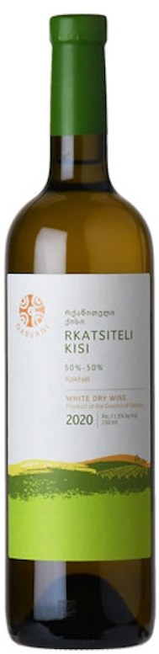
The Grapes of Georgia
Rkatsiteli: The Workhorse White
This white grape is the most widely planted in Georgia, and for good reason. It’s capable of making everything from dry, crisp table wines to complex, skin-contact amber wines. Rkatsiteli is known for its green apple, quince, and citrus flavors, and is the most widely planted white grape in Georgia and grown for centuries. It thrives particularly well in the Kakheti region and is often vinified using traditional qvevri methods.
Diversity: This grape is used to make everything from crisp, fresh whites to complex, amber-hued skin-contact wines. wine history.
Cultural heritage: It is considered one of the oldest known grape varieties, playing a key role in Georgia’s
Tasting Notes: Profile: Crisp and refreshing with flavors of green apple, pear, and quince. In skin-contact wines, expect additional notes of honey, apricot, and spices.
Finish: Clean and mineral, with a balanced acidity.

Slide 17
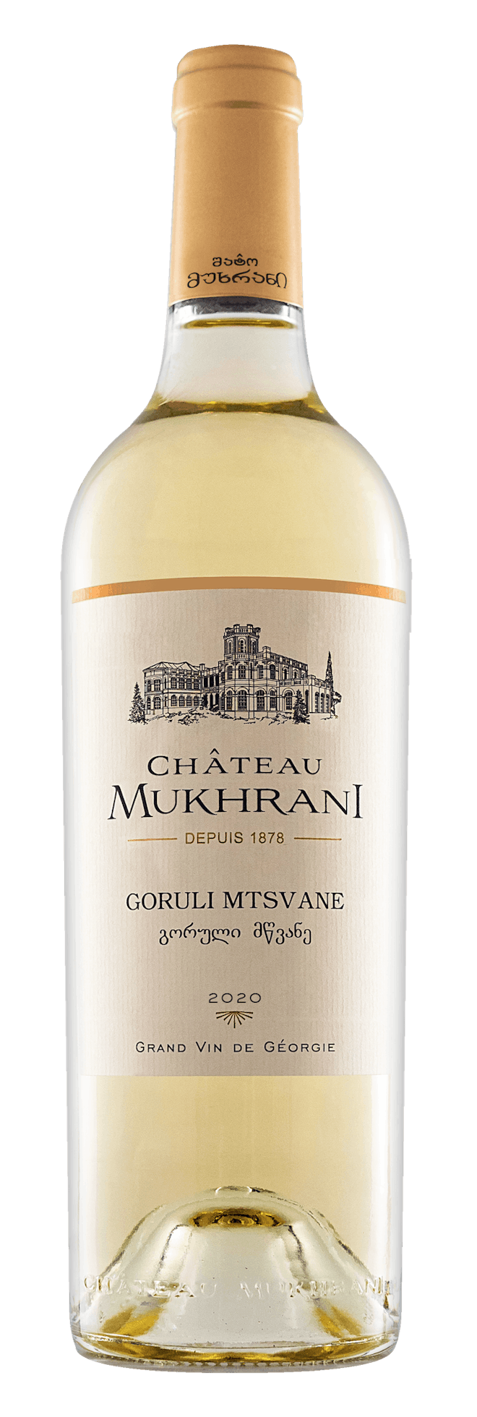
The Grapes of Georgia
Mtsvane: Green and Gorgeous
Mtsvane, which means "green" in Georgian, is an aromatic white grape known for its lively and fresh character. It is often blended with Rkatsiteli to add floral and stone fruit notes, but it also shines on its own in single-varietal wines.
Blending: Mtsvane is frequently used to enhance the aromatic complexity of Rkatsiteli and other whites.
Terroir Expressive: Mtsvane’s character is highly reflective of the region’s terroir.
Tasting Notes:
Profile: Floral aromas of jasmine and orange blossom, with flavors of lime, lemon, and stone fruits.
Finish: Zesty and refreshing, with bright acidity.

Slide 18

The Grapes of Georgia
Kisi: A Hidden Gem
Kisi is an indigenous white grape that has gained attention for producing both fresh white wines and complex, qvevri-aged amber wines. Though often overshadowed by Rkatsiteli, Kisi is a gem in Georgia’s viticulture.
Aromatics: Prized for its floral and fruit-forward aromas.
Amber Wine Production: Kisi excels in qvevri-aged wines, known for their rich texture and depth.
Tasting Notes: Profile: Tropical fruits like pineapple and mango, with apricot, honey, and nutty undertones in amber wines.
Finish: Long and complex, with a well-balanced structure.

Slide 19
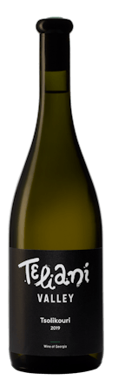
The Grapes of Georgia
Tsolikouri: Western Georgia’s Fresh White
Tsolikouri is a prominent white grape from the Imereti region, thriving in the cooler, more humid climate of western Georgia. It is known for producing bright, refreshing wines, often used for both still and sparkling styles.
Regional Specialty: It thrives in the western part of Georgia, especially in Imereti.
Sparkling Potential: Thanks to its high acidity, Tsolikouri is often used in sparkling wines.
Tasting Notes: Profile: Zesty citrus flavors such as lemon and lime, with green apple and subtle floral notes. Finish: Crisp and refreshing, with lively acidity.

Slide 20
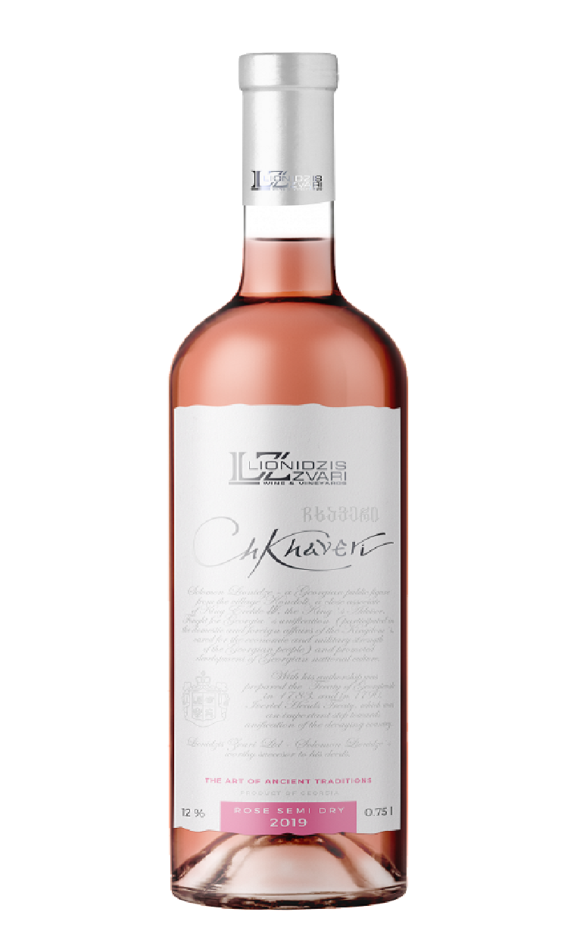
The Grapes of Georgia
Chkhaveri: The Rare Pink-Skinned Grape
Chkhaveri is a rare, pink-skinned grape from the Guria region, known for producing both light red and rosé wines. Nearly extinct at one point, this grape is now enjoying a revival, particularly for its rosé production.
Rarity: Chkhaveri’s near-extinction makes its resurgence significant for Georgian wine diversity.
Rosé Production: One of the few Georgian grapes primarily used to create high-quality rosé wines.
Tasting Notes
Profile: Delicate red fruits like strawberries and raspberries, with floral notes of rose and violet.
Finish: Light, refreshing, with bright acidity and a hint of minerality.

Slide 21
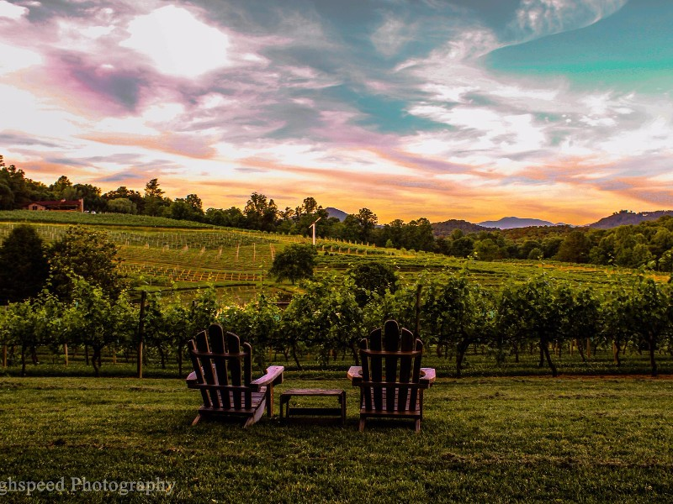
Notable Wineries in Georgia
A Closer Look at the Best Wineries
Georgia’s long-standing winemaking tradition is supported by a number of outstanding wineries, each of which has garnered international recognition for their dedication to quality and innovation. Among the many winemakers in Georgia, four stand out for their contributions to the revival of ancient practices, their international accolades, and the sheer quality of their wines. These are Pheasant’s Tears, Teliani Valley, Tsinandali Estate, and Shumi Winery. Below is an in-depth look at these acclaimed wineries and their unique contributions to the world of wine.

Slide 22
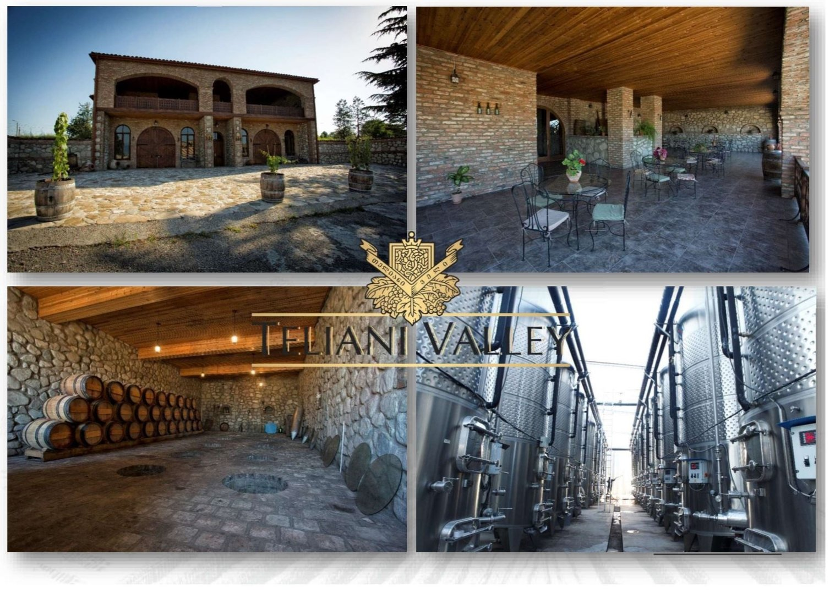
Teliani Valley Winery - Innovation Meets Tradition
Signature Wines:
Mukuzani Saperavi: A full-bodied dry red wine made from Saperavi grapes grown in the Mukuzani micro-zone, known for its aging potential and complex flavor profile of dark fruits, tobacco, and chocolate.
Rkatsiteli: Teliani Valley’s interpretation of this ancient white grape is a refreshing, crisp wine with notes of green apple, quince, and pear, making it a popular choice among white wine enthusiasts.
Accolades and Recognition: Teliani Valley has garnered numerous awards at international wine competitions, including the prestigious Decanter World Wine Awards and the International Wine Challenge. Their focus on both high-quality traditional wines and modern techniques has helped put Georgian wine on the global map. Their Mukuzani Saperavi, in particular, has won multiple gold medals and continues to be one of the most sought-after Georgian wines abroad.

Slide 23
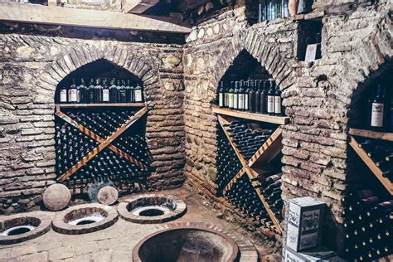
Pheasant’s Tears: A Pioneer of Natural Winemaking
Pheasant’s Tears is one of the most well-known names in Georgian winemaking, particularly in the natural wine movement. Founded in 2007 by American artist and winemaker John Wurdeman in collaboration with Georgian farmer Gela Patalishvili.
Pheasant’s Tears has become synonymous with traditional winemaking techniques, especially the use of qvevri (clay amphorae) to ferment and age wines. The name "Pheasant’s Tears" comes from an ancient Georgian saying that only the finest wines can make a pheasant cry.
Pheasant’s Tears is located in the Kakheti region, the heartland of Georgian wine production. The winery is dedicated to reviving Georgia’s ancient winemaking methods, focusing on indigenous grape varieties such as Saperavi, Kisi, Rkatsiteli, and others.
What sets this winery apart is its commitment to biodynamic and organic farming, which results in wines that are both expressive and deeply connected to the terroir.

Slide 24
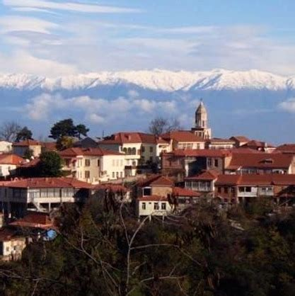
Pheasant’s Tears: A Pioneer of Natural Winemaking
Pheasant’s Tears Signature Wines:
Saperavi Qvevri: This natural red wine is fermented in qvevri and features intense flavors of dark berries, spices, and earthy undertones, with a long, tannic finish. It has gained significant recognition for its depth and complexity.
Kisi Amber Wine: One of Pheasant’s Tears’ standout offerings, this amber wine showcases tropical fruits, apricot, and a rich honeyed texture, thanks to its extended skin contact during fermentation.
Accolades and Recognition: Pheasant’s Tears has been a trailblazer in introducing Georgian wines to global markets, particularly in the natural wine scene. It regularly features at international wine exhibitions and has received glowing reviews from leading wine critics. Their wines are distributed worldwide, and their commitment to sustainable practices has earned them respect among connoisseurs and sommeliers alike.

Slide 25
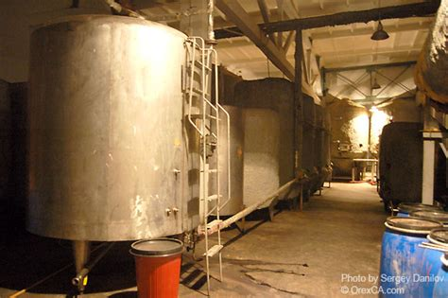
Teliani Valley: Innovation Meets Tradition
Teliani Valley Winery Estate is one of Georgia’s largest and most commercially successful wineries, known for its balance between traditional Georgian winemaking methods and modern production techniques.
Established in 1997, the winery is located in the Kakheti region, home to some of Georgia’s finest vineyards. Teliani Valley has played a significant role in boosting the international reputation of Georgian wines, producing a wide range of styles, from traditional qvevri wines to more contemporary, international-styled varieties.
What makes Teliani Valley unique is its ability to cater to both Georgian and global palates. While it remains rooted in Georgia’s rich winemaking tradition, the winery also collaborates with international winemakers to craft wines that appeal to broader audiences. This dual approach has made Teliani Valley Winery one of the most awarded and recognized wineries in Georgia.

Slide 26
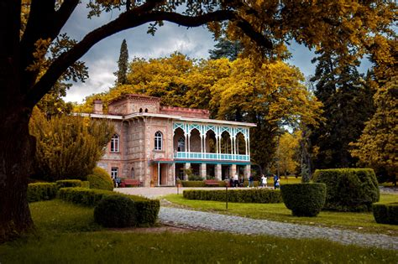
Tsinandali Estate The Historical Heart of Georgian Wine
Tsinandali Estate is not only one of the most famous wineries in Georgia but also one of the country’s most historically significant. The estate is located in the Kakheti region and dates back to the 19th century.
It was established by Prince Alexander Chavchavadze, a nobleman and poet who played a crucial role in modernizing Georgian winemaking. Chavchavadze introduced European winemaking techniques to Georgia and blended them with traditional methods, effectively creating the first modern winery in the country.
Today, Tsinandali Estate remains a symbol of Georgian winemaking heritage. The estate has been meticulously restored and continues to produce wines that honor its legacy while embracing contemporary standards.
It is particularly known for its blends of Rkatsiteli and Mtsvane, which are considered some of the finest examples of Georgian white wine.

Slide 27
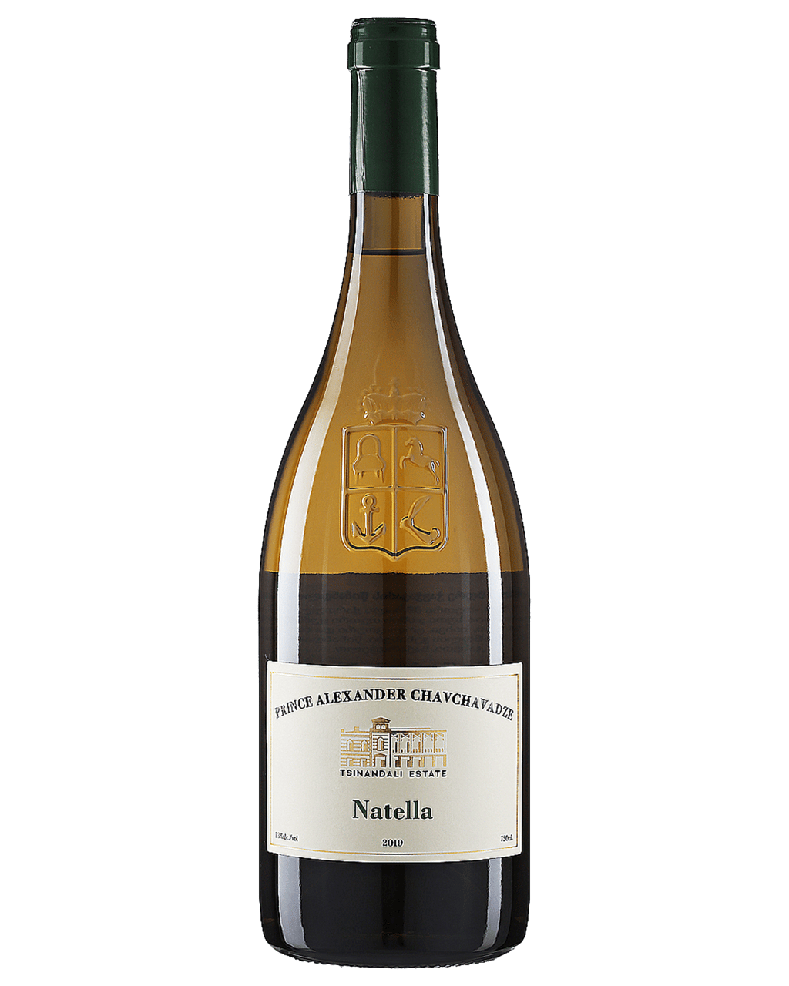
Teliani Meets Tradition
Tsinandali Estate Signature Wines:
Tsinandali White: A classic blend of Rkatsiteli and Mtsvane, this wine is crisp and aromatic, with notes of citrus, green apple, and a hint of floral freshness, showcasing the best qualities of both grapes.
Saperavi Reserve: A bold, full-bodied red wine made from carefully selected Saperavi grapes, aged in oak barrels to enhance its complexity and depth.
Accolades and Recognition: Tsinandali Estate has received widespread recognition for its dedication to preserving Georgian winemaking traditions while producing wines of exceptional quality.
The estate’s wines have been awarded medals at numerous international competitions, including the International Wine & Spirit Competition (IWSC). Additionally, Tsinandali Estate is a popular destination for wine tourists and has been featured in international travel and wine publications for its stunning historical setting and exceptional wines.

Slide 28
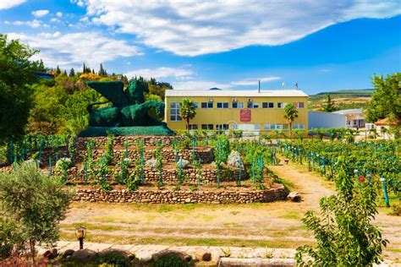
Shumi Winery: A Master of Qvevri Winemaking
Shumi Winery is renowned for its mastery of traditional Georgian qvevri winemaking, as well as its innovative approach to blending ancient practices with modern techniques.
Located in the Tsinandali district of Kakheti, Shumi was founded in 1997 and has since become one of Georgia’s leading producers of both modern and traditional wines.
Shumi Winery is particularly famous for its qvevri wines, where grapes are fermented with their skins, stems, and seeds in large clay amphorae buried underground. This ancient method imparts a unique richness and texture to the wines, especially the whites, which take on an amber hue and complex tannic structure.
The winery is also a steward of Georgian biodiversity, cultivating a large number of indigenous grape varieties in its vineyards.

Slide 29
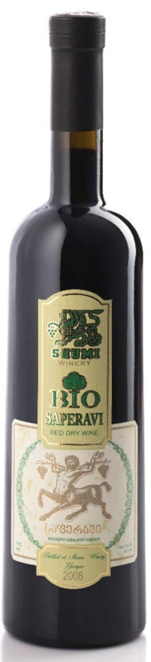
Shumi Winery
Signature Wines:
Rkatsiteli Qvevri: A quintessential amber wine, this qvevri-aged Rkatsiteli is known for its honeyed notes, dried apricot flavors, and bold tannic structure, making it one of the most celebrated Georgian amber wines.
Saperavi Grand Reserve: A premium red wine aged in both qvevri and oak barrels, this wine is full-bodied with flavors of dark berries, plum, tobacco, and spices, with an exceptional aging potential.
Accolades and Recognition: Shumi Winery has won numerous awards for its commitment to both tradition and innovation.
It has been recognized at major international wine competitions, including the Mundus Vini and Decanter awards, and its qvevri wines have been hailed as some of the finest examples of Georgian natural winemaking.

Slide 30
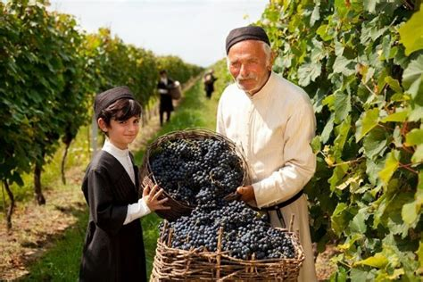
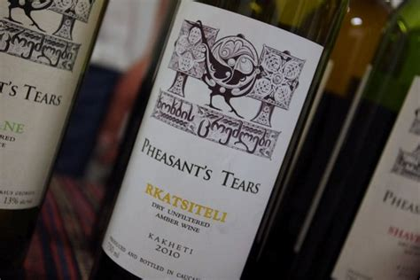
Georgian Wine Ambassadors
These four wineries—Pheasant’s Tears, Teliani Valley, Tsinandali Estate, and Shumi Winery—are not only leaders in Georgian wine production but also ambassadors for the country’s rich winemaking heritage.
Each winery brings something unique to the table, whether through innovative natural winemaking, modern production techniques, or the preservation of ancient traditions. Together, they are helping to raise the profile of Georgian wine on the global stage, introducing the world to the incredible diversity and depth of this ancient wine region.

Slide 31
Notable Wineries in Georgia
Pheasant’s Tears: Known for its natural qvevri-aged wines, particularly Saperavi and Kisi.
Teliani Valley: Produces a wide range of Saperavi styles, including dry and semi-sweet versions.
Tbilvino: Offers both traditional and modern expressions of Saperavi.
Tsinandali Estate: Famous for its Rkatsiteli blends, often with Mtsvane.
Shumi Winery: Specializes in traditional qvevri-aged Rkatsiteli wines.
Badagoni: A leading producer of both modern and traditional Rkatsiteli wines.
Kakheti Wine Cellar: Known for single-varietal Mtsvane wines.
Orgo: A producer of rich, skin-contact Kisi wines with impressive depth.
Baia’s Wine: A rising star in Imereti, producing excellent Tsolikouri wines, including sparkling varieties.
Ramaz Nikoladze’s Wine Cellar: Specializes in artisanal, natural Tsolikouri wines.
Gvino Zedashare: Renowned for its high-quality Chkhaveri wines.
Guria Wine: Focused on reviving and promoting the rare Chkhaveri variety.

Slide 32
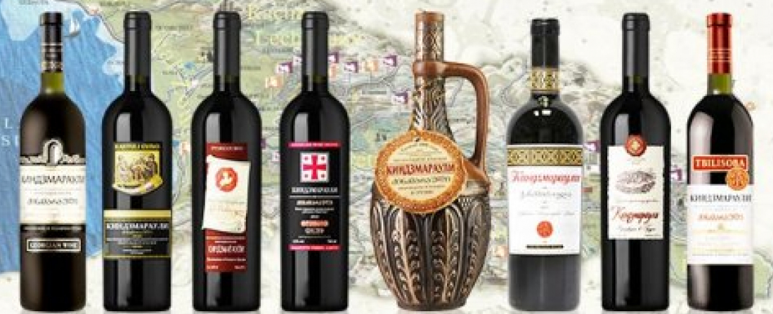
The Future of Georgian Wine
Georgia’s commitment to preserving its indigenous grape varieties, combined with a growing global interest in natural and traditional winemaking methods, is driving renewed interest in the country's wines. Whether you prefer bold reds like Saperavi or crisp whites like Rkatsiteli, Georgian wine offers a rich and diverse experience. For any wine enthusiast, exploring Georgian wines is a journey through 8,000 years of history and innovation.

Slide 33
Closing Thoughts
Georgian wine is a journey through centuries of history, rich tradition, and exceptional flavors. From the robust, tannic Saperavi to the vibrant, aromatic whites like Rkatsiteli and Mtsvane, Georgia’s native grape varieties offer wine lovers a diverse range of experiences.
The country’s unwavering commitment to preserving ancient winemaking practices, particularly the use of qvevri, gives its wines a distinctive character that sets them apart globally. Whether you’re an experienced wine connoisseur or just beginning to explore, Georgia’s wines showcase a unique blend of culture and craftsmanship.
These native grapes are the backbone of Georgian winemaking, each bringing something special to the table. Saperavi’s bold structure, Rkatsiteli’s versatility, and the bright, floral Mtsvane reflect the breadth of styles and flavors found in this ancient wine region.
With a growing global interest in natural and traditional wines, Georgia’s continued dedication to its indigenous varieties will ensure its wines gain more recognition worldwide, securing their place in the modern wine landscape.

Slide 34
Acknowledgement
My seminars are the result of many years of experience combined with many hours of research over the internet.
I would like to acknowledge the many source I have accessed.
These include Wine Spectator, Wine Enthusiast, BKWine Magazine, Wine & Spirits Magazine, American Vineyard Magazine, The Grapevine Magazine, Wikipedia.com, Britannica.com, and the various Government websites.

Slide 35
Citations and References
Comprehensive Guide to Georgian Wine Regions​, Georgia's 29 wine appellations, detailing specific regions such as Kakheti, Imereti, Kartli, and others, along with the unique characteristics of wines produced in each area​
National Wine Agency of Georgia: This resource was key in understanding the role of Georgian appellations, the preservation of traditional winemaking techniques, and the importance of specific grape varieties native to Georgia. Also invaluable for understanding the key grape varieties like Saperavi, Rkatsiteli, and Mtsvane, and their significance to Georgia’s wine culture.
Georgia.to: This site offered detailed descriptions of Georgian grape varieties, their tasting profiles, and the wineries that specialize in them​.
Pheasant’s Tears Winery Website: Offered specific insights into the production and character of their natural, qvevri-aged wines, particularly Saperavi and Kisi.
Wine Tours Georgia: Provided regional details and insights into specific wineries that are well-known for producing the top Georgian varietals, like Pheasant’s Tears and Shumi Winery​
Georgian Wine Heritage

