Slide 1
Gaspe, Quebec Canada
Port Guide
Presented by
Marc Silver

Slide 2
What I Will Cover
My Port Philosophy
Don’t Miss the Ship
Money
Exchanging Money
A Brief History of Civitavecchia
Maps
Transportation
Top Attractions & Points of Interest
Local Cuisine & Dining Options
Important Tips & Practical Advice
Conclusion

Slide 3
My Port Philosophy
I have been cruising for over 45 years and have taken over 100 cruises.
So, I consider myself an experienced cruiser.
The information I will present is based on those many years of
experience.
When I am on a cruise where the city, I want to visit is not the port city,
I always recommend taking a ship’s tour.
But when I am in a port with multiple attractions nearby and easy to see
on my own -
I will do it on my own.
This presentation is not like that.

Slide 4

Don’t Miss the Ship
How to Avoid Missing Your Ship
Pay attention to the time. - Ship time and local time are often
different.
Put a return-to-ship reminder on your phone.
Choose excursions wisely.
If a ship-sponsored excursion is late returning to port, the ship will
wait for you. If you are on your own???
Be Prepared
Have your Passport, Credit Card, and phone numbers for your ship
port agent.
What to Do If You Miss the Ship
Most cruise lines have port agents stationed in the port area to assist if your ship has left without you. If your are lucky, when cruisers are late returning to the vessel, the ship’s crew will often remove the passengers’ essential items – passports, cell phones, and medication -- from the ship to leave with the port agents.
The Port Officials can help you with contacting your ship
and making necessary travel arrangements.

Slide 5

Money
Italy uses the Euro (€) as its official currency.
As of October 2024, the exchange rate between
the Euro and the U.S. Dollar (USD) is about
1 EUR = 1.05 USD.
This means U.S. travelers should anticipate slightly
higher prices in terms of conversion, but Spain remains a relatively affordable destination compared to many other Western European countries.
When exchanging money, it’s best to avoid doing so at the port exchange kiosks, as they tend to have higher fees and less favorable rates.
Instead, consider using ATMs to withdraw Euros directly, as they often offer better rates. Additionally, credit and debit cards are widely accepted throughout Alicante, though having some cash on hand is always a good idea for smaller purchases or tips.

Slide 6
Exchanging Money
When exchanging money, it’s best to avoid doing
so at the port exchange kiosks, as they tend to
have higher fees and less favorable rates.
Instead, consider using ATMs to withdraw Euros
directly, as they often offer better rates.
Additionally, credit and debit cards are widely accepted throughout Italy, though having some cash on hand is always a good idea for smaller purchases.

Slide 7
A Brief History of Gaspe,
Quebec Canada
The Gaspé Peninsula, known as the "Birthplace of Canada," has a rich history spanning centuries. The Mi'kmaq people were the original inhabitants, skilled hunter-gatherers who may have had contact with Vikings as early as the 11th century.
European colonization began in 1534 when Jacques Cartier erected a cross in Gaspé Bay, claiming the land for France. The British gained control in 1758 under General James Wolfe, winning the decisive Battle of the Restigouche in 1760. The Gaspé officially became part of the Province of Quebec in 1763.
The peninsula attracted diverse immigrant groups over the following decades. Channel Island immigrants arrived in the 1750s, followed by Acadian refugees, Newfoundland fishermen, and Irish settlers. Scottish settlers came in waves, particularly after the Great Miramichi Fire of 1825. By 1850, the population reached 20,000, split evenly between English and French speakers.

Slide 8
A Brief History of Gaspe,
Quebec Canada
Economic development centered on fishing and shipbuilding. Charles Robin established a fishing monopoly in Paspébiac in 1767, while local shipyards produced over 600 vessels between 1777 and 1925. The railway reached Gaspé in 1911, and Highway 132 was completed around the peninsula in the 1920s.
The region played strategic roles in both World Wars. In 1914, the largest convoy ever to leave Canadian waters departed from Gaspé Harbour with over 30,000 troops. During WWII, Gaspé Bay served as a naval base during the Battle of the Gulf of St. Lawrence, when German U-boats sank 23 ships.
Modern developments include the creation of Forillon National Park in 1970 and Bonaventure Island bird sanctuary in 1985, both requiring family expropriations. Mining operations began in Murdochville in 1955, bringing new economic opportunities to the peninsula.

Slide 9
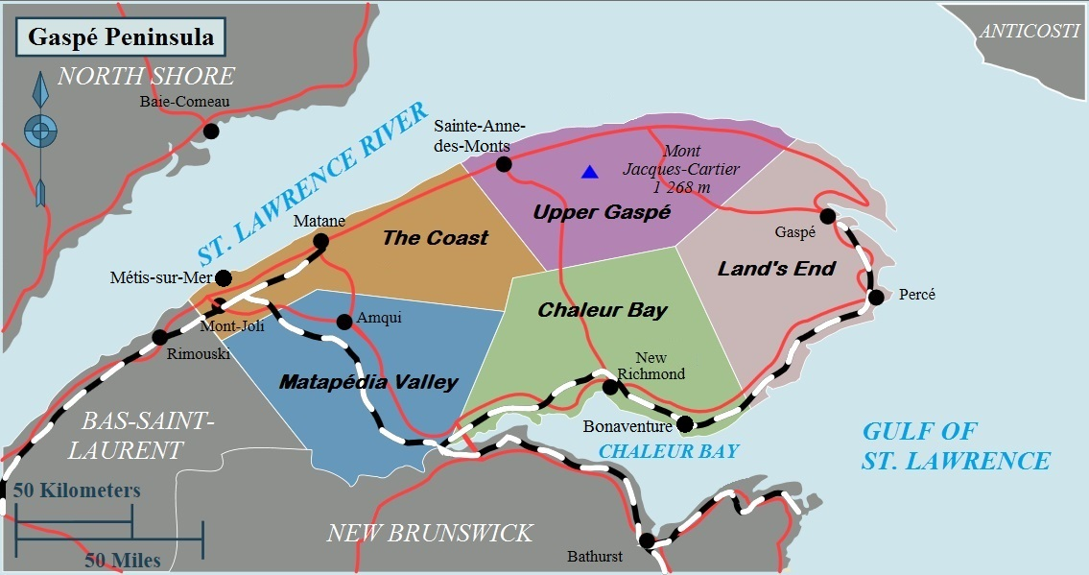
Area Map

Slide 10
Transportation
Transportation Options for Tourists

Slide 11
Transportation
Taxi Service:

Slide 12
Top Attractions & Points of Interest
Top Attractions & Points of Interest
The Colosseum: Hill: Combo tickets with the Colosseum cost 16€
Piazza Navona and the Pantheon: Both are free to visit and offer a fantastic glimpse of Rome’s Baroque architecture.

Slide 13
Local Cuisine & Dining Options
Must-try dishes: Start with Cacio e Pepe (pasta with cheese and pepper) or Carbonara. Don't forget supplì (fried rice balls) for a quick snack.
Where to eat:
  Trastevere: Great for authentic Roman food in a lively neighborhood.
  Campo de' Fiori: A bit touristy but with several excellent spots if you explore beyond the square.
  Avoid restaurants near major attractions: These often overcharge tourists for subpar meals.
Tipping culture: It’s not mandatory, but rounding up the bill or leaving a couple of euros for good service is appreciated.

Slide 14
Important Tips & Practical Advice
Time to visit attractions: Most of the major sites can be visited in 1-2 hours, but plan for 3-4 hours at the Vatican if you want to see it all.
Booking excursions: Cruise lines offer packages, but you’ll find better value booking independently through reputable tour companies.
Safety: Rome is generally safe, but watch out for pickpockets in crowded tourist areas. Stick to tap water—it's safe to drink and widely available.

Slide 15
Thanks For Coming
If you have any more questions, please ask.
I will do my best to answer them for you.
Have a great visit in Le Havre!

