Slide 1
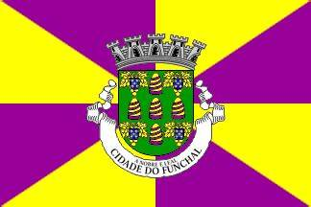
Funchal, Madeira Portugal
Port Presentation
Presented by
Marc Silver

Slide 2
What I Will Cover
My Port Philosophy
Don’t Miss the Ship
Money
Maps
Things You Should Know
Climate
Walking Tour
Points of Interest
Off the Beaten Path
Conclusion

Slide 3
My Port Philosophy
I have been cruising for over 46 years and have taken over 100 cruises.
So, I consider myself an experienced cruiser.
The information I will present is based on those many years of
experience.
When I am on a cruise where the city, I want to visit is not the port city,
I always recommend taking a ship’s tour.
But when I am in a port with multiple attractions nearby and easy to see on my own - I will do it on my own.
This presentation is for that type of port.

Slide 4
Don’t Miss the Ship
How to Avoid Missing Your Ship:
Pay attention to the time. - Ship time and local time are often different.
Put a return-to-ship reminder on your phone.
Choose excursions wisely:
If a ship-sponsored excursion is late returning to port, the ship will wait, but not for excursions taken on your own.
Be Prepared:
Have your Passport, Credit Card, and phone numbers for the ship port agent.
What to Do If You Miss the Ship:
Most cruise lines have port agents stationed in the port area to assist if your ship has left without you. Sometimes, when cruisers are late returning to the vessel, the ship's crew may remove the passengers' essential items -- passports, cell phones, and medication -- from the ship to leave with the port agents.
The Port Officials can help you with contacting your ship
and making necessary travel arrangements.

Slide 5
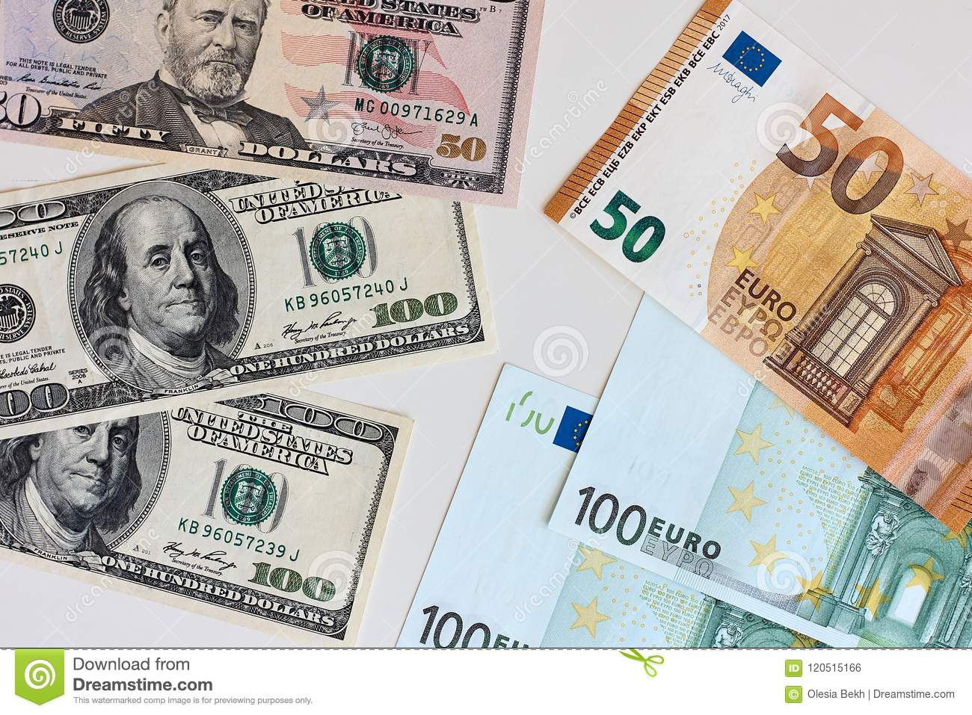
Money
The euro is the official currency of 20 European Union countries which collectively make up the euro area, also known as the euro zone.
Official Exchange is $1 to $1.079 US

Slide 6
Funchal, Madeira
Funchal is the capital of Madeira, an autonomous Portuguese region.
It’s built into a steep hillside above the bay, expect ups and downs if exploring by foot.
Famous as Cristiano Ronaldo’s birthplace. You’ll spot statues and themed boutiques.
Expect subtropical vibes, dense forests, and dramatic scale on the island, Madeira is often called “Europe’s Hawaii.”
Climate
Mild year-round, with summer highs near 75°F and winter around 60°F.
Afternoon breezes and occasional showers are common, carry a light rain jacket just in case.

Slide 7
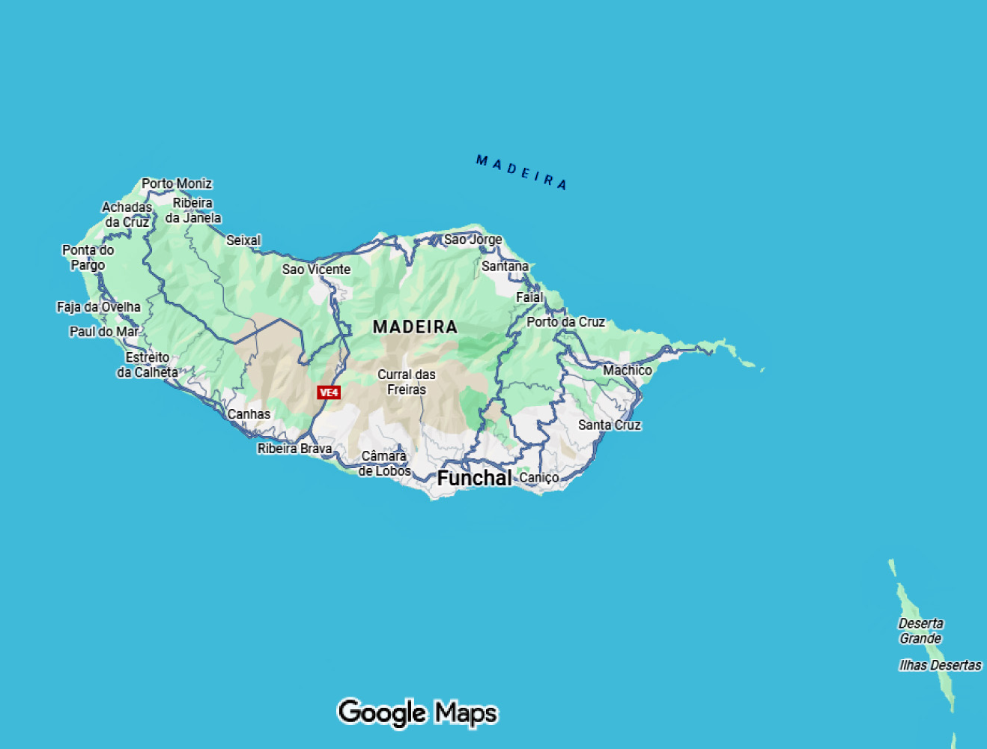
Madeira

Slide 8
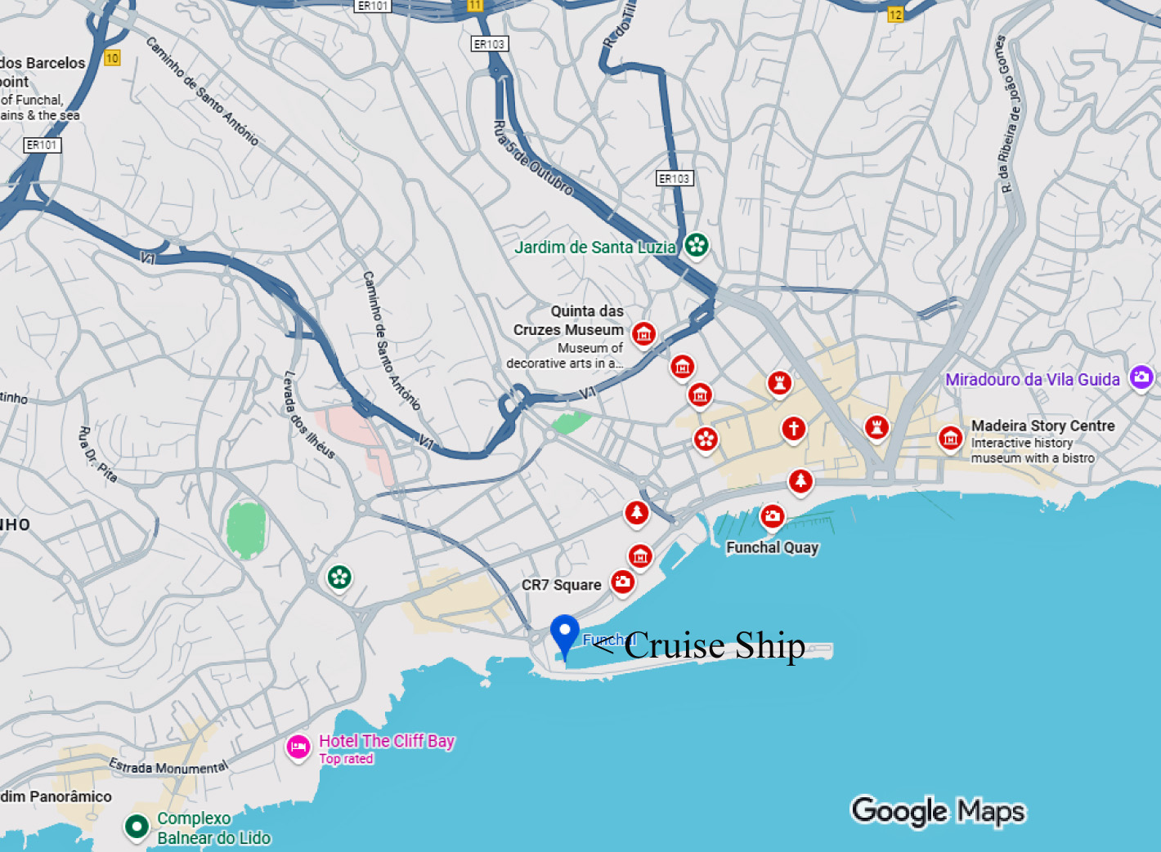
Funchal

Slide 9
Getting Around Funchal
Funchal is easy to navigate using a mix of walking, taxis, and cable cars.
Taxis are plentiful and reasonably priced, especially for short distances or uphill trips.
Local buses are available but are less intuitive for short port visits. Most visitors find walking and taxis sufficient.

Slide 10
Walking Tour
This is a relaxed loop that gives you a solid feel for Funchal in about two hours, longer if you linger.
Port Terminal → Avenida do Mar
A flat, scenic seaside walk past the marina and gardens.
Cristiano Ronaldo Statue & CR7 Museum
A popular photo stop near the harbor. Museum entry is optional.
Avenida Arriaga → Sé Cathedral
Built in 1514, this Gothic-Manueline cathedral is free to enter and worth a brief visit.
Mercado dos Lavradores
An Art Deco market with produce, flowers, and fish. Colorful, lively, and centrally located.
Santa Catarina Park
A peaceful green space with views over the harbor. Free and easy to access.
Fort of São Tiago
A 17th-century fort along the waterfront, excellent for photos. Free to explore.

Slide 11
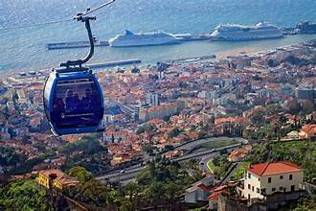
Points of Interest
Funchal Cable Car
Connects the city to
Monte with sweeping
harbor views.
Monte Palace Tropical
Garden
Lush gardens, tile art,
and panoramic viewpoints.
Madeira Botanical Garden
A quieter alternative with excellent plant collections and views.

Slide 12
Points of Interest
Site | Details | Admission
CR7 Museum | Ronaldo’s trophies & wax figure | €4.25 thetimes.co.uk+1thesun.co.uk+1
Sé Cathedral | Gothic-Manueline architecture | Free
Mercado dos Lavradores | Market stalls & azulejo tiles | Free
Sant’Art Museum | 15th–19th c. religious art | Free? Small fee likely (confirm locally)
Madeira Botanical Garden | 8 ha of gardens plus bird park | Adult €9–12 (typical)
Fort of São Tiago | Fort, battlements, ocean views | Free

Slide 13
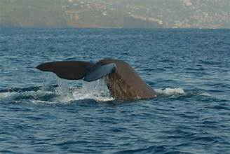
Off the Beaten Path
Cable Car + Monte Toboggan: Ride up in the cable car for scenic views (€15 round‑trip), then glide down in a wicker toboggan (€30 per ride)
Levada Walks: Easy canal-side trails in the hills some charge €3 per trail (starting January 2025).
Whale & Dolphin Tours: From the marina, expect ~€35 for a 3‑hour trip.
Blandy’s Wine Lodge:
Short tasting for free in their
shop, longer vintage
tours with tastings available
(€10–15 typical).

Slide 14
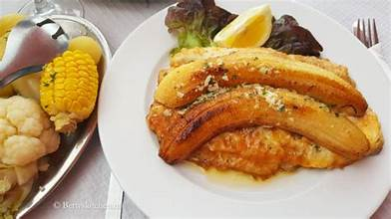
Local Food & Wine
Madeiran cuisine is simple, fresh, Local Food & Wine
Madeiran cuisine is simple, fresh, and satisfying.
Look for espada com banana
(black scabbardfish), seafood
stews, and bolo do caco garlic
bread.
Madeira wine ranges from dry
to rich and sweet, and tastings
are easy to find throughout the city.
You can eat well almost anywhere in Funchal, from casual cafés to fine dining.

Slide 15
Final Thoughts
Funchal is the ideal blend of city, sea, and scenery. You can wander through markets and cathedrals, ride a cable car, zoom down in a toboggan, and taste world-class Madeira wine, all in one day. It’s rich, relaxed, and rewarding.
Let me know if you’d like me to sketch a map slide or create annotated PowerPoint graphics to go with this.

Slide 16
Thanks for Coming
If you have any more questions, please ask.
I will do my best to answer them for you.
Have a great visit in Funchal, Madeira

