Slide 1
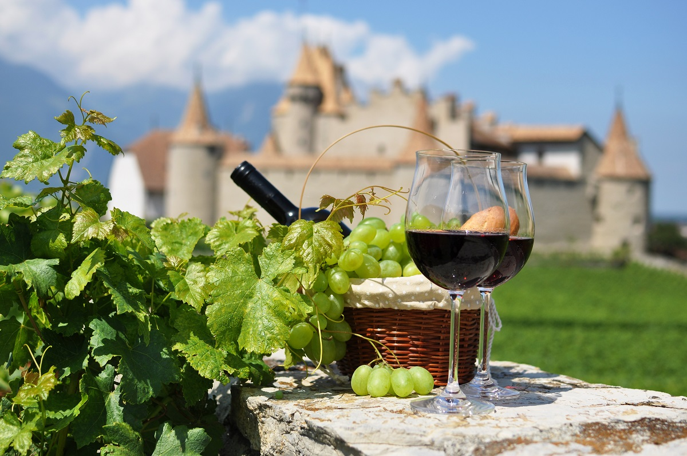
France’s Most Prominent Wineries The Big Four Presented by Marc Silver

Slide 2
What I Will Discuss
Today’s topics include:
French Wine
History of French Win
Terroir - Wine Regions of France
Château Margaux
Domaine de la Romanée-Conti
Château d’Yquem
Château Lafite Rothschild
The Art of French Winemaking
Wine Classification System
The Impact of French Wine on Global Markets
The Future of French Wine
Conclusion
Acknowledgement and Referances

Slide 3
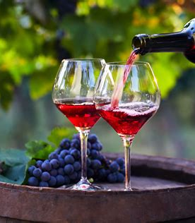
French Wine
French wine, revered worldwide for its quality and diversity, is more than just a beverage; it’s a symbol of France’s rich cultural heritage.
With a history that stretches back over 2,500 years, French wine embodies the perfect synergy between nature and human ingenuity.
From the rolling hills of Bordeaux to the sun-soaked vineyards of Provence, France offers an extraordinary range of wines, each reflecting the unique terroir and traditions of its region.

Slide 4
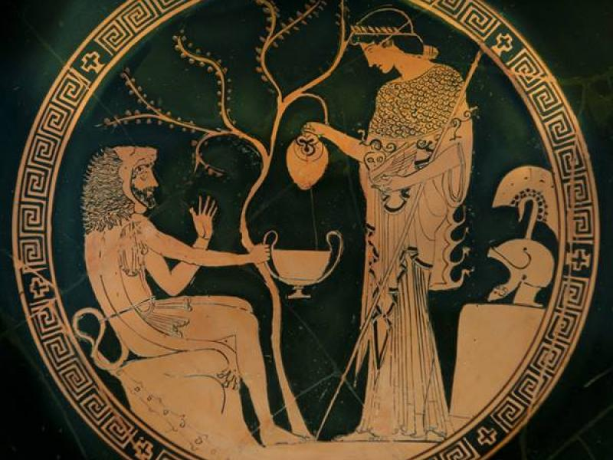
The History of French Wine
The history of French wine is deeply intertwined with the history of France itself. Viticulture in France dates to the 6th century BC when the Greeks established vineyards in the region that is now Provence.
The Romans later expanded wine production throughout Gaul (ancient France), introducing advanced viticulture techniques and spreading the culture of wine drinking.
During the Middle Ages, monasteries played a crucial role in preserving and advancing winemaking knowledge.
Monks meticulously cultivated vineyards, particularly in Burgundy and Champagne, producing wines for religious ceremonies and local consumption.

Slide 5
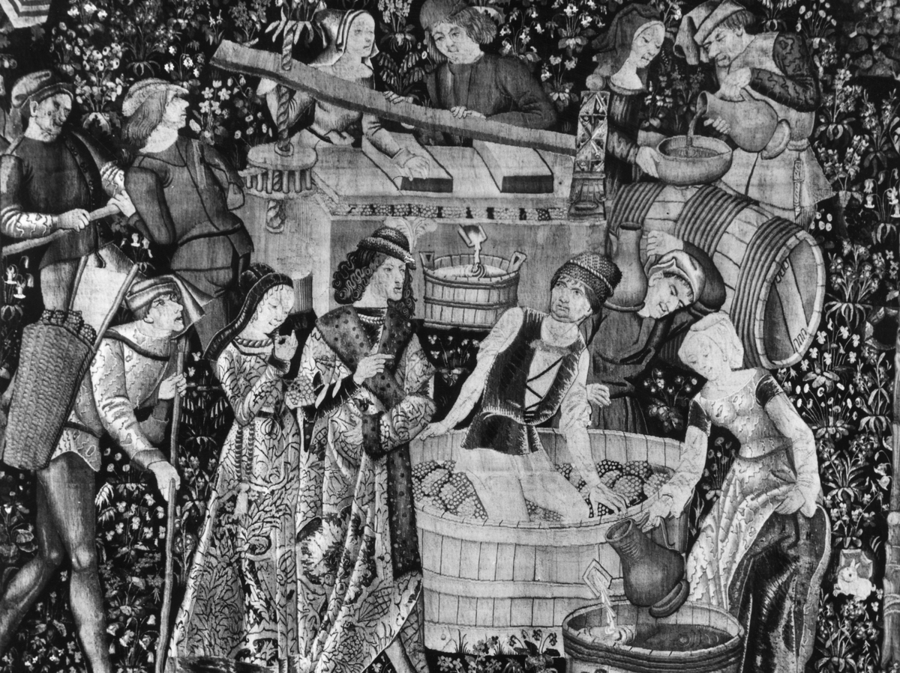
The History of French Wine
The reputation of French wine began to grow, and by the 17th century, French wines were being exported across Europe.
The 19th century saw significant developments in French winemaking. The classification of Bordeaux wines in 1855, commissioned by Napoleon III, set a benchmark for quality and established a hierarchy that still influences wine prices and reputations today.
However, the century also brought challenges, most notably the phylloxera epidemic, which devastated vineyards across Europe.
French winemakers eventually overcame this crisis by grafting their vines onto resistant American rootstocks.

Slide 6
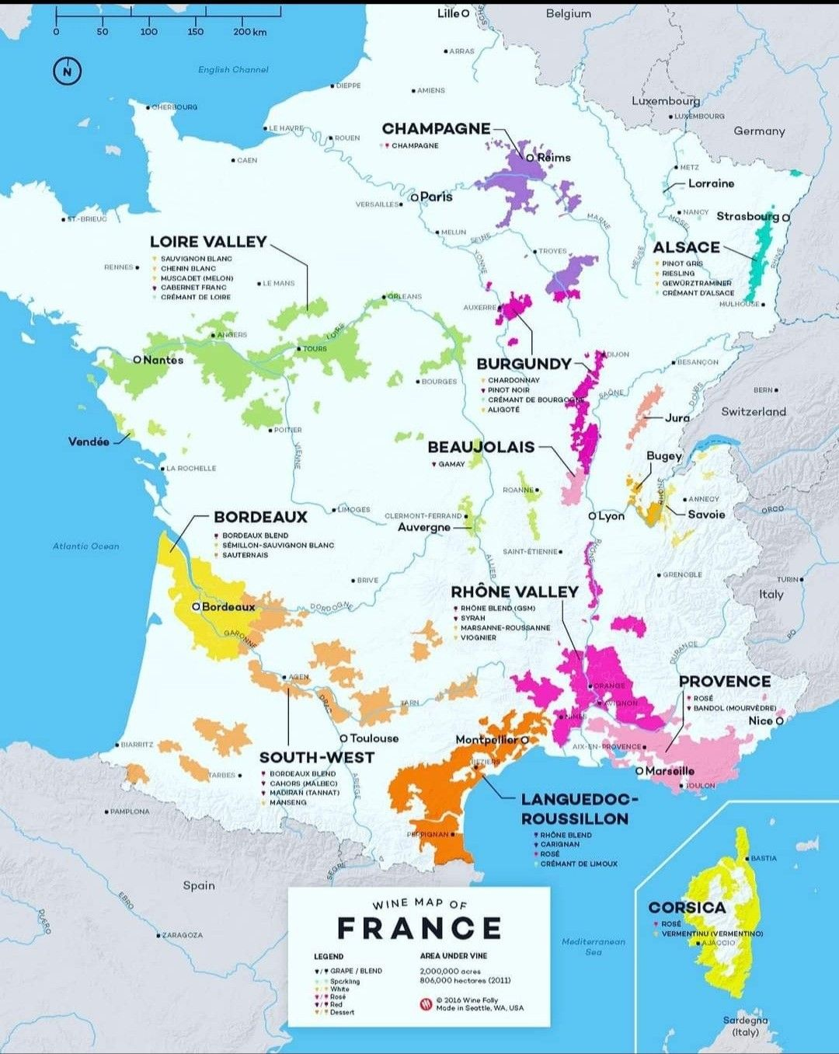
Terroir: The Soul of French Wine
The concept of terroir is central to French wine and is a term that encompasses the unique combination of soil, climate, topography, and human influence that gives each wine its distinct character.
France's varied geography and climate provide an ideal environment for a wide range of grape varieties, allowing for a diversity of wine styles unmatched by any other country.

Slide 7
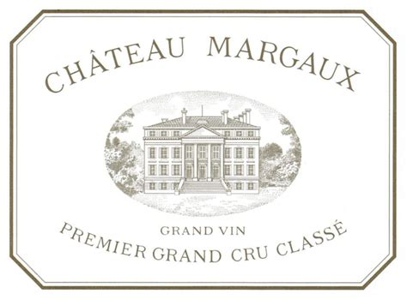
Château Margaux
Château Margaux is one of the most prestigious wine estates in the world, located in the Médoc region of Bordeaux, France.
It has a rich history and is renowned for producing some of the finest wines, particularly its Premier Cru (First Growth) Grand Vin, which is considered among the best red wines globally.
History of Château Margaux
Château Margaux’s history dates back to the 12th century when it was originally a castle estate. It began its transformation into a major wine-producing estate in the 16th century under the ownership of the Lestonnac family, who dedicated 265 hectares of the land to vineyards. By the 18th century, under the ownership of the Marquis de la Colonilla, Château Margaux was firmly established as one of the top producers in Bordeaux.
The estate was classified as a Premier Grand Cru Classé in the historic 1855 Bordeaux Classification, a ranking system established by Napoleon III to showcase the best wines at the Paris Exposition Universelle. Château Margaux was one of only five estates to receive this top classification in Bordeaux, and it remains in this elite group to this day.

Slide 8
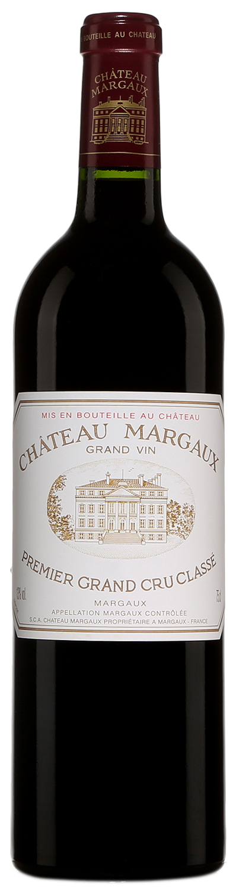
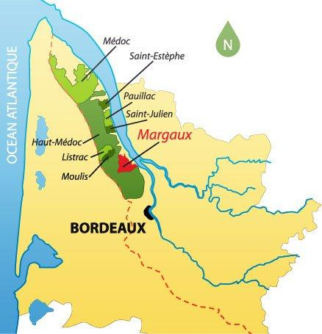
Château Margaux
Terroir and Viticulture
The Château Margaux estate is known for its exceptional terroir, which combines gravelly soils, excellent drainage, and proximity to the Gironde River.
These factors create ideal conditions for growing the estate’s primary grape, Cabernet Sauvignon, along with Merlot, Cabernet Franc, and Petit Verdot.
Château Margaux’s wines are famous for their elegance, depth, and age-worthiness. The unique combination of terroir and winemaking techniques results in wines that balance richness with freshness, structure with finesse.

Slide 9
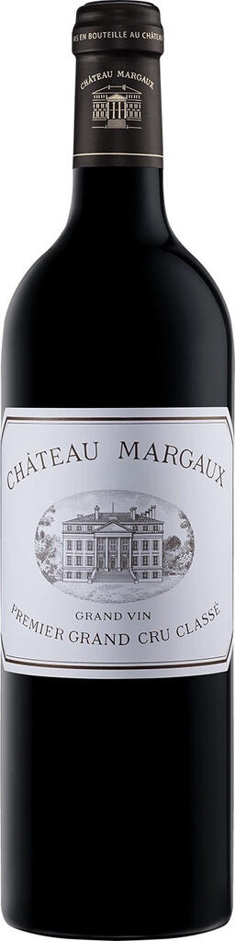
Château Margaux
Iconic Wines
Château Margaux Grand Vin: This is the estate’s flagship wine, a Premier Cru red made predominantly from Cabernet Sauvignon. It is known for its exceptional purity, complexity, and long aging potential. A bottle of Château Margaux Grand Vin from a great vintage can age for several decades, often improving with time.
Pavillon Rouge du Château Margaux: The estate’s second wine, made from younger vines and parcels not selected for the Grand Vin. While more approachable in its youth, Pavillon Rouge still carries much of the elegance and character of its more prestigious sibling.
Pavillon Blanc du Château Margaux: A white wine made entirely from Sauvignon Blanc, Pavillon Blanc is one of the rare white wines produced in the predominantly red-wine region of Bordeaux. It is appreciated for its freshness, complexity, and potential to age beautifully.

Slide 10
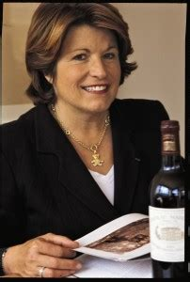
Château Margaux
Recent History and Ownership
In 1977, the estate was purchased by André Mentzelopoulos, a Greek-French businessman, who revitalized Château Margaux with major investments in both the vineyards and winery.
Today, it is still owned by the Mentzelopoulos family, with his daughter, Corinne Mentzelopoulos, overseeing operations.
Under her leadership, Château Margaux has continued to innovate while maintaining its traditional focus on producing world-class wines.

Slide 11
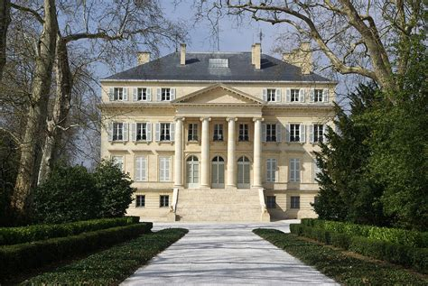
Château Margaux
Architectural and Cultural Significance
The château itself is a stunning example of neoclassical architecture, designed by architect Louis Combes in the early 19th century.
The estate’s wine cellars, designed by renowned architect Norman Foster, combine cutting-edge technology with a reverence for tradition, ensuring the wines are produced in optimal conditions.
Château Margaux stands as a symbol of French winemaking heritage, combining centuries-old traditions with a forward-thinking approach to vineyard management and winemaking.
Its wines are cherished by collectors and connoisseurs around the globe for their unparalleled elegance, structure, and aging potential.
Château Margaux - Achat grand vin et grand cru

Slide 12
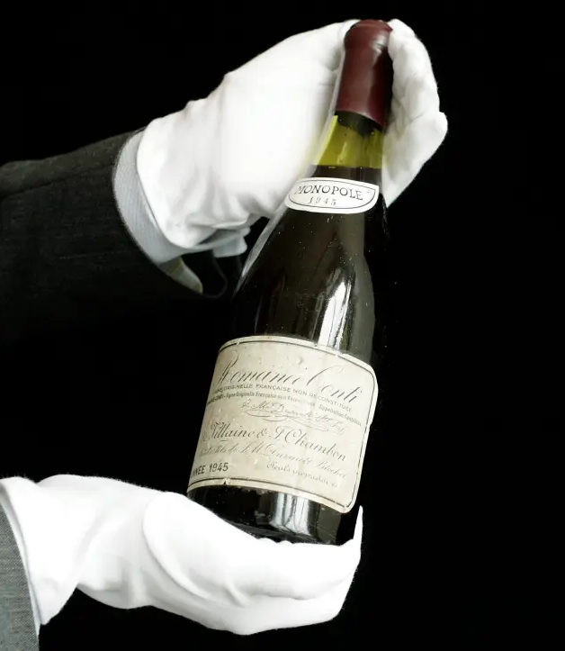
Domaine de la Romanée-Conti
Domaine de la Romanée-Conti (DRC) is one of the most revered and prestigious wineries in the world, located in the heart of the Burgundy region in France.
It is best known for producing some of the finest and most sought-after Pinot Noir wines, particularly from its eponymous vineyard, Romanée-Conti.
DRC's wines are not only considered among the best in Burgundy but are also some of the most coveted wines globally, commanding extraordinary prices and exclusivity.
The 1945 Romanée-Conti sold for $585K — Made it the most expensive bottle of wine ever sold.

Slide 13
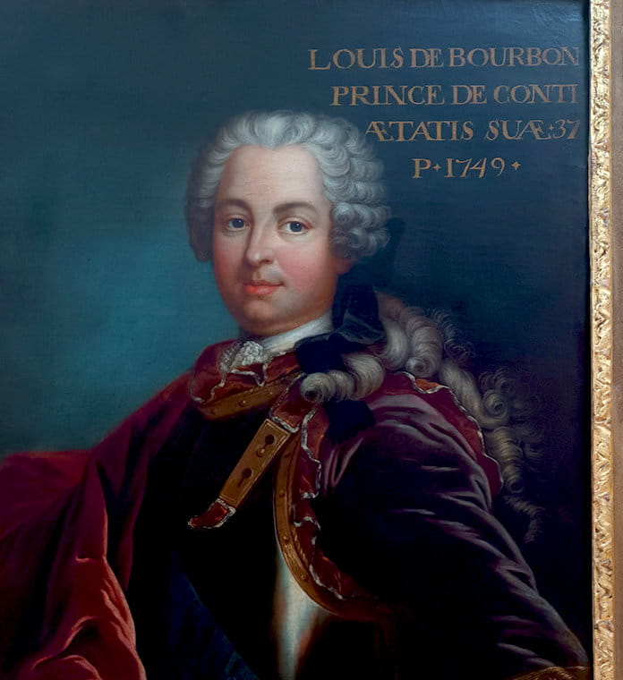
Domaine de la Romanée-Conti
Domaine de la Romanée-Conti (Burgundy)
The origins of the estate date back to the Middle Ages, but it became world-renowned in the 18th century.
In 1760, the vineyard was acquired by Prince Louis-François de Bourbon, who gave the estate its name after successfully outbidding Madame de Pompadour, the mistress of King Louis XV, for the property.
The vineyard was later passed through various ownerships until it came under the control of two families, the de Villaine and the Leroy families, who jointly manage it today.
Domaine de la Romanée-Conti (DRC) is synonymous with prestige in Burgundy. Located in the heart of the Côte de Nuits, DRC produces some of the most sought-after and expensive Pinot Noir wines in the world.

Slide 14
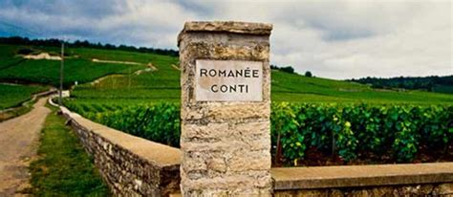
Domaine de la Romanée-Conti
Terroir and Viticulture
Domaine de la Romanée-Conti is located in the village of Vosne-Romanée in the Côte de Nuits sub-region of Burgundy.
The estate owns eight Grand Cru vineyards, including some of the most famous in the region: Romanée-Conti, La Tâche, Richebourg, Grands Échézeaux, Échézeaux, and Montrachet. Each vineyard has a unique terroir, which includes specific soil types, microclimates, and orientations that contribute to the distinctive character of the wines.
The estate’s wines are made using biodynamic farming practices, reflecting a deep commitment to sustainability and respect for the land. DRC’s approach to viticulture is meticulous, with a focus on low yields, manual harvesting, and precise vineyard management.
The vineyards are planted with old vines, and grapes are handpicked to ensure only the best fruit is used.
Romanée-Conti’s flagship wine, comes from a small vineyard with a unique terroir, yielding wines of exceptional purity and depth.

Slide 15
Domaine de la Romanée-Conti
Notable Wines
Romanée-Conti: The estate’s most famous and prized wine comes from its namesake vineyard, Romanée-Conti. This Pinot Noir wine is known for its extraordinary complexity, purity, and elegance. The production is extremely limited, often fewer than 6,000 bottles per vintage, making it one of the most expensive wines in the world. Romanée-Conti is famed for its rich aromas, fine tannins, and unparalleled ability to age for decades.
La Tâche: Another celebrated Grand Cru, La Tâche is a monopole (solely owned vineyard) of DRC, and is known for producing fuller-bodied, more robust Pinot Noir than Romanée-Conti. Like all of the estate’s wines, La Tâche is known for its exceptional balance and longevity.
Richebourg: This vineyard produces powerful and structured wines, with a richer, more concentrated style. Richebourg wines are often described as being more muscular than Romanée-Conti, but they still maintain the finesse and elegance characteristic of DRC.
Montrachet: While DRC is known primarily for its red wines, it also produces a highly regarded white wine from the Montrachet vineyard, made from Chardonnay. Montrachet from DRC is considered one of the finest white wines in the world, with incredible depth, richness, and balance.

Slide 16
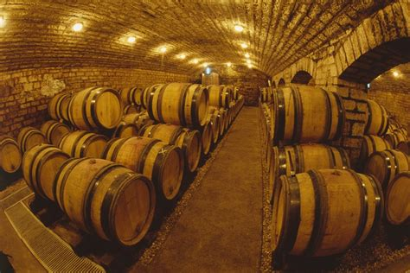
Domaine de la Romanée-Conti
Winemaking Philosophy
DRC’s winemaking process emphasizes minimal intervention, allowing the unique terroir of each vineyard to shine through.
The fermentation process is traditional, using indigenous yeasts and aging the wines in new oak barrels for up to 18 months.
The estate produces very limited quantities, and its wines are released in small allocations, contributing to their rarity and high value on the market.
The wines are known for their remarkable aging potential.
A bottle of Romanée-Conti or La Tâche can develop over several decades, evolving into something extraordinary with time. This makes the wines not only a symbol of luxury but also a long-term investment for collectors.

Slide 17
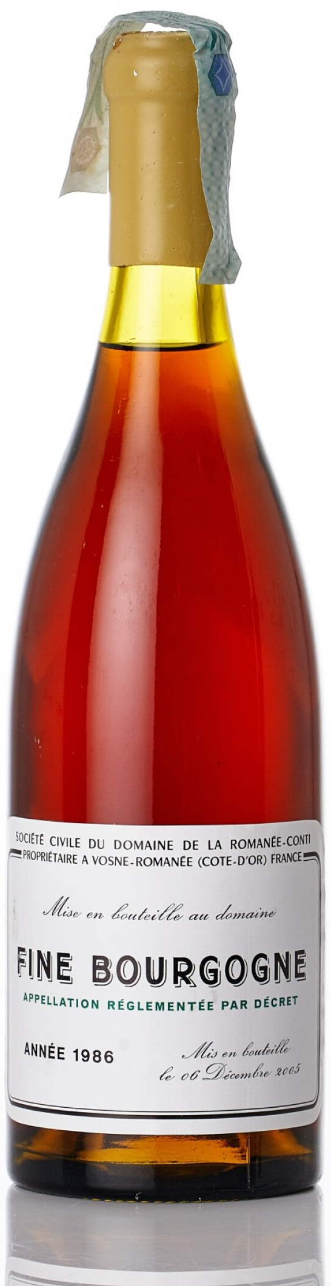
Domaine de la Romanée-Conti
Reputation and Legacy
Domaine de la Romanée-Conti is often referred to as the “holy grail” of wine. Due to its combination of rare terroir, exceptional winemaking, and limited production, DRC wines are highly sought after by collectors and enthusiasts worldwide.
A bottle from the estate, especially Romanée-Conti, can fetch tens of thousands of dollars, making it one of the most valuable wines in the world.
In addition to its high price, DRC’s wines are also known for their remarkable consistency in quality. Vintage after vintage, they are celebrated for their depth, complexity, and ability to age gracefully. The estate’s dedication to perfection and respect for tradition have cemented its place as a symbol of Burgundy’s winemaking excellence.
Conclusion
Domaine de la Romanée-Conti is not only a legend in the world of wine but also a testament to the artistry of winemaking in Burgundy.
Its wines reflect the utmost expression of terroir, craftsmanship, and tradition, making it one of the most admired and desired wine producers globally.

Slide 18
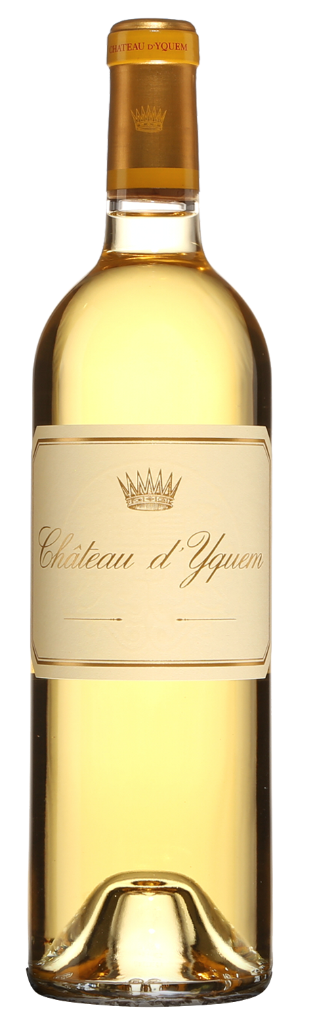
Château d’Yquem
Château d’Yquem is one of the most prestigious wine estates in the world, renowned for producing the finest sweet white wines. Located in the Sauternes appellation of the Bordeaux region, Château d’Yquem’s wines are celebrated for their exceptional sweetness, complexity, and extraordinary aging potential. The estate holds a unique position as the only winery to be classified as Premier Cru Supérieur (Superior First Growth) in the 1855 Bordeaux Classification.
History of Château d’Yquem
The history of Château d’Yquem dates back to the 16th century when the estate was acquired by the Sauvage family, who played a crucial role in developing its vineyards. Over the centuries, the estate was meticulously managed and passed through various noble families, most notably the Lur-Saluces family, who owned it for over 200 years.
In 1999, the estate became part of the luxury goods conglomerate LVMH (Moët Hennessy Louis Vuitton), although a member of the Lur-Saluces family remained involved in the management. This modern transition has helped Château d’Yquem maintain its elite status while continuing to produce top-quality wines with an artisanal approach.

Slide 19
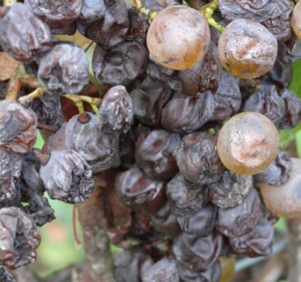
Château d’Yquem
The Unique Terroir
Château d’Yquem’s exceptional wine quality can be attributed to its unique terroir.
Located on a hilltop in Sauternes, the estate benefits from a specific microclimate that fosters the development of Botrytis cinerea, commonly known as noble rot. Noble rot is a crucial factor in making the sweet, complex wines that d’Yquem is known for.
The estate’s 113 hectares of vineyards are planted with Sémillon (about 75%) and Sauvignon Blanc (25%), with Sémillon providing richness and body, and Sauvignon Blanc contributing freshness and acidity.
The combination of grape varieties and the noble rot process leads to wines with remarkable depth and balance.

Slide 20
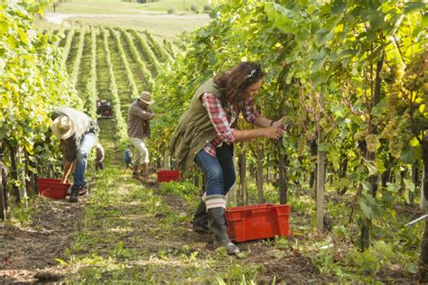
Château d’Yquem
The Winemaking Process
The production of Château d’Yquem is incredibly labor-intensive and time-consuming, reflecting the estate’s commitment to quality.
The noble rot, which shrivels the grapes and concentrates their sugars, develops under very specific conditions—cool, misty mornings followed by warm, sunny afternoons.
This natural process doesn’t occur every year, and there are vintages where Château d’Yquem does not produce a wine if the quality does not meet its high standards.
The harvest at Château d’Yquem is done by hand and often involves multiple passes through the vineyard to ensure that only the most perfectly botrytized grapes are selected. The yields are extremely low, which adds to the wine's rarity.
Once harvested, the grapes are carefully pressed, and the juice is fermented and aged in new oak barrels for 18 to 36 months. This extended aging period adds layers of complexity to the wine.

Slide 21
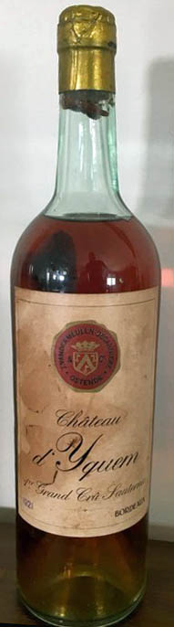
Château d’Yquem
Tasting Profile
Château d’Yquem is famous for its stunning sweetness balanced by vibrant acidity.
Its wines display an astonishing array of flavors, including apricot, honey, peach, tropical fruit, citrus, saffron, and vanilla, all wrapped in a luxurious, viscous texture.
As the wine ages, it develops even more complexity, with flavors of caramel, roasted nuts, and dried fruit emerging over time.
A well-aged bottle of Château d’Yquem can easily last a century or more, making it one of the longest-lived wines in the world.

Slide 22
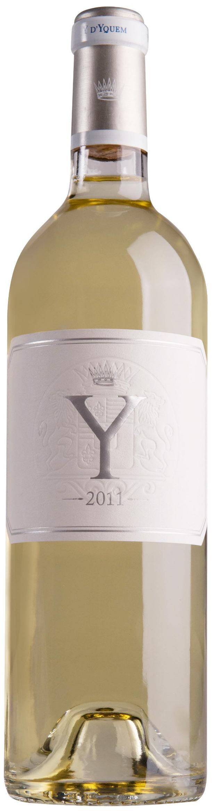
Château d’Yquem
Ygrec (Y d'Yquem)
In addition to its famous sweet wine, Château d’Yquem also produces a dry white wine called Ygrec (Y d'Yquem).
Made from a blend of Sauvignon Blanc and Sémillon, Ygrec is fresh, vibrant, and elegant, offering a unique contrast to the estate’s signature sweet Sauternes.
Though produced in much smaller quantities, Ygrec has gained a following among collectors and wine enthusiasts for its precision and complexity.

Slide 23
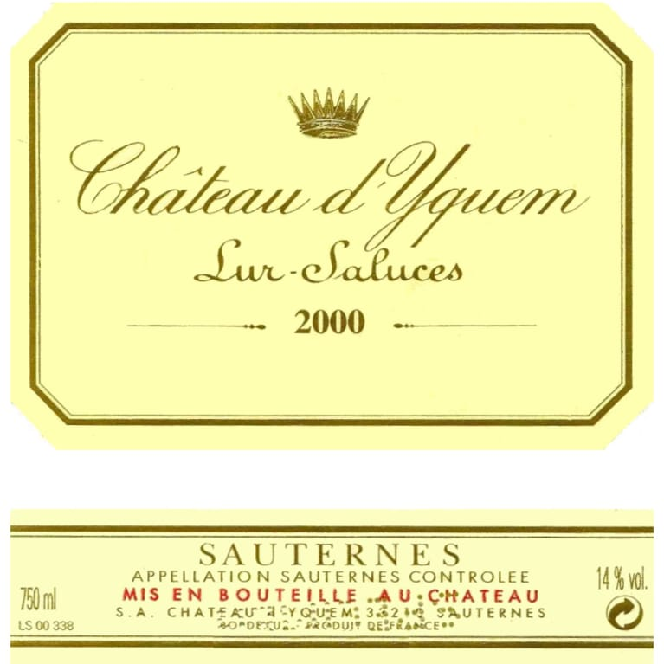
Château d’Yquem
Reputation and Legacy
Château d’Yquem occupies a special place in the world of wine, known for its ability to transcend the boundaries of what sweet wine can achieve.
It is often served at royal and state dinners, as well as in the most exclusive restaurants around the world. Its prestige is matched by its rarity, as only a limited number of bottles are produced each year, and even fewer are made available to the public.
The estate’s commitment to excellence, along with its storied history and the remarkable ability of its wines to age for decades, has made Château d’Yquem one of the most treasured and collectible wines in the world.
For connoisseurs, a bottle of Château d’Yquem represents the pinnacle of sweet wine production, a symbol of luxury, and a testament to the artistry of winemaking in Bordeaux.

Slide 24
Château d’Yquem
Notable Vintages
Château d’Yquem is known for consistently high-quality vintages, but certain years stand out as legendary. Some of the most acclaimed vintages include:
1811: One of the most famous vintages of Château d’Yquem, often referred to as one of the greatest wines ever made. This wine, produced during the "Comet Year" of 1811, is still known for its complexity and longevity.
1921: Another highly sought-after vintage, known for its richness and balance. It’s a collector’s favorite.
1945: A vintage produced in the immediate aftermath of World War II, this wine has gained legendary status for its exceptional concentration and aging potential.
2001: Often hailed as one of the greatest modern vintages of Château d’Yquem, it is known for its perfect balance of sweetness, acidity, and complexity.
2011: Celebrated for its finesse and elegance, this vintage is a prime example of the estate’s more recent triumphs.

Slide 25
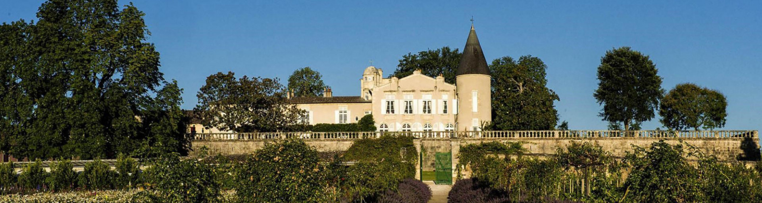
Château Lafite Rothschild
Château Lafite Rothschild is one of the most iconic and prestigious wine estates in the world, located in the Pauillac appellation of Bordeaux, France.
It is renowned for producing some of the finest red wines, primarily from Cabernet Sauvignon, and was classified as a Premier Grand Cru Classé (First Growth) in the famous 1855 Bordeaux Classification. This designation places Château Lafite Rothschild among the top wine estates in Bordeaux.

Slide 26
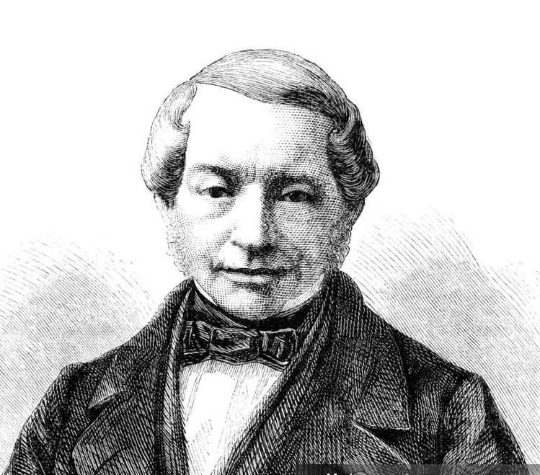
Château Lafite Rothschild
History
The origins of Château Lafite Rothschild date back to the late 17th century when the estate was already recognized for producing high-quality wines.
In 1868, it was purchased by Baron James de Rothschild, a member of the illustrious Rothschild banking family. Since then, it has remained under Rothschild ownership, with successive generations continuing to oversee the estate.
Baron De Rothschild Portrait 1869
Lafite Rothschild gained global recognition in the 18th century when it became a favorite of French nobility and the court of Louis XV.
The estate’s reputation for excellence continued to grow, making it one of the most coveted wines by collectors and connoisseurs worldwide.

Slide 27
Château Lafite Rothschild
Terroir and Viticulture
The terroir of Château Lafite Rothschild is considered one of the finest in Bordeaux.
The estate's vineyards, covering over 100 hectares, are planted predominantly with Cabernet Sauvignon (70%), along with Merlot, Cabernet Franc, and Petit Verdot.
The gravelly soils and close proximity to the Gironde River provide ideal conditions for growing powerful, structured, and elegant wines.
Lafite Rothschild’s winemaking philosophy emphasizes traditional methods, with a focus on preserving the unique expression of its terroir.
Each vintage is crafted with precision, resulting in wines that are known for their longevity and ability to age for decades.

Slide 28
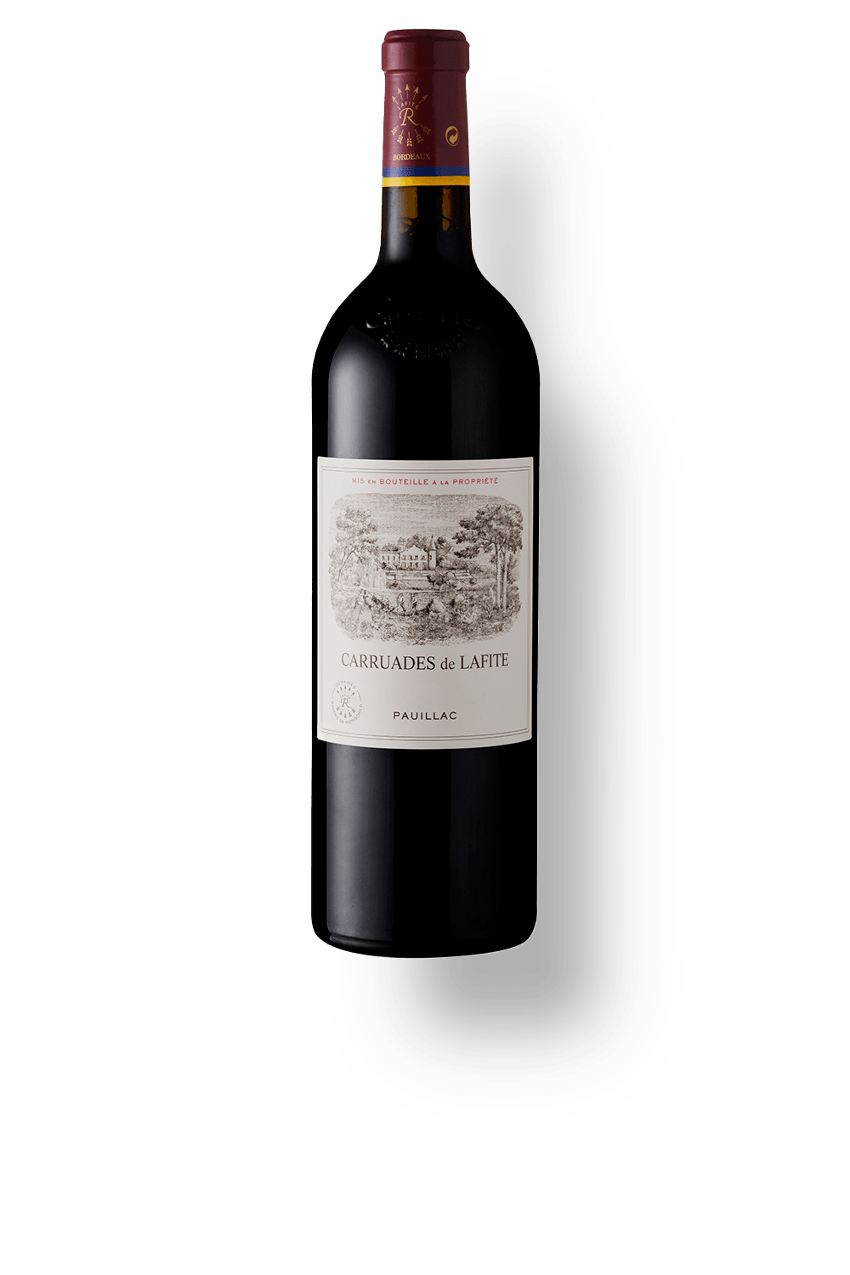
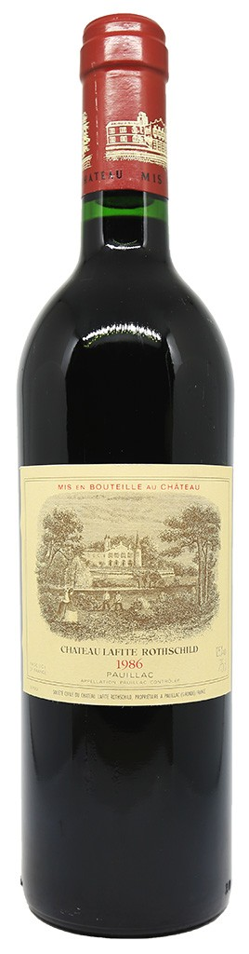
Château Lafite Rothschild
Notable Wines
Château Lafite Rothschild: The estate’s flagship wine is made primarily from Cabernet Sauvignon and is renowned for its balance, complexity, and elegance.
Lafite Rothschild wines are known for their deep aromas of blackcurrant, cedar, and graphite, along with finely integrated tannins and exceptional aging potential.
A well-made vintage can age gracefully for 50 years or more.
Carruades de Lafite: The estate’s second wine, Carruades de Lafite, offers a more approachable style while still carrying the hallmark quality of the Lafite vineyards.
It is typically softer and more fruit-forward than the Grand Vin.

Slide 29
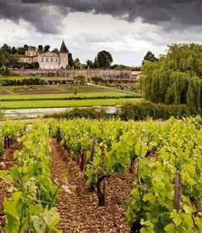
Château Lafite Rothschild
Reputation and Legacy
Château Lafite Rothschild is a symbol of luxury and refinement in the world of wine.
Its reputation for producing some of the best wines in Bordeaux has made it a favorite among collectors and investors, with certain vintages fetching astronomical prices at auction.
The estate’s commitment to quality, tradition, and excellence has solidified its status as one of the most respected and sought-after wine producers in the world.

Slide 30
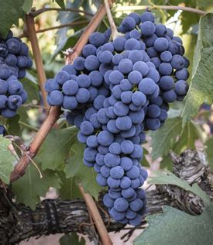
The Art of Winemaking in France
French winemaking is a blend of tradition and innovation, with techniques passed down through generations while also embracing modern advancements.
Winemakers in France have a deep respect for the land and strive to express the unique character of their terroir in each bottle.

Slide 31
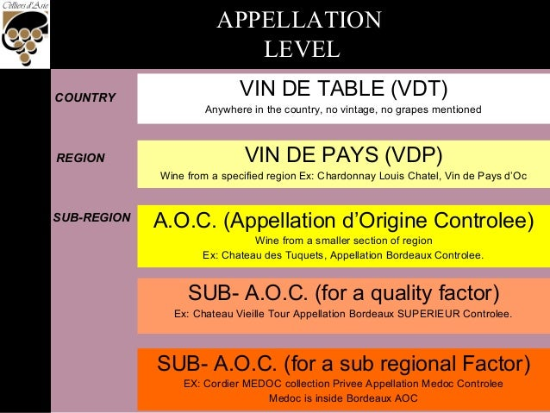
Wine Classification System
France has a complex system of wine classification that is designed to protect the integrity and quality of its wines.
The system is based on the concept of appellation, which designates the geographic origin of a wine and often imposes strict regulations on grape varieties, vineyard practices, and winemaking techniques.

Slide 32
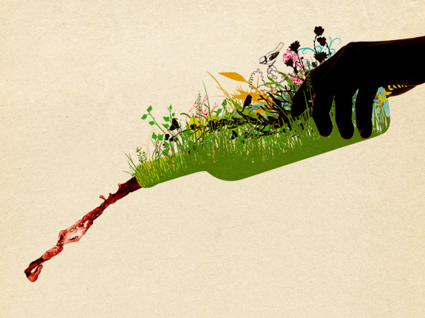
The Impact of French Wine on Global Markets
Sustainability and Innovation
Sustainability is increasingly important in the French wine industry, with many wineries adopting organic and biodynamic practices.
Innovation is also a key focus, with winemakers experimenting with new varietals, techniques, and wine styles to meet changing consumer preferences.

Slide 33
The Future of French Wine
As the world of wine continues to evolve, French winemakers are facing new challenges and opportunities.
Climate change is impacting the traditional growing seasons and grape varieties, leading some regions to experiment with new techniques and varieties better suited to warmer temperatures.
At the same time, there is a growing emphasis on sustainability and organic farming, with many winemakers seeking to reduce their environmental impact while maintaining the quality and character of their wines.
The global wine market is also becoming increasingly competitive, with wines from New World countries like the United States, Australia, and Chile gaining popularity.
Despite this, French wine remains the benchmark for quality and elegance, with a reputation that continues to command respect and admiration around the world.

Slide 34
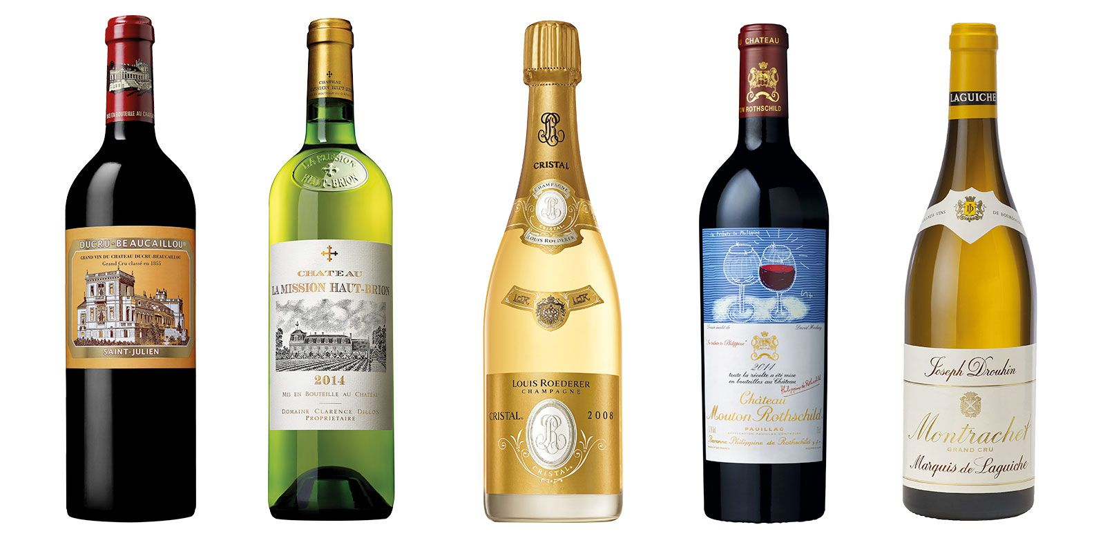
Conclusion
French wine is a testament to the artistry and dedication of its winemakers, who have honed their craft over centuries to produce some of the finest wines in the world.
Whether it’s a powerful Bordeaux, an elegant Burgundy, or a sparkling Champagne, each bottle of French wine tells a story of the land, the people, and the traditions that have shaped it.
As you explore the world of French wine, you’ll discover a rich tapestry of flavors and experiences that reflect the unique terroir of France’s diverse wine regions, making each sip a celebration of the country’s cultural heritage.

Slide 35
Conclusion
Summary of Findings
French wine is a testament to the country's rich history, diverse geography, and innovative spirit. From the noble reds of Rioja to the crisp whites of Rías Baixas and the complex Sherries of Jerez, Spain offers a wine experience that is both broad and deep.
Future Prospects for French Wine
The future of French wine looks promising, with growing international recognition and a strong commitment to quality and sustainability. However, continued success will depend on the industry's ability to adapt to changing market dynamics and consumer tastes.
Final Thoughts
French wine is more than just a beverage; it is a cultural expression that embodies the soul of Spain. As the country continues to evolve as a leading wine producer, its wines will undoubtedly remain a favorite among connoisseurs and casual drinkers alike.

Slide 36
Conclusion
My seminars are the result of many years of travel experience combined with many hours of research over the internet.
I would like to acknowledge the many source I have accessed.
References
A comprehensive list of sources used in the talk
The talk I provided was a conceptual, original synthesis based on general knowledge of French wine, its regions, varietals, and prominent wineries. Since it was generated as a comprehensive overview, specific external sources were not directly cited. However, if you need a list of potential sources that could be used to further explore the topics covered,
The talk I provided was written based on general knowledge about French wine, which includes historical information, regional specifics, winemaking techniques, and classification systems that are widely documented in literature, online resources, and educational materials about wine.
No specific external sources were directly consulted or cited during the creation of this article. If you need specific references or further reading on French wine, I can recommend sources or find up-to-date information using available tools.

Slide 37
Acknowledgement
My seminars are the result of many years of experience combined with many hours of research over the internet.
I would like to acknowledge the many source I have accessed.
These include Wine Spectator, Wine Enthusiast, BKWine Magazine, Wine & Spirits Magazine, American Vineyard Magazine, The Grapevine Magazine, Wikipedia.com, Britannica.com, and the various Government websites.

Slide 38
References
Wine and War: The French, the Nazis, and the Battle for France's Greatest Treasure by Don and Petie Kladstrup, Broadway Books, 2002.
The Oxford Companion to Wine, edited by Jancis Robinson, Oxford University Press, 2015.
The World Atlas of Wine, by Hugh Johnson and Jancis Robinson, Mitchell Beazley, 2019.
A History of Wine in Europe, 19th to 20th Centuries, Volume I: Winegrowing and Regional Features edited by Silvia A. Conca Messina, Palgrave Macmillan, 2021.
Terroir: The Role of Geology, Climate, and Culture in the Making of French Wines by James E. Wilson, University of California Press, 1998.

