Slide 1

Everyday Tech Unplugged
How the Gadgets You Love Actually Work
Presented By
Marc Silver

Slide 2
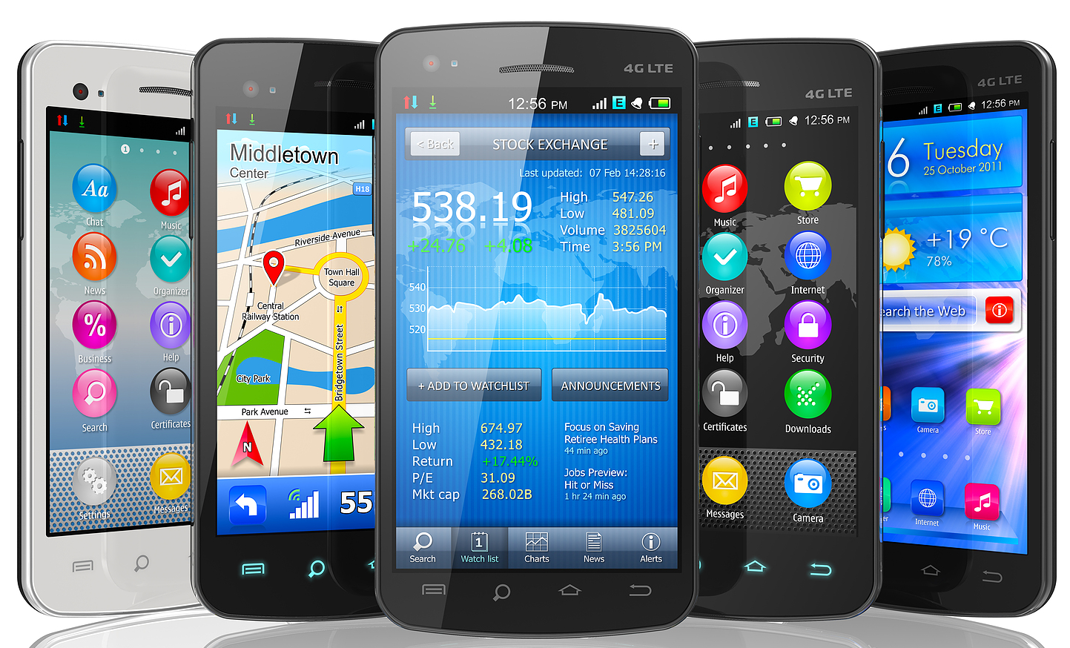
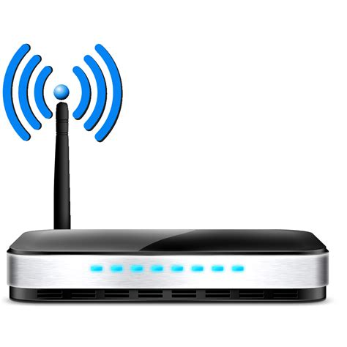
Introduction
Technology is an inseparable part
of our daily lives.
From the smartphone that wakes
you up in the morning to the Wi-Fi
router keeping you connected; these
devices are woven into the fabric of modern living.
They enhance convenience, boost productivity, and offer endless entertainment.
Yet, behind their sleek designs and seamless functionality lies a world of complex engineering and scientific innovation.

Slide 3

Introduction
How do these gadgets actually work? What makes them so reliable and indispensable?
Understanding the intricate systems within them not only satisfies our curiosity but also gives us a deeper appreciation of the technological marvels we often take for granted.
From electromagnetic waves powering Wi-Fi to sensors making smartphones smarter, every component is a testament to human ingenuity.
Let’s take a closer look at the hidden mechanics and brilliant engineering that make these everyday devices tick.

Slide 4
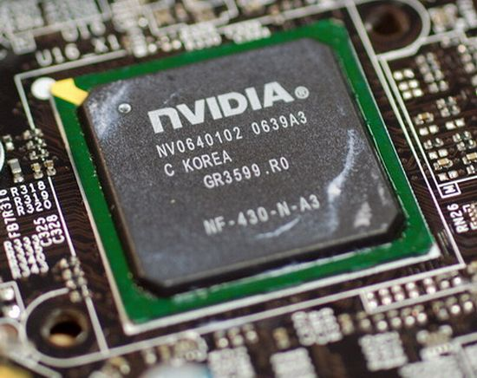
The Smartphone
Your Pocket-Sized Powerhouse
Smartphones are marvels of modern technology, combining multiple functions into a single device.
At their core is a powerful microprocessor, often compared to a tiny brain, capable of performing
billions of operations per second.
These processors work alongside
memory chips to store and retrieve
data, enabling seamless multitasking
and app usage.

Slide 5
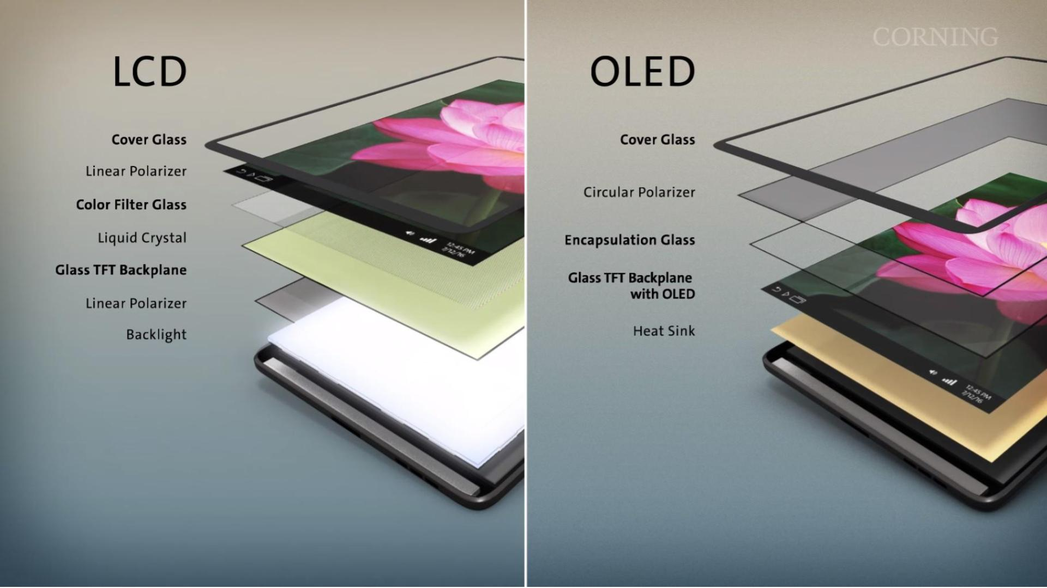
The Smartphone
Display Technology:
Most modern smartphones use OLED (Organic Light Emitting Diode) screens, which produce vibrant colors and deep blacks by lighting up individual pixels.
Unlike older LCD screens, OLEDs don’t require a backlight, making them more energy-efficient and thinner.
High-refresh-rate displays, offering smooth animations and transitions, are now a hallmark of premium smartphones.

Slide 6
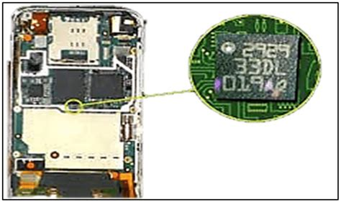
The Smartphone
Sensors Galore:
Your smartphone is packed with sensors—gyroscopes for detecting motion, accelerometers for tracking orientation, and proximity sensors to turn off the screen during calls.
Additionally, ambient light sensors adjust the brightness to save energy and reduce eye
strain, while barometers
measure atmospheric
pressure for apps like
weather forecasting.

Slide 7
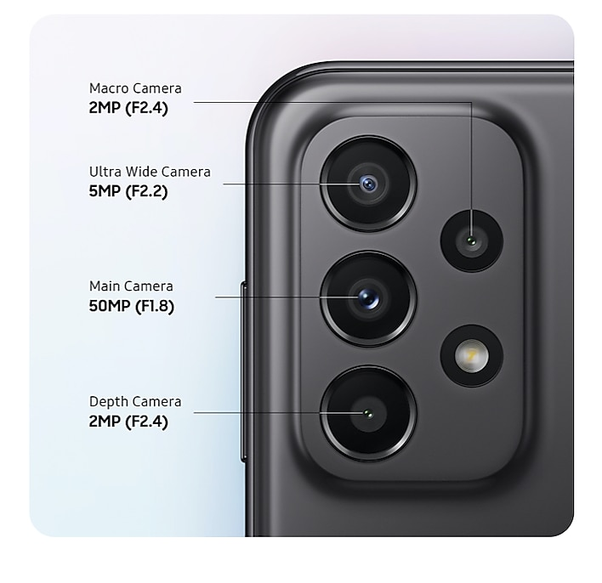
The Smartphone
Camera Systems:
Smartphone cameras have evolved into sophisticated imaging tools.
Multiple lenses—wide, ultra-wide, telephoto, and macro—enable users to capture a range of perspectives.
Advanced features like optical image stabilization (OIS), HDR (High Dynamic Range), and AI-driven scene recognition ensure stunning photos.
Computational photography, which combines multiple images into one, has further pushed the boundaries of what these tiny cameras can achieve.

Slide 8
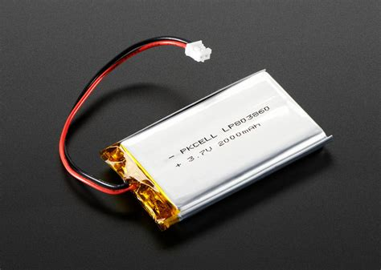
The Smartphone
Battery Management:
Modern smartphones use lithium-ion
batteries with smart energy
management systems.
These systems monitor app usage
and optimize performance to extend
battery life.
Features like fast charging and wireless charging add convenience, while battery health algorithms prevent overcharging to prolong battery lifespan.

Slide 9
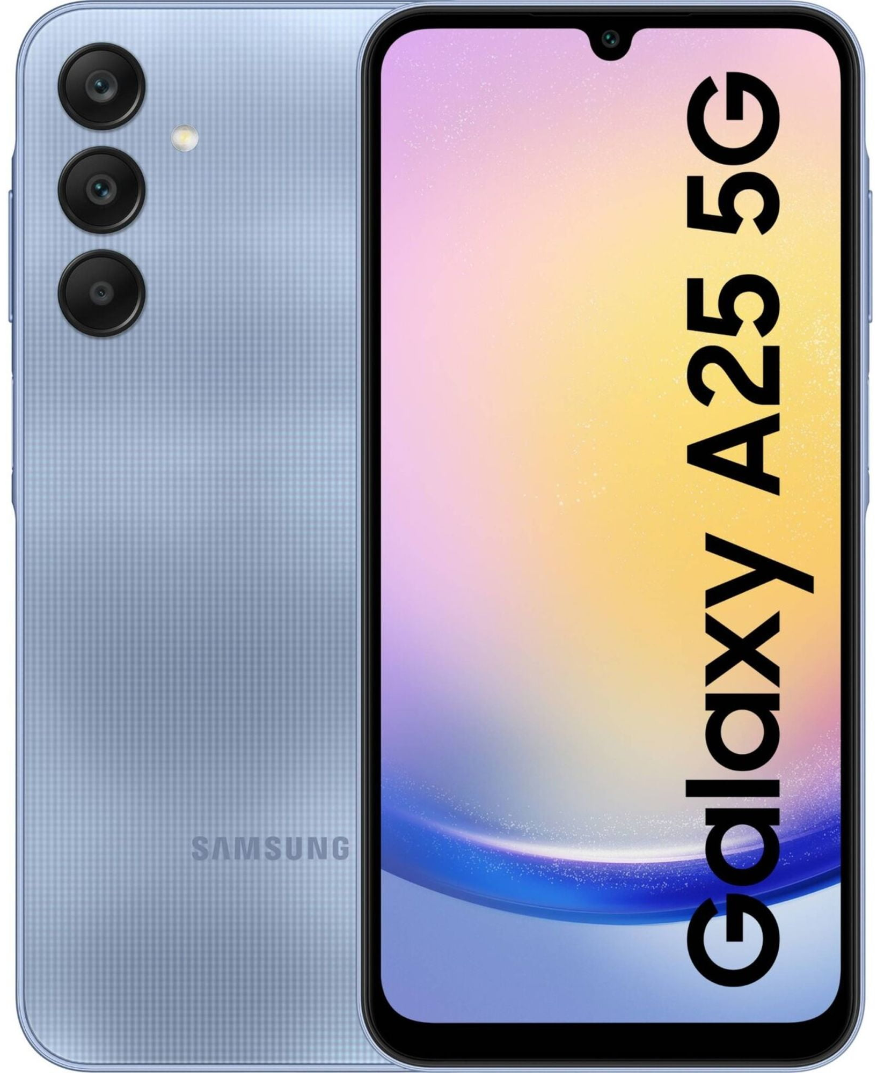
The Smartphone
Connectivity:
Smartphones support a wide array of connectivity options, including 5G for lightning-fast internet speeds, Wi-Fi for home networks, and Bluetooth for connecting peripherals.
Near Field Communication (NFC) enables contactless payments, while GPS ensures accurate location tracking for navigation apps.

Slide 10
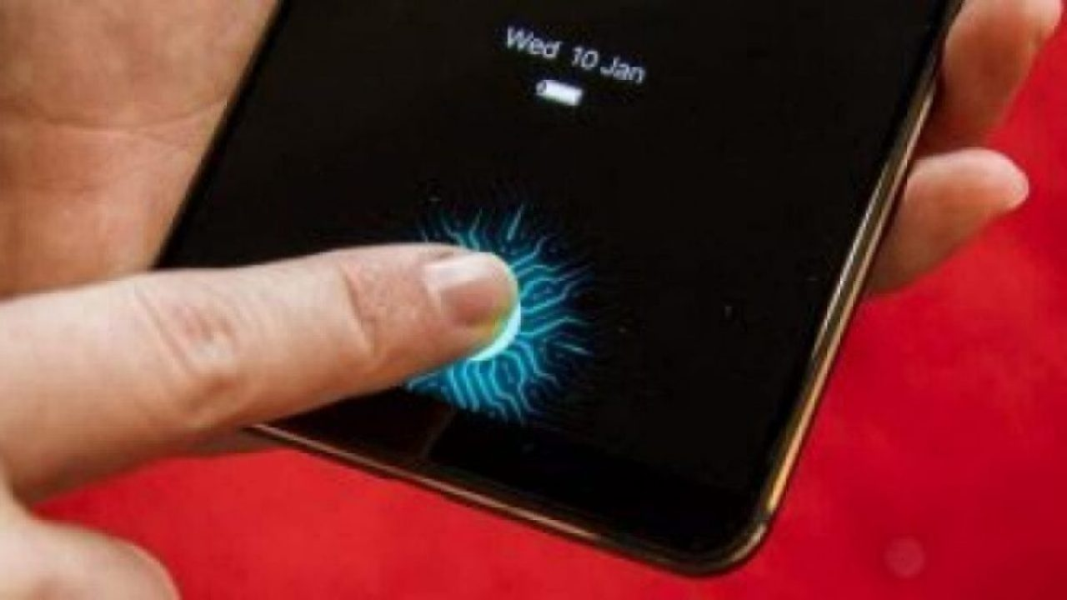
The Smartphone
Security Features:
Biometric authentication methods like fingerprint scanners and facial recognition protect your data.
These systems use machine learning algorithms to ensure accuracy and thwart spoofing attempts.
End-to-end encryption
secures communications,
making modern
smartphones a safe
platform for sensitive
transactions.

Slide 11
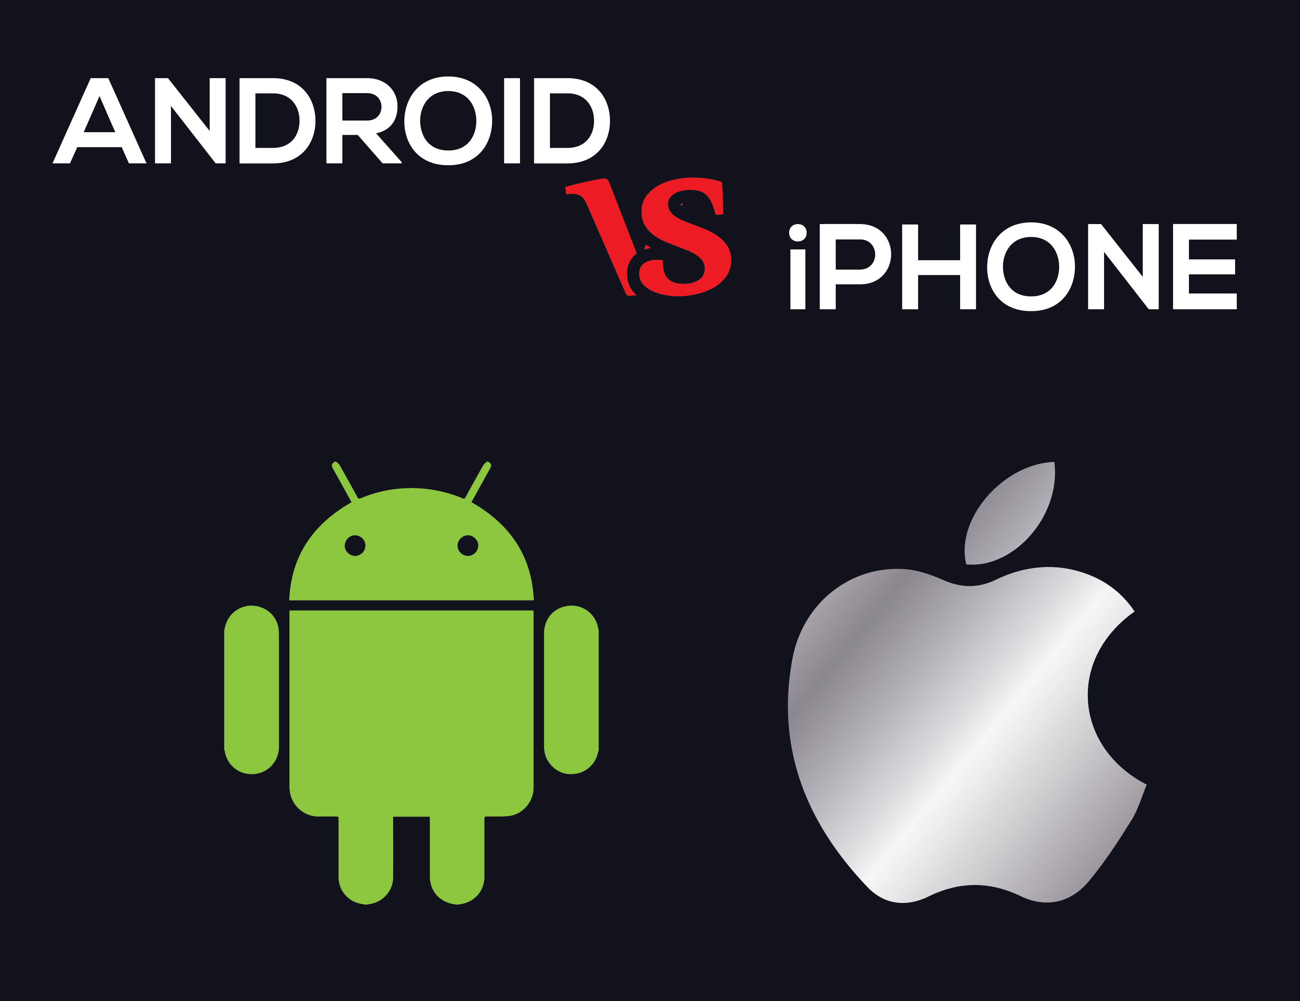
The Smartphone
Operating Systems and Apps:
Behind the scenes, operating systems like iOS and Android manage hardware resources and provide a platform for apps.
These systems are regularly updated with security patches and new features, ensuring devices remain secure and functional over time.
App stores offer millions of applications, catering to everything from productivity to entertainment.

Slide 12
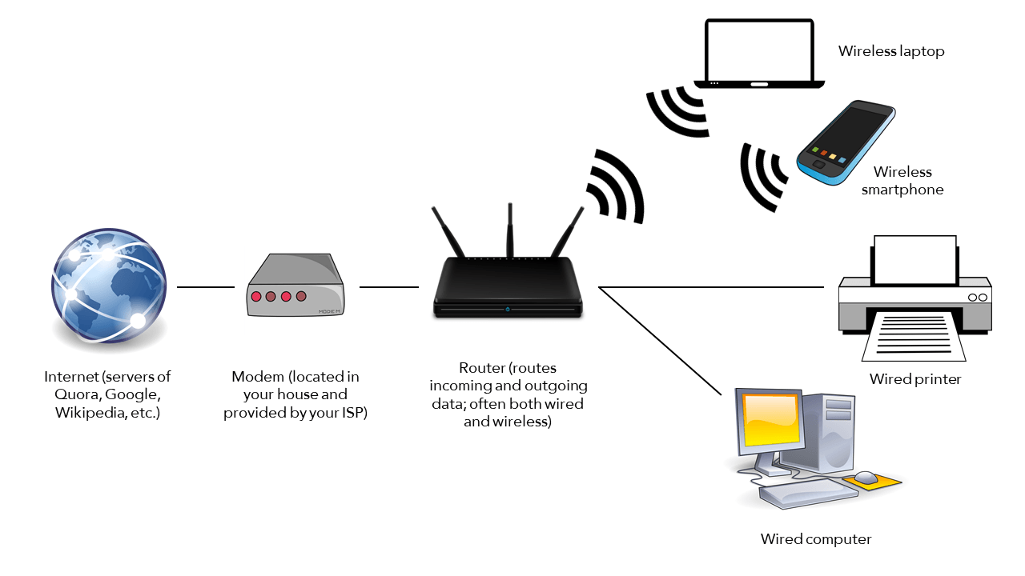
Wi-Fi: The Invisible Network
Wi-Fi has become so ubiquitous that it’s easy to take for granted. At its heart, Wi-Fi operates by transmitting data over radio waves.
Your router converts digital information into electromagnetic signals, which are then sent to your devices.
The process reverses
when your devices
send data back to the
router.

Slide 13
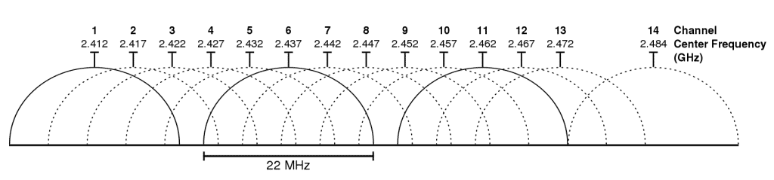
Wi-Fi: The Invisible Network
Frequency Bands: Wi-Fi typically uses two frequency bands: 2.4 GHz and 5 GHz.
The former offers better range, while the latter provides faster speeds over shorter distances.
Dual-band routers intelligently switch between these frequencies to optimize performance.

Slide 14
Wi-Fi: The Invisible Network
Encryption: To keep your data safe, Wi-Fi networks use encryption protocols like WPA3, ensuring that only authorized users can access your network.
While Wi-Fi excels at providing high-speed internet over longer distances, it’s not always the best solution for device-to-device communication, especially when proximity is key.
Enter Bluetooth: a technology designed to enable seamless
connections over short
distances, offering
convenience were Wi-Fi
might be overkill.

Slide 15
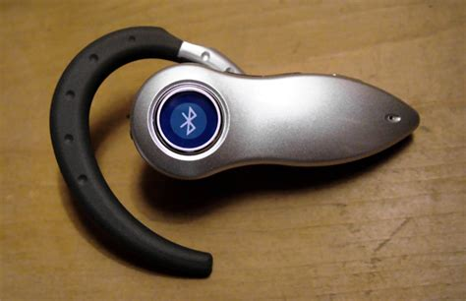
Bluetooth
Short-Range Magic
Bluetooth technology has revolutionized how devices communicate over short distances without the need for wires.
It operates by transmitting data via ultra-high frequency (UHF) radio waves in the 2.4 GHz range.
These signals are designed for short-range communication, typically within 30 feet (9 meters), making Bluetooth ideal for personal gadgets and small networks.

Slide 16

Bluetooth
How It Works:
Bluetooth uses a technique called frequency hopping spread spectrum (FHSS) to minimize interference.
It rapidly switches frequencies within its range, reducing the likelihood of overlapping with other devices.
This ensures stable connections even in
crowded environments.

Slide 17
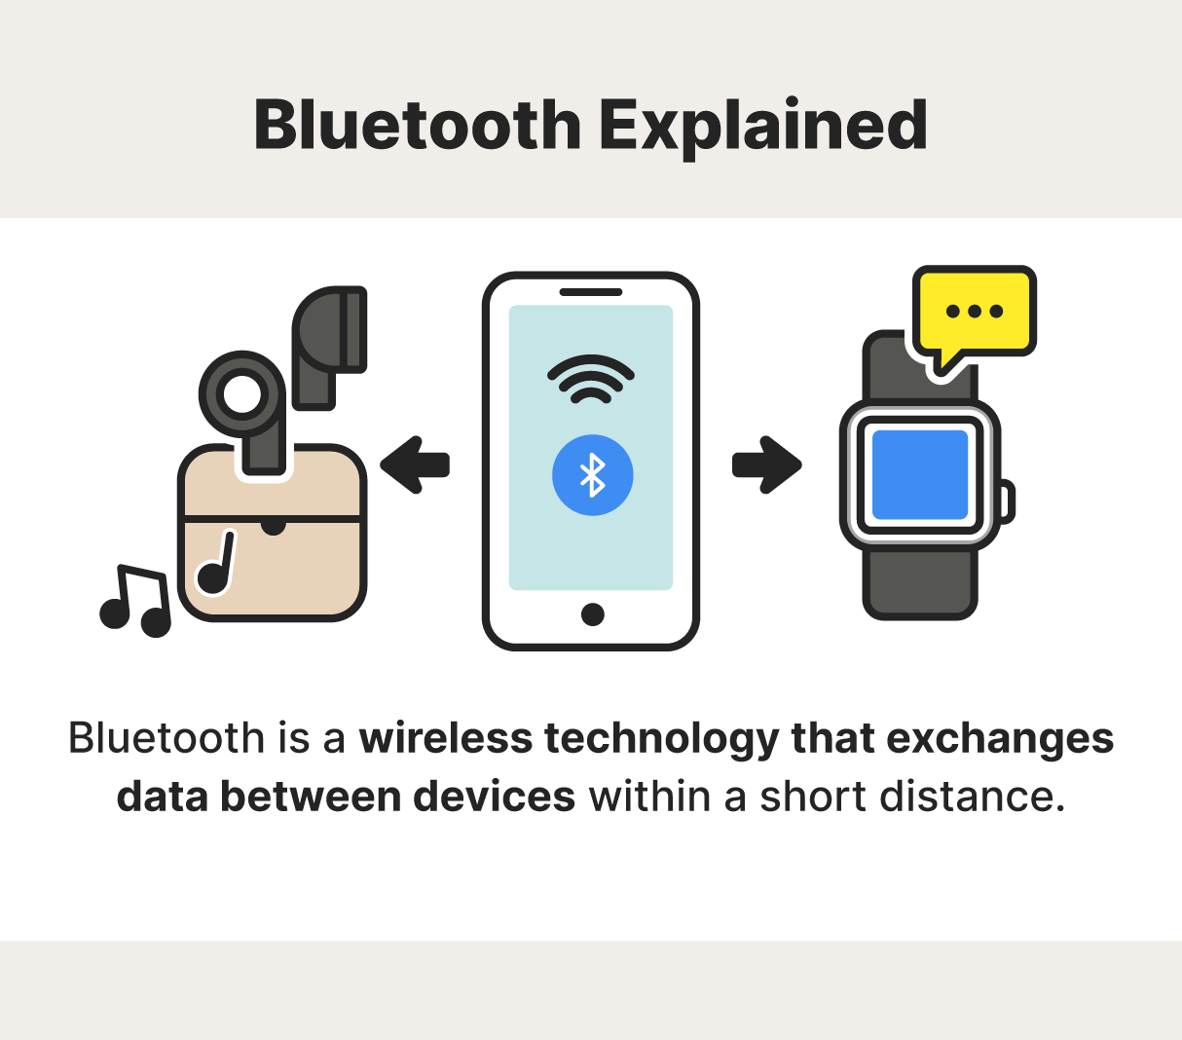
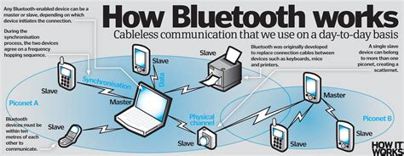
Bluetooth
Device Pairing:
To connect, Bluetooth devices go through a pairing process. This involves the exchange of unique digital keys, which act as a handshake to verify the connection.
Once paired, devices remember each other, enabling seamless reconnection in the future.

Slide 18
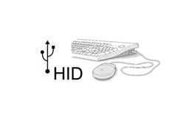
Bluetooth
Profiles and Use Cases:
Bluetooth supports a variety of profiles tailored for specific tasks.
For example, the Advanced Audio Distribution Profile (A2DP) is used for streaming high-quality audio to headphones or speakers, while the Human Interface Device (HID) profile enables communication with
peripherals like keyboards and mice.

Slide 19
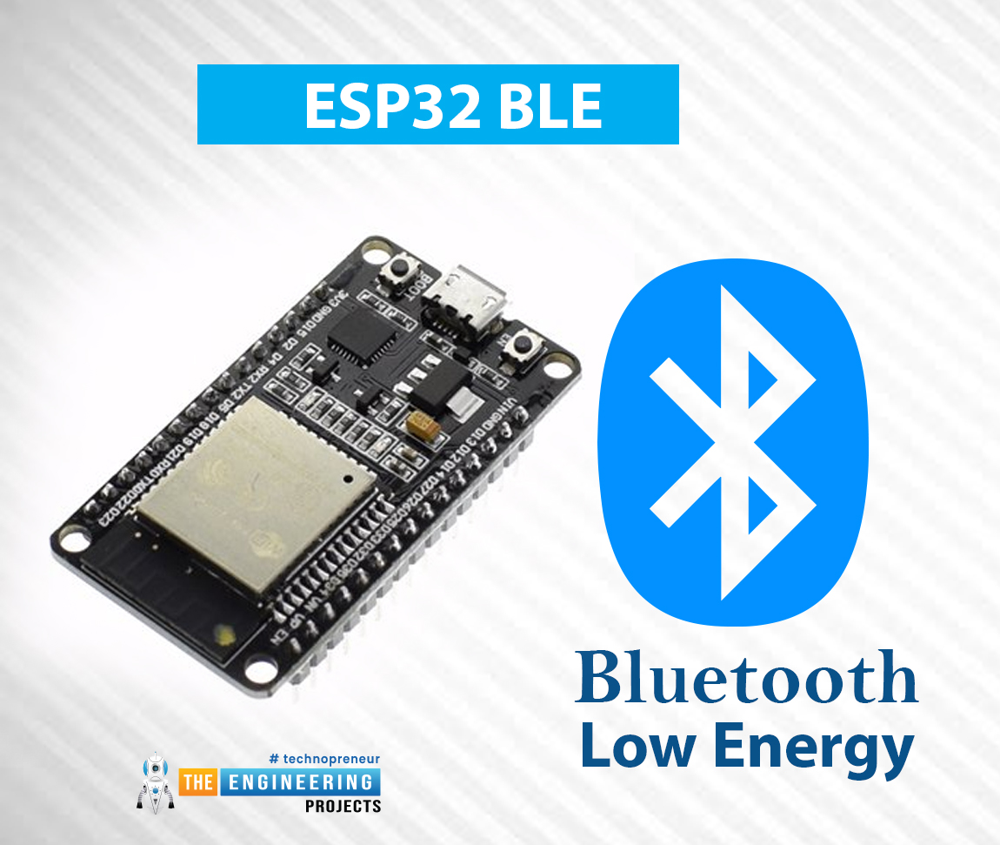
Bluetooth
Low Energy Consumption:
Modern Bluetooth devices use Bluetooth Low Energy (LE) technology, designed for applications like fitness trackers,
smartwatches, and IoT devices.
Bluetooth LE consumes minimal power, allowing
devices to operate for extended periods on small
batteries.
Security Features:
To ensure secure communication, Bluetooth employs encryption and authentication protocols. These measures protect data from being intercepted, ensuring privacy even in public spaces.

Slide 20
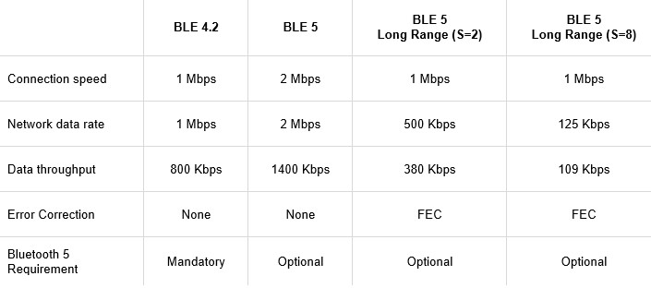
Bluetooth
The Future of Bluetooth:
With the introduction of Bluetooth 5.0 and beyond, the technology now supports faster data transfer rates, extended range, and enhanced broadcasting capabilities.
This has opened new possibilities for smart home systems, wearable tech, and industrial applications.

Slide 21

The Evolution of Batteries
Batteries power everything from your smartphone to your electric toothbrush.
Lithium-ion batteries, the most common type, store energy by moving lithium ions between two electrodes: the anode and the cathode.
During discharge, the ions flow
from the anode to the cathode,
generating an electric current.

Slide 22
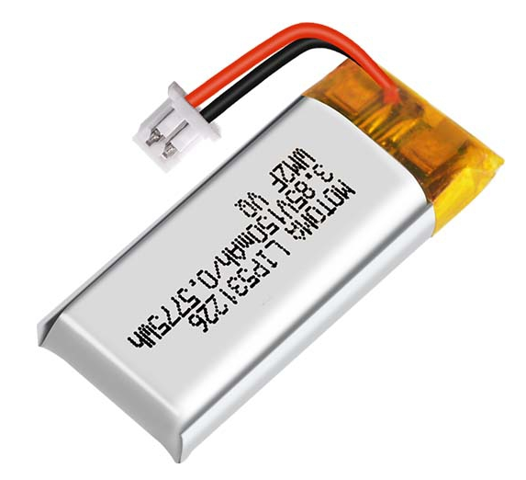
The Evolution of Batteries
Fast Charging: Advances in battery technology have introduced fast-charging capabilities, reducing the time it takes to recharge devices.
This is achieved by optimizing the flow of ions and using chargers with higher power outputs.

Slide 23
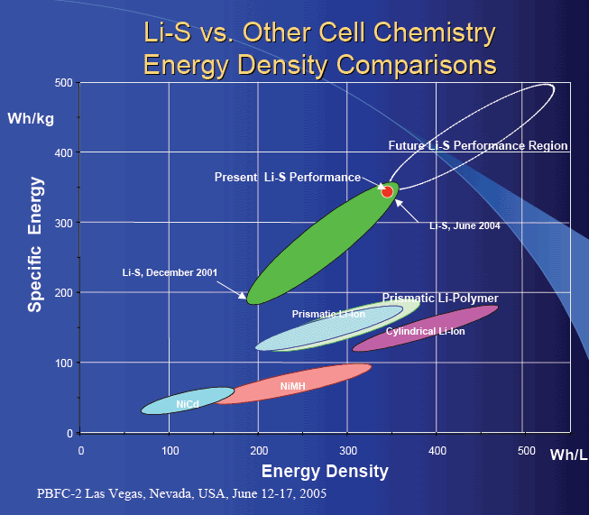
The Evolution of Batteries
Energy Density and Portability: Modern batteries are designed to maximize energy density, meaning they can store more energy in smaller packages.
This innovation has enabled
the sleek, lightweight designs
of today’s smartphones,
laptops, and wearable devices.

Slide 24
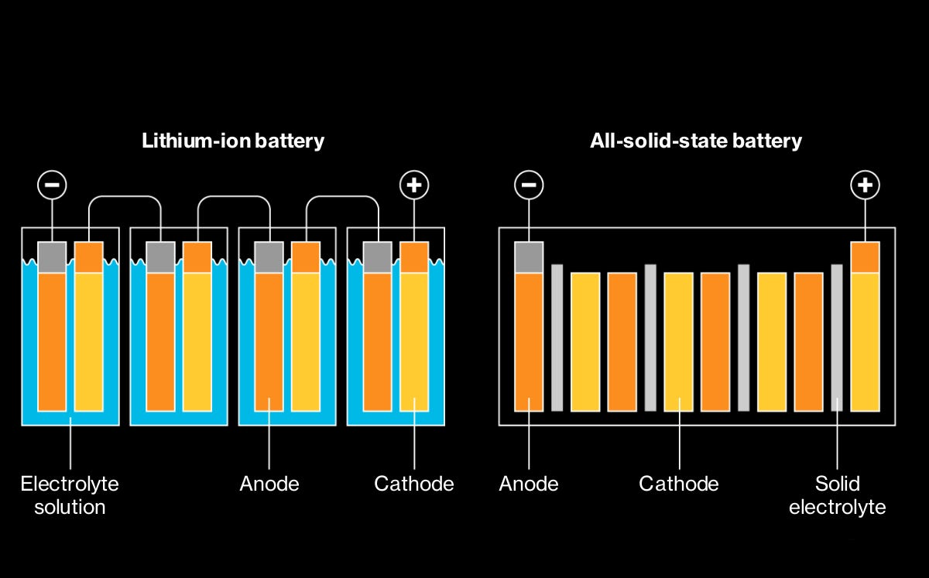
The Evolution of Batteries
Solid-State Batteries:
A promising advancement, solid-state batteries replace the liquid electrolyte with a solid one, offering higher energy density, faster charging, and improved safety.
While still in development, these batteries could revolutionize everything from consumer electronics to electric vehicles.
Battery Longevity:
With repeated charging cycles, batteries degrade over time.
To combat this, manufacturers incorporate smart charging technologies that manage charging speeds and avoid overheating, extending the battery’s lifespan.

Slide 25
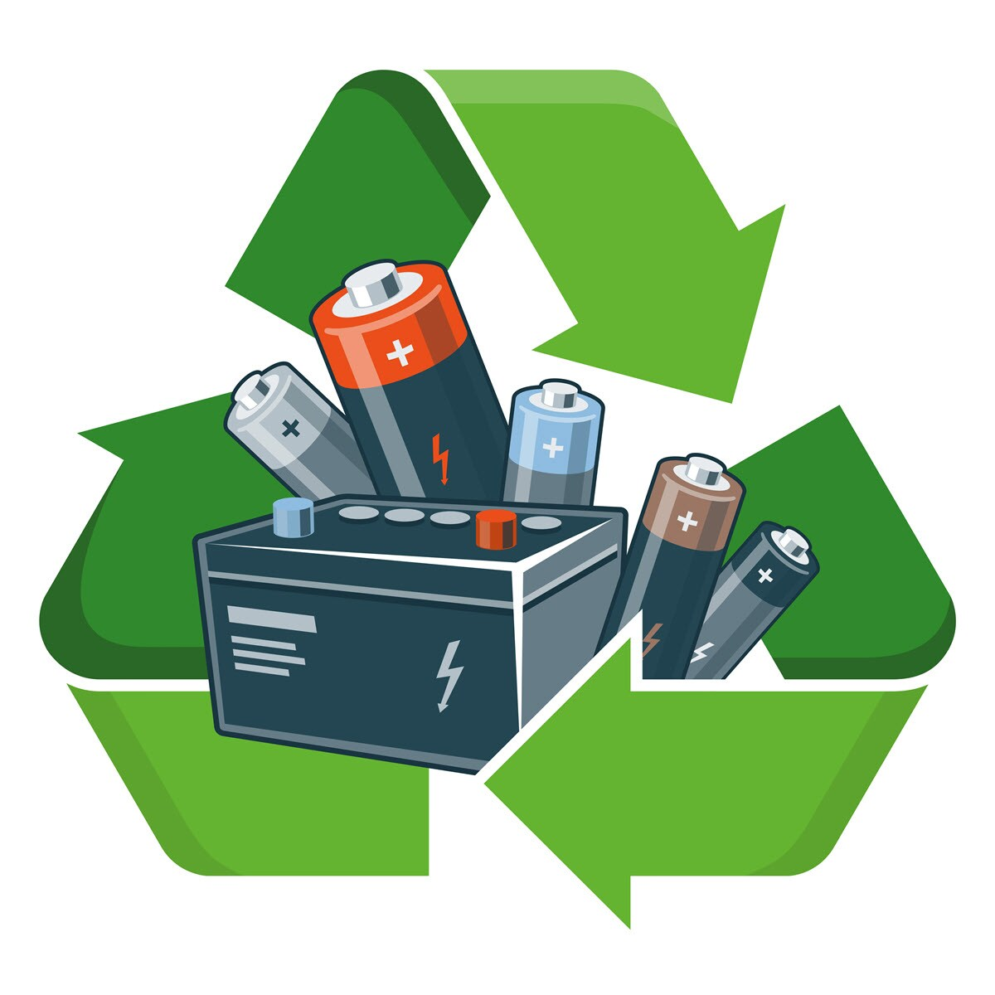
The Evolution of Batteries
Recycling Challenges:
As battery usage grows, so does the challenge of recycling them.
Initiatives to recover valuable materials like lithium, cobalt, and nickel are gaining momentum, reducing environmental impact and resource dependency.

Slide 26
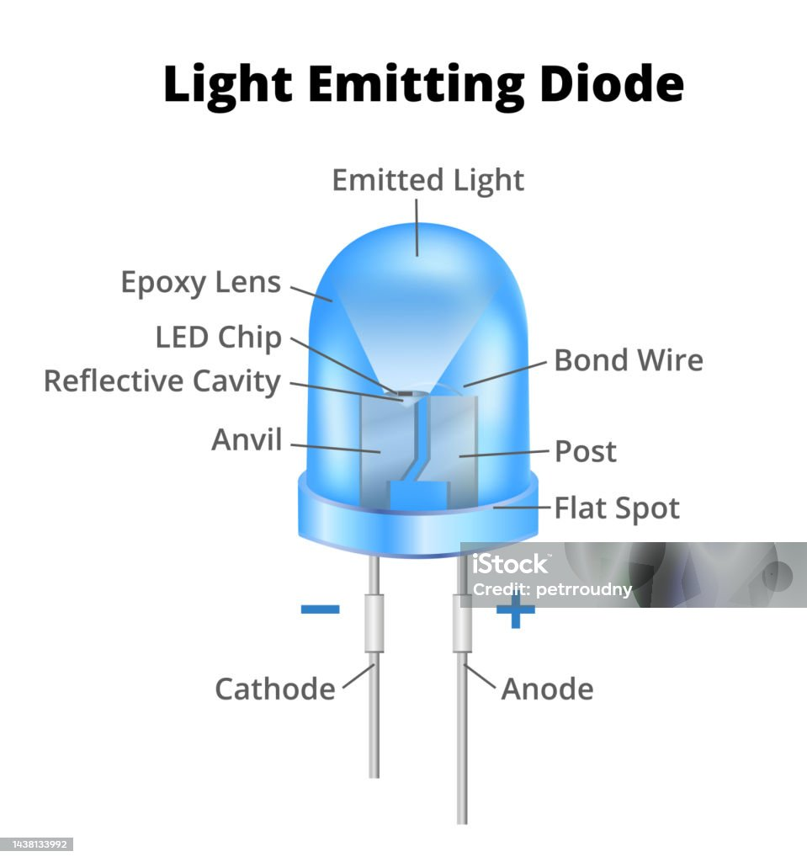
The Secret Behind LEDs
Light Emitting Diodes (LEDs) are everywhere, from flashlights to flat-screen TVs.
They work by passing an electric current through a semiconductor material, which emits light as a result.
Unlike traditional incandescent bulbs, LEDs are energy-efficient, long-lasting, and versatile.

Slide 27
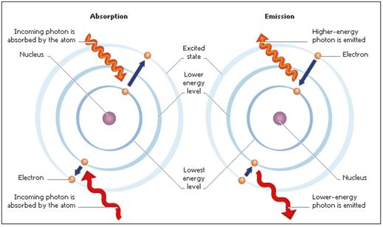
The Secret Behind LEDs
Why So Efficient?
LEDs convert almost all the energy they consume into light, with minimal heat generation.
This efficiency has made them the lighting standard for homes and businesses. Additionally, LEDs can be precisely dimmed and controlled, enabling
innovative lighting designs
for homes, offices, and even
smart devices.

Slide 28
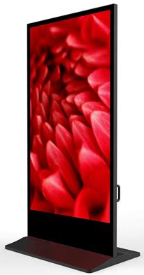
The Secret Behind LEDs
Beyond Lighting:
LEDs are not just limited to illumination. They are used
in digital displays, fiber-optic communications, and even
advanced medical devices such as phototherapy systems.
This versatility underscores the transformative potential
of LED technology in various fields.
Batteries power everything from your smartphone to
your electric toothbrush. Lithium-ion batteries, the most common type, store energy by moving lithium ions between two electrodes: the anode and the cathode. During discharge, the ions flow from the anode to the cathode, generating an electric current.

Slide 29
Conclusion
A Deeper Appreciation for Everyday Tech
The gadgets we use every day are the result of decades of scientific discovery and engineering brilliance. Understanding their inner workings not only satisfies curiosity but deepens our appreciation for the ingenuity behind them.
These technologies represent the combined efforts of countless innovators striving to make life easier, more efficient, and connected.
Each device, whether it’s the smartphone in your pocket or the LED light above your desk, showcases a unique blend of creativity and technical precision.
Recognizing these systems helps us make smarter decisions about how we use and care for our technology.

