Slide 1
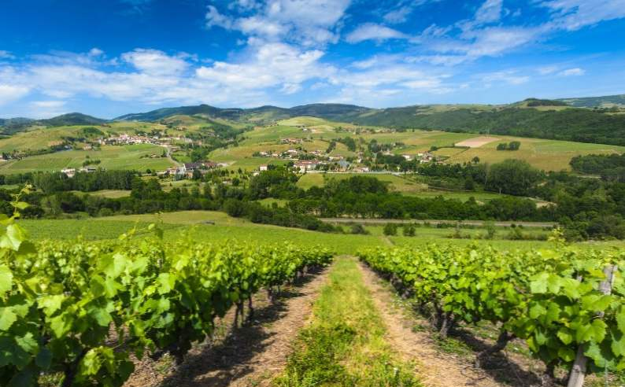
Europe’s Favorite Wine Regions Presented by Marc Silver

Slide 2
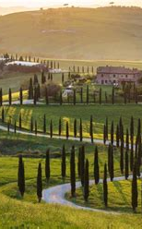
Europe’s Favorite Wine Regions
For wine enthusiasts, exploring Europe's wine regions is nothing short of a dream. The continent is home to some of the most exquisite vineyards, characterized by picturesque landscapes, warm climates, and outstanding food and wine pairings.
Whether it's the rolling hills of Tuscany or the steep riverbanks of the Douro Valley, Europe offers a rich tapestry of wine cultures, each with its own unique allure.
For those looking to immerse themselves in the world of European wines, this guide will help you discover some of the best regions across Europe, from the famed Champagne vineyards of France to the sun-soaked hills of Spain and Italy.
Each destination offers a unique experience that will leave you with unforgettable memories and perhaps a new favorite bottle of wine.

Slide 3
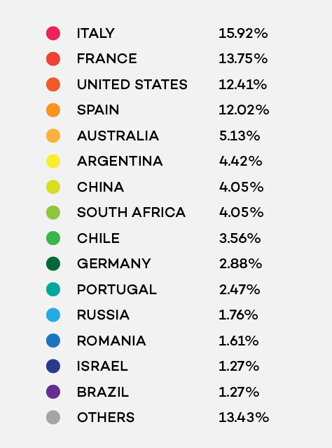
Europe’s Favorite Wine Regions
What Are the Best Wine Regions in Europe?
Wine preferences can be subjective, and many wine enthusiasts have personal favorites based on their palate.
While this list isn't definitive, it highlights some of Europe's most iconic and celebrated wine regions, where you can taste world-class wines and explore rich cultural traditions.
European wine production accounts for approximately 57% of the total production world wide.

Slide 4
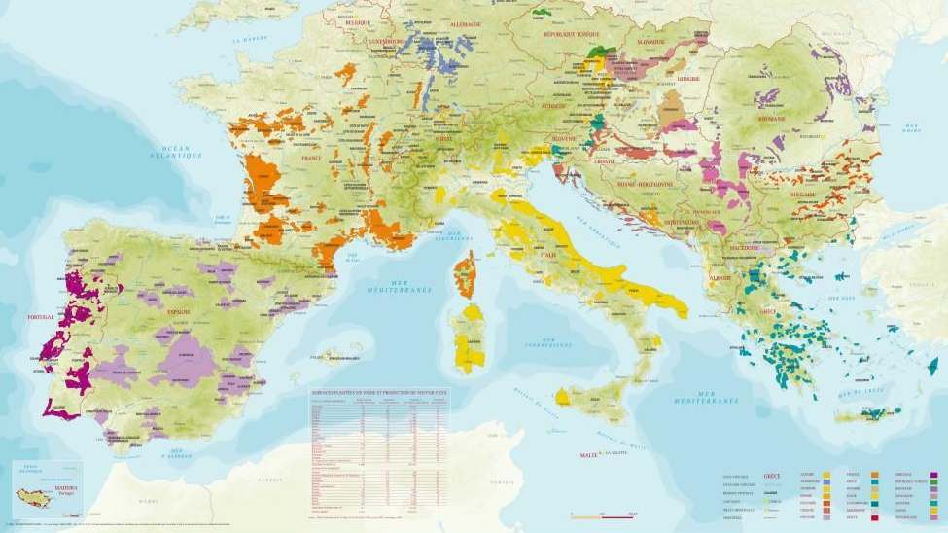
Europe’s Favorite Wine Regions

Slide 5
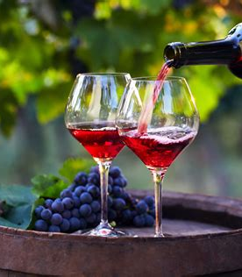
French Wine
French wine, revered worldwide for its quality and diversity, is more than just a beverage; it’s a symbol of France’s rich cultural heritage.
With a history that stretches back over 2,500 years, French wine embodies the perfect synergy between nature and human ingenuity.
From the rolling hills of Bordeaux to the sun-soaked vineyards of Provence, France offers an extraordinary range of wines, each reflecting the unique terroir and traditions of its region.

Slide 6
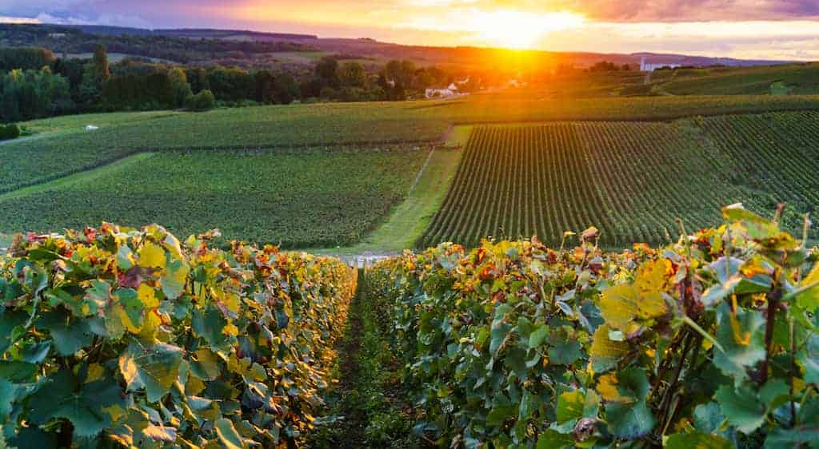
Champagne Region, France
Famed for its sparkling wines, the Champagne region is synonymous with luxury and celebration. Located just a short train ride from Paris, this region is perfect for a day trip.
You'll find prestigious Champagne houses like Veuve Clicquot and Taittinger in both Reims and Epernay, where you can tour cellars and enjoy tastings.
In addition to its wines, the Champagne region's UNESCO World Heritage status adds to its charm, with beautiful vineyard-covered hills that make it a must-see for wine lovers.

Slide 7
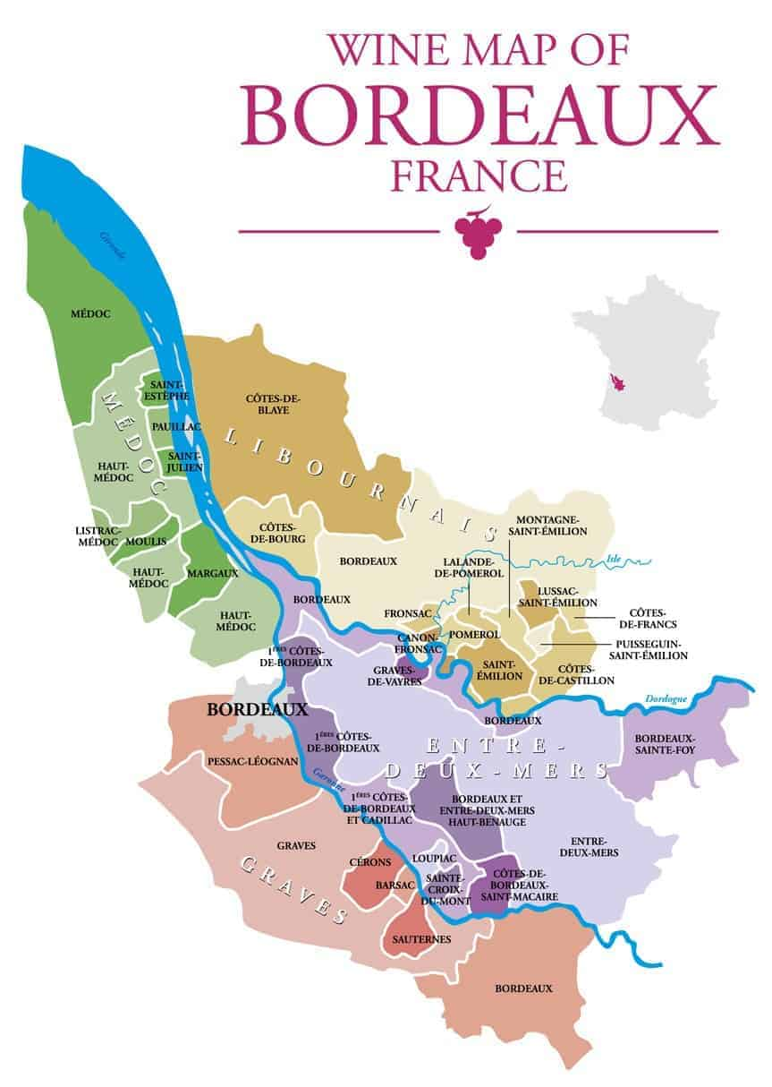
Bordeaux Wine Region, France
Bordeaux is often hailed as the wine capital of the world.
With a history stretching back centuries, it’s a region where wine and culture are inextricably linked.
Spend a week in Bordeaux, and you’ll barely scratch the surface, with regions like Médoc, Graves, and Saint-Émilion offering world-renowned wines.
Whether you’re a fan of full-bodied reds, delicate whites, or sweet wines from Sauternes, Bordeaux will keep you coming back for more.

Slide 8
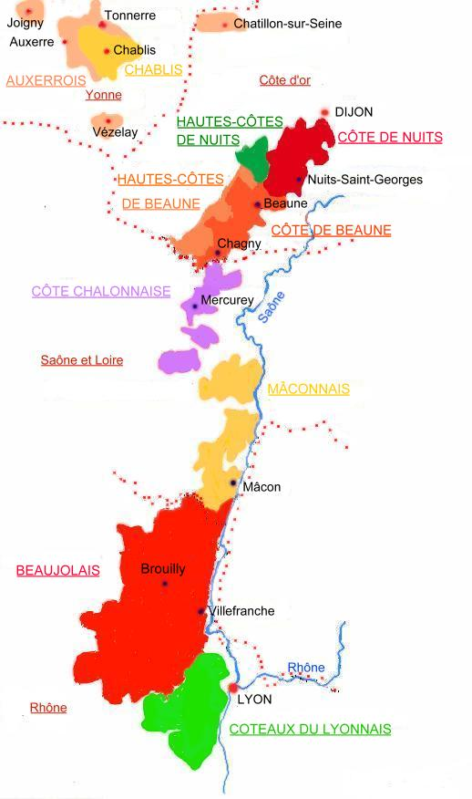
Burgundy (Bourgogne) Wine Region, France
Pinot Noir and Chardonnay enthusiasts flock to Burgundy, one of France's most prestigious wine regions.
Its vineyards, stretching from Dijon to Lyon, produce some of the most sought-after wines in the world, with terroir playing a critical role in their distinct characteristics.
In Burgundy, you’ll find a hierarchy of vineyards, from Grand Cru to village-level wines.
This region is steeped in tradition and produces wines that are revered for their complexity and longevity.

Slide 9
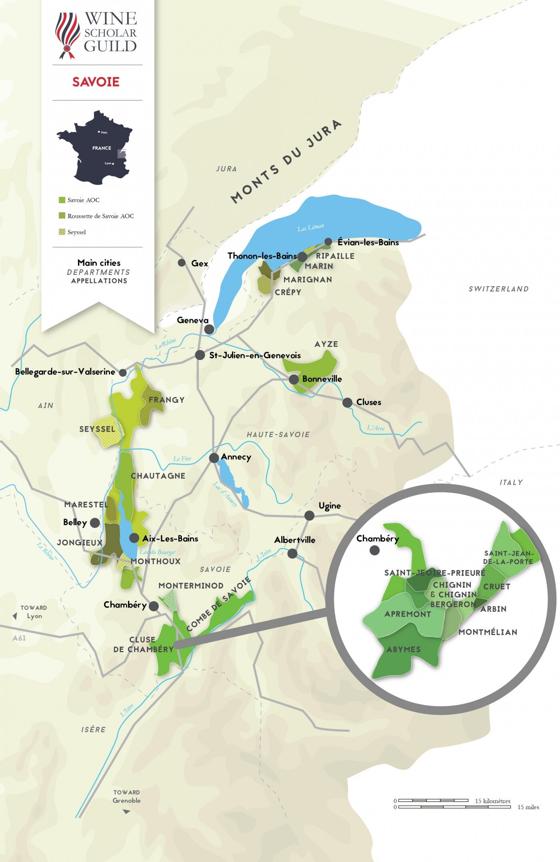
Savoie Wine Region, France
A hidden gem in the French Alps, Savoie is a small but beautiful wine region producing primarily white wines.
Grapes like Altesse and Roussanne dominate the vineyards, though you’ll also find reds made from Mondeuse and Gamay.
Savoie’s steep slopes and stunning alpine scenery make it a perfect destination for those looking to combine wine tasting with outdoor activities like hiking or skiing.

Slide 10
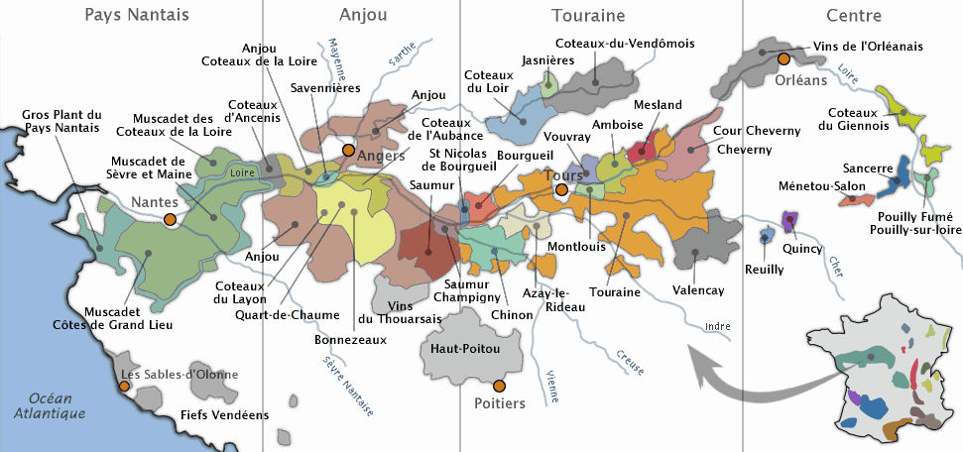
Loire Valley Wine Region, France
Stretching 280 kilometers along the Loire River, this region is a paradise for wine tourists.
Known for its elegant white wines made from Chenin Blanc and Sauvignon Blanc, the Loire Valley is home to sub-regions like Sancerre, Vouvray, and Pouilly-Fumé.
Aside from wine, the Loire is dotted with magnificent castles, adding an extra layer of magic.

Slide 11
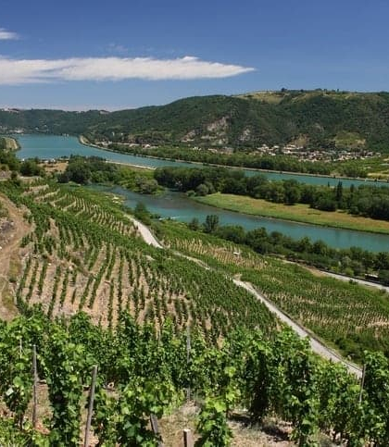
Rhone Valley Wine Region, France
The Rhone Valley produces some of France’s most celebrated wines, from Syrah in the north to Grenache-based blends in the south.
The region is divided into two main sub-regions: the northern Rhone, known for its bold reds and aromatic whites, and the southern Rhone, where you’ll find wines like Châteauneuf-du-Pape.
The rugged landscape of the Rhone Valley offers a dramatic setting for wine tasting, with ancient vineyards and hilltop villages.

Slide 12
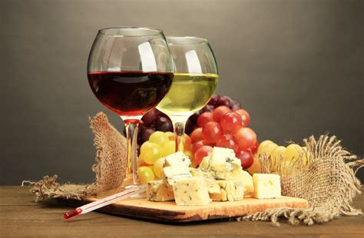
The Wines of Italy
Italy, a country synonymous with rich history, culture, and cuisine, is equally renowned for its diverse and exquisite wine offerings.
Italian wine is not just a beverage but a reflection of the country's geography, climate, and traditions.
This talk will delve into the world of Italian wines, exploring the regions, key grape varieties, wine styles, and notable producers.

Slide 13
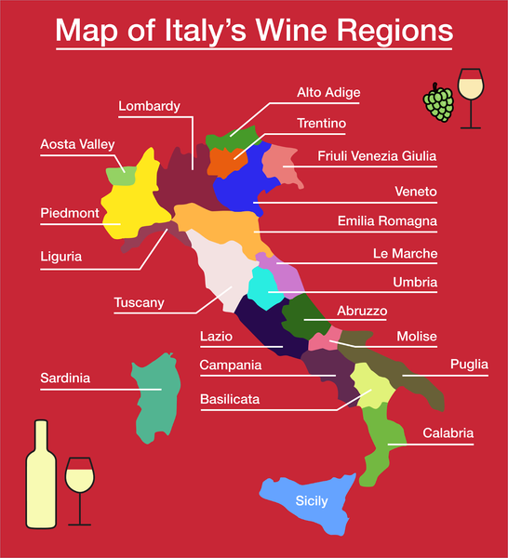
An Overview of Italian Wine Regions
Italy’s wine regions are as diverse as its landscape, ranging from the Alpine north to the Mediterranean south.
Each region boasts unique terroirs and climate conditions that contribute to the distinctiveness of its wines.
The result is a diverse range of wine types to suit every taste.

Slide 14
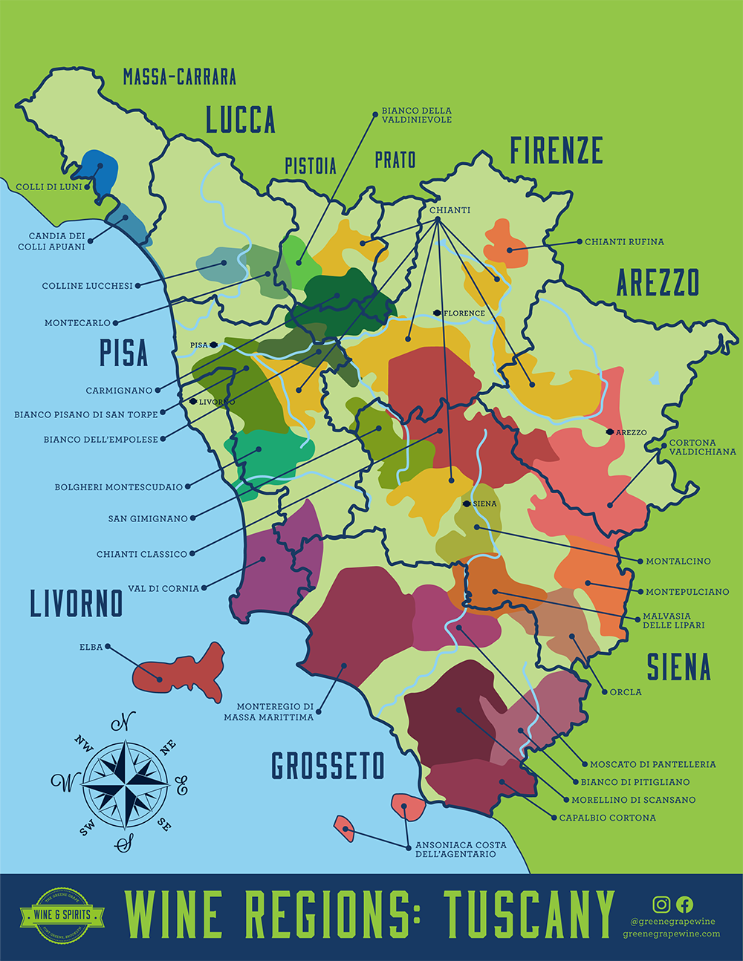
Tuscany Wine Region, Italy
Tuscany is perhaps Italy’s most famous wine region, thanks to its rolling hills, historic towns, and renowned wines like Chianti, Brunello di Montalcino, and Montepulciano.
Tuscany’s vineyards are often paired with culinary experiences, from olive oil tastings to cooking classes.
A leisurely exploration of Tuscany’s winding roads and hilltop towns will reward you with breathtaking vistas and exceptional wines.

Slide 15
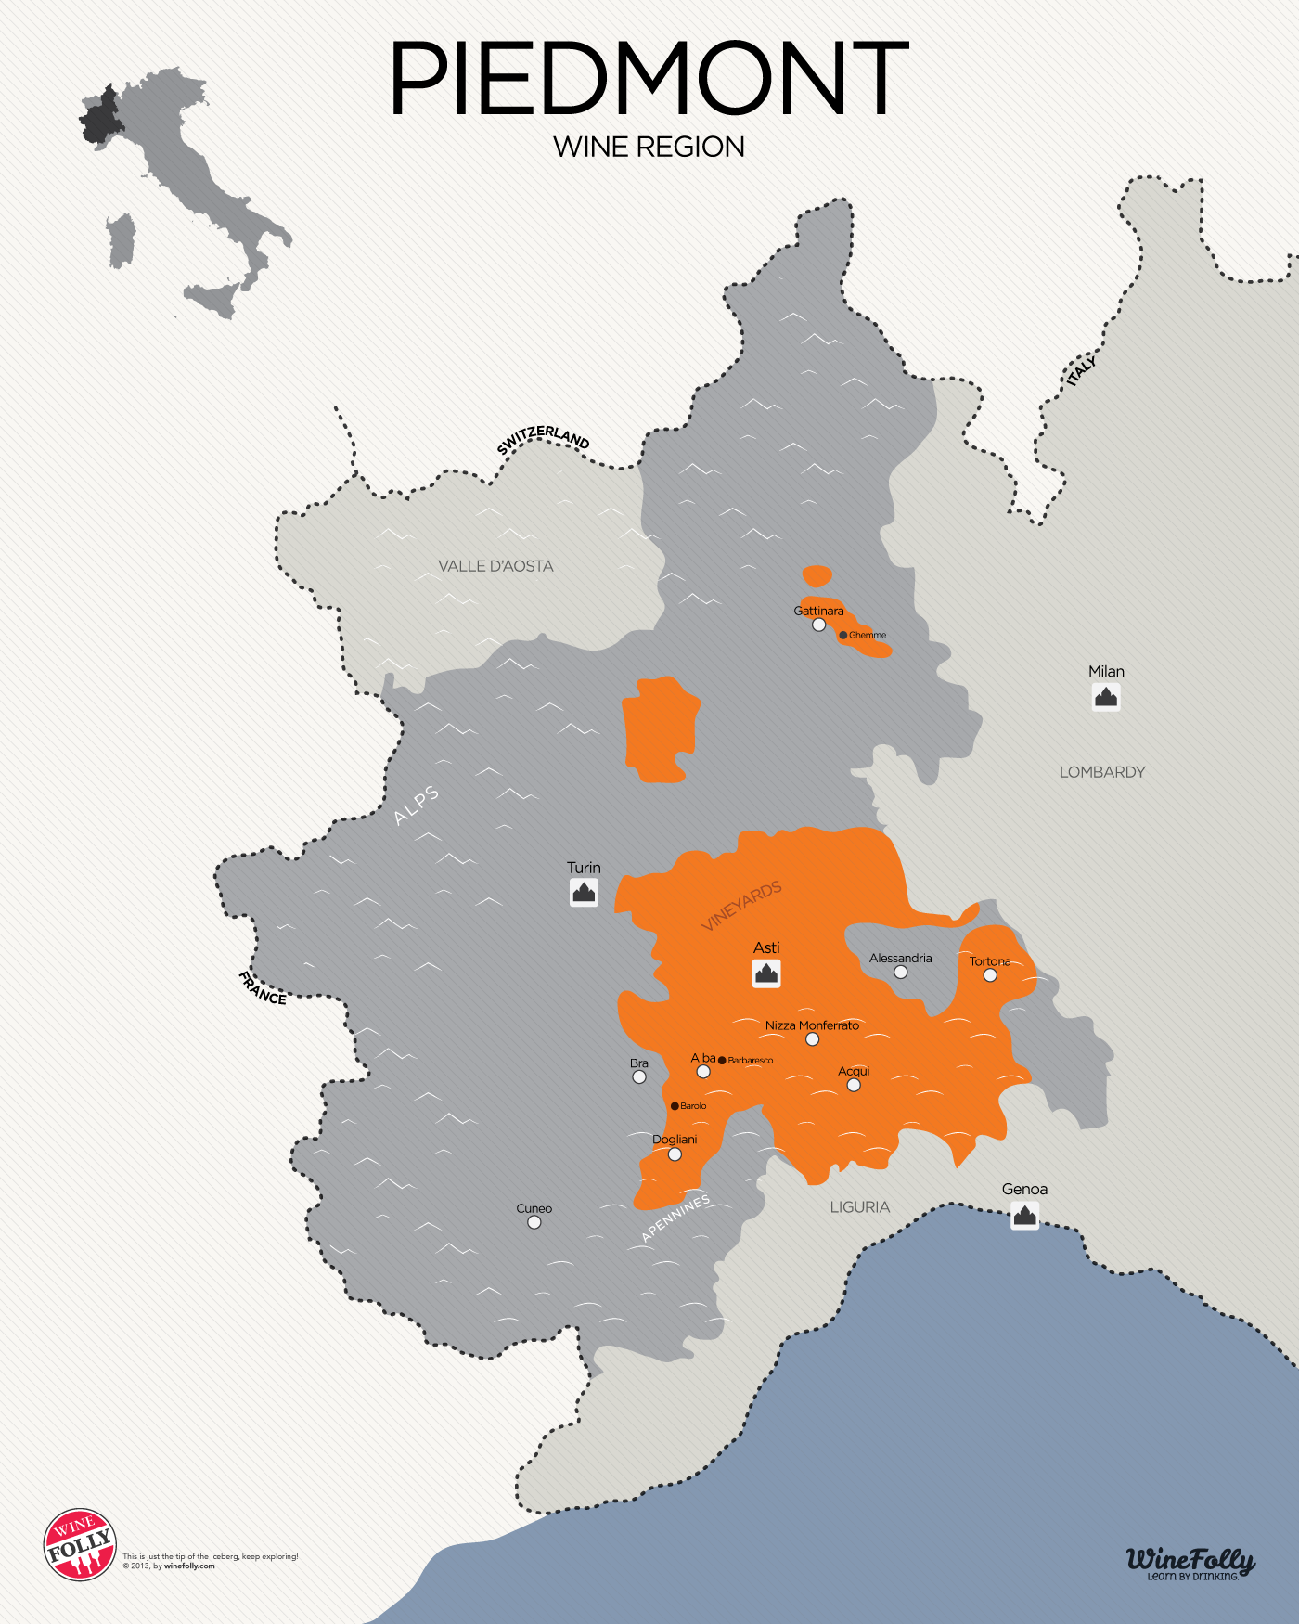
Piedmont Wine Region, Italy
Nestled in the northwestern corner of Italy, Piedmont is famous for its robust red wines, particularly Barolo and Barbaresco, both made from the Nebbiolo grape.
The region also offers lesser-known but equally remarkable white wines, such as Cortese, Arneis, and Erbaluce.
Piedmont's vineyard-strewn hills, backed by the towering Alps, provide a stunning setting for wine tasting.
This region is also a gastronomic paradise, where you can pair your wine with local delicacies like truffles and rich cheeses.

Slide 16
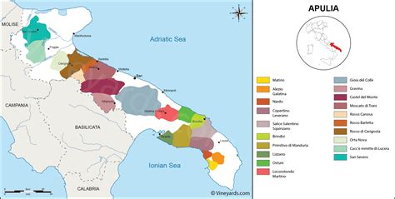
Puglia Wine Region, Italy
In Italy’s "heel," Puglia is known for its full-bodied red wines, particularly Primitivo and Negroamaro.
It’s a vast region with numerous DOCs (Denominazione di Origine Controllata), offering a wide variety of wines to suit every palate.
Aside from its reds, Puglia also produces refreshing white wines from grapes like Falanghina and Verdeca.
Spend time exploring one area or dive deep into the region to discover hidden gems in its wineries and olive groves.

Slide 17
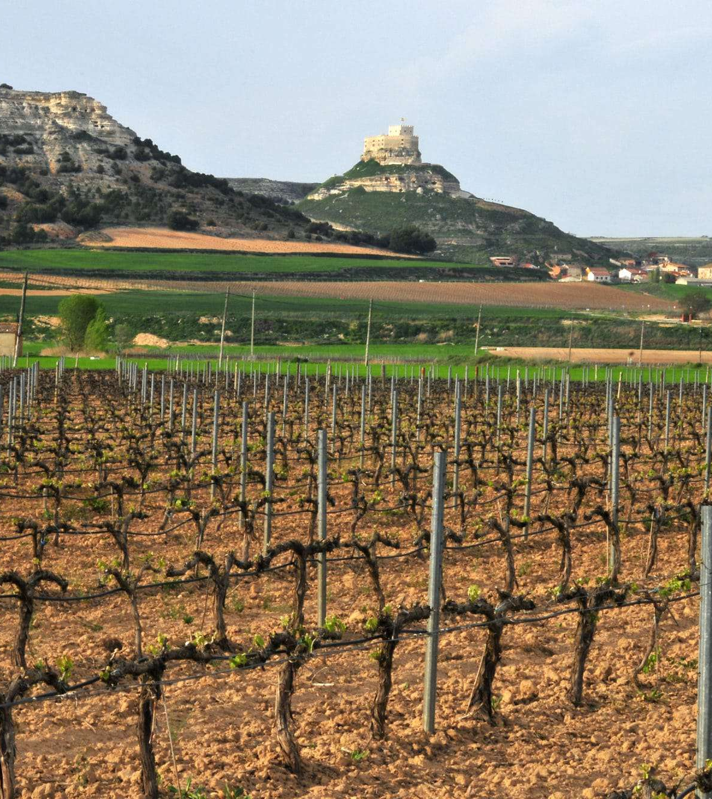
Spanish Wine
Spanish wine, renowned for its diversity and richness, holds a pivotal place in the global wine industry.
This talk explores the intricate landscape of Spanish wine, focusing on its various wine regions, the distinctive varietals that define them, and the prominent wineries that have shaped its international reputation.
By examining the history, geography, and cultural influences that contribute to Spain's winemaking tradition, this study provides a comprehensive understanding of the factors that have propelled Spanish wine to global acclaim.

Slide 18
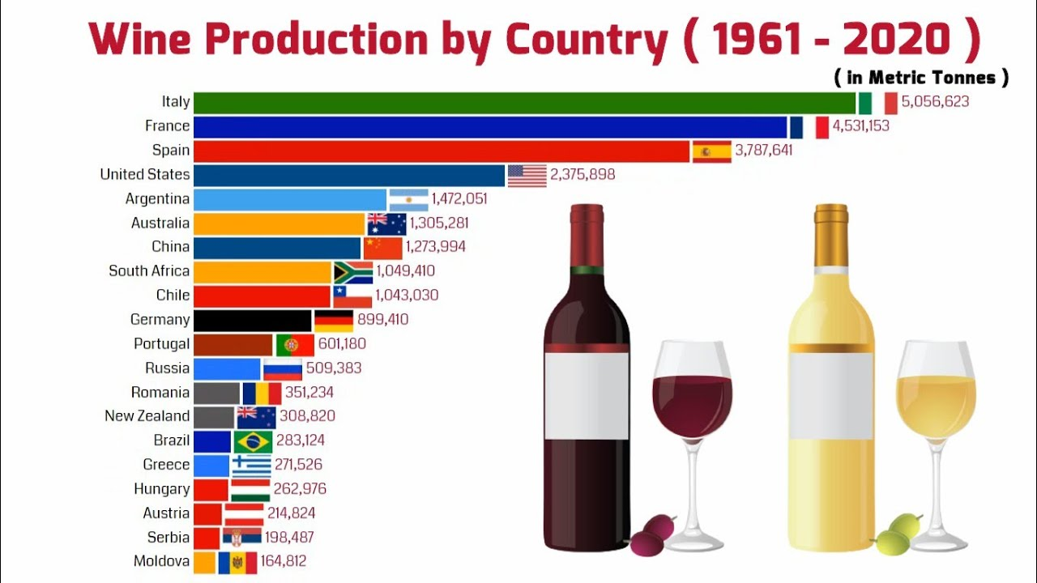
Overview of Spanish Wine
Spain is the third-largest wine producer in the world, behind France and Italy, and boasts the most extensive vineyard area globally.
Spanish wine's diversity is unparalleled, reflecting the country's varied climate, geography, and historical influences.
From the rich reds of Rioja to the sparkling Cava of Catalonia, Spain offers a wine for every palate.

Slide 19
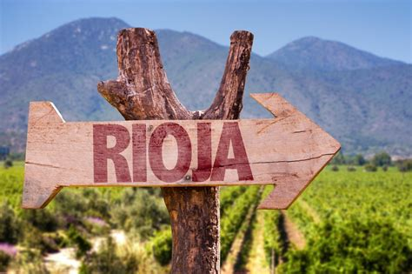
La Rioja Wine Region, Spain
La Rioja, nestled in the foothills of the Pyrenees, is the heartland of Spain’s Tempranillo wines.
Its wineries range from family-run vineyards to industrial giants, producing millions of bottles each year.
The region is easy to navigate, with breathtaking scenery and historic towns like Logroño that make it a perfect retreat.
In the fall, the landscape turns into a sea of red and gold as the vineyards prepare for harvest, making it an ideal time to visit.

Slide 20
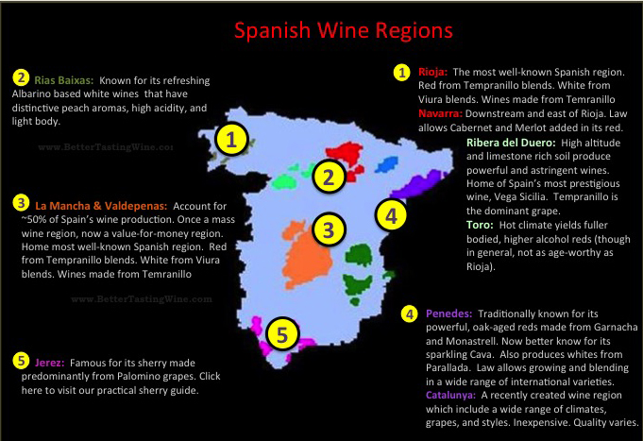
Rioja Wine Region of Spain
Rioja, Spain's most famous wine region, is divided into three sub-regions: Rioja Alta, Rioja Alavesa, and Rioja Baja.
Each sub-region has its unique climate and soil composition, contributing to the complexity of Rioja wines.
Tempranillo is the dominant grape, known for producing structured wines with aging potential.

Slide 21
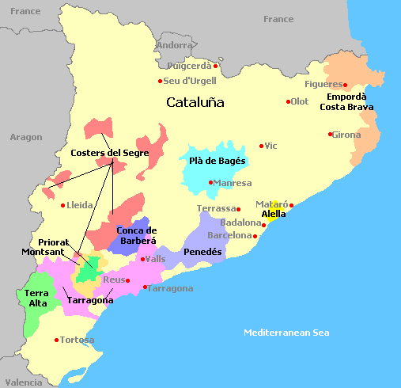
Catalonia Wine Region, Spain
Catalonia boasts 10 different wine regions, stretching from the Pyrenees to the Mediterranean coastline.
Garnacha and Carignan grapes are the backbone of Catalonia’s red wines, while the region is also known for producing Cava, Spain’s sparkling wine.
Whether you're exploring Barcelona's vibrant food and wine scene or heading out into the countryside, Catalonia offers something for every wine lover.

Slide 22
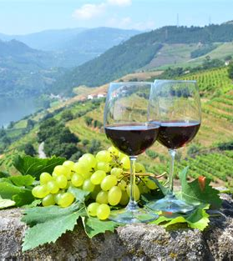
Portuguese Wine Regions
Portugal is home to several key wine regions, each known for unique grape varieties and styles of wine. Here are some of the main wine regions and grape varieties in Portugal:
Wine Regions:
Douro Valley:
Famous for Port wine production.
Also produces high-quality red and white table wines.
Grape varieties: Touriga Nacional, Touriga Franca, Tinta Roriz (Tempranillo), Tinto Cão, and others.

Slide 23
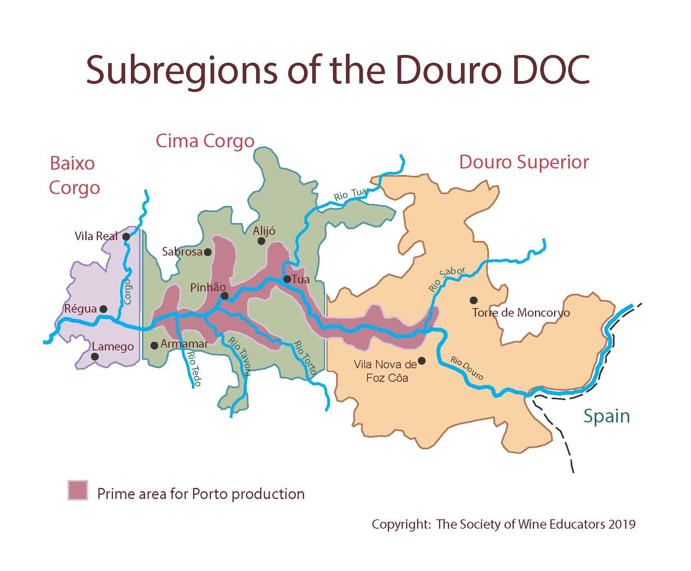
Douro Valley Wine Region, Portugal
The Douro Valley, a UNESCO World Heritage site, is one of the oldest and most stunning wine regions in the world.
Steep, terraced vineyards rise along the river, creating a dramatic backdrop for your wine journey.
While the Douro is famous for its port wines, the region also produces exceptional red and white table wines.
A visit to Porto and the nearby Vila Nova de Gaia, where much of the port is aged, is a must for any wine lover.

Slide 24
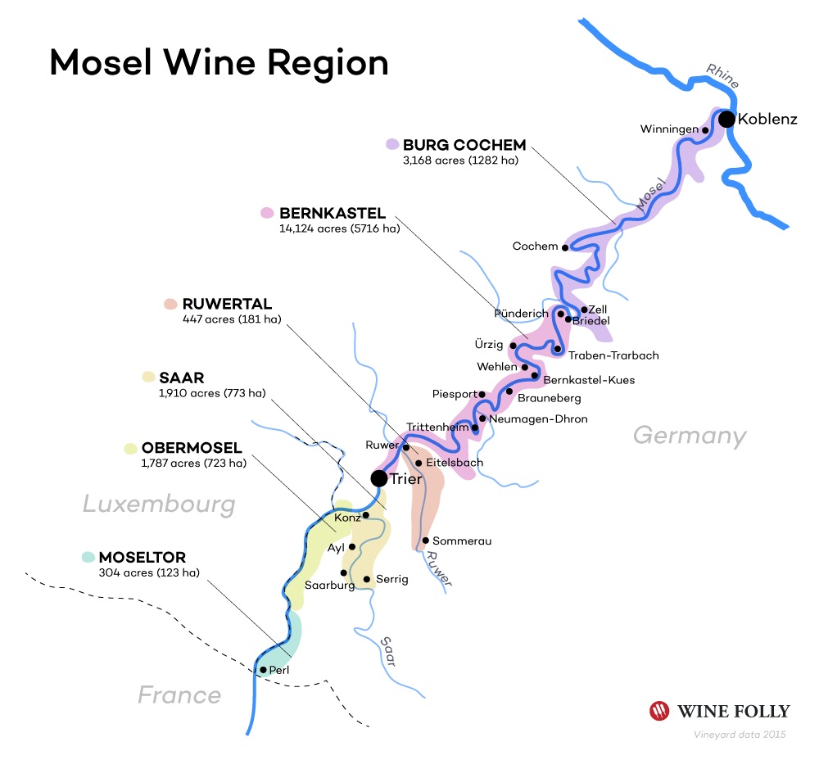
Mosel Wine Region, Germany
The Mosel region is synonymous with Riesling, producing some of the world’s best examples of this grape.
The vineyards, perched on steep slopes along the Mosel River, produce wines that are known for their floral aromas, vibrant acidity, and aging potential.
Aside from wine, the Mosel region offers charming villages, historic castles, and picturesque landscapes that make it a delightful destination for wine tourists.

Slide 25
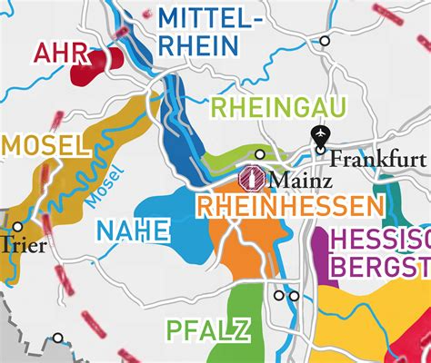
Rhineland-Palatinate Wine Region, Germany
Rhineland-Palatinate, located along the Moselle and Rhine rivers, is Germany’s second-largest wine region.
Known primarily for its crisp, dry Rieslings, this area also produces a wide variety of other wines, including whites, reds, and rosés.
The region is famous for its wine festivals, offering a lively atmosphere where you can enjoy both the wines and the local culture.

Slide 26
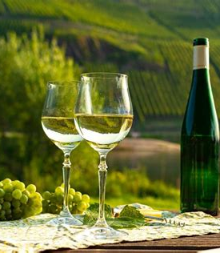
Riesling Reigns Supreme
The Mosel wine region is synonymous with Riesling, a noble grape variety that thrives in the cool climate and mineral-rich soils of the area.
Revered for its remarkable versatility and ability to reflect the terroirs, Mosel Rieslings captivate the senses with their ethereal aromas, brilliant acidity, crystalline purity and color.
From bone-dry to lusciously sweet, these wines span a spectrum of styles, each expressing the nuances of their vineyard of origin.

Slide 27
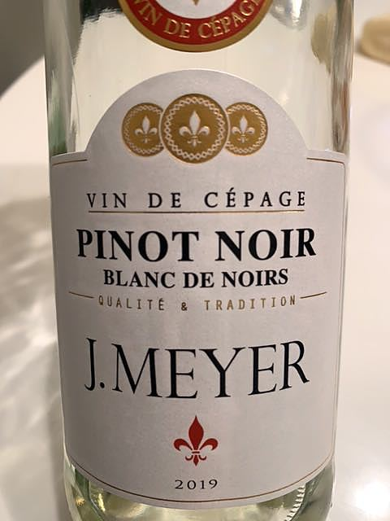
Beyond Riesling
The Riesling grape accounts for nearly 60% of the region's vineyards and is widely considered the most prestigious and highest quality wine grape of the Mosel but it cannot be planted on every vineyard site due to difficulties the grape has in ripening in particularly cool climates.
Factors such as altitude, aspect and sunlight exposure can have a pronounced effect not only one the resulting quality of the wine but also whether the Riesling grape will even ripen at all. While Riesling reigns supreme, the Mosel wine region also embraces a diverse array of grape varieties.
Muller-Thurgau, Pinot Blanc, and Pinot Noir thrive in the region's microclimates, producing wines of character and distinction.

Slide 28
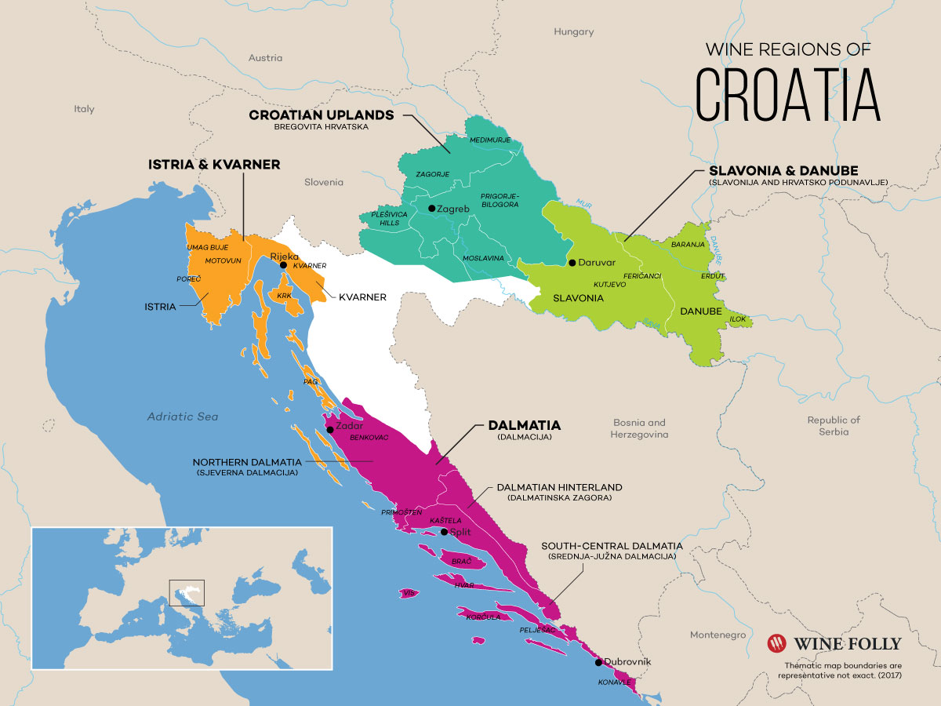
Istria Wine Region, Croatia
Istria, located on Croatia's northwest coast, is an up-and-coming wine destination.
Known for its fresh Malvasia white wines and bold Teran reds, Istria offers a unique taste of Croatian viticulture.
This region is home to small, family-owned wineries, many of which produce limited quantities of wine.
It’s the perfect destination for those seeking off-the-beaten-path wine experiences.

Slide 29
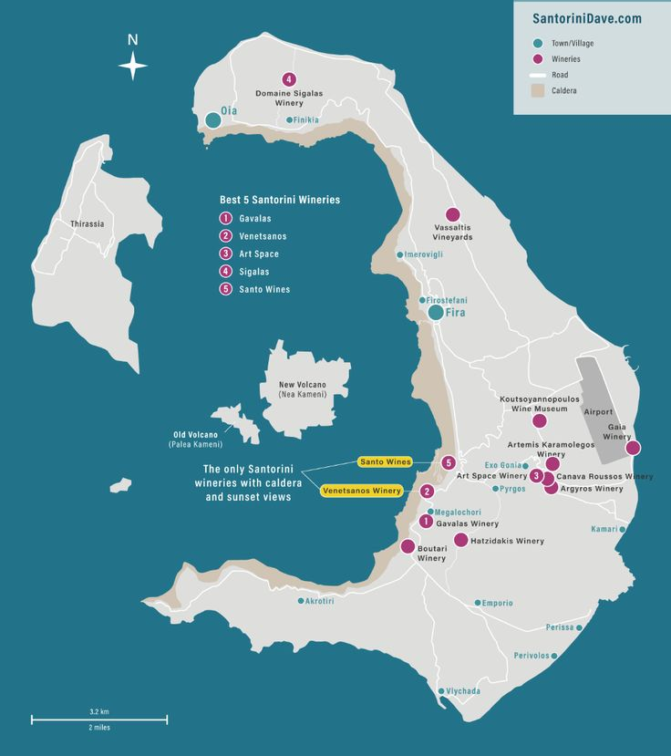
Santorini Wine Region, Greece
The Santorini Wine Region in Greece is renowned for its unique volcanic terroir, which gives its wines distinctive flavors and characteristics.
The island’s flagship grape, Assyrtiko, a bold white varietal that thrives in Santorini’s harsh dry conditions., producing crisp, mineral-driven white wines.
Santorini’s vineyards are among the oldest in the world, and the traditional koulara method, where vines are trained into basket shapes to protect against strong winds.
Visitors to Santorini can sip wine while enjoying breathtaking views of the Aegean Sea, making it a wine region like no other.

Slide 30
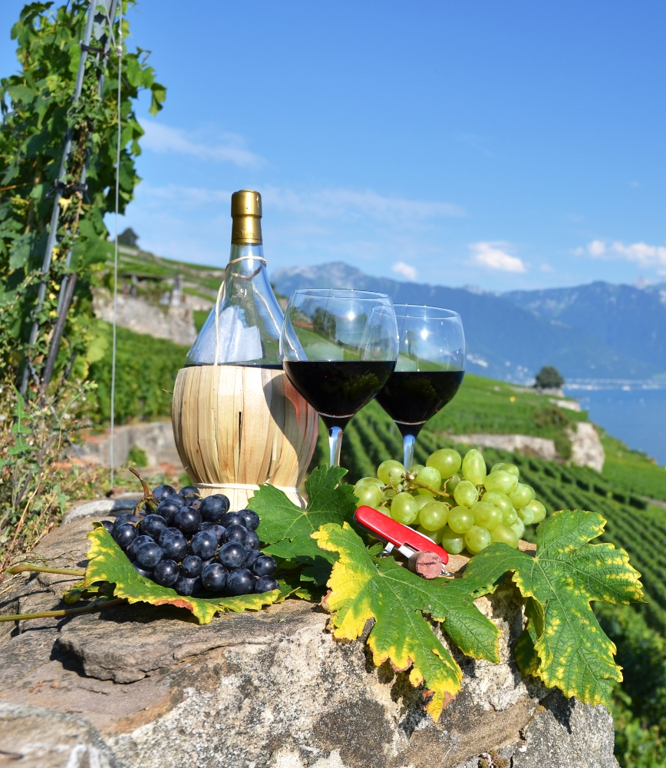
Lavaux Wine Region, Switzerland
Located between Lausanne and Montreux, the Lavaux region is a UNESCO World Heritage site famed for its terraced vineyards overlooking Lake Geneva.
The region is primarily known for its white wines made from Chasselas grapes.
Wine tasting in Lavaux is a scenic adventure, with walking trails that lead you through vineyards, offering incredible views of the lake and the Alps.

Slide 31
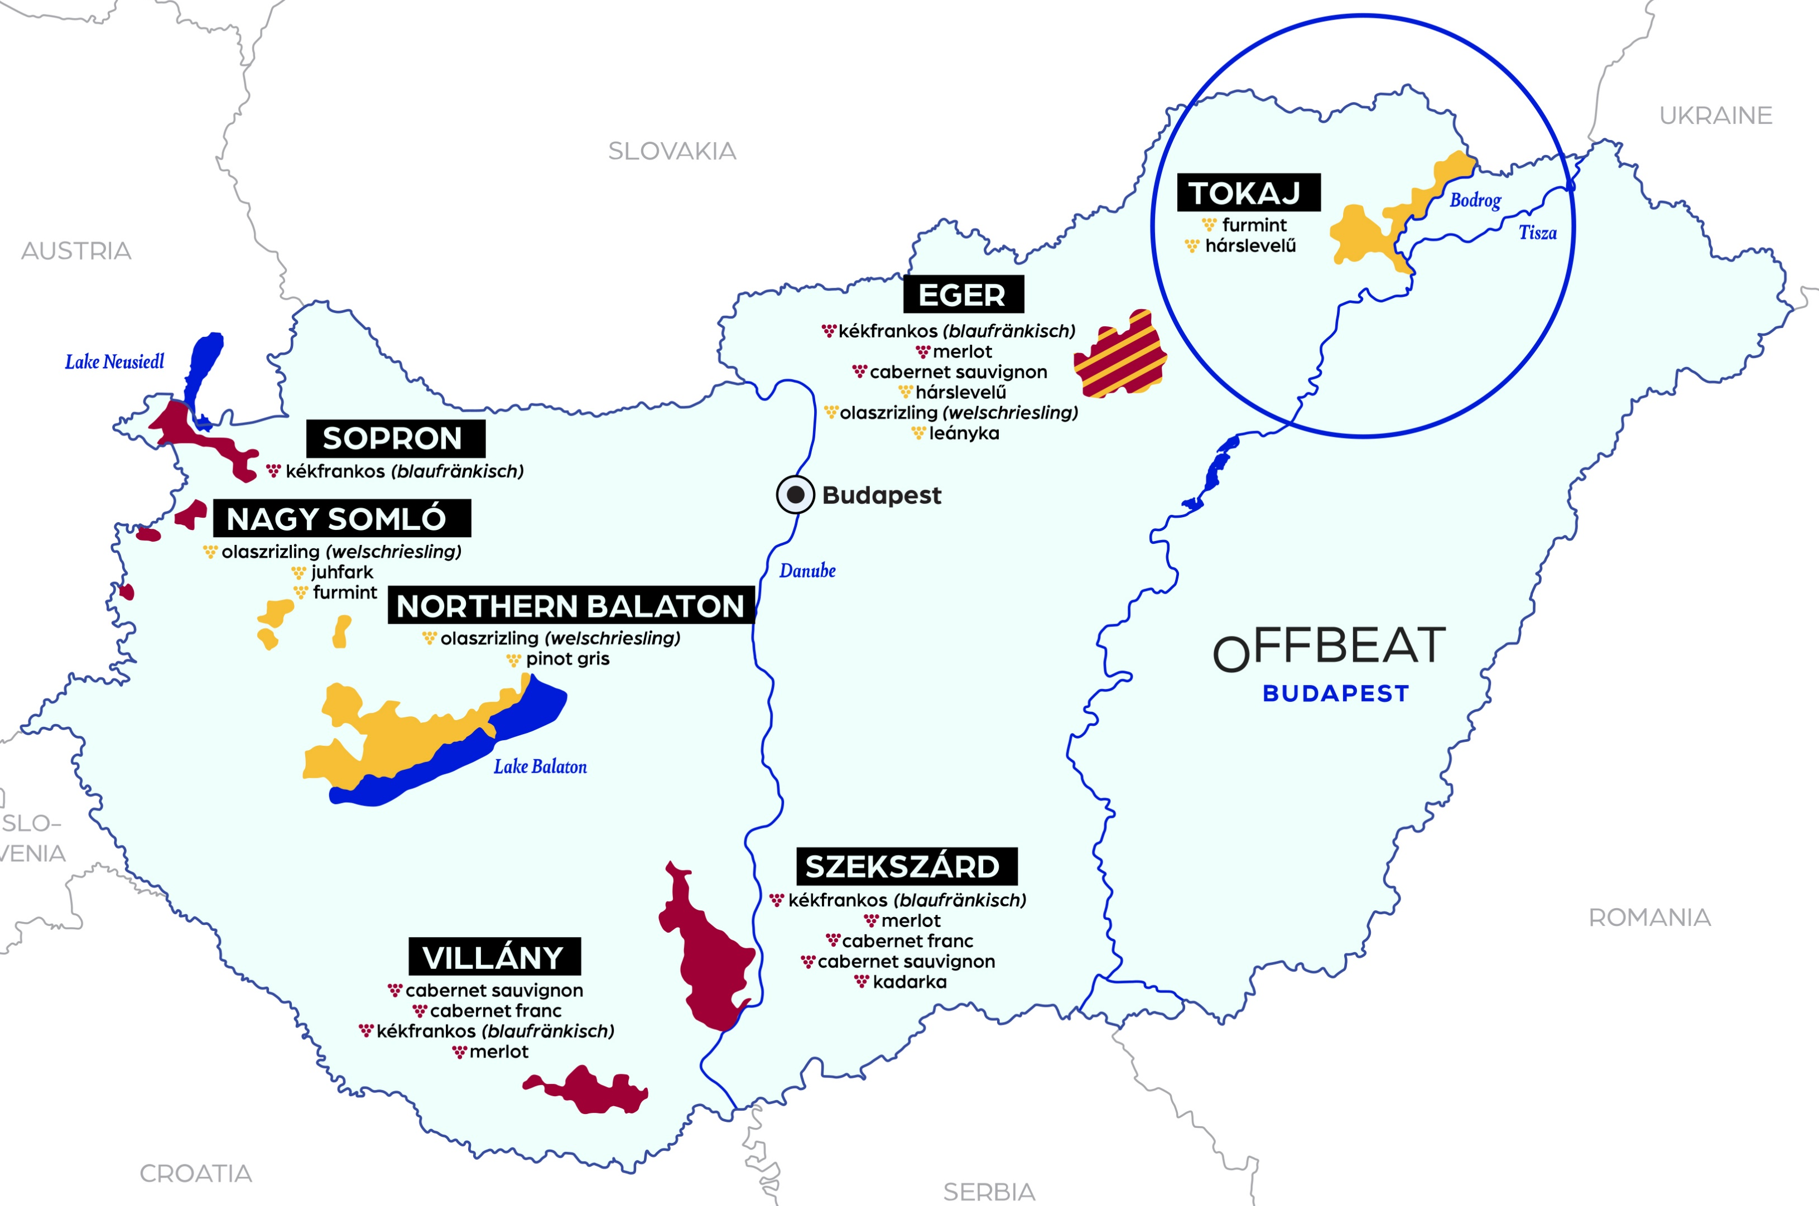
17. Tokaj-Hegyalja Wine Region, Hungary
The Tokaj-Hegyalja Wine Region is one of the oldest and most prestigious wine regions in the world, renowned for its sweet dessert wine, Tokaji Aszú.
Situated in northeastern Hungary, this site is famous for its volcanic soil and cool climate, ideal for growing the Furmint grape.
Tokaj's wine production is steeped in tradition, particularly its use of botrytized (noble rot) grapes, which concentrates their sugars and creates a luscious, sweet wine.
The cellars of Tokaj are as impressive as the wines, and this UNESCO World Heritage site is a must for any wine lover.

Slide 32
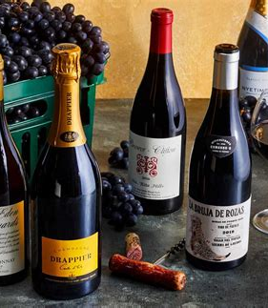
Conclusion
Europe is a wine lover's paradise, and no matter which region you choose to explore, you'll find an abundance of exceptional wines, stunning scenery, and rich cultural experiences.
Whether you're a fan of bold reds, crisp whites, or sparkling wines, there's a European wine region waiting to be discovered.

Slide 33
Conclusion
My seminars are the result of many years of travel experience combined with many hours of research over the internet.
I would like to acknowledge the many source I have accessed.
References
A comprehensive list of sources used in the talk
The talk I provided was a conceptual, original synthesis based on general knowledge of French wine, its regions, varietals, and prominent wineries. Since it was generated as a comprehensive overview, specific external sources were not directly cited. However, if you need a list of potential sources that could be used to further explore the topics covered,
The talk I provided was written based on general knowledge about French wine, which includes historical information, regional specifics, winemaking techniques, and classification systems that are widely documented in literature, online resources, and educational materials about wine.
No specific external sources were directly consulted or cited during the creation of this article. If you need specific references or further reading on French wine, I can recommend sources or find up-to-date information using available tools.

Slide 34
Acknowledgement
My seminars are the result of many years of experience combined with many hours of research over the internet.
I would like to acknowledge the many source I have accessed.
These include Wine Spectator, Wine Enthusiast, BKWine Magazine, Wine & Spirits Magazine, American Vineyard Magazine, The Grapevine Magazine, Wikipedia.com, Britannica.com, and the various Government websites.

Slide 35
References
Wine and War: The French, the Nazis, and the Battle for France's Greatest Treasure by Don and Petie Kladstrup, Broadway Books, 2002.
The Oxford Companion to Wine, edited by Jancis Robinson, Oxford University Press, 2015.
The World Atlas of Wine, by Hugh Johnson and Jancis Robinson, Mitchell Beazley, 2019.
A History of Wine in Europe, 19th to 20th Centuries, Volume I: Winegrowing and Regional Features edited by Silvia A. Conca Messina, Palgrave Macmillan, 2021.
Terroir: The Role of Geology, Climate, and Culture in the Making of French Wines by James E. Wilson, University of California Press, 1998.

