Slide 1


Essential Travel Apps for Caribbean Travel
A Comprehensive Guide & Tutorial
The Caribbean is a dream destination, but staying connected and navigating its many islands can be challenging. Internet access is spotty, roaming charges are high, and language barriers can make communication difficult.
Presented by Marc Silver

Slide 2

Offline Maps & Navigation: Your Travel Companion
Offline Maps
Turn-by-Turn Navigation
Download maps for entire regions before your trip.
Provides driving, walking, and cycling directions.
Points of Interest (POI)
Works Offline
Discover restaurants, landmarks, and accommodations.
Avoid high roaming charges and navigate unfamiliar places safely.

Slide 3
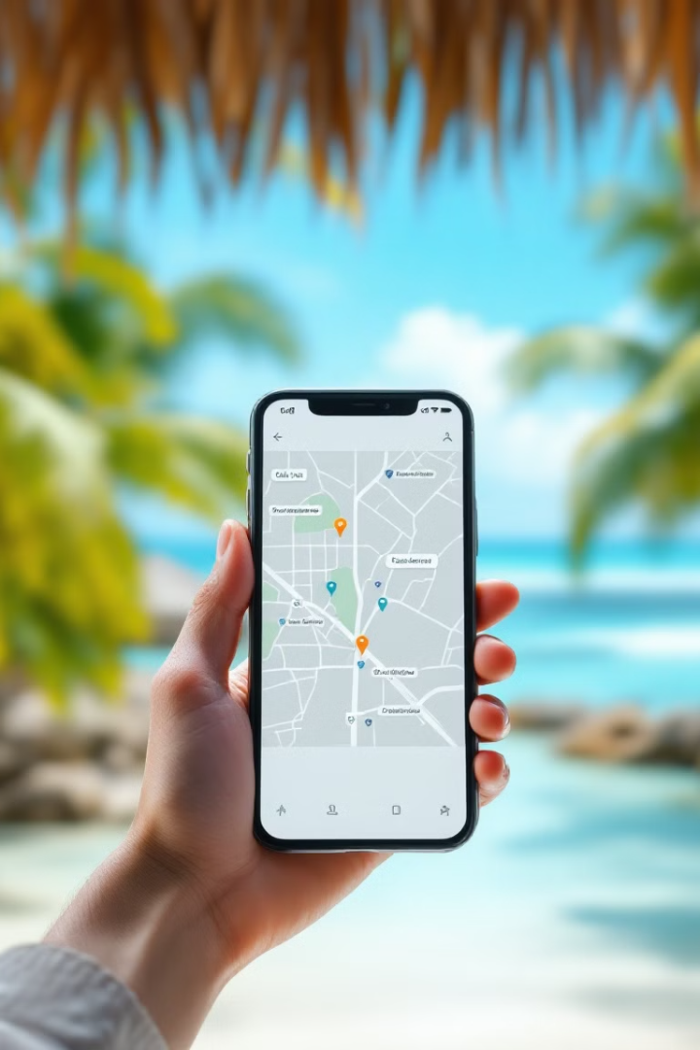
Using Offline Maps & Navigation
1
Download and Install
Get the app from your app store and grant permissions.
2
Download Maps
Save maps for offline use while on Wi-Fi.
3
Navigate
Use the app to find destinations and get turn-by-turn directions.
4
Save Locations
Bookmark important places and create custom lists.

Slide 4




Google Translate: Bridging Language Gaps
Offline Translation
Voice Translation
Camera Translation
Download language packs for use without internet.
Speak into the app for instant translation.
Point your camera at signs or menus to translate text.

Slide 5





Using Google Translate
Download and Install
Get the app and allow necessary permissions.
Download Language Packs
Save languages for offline use while on Wi-Fi.
Text Translation
Type or paste text for instant translation.
Voice and Camera Translation
Use microphone or camera for real-time translations.

Slide 6

Integrating Navigation and Translation Tools
Pre-Trip Preparation
Daily Usage
Safety Considerations
Download maps and language packs. Familiarize yourself with the apps.
Use navigation for routes. Utilize Google Translate for language barriers.
Bookmark key locations. Ensure offline mode is enabled.

Slide 7
Best Practices for Both Apps
Before Your Trip
During Your Trip
Download offline maps and language packs
Update when Wi-Fi is available
Test apps at home
Use MAPS.ME for navigation
Save key locations and phrases
Use Google Translate for communication

Slide 8

Safety Considerations
Emergency Preparedness
Stay Updated
Save emergency numbers and hotel location in both apps.
Regularly update saved locations when Wi-Fi is available.
Power Up
Stay Alert
Carry a portable battery pack to keep your phone charged.
Be mindful of surroundings when using your phone in public.

Slide 9
App Comparison: MAPS.ME vs Offline Maps & Navigation
MAPS.ME
Offline Maps & Navigation
Free for 3 days. Pro version costs $39.95. Detailed offline maps and navigation.
Completely free. Similar features to MAPS.ME. No time limit on usage.
Both apps offer offline navigation, but Offline Maps & Navigation is more cost-effective for longer trips.

Slide 10

Conclusion
By integrating these apps into your travel routine, you'll have reliable navigation and seamless communication throughout the Caribbean. Download them before your trip, practice using them, and enjoy exploring with confidence!
2
0
Essential Apps
Internet Needed
Offline Maps & Navigation and Google Translate
Both apps work offline, avoiding roaming charges
∞
Possibilities
Explore the Caribbean with ease and confidence

