Slide 1

Ensenada Mexico
Presented by
Fellow Cruiser
Marc Silver

Slide 2
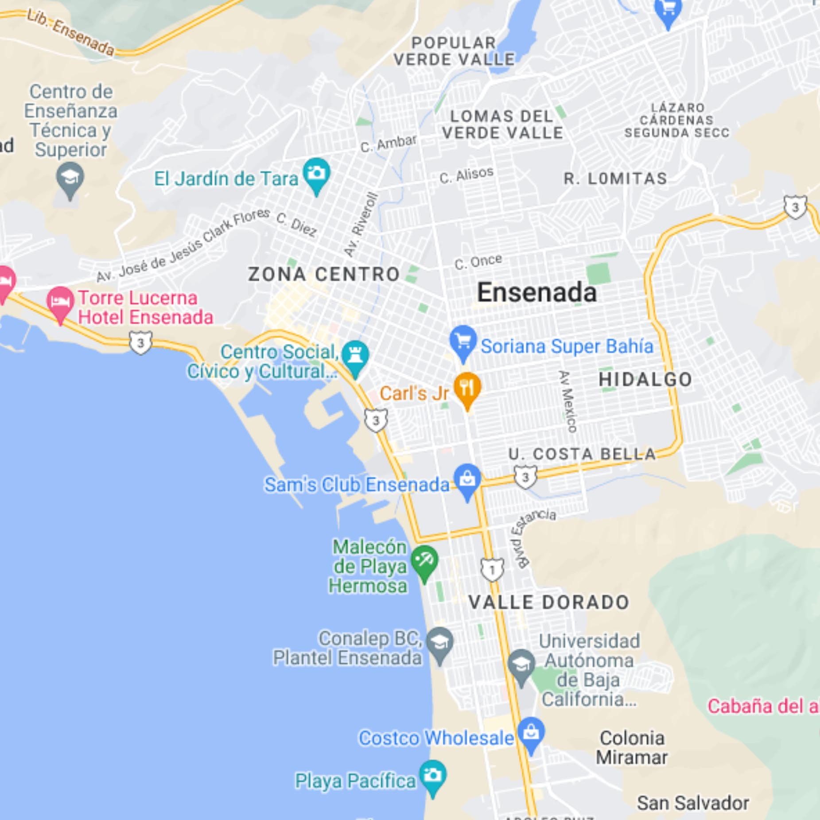
Map of Ensenada

Slide 3
Ensenada Visitor Information
What to Bring:
Comfortable walking shoes
Hat and sunglasses
Sunscreen (SPF 30+)
Reusable water bottle
Mexican pesos for food stalls and vendors
Light jacket — cool ocean breezes are common
Local Tips:
Many street vendors accept USD, but pesos may get better prices
Watch for uneven sidewalks and cobblestone areas
Public Wi-Fi is spotty — download maps ahead of time

Slide 4
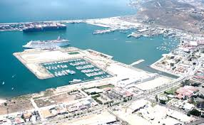
Ensenada Walking Tour
Start & End Point: Ensenada Cruise Ship Port (Malecon de Ensenada)
Total Distance: ~3 km (1.9 miles)
Duration: 2–3 hours at a relaxed pace
Difficulty: Easy — mostly flat with paved streets and
sidewalks
1. Ensenada Cruise Terminal (Malecon Area)
Your journey begins at the Ensenada Port Terminal, a
modern cruise facility with restrooms, souvenir shops,
currency exchange, and tourist information.
Insider Tip: Grab a free Ensenada map from the terminal
or snap a photo of the local taxi fare chart for reference later.
Walking Time to Next Stop: 5 minutes

Slide 5
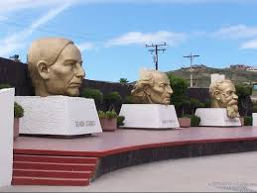
Ensenada Walking Tour
2. Plaza Cívica (Three Heads Park)
Walk along the waterfront to reach Plaza Cívica, a spacious open square known for its three large gold busts of Mexican heroes: Benito Juárez, Miguel Hidalgo, and Venustiano Carranza.
Highlights: Scenic photo ops with the large Mexican flag and views of the port. Look for food carts offering mango with chili or street corn (elote).
Insider Tip: This is a great place for people-watching and a quick snack.
Walking Time to Next Stop: 7 minutes
3. Riviera del Pacífico Cultural Center
Just a few blocks inland lies the Riviera del Pacífico, a 1930s Spanish-style casino-turned-cultural-center with lush gardens, tiled courtyards, and local art exhibits.
Attractions:
Mosaics and murals inside
The Bar Andaluz, said to be the birthplace of the Margarita cocktail
Boutique souvenir shops and local artisan vendors
Insider Tip: The Margarita here comes with a story. Ask your server about it.
Walking Time to Next Stop: 8 minutes

Slide 6
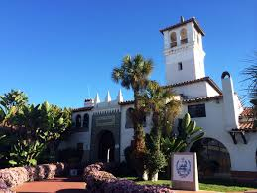
Ensenada Walking Tour
3. Riviera del Pacífico Cultural Center
Just a few blocks inland lies the Riviera del Pacífico, a 1930s Spanish-style casino-turned-cultural-center with lush gardens, tiled courtyards, and local art exhibits.
Attractions:
Mosaics and murals inside
The Bar Andaluz, said to be the birthplace of
the Margarita cocktail
Boutique souvenir shops and local artisan
vendors
Insider Tip: The Margarita here comes with a
story. Ask your server about it.
Walking Time to Next Stop: 8 minutes

Slide 7
Ensenada Walking Tour
4. El Parque de la Bandera & Dancing Fountain
Head back toward the waterfront and pass through El Parque de la Bandera, a pleasant seaside park with walking paths, open-air seating, and the famous dancing fountains that operate in sync with music on weekends and afternoons.
Features:
Refreshing sea breeze
Great photo backdrop with the pier and ocean
Playground if you’re traveling with kids
Walking Time to Next Stop: 5 minutes

Slide 8
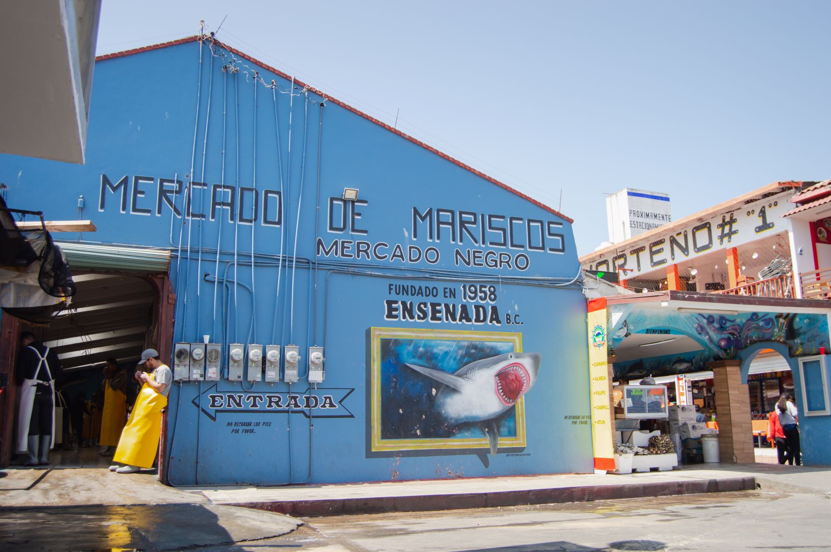
Ensenada Walking Tour
5. Mercado de Mariscos (Fish Market)
Stroll along the coast to reach Ensenada’s
Mercado de Mariscos, the local fish market
that’s full of character and local flavor.
Highlights:
Rows of seafood vendors
Sample a fresh ceviche tostada or a
Baja-style fish taco
Great chance to interact with locals and see
fishermen at work.
Insider Tip: Prices are better than in tourist
restaurants — and the quality is often better
too.
Walking Time to Final Stop: 5 minutes

Slide 9
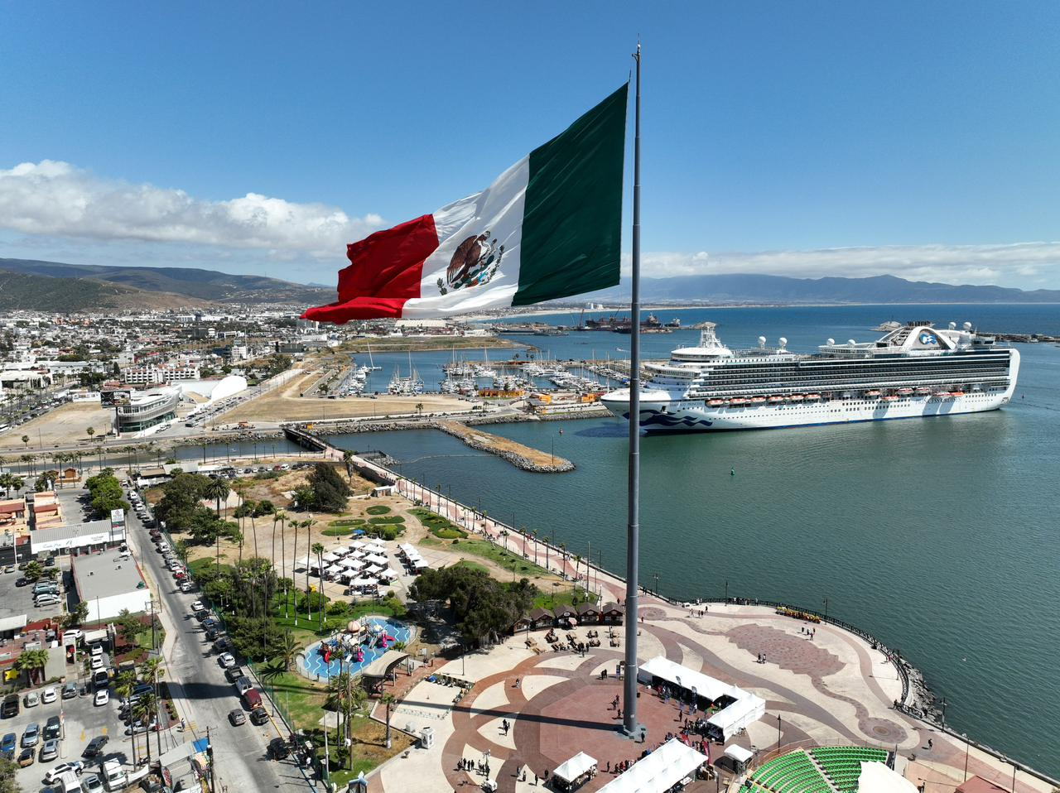
Ensenada Walking Tour
6. Return to Cruise Terminal
From the market, follow the scenic Malecón (boardwalk) along the waterfront, passing small shops and street performers as you make your way back to the terminal.
Optional Stops on the Return Walk:
Hussong’s Cantina (a few blocks inland): Mexico’s oldest cantina, open since 1892
Local craft stalls for handmade jewelry and trinkets
Walking Time: 10–12 minutes

Slide 10
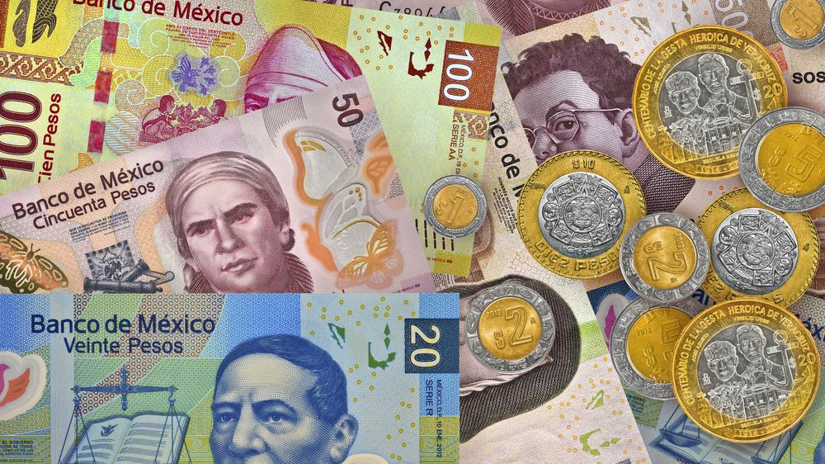
Money
The Peso is the official currency of Mexico
Official Exchange is 100 Pesos is $5.80 US
Or 17.35 Pesos to the US Dollar

Slide 11
Emergency Contacts
Emergency (Police/Ambulance): 911
Tourist Assistance: 078 (from local phone)
U.S. Consular Agency: +52-646-176-2411
Nearest Hospital: Hospital Velmar (10 min by taxi)

Slide 12
Final Thoughts
Ensenada is a beautiful City with a rich history and numerous attractions. Whether you're looking for stunning views, historic sites, or unique attractions, Ketchikan has something for everyone.
I hope this presentation will help when we visit Ensenada.

Slide 13
Thanks For Coming
If you have any more questions, please ask.
I will do my best to answer them for you.
Have a great visit in Ensenada!

