Slide 1
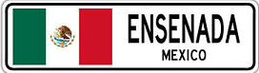
Ensenada Mexico
Presented by
Fellow Cruiser
Marc Silver

Slide 2
What I Will Cover
My Port Philosophy
Don’t Miss the Ship
Money
About Ensenada
History of Ensenada
Map of Ensenada
Ensenada Transportation
Places to see or at least consider
A few restaurant recommendations
Conclusion

Slide 3
My Port Philosophy
I have been cruising for over 45 years and have taken over 100 cruises.
So, I consider myself an experienced cruiser.
The information I will present is based on those many years of
experience.
When I am on a cruise where the city, I want to visit is not the port city,
I always recommend taking a ship’s tour.
But when I am in a port with multiple attractions nearby and easy to see
on my own -
I will do it on my own.
This presentation is not like that.

Slide 4

Don’t Miss the Ship
How to Avoid Missing Your Ship
Pay attention to the time. - Ship time and local time are often
different.
Put a return-to-ship reminder on your phone.
Choose excursions wisely.
If a ship-sponsored excursion is late returning to port, the ship will
wait for you. If you are on your own???
Be Prepared
Have your Passport, Credit Card, and phone numbers for your ship
port agent.
What to Do If You Miss the Ship
Most cruise lines have port agents stationed in the port area to assist if your ship has left without you. If your are lucky, when cruisers are late returning to the vessel, the ship’s crew will often remove the passengers’ essential items – passports, cell phones, and medication -- from the ship to leave with the port agents.
The Port Officials can help you with contacting your ship
and making necessary travel arrangements.

Slide 5
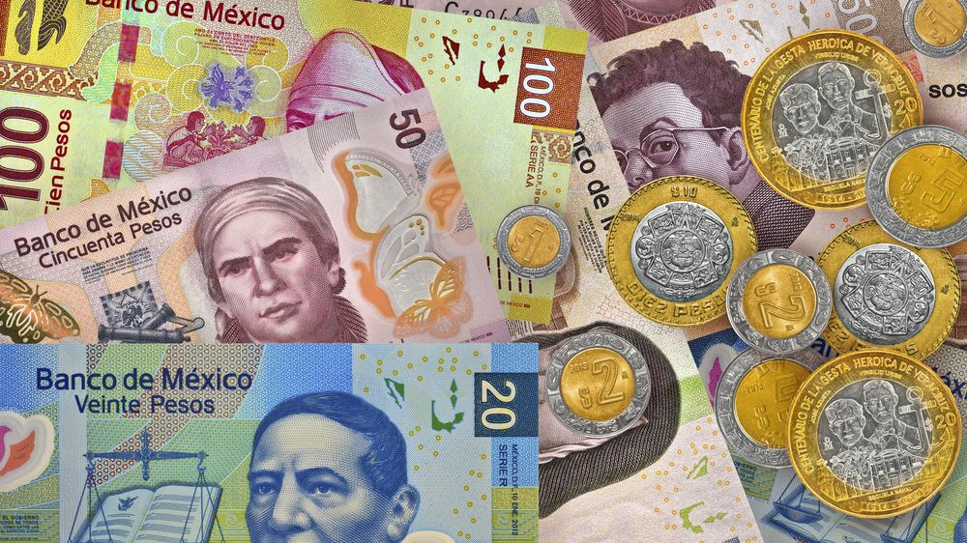
Money
The Peso is the official currency of Mexico
Official Exchange is 100 Pesos is $5.80 US
Or 17.35 Pesos to the US Dollar

Slide 6
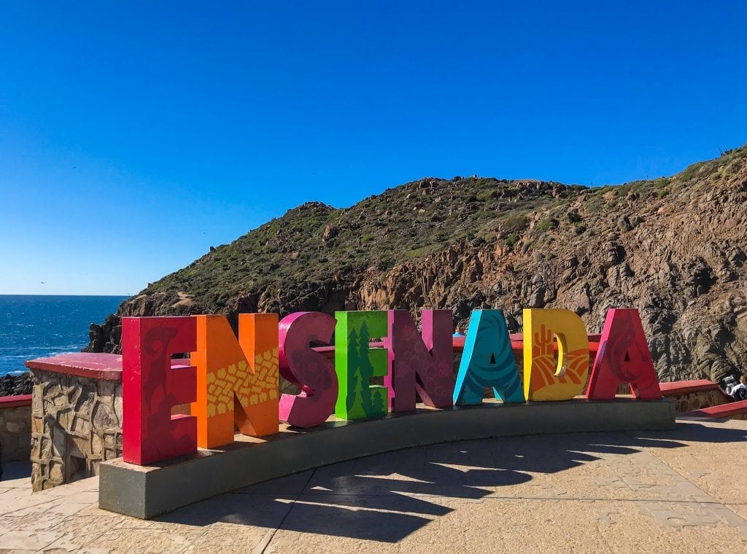
About Ensenada
Ensenada is situated on the Pacific Coast of Mexico. The city had a population of 279,765 in 2018, making it the third-largest city in Baja California. The city is an important international trade center and home to the Port of Ensenada, the second-busiest port in Mexico. Ensenada is a major tourist destination, owing to its warm climate and proximity to the Pacific Ocean.
Ensenada was founded in 1882 when the small community of Rancho Ensenada de Santos was made the regional capital for the northern partition of the Baja California Territory. The city grew significantly with the proliferation of mines in the surrounding mountains. While the Mexican Revolution curtailed much of Ensenada's expansion, the onset of Prohibition in the United States transformed the city into a popular tourist destination for Americans seeking entertainment and alcohol. Ensenada's reputation as a resort town was cemented by the 1950s and 1960s, which saw a construction boom and the city's rise in international prominence outside of North America.
Today, Ensenada is a major economic and cultural hub for Baja California.

Slide 7
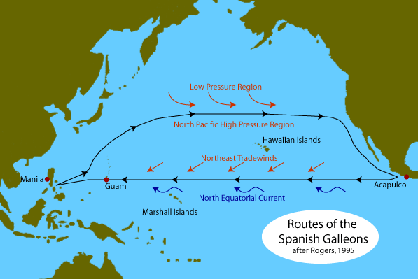
History of Ensenada
At the time the first European explorers arrived in the region, Yuman–Cochimí speaking peoples inhabited the region. These hunter-gatherer indigenous peoples lived in the Bay Area and interior valleys of the Sierra de Juárez and Sierra de San Pedro Mártir. The Kumeyaay had a village where the city was seated that was called Pa-tai.
The city was founded on September 17, 1542, under the name San Mateo.
In 1602, while mapping the coast of the Californias in search of safe harbors for returning Spanish galleons from Manila to Acapulco, Sebastián Vizcaíno renamed the city Ensenada de Todos Santos. Ensenada means "bay" or "cove".
The first permanent settlement was established by the Jesuits during the 17th or 18th century. After the expulsion of the Jesuits in 1768.

Slide 8
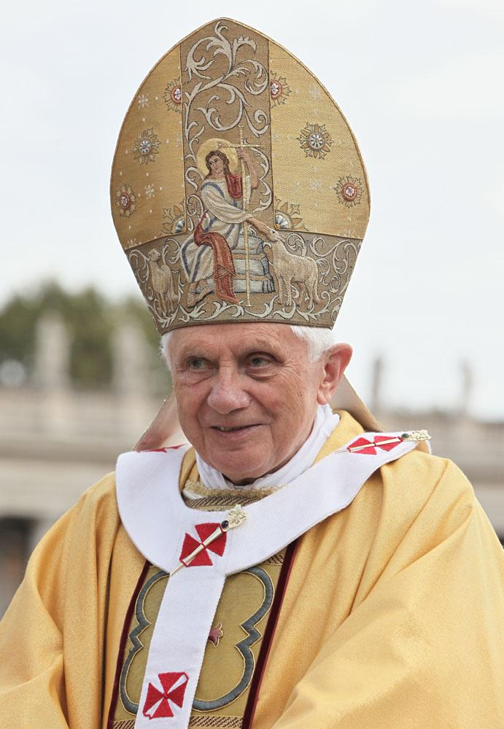
History of Ensenada
In 1882, Ensenada was designated the capital of Baja California, and attempts at developing the area were made by the English Mexican Land and Colonization Company. These were interrupted by the Mexican Revolution.
Ensenada truly began to flourish in the early 1950s, at which time the city's population had risen to 20,000. The hotel finally closed in 1964. It was later reopened as a cultural center and museum. By this time, other hotels had opened, and the population and economy of Ensenada had grown and diversified towards their present status.
On January 26, 2007, Pope Benedict XVI created the Roman Catholic Diocese of Ensenada with territory taken from the Archdiocese of Tijuana and Mexicali Diocese, making it a suffragan diocese of the Metropolitan Church of Tijuana.

Slide 9
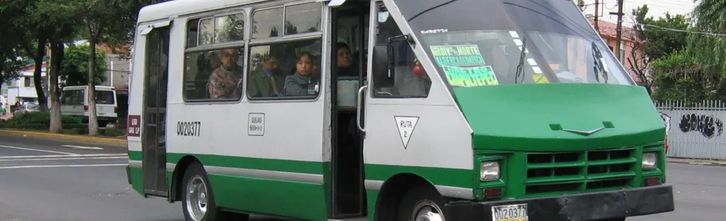
Getting Around Ensenada
Although you can get just about everywhere you need to go by walking, you may enjoy renting some wheels to explore the city.
Chavo's Sport Rentals, located on Blvd Costero (Lazaro Cardenas) and Castillo (Near the giant flagpole) has scooters, ATVs, and fancy-looking golf cart-type of vehicles.
If you are adventurous, or you are traveling on a tight budget... Their bus system is your best sightseeing option.
90% of the public transport in Ensenada is carried out by small buses. These vehicles are popularly known as "micros".
The basic fee to travel on "micro" is under 15 pesos. Be sure to have exact change!

Slide 10
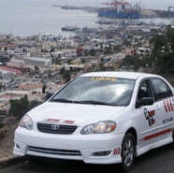
Ensenada Taxis
Taxis Amarillos can take you wherever you like. Passengers are auto-insured.
Taxis Colectivo is a fast taxi ride on a fixed route within the city. They charge about US 80 cents per person (in Mexican currency).

Slide 11
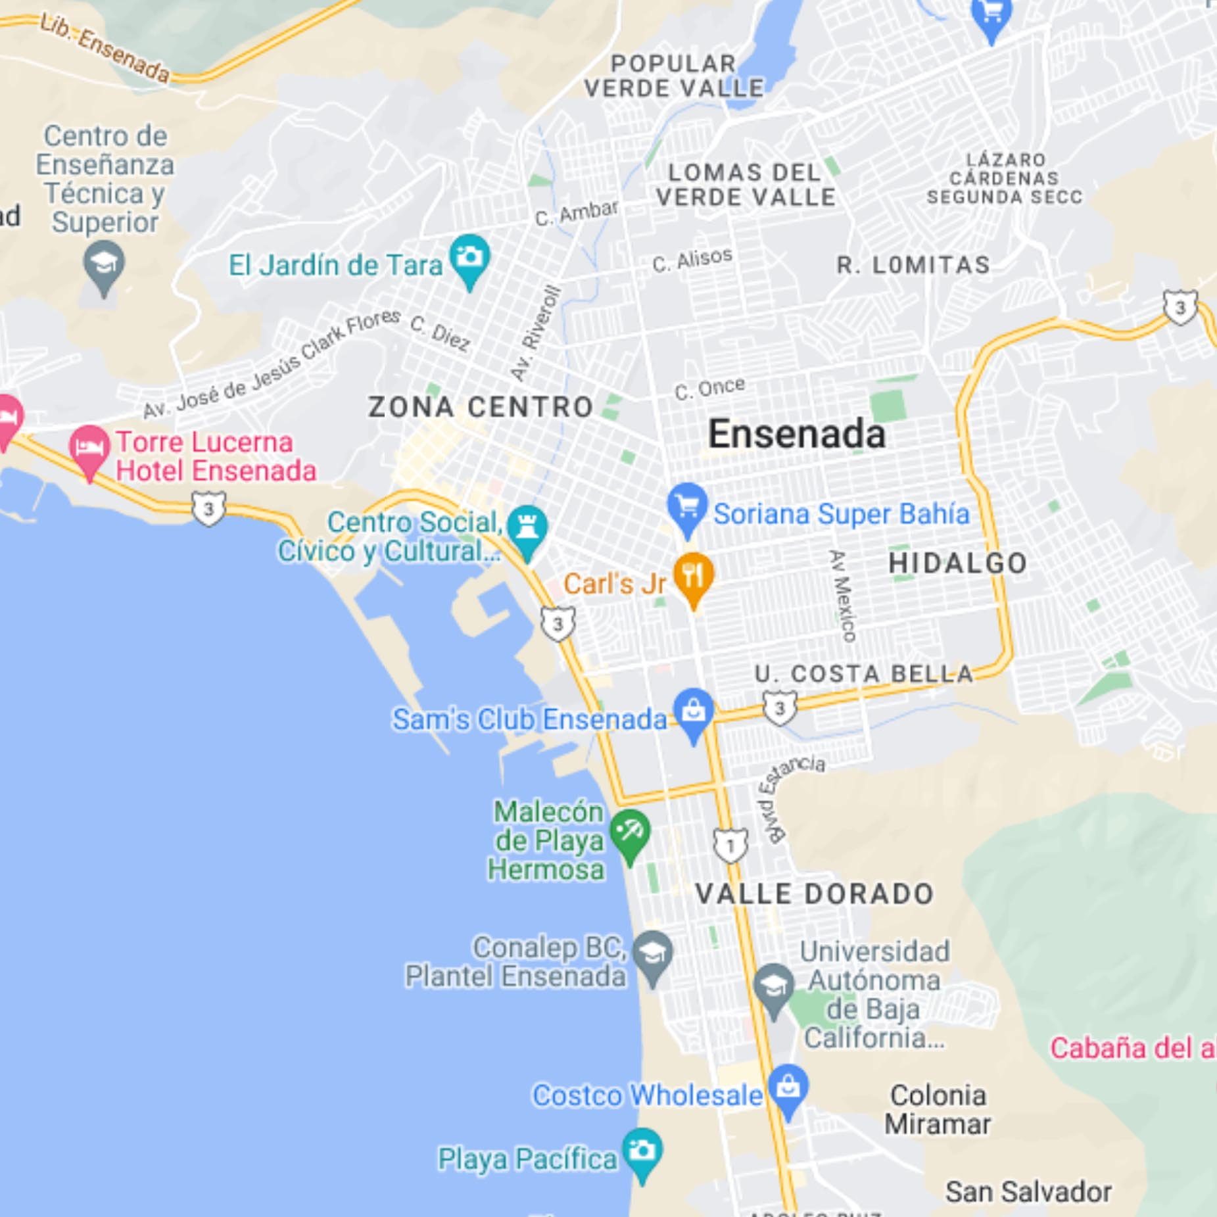
Map of Ensenada

Slide 12
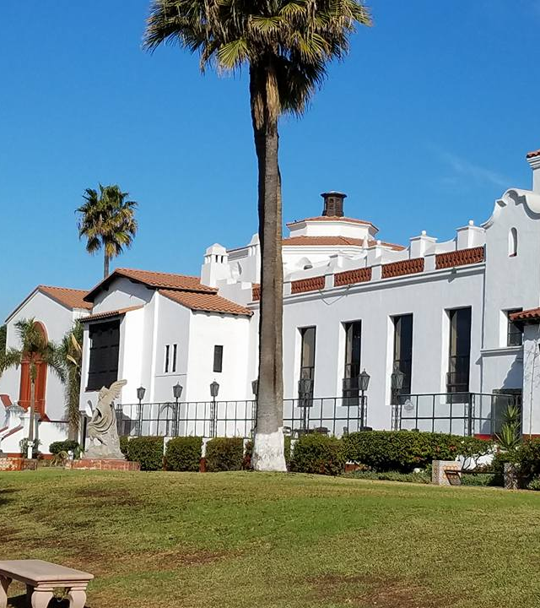
Ensenada Museum of History
If you are interested in History, a visit to the Ensenada Museum of History should be one of your top things to do in Ensenada.
Forming part of the Riviera Cultural Center, the museum is focused on portraying the history of the Baja Peninsul and also the significant individuals who contributed to the development of the area.
Among other things you get to learn in this museum include information about the influence of the explorers and European missionaries on the native local history which is written in both English and Spanish.

Slide 13
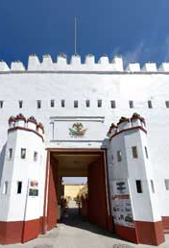
Regional Historical Museum
If you are a history lover visit the Regional Historical Museum.
Though also a history museum, the Regional Historical Museum is completely different from the Ensenada Museum of History of Riviera Cultural Center.
The museum is housed by a historical building in Ensenada which was formerly a local prison and has most of its exhibits displayed in rooms that were initially prison cells.

Slide 14
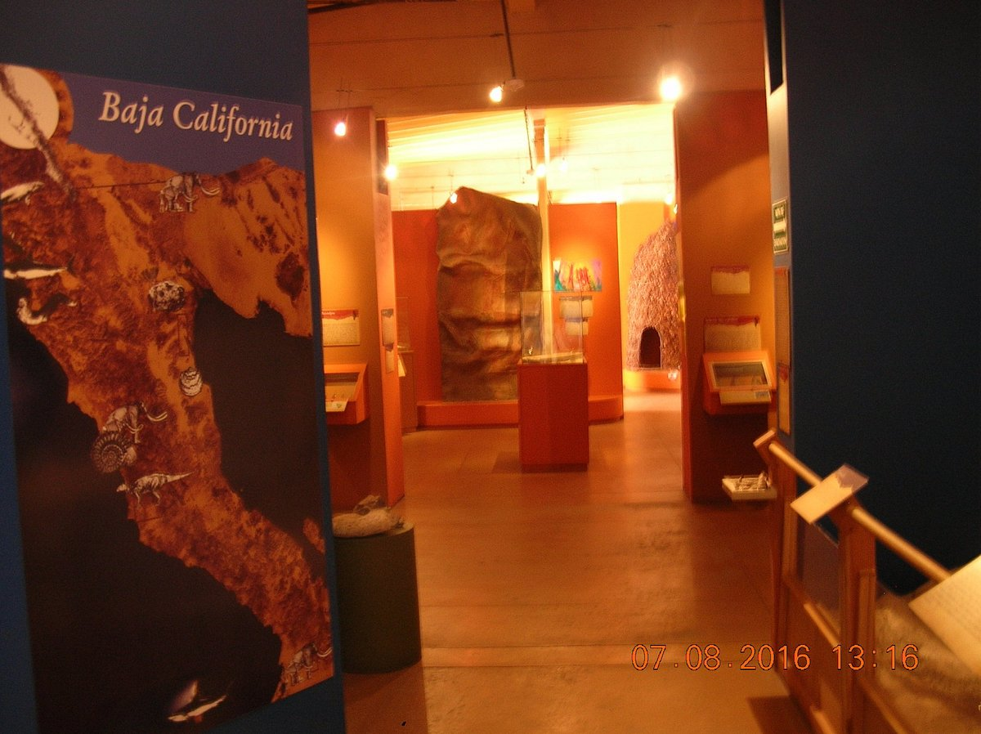
Museo de Historia de Ensenada
It is part of the facilities of the Riviera Social, Civic, and Cultural Center, a building whose construction dates back to 1930. It was inaugurated on May 20, 1993, with the aim of promoting appreciation for its roots and history among the inhabitants of the community.
Located just a half block off the main drag it includes, excellent displays and descriptions of the paleontology and anthropology of Baja California, including huge mammoth bones, lots of spear points and arrows, and baskets, dioramas, and explanations in Spanish and English.
if you can take a half hour away from the craziness of the shops, bars, and street vendors, you will love this free museum.
General Admission: Free

Slide 15
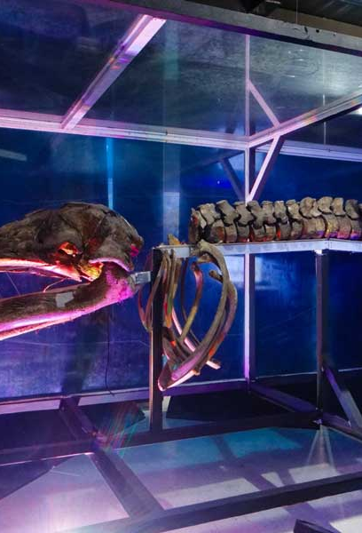
Caracol Science Museum
General Admission 60 pesos
Nestled in between the harbor and the enormous Riviera Center, Caracol Science Museum is an innovative and modern museum that features different marvelous works of science.
The museum consists of exhibits that teach visitors about Mexican and Baja engineering and scientific projects most of which have English captions.
Among several other permanent exhibits in the museum include a Manila galleon which was shipwrecked off the coast, The Heavens, and The Earth and much more.

Slide 16
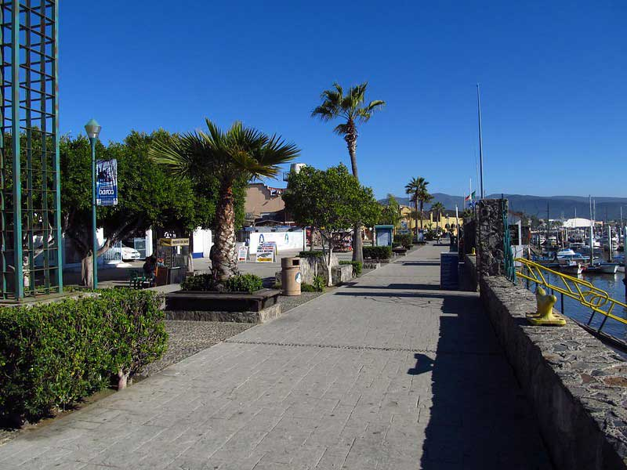
Walk the Malecon
The Malecon is a short enjoyable boardwalk located along Ensenada’s Bay of All Saints which begins at a fish market and extends to the park.
This boardwalk gives an amazing view of the sunrise and sunset which gives passersby an exciting strolling experience.
A popular feature of the Malecon is the large Mexican flag mounted in the area which is about 300 feet tall. Described by Tour guides to be one of the world’s largest flag, the Mexican flag of this area is about 28 meters wide and 50 meters long.
Furthermore, the Malecon also features talented artist who stands along the boardwalk performing live mariachi music and entertaining onlookers and passerby.

Slide 17
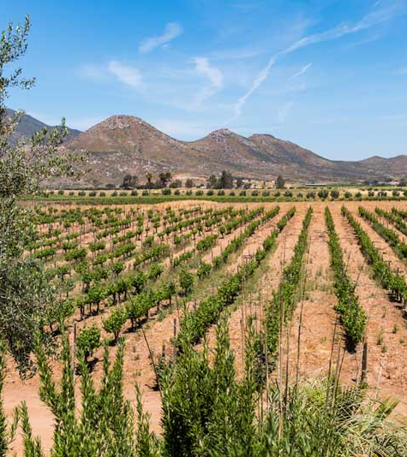
Explore the Wine Country
If you are a wine snob and think that the only place to experience fine wine is Napa, Sonoma, and Mendocino you may be surprised by some of the wines of this region.
Located about 20km north of Ensenada, Valle De Guadalup also known as the wine country is a popular tourist destination for wine lovers, it comprises more than 75 wineries.
The destination is frequented by many year after year as a result of its fine wines and intriguing dining with perfect velvety red wine, gourmet dishes, and cheese.
A perfect way to explore this wine village is by booking a tour that will take you through the beauty and amazement of this area as you taste a variety of local wines and cuisines.

Slide 18
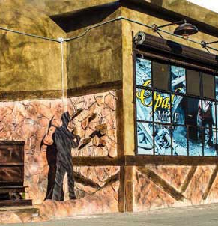
The Opal Mine
Don’t be confused this is not a museum. But if you want to purchase some excellent Mexican jewelry, visit The Opal Mine, a popular jewelry store that features varieties of beautiful locally-made jewelry including those made using fire opal, the national stone of Mexico.
The Opal Mine has customer-friendly staff who are ready to attend to visitors and guide them as they select from the hundreds of available jewelry designs.
This beautiful jewelry store has its interior designed to look like an original opal mine to create a picture of the origin of the polished stones.

Slide 19
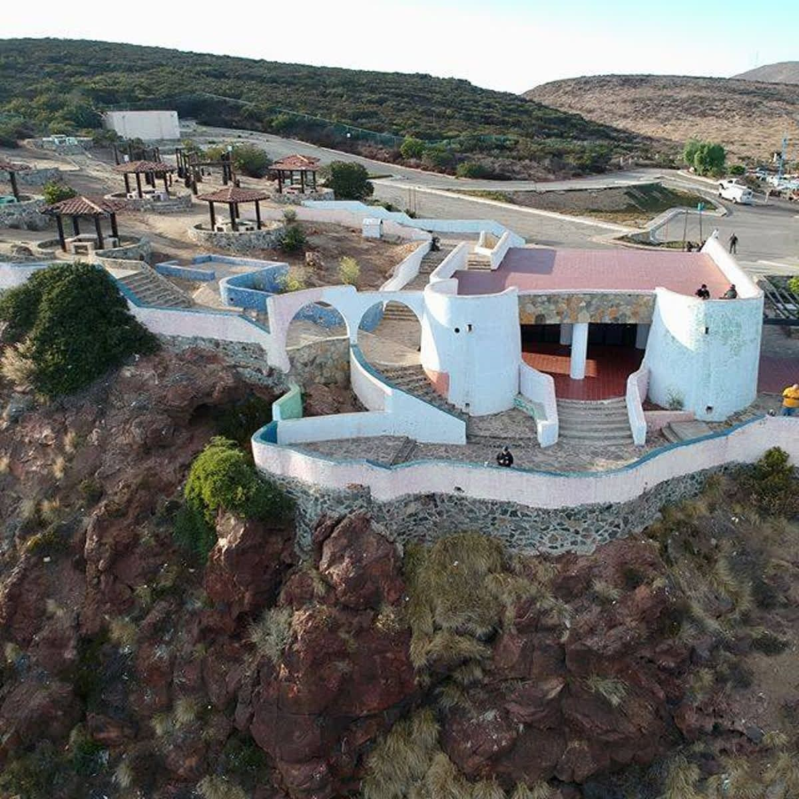
El Mirador
Atop the Colinas de Chapultepec, El Mirador offers panoramic views of the city and Bahía de Todos Santos. Climb or TAXI to this highest point in town, up Avenida Alemán from the western end of Calle 2a in central Ensenada.
Well worth the trip just for the view.

Slide 20
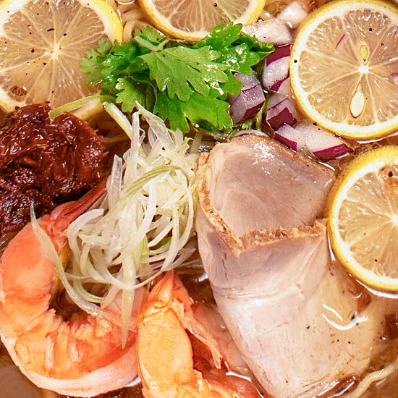
Restaurants in Ensenada
There are a lot of excellent restaurants in Ensenada. Especially for seafood.
Here are some recommendations:
Mexipon Ramen & Curry Bar $ Japanese, Asian, Vegan Options
Av. Virgilio Uribe #649 Interior #1 Zona Centro Plaza Delfines, Ensenada
Geppetto's Pizzeria & Bistro $$ - $$$ Italian, Pizza
Blv Costero #678 Col. Centro, Ensenada, Ensenada
Birrieria La Guadalajara $$ - $$$ Mexican, Latin
Calle Macheros S/N entre Primera y Segunda Zona Centro
IL Massimo $$$$ Italian, Mediterranean, European
Blvd. Costero Lazaro Cardenas 987 Av. Blancarte y Av. Castillo. Next to Subway
Mr Pampas Ensenada $$ - $$$ Steakhouse, Brazilian, Latin
Boulevard Lazaro Cardenas 1790 CP 22880, Ensenada
There are many excellent restaurants in Ensenada open for your pleasure.
Good Eating

Slide 21
Conclusion
Ensenada is a beautiful City with a rich history and numerous attractions. Whether you're looking for stunning views, historic sites, or unique attractions, Ketchikan has something for everyone.
I hope this presentation will help when we visit Ensenada.

Slide 22
Thanks For Coming
If you have any more questions, please ask.
I will do my best to answer them for you.
Have a great visit in Ensenada!

