Slide 1
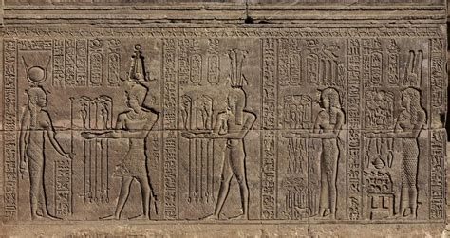
Egyptian Wine Presented by Marc Silver

Slide 2
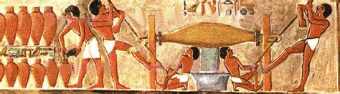
A Rediscovery of Ancient Craftsmanship
Egypt, a land where civilization itself took its first breath, is also one of the earliest known homes to winemaking.
This ancient tradition, which has evolved and adapted over thousands of years, is now making a comeback.
Wine enthusiasts might find themselves intrigued by the unique blend of history, terroir, and modern innovations in Egypt’s blossoming wine industry.

Slide 3
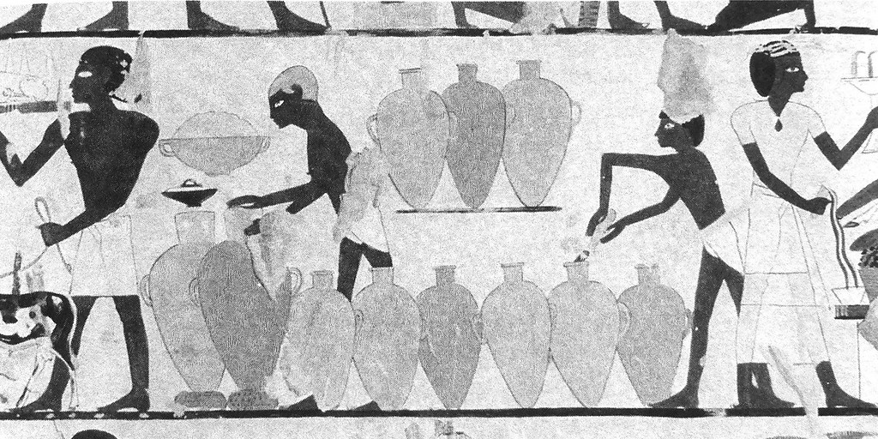
History of Egyptian Wine
Ancient Egypt: The Dawn of Viticulture
Egypt’s association with wine dates back to at least 3,000 BCE. The country’s arid climate, while seemingly inhospitable, offered unique conditions for winemaking along the fertile banks of the Nile River.
Archaeologists have uncovered wine amphorae and frescoes that depict winemaking scenes in royal tombs, evidence that wine held religious and ceremonial significance for the ancient Egyptians.

Slide 4
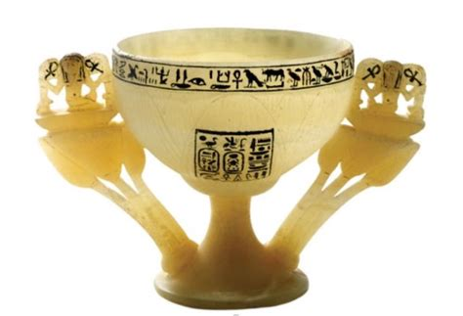
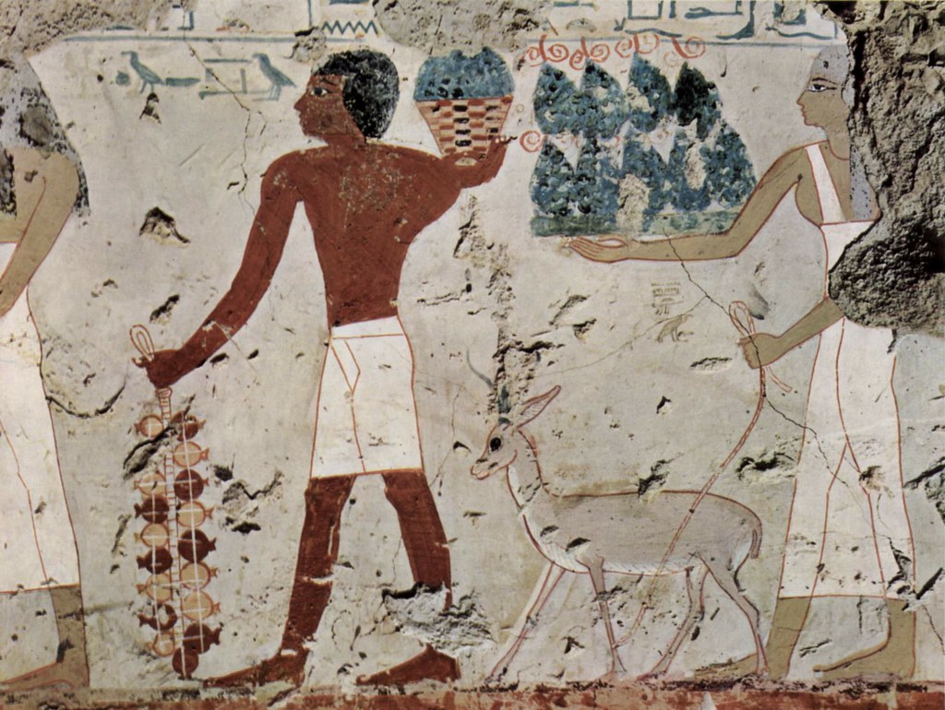
History of Egyptian Wine
Pharaohs and wine: Wine was often used as an offering to gods, as evidenced by its frequent depiction in temples.
Viticultural techniques: Early Egyptians cultivated grapes like white Muscat and red Khedive, using a simple trellising system to protect vines from scorching heat.
Wine and burial customs: During the Old and Middle Kingdoms, wine was an integral part of royal burials. King Tutankhamun’s tomb, for instance, contained numerous amphorae, highlighting the luxury and esteem of wine in Egyptian society.

Slide 5
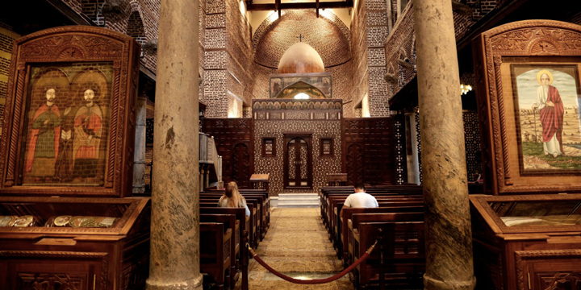
Islamic Period
Decline and Adaptation
As Islam became the dominant religion in Egypt around the 7th century CE, winemaking was largely curtailed due to religious restrictions. Wine production diminished considerably, although the tradition never fully disappeared. Some small-scale wine production continued, mainly for non-Muslim communities and medicinal purposes.
Monastic vineyards: Christian monasteries in Egypt kept wine production alive during this period, albeit on a much smaller scale.
Wine in trade: Despite religious prohibitions, Egypt’s role as a trade hub meant that some wine continued to flow through, primarily for export.
Notes:
Charles IV, King of Bohemia

Slide 6
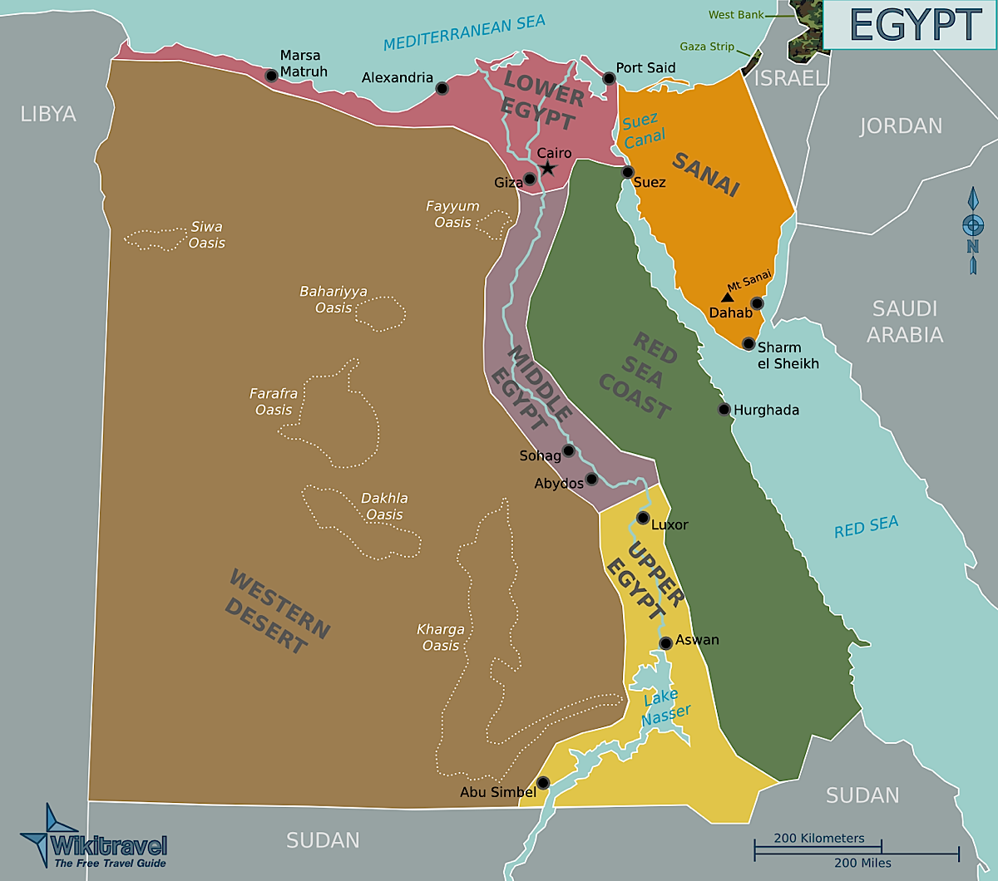
Wine Regions in Egypt
El Gouna Region
El Gouna, along the Red Sea coast, is Egypt’s most prominent wine-producing region today. Known for its proximity to major tourist destinations and a temperate microclimate, this region produces much of Egypt’s premium wine.
The region also plays host to wine tourism, with tasting tours and vineyard visits becoming increasingly popular.
Why visit: El Gouna offers a wine experience combined with coastal luxury, making it an excellent destination for both wine enthusiasts and leisure tourists.
Top varieties: Cabernet Sauvignon, Syrah, and Merlot.

Slide 7
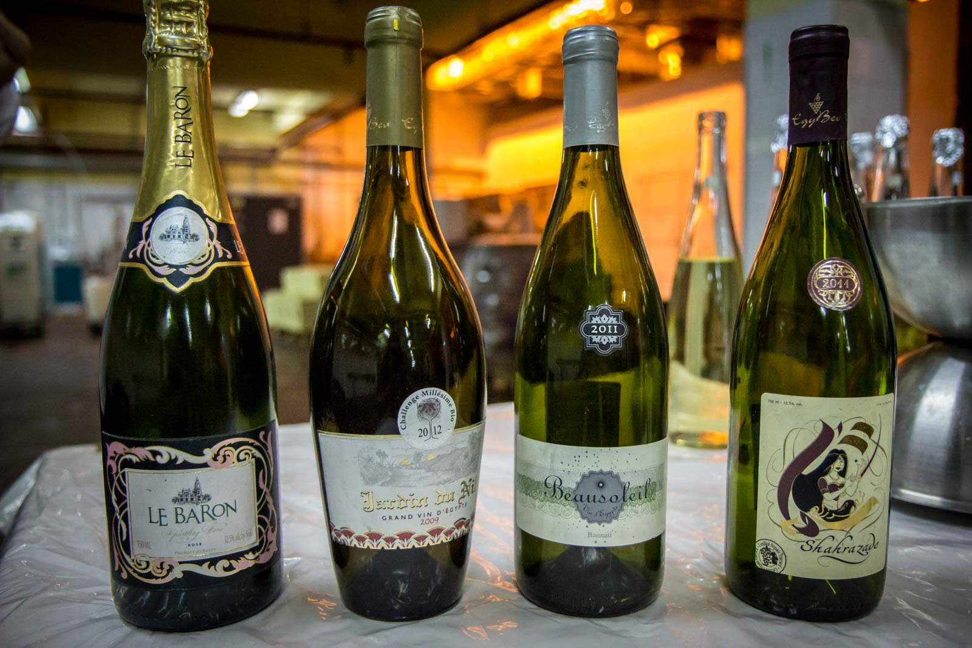
Regional Breakdown
El Gouna
Location: On the Red Sea, just north of Hurghada.
Terroir: Coastal influences, sandy soils, and moderate humidity allow for long ripening periods.
Climate: Hot days are followed by cool breezes, making it ideal for growing bold red varieties.
Key grapes: Cabernet Sauvignon, Merlot, and Syrah thrive here, producing wines with full-bodied textures and rich flavors.

Slide 8
Wine Regions in Egypt
Nile Delta Region
Historically, the Nile Delta was a fertile wine-growing region in ancient Egypt, and today it remains a key agricultural area.
The northern reaches of the Delta are home to several modern vineyards producing both red and white wines.
Why visit: The Delta offers a unique mix of history and modern viticulture, with many vineyards located near historic sites.
Top varieties: Muscat, Chardonnay, and Carignan.

Slide 9
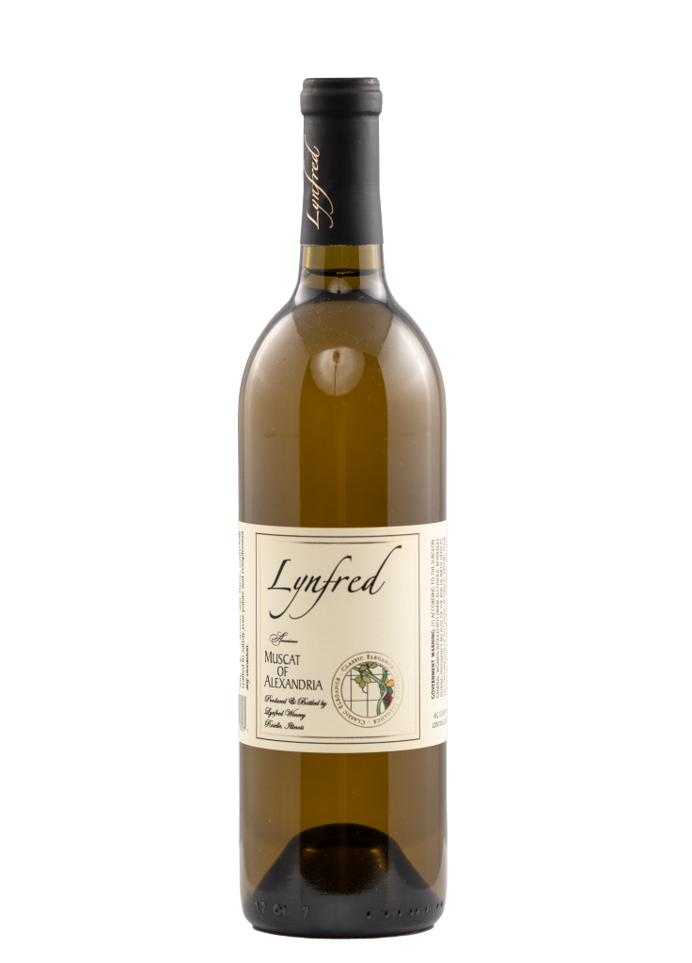
Regional Breakdown
Nile Delta
Location: North of Cairo, extending toward the Mediterranean.
Terroir: Alluvial soils and proximity to the Nile provide essential moisture, helping vines thrive in the otherwise arid landscape.
Climate: The Delta enjoys a Mediterranean climate with hot, dry summers and cool winters.
Key grapes: Muscat and Chardonnay produce refreshing white wines with floral and citrus notes.

Slide 10
Wine Regions in Egypt
Upper Egypt (Luxor and Aswan)
Winemaking in Upper Egypt is still in its infancy, but vineyards here are experimenting with new methods of growing grapes in this arid region. The intense heat presents challenges, but the proximity to ancient monuments and Nile River views make it a captivating destination.
Why visit: Wine tasting here is often paired with a visit to Luxor’s temples or a cruise down the Nile.
Top varieties: Syrah and Grenache.

Slide 11
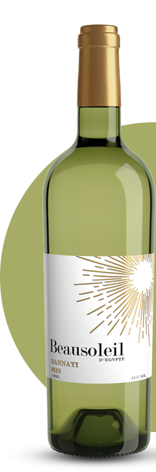
Regional Breakdown
Upper Egypt (Luxor and Aswan)
Location: Southern Egypt along the Nile.
Terroir: Rocky, sandy soils coupled with intense heat create challenging but rewarding growing conditions.
Climate: High temperatures during the day, with a significant drop at night, help preserve acidity in grapes.
Key grapes: Syrah and Grenache produce wines with concentrated fruit flavors and hints of spice.

Slide 12
Wine Regions in Egypt
Suez Canal and Sinai Peninsula
Though not a major wine region, small vineyards near the Suez Canal and the Sinai Peninsula have begun to emerge in recent years. The region’s rocky soil and intense sunlight provide a harsh but rewarding terroir.
Why visit: For adventurers, this region offers a unique experience combining winemaking and exploration of rugged landscapes.
Top varieties: Local hybrids.

Slide 13
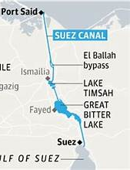
Wine Regions in Egypt
Suez Canal and Sinai Peninsula
The Suez Canal and the Sinai Peninsula are both significant landmarks in Egypt, known more for their strategic and historical importance than for winemaking. However, the emergence of small vineyards in this region adds an intriguing aspect to the area's profile, blending tradition with new agricultural ventures.
Suez Canal
The Suez Canal is a man-made waterway connecting the Mediterranean Sea to the Red Sea, providing a crucial maritime route between Europe and Asia. It is one of the world's most important and heavily used waterways, playing a key role in international trade.
The canal cuts through the Isthmus of Suez, and its surrounding areas have a predominantly desert climate with little rainfall, making agriculture challenging. However, with irrigation and innovative farming techniques, small-scale vineyards have started to take root.

Slide 14
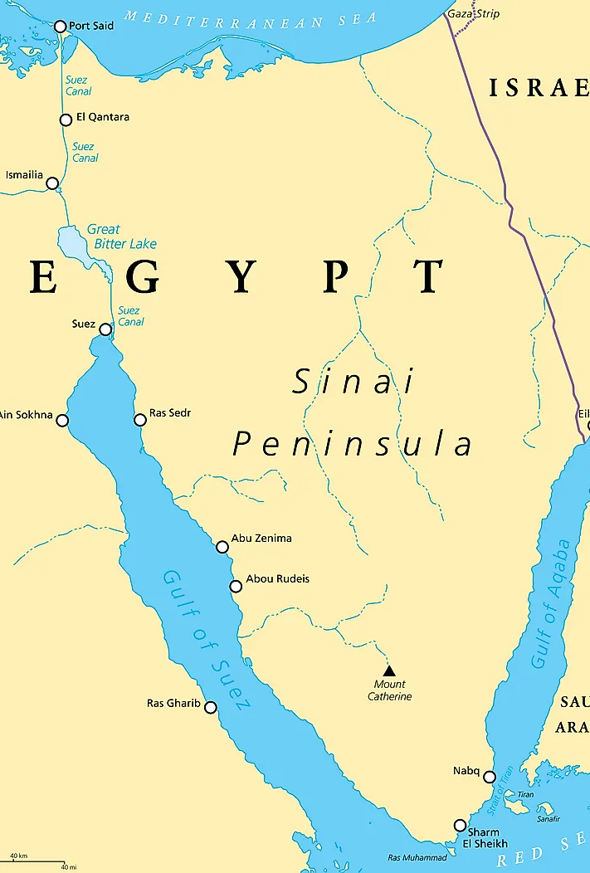
Wine Regions in Egypt
Sinai Peninsula
The Sinai Peninsula is a triangular landmass situated between the Mediterranean Sea to the north and the Red Sea to the south. It acts as a land bridge between Africa and Asia, and it holds significant historical, religious, and geopolitical importance.
The rugged, mountainous terrain of southern Sinai contrasts with the more fertile northern areas, though both regions are still largely arid. Sinai has traditionally been known for its mineral resources and tourism.
Emerging Vineyards
Despite the region's harsh conditions—rocky soil, extreme sunlight, and arid environment—these factors also create a unique terroir. The intense sunlight encourages grape ripening, while the rocky soil can stress the vines, leading to more concentrated flavors in the grapes.
Local winemakers are beginning to experiment with hybrid grape varieties that can withstand these difficult growing conditions.

Slide 15
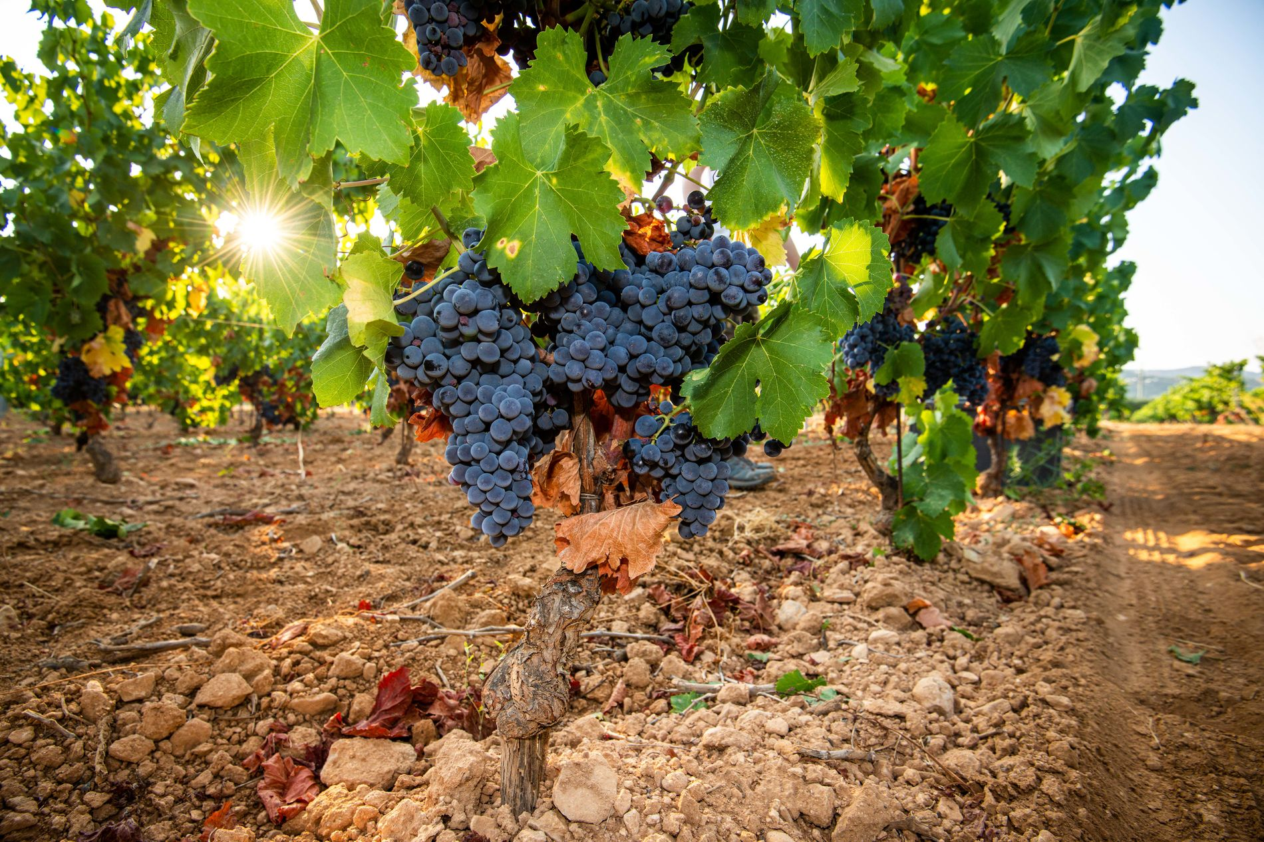
Egypt’s Unique Terroir
Egypt’s terroir is truly one-of-a-kind. Despite the country’s dry, desert-like environment, the convergence of the Nile River and nearby Mediterranean Sea creates pockets of fertile land with conditions suitable for viticulture.
Soil: Egyptian vineyards thrive on a combination of sandy and limestone soils, which offer excellent drainage and impart a mineral quality to the wines.
Climate: The country’s hot climate is tempered by cool evening breezes, especially near coastal areas like El Gouna and the Nile Delta. This diurnal temperature variation helps preserve acidity in the grapes, an essential component for balance in wine.
Watering methods: Due to minimal rainfall, Egyptian vineyards rely heavily on irrigation from the Nile. This careful management of water resources allows vintners to maintain control over the growth cycle of the vines.

Slide 16
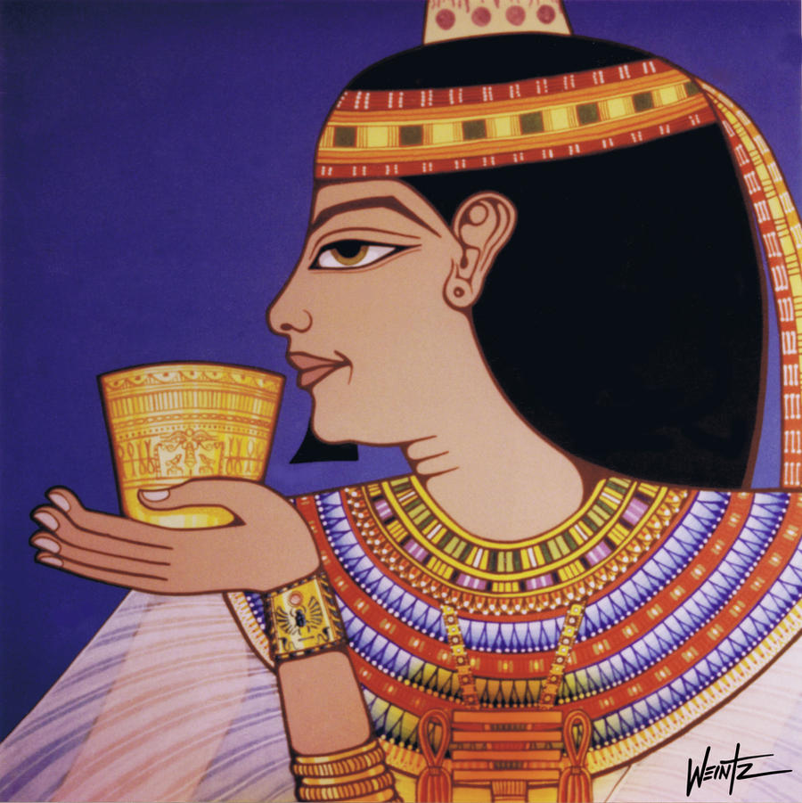
Varietals and Wine Characteristics
The grapes used in Egyptian wines are those found in the warmer, drier wine regions of Europe. For red wines, Cabernet Sauvignon, Syrah, Grenache, Bobal and Tempranillo are used, while the whites are made from Viognier, Chardonnay and Muscat.
Cabernet Sauvignon: A bold red variety that thrives in the hot climate of El Gouna. Tasting notes include dark fruits like blackberry and plum, along with hints of tobacco and spice. Pairs well with grilled lamb or beef.
Chardonnay: Known for its crisp acidity, Chardonnay from the Nile Delta offers notes of green apple, citrus, and subtle minerality. It pairs beautifully with seafood dishes.
Muscat: A fragrant white variety, Muscat is often made into both dry and sweet wines in Egypt. Expect floral aromas and flavors of peach and apricot, making it a delightful pairing for fruit-based desserts.

Slide 17
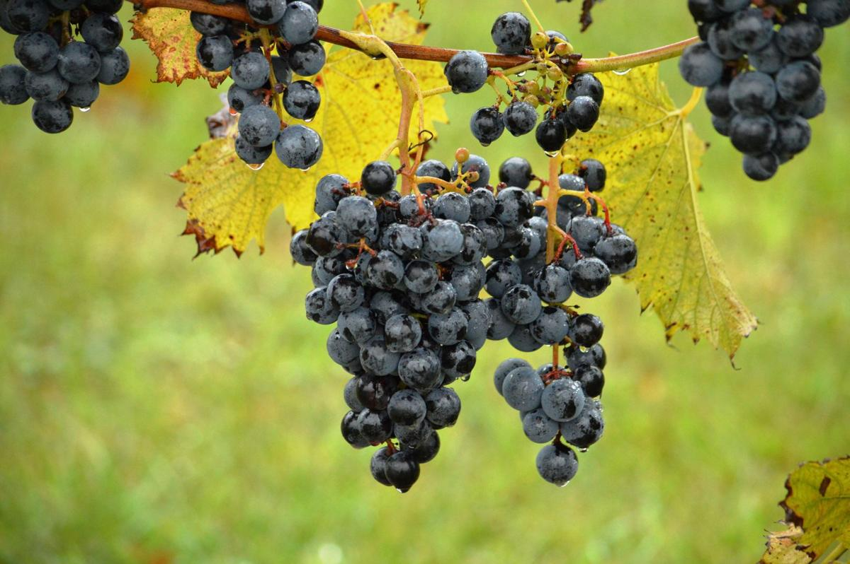
Egypt’s Hybrid Wine
Egypt’s hybrid wine varieties are a relatively new development in the country’s viticulture scene. Since Egypt is not traditionally known as a wine-producing nation—due to its hot, dry climate and desert soils—local winemakers have turned to hybrid grape varieties to overcome these challenges. Hybrids are crossbreeds of two or more grape species, designed to combine desirable traits like disease resistance, drought tolerance, and the ability to thrive in extreme weather conditions.
Why Hybrids?
Egypt’s intense sunlight, low humidity, and rocky, nutrient-poor soils make it difficult to grow traditional European grape varieties, such as Cabernet Sauvignon or Chardonnay. Therefore, hybrid grapes are better suited to these conditions because they are bred to:
Tolerate heat: Egypt’s summer temperatures can soar, but hybrid grapes are selected for their ability to withstand extreme heat without wilting or losing moisture.
Resist drought: Since irrigation is often necessary in Egypt’s vineyards, hybrid grapes tend to use water more efficiently, minimizing the amount of irrigation required.
Adapt to saline soils: Some hybrid varieties are more tolerant of saline or less fertile soils, which are common in the desert regions.

Slide 18
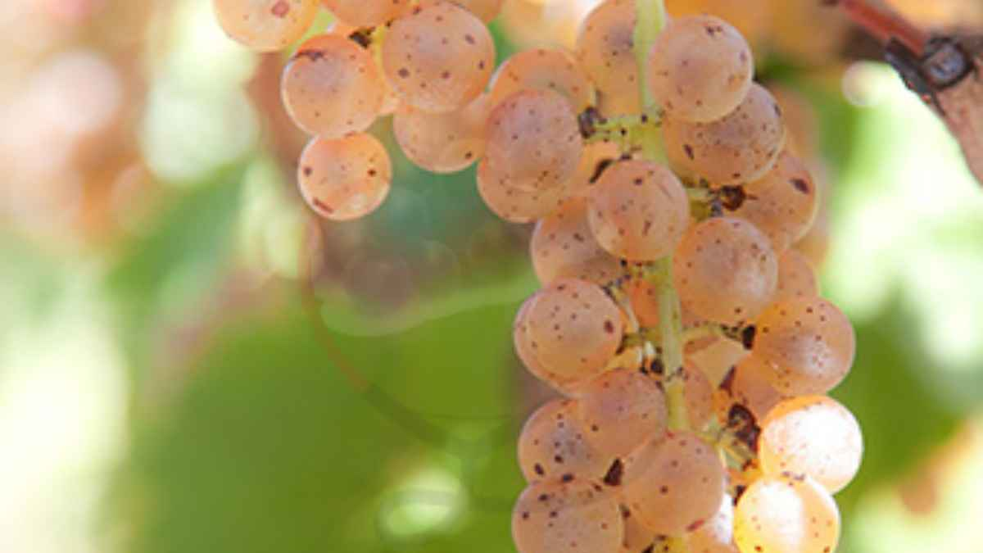
Egypt’s Hybrid Wine
Examples of Hybrid Varieties in Egypt
While specific hybrid varieties unique to Egypt may still be in experimental stages, some of the following global hybrids or locally adapted varieties might be found:
Vidal Blanc: A white hybrid variety known for its cold tolerance and disease resistance, Vidal Blanc could potentially be adapted for hot climates due to its hardy nature. It's often used for making both dry and sweet wines.
Chambourcin: A red hybrid grape known for its deep color and aromatic profile. It can grow well in a variety of climates, including hot and arid ones. It might be used in Egypt for making rich, robust red wines.

Slide 19
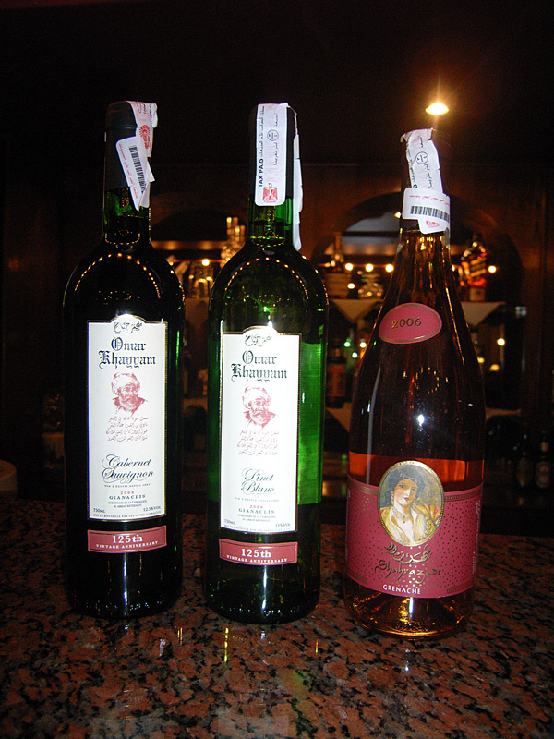
Egypt’s Hybrid Wine
Examples of Hybrid Varieties in Egypt
Noiret: This hybrid grape has a high tolerance for heat, making it ideal for warmer climates like Egypt’s. It produces wines with black pepper and cherry flavors.
Muscat of Alexandria: While not a hybrid, this ancient grape variety is widely used in Egypt. It thrives in hot climates and is known for its aromatic qualities. It could be considered a foundation for blending with hybrids to enhance wine flavors.

Slide 20
Egypt’s Hybrid Wine
Flavor Profiles
Egyptian hybrid wines tend to exhibit robust, concentrated flavors due to the stress that vines experience in the harsh climate. The rocky soils contribute to minerality in the wines, while the high sun exposure leads to ripe, fruity characteristics. Expect Egyptian hybrid wines to lean towards:
Full-bodied: Red hybrids tend to be bold, with intense flavors of dark fruit, spices, and sometimes a touch of smokiness.
Bright acidity: Despite the heat, well-made hybrids retain good acidity, especially in white wines, balancing out the fruitiness.
Minerality: The soil’s rocky nature can impart a subtle mineral character, giving the wines a distinct, almost earthy profile.
Future Potential
While Egypt’s wine industry is still developing, hybrids present a promising avenue for growth. By leveraging modern agricultural techniques and carefully chosen grape varieties, Egypt has the potential to carve out a niche in the global wine market with distinctive desert-grown wines.

Slide 21
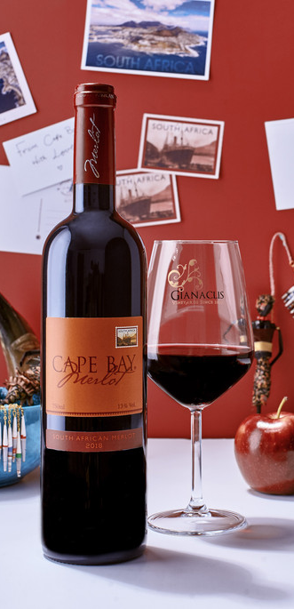
Notable Wineries Wines
Gianaclis Vineyards (El Gouna)
One of Egypt’s oldest and most prestigious wineries, Gianaclis produces a range of high-quality wines using both international and local grape varieties. Today, from a base in the Nile Delta south of Alexandria, Gianaclis farms 150 acres of vineyards.
The delta, benefiting from cooling breezes from the Mediterranean, offers a fertile environment for grapegrowing in the otherwise blistering heat of the Egyptian summer.
Their Obelisk Red is a standout, known for its deep complexity and smooth finish.

Slide 22
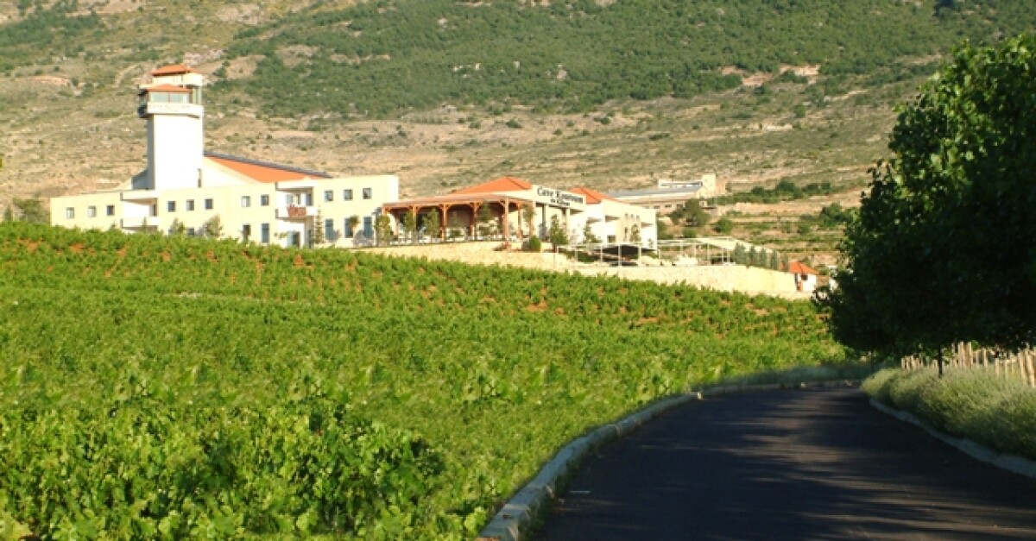
Notable Wineries and Signature Wines
Kouroum of the Nile (Nile Delta)
This winery is known for its innovative approach to winemaking, using organic methods to cultivate grapes.
Their Chardonnay Reserve offers a vibrant, fresh experience with balanced acidity.

Slide 23
Conclusion
Egypt’s wine industry is a rediscovered gem, blending ancient traditions with modern techniques to create a distinctive, evolving wine scene.
Whether you're a history buff, a wine enthusiast, or a curious traveler, Egypt’s wine regions offer a unique and memorable experience.
As this industry continues to grow, the future of Egyptian wine is as bright as the desert sun that nourishes its vineyards.

Slide 24
Acknowledgement
My seminars are the result of many years of experience combined with many hours of research over the internet.
I would like to acknowledge the many source I have accessed.
These include Wine Spectator, Wine Enthusiast, BKWine Magazine, Wine & Spirits Magazine, American Vineyard Magazine, The Grapevine Magazine, Wikipedia.com, Britannica.com, and the various Government websites.

Slide 25
Citations
Books and Articles on Ancient Egyptian Winemaking:
McGovern, P.E. Ancient Wine: The Search for the Origins of Viniculture. Princeton University Press, 2003.
Katzenstein, H.J. Wine and Viticulture in Ancient Egypt. BAR International Series, 2009.
• Academic Papers and Journals on Modern Egyptian Wine Industry:
Research articles from journals like The Journal of Wine Research or Viticulture and Enology Research.
Reports by Egyptian Ministry of Agriculture on modern viticulture techniques and wine production.
• Winery Websites:
Gianaclis Vineyards (https://www.gianaclisvineyards.com/)
Kouroum of the Nile (https://www.kouroumnile.com/)
• Tourism Websites and Blogs:
Egyptian tourism websites, which promote wine regions like El Gouna and Luxor as emerging wine tourism destinations.

