Slide 1
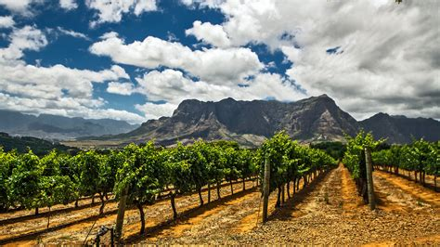
Emerging Wine Regions of East Africa Presented by Marc Silver

Slide 2
Emerging Wine Regions of East Africa
Emerging Wine Regions
Historical Beginnings
East Africa’s Terroir
Major Varietals
Cultural Significance
Sustainable Practices
Future Outlook
Final Thoughts
Achnolegment
References

Slide 3

Emerging Wine Regions
East Africa, known for its breathtaking landscapes and diverse cultures, is emerging as an unexpected but promising wine-producing region.
While traditionally overshadowed by established wine giants like South Africa, countries such as Kenya, Tanzania, and Ethiopia are developing unique wine identities.
This article explores the history, terroir, varietals, and future potential of these regions, offering a fresh perspective on East Africa’s growing wine scene.

Slide 4

Historical Beginnings
Historical Context
The history of winemaking in East Africa is relatively young compared to other parts of the continent.
Modern winemaking began in the mid-20th century, driven by European settlers and missionaries.
Italian occupiers planted the first vines in Ethiopia in the 1930s, and wine production began in 1936.

Slide 5
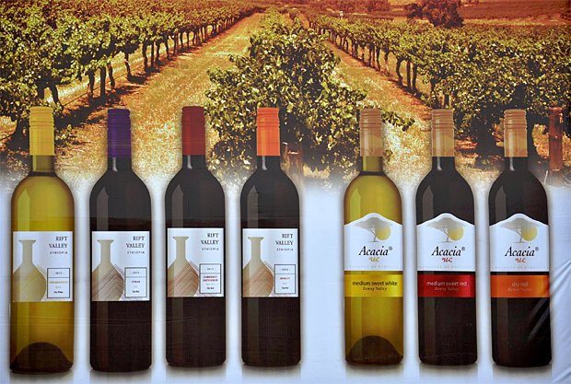
Historical Beginnings
Historical Context
Initially, the focus was on table grapes and small-scale production for local consumption. Over time, increased interest in viticulture and investment in modern techniques sparked the growth of the wine industry, particularly in Kenya and Ethiopia.
Ethiopia’s Rift Valley Winery, established in the 1990s, played a pivotal role in introducing international varietals to the region.

Slide 6
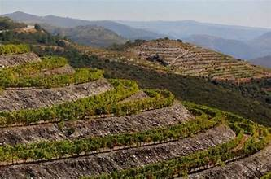
East Africa’s Terroir
Country-Specific Breakdown
Ethiopia’s Rift Valley boasts volcanic soils and high altitudes that provide optimal conditions for grape cultivation.
The region’s climate allows for slow ripening, which enhances flavor complexity and acidity in varietals such as Syrah and Chardonnay.
The Rift Valley Winery, a pioneer in Ethiopian winemaking, has been instrumental in shaping the country’s wine industry, introducing modern techniques and producing wines that are increasingly gaining international attention.

Slide 7
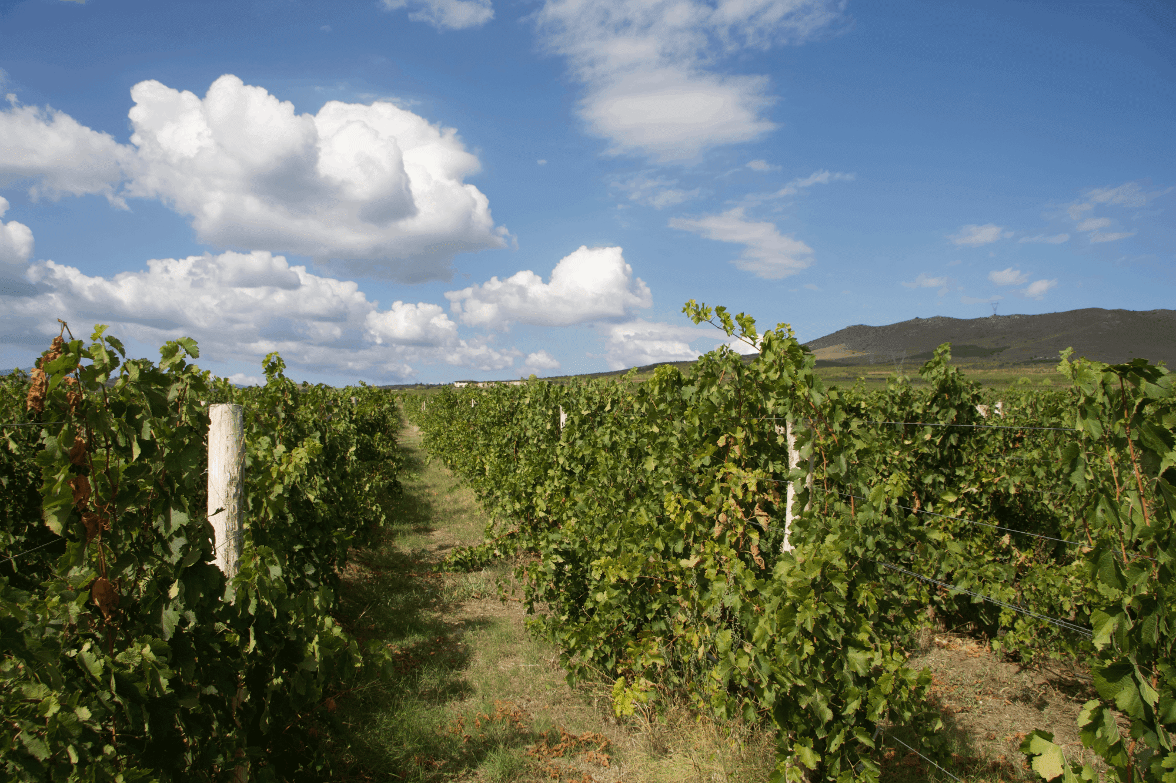
East Africa’s Terroir
Country-Specific Breakdown
Kenya’s wine production centers around the Great Rift Valley as well.
The temperate climate and fertile soils have encouraged the cultivation of varietals like Chenin Blanc and Cabernet Sauvignon.
Many wineries here are experimenting with irrigation methods to optimize grape quality.
The country’s burgeoning wine culture includes tasting tours and vineyard visits, making it an emerging destination for wine tourism.

Slide 8
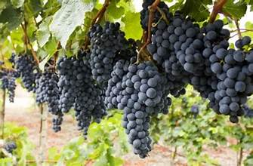
East Africa’s Terroir
Country-Specific Breakdown
Tanzania’s Dodoma region is defined by semi-arid conditions and sandy soils, which present challenges for viticulture but also contribute to the bold and distinctive profiles of its wines.
Shiraz and the indigenous Makutupora grape are the region’s stars, thriving under careful irrigation and innovative practices.
Tanzania’s wineries are focusing on sustainability and local engagement, bringing the country’s wine industry into the spotlight.East Africa’s terroir is as diverse as its landscapes.

Slide 9
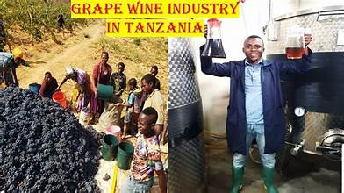
East Africa’s Terroir
Country-Specific Breakdown
The high altitudes and volcanic soils in regions like Ethiopia’s Rift Valley provide ideal conditions for grape cultivation.
Tanzania’s wine regions, such as Dodoma, are defined by sandy soils and semi-arid conditions, requiring innovative irrigation methods but resulting in distinctive wine profiles.
These environmental factors are helping to shape wines that reflect East Africa’s unique identity.

Slide 10

Major Varietals
East Africa’s wine industry primarily relies on international grape varieties, given the lack of native wine grapes in the region.
However, Tanzania’s Dodoma region boasts the Makutupora grape, a varietal considered unique to the area.
This grape has adapted well to the semi-arid conditions and is used to produce bold, distinctive red wines.
Its success demonstrates the potential for local varietals to emerge as defining features of East African winemaking.

Slide 11
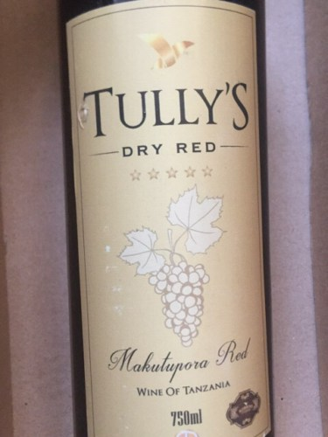
Major Varietals
East African winemakers are experimenting with a mix of international and local grape varieties.
In Ethiopia, Syrah and Chardonnay are among the most successful, producing wines with vibrant fruit flavors and balanced acidity.
Kenya has seen success with Chenin Blanc and Cabernet Sauvignon, often crafted into crisp, refreshing wines suited to the local climate.
Meanwhile, Tanzania’s Dodoma region is gaining attention for its bold red wines made from Shiraz and local varietals like Makutupora, which thrive in the region’s semi-arid conditions.

Slide 12
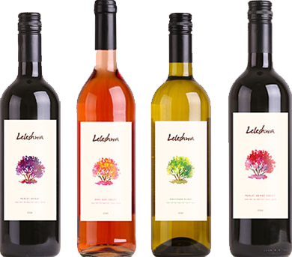
Leleshwa Winery
Leleshwa wines: 20 years ago, experts said they couldn’t grow grapes in Kenya. They decided to prove the experts wrong, so they planted a vineyard at Morendat.
It started out as a hobby, something fun and exotic, an excuse to spend the weekend in Naivasha. Two decades later, they produce over 80,000 bottles of wine every year.
Leleshwa wines capture the essence of the untamed Kenyan spirit. They produce four wines; a blend of Merlot and Shiraz, a Sauviengion Blanc, a Rosé and a Sweet Blend.

Slide 13
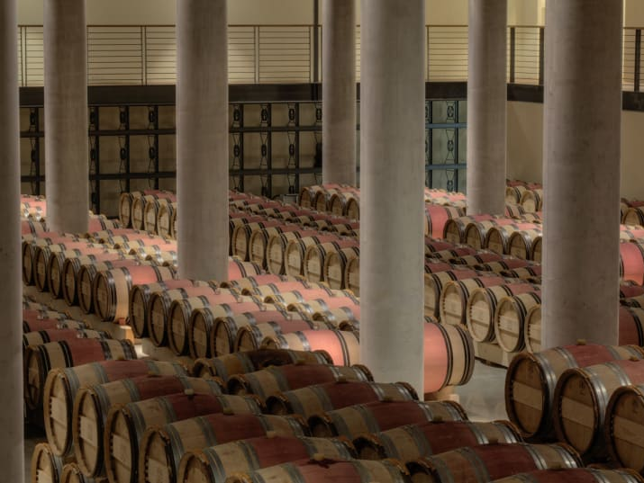
Castel Winery
Castel Winery, near Ziway in Ethiopia, is a standout in East Africa's wine industry.
Established by the French beverage giant Castel, the winery planted 750,000 Bordeaux vines over 125 hectares in 2007, producing reds like merlot, syrah, and cabernet sauvignon, and chardonnay for whites.
Ethiopia’s high plateau, diverse climate, and sandy soil offer an ideal setting for grape cultivation. Despite challenges like hailstorms and wildlife threats, Castel’s aromatic, fruity wines are gaining recognition.
Their efforts showcase Ethiopia’s potential beyond past hardships, making "Made in Ethiopia" a label to watch.Castel’s Ethiopian vineyards are also surrounded by a two-metre-wide trench to deter pythons, hippopotamuses and hyenas.

Slide 14

Cultural Significance
Wine is gradually becoming a part of East Africa’s social and cultural fabric.
In Ethiopia, wine has found a niche in urban centers, served alongside traditional dishes like doro wat.
Kenya’s burgeoning middle class is embracing wine culture, with tasting events and wine tours becoming popular activities.
In Tanzania, local wines are a source of pride, often featured in national celebrations and festivals.
The integration of wine into daily life and celebrations reflects its growing importance in the region’s culture.

Slide 15
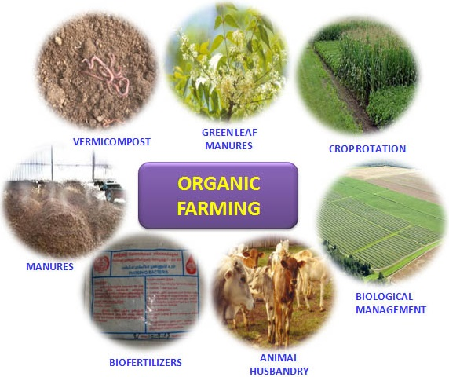
Sustainable Practices
Sustainability is a key focus for many East African wineries.
Ethiopia’s Rift Valley Winery has adopted organic farming practices to preserve soil health and biodiversity.
In Kenya, wineries are exploring solar-powered irrigation systems to combat water scarcity.
Tanzania’s producers are investing in community-driven initiatives, providing employment and training opportunities in rural areas.
These efforts not only enhance the environmental sustainability of wine production but also contribute to local economic development.

Slide 16

Future Outlook
With fewer established wineries and a relatively young history compared to major wine-producing regions, the industry’s story is still unfolding.
However, this also presents an exciting opportunity to explore its growth and potential.
The future of East Africa’s wine industry is bright.
Increased investment in infrastructure, technology, and education is helping local winemakers improve quality and expand production.
There is also growing interest from international wine markets, with exports to Europe and Asia beginning to take off. As global consumers seek unique and authentic wine experiences, East Africa’s distinct wines are poised to carve out a niche on the world stage.

Slide 17
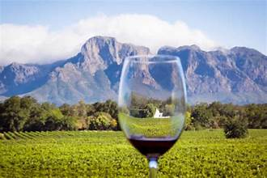
Final Thoughts
East Africa may be a newcomer to the world of winemaking, but its regions are already making a mark with unique terroirs, innovative practices, and a burgeoning wine culture.
By blending tradition with modernity, these emerging wine regions offer a glimpse into the future of winemaking on the continent.
Whether you’re a seasoned wine enthusiast or a curious explorer, East Africa’s wines are worth discovering.

Slide 18
Acknowledgement
My seminars are the result of many years of experience combined with many hours of research over the internet.
I would like to acknowledge the many source I have accessed.
These include Wine Spectator, Wine Enthusiast, BKWine Magazine, Wine & Spirits Magazine, American Vineyard Magazine, The Grapevine Magazine, Wikipedia.com, Britannica.com, and the various Government websites.

Slide 19
Citations and References
Rift Valley Winery. "Exploring Ethiopia's Terroir." Accessed 2024.
Kenya Wines Agency. "Viticulture in the Great Rift Valley." Accessed 2024.
Tanzania Wine Producers Association. "Sustainability in Dodoma's Wine Industry." Accessed 2024.

