Slide 1

Seward Alaska
Presented by
Fellow Cruiser
Marc Silver

Slide 2
What I Will Cover
My Port Philosophy
Don’t Miss the Ship
About Seward
Getting Around Seward
Points of Interest
Places to see or at least consider
Conclusion

Slide 3
My Port Philosophy
I have been cruising for over 45 years and have taken over 100 cruises.
So, I consider myself an experienced cruiser.
The information I will present is based on those many years of
experience.
When I am on a cruise where the city, I want to visit is not the port city,
I always recommend taking a ship’s tour.
But when I am in a port with multiple attractions nearby and easy to see
on my own -
I will do it on my own.
This presentation is for that type of port.

Slide 4
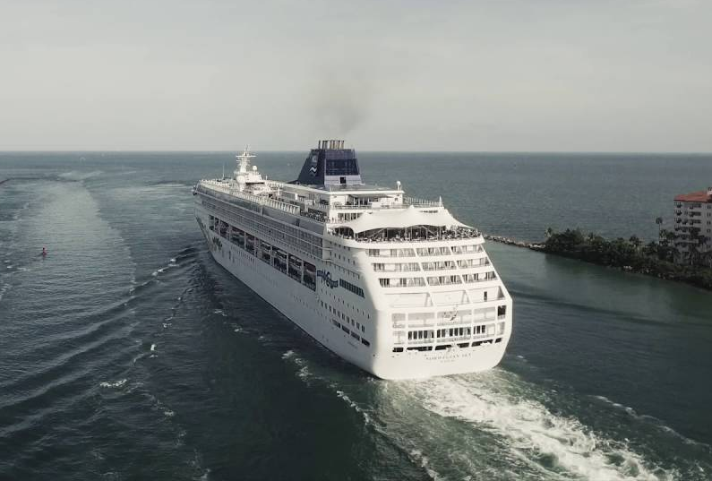
Don’t Miss the Ship
How to Avoid Missing Your Ship
Pay attention to the time. - Ship time and local time are often
different.
Put a return-to-ship reminder on your phone.
Choose excursions wisely.
If a ship-sponsored excursion is late returning to port for, the ship will
wait for you. If you are on your own???
Be Prepared
Have your Passport, Credit Card and phone numbers for your ship port agent.
What to Do If You Miss the Ship
Most cruise lines have port agents stationed in the port area to assist if your ship has left without you. If you’re lucky, when cruisers are late returning to the vessel, the ship's crew will often remove the passengers' essential items -- passports, cell phones, and medication -- from the ship to leave with the port agents.
The Port Officials can help you with contacting your ship
and making necessary travel arrangements.

Slide 5
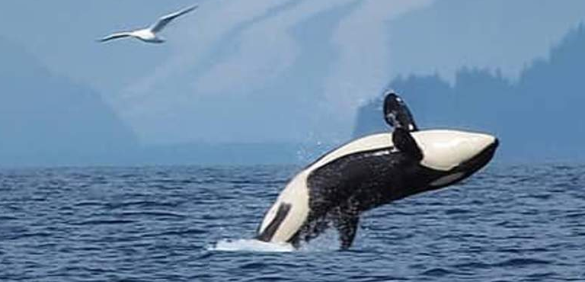
About Seward

Slide 6
History of Seward

Slide 7
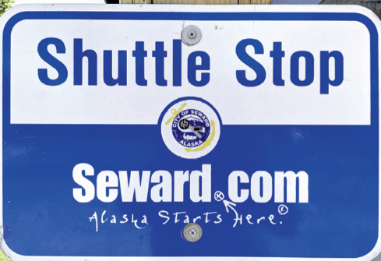
Getting Around Seward
Seward is compact and easy to navigate. The majority of activities and attractions are found within one mile of the boat harbor, so walking and biking—especially along the waterfront path—are feasible.

Slide 8
Free Shuttle Stops

Slide 9
Points of Interest

Slide 10
Alaska
General Admission from $35.20

Slide 11
Seward Boat Harbor
Fun place to check out. Great boats, beautiful views. Its fun to watch the boats come in with there catch of the days. Walk along the pier that is lined with a few places to eat and place to shop or take a tour. Great place to see and explore when you are in town.

Slide 12
Alaska Wildlife
Adult: $20 per person Youth (age 5-17): $16 per person Child (age 4 and under): FREE

Slide 13
Botanical Garden
Winter Admission Rates: September 13th - May 11th
Adult - $7 - Child - $5

Slide 14
Bear Creek

Slide 15
Park

Slide 16
Waterfall

Slide 17
Trail

Slide 18
Conclusion
Seward is a beautiful City with a rich history and numerous attractions. Whether you're looking for stunning views, historic sites, or unique attractions, Ketchikan has something for everyone.
I hope this presentation will help when we visit Seward.

Slide 19
Thanks For Coming
If you have any more questions, please ask.
I will do my best to answer them for you.
Have a great visit in Seward!

Slide 20
Acknowledgement
My seminars are the result of many years of travel experience combined with many hours of research over the internet.
I would like to acknowledge the many source I have accessed.
These include: Wikipedia.com, Britannica.com, Trip Advisor and the
various Museum, Park and Government websites.

