Slide 1

Dunedin
New Zealand
Presented by
Marc Silver
As they say in New Zealand, “Kia ora”
which is a Māori greeting for Welcome.

Slide 2
What I Will Cover
My Port Philosophy
Don’t Miss the Ship
Money
About Dunedin
Area Map of Dunedin
Map of Dunedin
Dunedin Transportation
Places to see or at least consider
A few restaurant recommendations
Conclusion

Slide 3
My Port Philosophy
I have been cruising for over 45 years and have taken over 200 cruises.
So, I consider myself an experienced cruiser.
The information I will present is based on those many years of
experience.
When I am on a cruise here the city, I want to visit is not the port city,
I always recommend taking a ship’s tour.
But when I am in a port with multiple attractions nearby and easy to see
on my own - I will do it on my own.
This presentation is for that type of port.

Slide 4

Don’t Miss the Ship
How to Avoid Missing Your Ship
Pay attention to the time. - Ship time and local time are often
different.
Put a return-to-ship reminder on your phone.
Choose excursions wisely.
If a ship-sponsored excursion is late returning to port, the ship will
wait for you. If you are on your own???
Be Prepared
Have your Passport, Credit Card, and phone numbers for your ship
port agent.
What to Do If You Miss the Ship
Most cruise lines have port agents stationed in the port area to assist if your ship has left without you. If your are lucky, when cruisers are late returning to the vessel, the ship’s crew will often remove the passengers’ essential items – passports, cell phones, and medication -- from the ship to leave with the port agents.
The Port Officials can help you with contacting your ship
and making necessary travel arrangements.

Slide 5

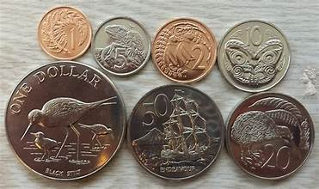
Money
The currency for Auckland is the New Zealand Dollar (NZD).
The conversion at the rate is $ 1.63 (NZD) to $1.00 U.S.
Or $1 (NZD) to $. 61 U.S.

Slide 6
About Cruise Ship Port
Port Chalmers is the gateway to the city of Dunedin. It is a small, historically rich town, and the gateway to the Dunedin, offering a huge range of activities for you to enjoy.
While your cruise ship is in port you have three main options on how to spend your day.
1. Stay in Port Chalmers, 2. Visit Dunedin or 3. Go further afield and visit the famous countryside of New Zealand.
Port Chalmers used to be an important trading town. Known in the early 19th century for its sealers and whalers and later a post in the Otago gold rush.
The prosperity it brought to early New Zealand is still shown in its fine architecture that you will find in the town center. You can easily explore it by foot and it is only a short walk from the cruise dock to the center of town.
Port Chalmers has shuttle busses and a visitors welcome center.
The port lies right in front of the center of Port Chalmers and there is also a local visitors center where you can find all kinds of information on taxi’s, local tours and bus service.

Slide 7
About Port Chalmers
Shuttle Service
Dunedin and Port Chalmers are about 9 miles apart from each other. Your shuttle bus will take scenic highway 88 and it will need approximately 20 minutes to get you into the center of Dunedin.
The drop off location is usually at the Dunedin Public Library, which is about 1 block from the Octagon.
Local tours
Tours are available at the visitors center at the dock and they also offer tours at the Dunedin tourist information. To reach the Dunedin tourist information you simply hop on the shuttle bus to Dunedin and walk to the tourist information center which is about a block away.
Public Transportation
There is public transportation in Port Chalmers, but it is limited. Bus 14 goes every 30 minutes from Harrington St. in Port Chalmers to Clyde Street in Dunedin. This bus will leave about 1km’s walk from the city center.

Slide 8

Dunedin History
Dunedin's known history dates back as far as 1100 AD with the arrival of Māori to the area and archaeological evidence points to a lengthy occupation by Māori prior to the arrival of Europeans
History
Archaeological evidence points to a lengthy occupation by Māori prior to the arrival of Europeans. The province and region of Otago takes its name from the Ngai Tahu village of Ōtākou at the mouth of the harbor.
Dunedin's wildlife drew European settlers to the area; It is not known exactly when sealers entered the harbor, however Māori oral tradition puts it sometime before 1810. By the late 1830s Otago Harbor had
become an international whaling port.

Slide 9
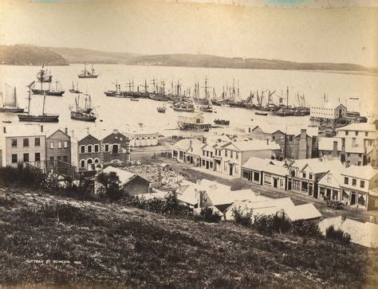
Dunedin History Cont.
Perched on the rim of an ancient volcano - the last eruptive phase ended over ten million years ago - Dunedin is the oldest city in New Zealand and still retains many of its historical buildings. Its name comes from Dùn Èideann, the Scottish Gaelic name for Edinburgh, the capital of Scotland. In Māori it is referred to as Ōtepoti.
The city itself was established in 1848 by the Lay Association of the Free Church of Scotland.
The gold rush in the Otago province during the 1860s caused Dunedin’s population, and wealth, to increase dramatically; it was for several years New Zealand’s largest and most prosperous city.

Slide 10
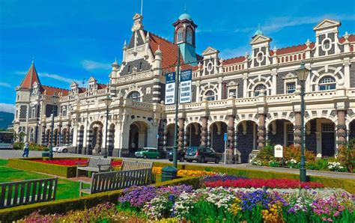
Dunedin History Cont.
During the 20th century the city's growth slowed significantly, leaving behind a rich tapestry of Edwardian and Victorian architectural heritage.
The Dunedin Railway Station, built in the Edwardian Baroque style, is Dunedin's most famous monument to its Golden Days, and New Zealand's most photographed building.
The University of Otago, New Zealand’s oldest, was founded in Dunedin in 1869, and since then students have made a major contribution to the city’s unique character.

Slide 11
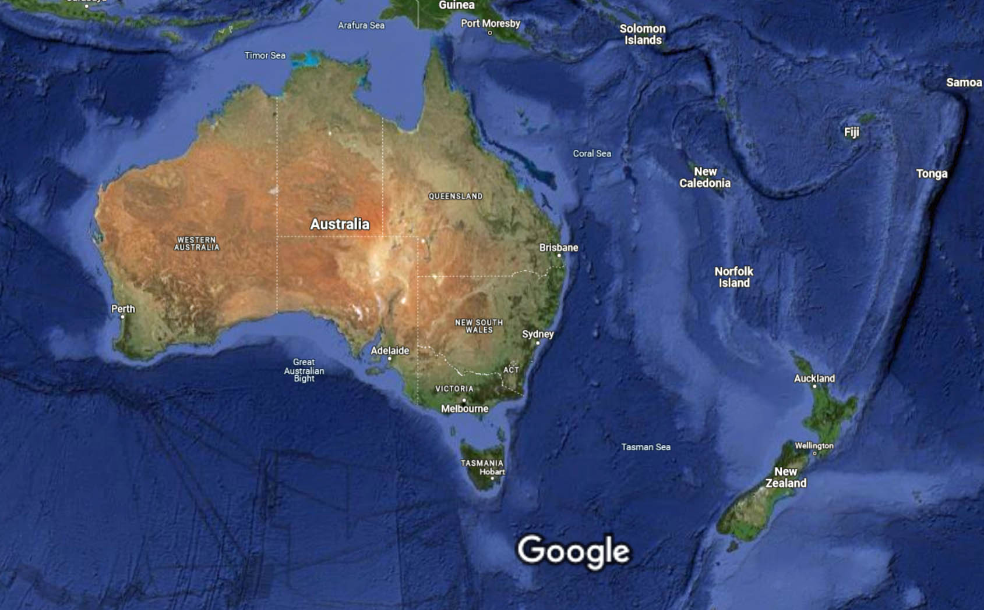

Slide 12
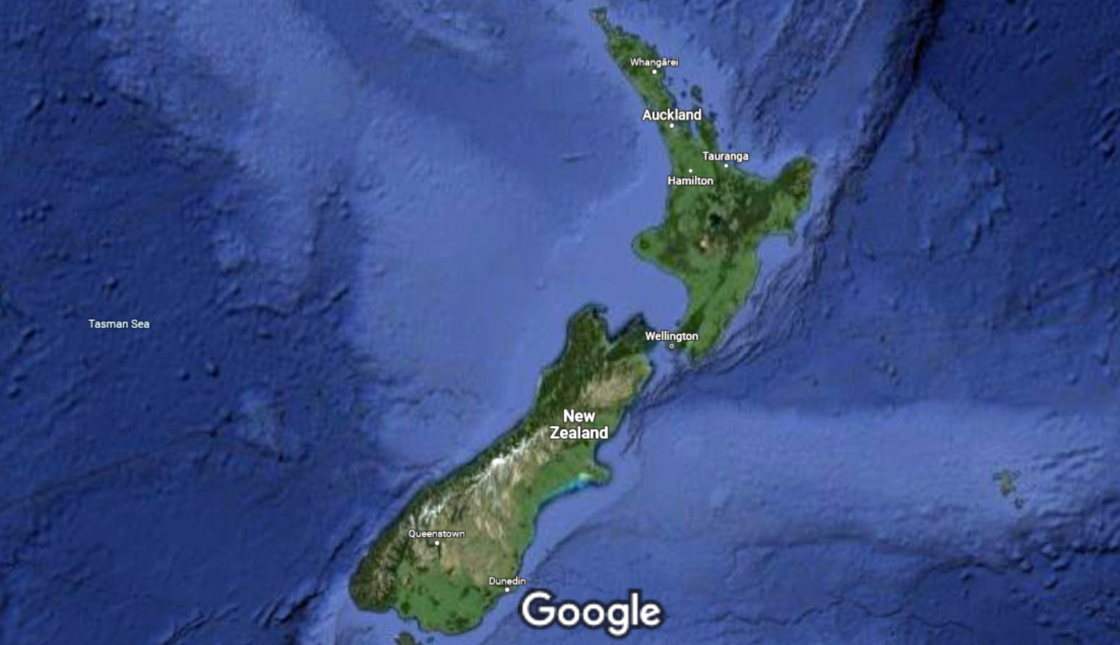
New Zealand
Dunedin

Slide 13
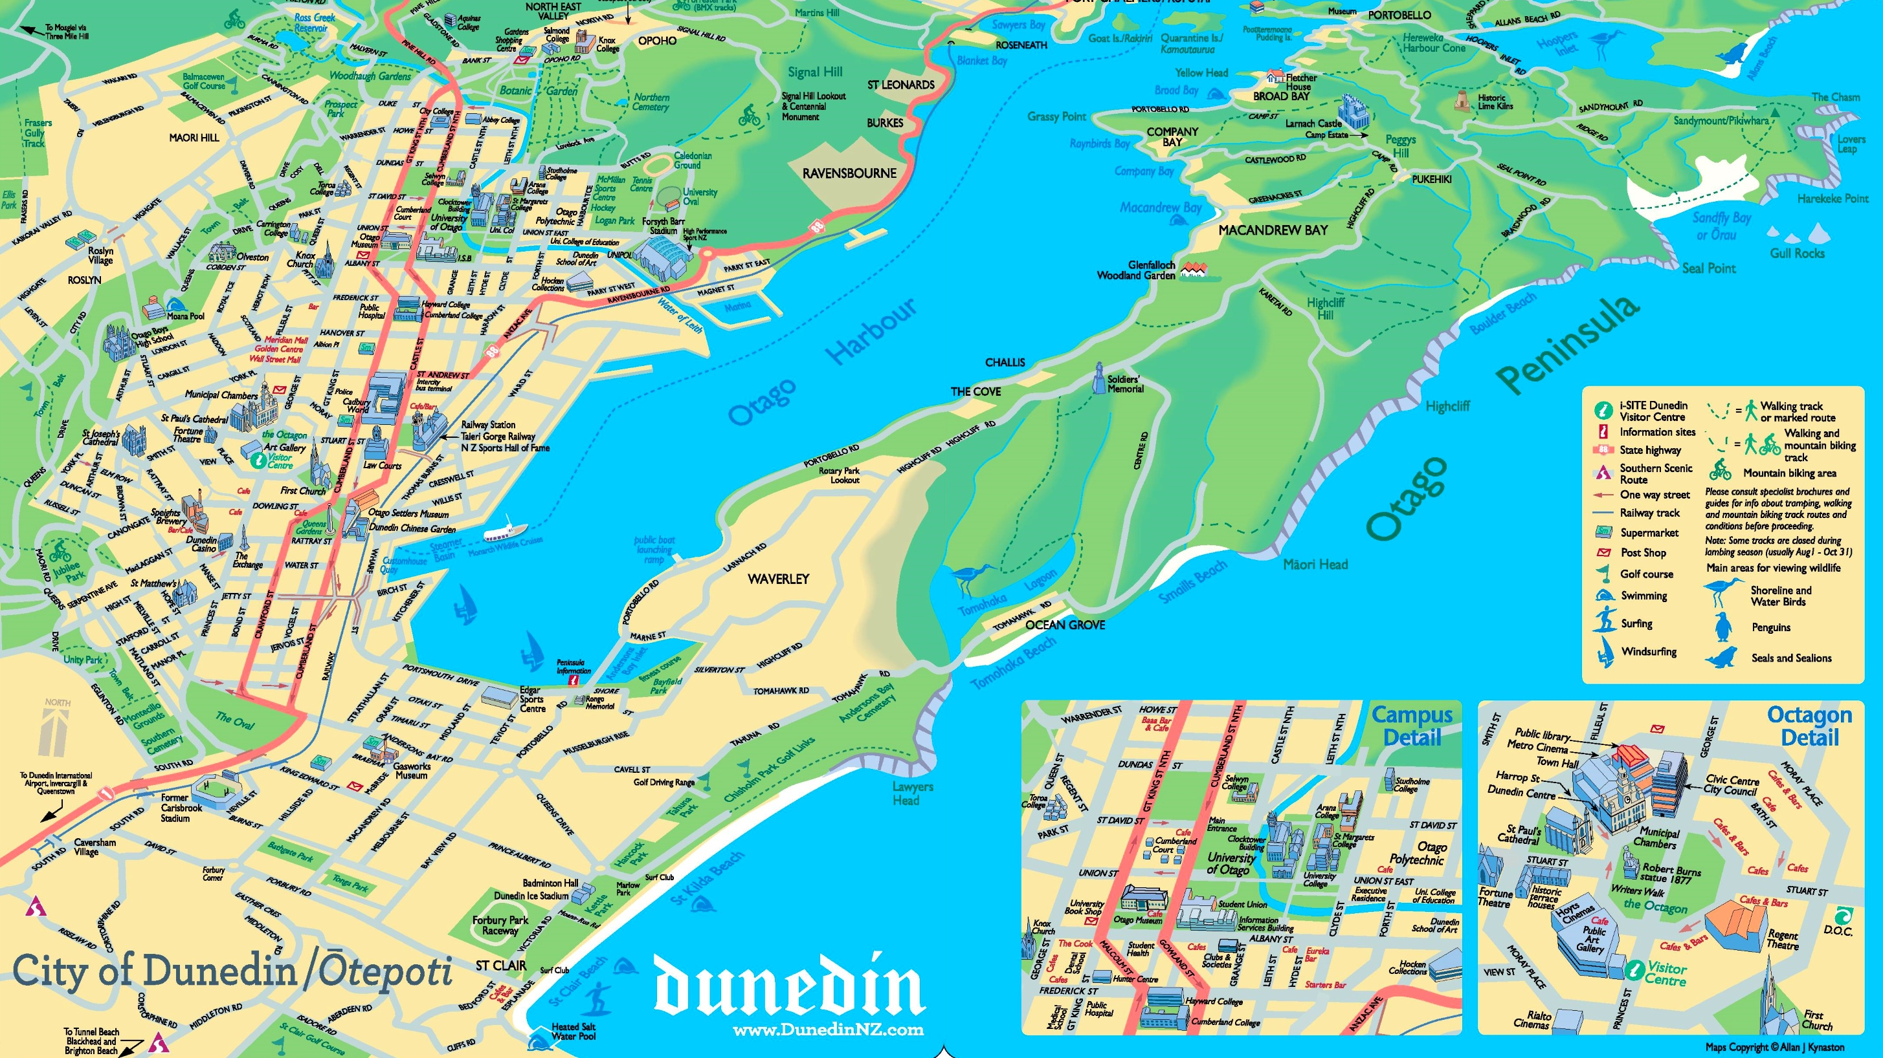
Map of Dunedin

Slide 14
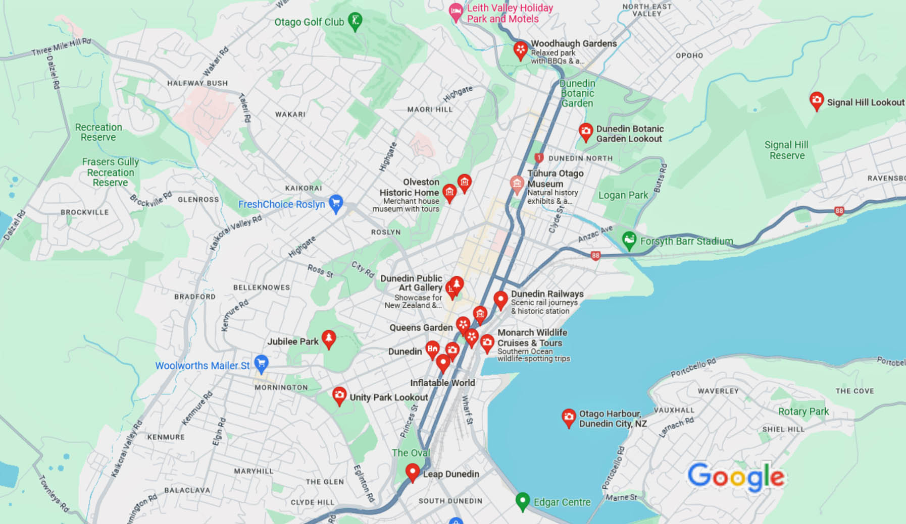
Map of Dunedin

Slide 15
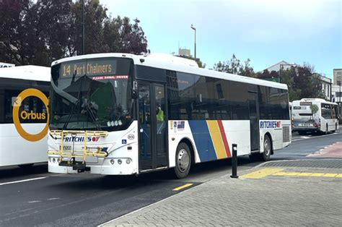
Dunedin Buses
Dunedin has one of the most comprehensive and user-friendly public transport Pay with cash in exact change.
Ways to travel to Dunedin from Port Chalmers.
Best: Line 14 bus 18min $2
Fastest: Taxi 14min $30–40
Shuttle Bus to Dunedin is $35 return

Slide 16

Dunedin Taxis
Standard taxis provide a safe and reliable way to explore the city or for transport between the cruise port and various attractions.
Like taxis in most locations the cost is significantly more expensive than other modes of transport.
Dunedin also has Uber and Ola rideshare service available.

Slide 17
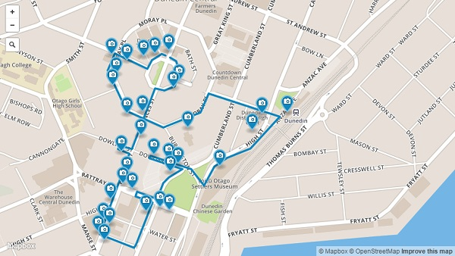
Dunedin Walking Tour
Dunedin was once New Zealand’s largest and wealthiest city, an important hub of commerce and trade. During these prosperous times, a great metropolitan center of grand Victorian and Edwardian buildings was constructed, taking inspiration from the style, street names and layout of Edinburgh, Scotland.
Most of these buildings remain today,
and it is said that Dunedin has the
finest collection of Victorian and
Edwardian buildings in the southern
hemisphere.

Slide 18
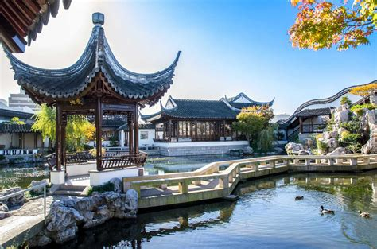
Dunedin Chinese Gardens
“Most cherished in this mundane world is a place without traffic, truly in the midst of a city there can be mountain and forest.” Wen Zhengming (1470 - 1559)
A perfect miniature of a traditional Chinese landscape painting, this Garden encapsulates the essence of nature.
Recognized as a six-star Garden of International Significance, its purpose is to guide you on a journey towards a deeper appreciation of history, culture, heritage, and tradition.
Its origins come from a desire to celebrate the city's Chinese heritage and its valuable sister city relationship with Shanghai.
Adult $11
Child (under 13 years with Adult) free

Slide 19
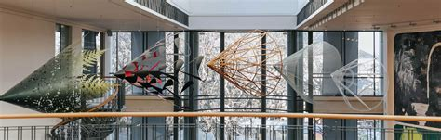
Dunedin Public Art Gallery
Dunedin Public Art Gallery is one of New Zealand's four major metropolitan art galleries. Established in 1884, the Gallery was New Zealand’s first Art Gallery and is renowned today for the richness of its historic collection and its close working relationship with major New Zealand artists.
The gallery is located right in the heart of Dunedin.
\The Gallery houses a significant collection of New Zealand artworks covering the period from 1860 to the present. The collection also contains major holdings of historical European art, Japanese
prints and the
decorative arts.
10am - 5pm Daily
(closed Christmas day)
Admission is free

Slide 20
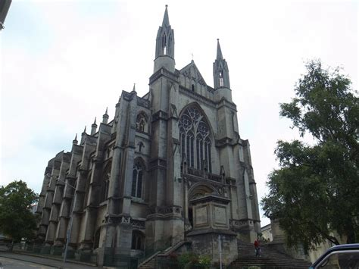
St. Paul’s Cathedral
St Paul’s Cathedral is part of the Anglican Church in New Zealand and Polynesia
The Church provides for three partners to order their affairs within their own cultural context: Tikanga Maori; Tikanga Pakeha; Tikanga Pasefika.
St Paul’s Cathedral is the mother church of the Anglican Diocese of Dunedin.
While the first parish church of St Paul was built on the site from 1862 to 1863, work on the modern incarnation of the church began in 1913.
Bishop Samuel Tarratt Nevill consecrated the cathedral on Feb. 12, 1919.
Construction on a new chancel, which features a more modernist design, started in December 1969 and finished in July 1971.

Slide 21
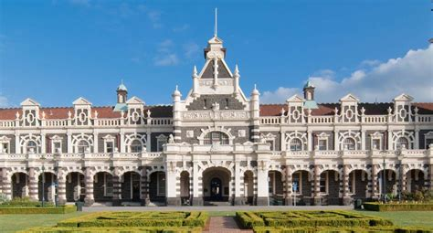
NZ Sports Hall of Fame
The New Zealand Sports Hall of Fame was established in 1990 as part of the celebrations to mark New Zealand's 150 years of organized settlement.
In the first year, 75 of New Zealand's greatest sports achievers were inducted - one for every two years of nationhood.
If you're walking from the Octagon in the center of Dunedin, head down towards the harbor via Stuart Street. If you follow this Stuart Street all the way you'll find Dunedin Railway Station at the end of it, on Anzac Square.
Once inside the railway station, the New Zealand Sports Hall of Fame is located on the upper floor.
Admission: Adult:$6
Senior: / Student $4
Child: $2

Slide 22
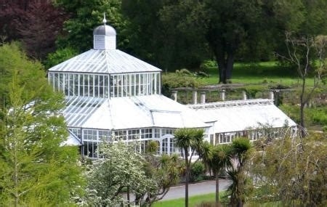
Dunedin Botanical Gardens
Located about 3 KM north of the Octagon is the Botanical Gardens.
Spend some time strolling around these stunning gardens from the lower formal garden up to the rhododendron dell.
There are several trails you can follow; the themes are volcanic, silent spaces, treasured plants, trees, play and off the beaten track.
Visit the winter garden, information center (ask for some food to feed the pigeons) and the aviary at the top of the gardens.

Slide 23
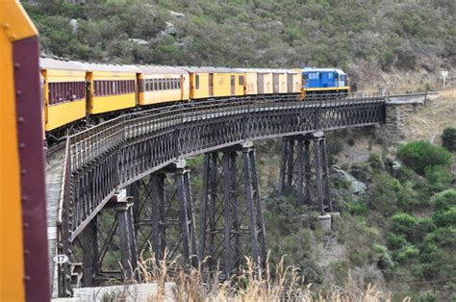
Taieri Gorge Train
Travel the fabled route of pioneers & prospectors through spectacular Taieri River Gorge.
This historic railway, from the 1870s, boasts wrought iron viaducts, tunnels and modern and vintage carriages.
The tour takes about 3.5 hours round trip to the Gorge.
If you're a train enthusiast, nature lover or adventure seeker - this train trip is a must-do!
Tickets: Adult:$69
Child 5-15: $10
Child <4 Free

Slide 24
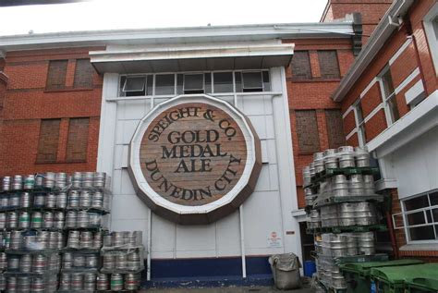
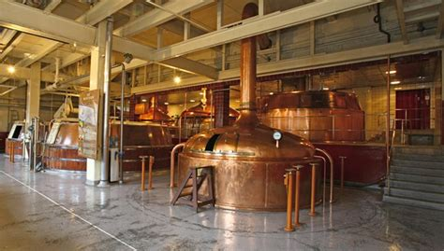
Spreights Brewery
Located on Rattray Street at the foot of City Rise, the same site it has occupied since 1876, Speight's Brewery brews the "Pride of the South," a favorite New Zealand beer.
No tour would be complete without sampling the fine product. In their brand new tasting room you’ll be able to taste the range. Fees apply

Slide 25
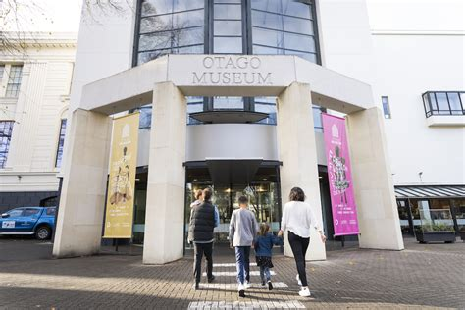
Otago Museum
The Otago Museum was founded in 1868 and has undergone many changes over the years. From the Octagon, the Museum is just over ½ a mile north.
It is the largest cultural and heritage institution in Otago and has a collection of over two million natural science
specimens and human history artifacts.
The Museum is Dunedin's most visited
attraction.
Entry to the Museum and the galleries is free.
On occasion, the Museum may charge a fee for a program, event or exhibition.
Donations are welcome.

Slide 26
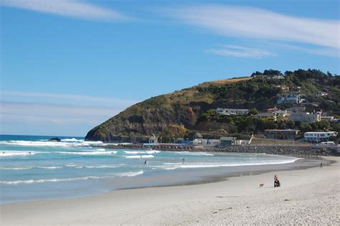
St Clair Beach
A sweeping white-sand beach just minutes from the central city.
St Clair is a popular spot for swimming, surfing, walking and dining out.
Regularly hosting national and South Island surfing championships.
The beach at St Clair is backed by sea wall, behind which is an esplanade consisting of pedestrian walkway and a one-way street.

Slide 27
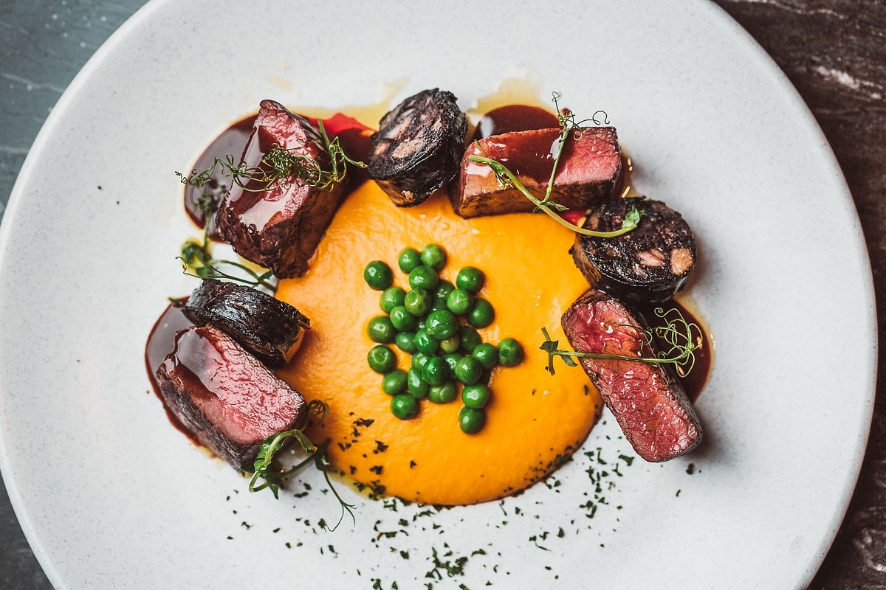
Restaurants in Dunedin
There are a lot of excellent restaurants in Hokkaido. Especially for seafood.
Here are some recommendations:
Restaurants in Dunedin:
Titi $$ - $$$, Swiss, International, European
Etrusco at the Savoy $$ - $$$, Italian, Pizza, European
Carey's Bay Historic Hotel $$ - $$$, Bar, Seafood, Pub
The Perc Café $$ - $$$, Quick Bites, Cafe, New Zealand
Ironic Cafe and Bar $$ - $$$, Cafe, European, Contemporary
No.7 Balmac $$ - $$$, Contemporary, New Zealand, Vegetarian
Prohibition Smokehouse $$ - $$$, Steakhouse, Grill, Vegetarian
1908 Restaurant $$ - $$$, International, European, New Zealand
The Press Club $$$$, European, Healthy, New Zealand
Glenfalloch Gardens Cafe and Restaurant $$ - $$$, International, European, Contemporary

Slide 28
Conclusion
Dunedin is a beautiful City with a rich history and numerous attractions. Regardless of what you're looking for, Dunedin has something for everyone.
I hope this presentation will help when we visit Dunedin!

Slide 29
Thanks For Coming
If you have any more questions, please ask.
I will do my best to answer them for you.
Have a great visit to Dunedin!

Slide 30
Acknowledgement
My seminars are the result of many years of travel experience combined with many hours of research over the internet.
I would like to acknowledge the many source I have accessed.
These include: Wikipedia.com, Britannica.com, and the
various Museum, Park and Government websites.

