Slide 1
Dun Laoghaire (Dublin), Ireland
Port Guide
Presented by
Marc Silver

Slide 2
What I Will Cover
My Port Philosophy
Don’t Miss the Ship
Money
Exchanging Money
A Brief History of Civitavecchia
Maps
Transportation
Top Attractions & Points of Interest
Local Cuisine & Dining Options
Important Tips & Practical Advice
Conclusion

Slide 3
My Port Philosophy
I have been cruising for over 45 years and have taken over 100 cruises.
So, I consider myself an experienced cruiser.
The information I will present is based on those many years of
experience.
When I am on a cruise where the city, I want to visit is not the port city,
I always recommend taking a ship’s tour.
But when I am in a port with multiple attractions nearby and easy to see
on my own -
I will do it on my own.
This presentation is not like that.

Slide 4

Don’t Miss the Ship
How to Avoid Missing Your Ship
Pay attention to the time. - Ship time and local time are often
different.
Put a return-to-ship reminder on your phone.
Choose excursions wisely.
If a ship-sponsored excursion is late returning to port, the ship will
wait for you. If you are on your own???
Be Prepared
Have your Passport, Credit Card, and phone numbers for your ship
port agent.
What to Do If You Miss the Ship
Most cruise lines have port agents stationed in the port area to assist if your ship has left without you. If your are lucky, when cruisers are late returning to the vessel, the ship’s crew will often remove the passengers’ essential items – passports, cell phones, and medication -- from the ship to leave with the port agents.
The Port Officials can help you with contacting your ship
and making necessary travel arrangements.

Slide 5

Money
Ireland uses the Euro (€) as its official currency.
Prices in Dublin are generally higher than in many European cities, especially for food and drinks. Expect costs similar to other major Western European capitals.
Credit and debit cards are accepted
almost everywhere, including
public transportation, cafés, and
small shops.
When exchanging money, it’s best
to avoid doing so at the port
exchange kiosks, as they tend to
have higher fees and less favorable
rates.

Slide 6
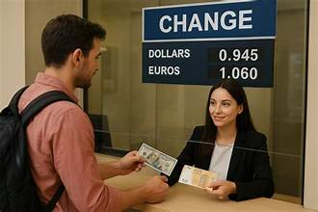
Exchanging Money
You usually do not need to exchange money in advance.
ATMs are easy to find and typically offer better exchange rates than currency exchange kiosks.
Avoid exchanging
money at the port unless absolutely necessary.
Having a small amount of cash is useful, but most visitors rely almost entirely on cards.

Slide 7
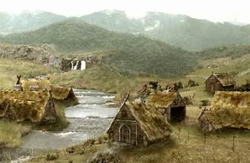
A Brief History of Dublin
Dublin began as a Viking settlement over a thousand years ago and grew into Ireland’s political, cultural, and literary heart.
Centuries of British rule shaped the city, followed by a turbulent struggle for independence in the early 20th century. Today, Dublin is a confident, modern capital that still wears its history openly.
You’ll see medieval streets, Georgian architecture, and reminders of rebellion and resilience woven into everyday life. Dublin’s past is never far away, and that is part of its appeal.

Slide 8
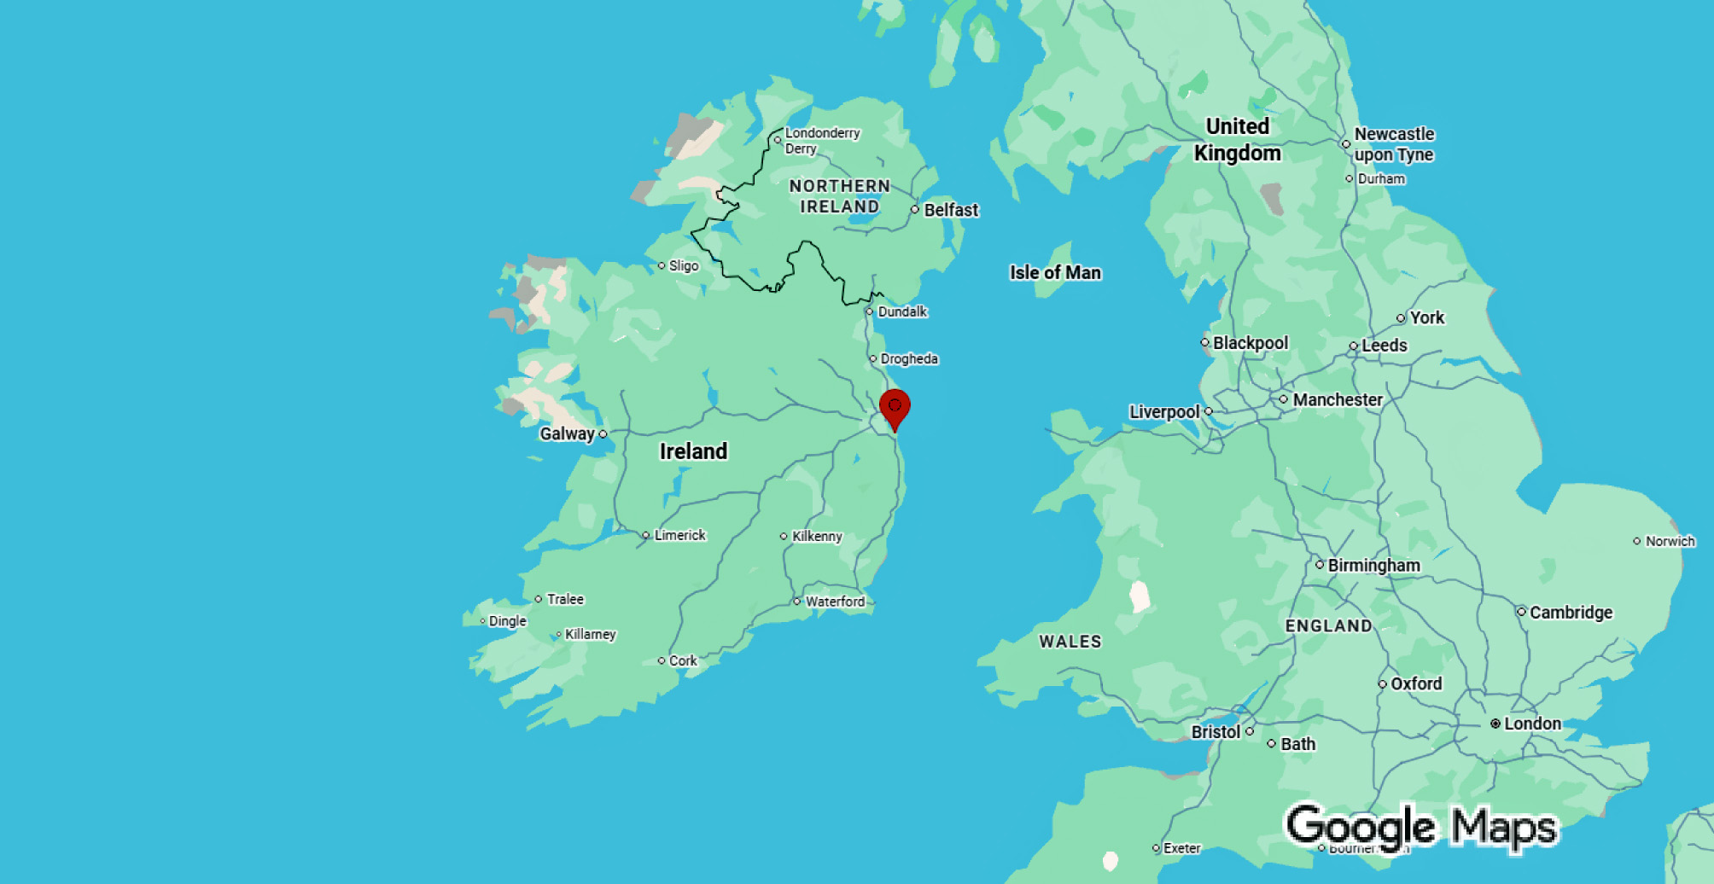
Ireland

Slide 9
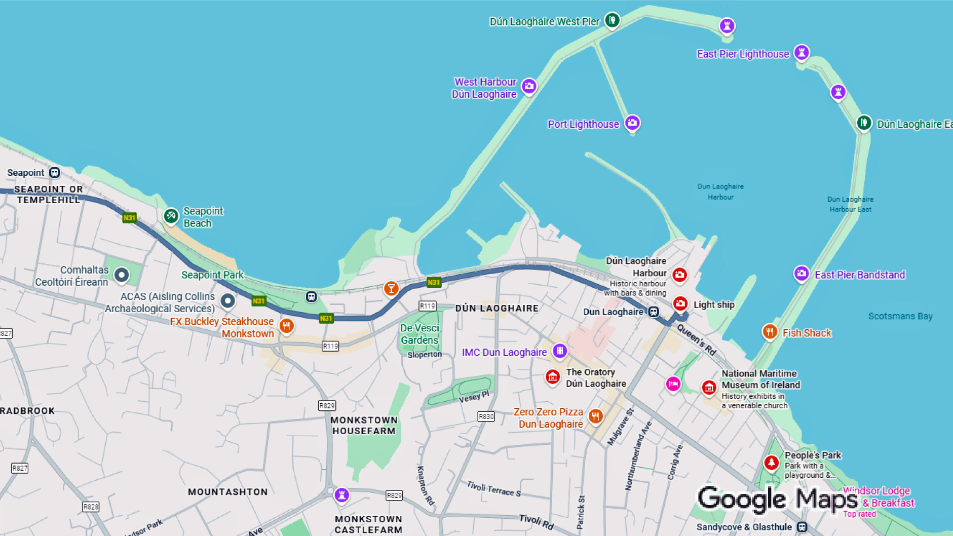
Dun Laoghaire

Slide 10
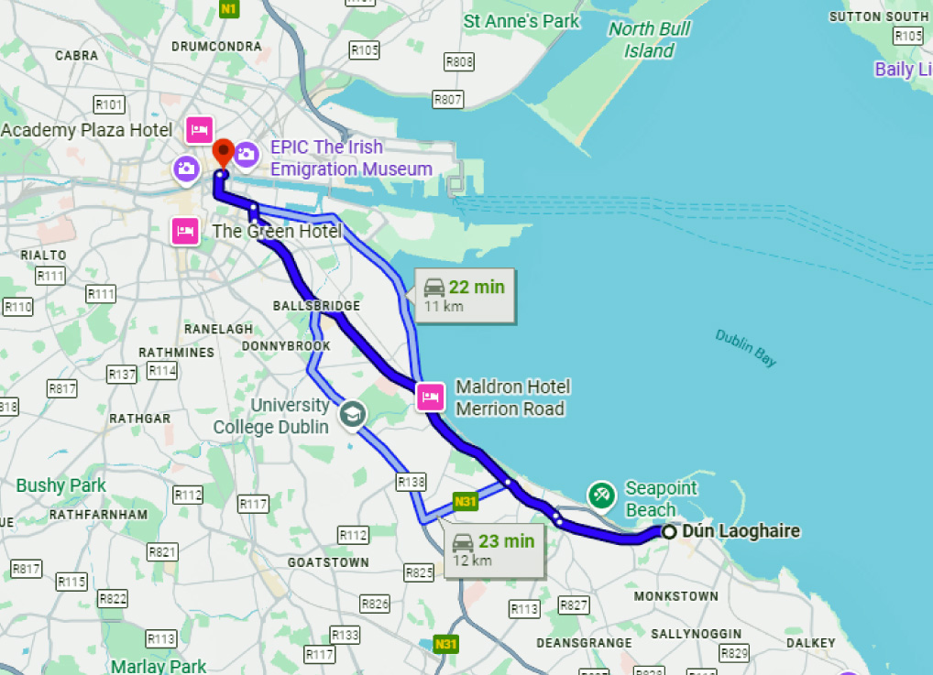
Transportation
Getting from Dún Laoghaire to Dublin
The most popular option is the DART commuter train, which runs directly from Dún Laoghaire to central Dublin in about 25 minutes. Trains are frequent, reliable, and easy to use.
Taxis are also available but are more expensive and can be slower during traffic.
For most visitors, the train is the best option.

Slide 11
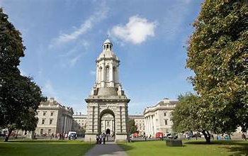
Top Attractions & Points of Interest
Trinity College Dublin
Home to the Book of Kells and one of Europe’s most beautiful libraries. Even a short visit is worthwhile.

Slide 12
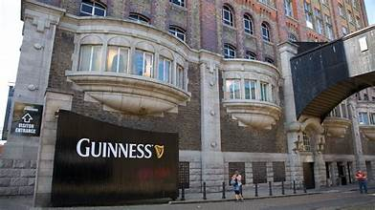
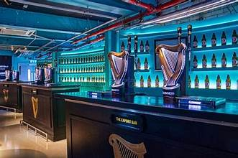
Top Attractions & Points of Interest
Guinness Storehouse
One of Dublin’s most popular attractions. The rooftop Gravity Bar offers panoramic city views.

Slide 13
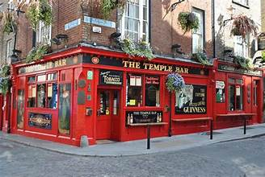
Top Attractions & Points of Interest
Temple Bar
A lively area known for pubs, music, and nightlife. Worth seeing, though prices here are higher.

Slide 14
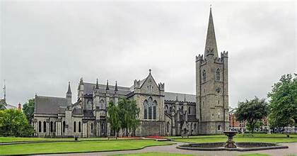
Top Attractions & Points of Interest
St. Patrick’s Cathedral
Ireland’s largest cathedral and a key part of the city’s
religious and political history.

Slide 15
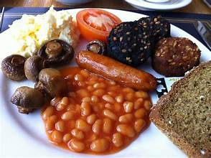
Local Cuisine & Dining Options
Irish food is hearty and comforting.
Look for dishes like Irish stew, seafood
chowder, and soda bread. Seafood is
particularly good, especially along the
coast.
For a more authentic experience, eat
slightly away from the most tourist-
heavy areas. Temple Bar is fun to see,
but better food values are found nearby.
Tipping is not required, but rounding up or leaving about 10 percent for good service is appreciated.

Slide 16
Important Tips & Practical Advice
Dublin weather can change quickly. A light jacket is always a good idea.
Wear comfortable walking shoes. The city is best explored on foot.
Dublin is generally safe, though pickpocketing can occur in crowded areas. Stay aware, especially around major attractions.
Most visitors can comfortably see two or three major sights without rushing.

Slide 17
Final Thoughts
Dún Laoghaire gives you easy access to one of Europe’s most engaging capitals.
Dublin combines history, literature, music, and modern energy in a way few cities manage. Whether you focus on landmarks or simply enjoy wandering, this is a port that delivers.
Thanks for coming today. If you have questions, I’ll be happy to help. Enjoy your visit to Dublin, and enjoy your day ashore.

Slide 18
Thanks For Coming
If you have any more questions, please ask.
I will do my best to answer them for you.
Have a great visit in Ireland!

