Slide 1
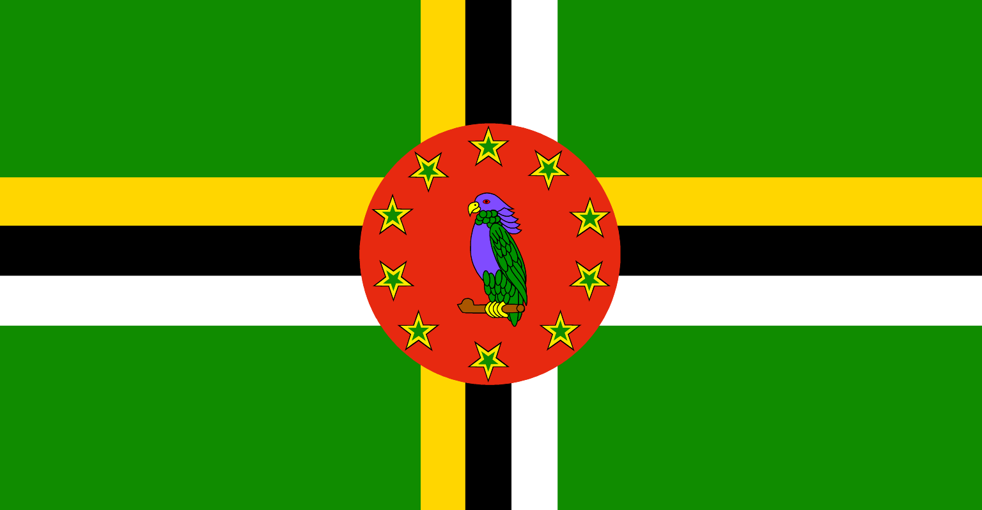
Dominica
Presented by fellow cruiser
Marc Silver

Slide 2
What I Will Cover
My Port Philosophy
Don’t Miss the Ship
Money
About Dominica
History of Dominica
Area Map of Dominica
Map of Dominica
Dominica Transportation
Places to see or at least consider
A few restaurant recommendations
Conclusion

Slide 3
My Port Philosophy
I have been cruising for over 45 years and have taken over 100 cruises.
So, I consider myself an experienced cruiser.
The information I will present is based on those many years of experience.
When I am on a cruise where the city, I want to visit is not the port city,
I always recommend taking a ship’s tour.
But when I am in a port with multiple attractions nearby and easy to see on my own - I will do it on my own.
This presentation is for that type of port.

Slide 4

Don’t Miss the Ship
How to Avoid Missing Your Ship
Pay attention to the time. - Ship time and local time are often
different.
Put a return-to-ship reminder on your phone.
Choose excursions wisely.
If a ship-sponsored excursion is late returning to port, the ship will
wait for you. If you are on your own???
Be Prepared
Have your Passport, Credit Card, and phone numbers for your ship
port agent.
What to Do If You Miss the Ship
Most cruise lines have port agents stationed in the port area to assist if your ship has left without you. If your are lucky, when cruisers are late returning to the vessel, the ship’s crew will often remove the passengers’ essential items – passports, cell phones, and medication -- from the ship to leave with the port agents.
The Port Officials can help you with contacting your ship
and making necessary travel arrangements.

Slide 5
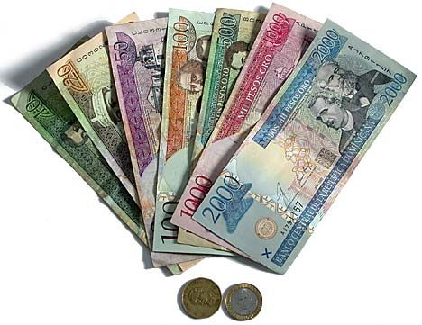
Dominican Money
The Dominican Pesos is the official currency of Dominica
Official Exchange is 100 DP is $1.76 US
Or 56.80 DP to the US Dollar

Slide 6
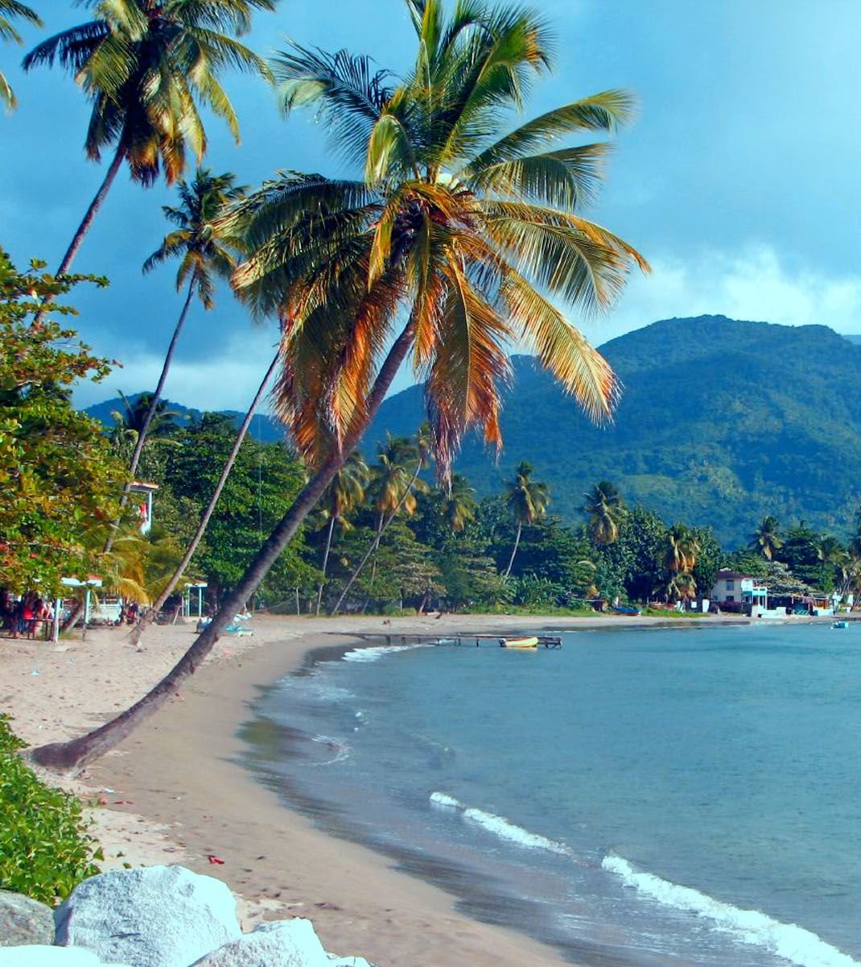
About Dominica
Dominica officially the Commonwealth of Dominica, is an island country in the Caribbean. The capital, Roseau, is located on the western side of the island. It is geographically situated as part of the Windward Islands chain in the Lesser Antilles archipelago in the Caribbean Sea. Dominica's closest neighbors are two constituent territories of the European Union, the overseas departments of France, Guadeloupe to the northwest, and Martinique to the south-southeast. Dominica comprises a land area of 290 sq mi, and the highest point is Morne Diablotins, at 1,447 m (4,747 ft) in elevation. Its population was 71,293 at the 2011 census.

Slide 7
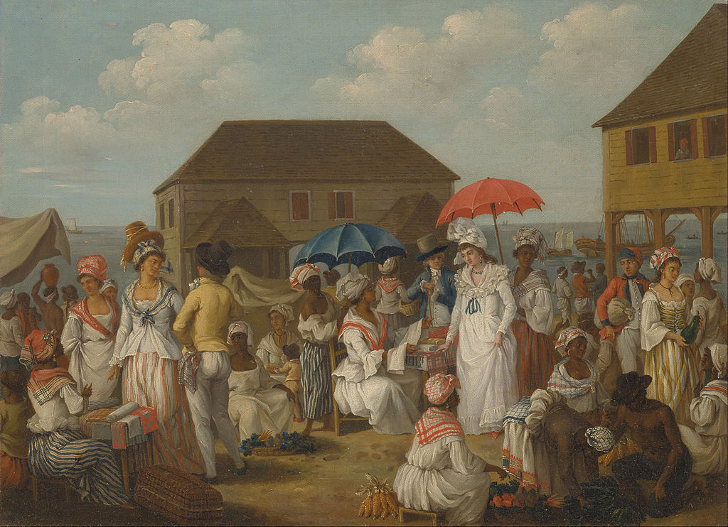
Dominica’s History
Spain had little success in colonizing Dominica. In 1632, the French Compagnie des Îles de l'Amérique claimed it and other "Petites Antilles" for France, but no physical occupation took place. Between 1642 and 1650, French missionary Raymond Breton became the first regular European visitor to the island.
In 1660, the French and English agreed that Dominica and St. Vincent should not be settled, but instead left to the Carib people as neutral territory, but natural resources attracted expeditions of English and French foresters, who began harvesting timber.
In 1690, the French established their first permanent settlements. French woodcutters from Martinique and Guadeloupe began to set up timber camps to supply the French islands with wood, and they gradually became permanent settlers. They brought the first enslaved Africans from West Africa to Dominique, as they called it in French.

Slide 8
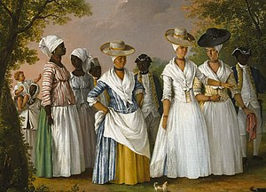
Dominica’s History
Great Britain established a small colony in 1805. It used Dominica as part of the Trans-Atlantic Slave Trade, by which slaves were imported and sold as labor in the islands as part of a trade that included producing and shipping sugar and coffee as commodity crops to Europe.
With the Slavery Abolition Act of 1833, Britain ended the institution of slavery throughout its empire, except in India. With freedom came enfranchisement. In 1835, the first three men of African descent were elected to the legislative assembly.
Many slaves from the neighboring French colonial islands of Guadeloupe and Martinique fled to Dominica.
Until 1958, Dominica was governed as part of the British Windward Islands. Caribbean islands sought independence from 1958 to 1962, and Dominica became a province of the short-lived West Indies Federation in 1958. After the federation dissolved in 1962, Dominica became an associated state of the United Kingdom in. On 3 November 1978, the Commonwealth of Dominica was granted independence as a republic, led by Prime Minister Patrick John.

Slide 9
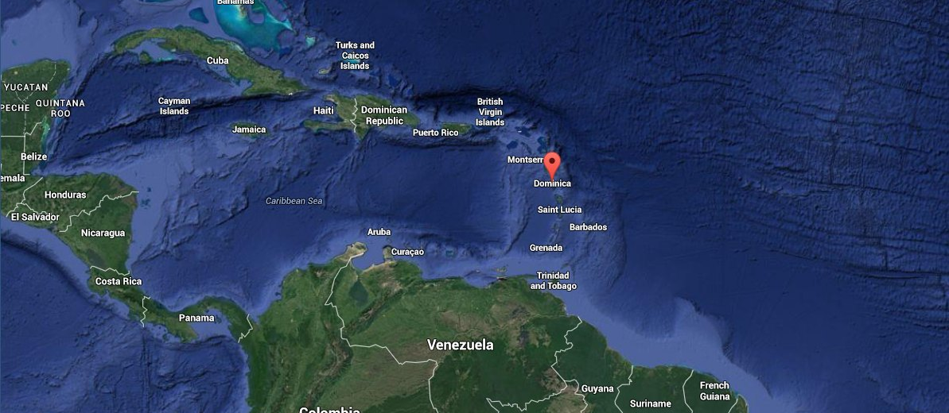
Area Map of Dominica

Slide 10
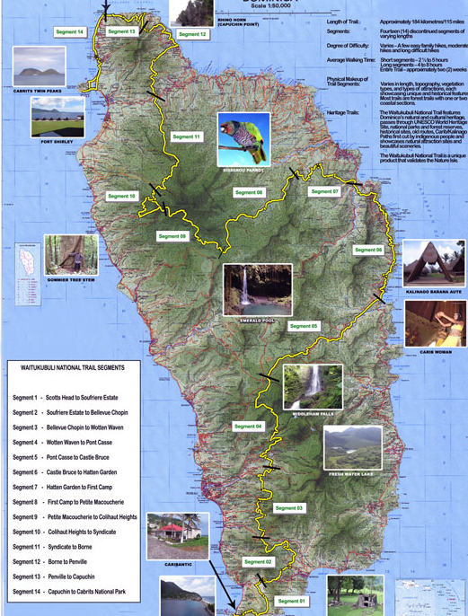
Map of Dominica

Slide 11
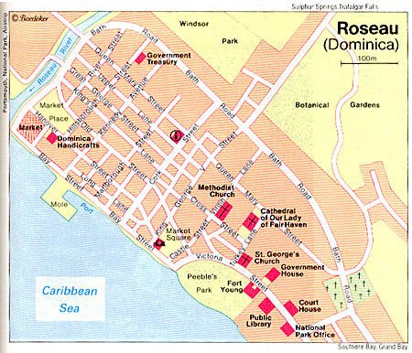
Map of Roseau
Dominica

Slide 12
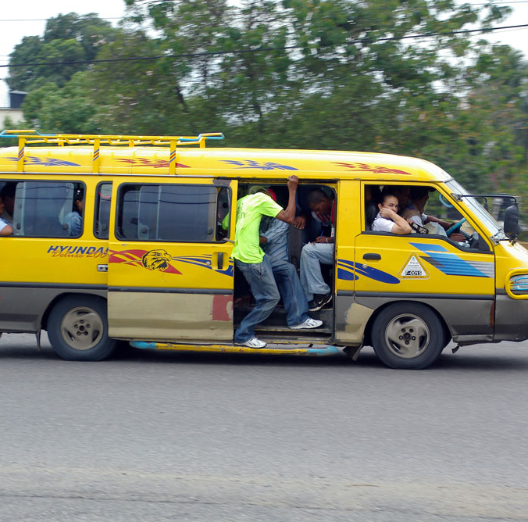
Dominica Bus Service
Dominica has a reliable public transportation system consisting of primarily private minibus operators. Bus stops can be found at designated points throughout the city depending on your destination.
The bus fares are standardized and range from EC$1.50 to EC$10.25 according to the specific route. Bus rotation is frequent throughout the day, but this method of transportation is not suitable for night travel.

Slide 13
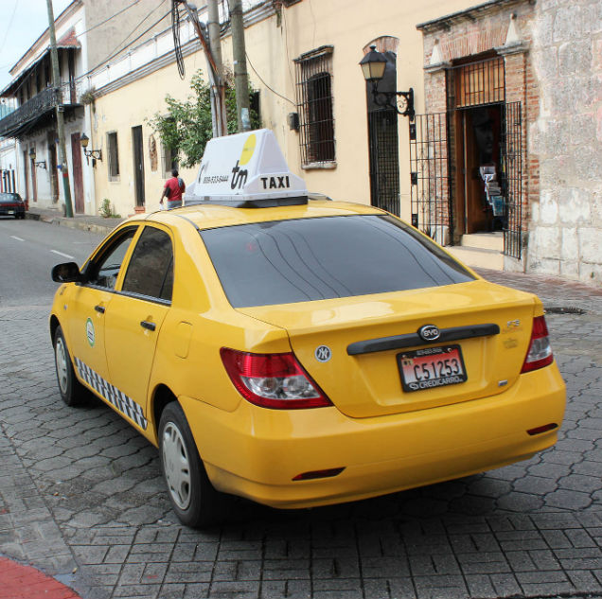
Dominica Taxis
Taxis are available at the airports and in Roseau and can be arranged all over the island.
They are easily identified by the letters, H, HA, or HB preceding the registration numbers on the number plates.

Slide 14
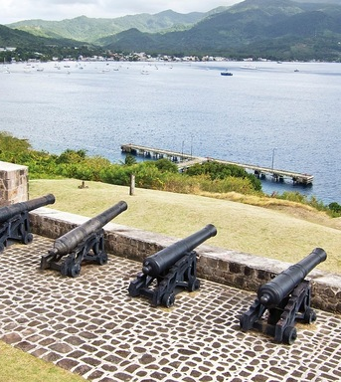
Cabrits National Park
In northwest Dominica, Cabrits National Park preserves lush rainforest, swampland, black-sand beaches, and thriving coral reefs. This scenic peninsula reveals panoramic views from its highest point, and the reefs offer some excellent snorkeling and diving opportunities.
The park is also home to one of the most interesting historical sites in Dominica. Here, you can visit the remains of Fort Shirley, an 18th-century British garrison with beautiful views of Prince Rupert Bay. A little museum at the entry sheds light on Dominica's colonial history.
Admission: US$5.00

Slide 15
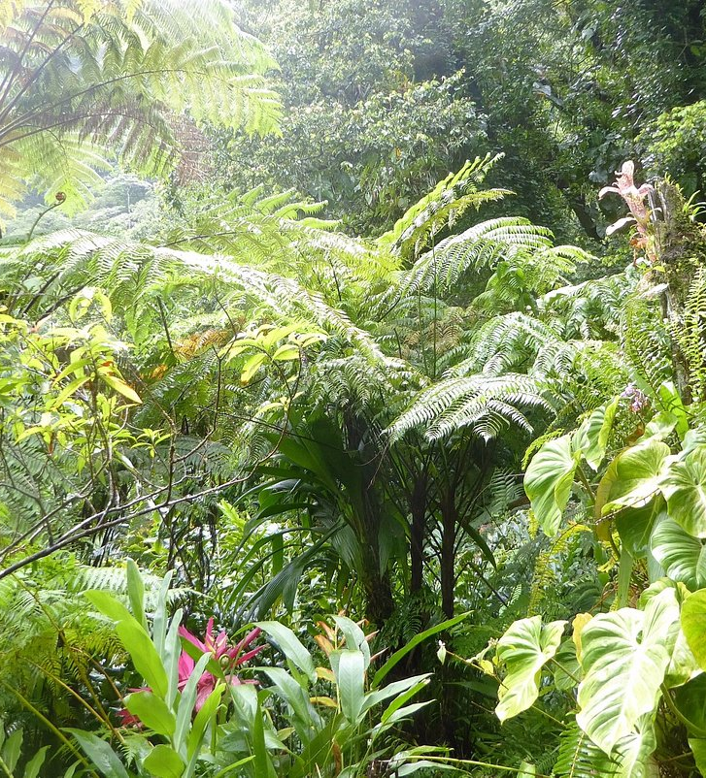
Papillote Tropical Gardens
Papillote Tropical Gardens are a haven for artists, botanists, and photographers. Fed by a small stream, these 10-acre gardens form the grounds of a charming eco-lodge, the Papillote Wilderness Retreat.
Paths wind among bamboo trees, ginger blossoms, indigenous orchids, bromeliads, and begonias. You can also see many frogs, birds, and butterflies in the lush gardens.
The twin Trafalgar Falls lie a short uphill hike from Papillote.
Admission is $10 US

Slide 16
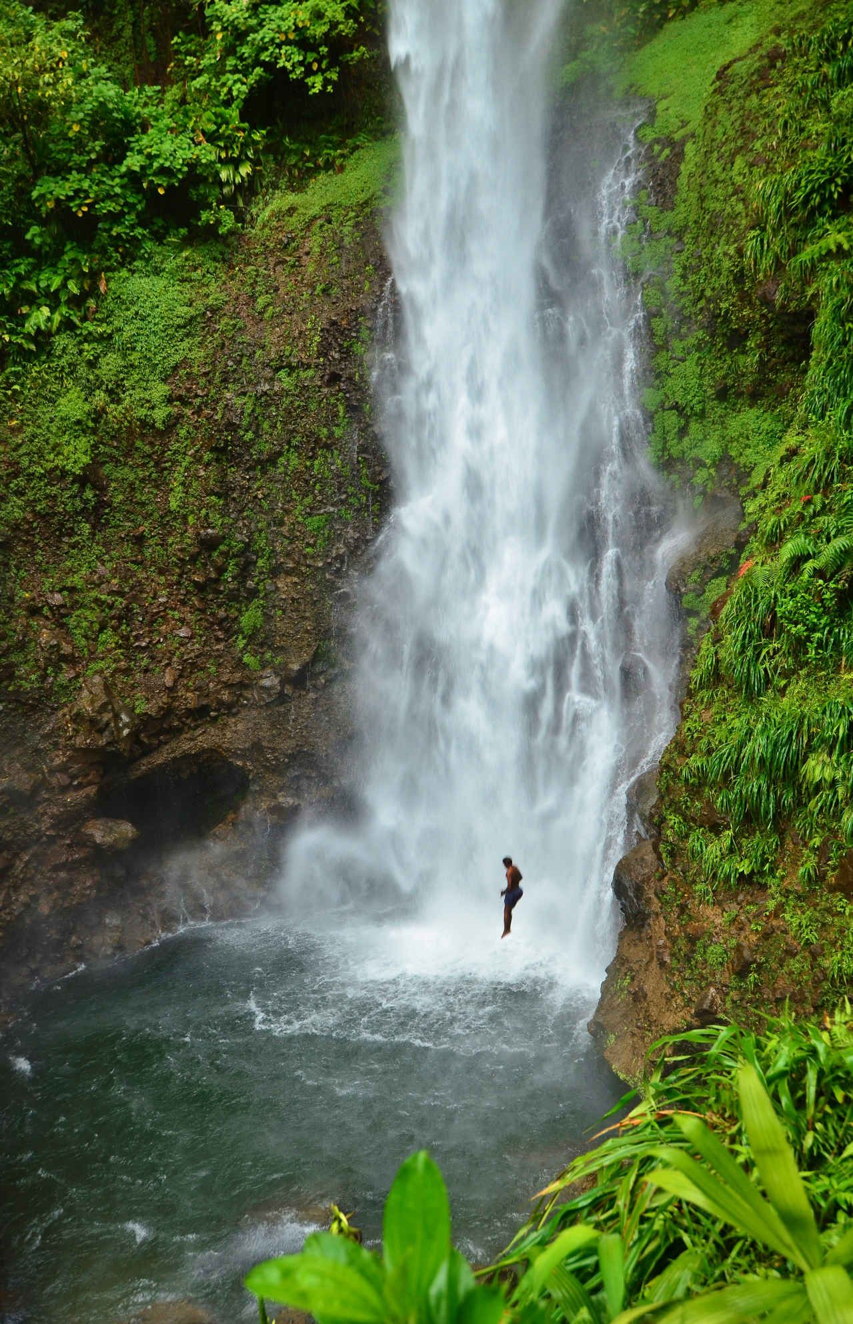
Morne Trois Pitons National Park
Morne Trois Pitons National Park is the jewel of Dominica. Encompassing much of the island's mountainous interior, the park is a primordial rainforest — from thick jungle, with giant ferns and wild orchids, to the stunted cloud forest on the upper slopes of 1,424-meter Morne Trois Pitons.
At Titou Gorge, you can swim in a crisp jade-green pool through the narrow canyon to a beautiful waterfall. One of the Pirates of the Caribbean movies was filmed in this magical spot.
Morne Trois Pitons is awash with natural wonders, highlighted by the Emerald Pool, Middleham Falls, Titou Gorge, and Boiling Lake, thought to be the second-largest fumarole in the world.
Admission Fee: US $5.00 (EC $13.25)

Slide 17
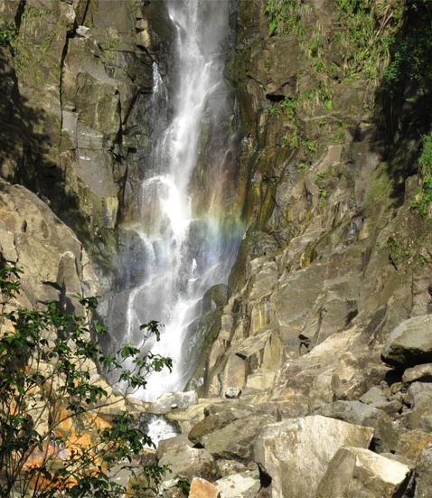
Trafalgar Falls
Located on the west side of Morne Trois Pitons National Park (around 6 miles from Roseau), the jaw-dropping Trafalgar Falls are two of the most-visited sights on the island. In addition to being incredibly impressive, they're also easily accessible for the most amateur hikers and adventure seekers.
The upper waterfall (colloquially referred to as "Father") cascades dramatically from the Trois Pitons River, across the Titou Gorge and empties into hot sulfur springs, while the lower waterfall ("Mother") flows gently from the river into a natural swimming pool.

Slide 18
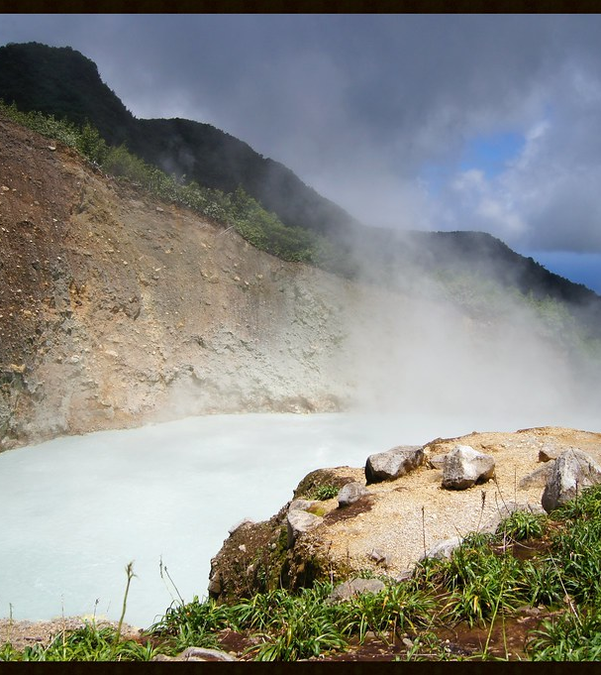
Boiling Lake
Boiling Lake is one of the most popular attractions in Morne Trois Pitons National Park. This eerie-looking pool of bubbling, gray-green water lies at the end of a strenuous, three-hour hike through thick forest. But it's worth it.
Geologists believe the 63-meter-wide actively boiling lake, the world’s second-largest, is a flooded fumarole, a crack in the earth allowing hot gases to vent from the molten lava below. The temperature at the edge of the lake ranges from 82-92 degrees Celsius and is at boiling point in the center..

Slide 19
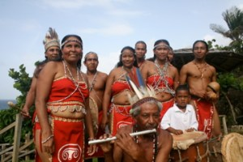
Model Village in Kalinago Territory
Dominica has the largest remaining tribe of Kalinago people (Carib Indians), in the Caribbean. If you want to learn a little about their fascinating culture, you can visit Kalinago Barana Autê, a model village, on the northeast coast, about 20 miles from Roseau.
Nestled amid banana and breadfruit trees, the village is a cluster of traditional wooden buildings. You can wander around the village and watch the Carib Indians carving dugout canoes, weaving baskets and mats, and sharing their knowledge of medicinal plants.

Slide 20
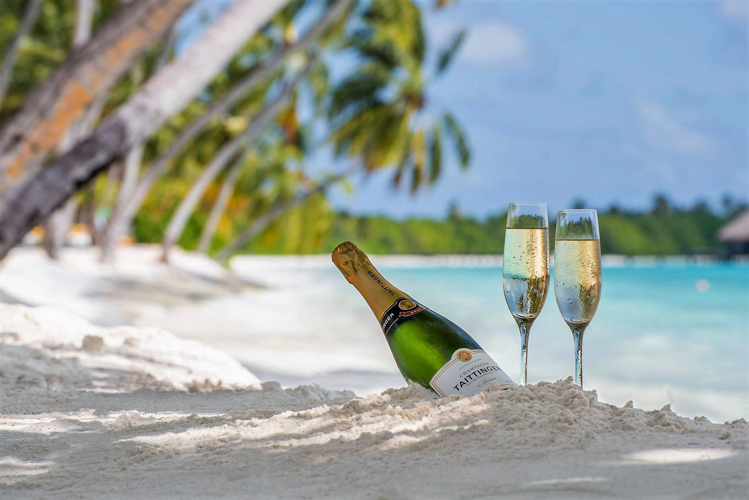
Dominica's Beaches
Mero Beach is one of the most popular stretches of the
coast. About a 25-minute drive from the capital, Roseau.
You can rent sun loungers and umbrellas and purchase
snacks and drinks from funky bamboo shacks along the
shoreline.
Purple Turtle Beach. This is another lovely palm-studded
stretch of beige-hued sand, with a popular namesake
restaurant along its edge. Vying for the most beautiful slice
of coast in Dominica is wild and remote.
Batibou Beach on the island's far north coast. Accessing the beach is an adventure and a workout walking down to the shore. Note that there is a $5 fee to access this beach.
Champagne Beach sees many tourists, mainly because it provides access to one of Dominica's famous tourist attractions: Champagne Reef, with its bubbly geothermal activity and warm waters.

Slide 21
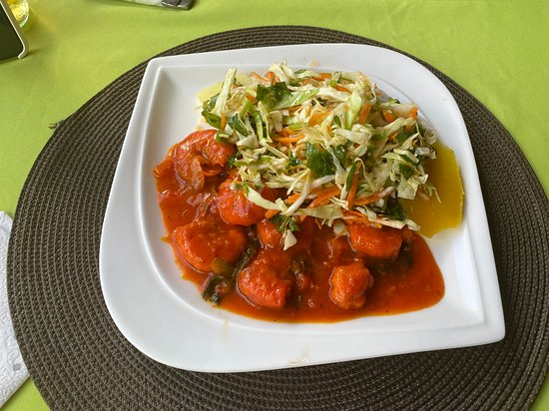
Restaurants
There are a lot of excellent restaurants in Hokkaido. Especially for seafood.
Here are some recommendations in Dominica:
Lacou Melrose House $$$$ Italian, French, Seafood, Contemporary
1 Hodges Lane, Roseau
Old Stone Grill & Bar $$ - $$$ Caribbean, Bar
15 Castle Street, Roseau
Pearl's Cuisine $$ - $$$ Caribbean
28 Great Marlborough Street Ground Floor, Roseau
Palisades Restaurant $$ - $$$ Caribbean , Vegetarian Friendly
Victoria Street, Roseau
Balas Bar $$ - $$$ Caribbean , Bar , Pub
Victoria St, Roseau Dominica
Wherever you choose, I am sure you will enjoy a wonderful meal.
Good Eating!

Slide 22
Conclusion
Dominica is a beautiful City with a rich history and numerous attractions. Regardless of what you're looking for, Dominica has something for everyone.
I hope this presentation will help when we visit Dominica!

Slide 23
Thanks For Coming
If you have any more questions, please ask.
I will do my best to answer them for you.
Have a great visit to Dominica !

