Slide 1
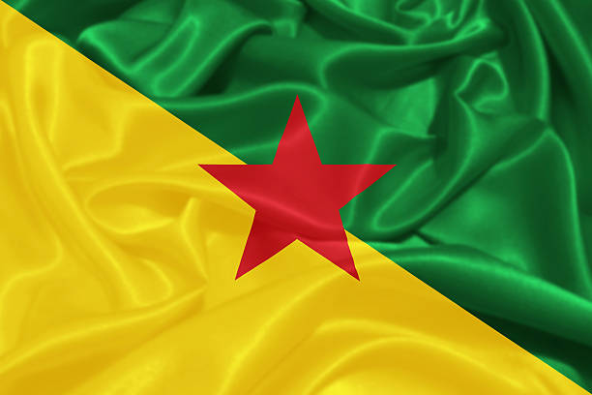
Devil's Island, French Guiana Presented by Fellow Cruiser Marc Silver

Slide 2
What I Will Cover
My Port Philosophy
Don’t Miss the Ship
Money
About Devil's Island
Devil's Island History
Area Map of Devil's Island
The Truth About Devil's Island
Things to do on Île Royale
Île Royale Walking Map
Conclusion

Slide 3
My Port Philosophy
I have been cruising for over 45 years and have taken over 100 cruises. So, I consider myself an experienced cruiser.
The information I will present is based on those many years of experience.
When I am on a cruise where the city, I want to visit is not the port city, I always recommend taking a ship’s tour.
But when I am in a port with multiple attractions nearby and easy to see on my own - I will do it on my own.
This presentation is for that type of port.

Slide 4

Don’t Miss the Ship
How to Avoid Missing Your Ship
Pay attention to the time. - Ship time and local time are often different.
Put a return-to-ship reminder on your phone.
Choose excursions wisely.
If a ship-sponsored excursion is late returning to port, the ship will wait for you. If you are on your own.
Be Prepared
Have your Passport, Credit Card, and phone numbers for your ship port agent.
What to Do If You Miss the Ship Most cruise lines have port agents stationed in the port area to assist if your ship has left without you. If your are lucky, when cruisers are late returning to the vessel, the ship’s crew will often remove the passengers’ essential items – passports, cell phones, and medication -- from the ship to leave with the port agents.
The Port Officials can help you with contacting your ship and making necessary travel arrangements.

Slide 5
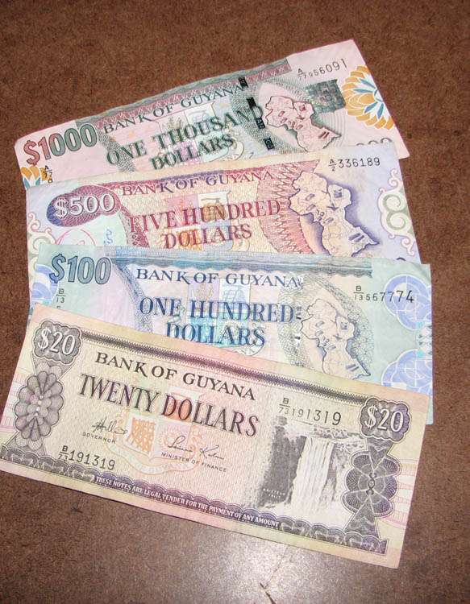
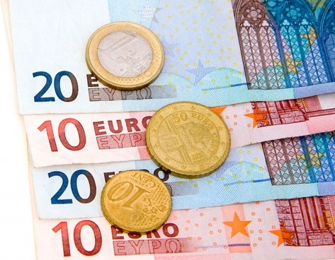
Money
The French Guiana Dollar
The official exchange rate is:
100 Guyanese Dollar = 48 Cents US
209.29 Guyanese Dollars to $1 US Dollar
Not like you’re going to spend any money.
French Guiana is a part of the European Union, and its official currency is the euro.

Slide 6
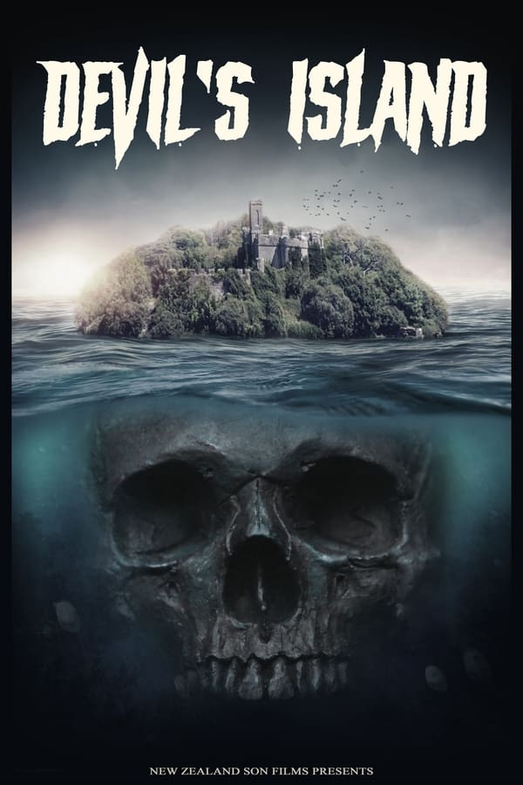
Devil's Island French Guiana
French Guiana is the second-largest region of France (more than one-seventh the size of Metropolitan France) and the largest outermost region within the European Union. It has a very low population density, with only 3.6 inhabitants per square kilometer (9.3/sq mi). Half of its 295,385 inhabitants in 2024 lived in the metropolitan area of Cayenne, its capital. Fully integrated in the French Republic since 1946.
Devil’s Island penal colony in French Guiana was home, at one time or another, to 80,000 of France’s worst criminals, the vast majority of whom never returned home. Made famous in Henri Charrière’s ‘Papillon’, prisoners endured a living death dubbed the ‘dry guillotine’.

Slide 7
Devil's Island French Guiana History
Before European colonization, the territory was originally inhabited by Native Americans, most speaking the Arawak language, of the Arawakan language family. The people identified as Lokono. The first French establishment was recorded in 1503, but France did not establish a durable presence until colonists founded Cayenne in 1643.
Guiana was developed as a slave society, where planters imported Africans as enslaved laborers on large sugar and other plantations in such numbers as to increase the population. The system of slavery in French Guiana continued until the French Revolution, when the National Convention voted to abolish the French slave trade and slavery in France’s overseas colonies in February 1794, months after enslaved Haitians had started a slave rebellion in the colony of Saint-Domingue.
Devil's Island was the site of a small prison facility, part of a larger penal system by the same name, which consisted of prisons on three islands and three larger prisons on the mainland. This was operated from 1852 to 1953.

Slide 8
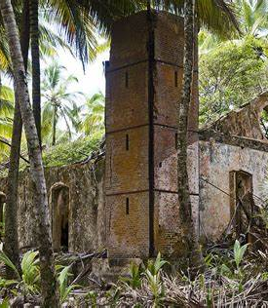
Devil's Island French Guiana History Cont.
From 1852 to 1953, the islands were the site of the notorious penal colony called "the Green Hell." Over the years, more than 80,000 men were transported to Devil's Island penal colony, coming from all walks of life.
The prisoners were located according to status. The least threatening criminals were on Île Royale, the site of the administrative activities, along with the guard's barracks, chapel, lighthouse, and prison hospital.
Dangerous prisoners were kept on Île St. Joseph, while those labeled the most hazardous were on Devil's Island, the least hospitable area.

Slide 9
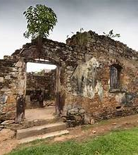
Devil's Island French Guiana History Cont.
The prison was closed in the early 1950s, possibly as a result of the adverse publicity engendered worldwide by former prisoner René Belbenoît, who escaped to the United States and first published his book Dry Guillotine in 1938.
The prisons were closed in 1953, and Île Royale is now a tourist destination. Visitors can explore the ruins of the prison, as well as the island's lush tropical vegetation. The island is also home to a variety of wildlife, including monkeys, birds, and reptiles. Île Royale is a unique destination that offers visitors a glimpse into the past and a chance to experience the beauty of the Caribbean.

Slide 10
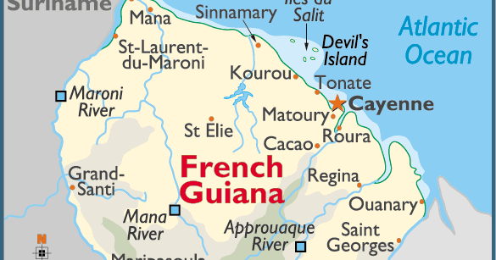
Area Map of Devil's Island French Guiana

Slide 11
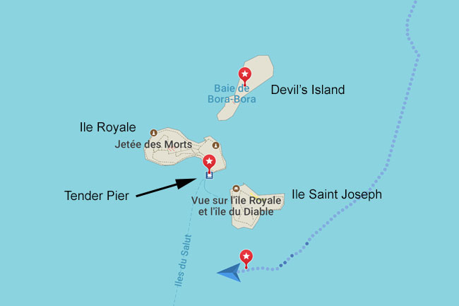
Map of Salvation Islands

Slide 12
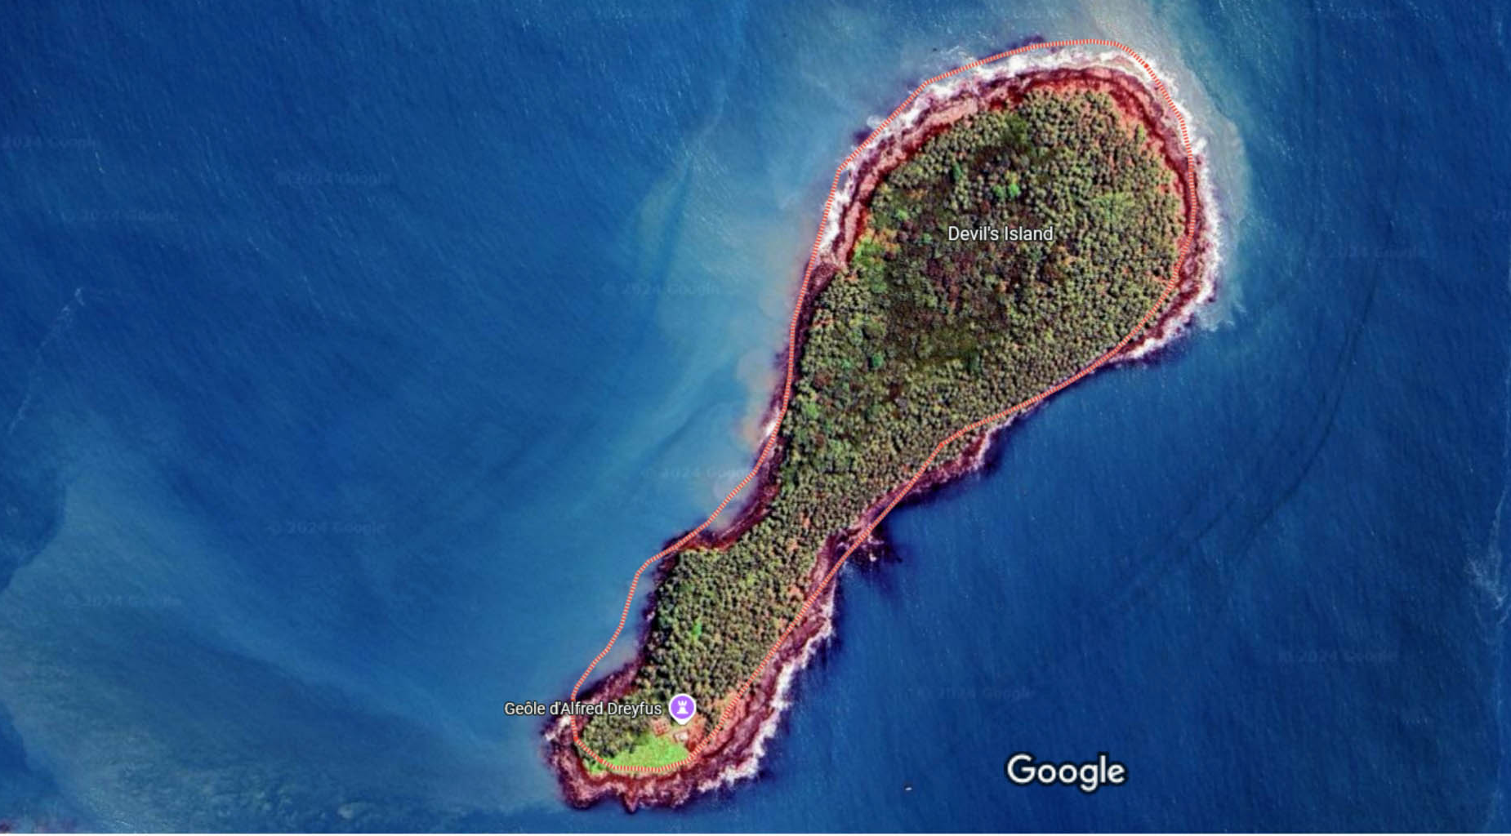
Devils Island

Slide 13
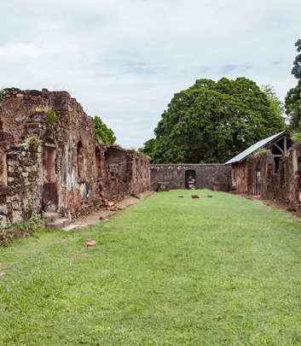
The Truth About Devil's Island
In French Guiana, South America, you'll find the three Îles du Salut, or the Salvation Islands—so named because they provided a healthier environment than the mainland for the French gold seekers of the 1760s.
About 8 miles off the coast from Kourou, are the three islands: Île du Diable (Devil's Island), Île St. Joseph, and Île Royale.
Devil's Island, the smallest of the three islands, is where the most dangerous prisoners lived. Access to visitors is strictly forbidden on the now uninhabited territory. The currents are so strong that no ships are allowed to dock here; it is unsafe for visitors.

Slide 14
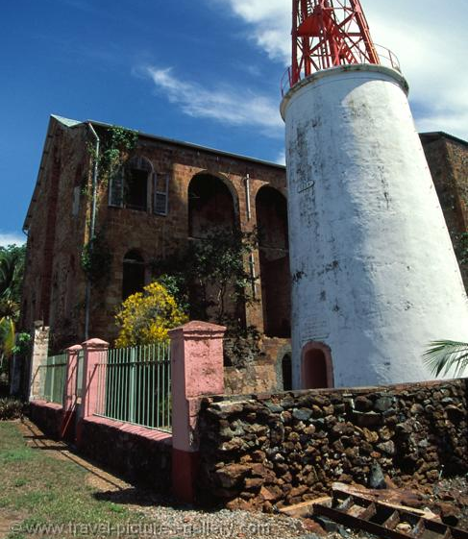
The Truth About Devil's Island Cont.
Access to Devil's Island, where the political convicts were held, is strictly forbidden. The reality is we will tour the ruins of Île Royale. the other islands are available for a half-day trip through the ship.
Given the hot and humid climate, it is advised to bring water, sunscreen, hats, and appropriate clothing.

Slide 15
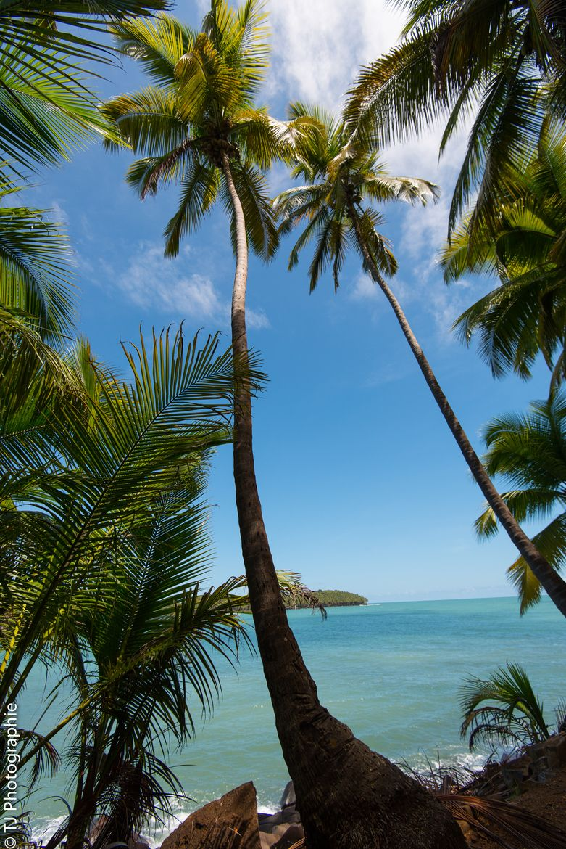
Things to do on Île Royale
Ile Royale, French Guiana is known for its stunning natural beauty and its many outdoor activities.
Visitors can explore the lush rainforest, take a boat tour of the many rivers and creeks, or relax on the beach.
There are also plenty of opportunities for fishing, kayaking, and bird watching. For those looking for a more adventurous experience, there are plenty of hiking trails and zip-lining courses.
The island also offers a variety of cultural activities, such as visiting local markets and learning about the history and culture of the area. No matter what type of experience you are looking for, Ile Royale, French Guiana has something to offer.

Slide 16
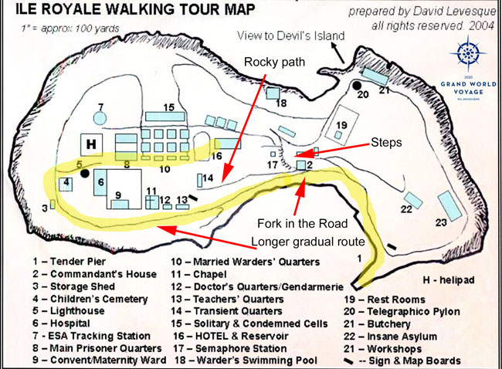
Map of Île Royale

Slide 17
Thanks For Coming
If you have any more questions, please ask.
I will do my best to answer them for you.
Have a great visit to Devil's Island!

