Slide 1

Darwin
Australia
Presented by
Marc Silver

Slide 2
What I Will Cover
My Port Philosophy
Don’t Miss the Ship
Money
About Darwin
Historical Darwin
Map of Australia
Map of Darwin
Getting Around Darwin
Places to see or at least consider
Restaurant recommendations
Conclusion
Acknowledgement

Slide 3
My Port Philosophy
I have been cruising for over 45 years and have taken over 200 cruises.
So, I consider myself an experienced cruiser.
The information I will present is based on those many years of
experience.
When I am on a cruise where the city, I want to visit is not the port city,
I always recommend taking a ship’s tour.
But when I am in a port with multiple attractions nearby and easy to see
on my own - I will do it on my own.
This presentation is for that type of port.

Slide 4

Don’t Miss the Ship
How to Avoid Missing Your Ship
Pay attention to the time. - Ship time and local time are often
different.
Put a return-to-ship reminder on your phone.
Choose excursions wisely.
If a ship-sponsored excursion is late returning to port, the ship will
wait for you. If you are on your own???
Be Prepared
Have your Passport, Credit Card, and phone numbers for your ship
port agent.
What to Do If You Miss the Ship
Most cruise lines have port agents stationed in the port area to assist if your ship has left without you. If your are lucky, when cruisers are late returning to the vessel, the ship’s crew will often remove the passengers’ essential items – passports, cell phones, and medication -- from the ship to leave with the port agents.
The Port Officials can help you with contacting your ship
and making necessary travel arrangements.

Slide 5
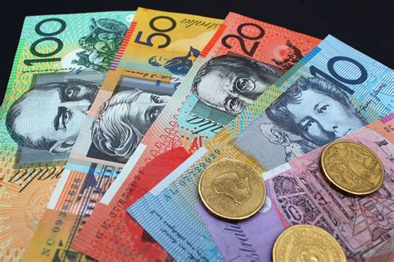
Money
The currency for Darwin is the Australian Dollar.
The conversion at the rate is $1.48 AUD to $1.00 U.S.
Or $1 AUD $.67 U.S.

Slide 6
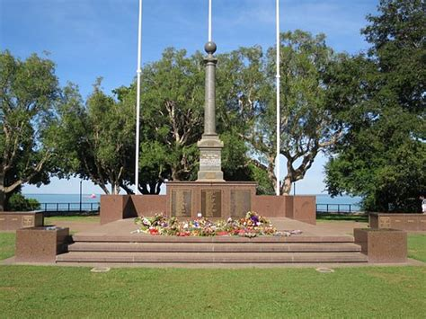
About Darwin
Darwin, capital and chief port of Northern Territory, Australia. It is situated on a low peninsula northeast of the entrance to its harbor, Port Darwin, a deep inlet of Beagle Gulf of the Timor Sea.
With everything from Asian food markets and crocodile encounters to open-air movies and sunset cruises, Darwin is as easy going as it is exciting.
Darwin has a lot to offer tourists to the area. Along with its crocodile encounters and harbor cruises, you'll find rich Aboriginal cultures here, evident through the vibrant Aboriginal art that fills the city's galleries, museums and streetscapes.
The city's proximity to Asia means you'll also find strong Asian influences, especially in the energetic food scene and buzzing night markets.

Slide 7
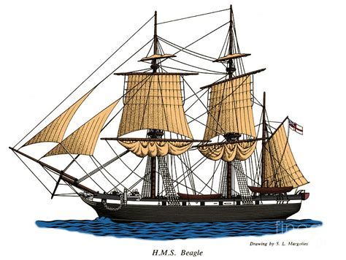
Historical Darwin
In 1839 a ship called The Beagle sailed to Darwin Harbor. The captain named the harbor after who had sailed with him on an earlier voyage.
The city of Darwin in Australia was founded in 1869. At first, the settlement was named Palmerston after the British prime minister. It was renamed after Charles Darwin in 1911.
In 1871 gold was discovered near Darwin and as a result, the new settlement thrived.
In 1872 Darwin was connected to other parts of
Australia by the Overland Telegraph Line. Government House was built in 1883. Palmerston Town Hall was also built in 1883 (although it was devastated by a cyclone in 1974). Furthermore, Fannie Bay Gaol was built in 1883.
Down’s Mart Theatre was built in 1885. The first Chinese Temple was built in Darwin in 1887. Victoria Hotel opened in 1894. However, in 1897 Darwin was damaged by a cyclone.

Slide 8
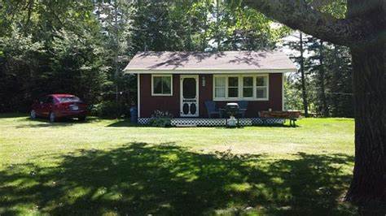
Historical Darwin
Lyons Cottages were built in 1925 and Old Admiralty House was built in 1937. By 1939 Darwin was still only a small settlement with a population of about 2,000.
During the Second World War, the Japanese carried out air raids on Darwin. The first air raid on Darwin was on 19 February 1942. The air raids killed hundreds of people and devastated Darwin.
After the Second World War Darwin grew rapidly. Darwin was officially made a city in 1959.
Casuarina Square Shopping Centre opened in 1973. Indo-Pacific in Darwin opened to the public in 1974.

Slide 9
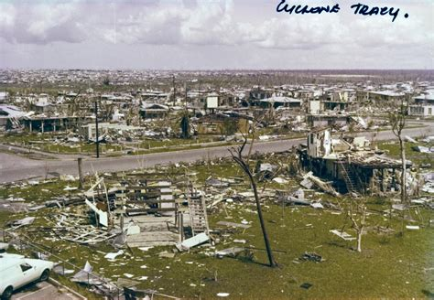
Historical Darwin
In 1974 Darwin was devastated by cyclone Tracy. It struck early on Christmas Day 1974, and it killed 66 people. The cyclone also destroyed many buildings in Darwin. Most of the city’s population was evacuated.
Darwin was rebuilt. The Northern Territory Library opened in 1980 and The Museum and Art Gallery of the Northern Territory opened in 1981. Darwin Entertainment Centre opened in 1986. Marrara Stadium was built in 1991.
Meanwhile, in 2004 Darwin was linked to South Australia by train.
Darwin Convention Centre and Crocosaurus Cove opened in 2008.
Today Darwin is a flourishing and fast-growing city. Today the population of Darwin is 142,000.

Slide 10
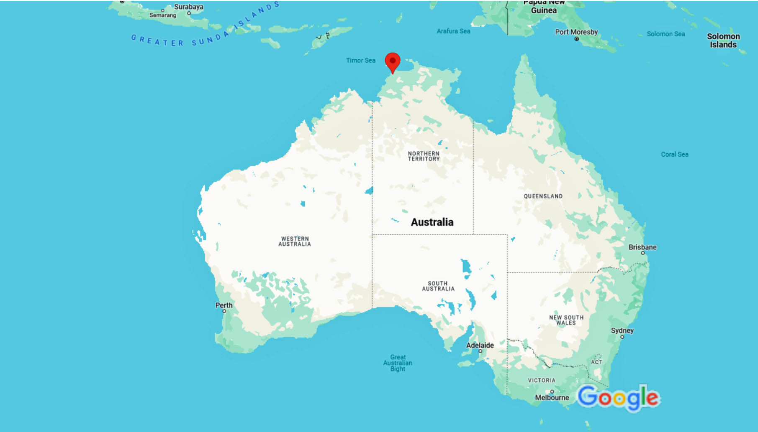
Map of Australia
Darwin

Slide 11
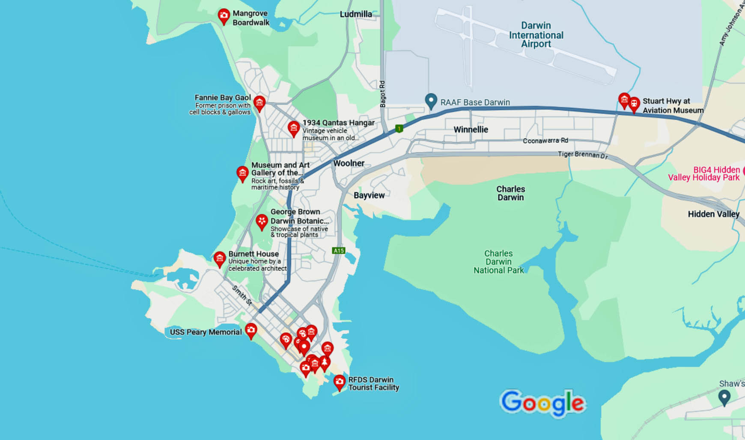
Map of Darwin

Slide 12
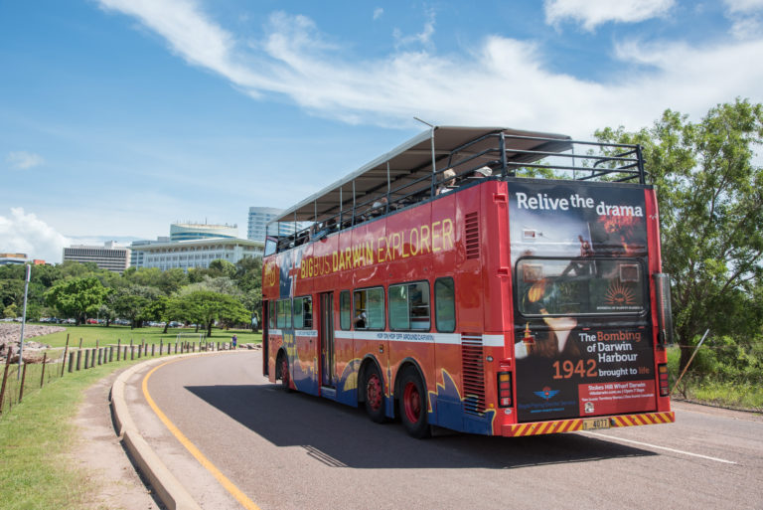
Darwin Rapid Transit
Darwin might be Australia’s smallest capital city, but it has an excellent public transport network – with buses in Darwin operating 7 days a week, two passenger ferries, plus a fleet of e-scooters and e-bikes!
Unlimited bus travel until the last service of the day is available for only.
$7 full fare
$2 concession fare
E-scooters and E-bikes are a great option for commuters, providing a quick, environmentally friendly and inexpensive mode of transport to move around the city. To access you will need to register at: https://www.ridebeam.com

Slide 13

Darwin Taxis
Standard taxis provide a safe and reliable way to explore the city or for transport between the cruise port and various attractions.
Like taxis in most locations the cost is significantly more expensive than other modes of transport.
Darwin also has Uber and Lyft rideshare available.
You can book with 13cabs online or with their app.

Slide 14
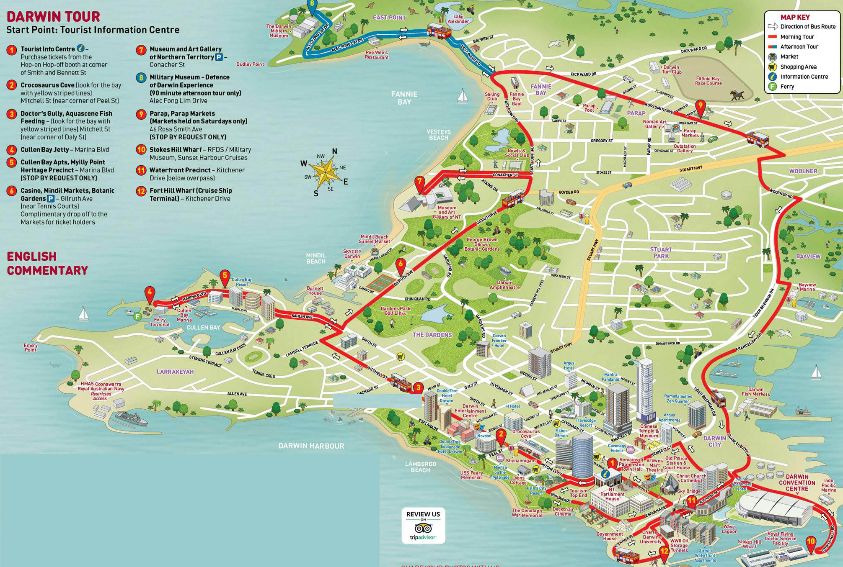
Darwin Walking Tour
Take a Darwin walking tour of the points of interesting and historic buildings in Downtown Darwin.
2. Crocosaurus Cove
3. Doctor’ Gully
4. Cullen Bay Jetty
5. Mindil Market
6. Botanic Gardens
7. Museum and Art Galley
8. Military Museum
10. Stokes Hill Wharf
12. Cruise Ship Terminal

Slide 15
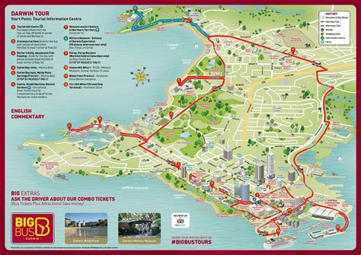
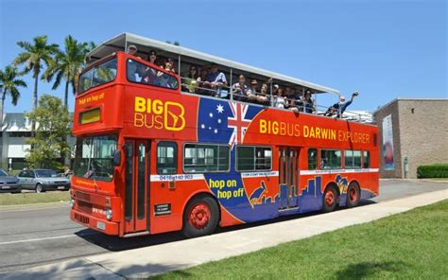
Hop-on Hop-off Tour
The Darwin hop-on hop-off bus tour by Big Bus provides all the benefits of a guided tour—including hassle-free transport and on-board audio commentary—with the flexibility of independent travel.
½ Day Adult $47, Child $30

Slide 16
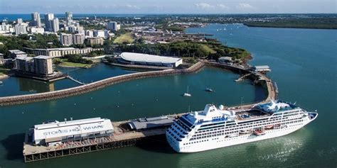
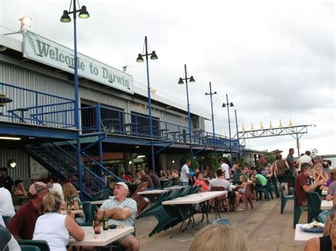
Stokes Hill Wharf
Stokes Hill Wharf is the closest tourist hot spot when you get off the ship. Just a few minutes’ walk away, this working wharf is where harbor cruises, Jet Ski tours, and fishing charters depart, but it's also a top spot for waterfront dining.
Craving an alfresco meal? Fresh-caught seafood is the specialty here, but you'll find everything from Asian fusion to modern Mexican, pizza, and pasta.

Slide 17
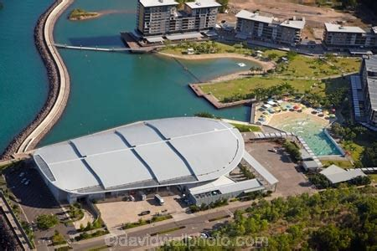
Darwin Waterfront Precinct
Darwin Waterfront is ground zero for family fun. This pedestrian-friendly precinct in the heart of Darwin's CBD features tourist attractions, galleries, restaurants, shops, and beautiful water views. It's easy to get around here. A promenade links the precinct to the Darwin CBD, and you can stroll along a waterfront path to all the attractions.
Feeling hot and sticky after all your sightseeing?
Bring your swimsuit and take a dip in the lagoon
pool or bask on the man-made white-sand beach.
Traveling with the kids? They'll love bouncing
around on the Aqua Park, swimming in the wave
lagoon, or clambering up the climbing wall and
ropes course in the Waterfront Park.

Slide 18
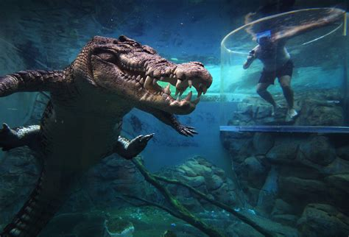
Crocosaurus Cove
Crocosaurus Cove, in the heart of the Darwin city center claims to have the largest display of Australian reptiles in the world.
If you're looking for unusual things to do in Darwin, something that will really get your heart pumping, the "Cage of Death" is for you.
This unique attraction plunges you into the water in a protective enclosure, where you will come face to face with a giant saltwater crocodile.
Adults: $40
Seniors: $32
Children 5 -12: $25

Slide 19
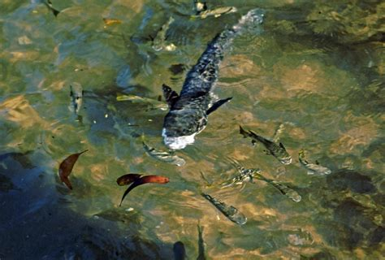
Doctor’ Gully
Darwin's Doctors Gully is known for Aqua-scene Fish Feeding and as the Darwin Catalina Flying Boat base.
At Aquascene milkfish, mullet, catfish, barramundi, rays and others feed on bread.
At high tide the water boils with hundreds of fish looking for a free feed, and the visitors are happy to oblige. This scene has become
one of Darwin's best known tourist attractions
and brings hundreds of people to the area at
high tide.
Fish Feeding Admission:
Adults: $15
Children 2 to 15 - $10 each
Children under 3 - free

Slide 20
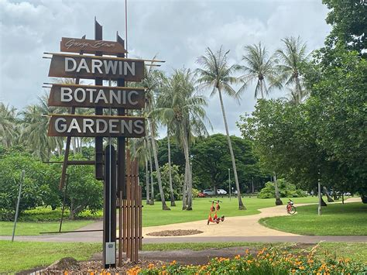
George Brown Darwin Botanic Gardens
Spanning 103.8 Acres, the George Brown Darwin Botanic Gardens are among a few in the world where both estuary and marine plants grow naturally. Maurice Holtze, a Russian immigrant, laid out the gardens in 1891 to contain a great variety of tropical plants, both native and exotic species.
Highlights are the palms, a miniature rainforest
with a waterfall and pond, the orchid garden,
and the collection of baobabs in the woodland
section. A network of paths connects the main
gardens, and an amphitheater hosts live
performances.

Slide 21
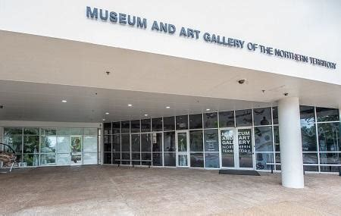
Museum and Art Gallery of the
Northern Territory
Tucked in a tropical garden on Darwin Harbor, the Museum and Art Gallery of the Northern Territory is one of seven museums in the Northern Territory and provides an excellent one-stop dose of history and culture.
If you only have one day in Darwin, this museum is a must-see.
The gallery hosts an impressive collection of Aboriginal, Asian, and Oceanic art, as well as works by Australian painters, while the museum provides an overview of the region's history.

Slide 22
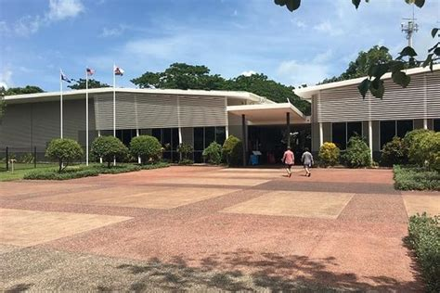
Darwin Military Museum
You can browse the exhibits in the Darwin Military Museum, which is set in beautiful tropical gardens surrounded by the sea in the East Point Reserve.
The museum documents Darwin's role during WWII as an important naval base frequently attacked by Japanese bombers from February 1942 onwards.
Within the grounds are a coastal battery, observation towers, bunkers, and gun positions dating from that period.

Slide 23
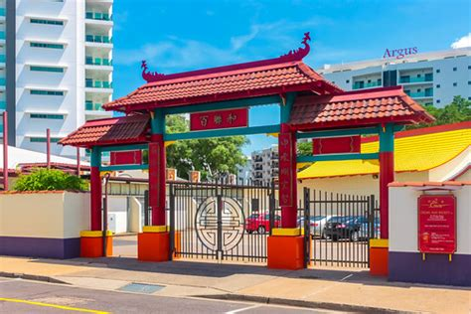
Museum Chung Wah
Originally built in 1887 for Darwin's sizable Chinese community, the Chinese Temple offers a colorful jolt of Chinese culture on a hot Darwin day. The present building dates from 1977 after Cyclone Tracy destroyed the previous structure, and worshipers visit here every day to practice a blend of Buddhism, Taoism, and Confucianism.
Museum Chung Wah illuminates more than a century of history of Chinese immigrants in the Northern Territory.
Chinese immigrants came to Australia during the Gold Rush, and the museum's exhibits, including photographs, personal stories, and artifacts tell the story of their important contribution to the community.

Slide 24
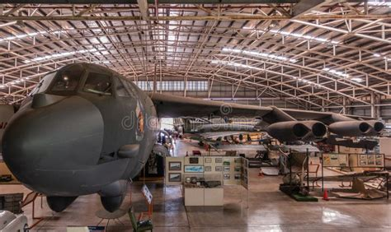
Darwin Aviation Museum
Aviation aficionados will have a field day at the Darwin Aviation Museum.
Stealing the show is a huge B52 Bomber on loan from the US Air Force, one of only two in the world on public display outside the States.
Among the 19 aircraft exhibited are Sabre jets; a Spitfire replica; and helicopters, including a Royal Australian Navy Wessex helicopter that helped clean up Darwin after Cyclone Tracy.
Videos on aviation and the bombing of Darwin provide a fascinating historical background.
Admission Fee:
Adults $20.00 - Seniors / Pensioners $15.00
Children (under 12) $10.00
Family $50.00

Slide 25
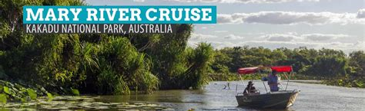
Beautiful scenery, saltwater crocodiles, birds, and other wildlife are the highlights of the Mary River Wetlands. Birders will also have plenty to see here. Ibis, jabiru, jacana, brolga, whistling ducks, and sea eagles are just some of the species in the wetland's ecosystem.
The wetlands lie about a 90-minute drive from Darwin and are home to one of the country's highest concentration of saltwater crocodiles.
This full-day tour includes a stop at the Windows on the Wetlands Visitor Centre, a 2.5-hour cruise on an open-sided boat, a delicious lunch, as well as hotel pickup and drop-off.
Cost: $65 adult / $30 child (3 to 13 years)

Slide 26
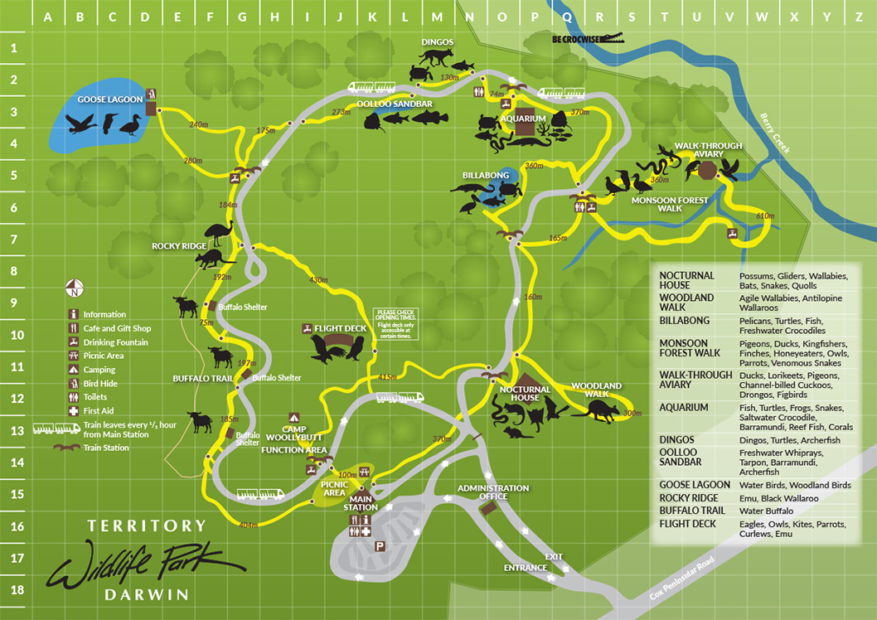
Territory Wildlife Park
About a 45-minute drive south of Darwin, the Territory Wildlife Park is a great option to see a wide variety of native animals.
This popular wildlife park is home to a vast array of animals, living in wetland, woodland, and monsoon forest habitats.
Walking trails and free shuttles link the attractions, which include an aquarium, aviary, and nocturnal house.
Highlights include the excellent raptor show, the spitting archerfish, freshwater whipray encounters, and the excellent presentations by naturalists.
Take plenty of water, and wear good walking shoes.
Entrance Fee: Adult- $26
Child- $13
Family- $45.50

Slide 27
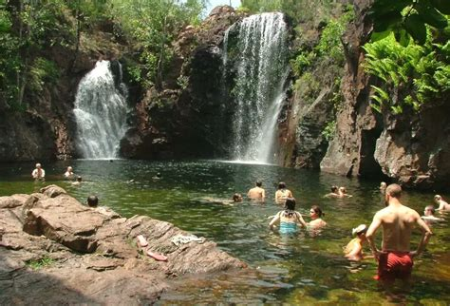
Litchfield National Park
Only a 60-minute drive south of Darwin, Litchfield National Park is possibly the Northern Territory’s best-kept secret.
The park is filled with stunning waterfalls and waterholes that are surrounded by monsoonal vine forests – all of which offer a cool respite on warm summer days.
A drive through Litchfield is full of contrasts and some of the most enormous termite mounds in the Top End.
Litchfield offers a rewarding taste of Top End wilderness on an easy day trip from Darwin. It's about 67 miles from the capital, and the park is nearly 580 square miles in area.
The many Waterfalls are a highlight throughout the park.

Slide 28
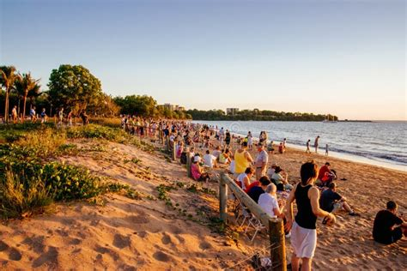
Mindil Beach
Mindil Beach, five minutes from the city center, is one of the best places in Darwin to watch the sunset.
Tourists and locals alike head here late in the afternoon, stake a spot on the soft sand, and wait for Sunset.
Boats bob on the calm sea, silhouetted against a fiery sky, as the sun sinks in a tropical blaze over the placid Timor Sea. It's one of Darwin's simple pleasures.
Mindil Beach Sunset Market is host to over 200 specialty stores and food vendors, it’s a truly unique experience.

Slide 29
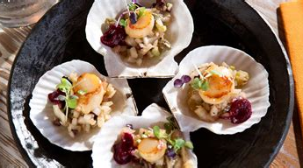
Restaurants in Darwin
There are some excellent restaurants in Darwin.
Here are some recommendations:
Pee Wee's at the Point $$$$, International, Australian, Vegetarian
Pepper Berry Restaurant $$$$, Contemporary, Australian, Vegetarian
Wharf One Food & Wine $$ - $$$, Australian, Vegetarian Friendly, Vegan
Hanuman Restaurant $$ - $$$, Indian, Nonya/Malaysian, Vegetarian
Darwin Trailer Boat Club $$ - $$$, Bar, Asian, Pub
Laneway Specialty Coffee $$ - $$$, Cafe, Healthy, Australian
Moorish Café $$ - $$$, Moroccan, Mediterranean, Spanish
Lazy Susans Eating House $$ - $$$, Chinese, Hong Kong, Vegetarian
Saffron $$ - $$$, Indian, Asian, Vegetarian
Vots Greek Taverna $$ - $$$, Greek, Vegetarian Friendly, Vegan
If you decide to eat out, I hope theses recommendations are helpful!

Slide 30
Conclusion
Darwin is a beautiful City with a rich history and numerous attractions. Regardless of what you're looking for, Darwin has something for everyone.
I hope this presentation will help when we visit Darwin!

Slide 31
Thanks For Coming
If you have any more questions, please ask.
I will do my best to answer them for you.
Have a great visit to Darwin!

Slide 32
Acknowledgement
My seminars are the result of many years of travel experience combined with many hours of research over the internet.
I would like to acknowledge the many source I have accessed.
These include: Wikipedia.com, Britannica.com, and the
various Museum, Park and Government websites.

