Slide 1
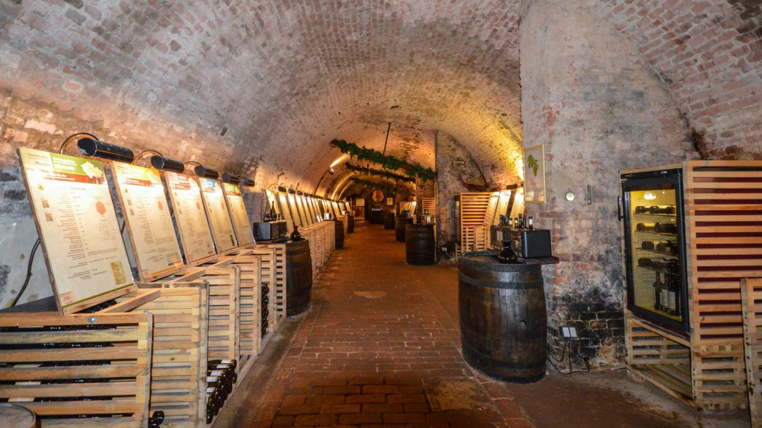
Wine of the Czech Republic
Presented by
Marc Silver

Slide 2
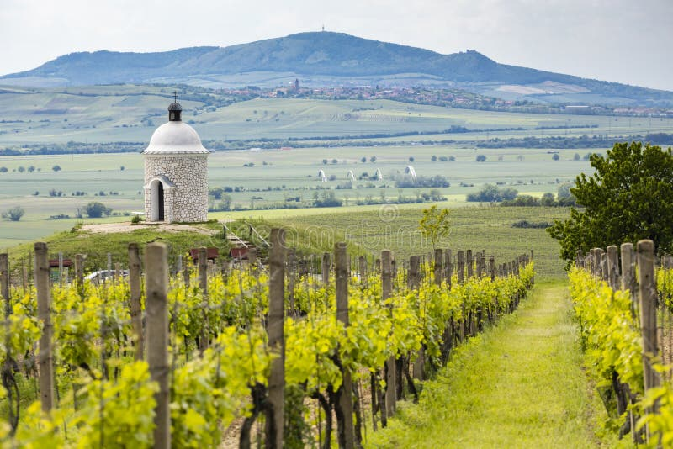
Tradition Meets Innovation
The Czech Republic, though often overshadowed by its more famous winemaking neighbors like France, Italy, and Germany, boasts a viticultural tradition that is rich in history, diversity, and innovation.
From the vineyards of Moravia
to the rolling hills of Bohemia,
Czech wines are slowly making
their mark on the global wine
stage, cherished by enthusiasts
for their uniqueness, elegance,
and reflection of their terroir.

Slide 3
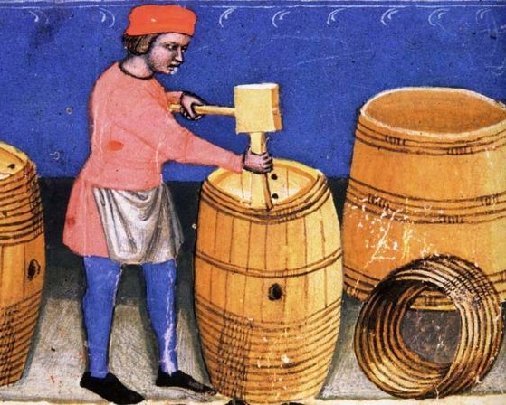
History of Czech Wine: From Ancient to Modern Times
Ancient Roots: From the Romans to the Middle Ages
Winemaking in what is now the Czech Republic dates back over 2,000 years, with evidence that the Romans introduced viticulture to the region during their expansion through Europe.
The fertile lands of Moravia were particularly suited to growing grapes, and as the Roman Empire spread its influence, so too did their agricultural practices.
In the early Middle Ages, winemaking gained further traction with the spread of Christianity. Monasteries became the custodians of viticulture, with monks cultivating grapes to produce wine for religious ceremonies.
The church's role in wine production helped establish winemaking as a respected and protected industry during this period.

Slide 4

The Golden Age of Czech Winemaking
14th - 16th Century
The Czech wine industry reached its zenith in the 14th century
during the reign of Charles IV, King of Bohemia and Holy Roman Emperor.
Charles IV recognized the economic and cultural importance of winemaking
and encouraged the cultivation of vineyards throughout Bohemia and
Moravia.
He issued decrees promoting vine planting and established viticultural laws
that protected the quality and authenticity of Czech wines.
By the 16th century, the Czech Republic was home to some of the most
extensive vineyards in Europe, and winemaking became deeply ingrained in
the cultural fabric of the nation.
However, this Golden Age was not to last, as the Thirty Years' War
(1618–1648) and subsequent political upheavals led to a decline in vineyard
maintenance and winemaking traditions.
Charles IV, King of Bohemia
Notes:
Charles IV, King of Bohemia

Slide 5
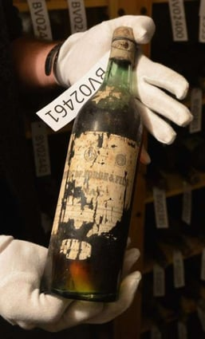
Decline and Revival
17th Century to the 19th Century
The devastation of the Thirty Years’ War wreaked havoc on the Czech wine industry, with many vineyards destroyed or abandoned.
The industry struggled to recover as economic conditions and political instability continued to hinder the growth of viticulture. Additionally, competition from the burgeoning beer industry in Bohemia, particularly the rise of Pilsner beer in the 19th century, further stifled wine production.
However, the 19th century also saw the advent of modern winemaking techniques, which helped reinvigorate the industry.
Czech vintners began to adopt scientific approaches to viticulture, experimenting with grape varieties and improving vineyard management techniques.

Slide 6
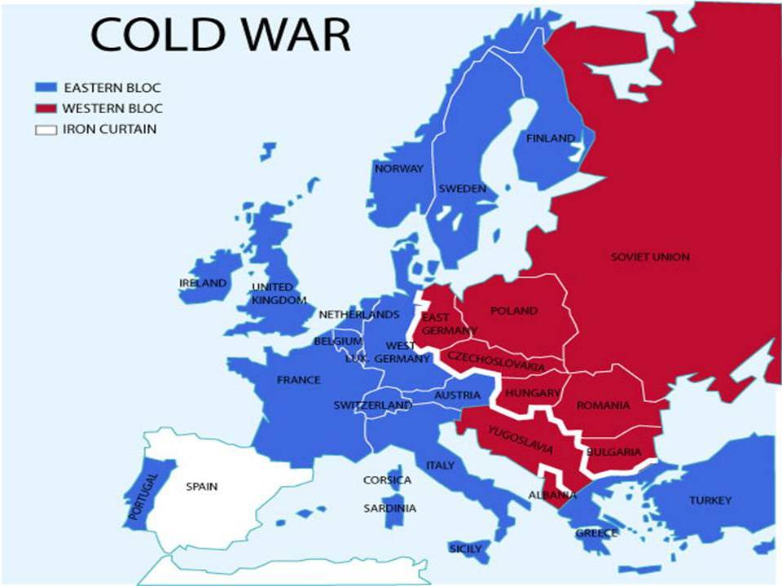
Modern Revival
Post-Communist Era and the 21st Century
The 20th century brought a new set of challenges, particularly
under Communist rule (1948-1989), when wine production
was nationalized, and a focus on quantity over quality led to
a decline in the reputation of Czech wines.
Despite this, Moravian wines remained popular domestically.
The fall of Communism in 1989 marked a new era for Czech
winemaking. Private ownership returned, and winemakers
once again focused on quality. Investment in vineyards, new winemaking technology, and an emphasis on traditional methods led to a renaissance in the wine industry.
By the 21st century, Czech wines were increasingly recognized on the international stage, and the country’s wine regions began attracting tourists and wine lovers from around the world.

Slide 7
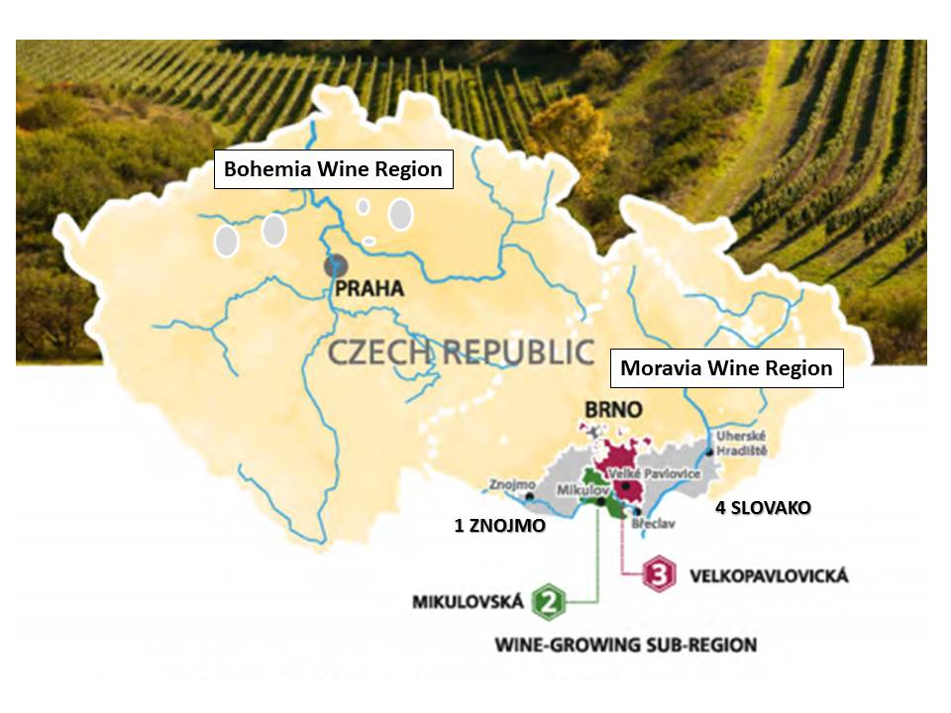
Wine Regions of the Czech Republic
Moravia: The Heart of Czech Winemaking
The Moravian region, located in the southeastern part of the Czech Republic, is the undisputed center of Czech winemaking, producing around 96% of the country's wine.
Moravia's diverse microclimates, combined with its rolling hills and varied soils, create ideal conditions for cultivating both white and red grape varieties.

Slide 8
Wine Regions of the Czech Republic
Moravia
Moravia's four subregions—Znojmo, Mikulov, Velké Pavlovice, and Slovácko—each offer unique terroir and wine styles, contributing to the region's rich winemaking tapestry.
The region is renowned for its white wines, especially those made from grapes like Grüner Veltliner, Riesling, and Müller-Thurgau, but it also produces high-quality red wines from varieties such as Blaufränkisch (known locally as Frankovka) and Saint Laurent.
Tourism in Moravia: Moravia is a haven for wine tourists, offering picturesque vineyards, charming wine cellars, and numerous wine festivals.
The town of Znojmo, in particular, is famous for its wine festivals, medieval architecture, and stunning views of the surrounding vineyards.

Slide 9
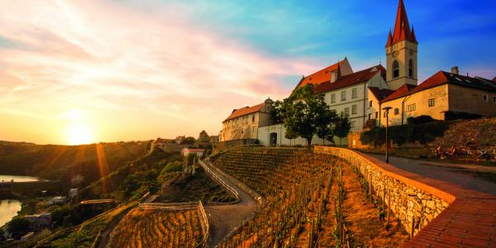
Regional Breakdown
Znojmo (Moravia)
Terroir & Climate: Located near the Austrian border, Znojmo enjoys a mix of limestone and granite soils, with a relatively warm climate influenced by the Pannonian Plain.
Grape Varieties: Znojmo is best known for its aromatic white wines, particularly Grüner Veltliner, Sauvignon Blanc, and Riesling. The cool nights in the region help preserve acidity in the grapes, leading to fresh, vibrant wines.
Wine Characteristics: Znojmo's wines are characterized by their minerality, bright acidity, and expressive aromas of citrus, stone fruit, and herbs.

Slide 10
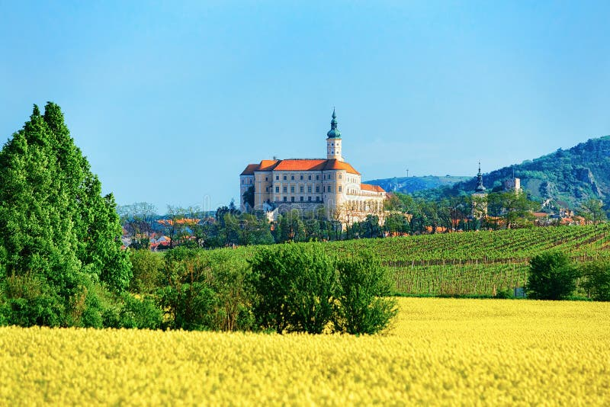
Regional Breakdown
Mikulov (Moravia)
Terroir & Climate: Situated around the town of
Mikulov, this region has limestone-rich soils that
are perfect for cultivating white grapes.
The region enjoys warm days and cool nights,
which contribute to the balanced ripening of the grapes.
Grape Varieties: Riesling, Chardonnay, and Welschriesling are the stars of the Mikulov region.
Wine Characteristics: Wines from Mikulov tend to be elegant and complex, with a distinctive minerality and floral notes.

Slide 11
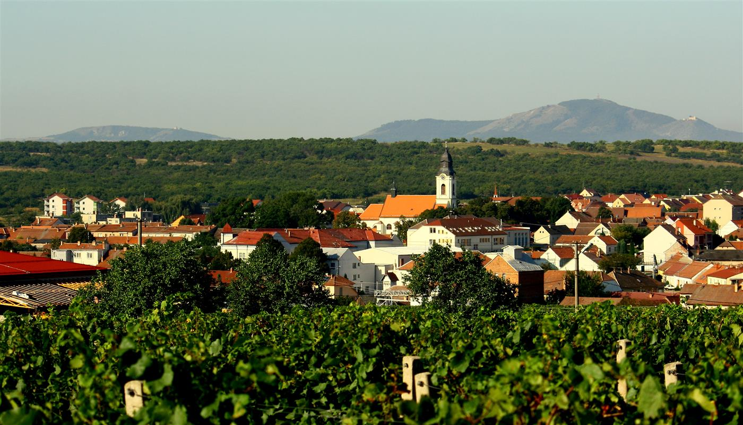
Regional Breakdown
Velké Pavlovice (Moravia)
Terroir & Climate: Known for its fertile loess soils and warmer climate, Velké Pavlovice is the premier red wine region in the Czech Republic.
Grape Varieties: Blaufränkisch (Frankovka), Saint Laurent, and Pinot Noir are the dominant red grapes in this region.
Wine Characteristics: The red wines of
Velké Pavlovice are rich and full-bodied,
with flavors of dark fruit, spices, and
earthy undertones.

Slide 12
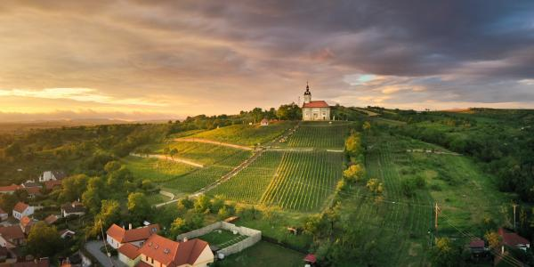
Regional Breakdown
Slovácko (Moravia)
Terroir & Climate: Slovácko is located in the eastern part of Moravia and is known for its diverse soils and microclimates.
Grape Varieties: This region is known for a mix of both white and red varieties, including Riesling, Müller-Thurgau, and Cabernet Moravia.
Wine Characteristics: Slovácko's wines are known for their balance and complexity, often displaying a harmony of fruit, acidity, and minerality.

Slide 13
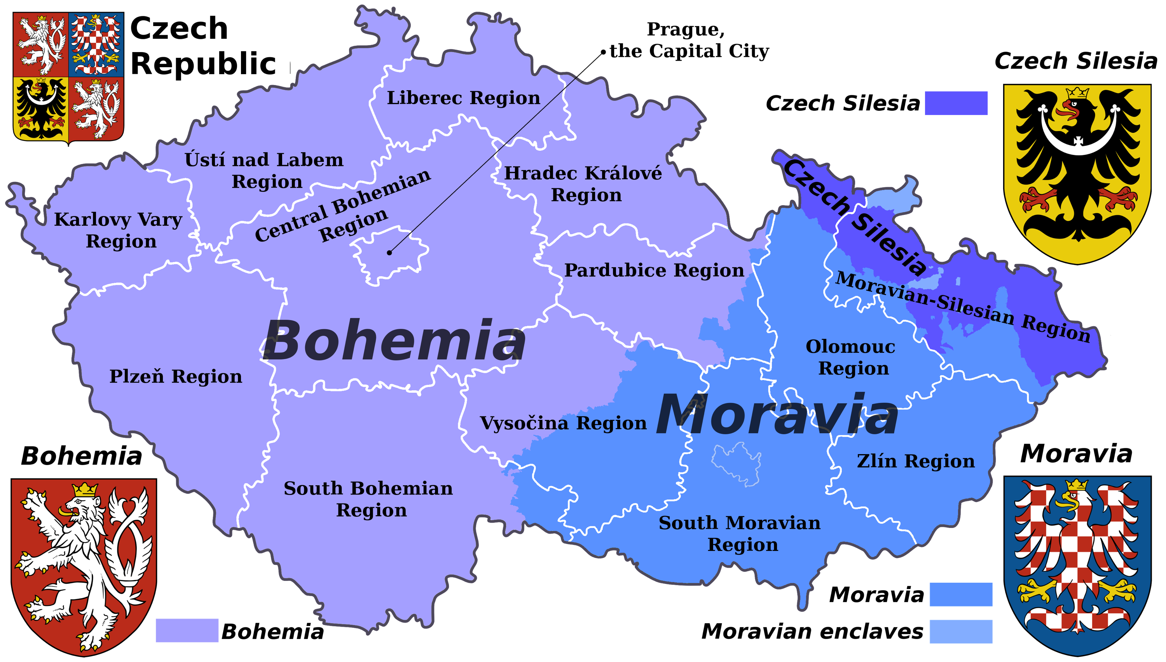
Wine Regions of the Czech Republic
Bohemia: The Lesser-Known Gem
Bohemia, located in the western part of the country,
may be smaller in terms of wine production (accounting
for only 4% of Czech wine), but it is no less important in
terms of quality and historical significance.
Bohemia has a cooler climate than Moravia, which lends
itself to the production of sparkling wines and crisp, aromatic whites.
The Litoměřice and Mělník regions in Bohemia are particularly noteworthy. Mělník, situated along the banks of the Vltava River, has a winemaking tradition dating back to the 9th century and is known for its Pinot Noir and Müller-Thurgau.
Tourism in Bohemia: Bohemia’s proximity to Prague makes it an easy destination for wine tourists.
Visitors can explore historic vineyards and wine cellars, as well as the beautiful town of Mělník, which offers breathtaking views of the Vltava River and nearby castles.

Slide 14
Wine Regions of the Czech Republic
Moravia: The Heart of Czech Winemaking
The Moravian region, located in the southeastern part of the Czech Republic, is the undisputed center of Czech winemaking, producing around 96% of the country's wine.
Moravia's diverse microclimates, combined with its rolling hills and varied soils, create ideal conditions for cultivating both white and red grape varieties.

Slide 15
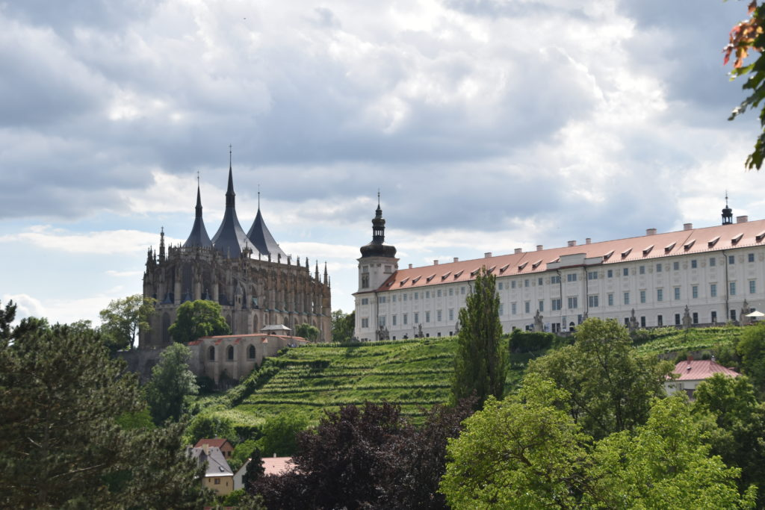
Wine Regions of the Czech Republic
Lesser-Known Regions: Blending Tradition and Innovation
Several smaller regions in the Czech Republic, while not as
well-known internationally, are making strides in the wine
making world.
Regions like Kutná Hora, located east of Prague, are emerging
as significant players in organic and biodynamic viticulture.
These regions, though smaller in scale, contribute to the diversity and innovation within the Czech wine industry.
Tourism in Lesser-Known Regions: These regions are ideal for wine tourists seeking a more off-the-beaten-path experience.
Visitors can explore boutique wineries, taste experimental wines, and enjoy the scenic beauty of the Czech countryside.

Slide 16
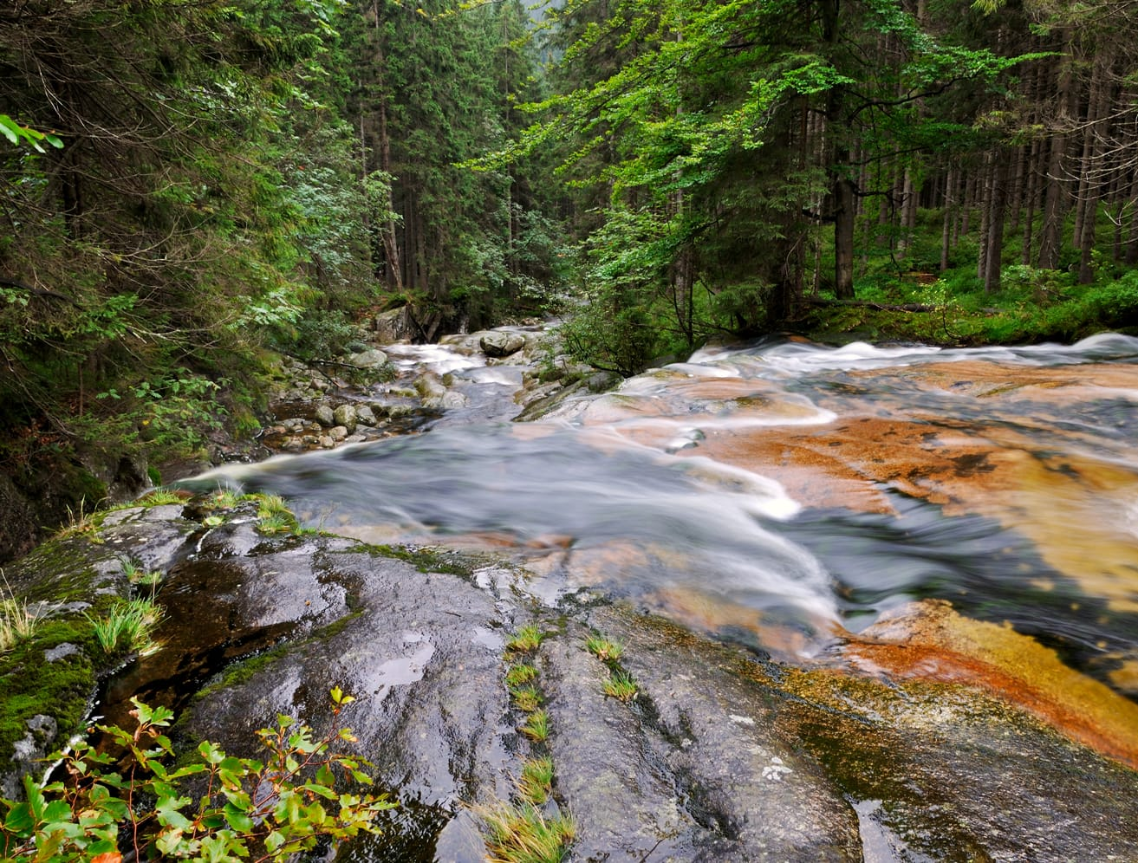
Czech Republic's Unique Terroir
The Czech Republic's diverse terroir is a key factor in the uniqueness of its wines. From the limestone soils of Moravia to the volcanic formations of Bohemia, the country's geology plays a crucial role in the flavor profiles of its wines.
Geology: Moravia is characterized by limestone and loess soils, which are particularly well-suited for white grape varieties, imparting minerality and freshness to the wines. Bohemia, on the other hand, has a mix of volcanic and alluvial soils, contributing to the distinct character of its wines.
Climate: The Czech Republic has a continental climate with warm summers and cold winters. The Moravian region benefits from the warm winds of the Pannonian Plain, which help grapes ripen fully, while the cooler climate in Bohemia favors the production of white wines and sparkling wines.
Geography: The hills of Moravia create diverse microclimates that allow for a wide range of grape varieties, while the river valleys of Bohemia provide ideal conditions for viticulture.

Slide 17
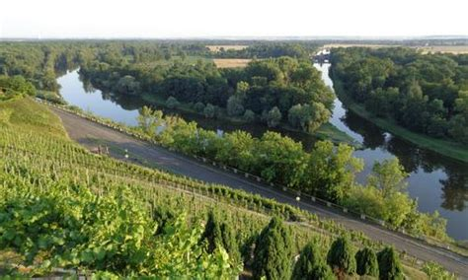
Regional Breakdown
Mělník (Bohemia)
Terroir & Climate: Mělník, located near Prague, has a cooler climate and alluvial soils that are perfect for growing Pinot Noir and Müller-Thurgau.
Wine Characteristics: The wines from Mělník are typically elegant and light, with bright acidity and delicate fruit flavors.

Slide 18
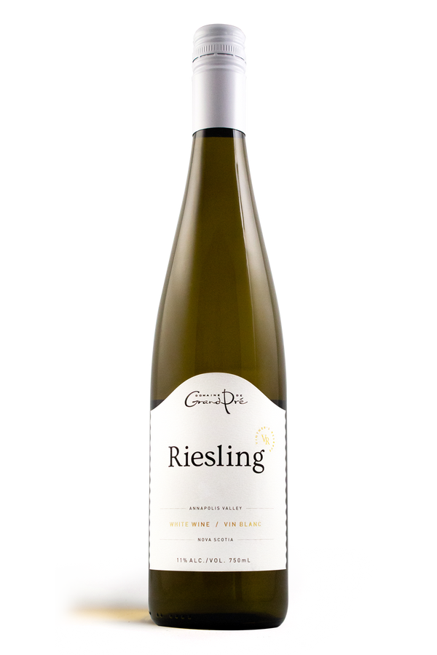
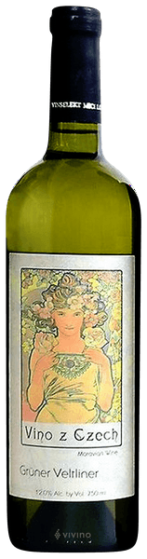
Varietals and Wine Characteristics
Grüner Veltliner
Tasting Notes: Crisp and refreshing with notes of green apple, white pepper, and citrus.
Food Pairings: Pairs beautifully with fresh salads, seafood, and Asian cuisine.
Riesling
Tasting Notes: Aromatic with notes of apricot, lime, and honey, with a balance of sweetness and acidity.
Food Pairings: Perfect with spicy foods, pork, and soft cheeses.

Slide 19
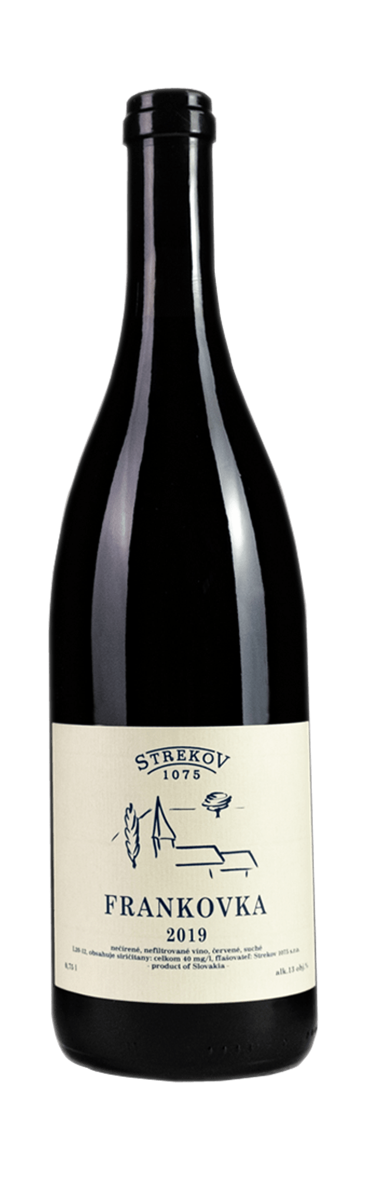
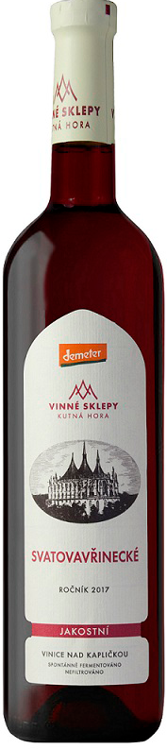
Varietals and Wine Characteristics
Blaufränkisch (Frankovka)
Tasting Notes: Rich and spicy, with flavors of dark berries, pepper, and earthy undertones.
Food Pairings: Pairs well with grilled meats, game, and hearty stews.
Saint Laurent
Tasting Notes: Dark fruit flavors with hints of cherry, plum, and a touch of smokiness.
Food Pairings: Ideal with roast duck, lamb, or mushroom dishes.

Slide 20
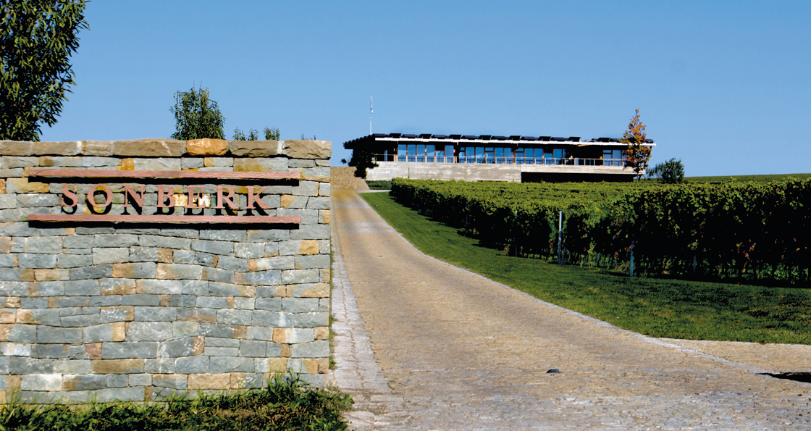
Notable Wineries and Signature Wines
Sonberk Winery (Mikulov)
Sonberk is one of the most acclaimed wineries in Moravia, known for its exceptional Rieslings and Pálava wines. Their dedication to sustainable practices and traditional winemaking methods sets them apart.
Signature Wine: Sonberk Riesling, praised for its complexity, minerality, and aging potential.

Slide 21

Notable Wineries and Signature Wines
Vinařství Gala (Velké Pavlovice)
Gala is a leading producer of red wines in the Velké Pavlovice region, particularly known for their Blaufränkisch and Pinot Noir.
Signature Wine: Gala Blaufränkisch, celebrated for its depth, structure, and spicy character.

Slide 22
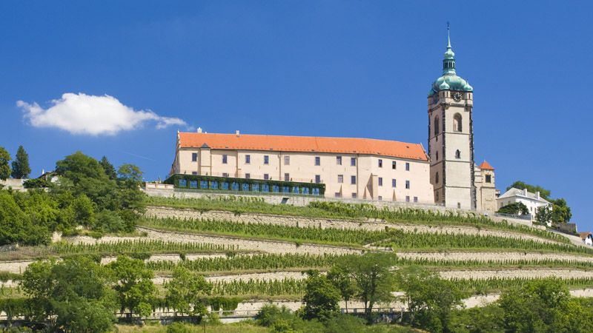
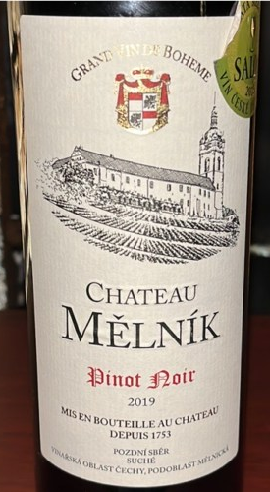
Notable Wineries and Signature Wines
Chateau Mělník (Mělník)
One of the oldest wineries in Bohemia, Chateau Mělník produces elegant wines from Pinot Noir and Müller-Thurgau, reflecting the region's long winemaking tradition.
Signature Wine: Mělník Pinot Noir, known for its delicate red fruit flavors and refined tannins.

Slide 23

Conclusion
The Czech Republic's wine industry, though often overlooked, is a hidden gem for wine enthusiasts.
With its rich history, diverse wine regions, and unique terroir, the country offers a treasure trove of wines waiting to be discovered.
Whether you're exploring the aromatic whites of Znojmo or the rich reds of Velké Pavlovice, Czech wines promise an unforgettable journey of flavors and traditions.

Slide 24
Acknowledgement
My seminars are the result of many years of experience combined with many hours of research over the internet.
I would like to acknowledge the many source I have accessed.
These include Wine Spectator, Wine Enthusiast, BKWine Magazine, Wine & Spirits Magazine, American Vineyard Magazine, The Grapevine Magazine, Wikipedia.com, Britannica.com, and the
various Government websites.

Slide 25
Citations
Books:
Robinson, Jancis. The Oxford Companion to Wine. Oxford University Press, 2015.
Stevenson, Tom. The Sotheby’s Wine Encyclopedia. DK Publishing, 2020.
Halliday, James. Wine Atlas of the World. Mitchell Beazley, 2017.
Wine Industry Reports:
Czech Wine Industry Overview, International Organisation of Vine and Wine (OIV) Reports.
Wine Market in the Czech Republic, MarketLine Industry Profiles, 2022.
Online Sources:
Czech Wine Growers Association (Svaz vinařů České republiky): Official website provides updates on Czech wine production and regulations.
Wines of Czech Republic (official tourism and wine promotion): https://www.wineofczechrepublic.cz/en/
Moravian Wine Trails: Information about wine tourism and the key wine regions of Moravia.
Articles and Journals:
Wine Enthusiast: "Czech Wines Gaining Global Recognition", June 2022.
Decanter: "Exploring the Wines of Moravia", April 2023.
VinePair: "The Rising Star of Czech Wine", September 2023.
Historical Context:
National Museum Prague archives for information on the history of winemaking in the Czech Republic during the reign of Charles IV.

