Slide 1
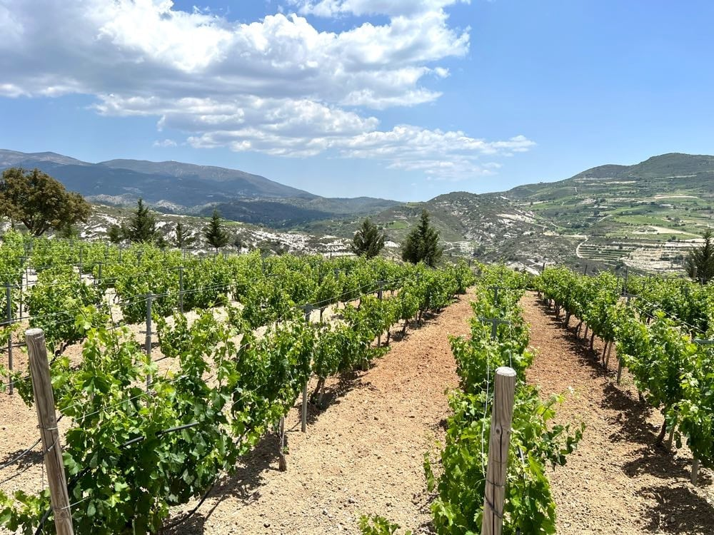
The Wines of Cyprus
An Exploration of Cyprus's Rich Wine Heritage
Presented by
Marc Silver

Slide 2
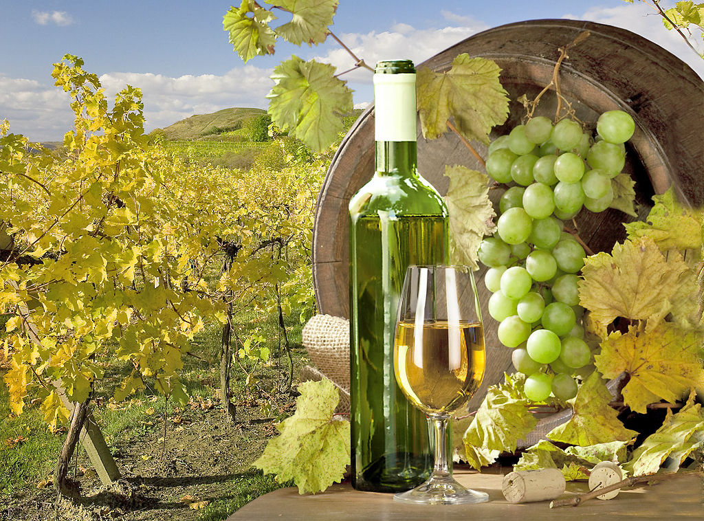
The Heartbeat of
Cypriot Wine Heritage
Cyprus, a Mediterranean island blessed with fertile soils and a rich vinous heritage, is home to some of the world’s oldest winemaking traditions.
The island's wines offer a unique blend of history, terroir, and bold varietals, offering a glimpse into ancient rituals and modern revival.
Cyprus is notable for its indigenous grapes, distinctive wine regions, and commitment to preserving traditional winemaking techniques while embracing modern innovation.

Slide 3
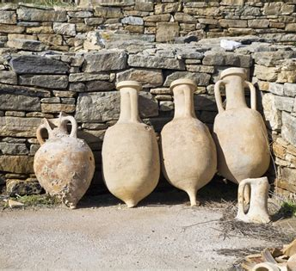
Cyprus’s Historical Tapestry of Wine
Cyprus’s winemaking history stretches back over 6,000 years, making it one of the oldest wine-producing regions in the world.
Archaeological evidence shows that wine production on the island began during the Chalcolithic period, with amphoras and grape seeds unearthed in ancient sites suggesting that viticulture was deeply embedded in early Cypriot society.

Slide 4

Cyprus’s Historical Tapestry of Wine Cont.
One of the most storied aspects of Cypriot wine history is the creation of Commandaria, a sweet wine produced since at least the 12th century.
During the Crusades, this wine gained
fame when the Knights of St. John
took control of the island.
Commandaria’s rich, sun-dried grapes
and long aging process made it a
coveted commodity.
It is often referred to as one of the
world’s oldest named wines still in
production today.

Slide 5

Cyprus’s Historical Tapestry of Wine Cont.
Post-independence, Cyprus focused on mass production, but from the 1980s, local winemakers shifted towards quality over quantity.
Revival of native grape varieties and modern winemaking techniques marked a renaissance in the late 1990s and early 2000s.
The island’s strategic location between Europe, Asia, and Africa meant that it was a hub for trade, allowing Cypriot wines to find their way to distant lands, including Greece, Egypt, and even as far as Rome.

Slide 6
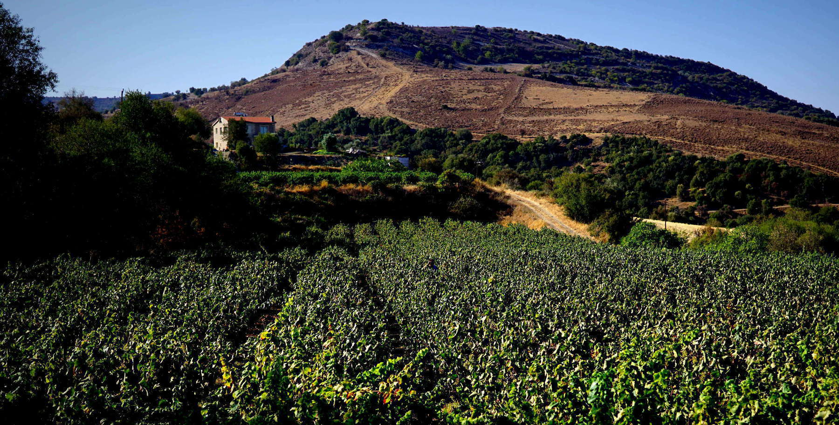
Unique Terroir of Cyprus
Cyprus’s terroir is distinct due to its combination of high-altitude vineyards, phylloxera-free soils, and a warm Mediterranean climate.
The higher elevation and rocky terrain provide excellent drainage, which reduces the risk of overwatering and allows the vines to develop deep root systems.
Moreover, Cyprus benefits from long, sunny days, which are essential for ripening grapes fully while retaining their natural acidity due to the cooling influence of the mountains.

Slide 7
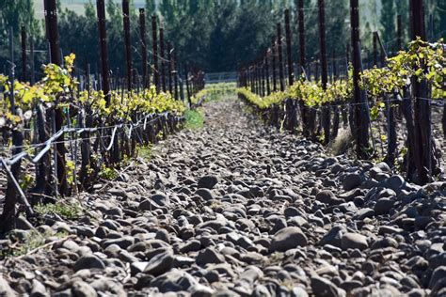
Unique Terroir of Cyprus
Another unique aspect of Cypriot viticulture is that many vines are still grown on their own rootstock, as the island has remained free from the phylloxera pest that devastated much of Europe’s vineyards in the 19th century.
Higher altitudes allow for cooler temperatures, preserving acidity in grapes.
Phylloxera-free soils mean many vines are grown on their original rootstocks, unlike most of Europe.
Long, sunny days, tempered by mountain cooling, provide ideal ripening conditions for both native and international varieties.

Slide 8
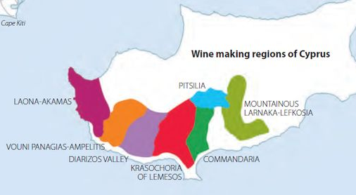
Wine Regions of Cyprus
The terroir of Cyprus is as varied as its landscape, with mountainous areas, coastal plains, and rolling vineyards offering diverse microclimates ideal for grape cultivation.
The island has four main wine regions, and 3 minor regions, each offering unique characteristics, and seven PDO (Protected Designation of Origin) zones where specific types of wine are made under strict regulations:
Krasochoria Lemesou
Commandaria Region
Pitsilia Region
Laona-Akamas
Vouni Panigias
Diarizos Valley
Larnaka-Lefkosia
4.
3.
5.
7.
1.
6.
2.

Slide 9
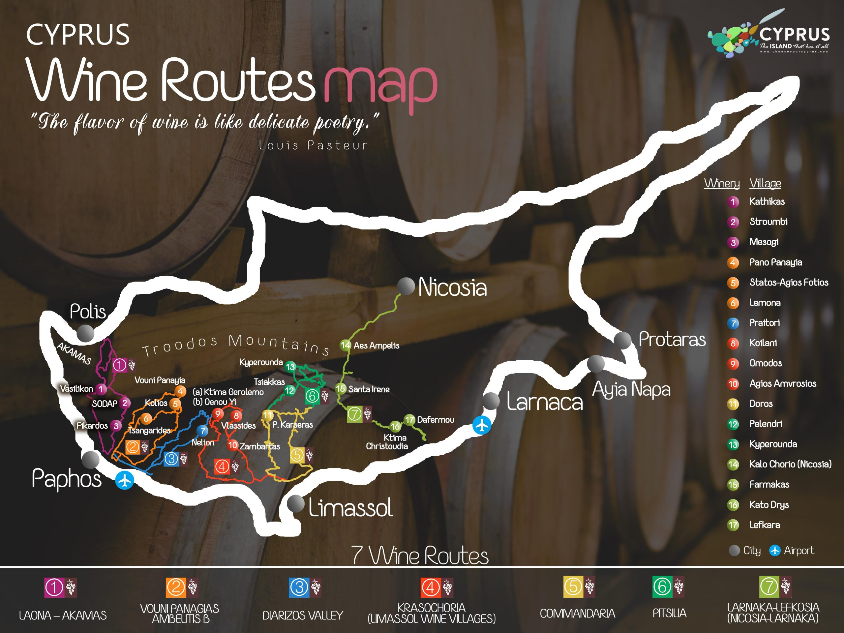

Slide 10
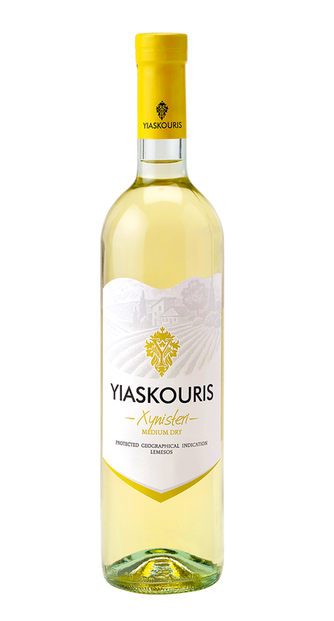
Krasochoria Lemesou
Limassol Wine Villages
Located in the southern part of Cyprus, this region is renowned for producing some of the island’s best wines.
The vineyards are nestled in the foothills of the Troodos Mountains, with altitudes ranging from 400 to 800 meters.
The cooler, elevated terrain allows for slower ripening, resulting in wines with greater complexity and balance.
The regions Terroir is a combination of Limestone and volcanic soils, altitude between 400-800 meters.
Prominent Varietals: Xynisteri (crisp, citrusy white) and Maratheftiko (bold red with dark fruit and spices).
Notable Wineries: Zambartas Winery, known for blends of native and international varietals.

Slide 11
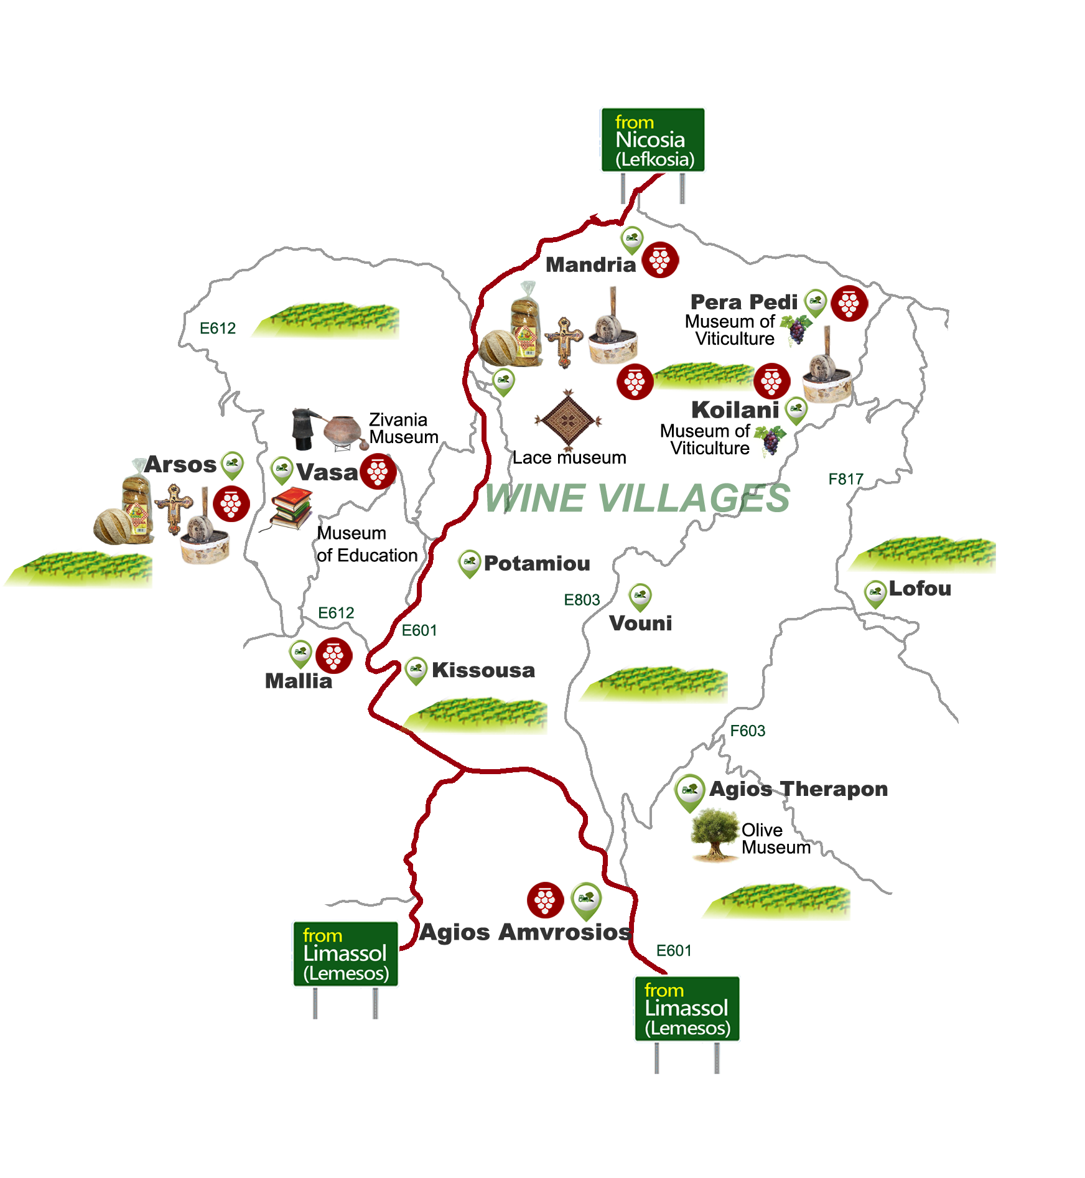
Krasochoria Lemesou
Limassol Wine Villages
Prominent Varietals:
  Xynisteri: The flagship white grape of Cyprus. This varietal produces light, crisp wines with aromas of citrus, green apple, and herbs. It’s often described as refreshing with a clean finish. Pair Xynisteri with seafood, grilled vegetables, or light salads.
  Maratheftiko: A bold red varietal known for its deep
  color and robust tannins.
  The wine boasts flavors of dark berries,
  spices, and a touch of earthiness.
  It’s perfect with lamb dishes, game,
  or rich stews.

Slide 12
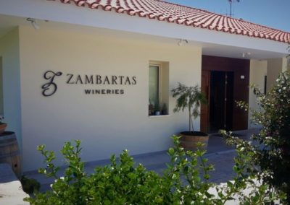
Krasochoria Lemesou
Limassol Wine Villages
  Notable Wineries:
  Zambartas Winery: Zambartas has gained recognition for producing exceptional blends of
  native and international varietals.
  Their Xynisteri is particularly celebrated for its purity and freshness.

Slide 13
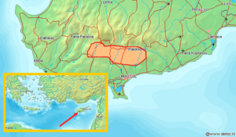
Commandaria Region
This historic wine-producing area sits in the foothills of the Troodos Mountains, northeast of Limassol. The Commandaria region is renowned for its eponymous sweet wine, which holds PDO status.
Location:
Foothills of
the Troodos
Mountains,
northeast of
Limassol.

Slide 14
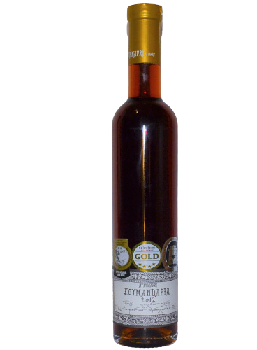
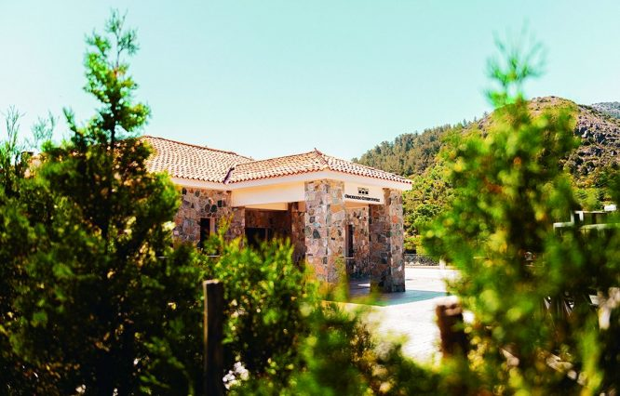
Commandaria Region
Terroir: Rocky, dry soils at altitudes of 500-900 meters.
Prominent Varietal: Mavro and Xynisteri, used to produce
the renowned Commandaria wine.
Wine Characteristics: Luscious sweet wine with notes of
dried fruit, caramel, and honey.
Notable Wineries:
Kyperounda Winery,
famed for crafting
exceptional Commandaria wines.

Slide 15
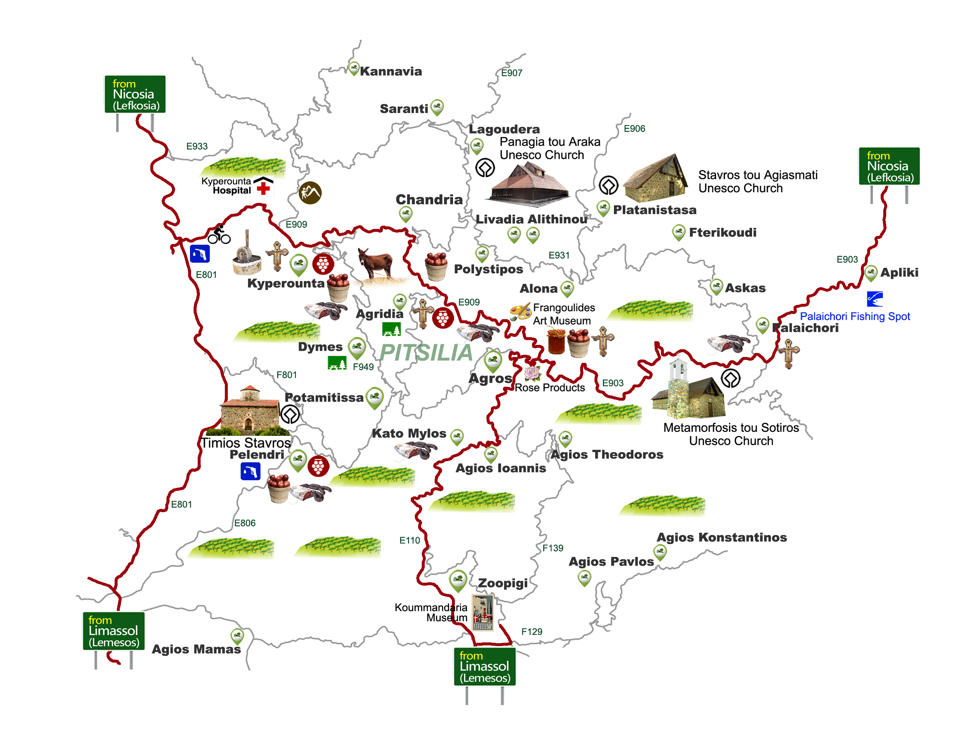
Pitsilia Region
Pitsilia is one of Cyprus's most elevated wine regions, located on the eastern slopes of the Troodos Mountains.
This area benefits from cooler temperatures and higher altitudes, resulting in elegant, structured wines.
Pitsilia grows local grape varieties as well as the rare and ancient red variety of Maratheftiko.
The grapes grown at these
highest points are taken to two
local winemakers for the
production of fine wines.

Slide 16
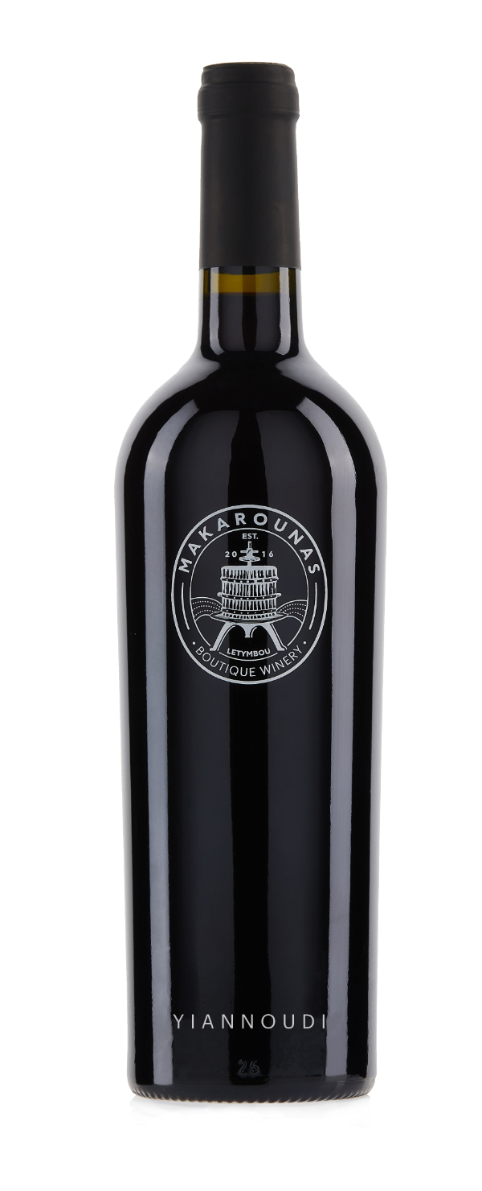
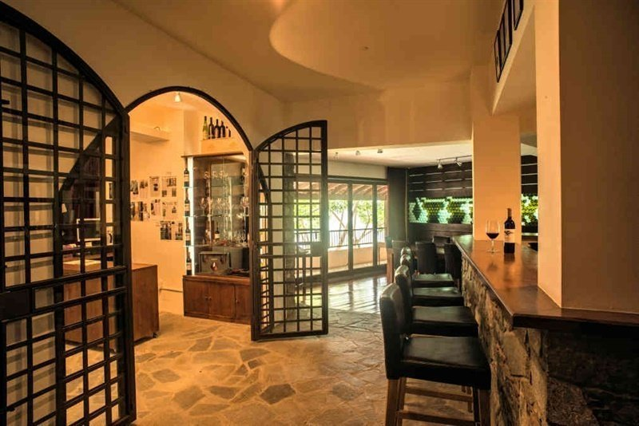
Pitsilia Region
Terroir: Vineyards range from 900 to 1,400 meters, with cool mountain air maintaining acidity.
Prominent Varietals: Yiannoudi (red with bright acidity and raspberry notes) and Ofthalmo (lighter, berry-driven red).
Notable Wineries:
Tsiakkas Winery,
known for organic
farming and focusing
on native varieties.

Slide 17
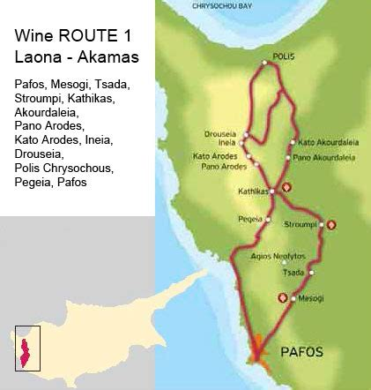
Laona-Akamas Region
This region, located in the northwest of the island near Paphos, is gaining attention for its boutique wineries and small-scale production. The region is primarily focused on organic and sustainable viticulture.
Location: Northwest Cyprus, near Paphos.
Terroir: Limestone soils and maritime influences from the coast.
Prominent Varietal: Lefkada (deep, tannic red wine with dark fruit and spice).
Notable Wineries: Vouni Panayia Winery, known for producing minimal-intervention wines.

Slide 18
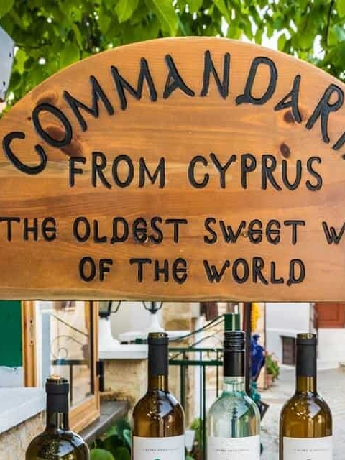
Conclusion
A Revival in Every Glass
Cyprus’s wine industry has come a long way, transforming from mass production to quality-focused, boutique wines that express the island’s unique history and terroir.
Whether it's the sun-drenched Commandaria or the refreshing Xynisteri, Cypriot wines offer a glimpse into an ancient tradition reborn for the modern palate.

Slide 19
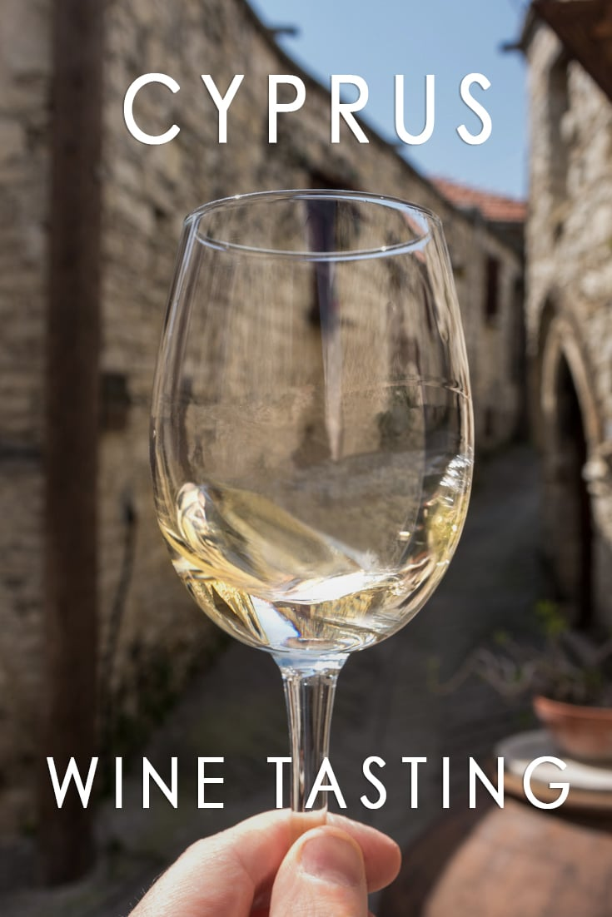
Conclusion
A Revival in Every Glass
For wine lovers eager to explore unique and diverse wines, Cyprus should be at the top of the list, with each region and varietal offering a new story in every bottle.
From the ancient days of Commandaria to the modern revival of native varietals, Cyprus offers a wealth of unique wines.
With its diverse terroirs, high-altitude vineyards, and centuries-old history, Cyprus should be on every wine enthusiast’s list.
Explore the unique flavors of Cyprus wines and experience the island’s rich vinous heritage in every sip.

Slide 20
Acknowledgement
My seminars are the result of many years of experience combined with many hours of research over the internet.
I would like to acknowledge the many sources
I have accessed.
These include Wine Spectator, Wine Enthusiast, BKWine Magazine, Wine & Spirits Magazine, American Vineyard Magazine, The Grapevine Magazine, Wikipedia.com, Britannica.com, and the
various Government websites.

Slide 21
References
GuildSomm International. "Cyprus Wine Overview." GuildSomm. Accessed September 29, 2024.
Vinerra. "Cyprus Wine Regions, Grape Varieties, and Wines." Vinerra. Accessed September 29, 2024.
Wines of Cyprus. "Cyprus Wine History and Terroir." Wines of Cyprus. Accessed September 29, 2024.
GuildSomm: Detailed information on Cyprus’s wine history and the importance of indigenous varieties such as Xynisteri and Maratheftiko.
Vinerra: Insight into the different wine regions, terroir, and major grape varietals of Cyprus.
Wines of Cyprus: Background on the modern development of Cyprus’s wine industry, particularly the focus on quality over quantity and the resurgence of native grapes.

