Slide 1
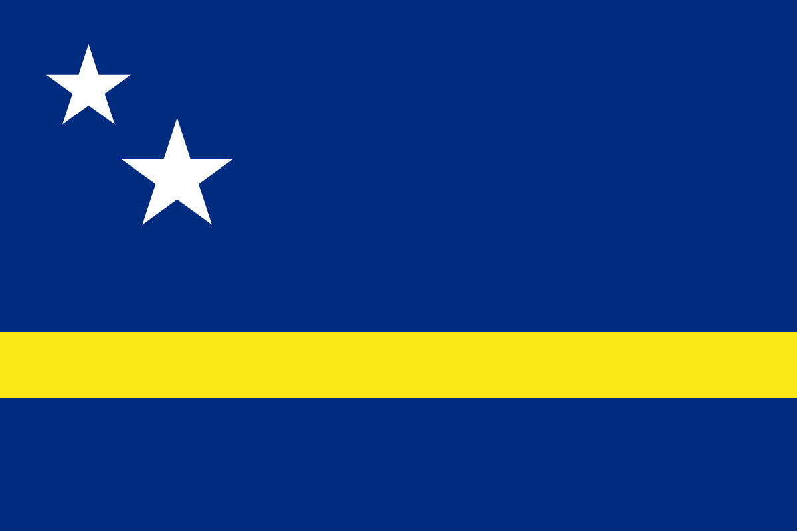
Curaçao
Presented by
Fellow Cruiser
Marc Silver

Slide 2
What I Will Cover
My Port Philosophy
Don’t Miss the Ship
Money
VAT Refunds
About Curaçao,
History of Curaçao,
Transportation
Points of Interest
Places to see or at least consider
A few restaurant recommendations
Conclusion

Slide 3
My Port Philosophy
I have been cruising for over 45 years and have taken over 100 cruises.
So, I consider myself an experienced cruiser.
The information I will present is based on those many years of
experience.
When I am on a cruise where the city, I want to visit is not the port city,
I always recommend taking a ship’s tour.
But when I am in a port with multiple attractions nearby and easy to see
on my own -
I will do it on my own.
This presentation is for that type of port.

Slide 4
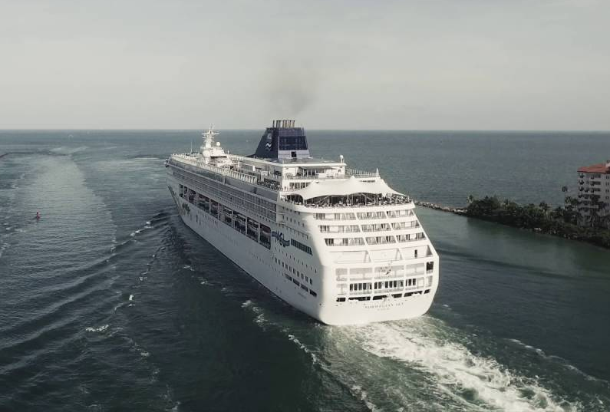
Don’t Miss the Ship
How to Avoid Missing Your Ship
Pay attention to the time. - Ship time and local time are often
different.
Put a return-to-ship reminder on your phone.
Choose excursions wisely.
If a ship-sponsored excursion is late returning to port for, the ship will
wait for you. If you are on your own???
Be Prepared
Have your Passport, Credit Card and phone numbers for your ship port agent.
What to Do If You Miss the Ship
Most cruise lines have port agents stationed in the port area to assist if your ship has left without you. If you’re lucky, when cruisers are late returning to the vessel, the ship's crew will often remove the passengers' essential items -- passports, cell phones and medication -- from the ship to leave with the port agents.
The Port Officials can help you with contacting your ship
and making necessary travel arrangements.

Slide 5
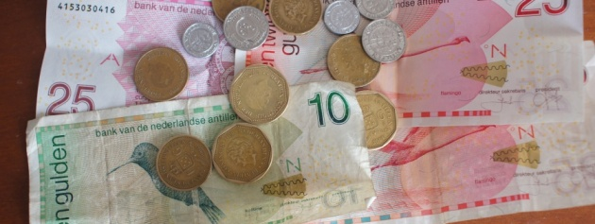
Money
The currency used in Curaçao is the Antillean Guilder (ANG), also called the Florin. The Antillean Guilder's exchange rate is fixed to the US Dollar at a price of 1 USD = 1.80 ANG.
You can use US Dollars everywhere in Curaçao. In stores and restaurants, the exchange rate used is usually 1 USD = 1.75 ANG for ease of calculation.

Slide 6
VAT Refunds
Curacao's main VAT rate is 6%, with other rates including 9% and 7% that can apply to certain transactions. The Turnover tax (TOT) is administered by the Inspectie der Belastingen in Willemstad and applies to most purchases of goods within Curacao. A VAT refund may be available to visitors who qualify for VAT-free purchases in Curaçao.
Your total gross purchase amounts will be summed and rounded to the nearest Antillean Guilder. From this total, the total amount of VAT refund will be calculated, based on the 6% standard VAT rate in Curacao. For example: $100 spent (incl. 6% VAT) = $94.00 base price + $6.00 VAT paid.
Your Tax-Free Forms must be export-validated in order to be accepted for a tax refund. Validation confirms that the products have been exported from Curacao, and will often be done in the airport as you leave the country.
In short… Is it really worth jumping through all the hoops?

Slide 7
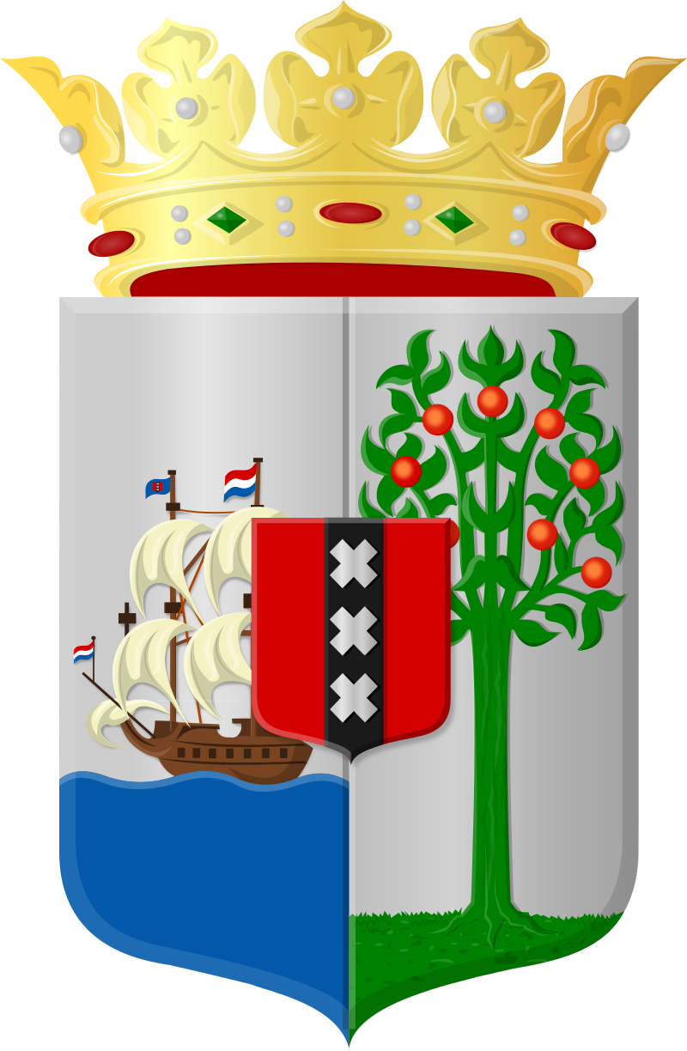
Curaçao
Curaçao, officially the Country of Curaçao, is a Lesser Antilles island in the southern Caribbean Sea and the Dutch Caribbean region, about 65 km north of the Venezuela coast. It is a constituent country of the Kingdom of the Netherlands. Together with Aruba and Bonaire, it forms the ABC.
Curaçao was formerly part of the Curaçao and Dependencies colony from 1815 to 1954 and later the Netherlands Antilles from 1954 to 2010, as the Island Territory of Curaçao and is now formally called the Country of Curaçao. It includes the main island of Curaçao and the much smaller, uninhabited island of Klein Curaçao its capital is Willemstad.

Slide 8
Historical Curaçao
The first known inhabitants of the island of Curaçao were the Caiquetio Indians of the Arawak tribe from Venezuela. During the Pre-Ceramic period, 2500 BC - 1000 AD, this seminomadic tribe fished, hunted, and gathered food, depending mostly on the sea for survival. They created tools out of roughly flaked stones and shells and lived in small family groups in the coastal areas known today as Malmok and Palm Beach.
In 1634, during the Eighty Years' War of Independence between the Republic of the Netherlands and Spain, the Dutch West India Company under Admiral Johann van Walbeeck invaded the island; the Spanish surrendered in San Juan in August. Approximately 30 Spaniards and many indigenous people were then deported to Santa Ana de Coro in Venezuela. About 30 Taíno families were allowed to live on the island while Dutch colonists started settling there.

Slide 9
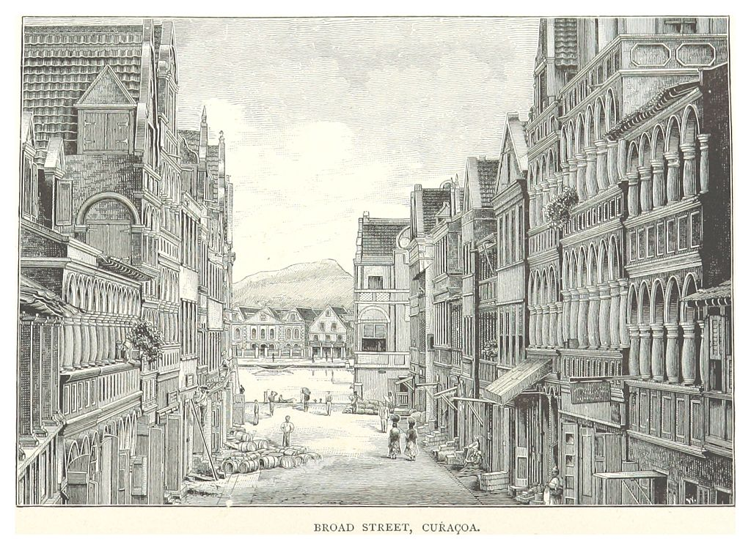
History of Curaçao
The Dutch West India Company founded the capital of Willemstad on the banks of an inlet called the Schottegat; the natural harbor proved an ideal place for trade. Commerce and shipping—and piracy—became Curaçao's most important economic activities. Later, salt mining became a major industry, the mineral being a lucrative export at the time. From 1662, the Dutch West India Company made Curaçao a center of the Atlantic slave trade, often bringing
slaves from West Africa to the island, before selling them elsewhere in the Caribbean.
Sephardic Jews fleeing persecution in Spain and Portugal sought haven in Dutch Brazil and the Dutch Republic. Many settled in Curaçao, where they made significant contributions to its civil society, cultural development, and economic prosperity.
Many Dutch colonists grew affluent from the slave trade, building impressive colonial buildings in the capital of Willemstad; the city is now a UNESCO World Heritage Site.

Slide 10
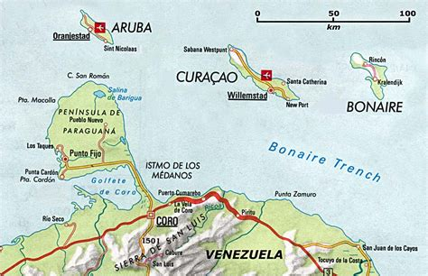

Slide 11
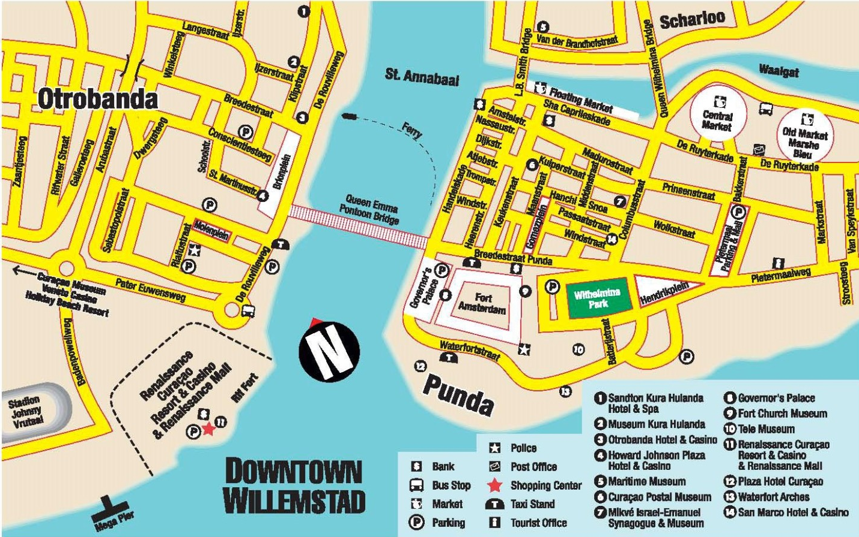
Map of Curaçao

Slide 12
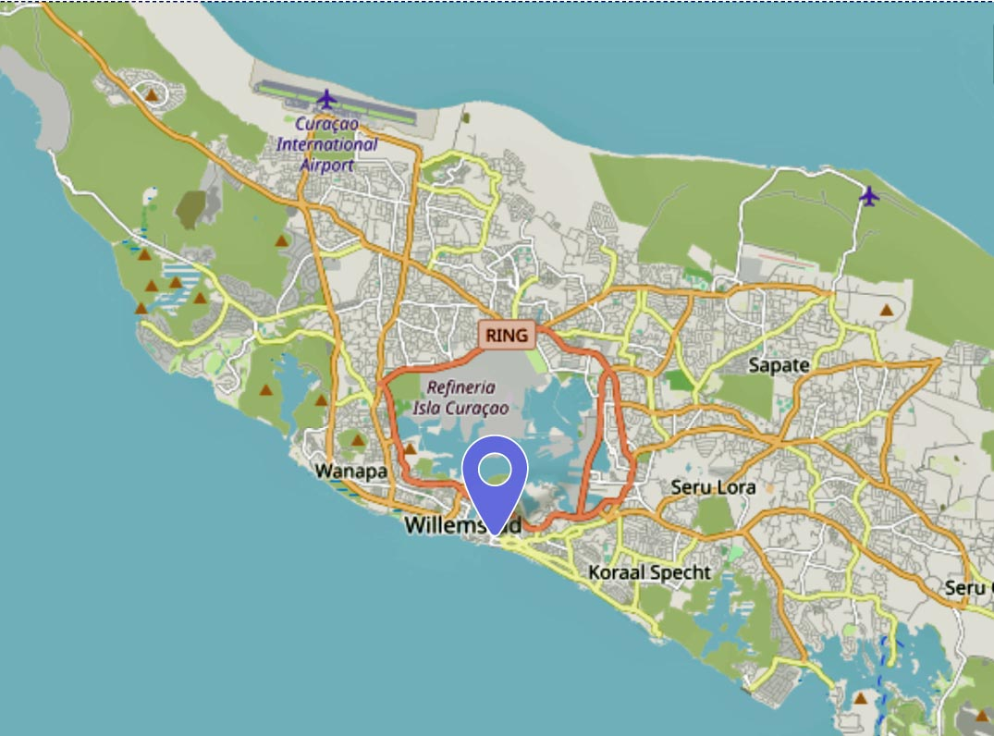
Curaçao Bus
Public transportation in Curaçao is limited. The large "Konvooi" buses will get you around Willemstad, with stations located in Punda and Otrobanda. However, buses only run about once an hour on weekdays, and even more rarely on weekends.
Buses will also shuttle you westward, but service along these routes is infrequent (every two hours or so).
One-way fares vary but generally cost 2 guilders (or about $1.15). You can also ride the smaller "buses" that run more frequently but have no set schedule.

Slide 13
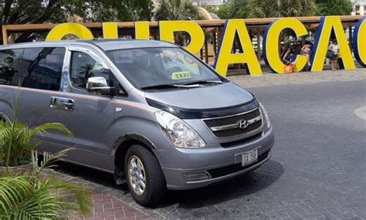
Taxis in Curaçao
Taxis are good for short jaunts around Willemstad, but longer journeys and island tours will put a considerable dent in your wallet. Curaçao's taxis are unmetered, but drivers may have rate sheets available for different destinations. A cab ride to the northwestern side of the island will cost you about $80 to $100.
Also, taxi drivers expect a 10-percent tip. It's best to agree on a fare before you enter the cab.
Some taxis offer private island tours, so that’s also a way of getting around Curaçao!
Please note that the taxi fee covers a ride for a maximum of five passengers, so if you have a larger group, you’ll need to arrange it accordingly.

Slide 14
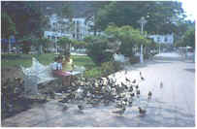
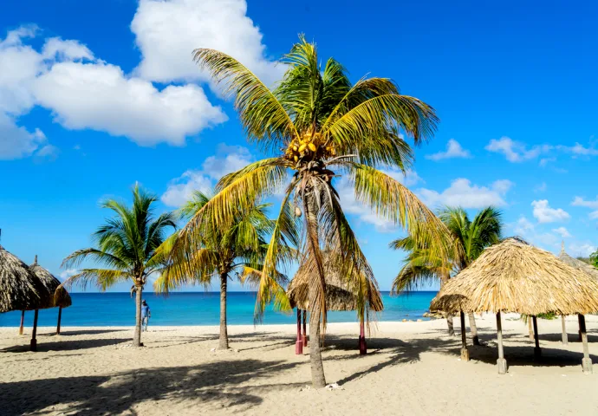
Daaibooi Beach
A small bay close to town, this beach has good snorkeling along its rocky ledge and a small fishermen's cove. Pergolas provide adequate shade and there is also a snack bar that is open both during the week and on the weekend. To the west of the beach, a small trail leads into the countryside.

Slide 15


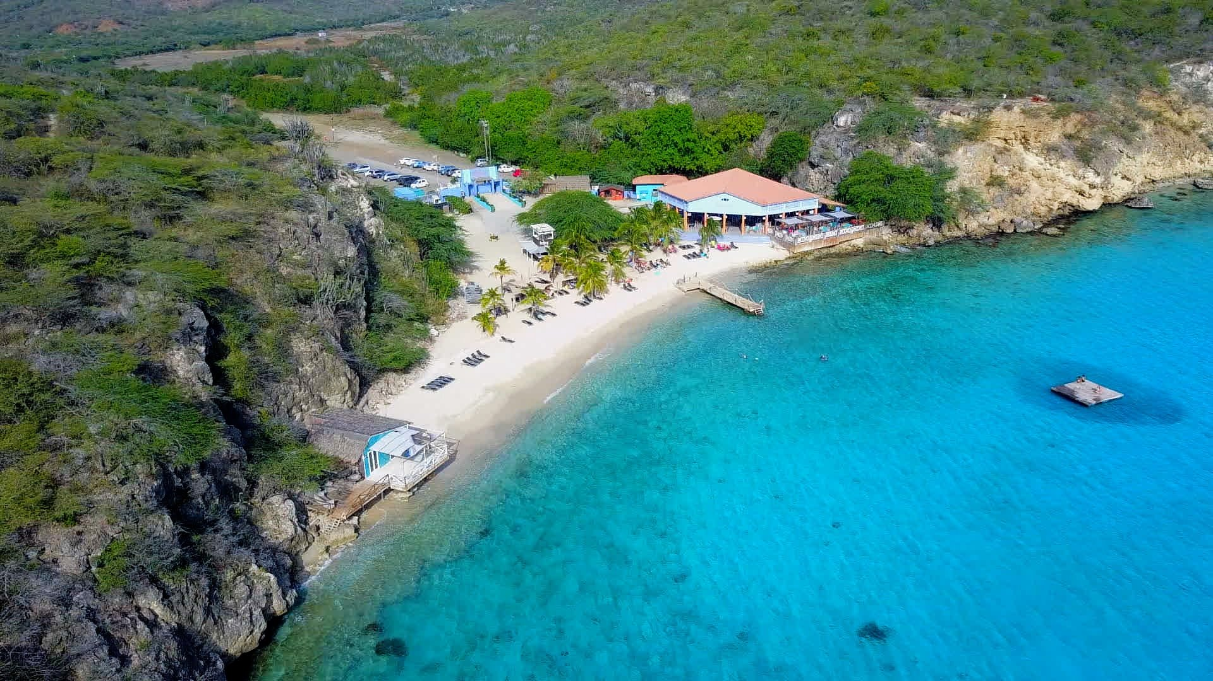
Kokomo Beach
Kokomo is the ideal beach to enjoy a quiet day with the whole family, have a great lunch, try one of our delicious cocktails or just fall in love with the crystal-clear water!! We have lounges to relax, read a book, or just hang out with an ice-cold beer! Kokomo has no entrance fee.
Kokomo also has a professional dive center that can show you the amazing underwater world of Kokomo Beach.

Slide 16
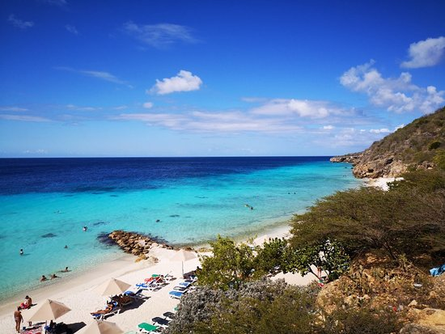
Playa Porto Mari
Playa Porto Mari is a beautiful sandy bay to be found on the private estate of Plantages "Porto Mari" on the west coast. Its white coral sand beach, with clear and calm water, is a true paradise for water lovers. The unique "double" reef is easily accessible from the shore, providing a fascinating snorkel and dive site. There's a dive operator at the beach. For landlubbers, two nature trails have their starting point at the beach parking lot. All activities at Playa Porto Mari are managed in an environmentally responsible manner. For example, water is recycled and used for toilets and irrigation
purposes, the boardwalks are made from discarded pallets or "Trex", a recycled product, and their publications are printed on 100% wood-free recycled paper. Playa Porto Mari is open every day and the beachside bar and restaurant offer visitors a variety of delicious tropical drinks and meals.

Slide 17
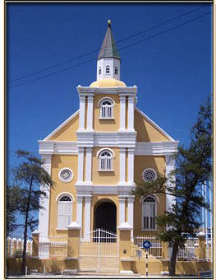
Jewish Cultural Historical Museum
Explore almost 400 years of Jewish history on Curaҫao at the Jewish Cultural Historical Museum, located adjacent to the majestic Mikvé Israel-Emanuel synagogue. The Timeline at the museum’s entry gate gives you a glimpse of Curaҫao Jewish history within world history, and the museum’s permanent exhibits delve deeper, illustrated by ancient objects, many of which are still in use at the synagogue. Visit to the synagogue is included in the entry fee.
Tickets are purchased at the synagogue entrance. The entrance fee is US $10

Slide 18
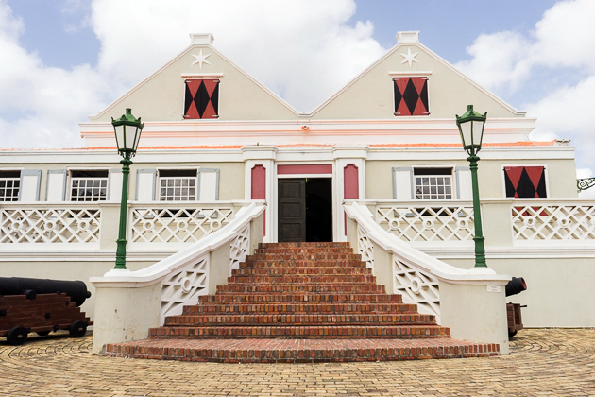
Curaçao Museum
Located in the Western part of Otrobanda, the Curacao Museum is housed in a colonial-style building and conveys an air of authenticity at the very first glance. In this spacious museum the geological history of Curacao is displayed, as well as pre-Colombian Indian artifacts; maps and charts of America and the Caribbean region; professions the afro-Curaçaoan practiced after the abolition of slavery, their beliefs and mode of living, a traditional plantation kitchen; antique mahogany furniture (18th and 19th century) and paintings by local and international artist.
Unique in the Caribbean region is the carillon with 47
bells. The Snipgallery houses the cockpit of the "Snip", the
first KLM plane to cross the Atlantic Ocean in 1934. The
large shaded grounds are a pleasant place to stroll.
Ticket: Adults: $11.54

Slide 19
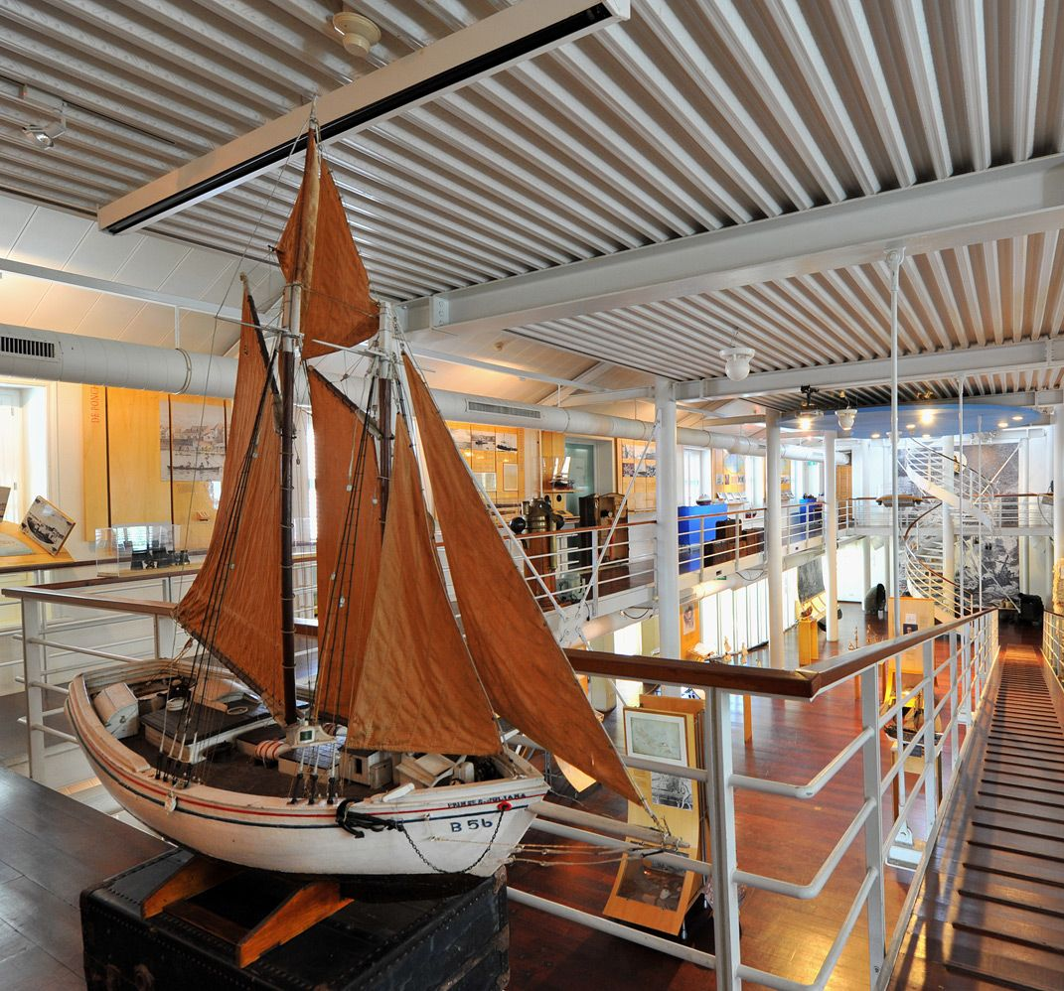
Maritime Museum Curacao
Situated in the heart of the world-renowned Scharloo neighborhood of Willemstad, a UNESCO World Heritage site, the Curaçao Maritime Museum is just steps away from the floating Queen Emma bridge and cruise terminals.
The Curaçao Maritime Museum takes you on a journey of discovery of more than 500 years of Curaçao's maritime and national history.
Discover Curaçao's maritime heritage at our museum, featuring nautical charts, ship models, navigation equipment, and engaging displays.
Immerse yourself in Curaçao's rich maritime history and experience the legacy that has shaped the island's identity.
Adult : US$ 10.00
Child 6-17 US$ 7.00
Child less than 6 years old: Free

Slide 20
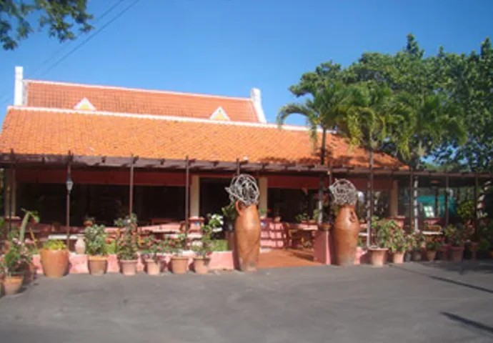
Landhuis Daniel Plantation
Plantation Daniel was established around 1650. Tradition has it that it was built by a castaway who washed ashore on St. Daniel’s Day. According to others, the plantation was named after Daniel Ellis -an Englishman employed by the Dutch West Indian Company- who built the plantation house in the first half of the 1700s, It is one of the oldest, still existing plantation houses of Curacao.
Agriculture and cattle breeding was never very successful at Daniel and in the 1800s the plantation was put up for auction several times. In the 1900s the plantation was abandoned and in the 1950s the plantation house had become a ruin. In 1997 Country House was transformed into a beautiful guesthouse/hotel and restaurant.

Slide 21
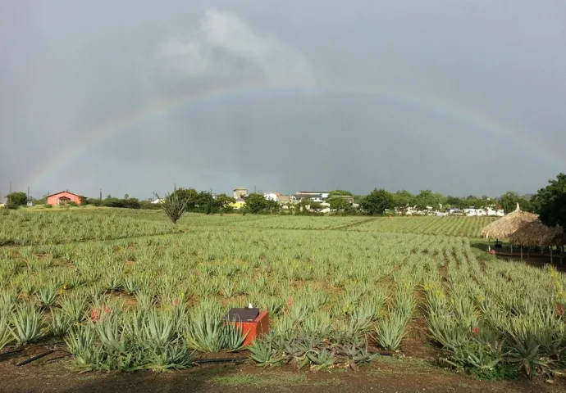
Curaloe (The Aloe Vera Plantation Curaçao)
Feel free to visit the plantation; no reservations are necessary and there is no admission fee. Shop attendants will offer you information about the plantation and products, and you can watch a video of the production process. You are free to browse around the plantation premises, test products and enjoy a nice cup of coffee under our “palapa” while taking in the serene environment.
Admission Free

Slide 22
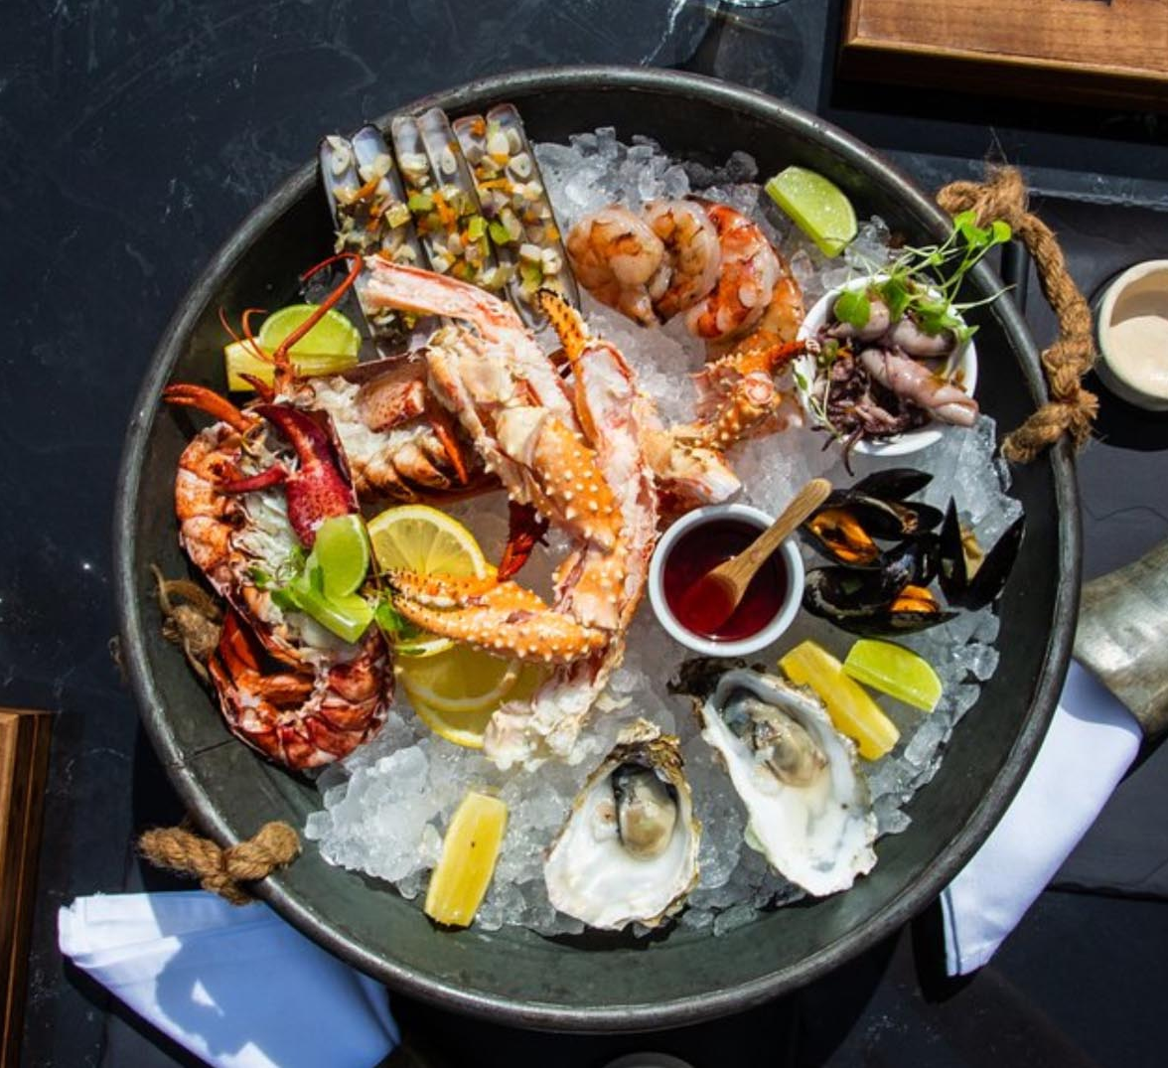
Curaçao Restaurants
Curaçao has many excellent restaurants. Many of us on the ship are
foodies, so naturally, we’re always on the hunt to eat at the most
exclusive spots anytime we travel.
Here are a few of the best restaurants to consider in downtown Curaçao.
Bodega Siete Gotas $$$$ Steakhouse, Caribbean, Seafood
Ferdinandstraat # 28, Willemstad
Baoase Culinary Beach Restaurant $$$$ Caribbean, Seafood, European
Winterswijkstraat 2, Willemstad
De buurvrouw $$ - $$$ Dutch, Seafood, International
Martha Koosje 8, Willemstad
Gouverneur de Rouville $$ - $$$ Caribbean, Seafood, International
De Rouvilleweg 9-F Otrobanda Waterfront, Willemstad
Ceviche 91 Curaçao $$ - $$$ Caribbean, Peruvian, Seafood
Riffort Village Renaissance 701 4th Floor, Willemstad
For those of you who just like good food, you can’t go wrong just about anywhere you go in Curaçao.
GOOD EATING

Slide 23
Conclusion
Curaçao is a beautiful Island with a rich history and numerous attractions. Whether you're looking for stunning beaches, historic sites, or unique attractions, Curaçao has something for everyone.
I hope this presentation will help when we visit Curaçao!

Slide 24
Thanks For Coming
If you have any more questions, please ask.
I will do my best to answer them for you.
Have a great visit in Curaçao!

