Slide 1
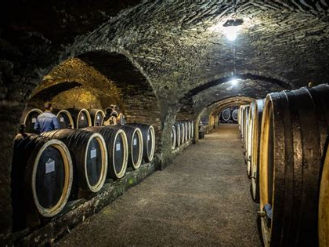
The World of Croatian Wine
Presented by
Marc Silver

Slide 2
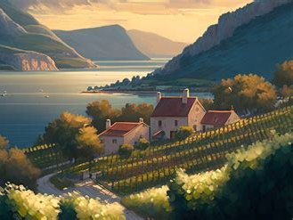
Discussion Points
Overview of Croatia's wine history
Prominent Varietals
Discussion of terroir, climate, and varietals
Croatia's Wine Regions
The Unique Terroir of Croatia
Conclusion

Slide 3

The Rich History of Croatia Wines
Introduction
Croatia, with its picturesque coastline and rolling hills, is not only a hidden gem for travelers but also an emerging star in the world of wine.
From crisp whites to bold reds, Croatia's diverse terroir and long-standing viticultural tradition have given rise to a remarkable array of wine styles.
Croatia has a history dating back thousands of years, and their wines are finally beginning to receive the international recognition they deserve.
I will guide you through Croatia’s
fascinating wine history, explore its
key wine regions, and showcase its
notable varietals. Whether you're a
casual drinker or a seasoned
oenophile, Croatia’s wine scene
offers something unique for every
palate.

Slide 4
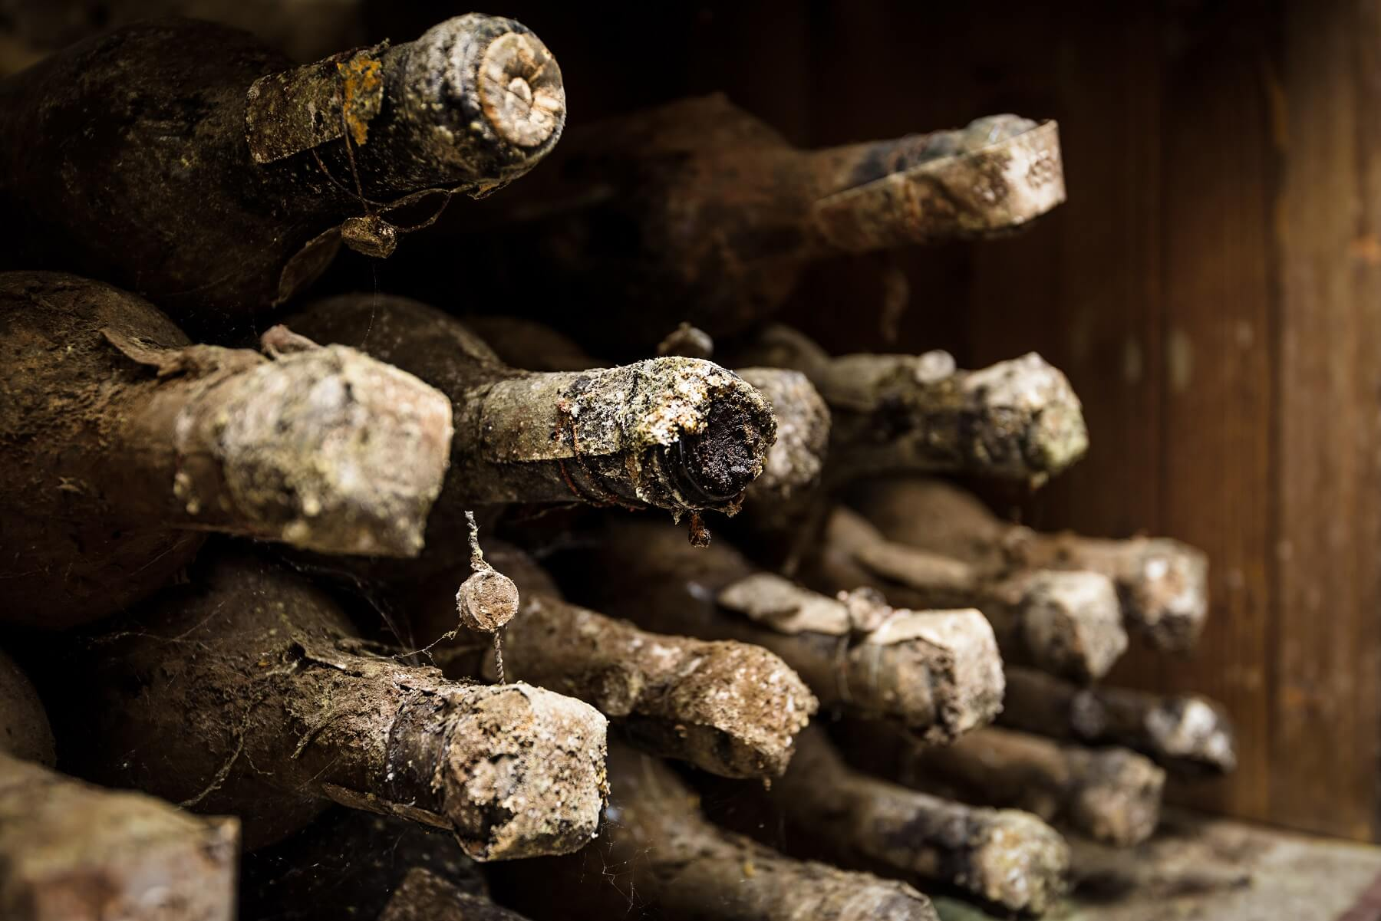
Croatia's Wine History
A Historical Overview of Croatian Wine
Croatia's wine history stretches back at least 2,500 years to the time of the Illyrians and Ancient Greeks, who first brought the vine to its fertile soil.
Situated along the Adriatic Sea, Croatia was influenced early on by its proximity to Italy and Greece, two ancient leaders in the world of wine.
The Greek settlers on the island of Hvar in the 4th century BCE established the first organized vineyards, a legacy that still remains on the island today.

Slide 5
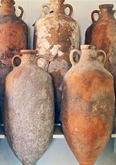
Croatia's Wine History
Roman viticulture further advanced winemaking techniques in Croatia, and by the time of the Roman Empire, wine was an essential part of life, culture, and commerce. It was during this era that Croatia’s wine tradition began to flourish.
With the fall of the Roman Empire, winemaking continued under the Byzantine and later Venetian rule, especially along the Dalmatian coast, where trade routes encouraged the exchange of wine knowledge.
By the Middle Ages, many Croatian monasteries had established vineyards, ensuring that viticulture remained a central part of the country’s agrarian economy.

Slide 6

Croatia's Wine History
The Ottoman invasions in the 15th and 16th centuries devastated much of the viticulture on the mainland, though coastal areas like Dalmatia remained relatively unaffected.
The influence of Austro-Hungarian rule in the 18th and 19th centuries helped modernize and expand winemaking practices across the country.
Croatia's wine industry faced yet another setback in the late 19th century with the phylloxera epidemic, which ravaged vineyards throughout Europe.

Slide 7
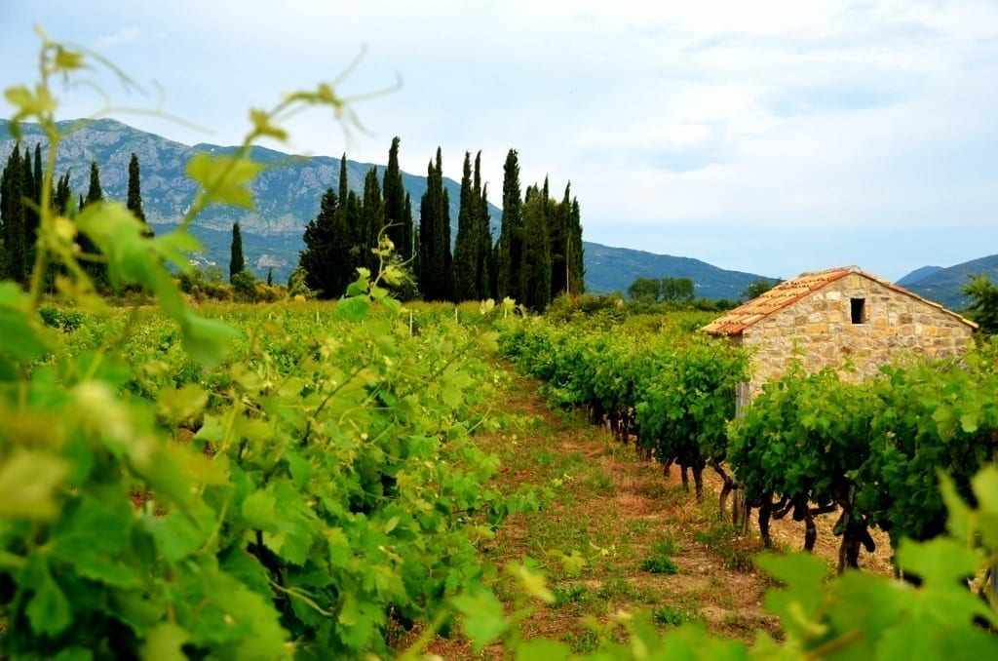
Croatia's Wine History
After World War II, Croatia—then part of Yugoslavia—began to rebuild its wine industry under state-controlled cooperatives, which emphasized quantity over quality.
It wasn’t until Croatia declared independence in the early 1990s that winemaking began to shift focus toward quality production, with many small, family-owned wineries returning to traditional methods and native varietals.
Today, Croatia’s wine renaissance is
in full swing, attracting global
attention with its distinctive regional
styles and indigenous grapes.

Slide 8
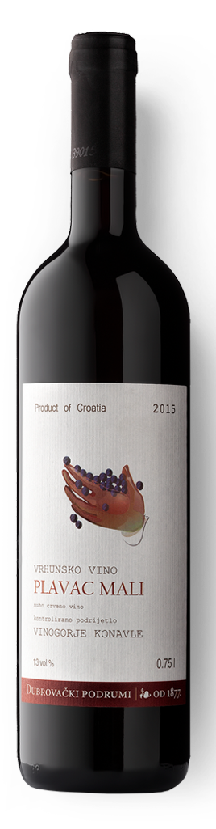
Prominent Varietals
Plavac Mali (Red): Plavac Mali is the king of Dalmatian reds, known for its dark color, high tannins, and rich flavors of blackberry, dark cherry, and dried figs.
With time, it develops notes of leather, smoke, and earth.
Plavac Mali is closely related to Zinfandel and offers a bold, structured palate, with higher alcohol content (often above 14%).
It pairs beautifully with robust dishes like grilled lamb, steak, and game meats.

Slide 9
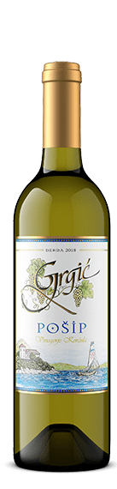
Prominent Varietals
Pošip (White): A golden-hued white wine, Pošip is indigenous to the island of Korčula and offers flavors of dried apricots, figs, and honey, with a subtle minerality a result of the limestone soils.
It is fresh and aromatic, making it
an ideal companion for seafood
dishes, especially grilled fish,
oysters, and shellfish.

Slide 10
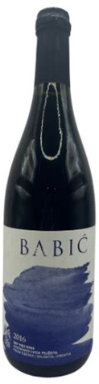
Prominent Varietals
Babić (Red): Hailing from the Primošten area, Babić is a deep, ruby red wine with flavors of dark berries, pepper, and herbs.
It is medium-bodied with pronounced acidity, pairing well with grilled meats, mature cheeses, and hearty stews.

Slide 11
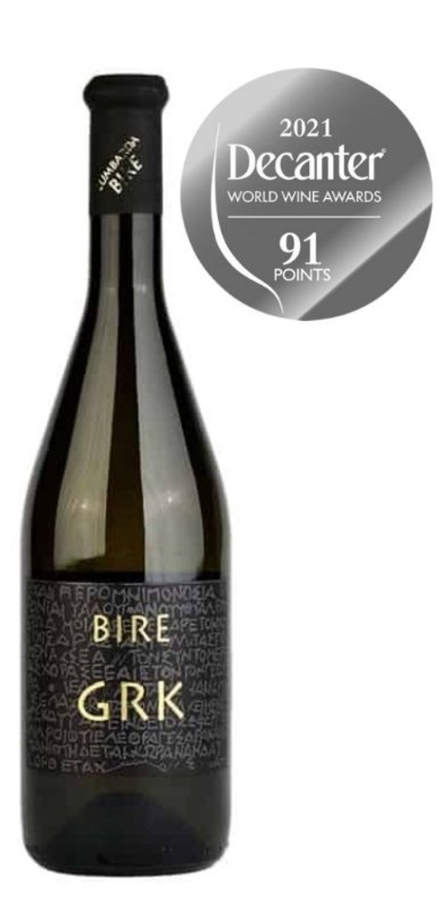
Prominent Varietals
Grk (White): Grown on the island of Korčula, Grk is a rare and intriguing white wine with saline minerality, notes of green apple, and bitter almond.
Its natural acidity and unique complexity make it a perfect match for fresh seafood and Mediterranean cuisine.

Slide 12
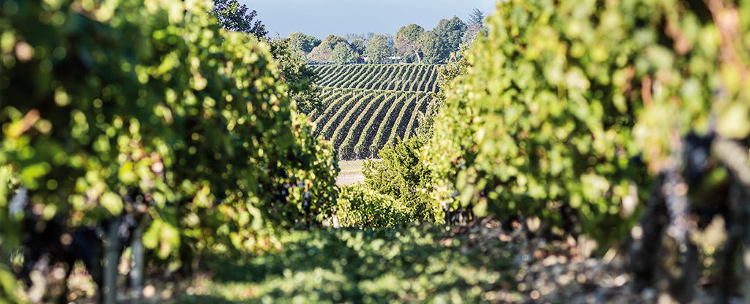
The Unique Terroir of Croatia
Mediterranean and Continental climates
Diverse topography: coastal vineyards, islands, and mountains
Rich soils: limestone, red soil, karst
Proximity to the Adriatic Sea
Distinct microclimates

Slide 13

The Unique Terroir of Croatia
What truly sets Croatia apart as a wine-growing country is its remarkably diverse terroir, shaped by its varied geography and climate.
The country’s wine regions range from coastal Mediterranean environments, where the sun shines nearly year-round, to inland areas with cooler, continental climates.
This diversity allows for a wide array
of grape varieties to thrive, from the
heat-loving Plavac Mali in Dalmatia
to the fresh, aromatic Graševina in
Slavonia.

Slide 14
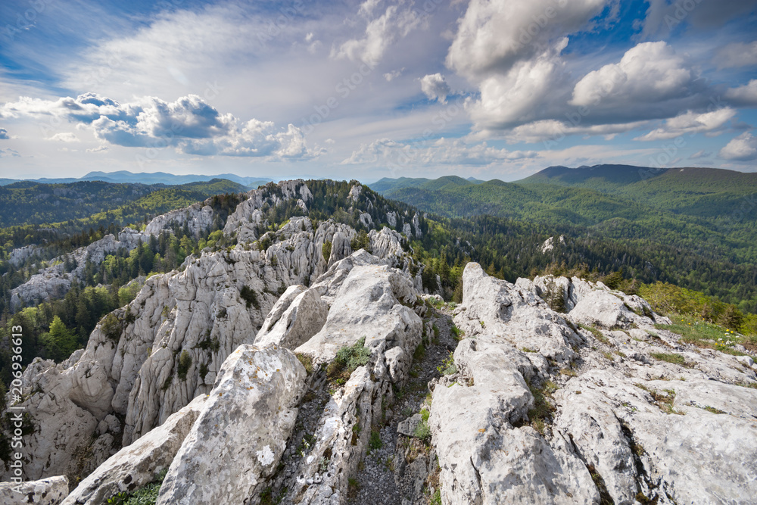
The Unique Terroir of Croatia
One of Croatia’s defining features is its limestone and karst landscapes, particularly in regions like Istria and Dalmatia.
These soils are rich in minerals, which contribute to the distinctive minerality found in many of the country’s wines.
The influence of the Adriatic Sea also plays a significant role, especially in the coastal regions, where the salty sea breezes impart a subtle brininess to wines like Grk and Pošip.

Slide 15
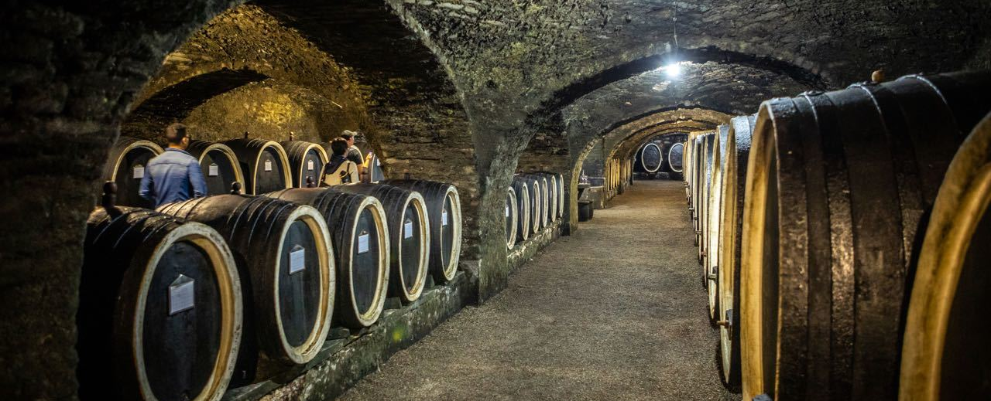
The Unique Terroir of Croatia
Croatia’s combination of old-world tradition and new-world innovation is another key aspect of its terroir.
Winemakers here have embraced modern techniques while maintaining a deep respect for their native grape varieties and ancient methods, such as amphora-aged wines and minimal intervention practices.

Slide 16
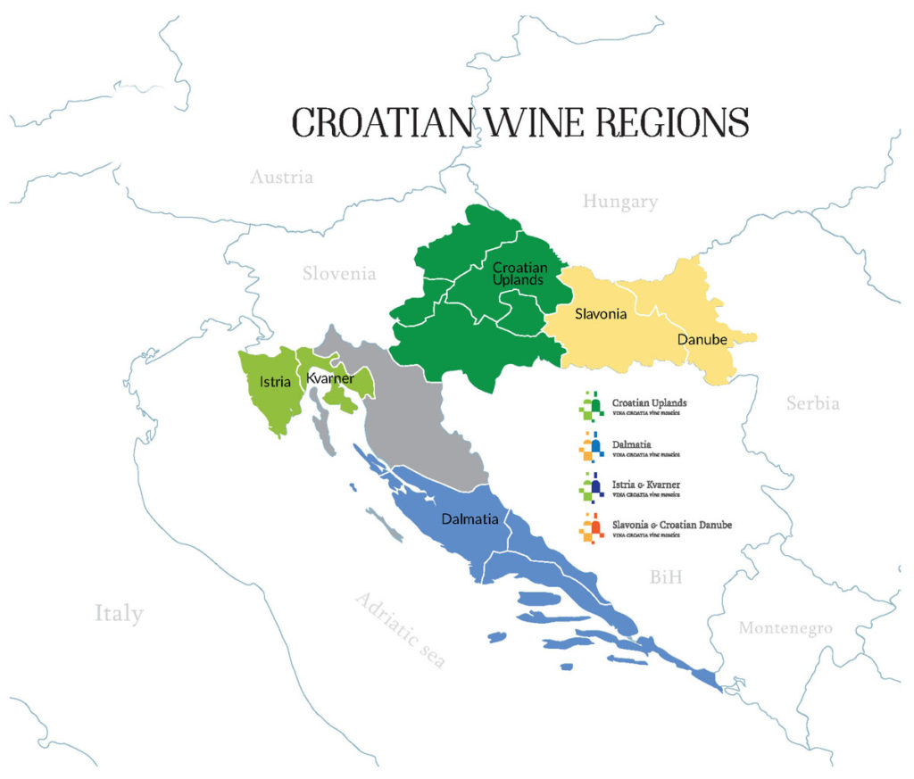
Croatia’s Wine Regions
Croatia boasts four main wine regions, each with its own unique terroir, climate, and grape varieties.
These are Dalmatia, Istria and Kvarner,
Slavonia and the Danube, and Central Croatia.
These regions can be divided into two
overarching climatic zones: the Mediterranean
coastal regions of Dalmatia, Istria, and Kvarner,
and the continental climates of Slavonia and
Central Croatia.
Let’s take a deep dive into each of these
regions, their terroirs, prominent varietals, and
what makes them special.

Slide 17
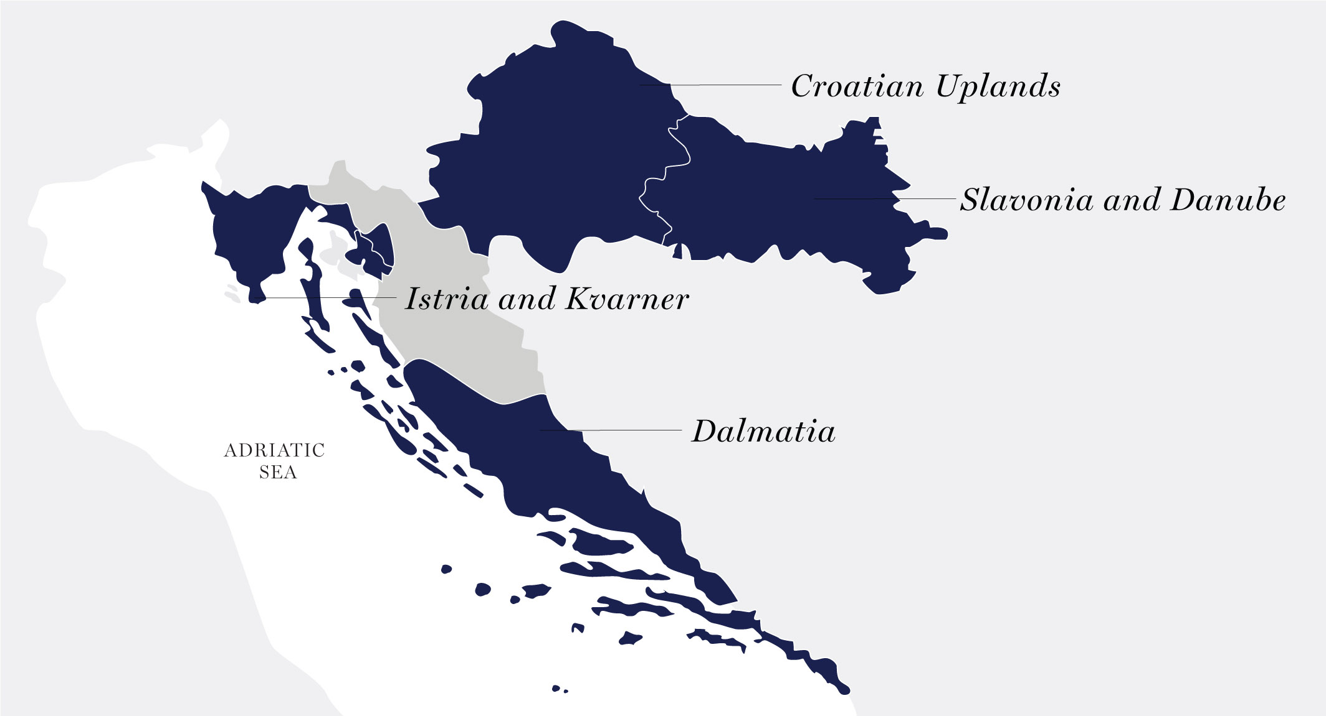
Dalmatia
The Jewel of Croatia’s Wine Scene
Location & Terroir:
Dalmatia stretches along the Adriatic coast from the island of Pag in the north to Dubrovnik in the south.
Its dramatic landscapes are characterized by steep vineyards that rise from the azure sea to rocky hillsides.
The region's proximity to the Mediterranean provides warm, sunny days, while the cool breezes from the sea and the mountains temper the heat.
The region's diverse soils, ranging from karst limestone to red clay, give rise to a wide variety of unique
wines.

Slide 18
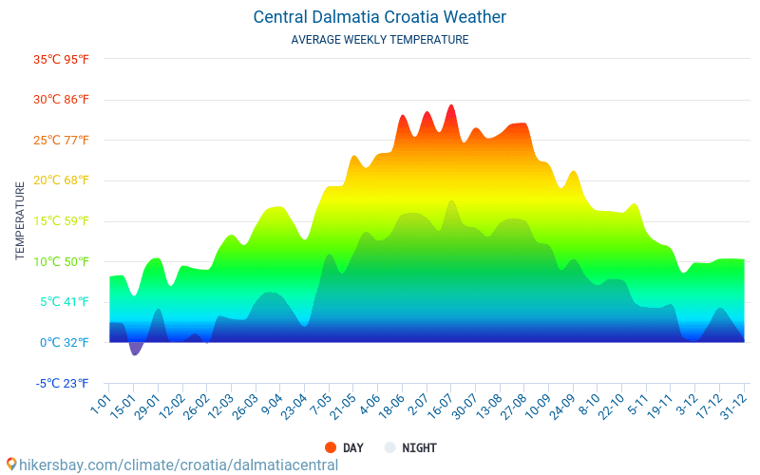
Dalmatia
The Jewel of Croatia’s Wine Scene
Climate:
The Mediterranean climate of Dalmatia is marked by hot, dry summers and mild winters, ideal for producing rich, full-bodied red wines.
The dry conditions also reduce the risk of disease in the vineyards, allowing for organic and natural winemaking techniques to flourish.

Slide 19
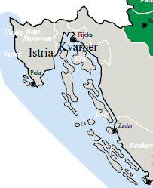
Istria and Kvarner
The Heart of Croatian White Wines
Location & Terroir
Istria, often referred to as the "Tuscany of Croatia," is a peninsula located in the northwest of the country, bordered by Slovenia to the north and Italy across the Adriatic Sea.
The region features rolling hills and lush
greenery, with vineyards nestled among
olive groves and forests.
The soils of Istria are primarily composed of
terra rossa (red clay), rich in iron, as well
as marl and limestone, which contribute to
the minerality of its wines.

Slide 20
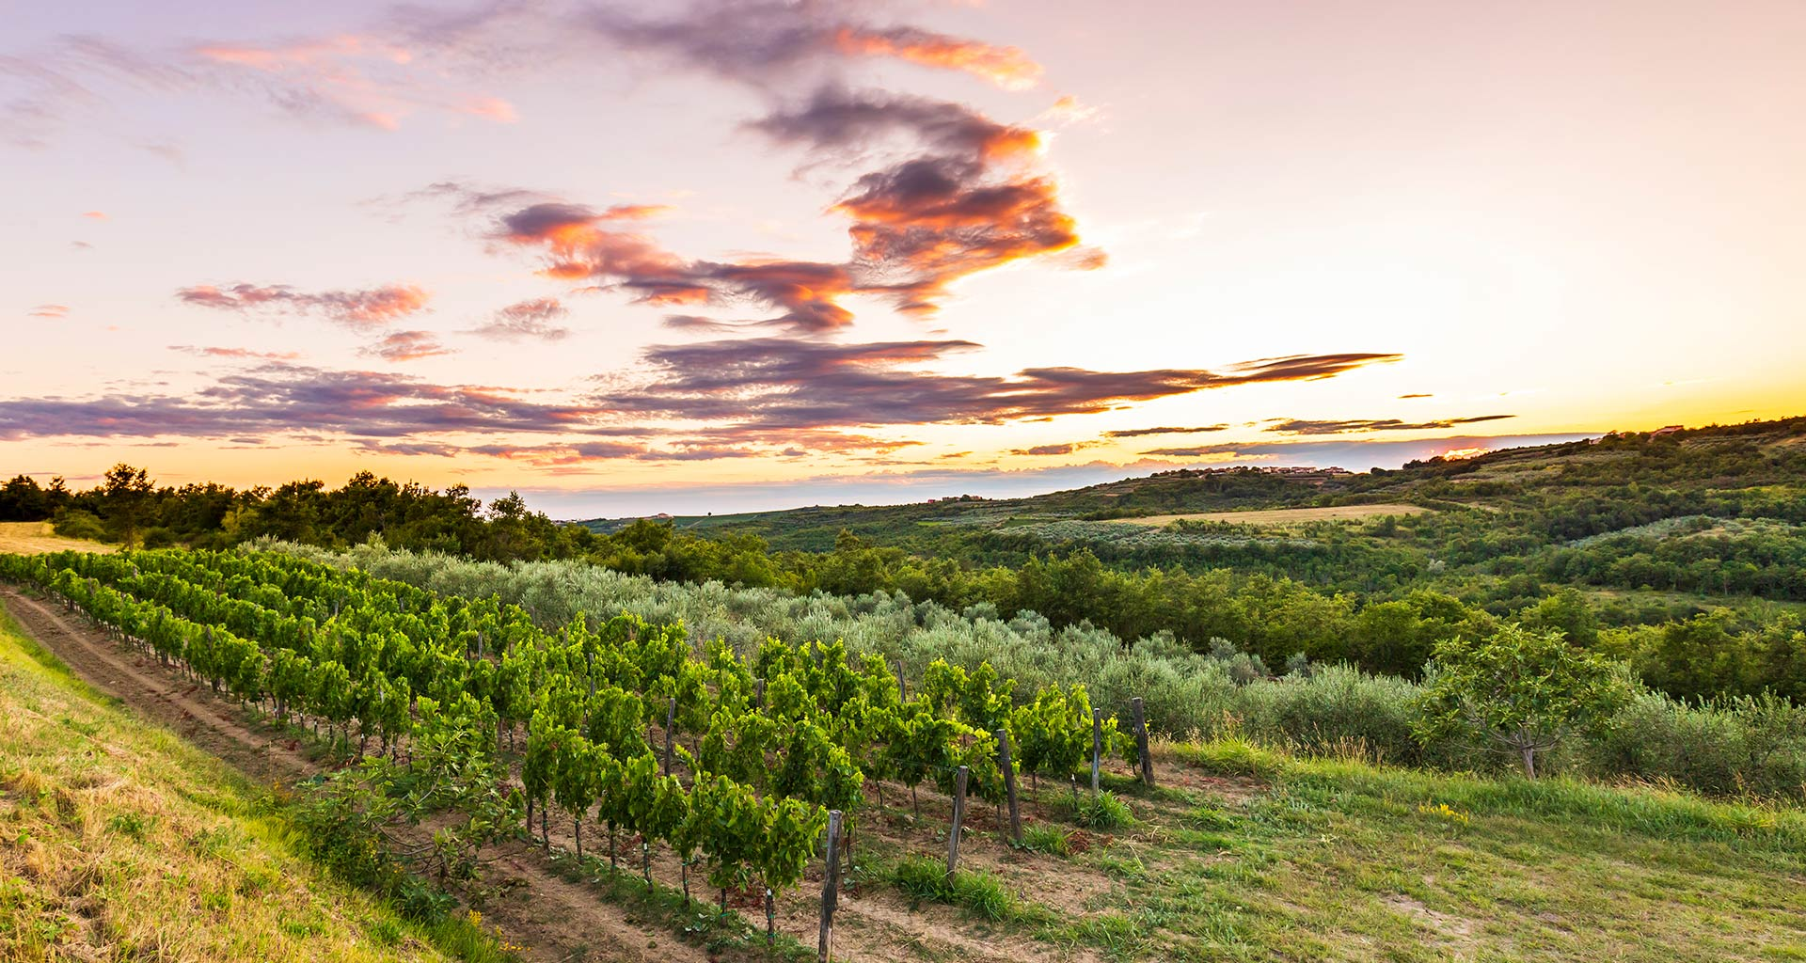
Istria and Kvarner
Climate:
Istria enjoys a warm Mediterranean climate, but its proximity to the Alps also brings cooler evenings and more rainfall compared to Dalmatia, allowing for fresher, more delicate wines.
The Kvarner region, with its islands and coastal areas, shares a similar climate but experiences slightly cooler temperatures due to its exposure to northern winds.

Slide 21
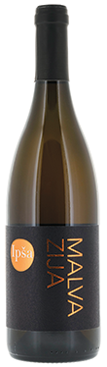
Istria and Kvarner
Prominent Varietals & Tasting Notes:
Malvazija Istarska (White): The star grape of Istria, Malvazija Istarska produces wines with floral aromas, flavors of ripe apples, peaches, and almonds, and a distinct minerality.
It is a versatile wine, often produced in both fresh, zesty styles and more complex, barrel-aged versions.
Its bright acidity and minerality make it an excellent pairing for seafood risotto, white fish, and fresh goat cheeses.

Slide 22
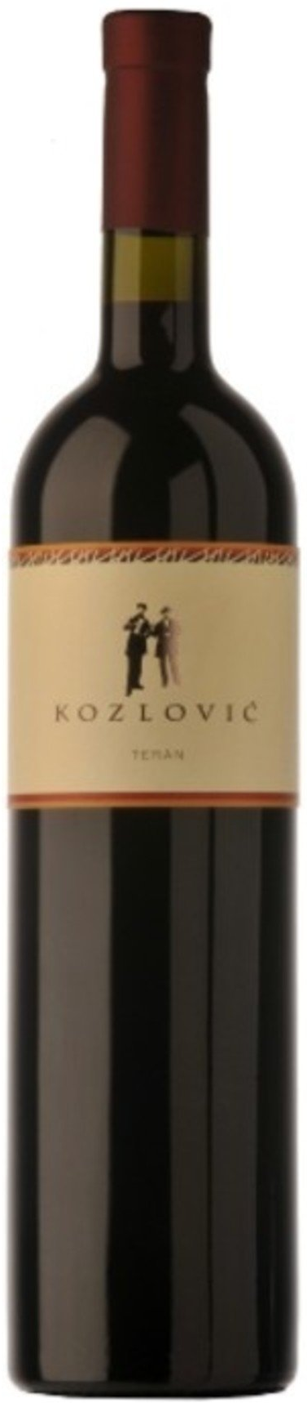
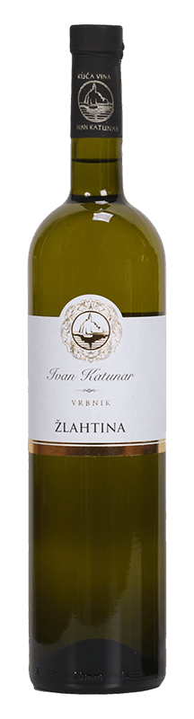
Istria and Kvarner
Prominent Varietals & Tasting Notes:
Teran (Red): A robust and earthy red wine with high acidity and flavors of blackberries, plums, and spices. Teran is known for its rustic charm and pairs wonderfully with Istrian truffles, prosciutto, and hearty game dishes.
Žlahtina (White): Native to the Kvarner region, particularly the island of Krk, Žlahtina is a light, crisp white wine with citrus and floral notes. Its refreshing acidity makes it a great match for seafood, grilled vegetables, and light salads.

Slide 23
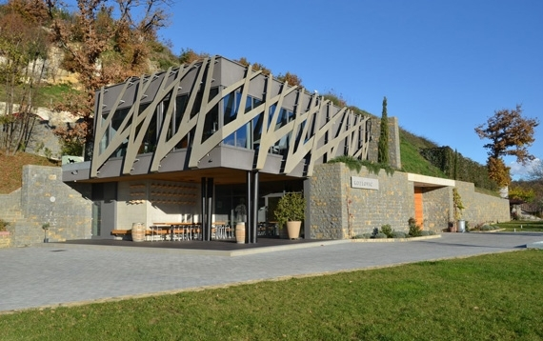
Notable Wineries of Istria
Kozlović Winery: One of the most
prestigious wineries in Istria,
Kozlović is known for its high-quality
Malvazija Istarska and Teran.
The winery combines traditional methods
with modern technology, resulting in wines that reflect the region’s terroir while maintaining elegance and finesse.
Coronica: Situated near the town of Umag, Coronica is famous for its Malvazija Istarska, which showcases the iron-rich terra rossa soil of the region.
Their wines are known for their purity, minerality, and precision.

Slide 24
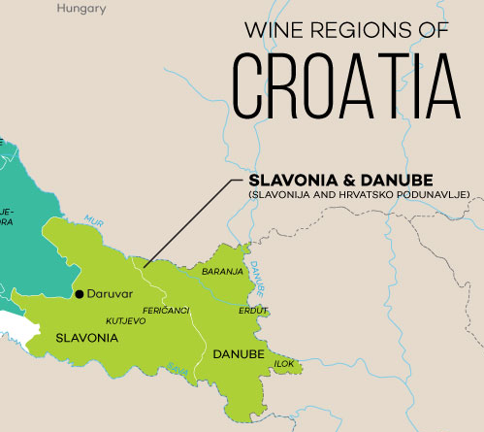
Slavonia and the Danube:
The Kingdom of Graševina
Location & Terroir:
Slavonia is located in the northeastern part of Croatia, far from the coastal regions.
This is a flat, fertile region with vast vineyards stretching across plains and rolling hills. The soils here are mostly alluvial, with loam and sand, perfect for growing white varietals.

Slide 25

Slavonia & Danube
Climate:
The continental climate of Slavonia is characterized by cold winters and hot summers, with significant temperature fluctuations between day and night.
This helps the grapes retain acidity, making for crisp, refreshing wines.

Slide 26
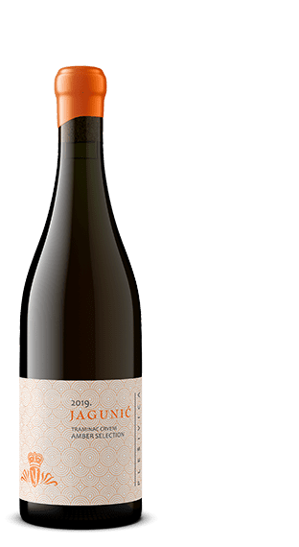
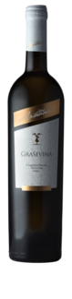
Slavonia & Danube
Prominent Varietals
Graševina (White): Graševina, also known as Welschriesling in other parts of Central Europe, is the most widely planted grape variety in Croatia. It produces wines with
Traminac (White): Known internationally as Gewürztraminer, Traminac thrives in Slavonia’s continental climate.
This aromatic white wine bursts with notes of rose petals, lychee, and tropical fruits, often with a touch of spice and honey on the finish.
It has a lush, oily texture but is balanced by a vibrant acidity. Traminac pairs beautifully with Asian dishes, spicy foods, or rich desserts like crème Brulé.

Slide 27
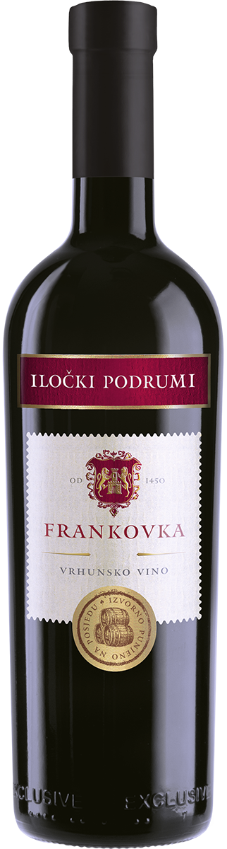
Slavonia & Danube
Prominent Varietals
Frankovka (Red): Known as Blaufränkisch in Austria and Hungary, Frankovka is a dark-skinned red grape that produces medium-bodied wines with flavors of blackberries, sour cherries, and a touch of pepper.
Its bright acidity and moderate tannins make it versatile for food pairing, especially with barbecued meats, sausages, and goulash.

Slide 28
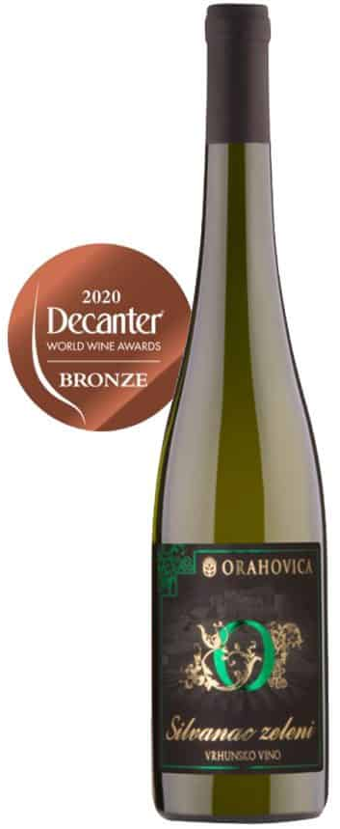
Slavonia & Danube
Prominent Varietals
Silvanac Zeleni (White): Known as Silvaner in Germany and Austria, Silvanac Zeleni is a fresh and delicate white wine with citrus and green apple flavors, underscored by herbaceous and mineral notes.
It’s a lighter, more subtle wine that pairs well with fresh salads, soft cheeses, and delicate fish dishes like grilled trout.

Slide 29
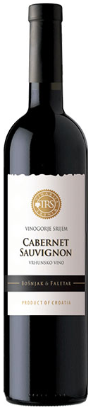
Slavonia & Danube
Prominent Varietals
Cabernet Sauvignon (Red): While Cabernet Sauvignon is not native to Croatia, it has been successfully cultivated in the Slavonian region.
Wines from this grape here tend to have a slightly lighter body compared to their counterparts in warmer regions, but they still exhibit classic notes of blackcurrant, cedar, and pepper.
Slavonian Cabernet Sauvignon pairs well with grilled meats, aged cheeses, and robust stews.

Slide 30

Notable Wineries
Slavonia and the Danube
Kutjevo Winery: One of the oldest and most renowned wineries in Croatia,
Kutjevo is synonymous with Graševina. Their wines are celebrated for their freshness, minerality, and balance, offering both approachable, everyday wines and more complex, barrel-aged versions.
Kutjevo also produces excellent Traminac, which is often slightly off-dry with a hint of sweetness.

Slide 31
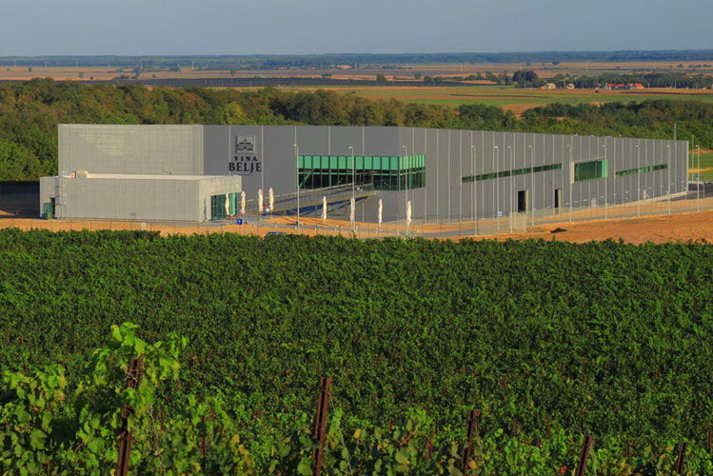
Notable Wineries
Slavonia and the Danube
Belje Winery: Located in Baranja, near the confluence of the Danube and Drava rivers, Belje Winery is known for its extensive vineyards and high-quality Graševina.
Their wines are characterized by crisp acidity and rich fruit flavors, and they also produce fine Frankovka and Cabernet Sauvignon.

Slide 32
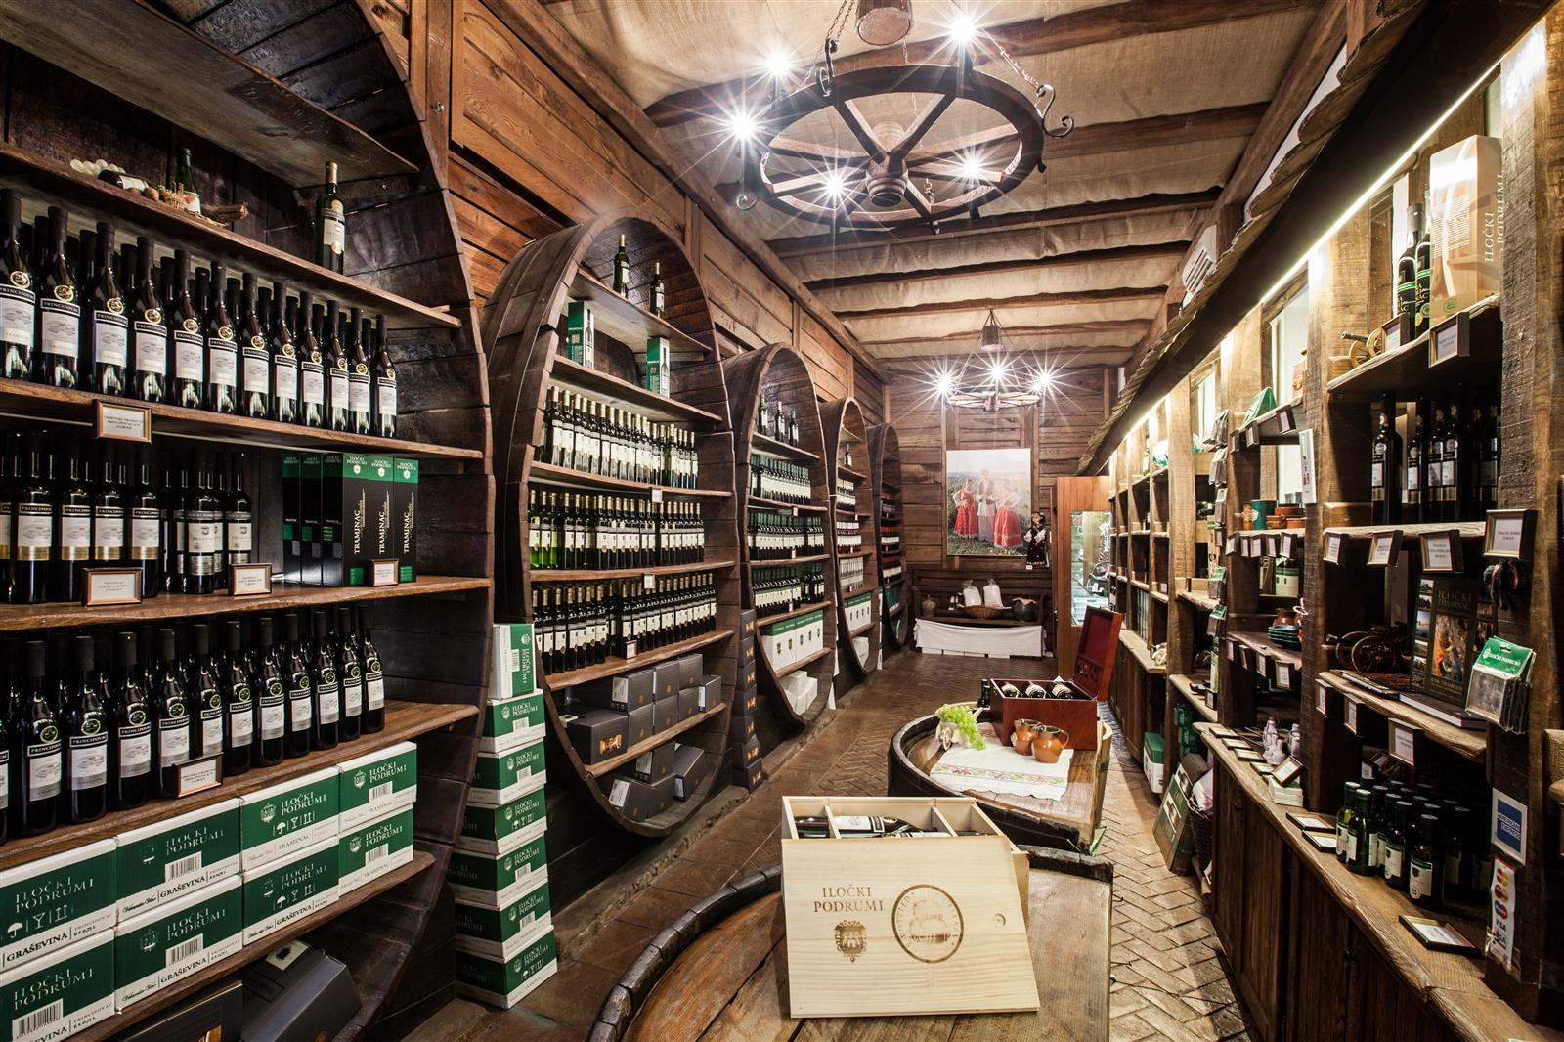
Notable Wineries
Slavonia and the Danube
Iločki Podrumi: Situated in the town of Ilok, Iločki Podrumi is one of Croatia’s most historic wineries, with a tradition that dates back to Roman times.
Their Graševina is particularly famous, having been served at Queen Elizabeth II's coronation.
Iločki Podrumi also excels in
producing Traminac, which is
aromatic, elegant, and perfect
for special occasions.

Slide 33
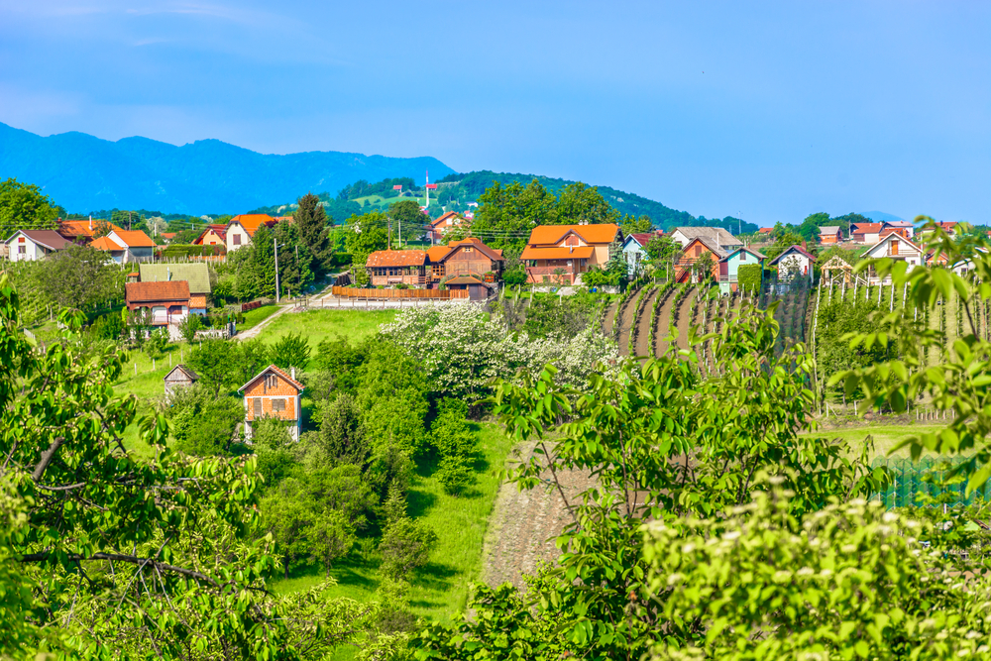
Central Croatia
The Land of Versatility
Location & Terroir:
Central Croatia, also known as the Croatian Uplands, is the least internationally recognized wine region in the country, but it is gaining prominence due to its unique location and diverse terroir.
This area lies between the Adriatic coast and Slavonia, featuring hilly terrain with varying soil types, including clay, loam, and limestone.

Slide 34
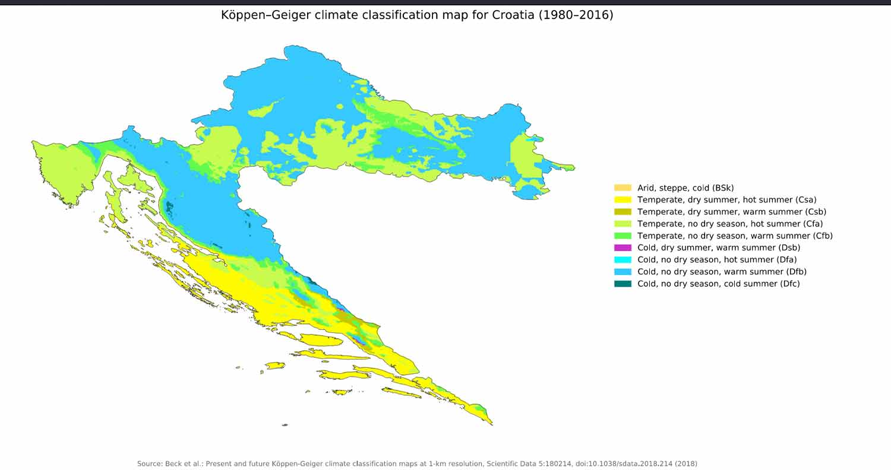
Central Croatia
The Land of Versatility
Climate: The continental climate of Central Croatia is similar to that of Slavonia, with cold winters and hot summers, but it tends to be more moderate due to the proximity to the Dinaric Alps.
This region sees significant diurnal temperature variation, which allows for slow grape ripening and the development of complex flavors.

Slide 35
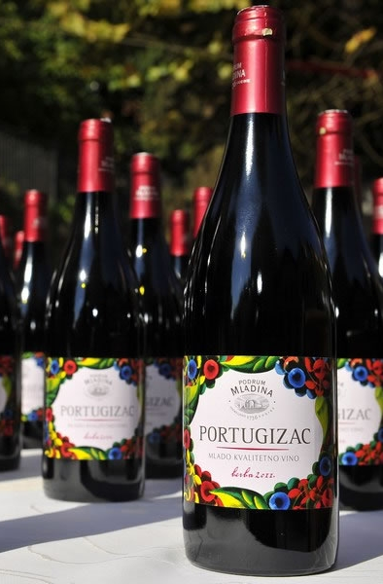
Central Croatia
Prominent Varietals
Portugizac (Red): Portugizac is a light, early-ripening red wine with juicy red fruit flavors like strawberries, raspberries, and cherries.
It is often consumed young, similar to Beaujolais Nouveau, and has soft tannins and bright acidity.
Its freshness makes it a great choice for casual drinking, and it pairs well with charcuterie, roasted chicken, and light pasta dishes.

Slide 36
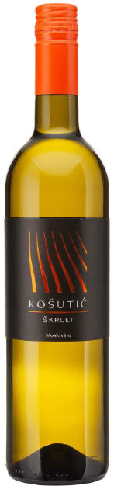
Central Croatia
Prominent Varietals
Škrlet (White): Indigenous to the Croatian Uplands, Škrlet is a fresh, light white wine with citrus and floral aromas.
It is delicate and refreshing, with lively acidity and hints of green apple and pear on the palate.
Škrlet pairs well with light seafood dishes, sushi, and fresh salads.

Slide 37
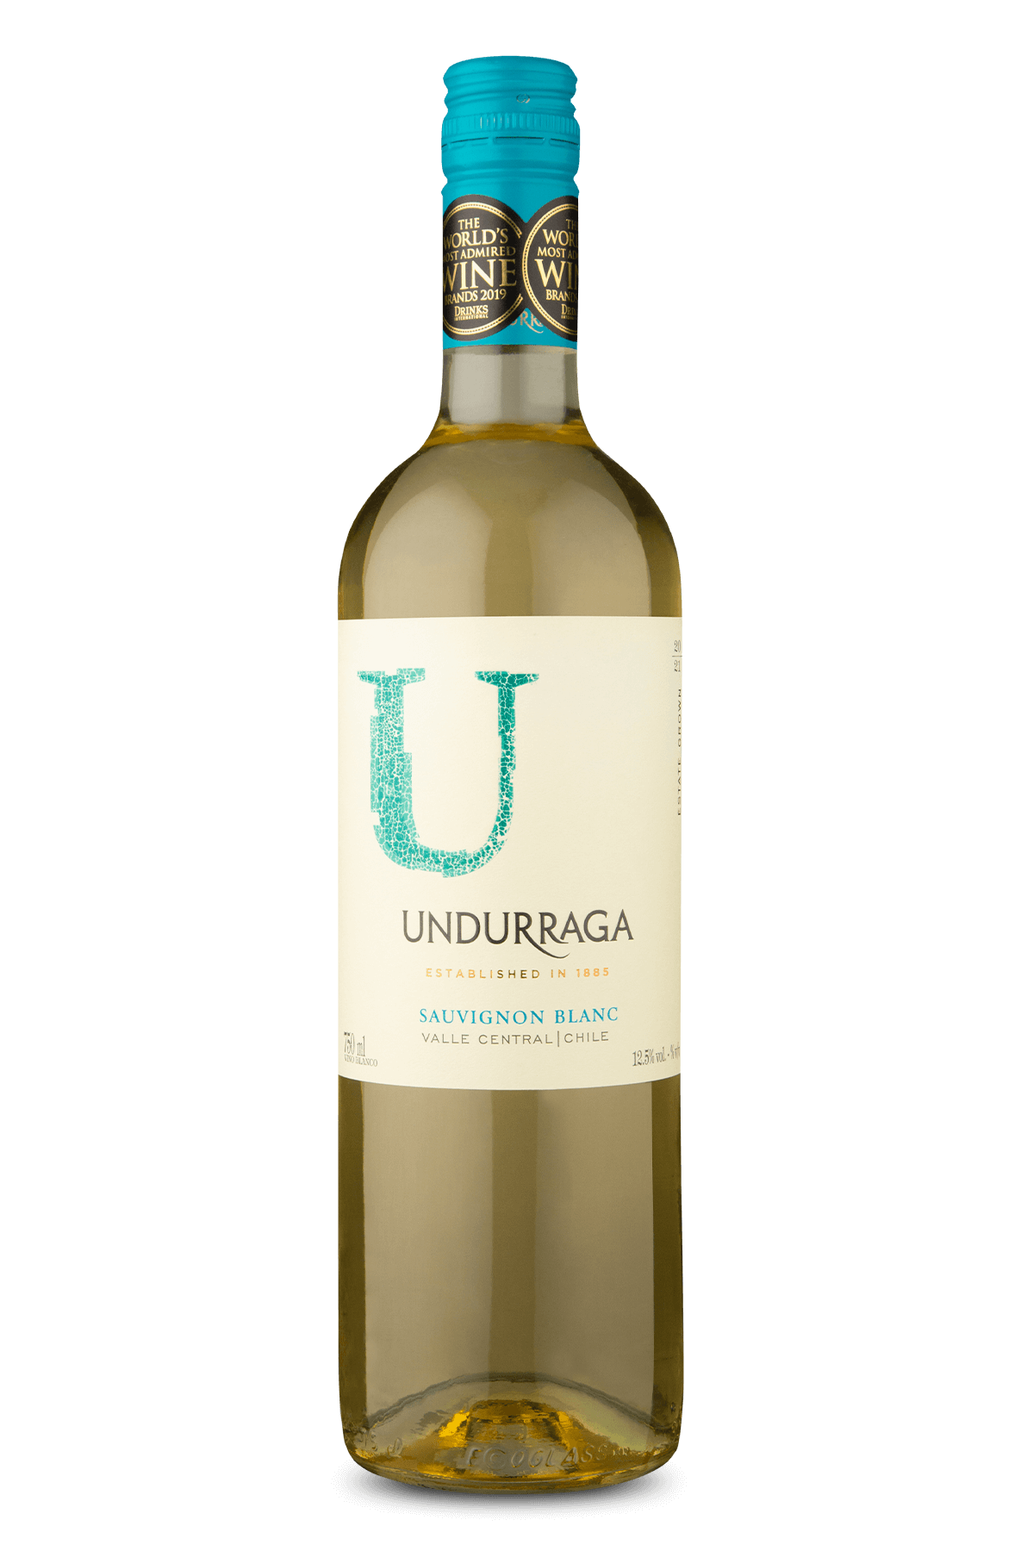
Central Croatia
Prominent Varietals
Sauvignon Blanc (White): In the cooler areas of Central Croatia, Sauvignon Blanc thrives and produces crisp, aromatic wines with notes of elderflower, gooseberry, and citrus.
It has vibrant acidity, making it an excellent match for asparagus dishes, grilled vegetables, and goat cheese.

Slide 38
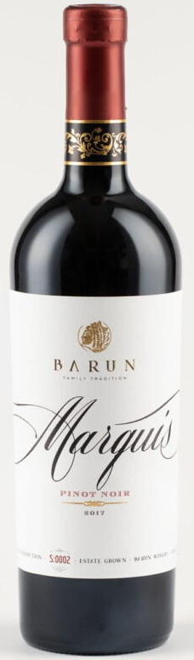
Central Croatia
Prominent Varietals
Pinot Noir (Red): The cooler climate of the Croatian Uplands is also suitable for growing Pinot Noir, a finicky grape that requires specific conditions to shine.
Croatian Pinot Noirs are elegant, with flavors of red cherry, raspberry, and earth, often displaying a silky texture.
It pairs beautifully with roasted duck, salmon, and mushroom dishes.

Slide 39
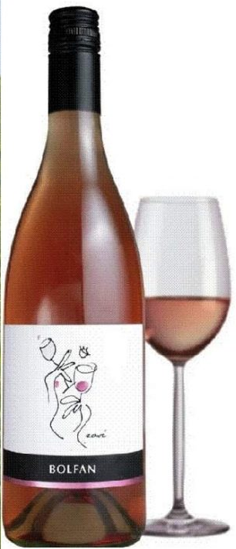
Central Croatia
Notable Wineries
Bolfan Vinski Vrh: Located in the Zagorje region, Bolfan Vinski Vrh is known for its commitment to organic and biodynamic winemaking.
Their Škrlet and Pinot Noir are particularly noteworthy, offering clean, pure expressions of the local terroir.
Bolfan’s wines are marked by freshness, minerality, and elegance.

Slide 40
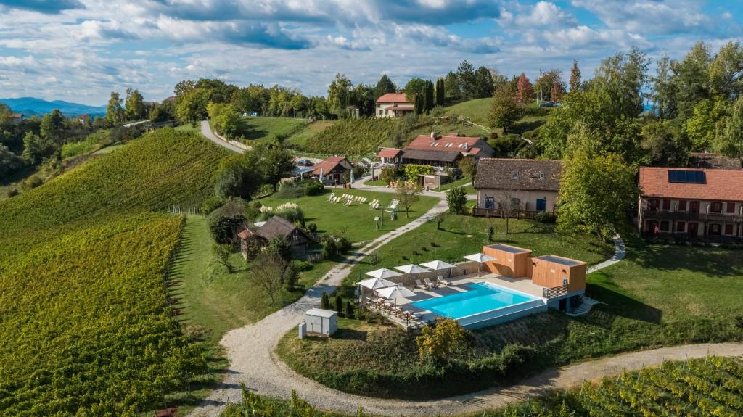
Central Croatia
Notable Wineries
Vuglec Breg: This family-run winery in the heart of Central Croatia produces a wide range of varietals, from Portugizac to Sauvignon Blanc.
Their wines are approachable and food-friendly, with a focus on capturing the essence of the Croatian Uplands.
The winery also offers a
beautiful setting for tastings,
surrounded by vineyards and
countryside views.

Slide 41
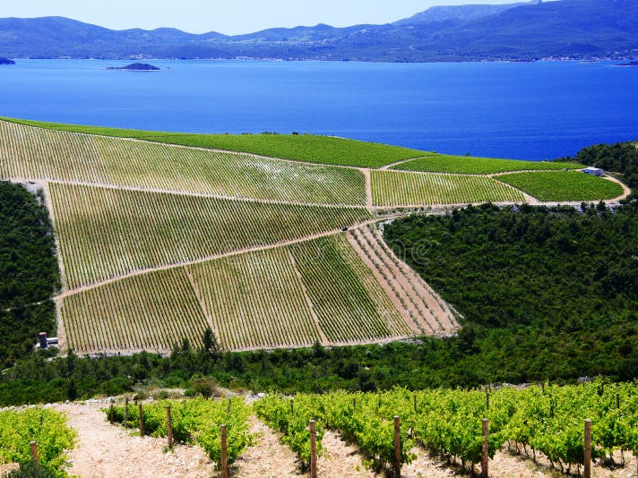
Conclusion
Croatia’s wine scene is as complex and captivating as its history.
From the sun-drenched vineyards of Dalmatia, where robust reds like Plavac Mali reign supreme, to the cool hills of Istria and the crisp whites of Slavonia, the country offers an extraordinary diversity of wines that reflect its unique terroir.
As Croatian wine continues to gain recognition on the global stage, it remains a treasure trove for wine enthusiasts looking to discover something new and authentically connected to centuries-old traditions.

Slide 42
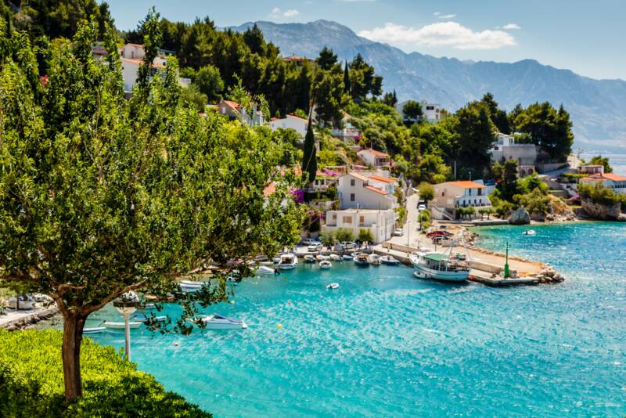
Conclusion
Whether you're sipping a bottle of Pošip while gazing at the Adriatic or enjoying a glass of Graševina with a hearty meal in the Croatian countryside, the wines of Croatia offer a journey through time, culture, and place.
They are the result of a
perfect blend of history,
terroir, and passion,
making them a must-try
for anyone who appreciates
fine wine.

Slide 43
References
'Wine Grapes of Croatia' by Jancis Robinson
Tomac, B., "Croatian Wine Renaissance," Wine Spectator, 2022.
Janković, S., "History of Croatian Winemaking," Decanter, 2021.
Marić, I., Wines of Croatia: A Complete Guide to Indigenous Grapes, Zagreb, 2020.
Plenković, M., "The Unique Terroir of Dalmatia," Vineyards of the Adriatic, 2019.
Horvat, A., Istria and Its Wines, Istrian Wine Press, 2018.
Croatian Wine Institute: www.croatianwineinstitute.hr
Wineries of Croatia: www.wineriesofcroatia.com

