Slide 1

Cozumel, Mexico Port Guide Presented by Marc Silver

Slide 2
What I Will Cover
Port Philosophy & Safety
Don’t Miss the Ship
Money & Practical Information
About Cozumel
Transportation Options
Must-See Attractions
Beach Recommendations
Restaurant Highlights
Shopping Tips
Conclusion

Slide 3
My Port Philosophy
I have been cruising for over 45 years and have taken over 100 cruises. So, I consider myself an experienced cruiser.
The information I will present is based on those many years of
experience.
When I am on a cruise where the city, I want to visit is not the port city,
I always recommend taking a ship’s tour.
But when I am in a port with multiple attractions nearby and easy to see
on my own - I will do it on my own.
This presentation is not like that.

Slide 4

Don’t Miss the Ship
How to Avoid Missing Your Ship
Pay attention to the time. - Ship time and local time are often different.
Put a return-to-ship reminder on your phone.
Choose excursions wisely.
If a ship-sponsored excursion is late returning to port, the ship will wait for you. If you are on your own???
Be Prepared
Have your Passport, Credit Card, and phone numbers for your ship port agent. Emergency: 066 Tourist Police: (987) 869-0707
What to Do If You Miss the Ship Most cruise lines have port agents stationed in the port area to assist if your ship has left without you. If you are lucky, when cruisers are late returning to the vessel, the ship’s crew will often remove the passengers’ essential items – passports, cell phones, and medication -- from the ship to leave with the port agents.
The Port Officials can help you with contacting your ship and making necessary travel arrangements.

Slide 5
Exchanging Money
When exchanging money, it’s best to avoid doing so at the port exchange kiosks, as they tend to have higher fees and less favorable rates.
Instead, consider using ATMs to withdraw Pesos directly, as they often offer better rates.
Mexican Peso (MXN) is official currency
Current exchange rate: Approximately 17 pesos = 1 USD
US dollars widely accepted but change given in pesos
Credit cards accepted at most establishments
ATMs available near port (Banco Azteca recommended)

Slide 6
Weather Considerations
Average temperatures: 75-85°F (24-29°C)
Humidity is high year-round
Rainy season: June to October
Hurricane season: June to November

Slide 7
Historical Context
Maya first settled the island around 2000 years ago
Name derives from Mayan "Cuzamil" meaning "Island of Swallows"
Spanish arrived in 1518
Jacques Cousteau discovered Cozumel's reefs in 1960s
Now Mexico's largest Caribbean island

Slide 8
Geographic Overview
Located 12 miles off Yucatan Peninsula
30 miles long and 10 miles wide
Population: approximately 100,000
Known for world-class scuba diving and snorkeling

Slide 9
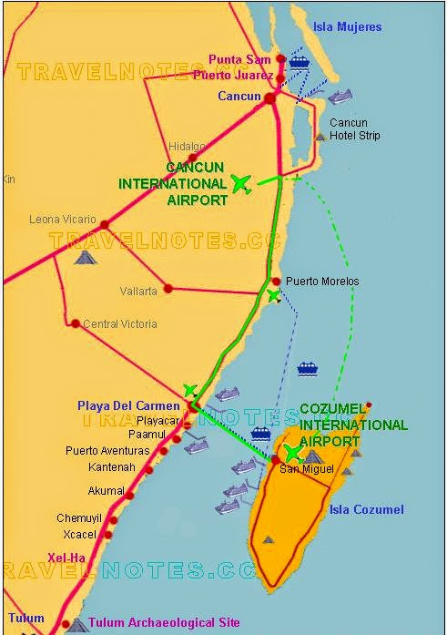
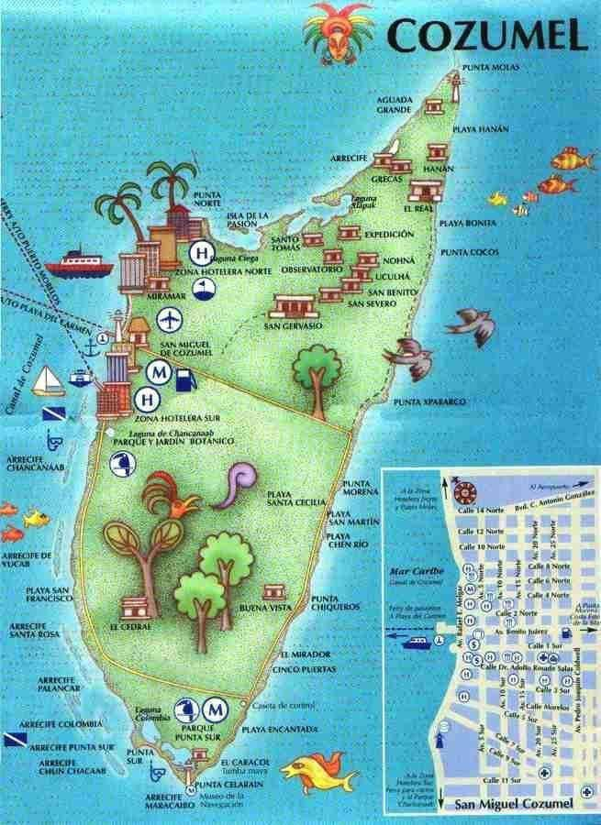
Cozumel Mexico

Slide 10
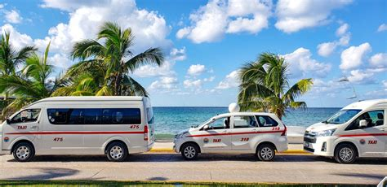
Transportation
Taxis
Fixed rates posted at taxi stands
Downtown: $8 USD
Beach Clubs: $15-20 USD
Island Tour: $95-100 USD (3-4 hours)
No meter system - agree on price before entering

Slide 11
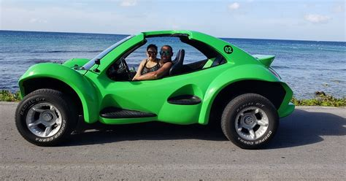
Transportation
Rental Cars
Major agencies at port
Average cost: $60-80 USD/day
International driver's license not required
Drive on right side
Full insurance recommended

Slide 12
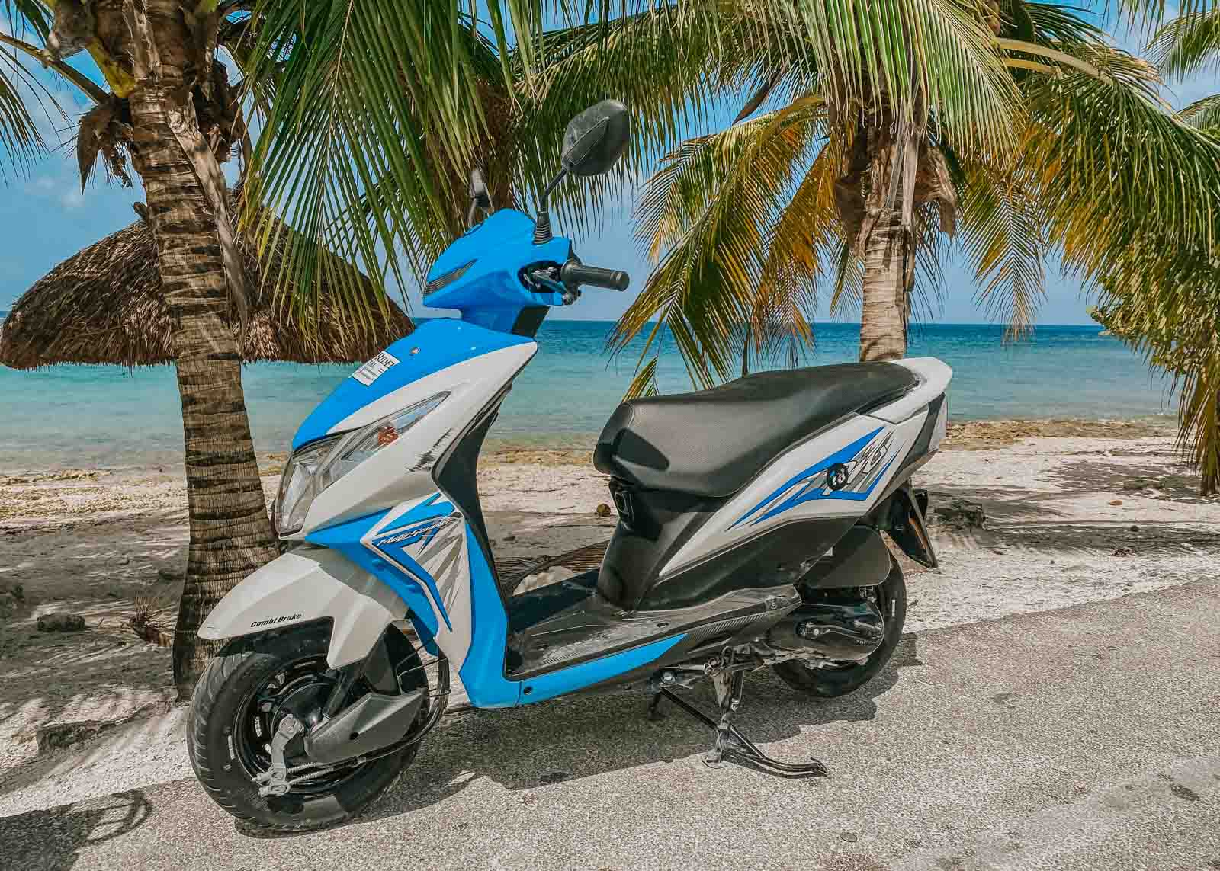
Transportation
Scooters
Around $30-40 USD/day
Requires deposit and driver's license
Not recommended for inexperienced riders
Helmet required by law

Slide 13
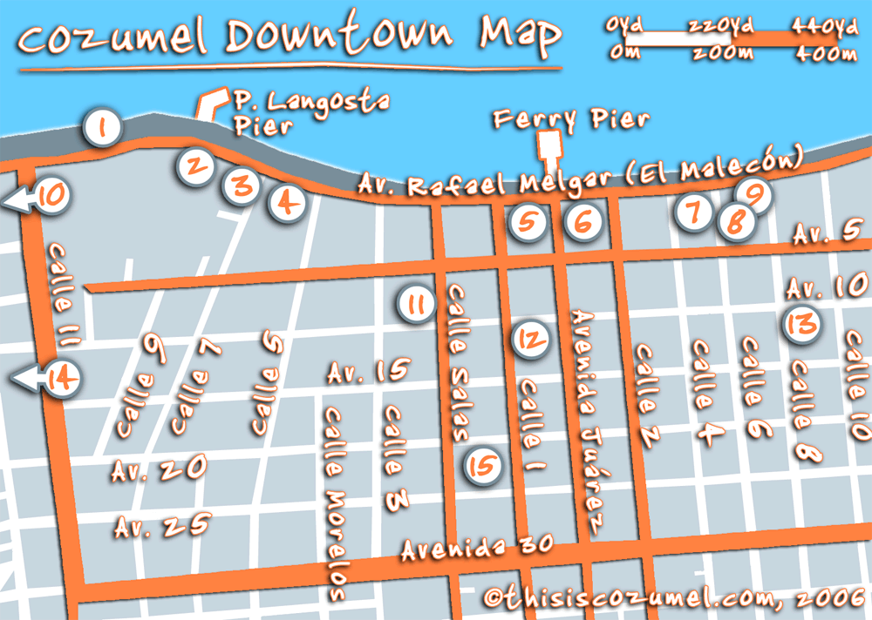
Top Attractions & Points of Interest
San Miguel Town Center
Walking distance from International Pier
Central Plaza (Zócalo)
Free walking tours at 9 AM and 1 PM
Local markets and shops
Church of San Miguel

Slide 14
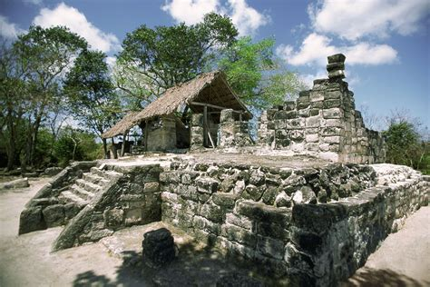
Top Attractions & Points of Interest
San Gervasio Mayan Ruins
Admission: $11 USD
Located center of island
Dedicated to goddess Ixchel
Guide recommended ($20 USD)
Open 8 AM - 3:45 PM
Wear comfortable shoes
Bring water and mosquito repellent

Slide 15
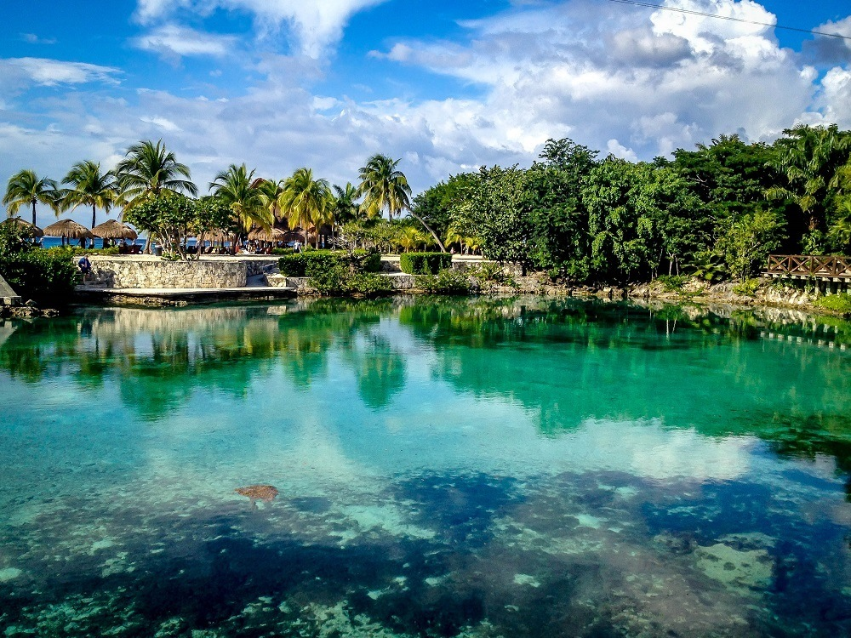
Top Attractions & Points of Interest
Chankanaab National Park
Admission: $25 USD
Snorkeling from shore
Sea lion show
Botanical gardens
Beach facilities
Restaurant and bars
Walking distance from cruise port

Slide 16
Beach Recommendations
Paradise Beach
Admission: $3 USD
Full facilities
Water activities available
Food and drink service
Clean restrooms
Beach chairs and umbrellas

Slide 17
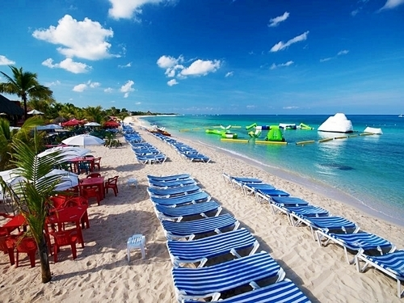
Beach Recommendations
Mr. Sanchos Beach Club
All-inclusive option ($65 USD)
Free basic admission
Pool and beach access
Water sports available
Popular with cruise passengers
Reservation recommended

Slide 18
Local Cuisine & Dining Options
La Cocay $$$$
Location: Downtown San Miguel, Mediterranean-Mexican fusion, Famous for seafood
La Mission $$
Location: Waterfront, Authentic Mexican cuisine, Fresh seafood, Great margaritas, Ocean view
Casa Denis $$
Oldest restaurant in Cozumel, Traditional Mexican, Historic atmosphere, Located in central plaza
Famous mole sauce
Jeanie's $
Location: Near port, American breakfast, Mexican classics, Quick service, Popular with locals

Slide 19
Shopping Tips
Best Areas
Royal Village Shopping Center (at port)
Downtown San Miguel
Front Street (Avenida Rafael Melgar)
Popular Items
Silver jewelry (look for .925 stamp)
Mexican vanilla
Tequila
Local handicrafts
Mexican blankets
Negotiating
Expected in markets
Fixed prices in port shops
Start at 40-50% of asking price
Be prepared to walk away
Final Tips
Carry water and sunscreen
Use biodegradable sunscreen for water activities
Keep ship time in mind
Have small US bills for tips
Take photos of tour tickets and ship card

Slide 20
Conclusion
Cozumel offers something for everyone:
Beautiful beaches
Rich history
Great shopping
Excellent diving/snorkeling
Safe and easy to navigate

Slide 21
Thanks For Coming
If you have any more questions, please ask.
I will do my best to answer them for you.
Have a great visit in Cozumel !

