Slide 1
Coquimbo & La Serena, Chile
Presented by
Marc Silver

Slide 2
What I Will Cover
My Port Philosophy
Don’t Miss the Ship
Money and Currency Tips
A Brief History of Coquimbo & La Serena
Transportation
Top Attractions & Points of Interest
Important Tips & Practical Advice
Conclusion

Slide 3
My Port Philosophy
I have been cruising for over 46 years and have taken over 100 cruises.
So, I consider myself an experienced cruiser.
The information I will present is based on those many years of experience.
When I am on a cruise where the city, I want to visit is not the port city, I always recommend taking a ship’s tour.
Lima is a fascinating port call — full of history, art, and incredible food. But the port of Callao, where ships dock, is industrial and distant from the city center.
For that reason, I strongly recommend organized ship tours or private, reputable excursions into Lima itself.

Slide 4
About the Port
Coquimbo and La Serena are twin coastal gems close enough to explore independently, but rich enough in culture to reward guided tours.
Since the highlights are only about 7 miles apart, this is a port where you can comfortably explore on your own if you plan carefully.

Slide 5

Don’t Miss the Ship
How to Avoid Missing Your Ship
Pay attention to the time. - Ship time and local time
are often different.
Put a return-to-ship reminder on your phone.
Choose excursions wisely.
If a ship-sponsored excursion is late returning to port,
the ship will wait for you. If you are on your own.
Be Prepared
Have your Passport, Credit Card, and phone numbers for your ship port agent.
What to Do If You Miss the Ship
Most cruise lines have port agents stationed in the port area to assist if your ship has left without you. If you are lucky, when cruisers are late returning to the vessel, the ship’s crew will often remove the passengers’ essential items – passports, cell phones, and medication -- from the ship to leave with the port agents.
The Port Officials can help you with contacting your ship
and making necessary travel arrangements.

Slide 6
Money
Chile’s currency is the Chilean Peso (CLP).
U.S. dollars are accepted at some tourist venues, but you’ll get better value using pesos.
Credit cards are widely accepted, and ATMs are available in La Serena.
Always carry a few small bills for taxis or small purchases.
The official exchange rate is:
1 USD = 950 CLP
100 CLP = 0.10 US Dollars

Slide 7
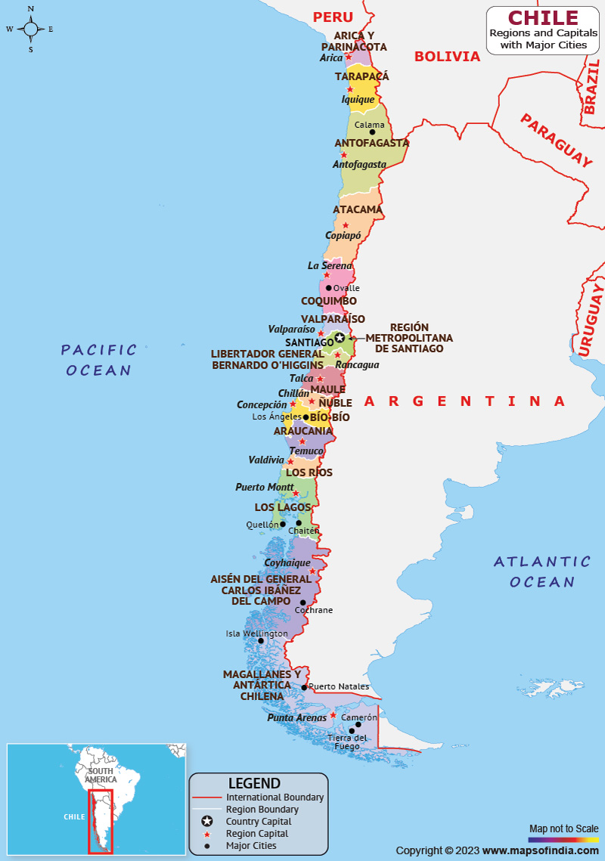

Slide 8
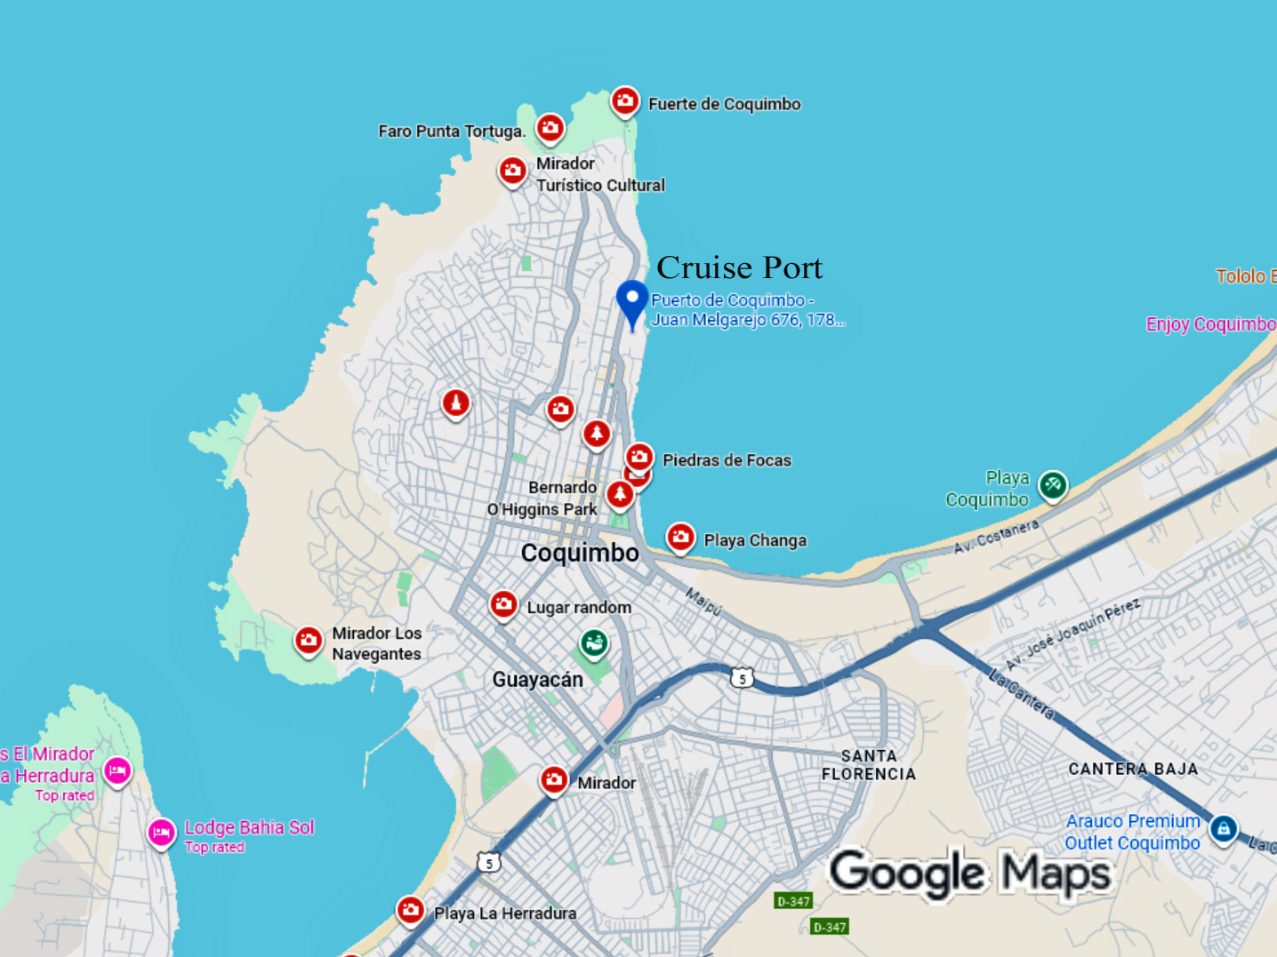

Slide 9
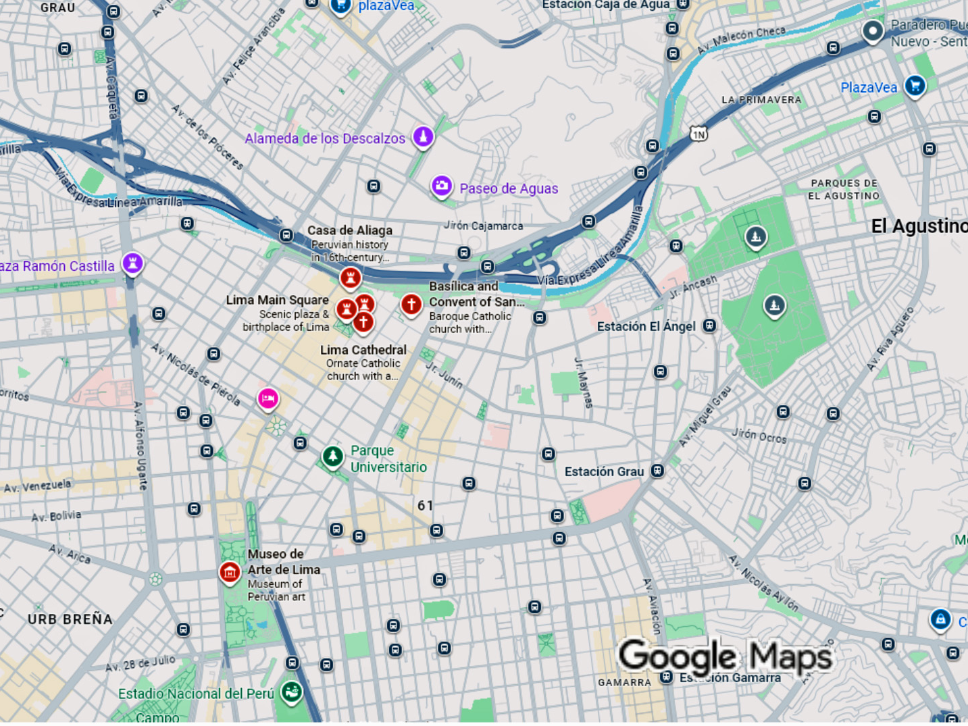

Slide 10
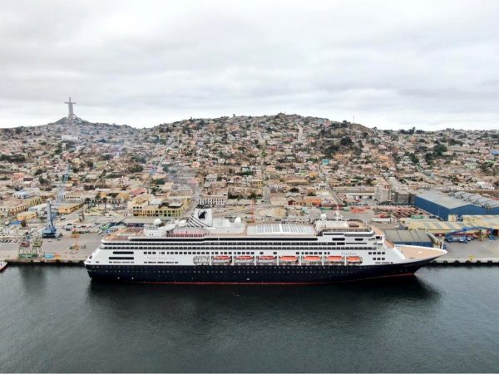
Welcome to Coquimbo & La Serena
Welcome to Chile’s northern coast, where colonial charm meets ocean breeze.
Coquimbo is a working port and fishing town, while nearby La Serena is one of Chile’s oldest cities, known for its Spanish architecture, beaches, and warm climate.
Together, they create one
of Chile’s most scenic and
relaxed coastal destinations.
Notes:
Many of you associate Great wine and Chile. There is one winery Cavas Del Valle about 2 hours east of the port that specialize on Rose and Cava wine.

Slide 11
A Brief History of the Area
La Serena was founded in 1544, making it Chile’s second-oldest city after Santiago. It prospered during colonial times as a port and trade center.
Coquimbo developed later as a shipping hub for minerals and agriculture.
Both towns have endured pirate attacks, earthquakes, and rebuilding, yet they’ve preserved a unique blend of colonial heritage and maritime vitality.

Slide 12
Transportation
The port of Coquimbo is just 7 miles (11 km) from La Serena, about a 15 to 20-minute drive.
Taxis are available at the terminal; negotiate fares before boarding.
A local shuttle or taxi is best for visiting La Serena’s old town or the beaches. Expect a $5 to $7 charge each way.
Traffic is light, and the roads between the two cities are modern and safe.

Slide 13
Top Attractions & Points of Interest
La Serena Historic Center – Cobbled streets, colonial-era churches, and lively plazas.
Avenida del Mar – Scenic beachfront road lined with restaurants and cafes.
La Recova Market – A colorful artisan and food market in La Serena.
El Faro Monumental – Iconic lighthouse and photo spot overlooking the Pacific.
Coquimbo Cross of the Third Millennium – A massive hilltop cross offering panoramic views.
Nearby: Elqui Valley – Known for pisco distilleries and observatories under crystal-clear skies.

Slide 14
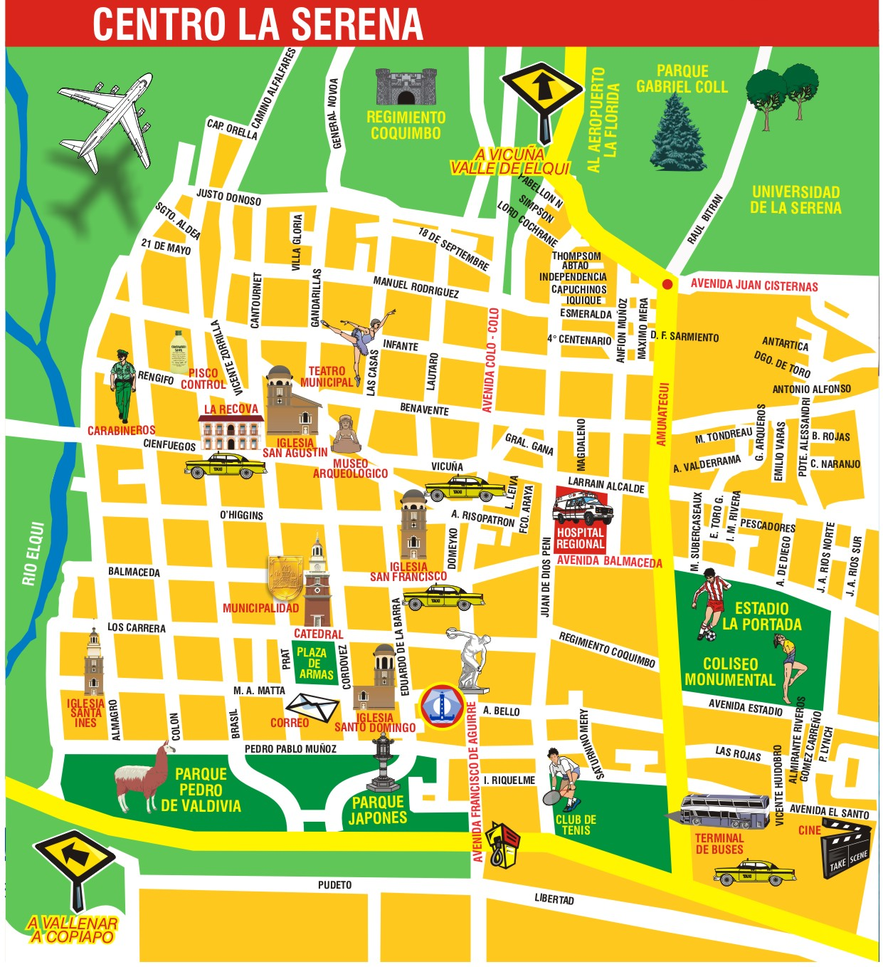
Top Attractions & Points of Interest
La Serena Historic Center is a tapestry of Cobbled streets, colonial-era churches, and lively plazas.

Slide 15
Top Attractions & Points of Interest
Avenida del Mar – Scenic beachfront road lined with restaurants and cafes.

Slide 16
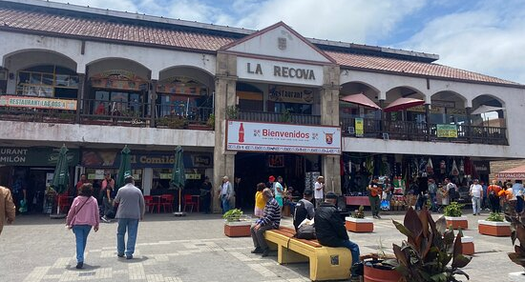
Top Attractions & Points of Interest
La Recova Market – A colorful artisan and food market in La Serena.

Slide 17
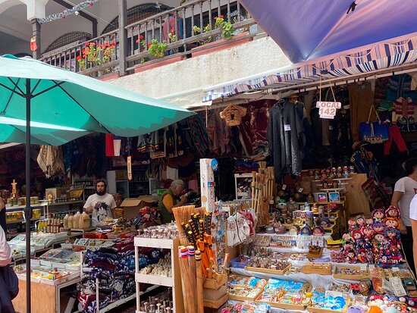
Top Attractions & Points of Interest
La Recova Market – A colorful artisan and food market in La Serena.

Slide 18
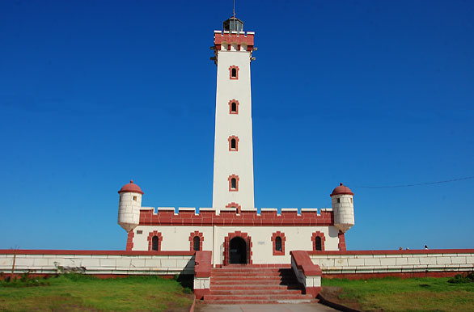
Top Attractions & Points of Interest
El Faro Monumental – Iconic lighthouse and photo spot overlooking the Pacific.

Slide 19
Top Attractions & Points of Interest
Coquimbo Cross of the Third Millennium – A massive hilltop cross offering panoramic views.

Slide 20
Important Tips & Practical Advice
The port area is secure but industrial — follow crew or shuttle guidance.
Mornings are ideal for sightseeing; afternoons bring stronger coastal winds.
Weather is mild year-round — bring a light jacket.
Shops close for siesta (around 1–3 p.m.), so plan around it.
Return to the ship at least one hour before departure.

Slide 21
Conclusion
Coquimbo and La Serena offer the best of northern Chile, history, sunshine, and seaside beauty.
From colonial streets to Elqui Valley vineyards, this is a destination that feels both relaxed and deeply Chilean.
Enjoy your day ashore, and bring back memories (and maybe a bottle of pisco) to share!
Thank You for Coming!

