Slide 1

Cooktown
Australia
Presented by
Marc Silver

Slide 2
What I Will Cover
My Port Philosophy
Don’t Miss the Ship
Money
About Cooktown
Area Map of Cooktown
Map of Cooktown
Cooktown Transportation
Places to see or at least consider
A few restaurant recommendations
Conclusion

Slide 3
My Port Philosophy
I have been cruising for over 45 years and have taken over 200 cruises.
So, I consider myself an experienced cruiser.
The information I will present is based on those many years of
experience.
When I am on a cruise where the city, I want to visit is not the port city,
I always recommend taking a ship’s tour.
But when I am in a port with multiple attractions nearby and easy to see
on my own - I will do it on my own.
This presentation is for that type of port.

Slide 4

Don’t Miss the Ship
How to Avoid Missing Your Ship
Pay attention to the time. - Ship time and local time are often
different.
Put a return-to-ship reminder on your phone.
Choose excursions wisely.
If a ship-sponsored excursion is late returning to port, the ship will
wait for you. If you are on your own???
Be Prepared
Have your Passport, Credit Card, and phone numbers for your ship
port agent.
What to Do If You Miss the Ship
Most cruise lines have port agents stationed in the port area to assist if your ship has left without you. If your are lucky, when cruisers are late returning to the vessel, the ship’s crew will often remove the passengers’ essential items – passports, cell phones, and medication -- from the ship to leave with the port agents.
The Port Officials can help you with contacting your ship
and making necessary travel arrangements.

Slide 5
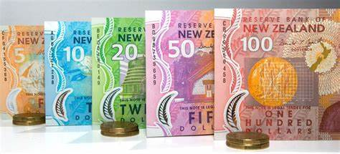
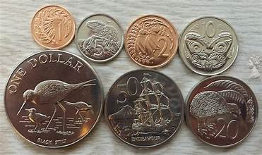
Money
The currency for Auckland is the New Zealand Dollar (NZD).
The conversion at the rate is $ 1.63 (NZD) to $1.00 U.S.
Or $1 (NZD) to $. 61 U.S.

Slide 6
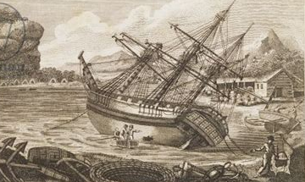
About Cooktown
Named after Captain Cook, Cooktown in North Queensland, is the northern gateway to the Great Barrier Reef.
Cooktown has over two centuries of rich
history. Cooktown was the site of the first
European ‘settlement’ in Australia when
Captain James Cook, having accidentally
struck the Great Barrier Reef, off the coast
north of Cape Tribulation, struggled up the
coast and beached the Endeavour on the
shores of the Endeavour River.
Cook and his crew were to stay on the
edge of the Endeavour River from June
17th to August 4th, 1770, the longest time they were to spend at any location in Australia. Learn more about Cook’s history in the Great Barrier Reef.

Slide 7
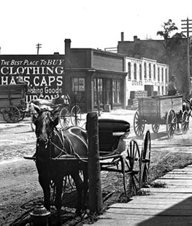
Historical Cooktown
In 1770, Captain James Cook sailed along the east coast of Australia and named coastal features in this region including Cape Cleveland, Cleveland Bay and Magnetic Island.
While he did not land in the region, he noted use of the land by Indigenous inhabitants.
Cooktown was founded in 1864 as a port for the fledgling pastoral industry in North Queensland.
Following the discovery of gold in the immediate interior at Ravenswood and then Charters Towers, the town developed into the principal trading center for North Queensland.

Slide 8
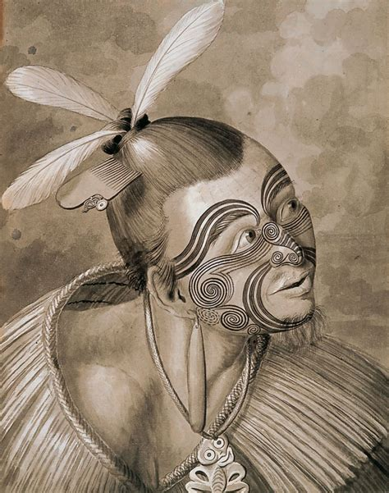
Historical Cooktown Cont.
Cooktown is one of the few large towns in the Cape York. The scientist Joseph Banks and Swedish naturalist Daniel Solander, who accompanied Cook on the expedition, took advantage of the 7-week stay to collect, preserve and document over 200 new species of plants, which formed the vast majority of the collection brought back to England from Australia.
The young artist Sydney Parkinson illustrated the specimens, and he was the first British artist to portray Aboriginal people from direct observation. The illustrations were later published as the famous Banks' Florilegium.

Slide 9
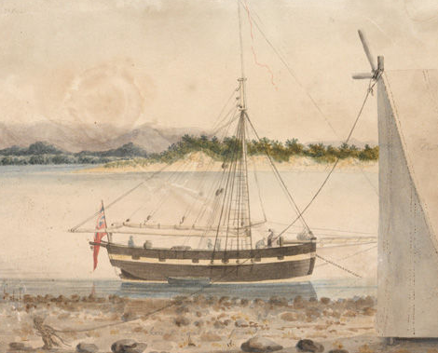
Historical Cooktown Cont.
The next recorded European expedition to the area was in 1819, when Captain Phillip Parker King on board HMS Mermaid, visited the Endeavour River during his surveying voyage around Australia.
They camped for two weeks at the mouth of the river in order to construct a new dinghy, and had mostly friendly interactions with the local Aboriginal people until an argument occurred over the possession of clothes. Spears and musket-fire were exchanged but no injuries were sustained.
HMS Mermaid

Slide 10
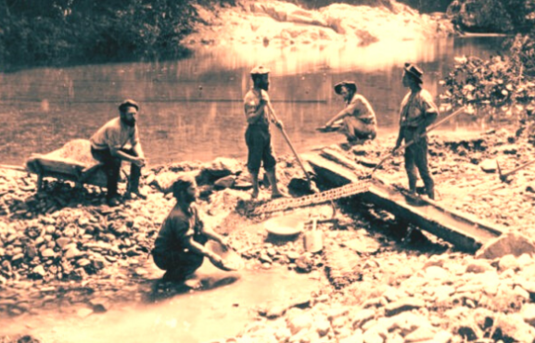
Historical Cooktown Cont.
In 1872, William Hann discovered gold in the Palmer River, about 120 miles inland from the Endeavour River. His findings were reported to James Venture Mulligan who led an expedition to the Palmer River in 1873. Mulligan's expedition found quantities of alluvial gold and thus began the gold rush that was to bring prospectors from all over the world.
MacMillan soon after led an expedition of 110 diggers, police and officials to blaze a trail from Cooktown to the Palmer River Goldfields.
At Battle Camp, a large group of Aboriginal men approached MacMillan's camp yelling a war cry, but were forced back by gunfire, some of whom were killed. The expedition members then pursued them to a lagoon where many more were shot.

Slide 11
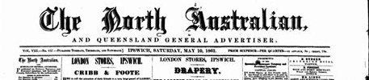
Historical Cooktown Cont.
Population estimates vary widely, but there were probably around 7,000 people in the area and about 4,000 permanent residents in the town by 1880.
At that time, Cooktown boasted a large number of hotels and guest houses. There were 47 licensed pubs within the town boundaries in 1874
There were also a number of illegal grog shops and several brothels. There were bakeries, a brewery and a soft drinks factory, dressmakers and milliners, a brickworks, a cabinetmaker, and two newspapers.

Slide 12
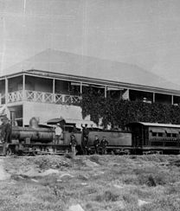
Historical Cooktown Cont.
Transport was an ongoing problem for the new settlers. Getting supplies and people to the goldfields often took three weeks. After every wet season, the tracks and bridges had to be remade.
A railway line from Cooktown to Maytown, was planned, but it took five years to get the 67 miles to Laura – and that is where it stopped.
By that time the gold was petering out, so the Queensland Government refused further funding for the venture.
In spite of this, the train proved to be a lifeline for the Peninsula people connecting the hinterland to Cooktown, from where one could catch a boat to Cairns and other southern ports.

Slide 13
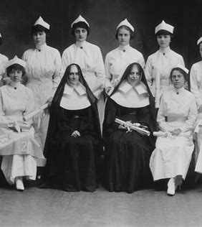
Historical Cooktown Cont.
In 1886, Lutheran missionaries came to Cooktown to establish a secure place for the Aboriginal peoSisters of Mercy Order ple who were living in abominable conditions on the edge of the town.
Missions were established at Elim on the beach (later they moved inland to Hopevale), and Wujal Wujal, near the mouth of the Bloomfield River.
In 1888, five Irish nuns from the arrived in Cooktown and established a Catholic convent school. The original building is now used as the Cooktown Museum.

Slide 14
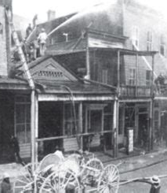
Historical Cooktown Cont.
With the gold rush over, the number of people living in the area started dwindling.
Two major fires struck Cooktown, 1875 and 1919 when whole blocks of buildings in the main street were burned to the ground.
By 1940, little evidence of Cooktown or Maytown's interesting past remained.
During the Second World War, Cooktown became an important base for the war effort. The civilian population of Cooktown was encouraged to evacuate in face of the Japanese advances and by 1942 the vast majority had left.

Slide 15
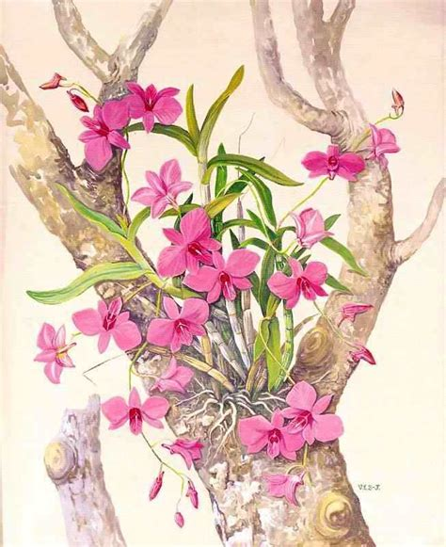
Historical Cooktown Cont.
With the closure of the rail link to Laura in 1961 and the "Peninsula Development Road" opened up to the south, the population declined to just a few hundred people before it gradually began to climb.
Since then, Cooktown and the Endeavour River Valley area have become a major attraction to biologists and illustrators of plants and animals.
Vera Scarth-Johnson, spent almost thirty years (1972 to 1999) illustrating the flowering plants of the region and then gave her collection to the people of Cooktown. Following her wishes, a beautiful gallery and nature interpretive center was built in the Cooktown Botanic Gardens to house her collection and promote the study and appreciation of the flora and .

Slide 16
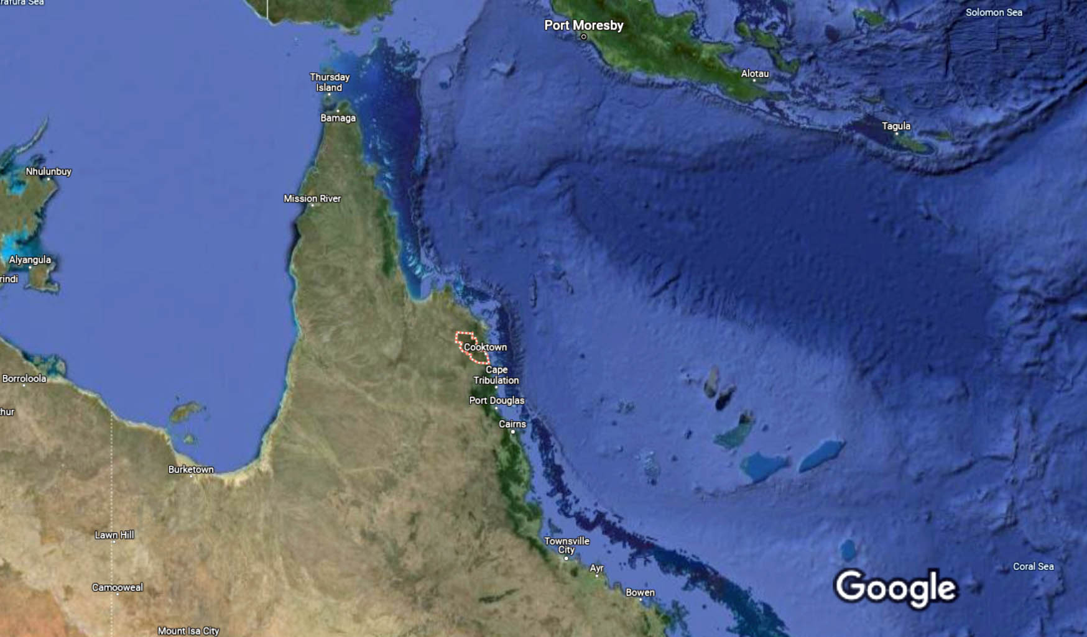
Cooktown Area Map
Cooktown

Slide 17
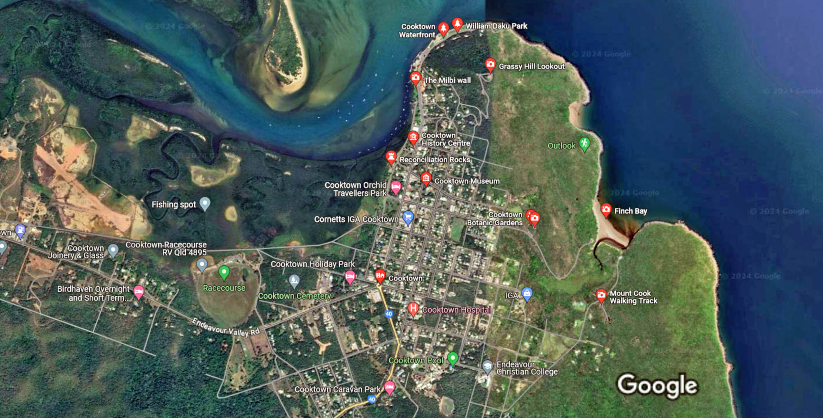
Map of Cooktown

Slide 18
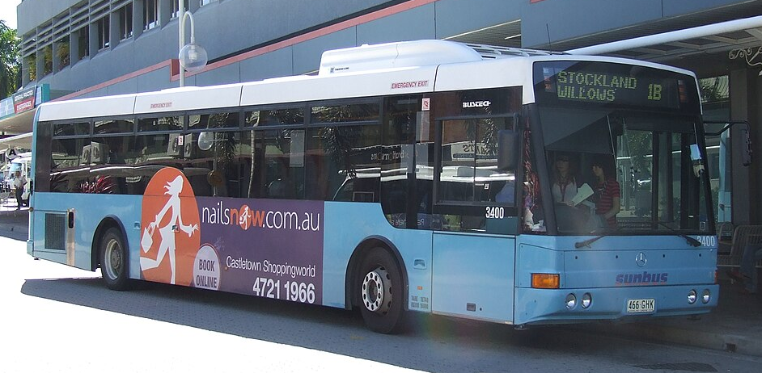
Cooktown Transit
Cooktown's public transport system consists of bus services operated by Kinetic.
They provide regular bus service throughout the city. Cooktown has one of the most comprehensive and user-friendly public transit systems.
Pay with cash in exact change.
An all-day bus pass costs $4.80 to $8.40

Slide 19
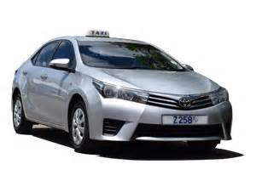
Cooktown Taxis
Standard taxis provide a safe and reliable way to explore the city or for transport between the cruise port and various attractions.
Cooktown Taxi has teamed up with “131 008” to provide taxi services for the Cooktown region. Taxis can be booked online or by calling 131 008
Like taxis in most locations the cost is significantly more expensive than other modes of transport.
Ride Share companies are also available.
These include, but are not limited to:
Uber, Ola, Shebah and DiDi

Slide 20
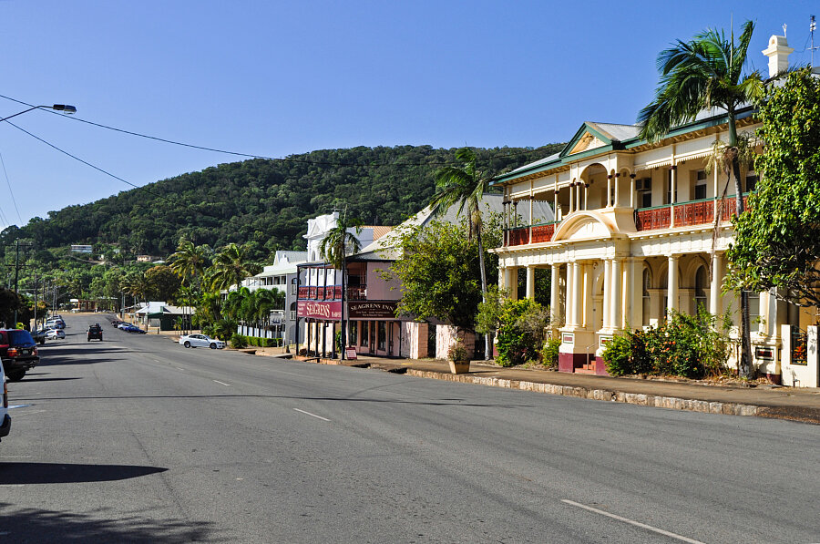
Walking Tour
Take a walking tour of the interesting points and historic buildings in Cooktown. With tons of historic buildings located throughout Cooktown, this place is ideal for a self-guided walking tour.
Head to Charlotte Street in the and walk in the footsteps of Captain Cook. Along this street is a line of historical buildings and sites in keeping with the theme of Cooktown history.
Here you will also find the Cooktown History Centre. Run by the Cooktown & District Historical Society, the center is housed in the oldest building in Charlotte Street erected in 1875.
Filled with stories, photos, interactive displays, murals and oral histories, the exhibitions walk visitors through historic railway, early roads, early families, and life of the local indigenous people.

Slide 21
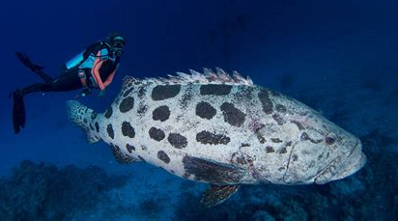
Diving Cooktown
Experience the best Scuba diving from Cooktown to Cape York, exploring some of the top dive spots. Dive among coral reefs and discover the myriad fish species and abundance of marine life in the Great Barrier Reef.
Diving at Lizard & North Direction Islands
Explore the remote Lizard and North Direction Islands by diving, snorkeling, and kayakin.
Diving the Ribbon Reefs
Between Cooktown and Lizard Island, the reef is right on the edge of the Continental Shelf. This means that nutrient-rich water comes up from below, which is good for fish and corals.
Diving The Cod Hole
Divers go to the Cod Hole to spot big potato cod. These fish are very curious, and they don’t mind getting close to divers. A great chance to take pictures of these interesting people or just hang out with them and enjoy their company.

Slide 22
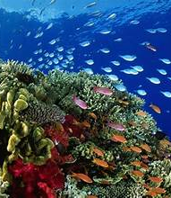
Great Barrier Reef
Cooktown is a popular jumping-off point for visiting the World Heritage-listed Great Barrier Reef, one of Australia's most precious tourism treasures.
Day trips typically include a 2.5-hour boat ride to a nearby reef, where you can snorkel or dive with sea turtles, stingrays, reef sharks, Maori wrasse, and a dazzling diversity of other marine life among the colorful coral reefs.

Slide 23
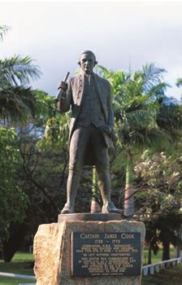
Sherin Esplanade
After walking downtown, you concentrate your efforts in Cooktown by heading to the Sherin Esplanade that runs along the waterside just West of Charlotte Street.
Here you’ll find a ton of historical artefacts, all set to the backdrop of some beautiful gardens and the Endeavour River.
Highlights include the Cook Monument, the Milbi Wall and the Queen’s Steps, which were constructed especially for the Royal visit in 1970.

Slide 24
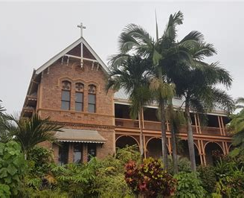
James Cook Museum
One of the best historical exhibitions in Queensland is the James Cook Museum a;so called the Cooktown Museum is an absolute must when it comes to the best things to do in this town.
Set within the old convent school building, everything about the place is fantastic it’s crammed full of information about the landing of James Cook and beautifully displayed.
Entrance Fee:
Adult - $25 / Senior $20
CHILD - $15 (3 - 13 years)
Child under 4 Free

Slide 25
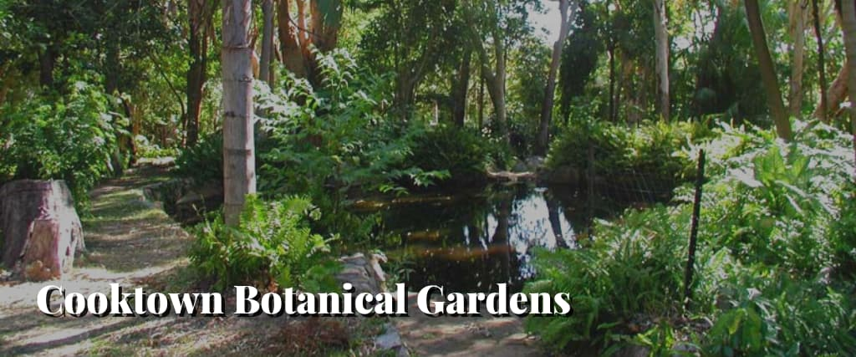
Cooktown Botanic Gardens
On the edge of Cooktown is an expansive 154-acre property filled with fauna and flora. The Cooktown Botanic Gardens were established in 1878 making them one of Queensland's oldest regional botanic gardens.
The Botanic Garden is open all year round and has an impressive variety of flowers in bloom during different times of the year.
The Cooktown Orchid, Queensland’s State Emblem, is in full bloom in May.

Slide 26
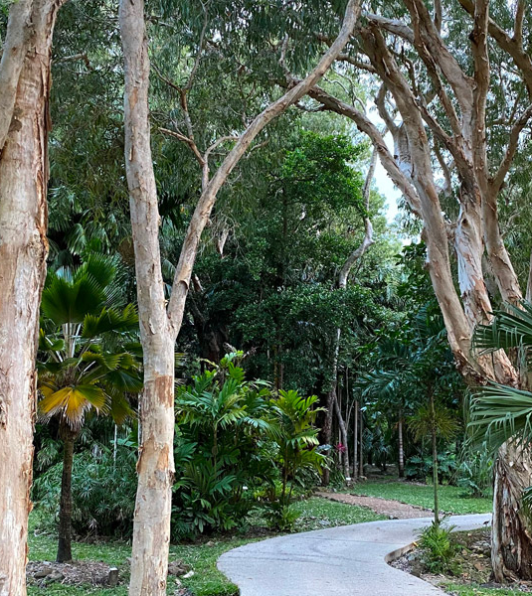
The Solander Garden
The Solander Garden is the primary living collection of the Botanic Gardens. It is home to 325 plants collected by Sir Joseph Banks and Daniel Solander during their journey on the Bark Endeavour with Captain Cook at the Endeavour River in 1770.
Gallop Botanic Reserve, established in 1878, is one of Queensland’s oldest regional botanic gardens and houses collections of species traditionally used by the local Aboriginal people; rare and threatened plants and a collection of plants collected by Joseph Banks in 1770.

Slide 27
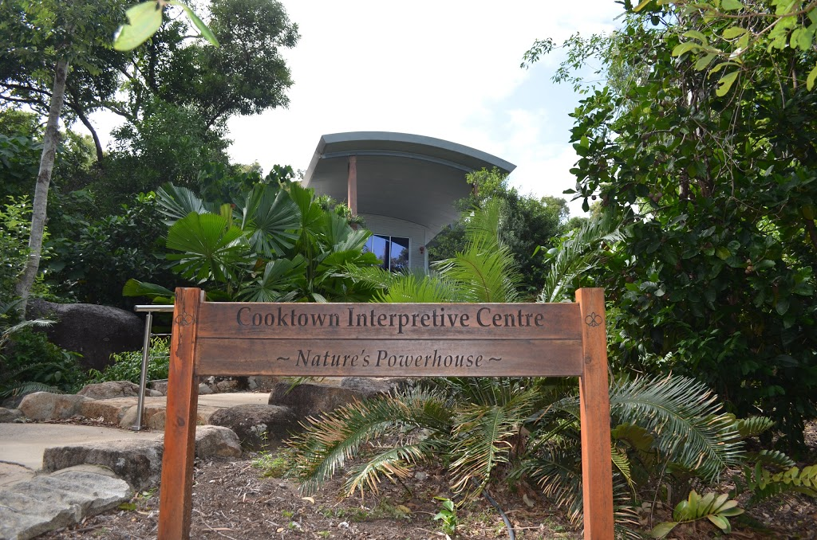
Nature Power House
After strolling through the Botanic Garden, make your way to Nature’s Powerhouse. It’s situated within the garden is also Cooktown’s official Visitor Information Center. Here you can understand the landscape and layout of Cooktown and plot your vacation well. It also has a lot of information about the flora and fauna
unique to the area.
Nature’s Powerhouse holds a priceless
collection of botanical illustrations of the f
lowering plants of the Endeavour River.
These were done by world-renowned
artist Vera Scarth-Johnson.

Slide 28
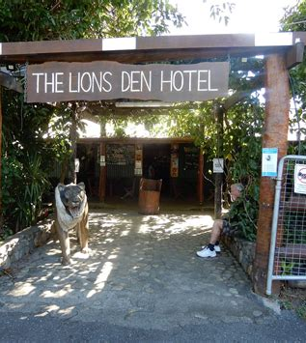
Lions Den Hotel
The Lions Den Hotel is a necessary pitstop when in Cooktown. This landmark hotel was established in 1875 and has its history literally written all over its walls.
The tradition started when miners wrote on the walls to keep track of their tab. Since then, guests have been welcome to write notes and add to the already quirky decor of the place.
It’s a great place for families as well with a children’s playground, natural swimming holes and beautiful grounds overlooked by mysterious Black Mountain.

Slide 29
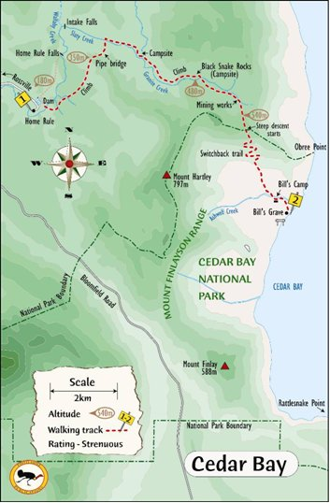
Cedar Bay National Park
A 40-km trip to the south brings you Cedar Bay National Park. Cedar Bay is also called Mangkalba by the Eastern Kuku Yalanji people. It’s their traditional country which extends to Mossman.
The park used to be known for turtle hunting but was then turned into a park marked by its remoteness, flanked by a tropical rainforest and expansive sandy beaches.
Inside the park is the Home Rule Walking Track. This 17 km track is steep and rough but takes you through lush rainforests and possible sightings of the elusive Bennett’s tree kangaroo. It’s also possible to do bush camping near the coastal vegetation, but you have to bring your own gear and acquire the proper permits

Slide 30
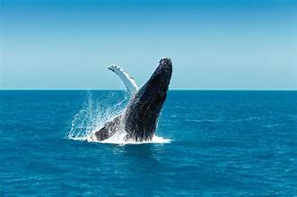
Whale Watching Tour
Seeing a humpback whale breach from the water is an unforgettable sight. Sign up for a whale watching cruise near Cooktown, and you have a good chance to tick it off your sightseeing list. From July through September, humpback whales swim the warm waters around the Palm Islands, just north of Cooktown.
Depending on conditions, tours typically cruise along the waters off Cooktown, around Magnetic Island, and in the sheltered bays of the Palm Islands in search of these gentle giants. Most include morning or afternoon tea.
Marine biologist lead tours from most tour companies.
No matter which tour you take, you also have the opportunity to spot other wildlife, including turtles, dugongs, different species of dolphins, and seabirds.
Tour Price Varies: Adults $165, Children 6-16. $85 3-6 $45

Slide 31
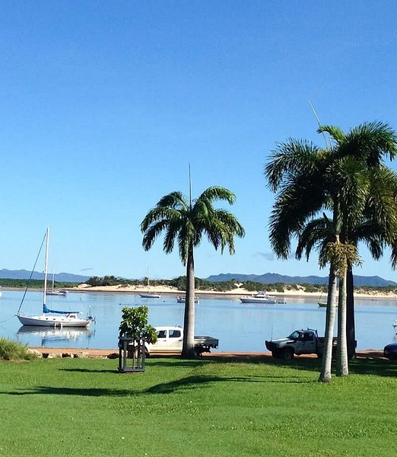
Finch Bay
For more spectacular beaches, go past the Botanic Gardens and bask in the sun at Finch Bay. It’s only a 5-minute drive or a half-hour walk from the town center, making it one of the most popular beaches in Cooktown.
The beach at Finch Bay stretches for around 500 meters. However, because we’re talking about Australia, there are crocodile sightings because Alligator Creek and its mangroves cross part of the beach.
There are warning signs and alerts all the time, so swimming is still safe for as long as you follow these signals. This creek also separates the bay from the mountains, which lend a beautiful backdrop, especially around sunset.

Slide 32
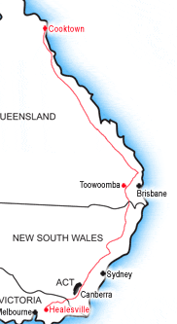
Bicentennial National Trail
The Bicentennial National Trail is not meant to be done in one go as it winds through the length of the country. It’s the longest marked and non-motorized trekking route in the world that stretches 5,330 kilometers.
This trail makes the Appalachia trail seem small. The Trail goes through 18 National Parks and stretches from Cooktown in North Queensland to Healesville in Victoria.
The trail is meant to be self-reliant, so you can take parts of the trail without a guide.
Trekkers follow ancient routes taken by Australia’s early pioneers aboard coaches, through old packhorse trails, and country roads.

Slide 33
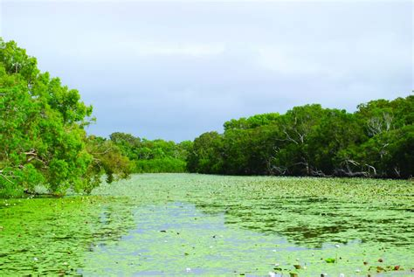
Keatings Lagoon
Keatings Lagoon Conservation Park is 8 km south of Cooktown. The Gungrade Aboriginal Corporation built the 1.5-km boardwalk and walking trail at the edge of the park.
It’s an important bird sanctuary, lush with wetland vegetation. The freshwater lagoon creates an ideal watering hole and food sources for animals and migratory birds.
The walk is self-guided and visitors can enjoy a relaxed lunch in the picnic area within the park.

Slide 34
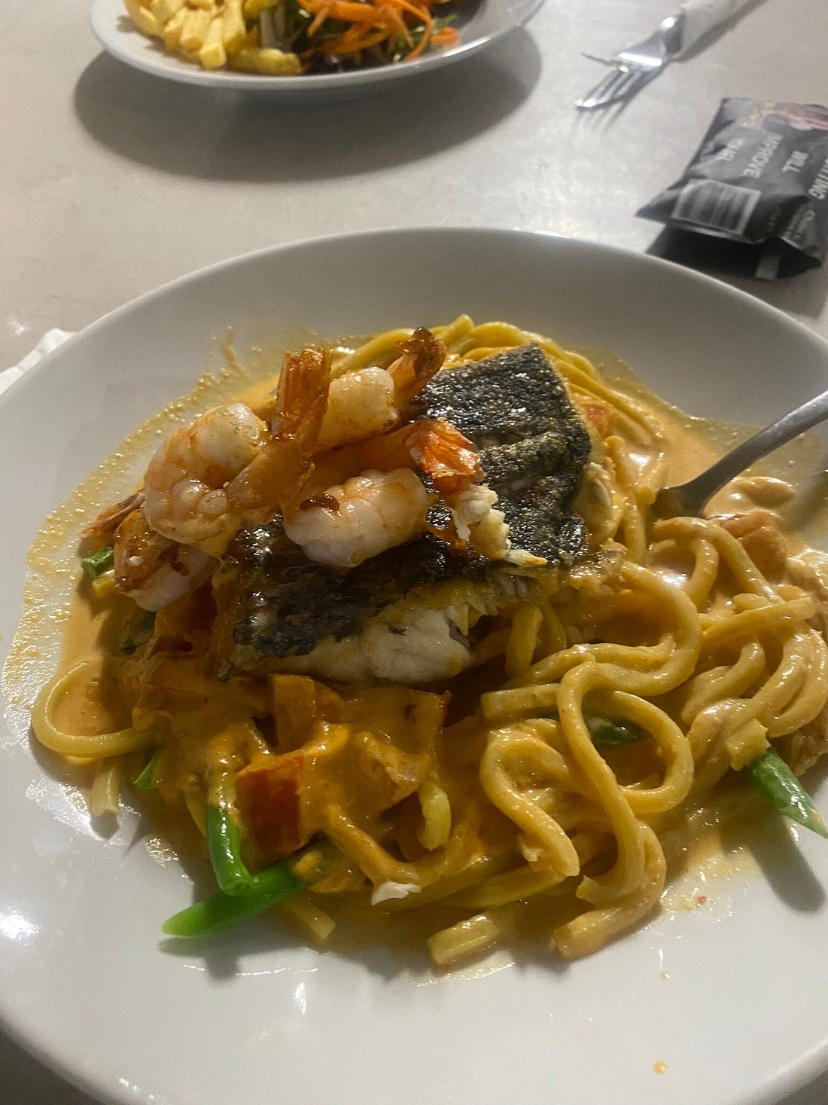
Restaurants Recommendations
There are a lot of excellent restaurants in Cooktown. Especially for seafood.
Here are some recommendations for Restaurants in Cooktown:
Jackey Jackey Thai Restaurant $$ - $$$, Asian, Thai, Vegetarian
Bowled Over Bistro $$ - $$$, Quick Bites, Bar, Seafood
The Food Shed $$ - $$$, Quick Bites, Italian, Pizza
Timarks Bistro $ Pub, Australian, Gastropub
Cooktown RSL Memorial Club $$ - $$$, Steakhouse, Australian
River of Gold Restaurant $$ - $$$, Seafood, Australian, Vegetarian
Balcony Restaurant $$ - $$$, Contemporary, Australian, Vegetarian
For those of you that just like good food, you can’t go wrong just about anywhere you go.
GOOD EATING

Slide 35
Conclusion
Cooktown is a beautiful City with a rich history and numerous attractions. Regardless of what you're looking for, Cooktown has something for everyone.
I hope this presentation will help when we visit Cooktown!

Slide 36
Thanks For Coming
If you have any more questions, please ask.
I will do my best to answer them for you.
Have a great visit to Cooktown!

Slide 37
Acknowledgement
My seminars are the result of many years of travel experience combined with many hours of research over the internet.
I would like to acknowledge the many source I have accessed.
These include: Wikipedia.com, Britannica.com, and the
various Museum, Park and Government websites.

