Slide 1

Chinese Dynastic History Part 4 1368 CE to 1911 CE Presented by Marc Silver

Slide 2
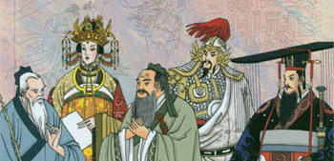
Chinese Dynastic History Part 4
Chinese history from 1368 to 1911 CE encompasses two of the nation's most pivotal and transformative dynasties: the Ming (1368–1644) and the Qing (1644–1911).
This era marks a period of resurgence, imperial consolidation, and, eventually, the challenges of modernity that would reshape China’s socio-political landscape. The Ming dynasty, established after the fall of the Yuan Empire, sought to restore Han Chinese rule and promote cultural revival through Confucian ideals.
It is renowned for its maritime expeditions, artistic developments, and agricultural reforms, but also for internal strife and the rise of eunuch influence.
The Qing dynasty, founded by the Manchu people, followed in the wake of Ming’s collapse, becoming the last imperial dynasty of China.
The Qing rulers oversaw an era of territorial expansion, administrative efficiency, and relative stability. However, they also faced increasing foreign pressure, internal rebellions, and an inability to modernize rapidly in the face of Western imperialism. The period ended with the fall of the Qing in 1911, marking the close of over two millennia of imperial rule and paving the way for the modern republic.

Slide 3
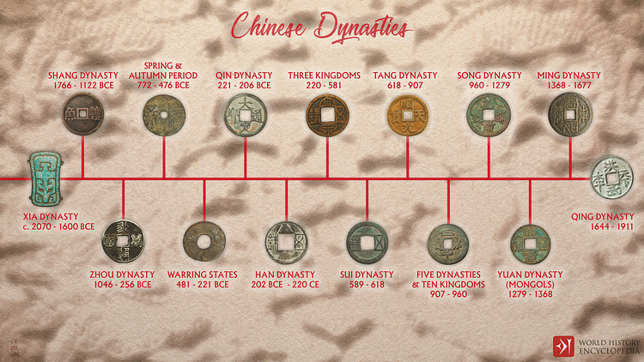

Slide 4
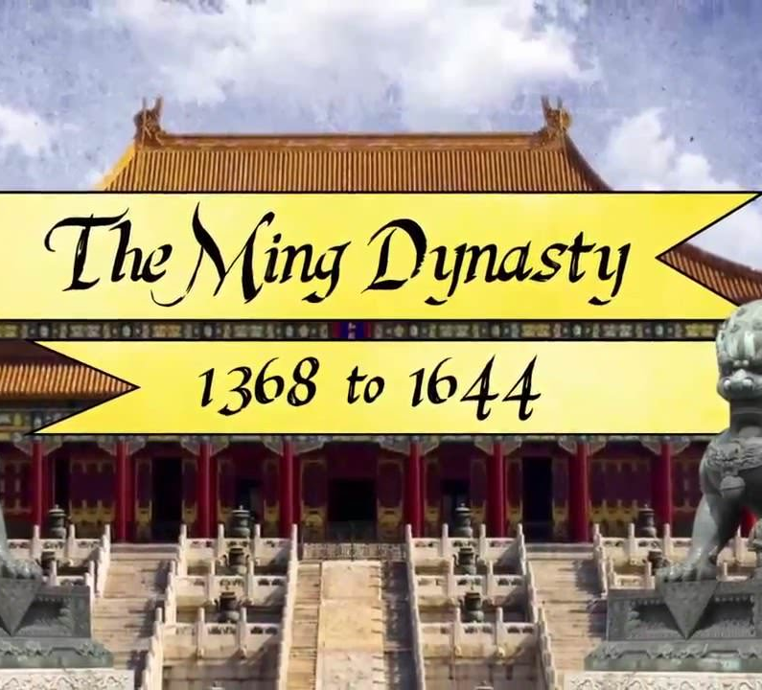
A Tale of Triumph and Turmoil
In 1368, China witnessed a historic shift as it fell under the rule of an ethnic Chinese dynasty for the first time in over a century.
This marked the beginning of the Ming Dynasty (Ming Chao), which would rule China from 1368 to 1644.
The Ming era, characterized by both remarkable achievements and profound challenges, left an indelible mark on Chinese history.

Slide 5
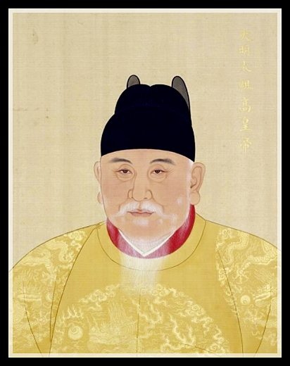
The Ascension of Emperor Taizu
The founder of the Ming Dynasty, Emperor Taizu, began his life far from the imperial palace.
Born as a commoner and orphaned at the age of sixteen, Taizu spent part of his youth in a Buddhist monastery.
His humble beginnings and subsequent rise to power are emblematic of the tumultuous period of rebellion and instability that preceded the Ming Dynasty.
Joining and eventually leading a rebel faction, Taizu first captured Nanjing and then marched north to seize the Mongol capital of Beijing.
The Mongol Emperor, unable to withstand Taizu’s forces, fled, and Taizu established the Ming Dynasty.

Slide 6
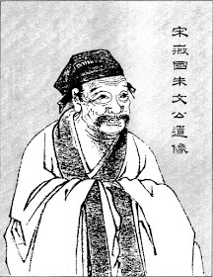
The Ming Dynasty
Emperor Taizu’s reign was marked by both reform and ruthlessness.
He carried out several purges of the elite and intellectuals, consolidating his power and rooting out potential rivals.
Despite his harsh methods, Taizu maintained the imperial examination system, which continued to test candidates on the Confucian classics: the Analects of Confucius (Lun Yu), the writings of Mencius (Meng Zi), the Doctrine of the Mean (Zhong Yong), and the Great Learning (Da Xue), as interpreted by the scholar Zhu Xi.
This system played a critical role in the administration of the empire, ensuring that meritocracy remained a cornerstone of governance.
Zhu Xi (Chu Hsi)
Chinese Scholar

Slide 7
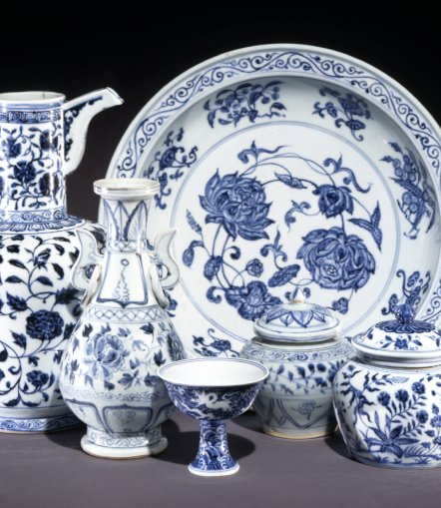
Cultural Flourishing and Foreign Relations
The Ming Dynasty is renowned for its cultural achievements, including a flourishing of literature and publishing.
The period saw an explosion in the production of vernacular literature, making significant contributions to Chinese cultural and intellectual life.
Additionally, Ming blue-and-white porcelain became highly prized in Europe, reflecting the era's artistic and commercial vibrancy.

Slide 8
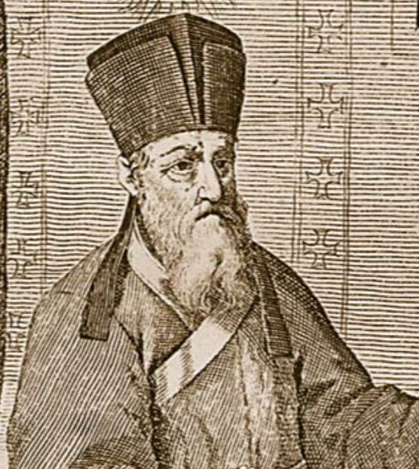
Cultural Flourishing and Foreign Relations
Religiously, the early Ming emperors were inclined towards Taoism, and Emperor Taizu notably banned Christianity.
However, this stance would shift in the later years of the dynasty.
The arrival of Jesuit missionaries, including the renowned Matteo Ricci, who lived in Beijing from 1601 to 1610, introduced advanced knowledge in astronomy, mathematics, and geography to China.
Ricci and his fellow missionaries fostered a degree of cultural exchange and intellectual dialogue between China and the West.
Jesuit Matteo Ricci

Slide 9
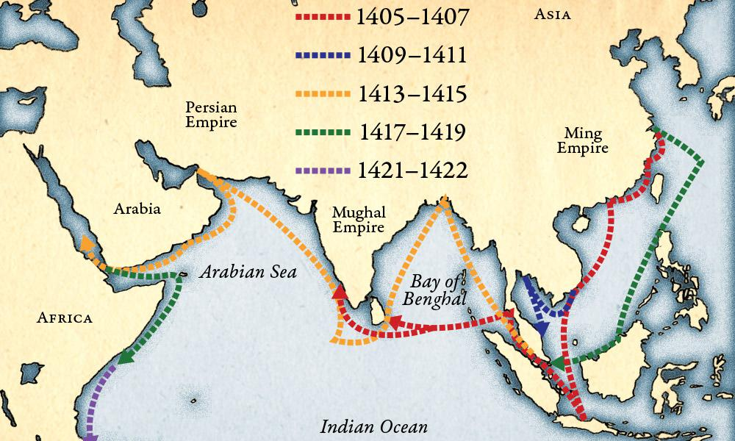
Challenges and Expansion
The Ming Dynasty faced significant challenges, particularly in border control. The Great Wall, as seen today, was extensively rebuilt and expanded during this period to defend against Mongol incursions. Along the coasts, China grappled with threats from pirates and smugglers, which complicated maritime security and trade.
In terms of naval power, the Ming Dynasty experienced a period of significant expansion.
The explorer Zheng He, under an imperial commission, undertook several voyages to establish tributary relations and explored beyond China.
Zheng He’s expeditions reached as far as the East African coast, demonstrating China’s growing maritime capabilities.
Despite this, Ming policy remained cautious regarding foreigners, limiting their interactions primarily to trading posts and treating them as tribute states rather than integrating them fully into the Chinese economic and political sphere.

Slide 10
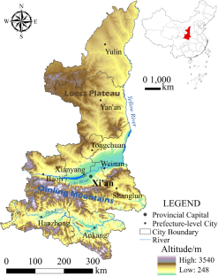
Decline and Fall
Despite initial successes, the Ming Dynasty began to face severe internal and external pressures by the 1600s. The government, having grown excessively large and expensive, struggled with fiscal difficulties.
A drop in temperatures led to a shorter growing season and resulted in a devastating famine between 1627 and 1628. This environmental crisis exacerbated existing economic strains and social unrest.
Widespread banditry and a breakdown in central authority further undermined the Ming regime.
Trade disruptions with Japan and Spain, crucial sources of silver, worsened fiscal problems, leading to economic instability.

Slide 11
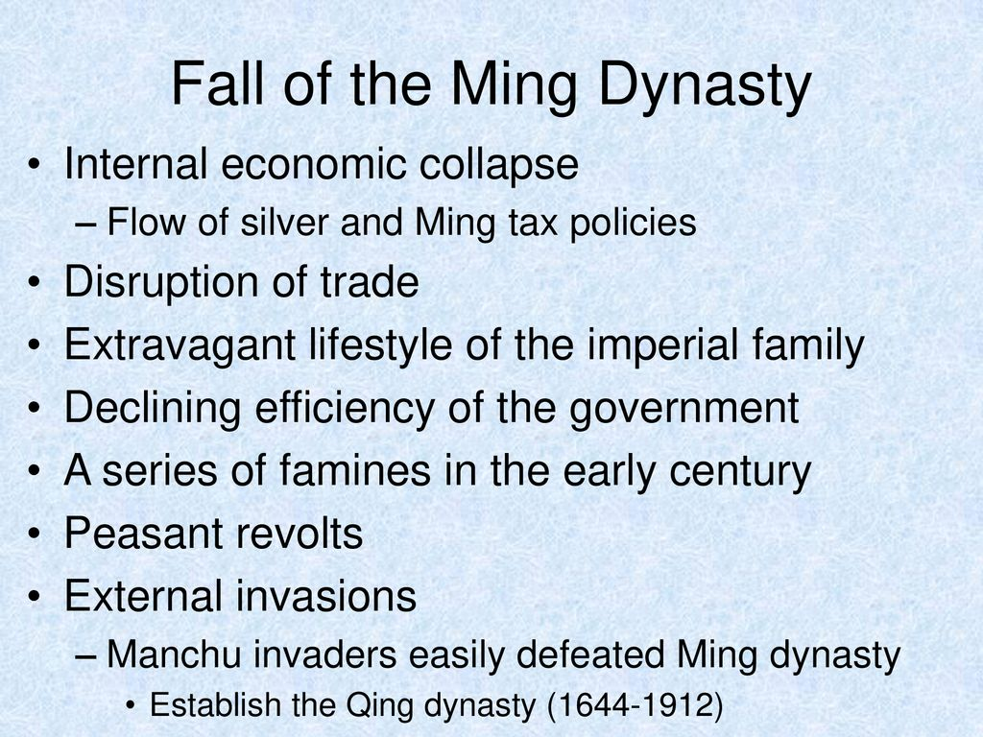
Decline and Fall
The combination of internal discontent, administrative inefficiency, and external pressures eventually led to a fragmentation of power, with various factions vying for control.
By the mid-17th century, the Ming Dynasty’s mandate of heaven, the traditional justification for imperial rule, had effectively expired.
The dynasty's inability to address its mounting crises paved the way for the rise of the Manchu-led Qing Dynasty, which would eventually replace the Ming and usher in a new era in Chinese history.
The fall of the Ming Dynasty thus marked the end of an important chapter in China's imperial past, characterized by both remarkable achievements and profound challenges.

Slide 12
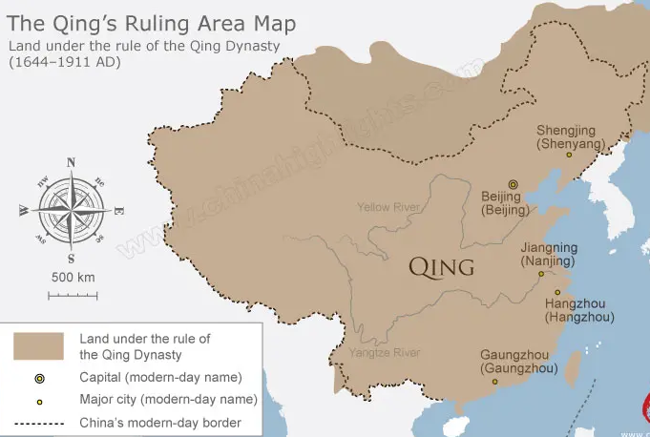
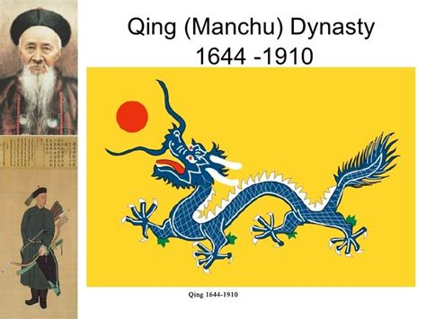
The Ming Dynasty
The Revival, Flourishing, and Decline of China’s Imperial Power
In 1368, China saw the return of rule by an ethnic Chinese dynasty with the establishment of the Ming Dynasty (Ming Chao), which would govern from 1368 to 1644.
This transition marked a significant moment in Chinese history, ending over a century of Mongol domination under the Yuan Dynasty.

Slide 13
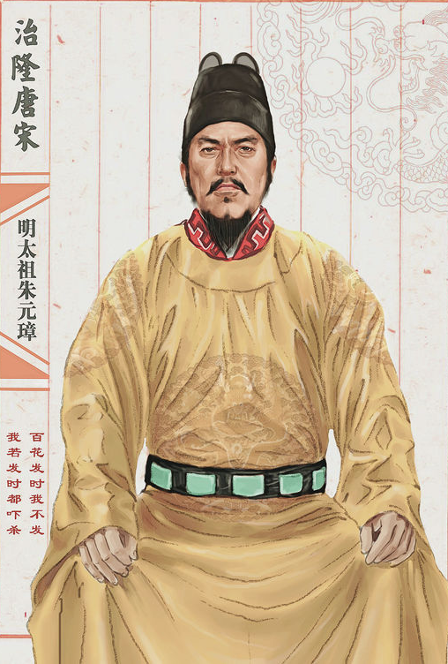
The Rise of Emperor Taizu
The Ming Dynasty was founded by Zhu Yuanzhang, known posthumously as Emperor Taizu. His rise to power is a remarkable story of transformation from a commoner to an emperor. Born into poverty, Taizu’s early years were marked by hardship.
After losing his parents at sixteen, he spent time in a Buddhist temple, where he began to cultivate his leadership qualities.
His fortunes changed when he joined a rebel group during the declining years of the Yuan Dynasty. Through strategic acumen and relentless determination, he captured Nanjing and later led his forces to Beijing, the Mongol capital.
The Mongol Emperor’s flight and Taizu’s subsequent establishment of the Ming Dynasty signaled a new era in Chinese history.

Slide 14
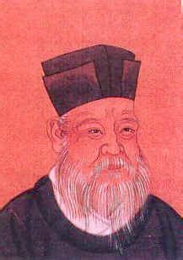
Taizu’s Reforms and Governance
Emperor Taizu's rule was characterized by both significant reforms and severe purges.
He worked to consolidate his power by purging perceived threats from the elite and literati, which fostered a climate of fear and strict control.
Despite his harsh methods, Taizu maintained the imperial examination system, a cornerstone of Chinese governance.
This system, which tested candidates on the Confucian classics, including the Analects of Confucius (Lun Yu), the writings of Mencius (Meng Zi), the Doctrine of the Mean (Zhong Yong), and the Great Learning (Da Xue), continued to function under the Ming.
The interpretation of these texts by the scholar Zhu Xi remained a guiding force in the administration of the empire.
Zhu Xi
Neoconfucian philosopher, poet, and politician during the Ming Song dynasty

Slide 15
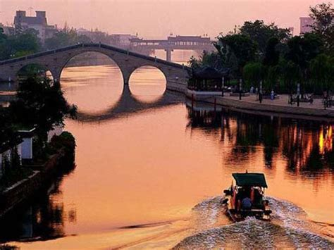
Cultural Flourishing and Technological Advances
The Ming Dynasty is renowned for its cultural achievements. This period saw an explosion in publishing and the production of vernacular literature, which contributed to a vibrant intellectual and artistic environment.
Ming blue-and-white porcelain became highly prized in Europe, symbolizing the era’s artistic and economic prosperity.
In the religious sphere, the early Ming emperors showed a preference for Taoism, and Emperor Taizu even outlawed Christianity.
However, the latter part of the dynasty witnessed a shift as Jesuit missionaries, including the prominent Matteo Ricci, brought advanced knowledge in astronomy, mathematics, and geography to China. Ricci’s presence in Beijing from 1601 to 1610 facilitated significant cultural and scientific exchanges between China and the West.

Slide 16
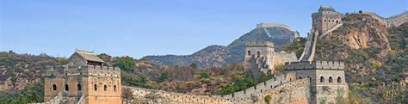
Challenges and Military Endeavors
The Ming Dynasty faced substantial challenges in securing and maintaining its borders.
The Great Wall, as seen today, was extensively rebuilt and fortified during the Ming period to defend against Mongol incursions.
Along the coasts, the Ming government struggled with threats from smugglers and pirates, complicating maritime security.

Slide 17
Challenges and Military Endeavors
The Ming Dynasty also saw a marked increase in naval power.
The emperor dispatched the explorer Zheng He on several major voyages to establish tributary relationships and explore distant lands.
Zheng He’s expeditions reached as far as the East African coast, showcasing China's maritime capabilities and fostering international trade.
Despite the Ming’s cautious approach to foreign relations, regarding many Western powers as mere tribute states and limiting them to trading posts, these interactions were crucial for China’s economic and diplomatic engagements.

Slide 18
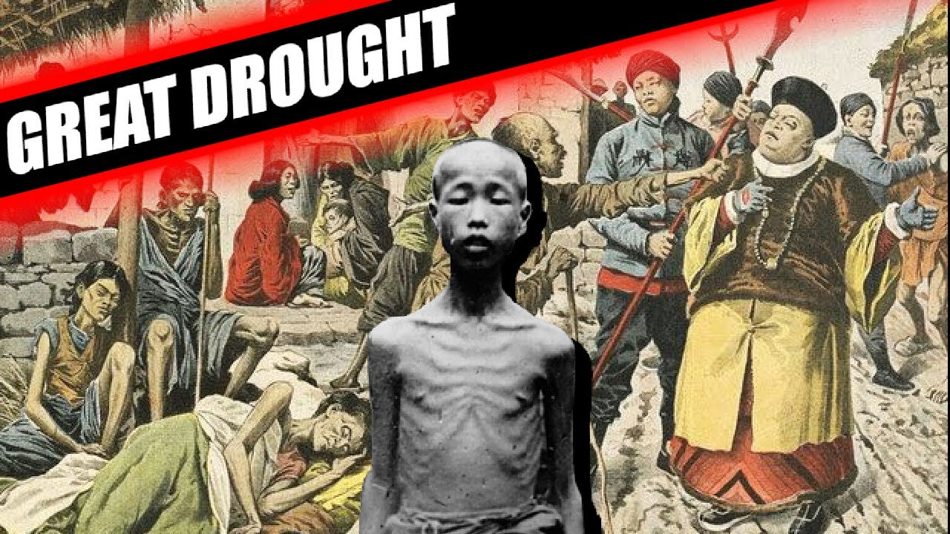
Decline and Fall
By the 1600s, the Ming Dynasty faced a series of severe internal and external pressures. The government had expanded to an unsustainable size, leading to inefficiencies and fiscal strain.
A drop in temperatures during this period resulted in a shorter growing season and a devastating famine between 1627 and 1628, which further strained resources and contributed to widespread suffering.
Social unrest grew as gangs ravaged the countryside, and the state struggled to respond effectively due to its depleted financial resources.
Additionally, trade disruptions with Japan and Spain, coupled with a decline in the influx of silver, exacerbated the empire's economic troubles.

Slide 19
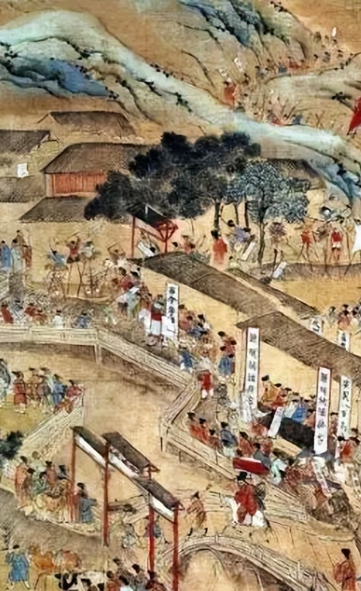
Decline and Fall
As the Ming Dynasty’s administrative capabilities faltered, various factions vied for control, signaling a breakdown in central authority.
By the mid-17th century, the Ming Dynasty's "mandate of heaven"—the divine right to rule—had effectively expired.
The combination of internal decay, economic troubles, and external pressures paved the way for the rise of the Manchu-led Qing Dynasty, which would succeed the Ming and usher in a new era in Chinese history.
The Ming Dynasty’s legacy remains a testament to a period of profound cultural flourishing and significant challenges, shaping the trajectory of Chinese history for centuries to come.

Slide 20
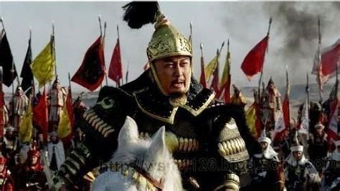
The Rise and Fall of the Qing Dynasty
From Glory to Decline
In 1644, China faced a dramatic upheaval.
The Ming Dynasty, which had ruled China for nearly 300 years, fell when the warlord Li Zicheng captured Beijing and the Ming Emperor committed suicide.
This marked the beginning of the Qing Dynasty (Qing Chao), also known as Da Qing or The Great Qing, which would govern China from 1644 to 1912.
The Qing Dynasty ushered in a period of considerable wealth, stability, and territorial expansion, though it ultimately faced significant challenges from both internal and external forces.

Slide 21
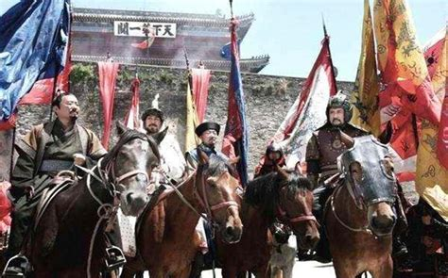
The Rise and Fall of the Qing Dynasty
The Establishment of the Qing Dynasty
The collapse of the Ming Dynasty was followed by a swift rise of the Manchu-led Qing Dynasty.
As the Ming government crumbled, the Manchus, who had been building their power outside the Great Wall, advanced into China.
A crucial turning point came when Wu Sangui, a Ming general stationed at a Great Wall outpost, decided to ally with the Manchus against Li Zicheng’s rebels.
This alliance facilitated the establishment of the Qing Dynasty and marked the beginning of another era of foreign rule over China.

Slide 22
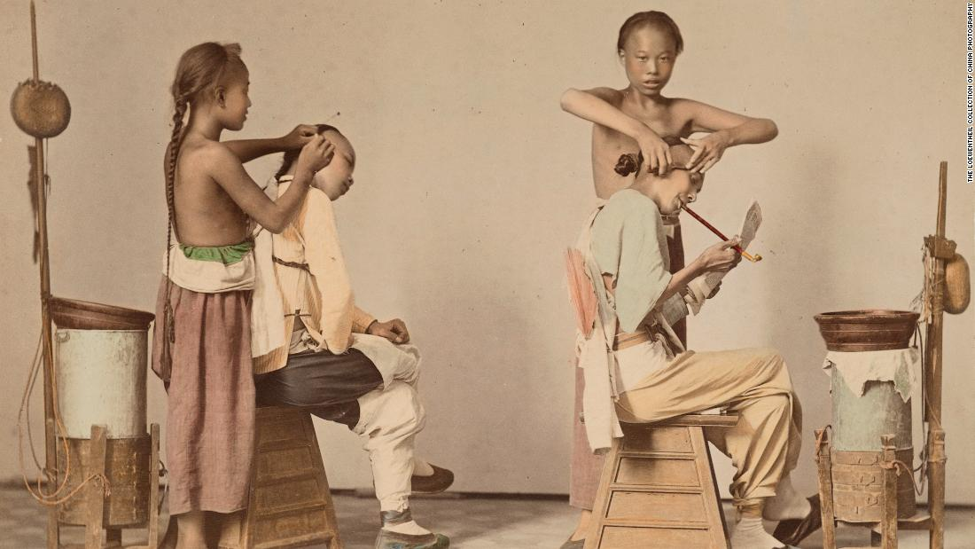
The Qing Dynasty’s Consolidation and Reforms
The Qing rulers sought to solidify their control and integrate their rule with Chinese traditions. In 1645, the Qing government issued a decree requiring all Han Chinese men to adopt the Manchu hairstyle, known as the queue, and to shave the front of their heads.
This edict was a symbol of loyalty to the new regime and a means of distinguishing between the ruling Manchus and the Chinese populace.
Noncompliance was met with severe penalties, and it took several decades for the Qing to fully suppress the remaining Ming loyalists.
Under Emperor Kangxi, who ascended to the throne in 1669, the Qing Dynasty entered a period of remarkable stability and prosperity.

Slide 23
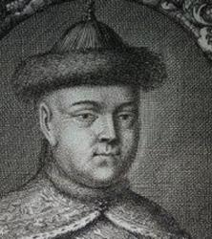
Cultural and Administrative Achievements
Emperor Kangxi was a patron of both Chinese culture and Western knowledge.
He continued the imperial examination system, allowing ethnic Chinese to participate in government and contribute to the administration.
Kangxi also commissioned the compilation of the Kangxi Dictionary, a monumental work that standardized Chinese characters and contributed to the preservation of Chinese culture.
Kangxi welcomed Jesuit missionaries to his court, appointing them to the Imperial Board of Astronomy.
These missionaries introduced advanced Western scientific knowledge, further enriching China’s intellectual landscape.

Slide 24
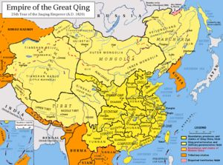
Expansion and International Relations
The Qing Dynasty saw significant territorial expansion. Under Kangxi and Qianlong, China extended its borders to include Tibet, Xinjiang in the west, Mongolia in the north, and Taiwan, which had previously been a Dutch colonial outpost. This expansion solidified China’s position as a major power in Asia.
However, the Qing Dynasty also faced growing external pressures.
The dynasty adhered to Confucian principles, which became more stringent over time, partly due to concerns about the instability seen in the late Ming period.

Slide 25
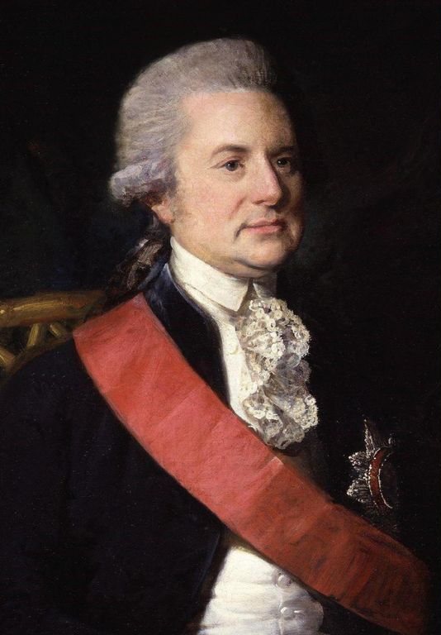
Expansion and International Relations
The Qing government limited Western trade to certain ports and viewed Western powers as tribute states rather than equal partners.
In 1793, the British envoy Lord Macartney visited China with gifts aimed at fostering trade relations. Despite the British attempt to stimulate interest in British goods, Emperor Qianlong dismissed these overtures, asserting that China had no need for foreign products.
This sentiment was articulated in a letter to the King of England, declaring that China possessed all things it needed.

Slide 26
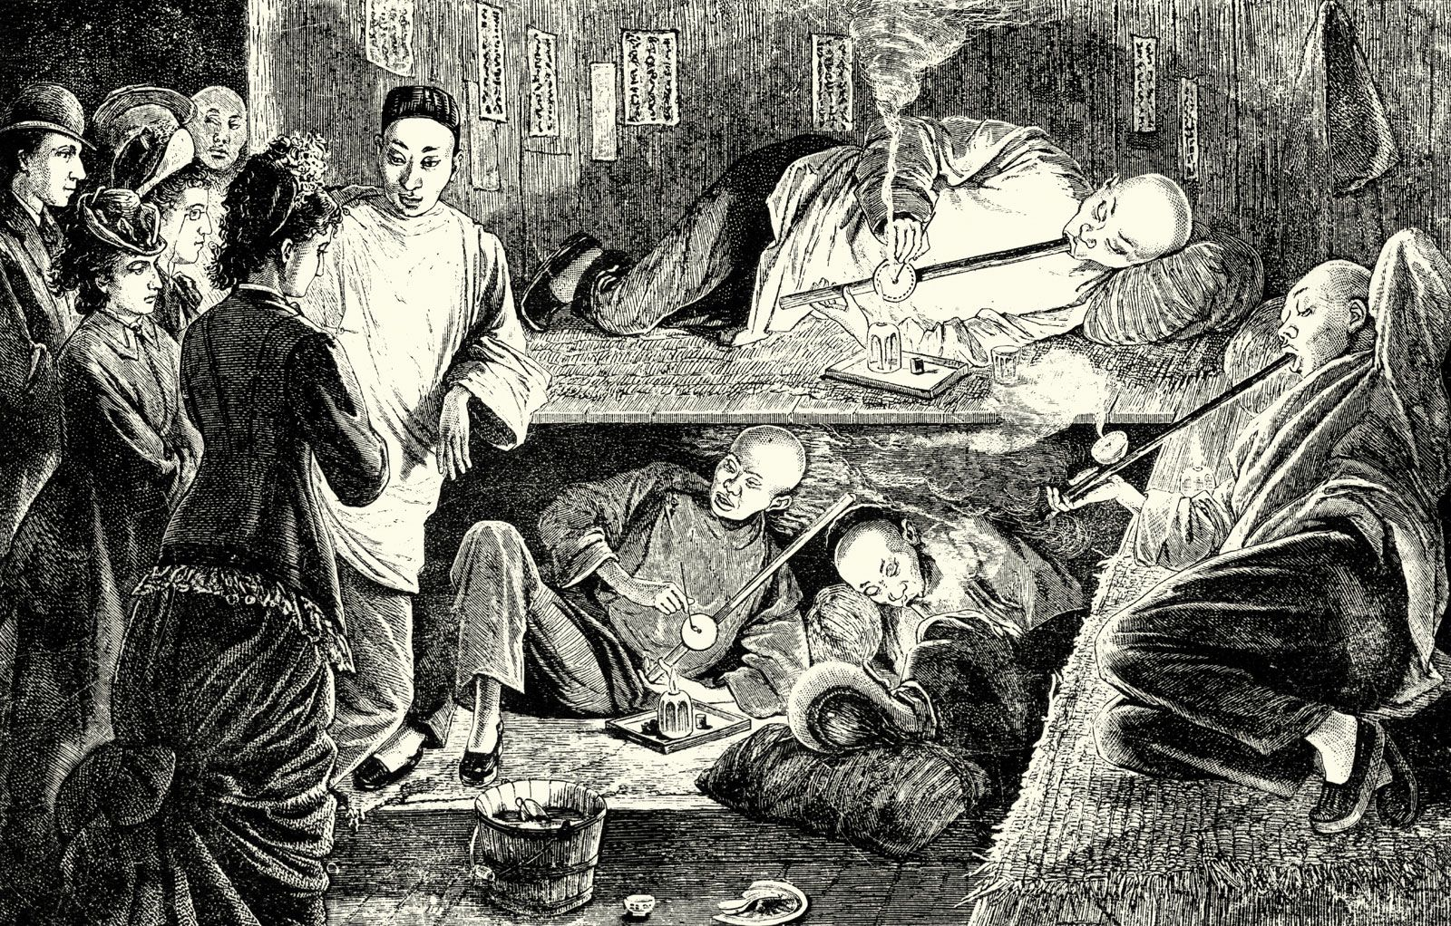
Economic Strains and the Opium Trade
By 1800, British demand for Chinese tea had led to a significant trade imbalance, with British silver flowing into China but not returning.
To address this imbalance, the British East India Company began importing opium from India into China, creating a profitable trade loop but also leading to widespread addiction.
The Qing court recognized the dangers of opium and attempted to curtail its trade, which led to conflicts with Britain. The resulting Opium Wars (1839-1842 and 1856-1860) forced China into several unequal treaties.
These treaties opened additional ports to British trade, ceded Hong Kong to Britain, and allowed the opium trade to continue.

Slide 27
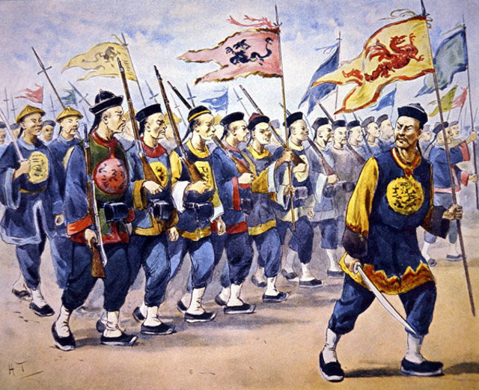
Internal Rebellions and Western Encroachment
The 19th century was marked by internal strife and external encroachments.
The Taiping Rebellion (1850-1864), one of the largest and bloodiest conflicts in history, challenged Qing authority and further strained the dynasty’s resources.
The Qing government faced further pressure from Western powers as well as Japan, who occupied parts of Chinese territory and forced the opening of more ports.

Slide 28
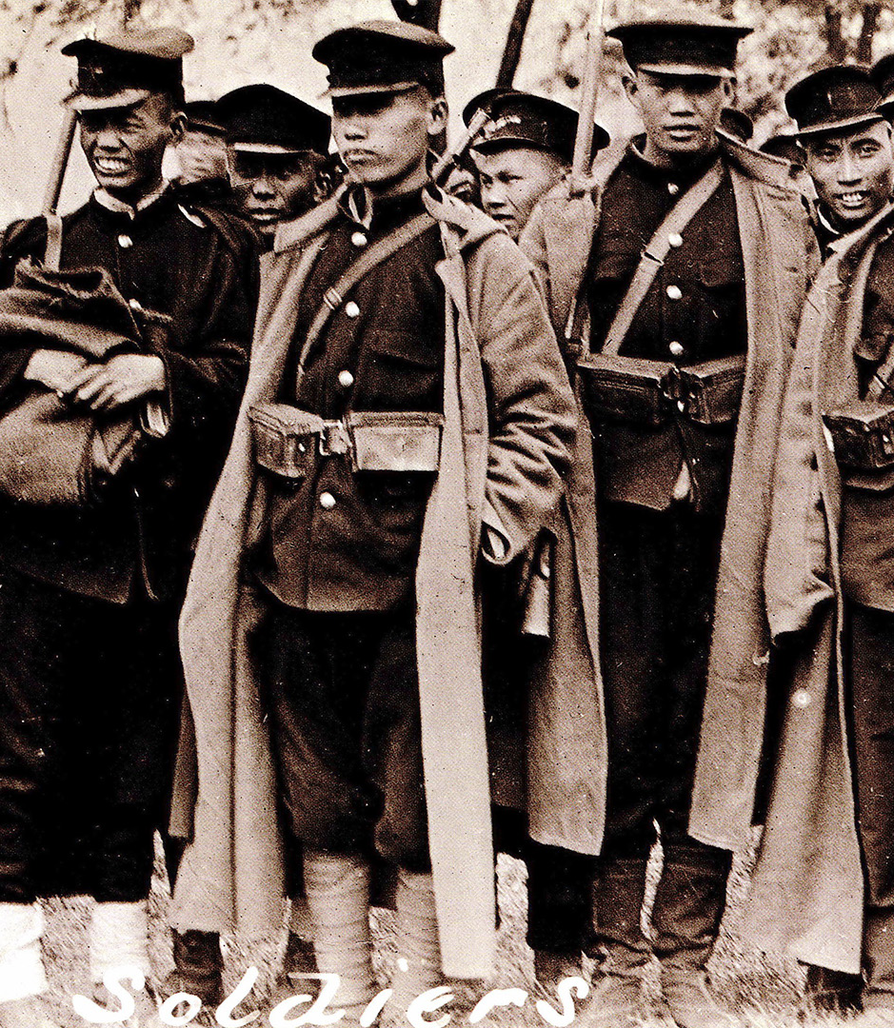
Internal Rebellions and Western Encroachment
Modernization Efforts: In response to the mounting pressures from both within and outside, the Qing Dynasty began to adopt some aspects of Western learning and technology to strengthen its rule.
This period saw efforts to modernize China's military, industry, and administrative practices, though these reforms were often too limited and came too late to prevent the dynasty’s eventual decline.
By the early 20th century, the Qing Dynasty’s inability to address internal turmoil and external pressures led to its collapse and the establishment of the Republic of China.
The Qing era remains a complex chapter in Chinese history, characterized by significant achievements and profound challenges that shaped the trajectory of modern China.

Slide 29
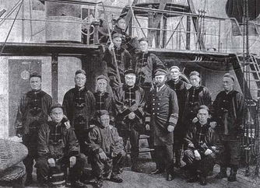
A Prelude to Modern China
The Self-Strengthening Movement (Zi qiang yun dong), spanning from 1861 to 1895, was a crucial yet ultimately flawed attempt by late Qing China to modernize and respond to the pressures of Western imperialism and internal strife.
This period marked a pivotal shift as China sought to industrialize, enhance its military capabilities, and adopt Western technologies and knowledge.
However, the movement's shortcomings and the broader geopolitical challenges faced by the Qing Dynasty led to a series of humiliations and transformations that shaped the trajectory of modern China.

Slide 30
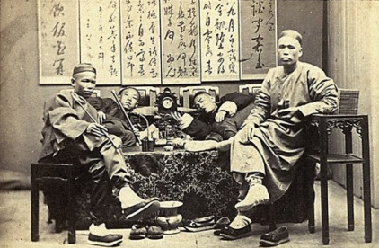
Initiatives of the Self-Strengthening Movement
The Self-Strengthening Movement aimed to modernize China’s military and industrial sectors by adopting Western innovations. Key initiatives included:
Industrialization: Efforts were made to build factories, railroads, and shipyards to stimulate economic development and increase production capabilities.
Military Modernization: The Qing government invested in acquiring and building Western-style weapons and warships to strengthen China's military forces.
Education and Science: The movement promoted the study of Western science, mathematics, and engineering, aiming to bridge the technological gap between China and the Western powers.
Despite these efforts, the movement faced significant obstacles. Bureaucratic inefficiencies, corruption, and resistance to change hindered progress, and the reforms were often poorly implemented.

Slide 31
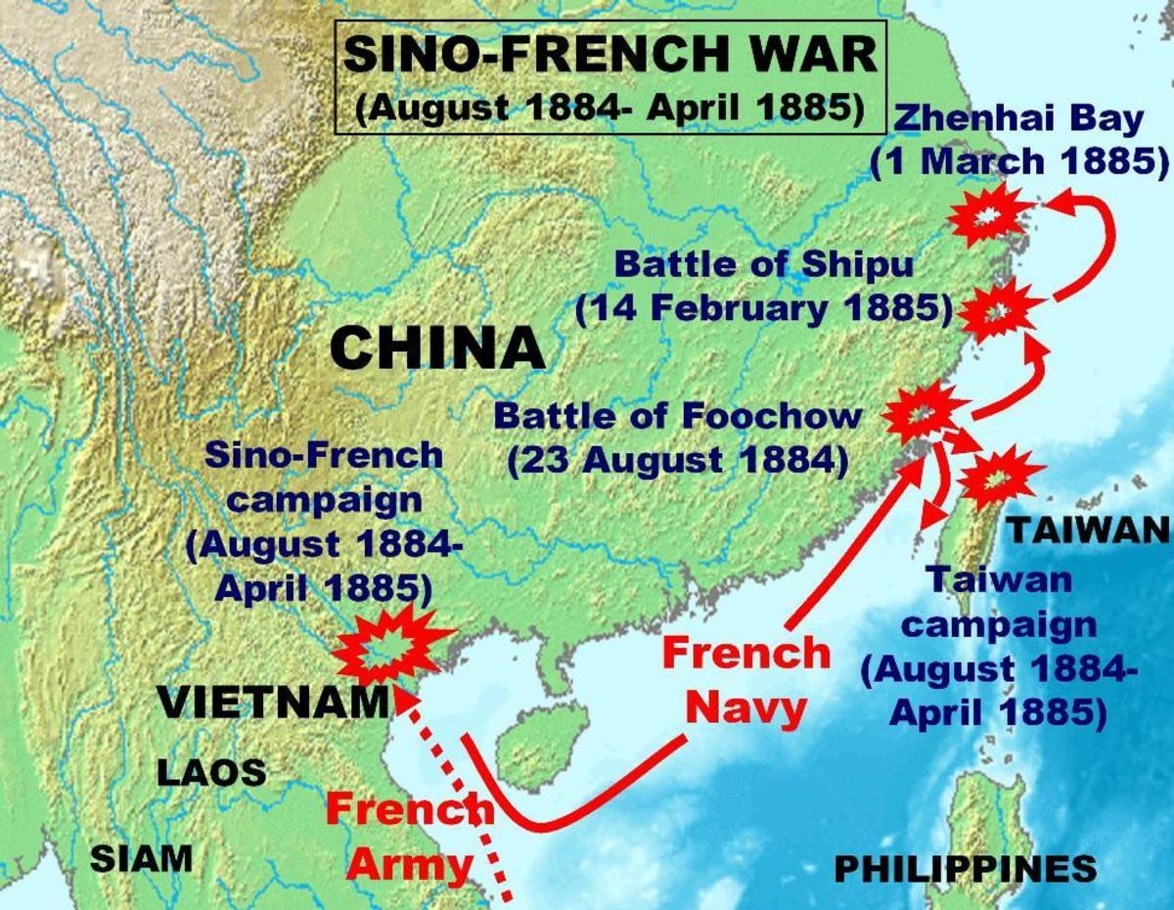
The Limitations Exposed
The inadequacies of the Self-Strengthening Movement were starkly revealed during the Sino-French War in the 1880s.
In a notable instance of military failure, the French managed to destroy an entire fleet of new Chinese warships in just one hour, highlighting the ineffective modernization of the Qing military.
The movement’s failures were compounded by China’s defeat in the First Sino-Japanese War (1894-1895), a conflict over control of Korea.
The war ended disastrously for China, resulting in the Treaty of Shimonoseki, which forced China to cede Taiwan and the Liaodong Peninsula to Japan and pay a hefty indemnity.
This defeat underscored China’s weakened state and opened the door to further foreign encroachments.

Slide 32
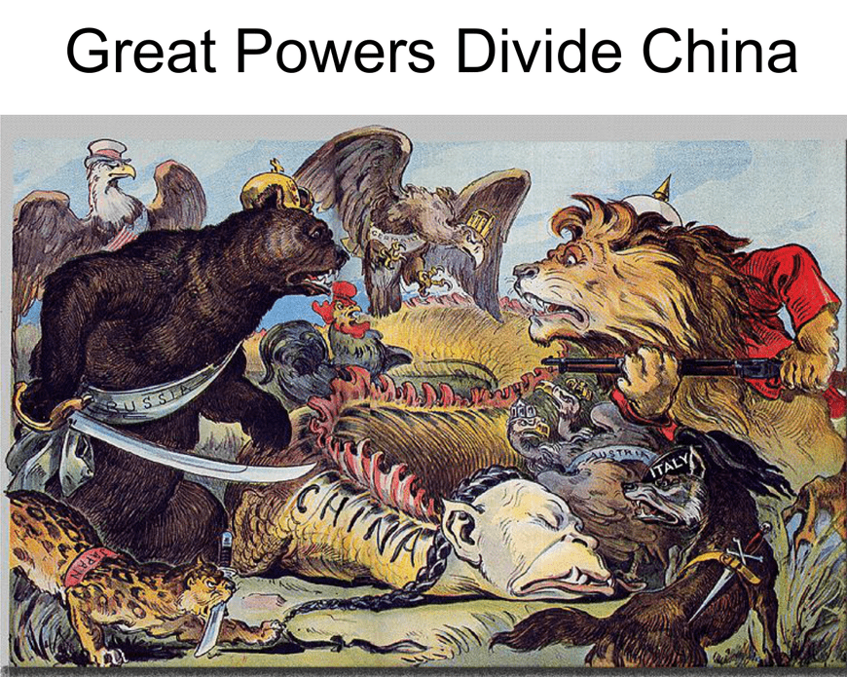
The Scramble for Concessions
By the end of the 19th century, China faced a "scramble for concessions" similar to the partitioning of Africa by Western powers.
Foreign nations seized various territories and established spheres of influence within China, further eroding Chinese sovereignty.
This period was marked by a series of unequal treaties that granted foreign powers significant control over Chinese territories and trade.

Slide 33
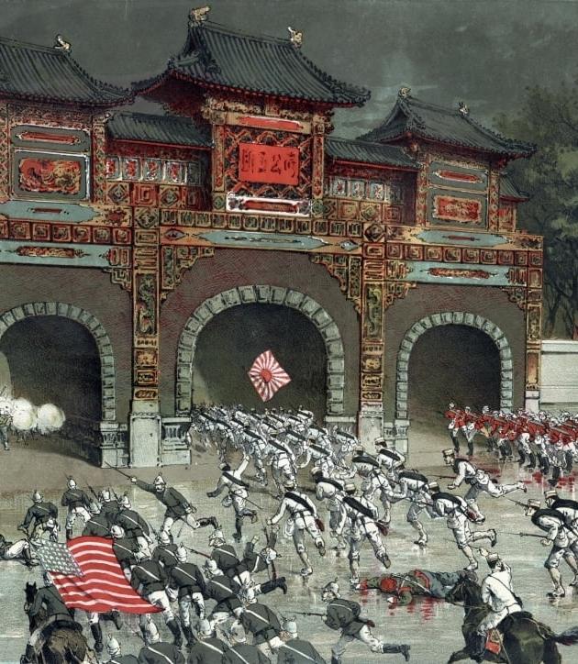
The Boxer Rebellion and Foreign Intervention
In 1900, the Boxer Rebellion erupted, fueled by anti-foreign and anti-Christian sentiments.
The uprising prompted an international response, with an alliance of eight Western powers and Japan sending a combined force of 20,000 soldiers to suppress the rebellion.
The allied forces marched from Tianjin to Beijing, quelling the uprising and subsequently looting the capital.
The Qing Dynasty was compelled to pay a staggering indemnity, twice the annual government revenue, as compensation to the foreign powers.

Slide 34

The Fall of the Qing Dynasty
The Qing Dynasty, despite holding onto power through the early 20th century, was increasingly seen as ineffective and corrupt.
In 1905, the century-old imperial examination system, a hallmark of Confucian governance, was abolished in favor of a modern Western-style education system.
This reform marked a significant shift away from traditional practices.
The final blow came in 1912 when the last Qing Emperor, Puyi, abdicated, leading to the establishment of the Republic of China.
This transition marked the end of over two millennia of imperial rule and the beginning of China’s modern era.

Slide 35
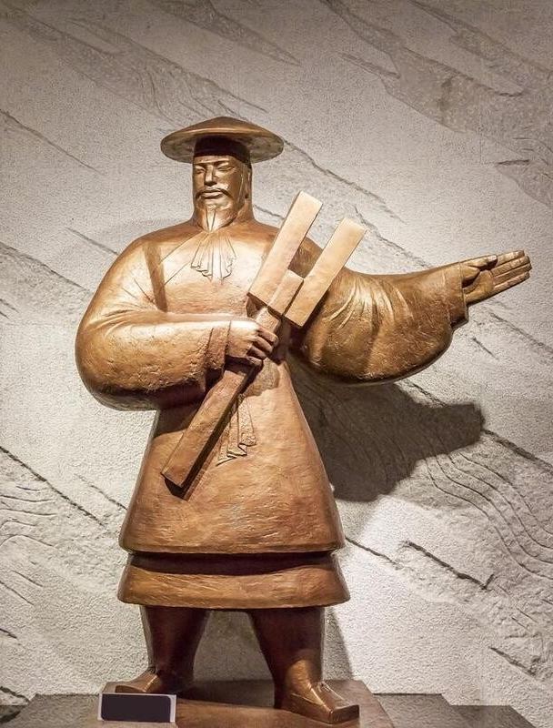
Legacy and Reflection
The end of the Qing Dynasty ushered in a period of profound change, leading to significant disruptions in traditional Chinese culture and one of the largest losse of life in Chinese history.
Despite the challenges and turmoil of this era, scholars today often look back at the imperial examination system and Confucian values with a sense of respect.
The examination system is viewed by some as an advanced political mechanism that provided a meritocratic element to governance.
Many modern observers argue that aspects of Confucianism could be vital in revitalizing Chinese culture and addressing contemporary societal issues.
By revisiting and understanding China’s rich historical and philosophical heritage, there is potential to glean insights that could positively impact modern society.

Slide 36
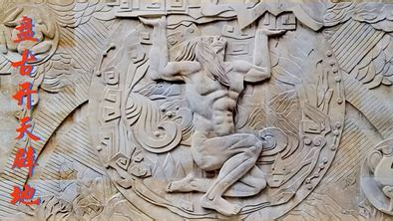
Conclusion
China’s 5,000-year history offers invaluable lessons on resilience, adaptation, and the complexities of cultural and political transformation.
As we reflect on this historical journey, it becomes clear that both the achievements and failures of past eras can provide guidance for contemporary and future challenges.
The written records of China’s past remain a treasure trove of knowledge, awaiting further exploration and rediscovery.

Slide 37
Thankyou for Coming!
I hope you enjoyed my talk!
If you have any more questions, please ask.
I will do my best to answer them for you.
I can be reached by e-mail at
marcs@sonic.net

Slide 38
Acknowledgement
My seminars are the result of many years of experience combined with many hours of research over the internet.
I would like to acknowledge the many source I have accessed.

Slide 39
References
Keightley, D. N. (1978). Sources of Shang History: The Oracle-Bone Inscriptions of Bronze Age China. University of California Press.
Chang, K. C. (1980). Shang Civilization. Yale University Press.
Liu, L. (2004). The Chinese Neolithic: Trajectories to Early States. Cambridge University Press.
Shaughnessy, E. L. (1999). The Cambridge History of Ancient China: From the Origins of Civilization to 221 BC. Cambridge University Press.
Li, F. (2006). Bureaucracy and the State in Early China: Governing the Western Zhou. Cambridge University Press.
Creel, H. G. (1960). Confucius: The Man and the Myth. John Day Company.
Pines, Y. (2002). Foundations of Confucian Thought: Intellectual Life in the Chunqiu Period, 722–453 BCE. University of Hawaii Press.
Loewe, M. (1999). The Cambridge History of Ancient China: From the Origins of Civilization to 221 BC. Cambridge University Press.
Wood, F. (2008). China's First Emperor and His Terracotta Warriors. Macmillan.
Sima Qian. (1993). Records of the Grand Historian: Qin Dynasty. Columbia University Press.

Slide 40
References
Twitchett, D., & Loewe, M. (1986). The Cambridge History of China: Volume 1, The Ch'in and Han Empires, 221 BC – AD 220. Cambridge University Press.
de Crespigny, R. (2010). Imperial Warlord: A Biography of Cao Cao 155-220 AD. Brill.
Roberts, M. (1991). Three Kingdoms: A Historical Novel. University of California Press
Wright, A. F. (1959). Buddhism in Chinese History. Stanford University Press.
Zürcher, E. (2007). The Buddhist Conquest of China: The Spread and Adaptation of Buddhism in Early Medieval China. Brill.
Ch’en, K. (1973). Buddhism in China: A Historical Survey. Princeton University Press.
Benn, C. (2002). China's Golden Age: Everyday Life in the Tang Dynasty. Oxford University Press. Mote, F. W. (1999). Imperial China 900–1800. Harvard University Press.
Ebrey, P. B. (2010). The Cambridge Illustrated History of China. Cambridge University Press.
Mote, F. W. (1999). Imperial China 900–1800. Harvard University Press.
Kuhn, D. (2009). The Age of Confucian Rule: The Song Transformation of China. Harvard University Press.
Andrade, T. (2016). The Gunpowder Age: China, Military Innovation, and the Rise of the West in World History. Princeton University Press.

