Slide 1

Chinese Dynastic History
Part 3
960 CE to 1368 CE
Presented by
Marc Silver

Slide 2
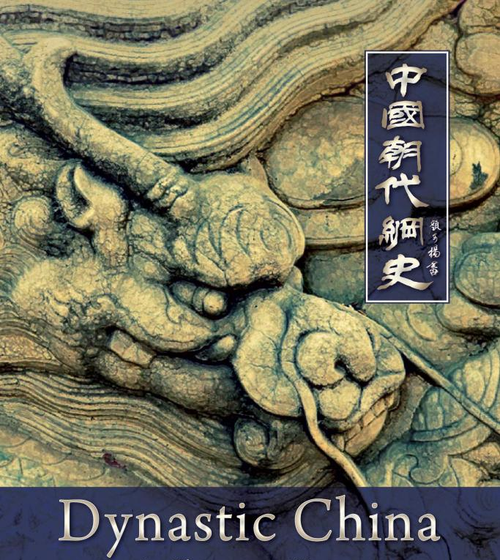
Chinese Dynastic History Part 3
Introduction:
Spanning from the Song Dynasty to the fall of theYuan Dynasty, the period between 960 and 1279 CE was transformative for China’s political, cultural, and social landscape.
Each of the dynasties played a pivotal role in shaping China's identity and its interactions with the broader world.
The Song Dynasty (960–1279 CE) is remembered for its significant advancements in science, technology, and economics, despite external threats from northern nomadic tribes.
The Yuan Dynasty (1271–1368 CE), established by Kublai Khan, marked the first foreign rule over China and promoted extensive cultural exchange across Eurasia, especially along the Silk Road.

Slide 3
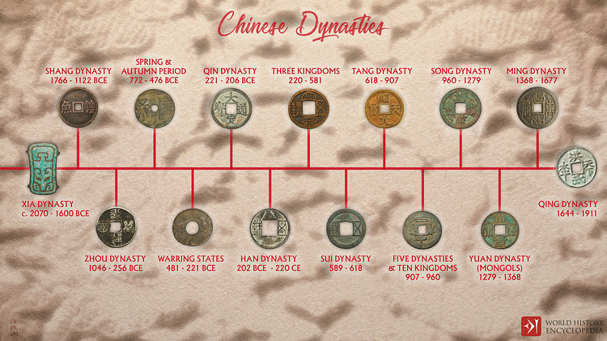

Slide 4
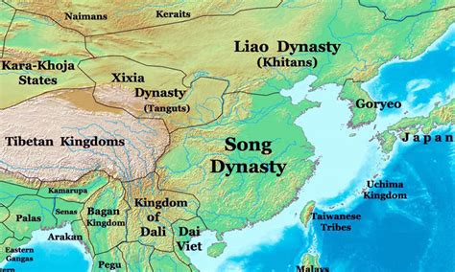
The Song Dynasty
Economic Strength, Military Weakness
Founded by Emperor Taizu, the Song Dynasty (960–1276 CE)
marked a new era in Chinese history.
Unlike the Tang Dynasty, which was characterized by military
conquests and expansion, the Song was more focused on
internal development, particularly in the realms of economics,
culture, and technology.
This was a period of rapid economic growth, with advances in agriculture, trade, and urbanization.
However, despite its internal prosperity, the Song Dynasty struggled to exert the same military dominance over Asia as the Han and Tang dynasties had. The Song military was relatively weak, and the dynasty faced constant pressure from powerful northern neighbors.
In 1126 CE, disaster struck when the Jurchens, a nomadic people from the north, attacked the Song capital of Kaifeng. The emperor and more than 3,000 members of the imperial family were captured and taken north as prisoners. This marked the fall of the Northern Song.

Slide 5
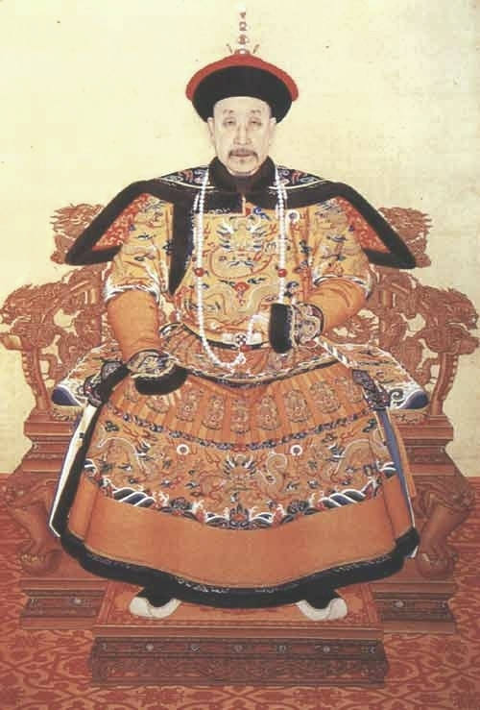
The Southern Song
Cultural Flourishing Despite Territorial Loss
Despite losing control of the northern heartland, the Song Dynasty survived for another century and a half by regrouping in the south.
Emperor Gaozong, the younger son of the captured emperor, established a new capital at Hangzhou and founded the Southern Song Dynasty (1127–1276 CE). Though militarily weakened, the Southern Song is remembered for its cultural and intellectual achievements.
During this period, markets were less restricted, and a vibrant urban culture emerged.
Tea houses, puppet shows, storytelling, and poetry became popular forms of entertainment. One distinctive cultural development was the rise of Song Ci, a form of lyrical poetry that flourished during this time.

Slide 6
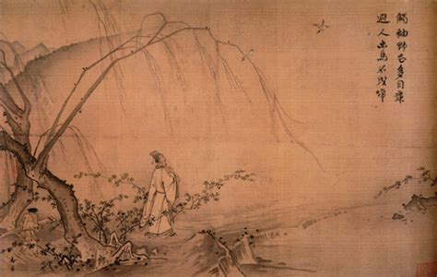
The Southern Song
A Flourishing Cultural Despite Territorial Loss
The arts also thrived, particularly landscape painting (Shan Shui Hua), which became symbolic of the Southern Song’s identity. In the early Northern Song, artists created grand, expansive scenes, but after the loss of the north, Southern Song paintings grew smaller and more introspective.
Often, these works left vast portions of the canvas empty, a metaphor for the loss of the Chinese heartland and the sense of emptiness that pervaded society following the defeat of the Northern Song.
On a philosophical level, scholars of the Southern Song sought to preserve Confucian values. One of the most important figures during this time was Zhu Xi, a scholar who wrote influential commentaries on the Confucian classics.
His works became the foundation of the civil service examination system, which lasted until 1905.

Slide 7
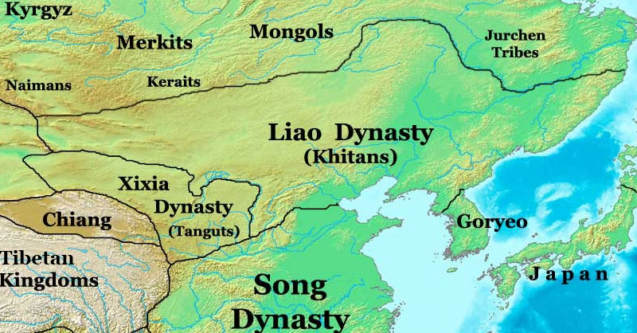
The Liao Dynasty
Foreign Rule and the Precedent for Future Dynasties
Even as the Song Dynasty reigned over the central and southern parts of China, foreign rule had already begun to take root in the north. One of the most significant foreign powers of this time was the Liao Dynasty (Liao Chao), which was founded in 907 CE by the Khitan people, a nomadic group that inhabited the northeastern region of China.
The Liao Dynasty, though foreign in origin, adopted many elements of Chinese governance and culture. The Khitan rulers took on the Chinese imperial system of hereditary succession, marking a departure from their traditional practice of electing clan chiefs.
The Liao's blending of Khitan and Chinese practices set a precedent for future foreign dynasties.
The Liao Dynasty lasted from 907 to 1125 CE, and though it was eventually defeated by the Jurchens, its existence foreshadowed the eventual rise of foreign dominance over China, a theme that would continue in subsequent centuries with the Mongols and later the Manchus.

Slide 8
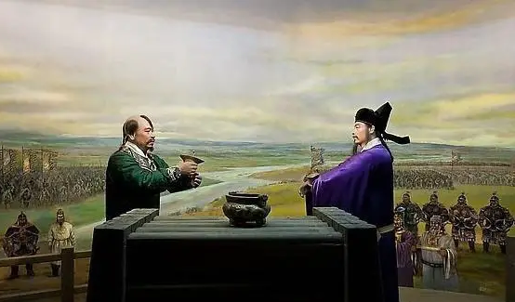
The Liao Dynasty
The Legacy of the Song and Liao Dynasties
While the Song Dynasty may not have had the military
might of its predecessors, its legacy is largely defined
by its economic prosperity and cultural richness. The
Song period saw significant advances in literature, painting, philosophy, and the development of urban culture.
Although the capture of the Northern Song’s capital was a devastating blow, the dynasty’s intellectual and cultural achievements of the Song era left a lasting mark on Chinese history.
Simultaneously, the Liao Dynasty played a crucial role in the broader narrative of China’s history, representing the first in a series of foreign dynasties that would challenge the notion of Chinese supremacy and shape the country’s future political landscape. The Liao’s adoption of Chinese governance also highlighted the Sinicization of foreign rulers, a pattern that would continue throughout China’s history, particularly under the Mongol and Manchu rulers.

Slide 9
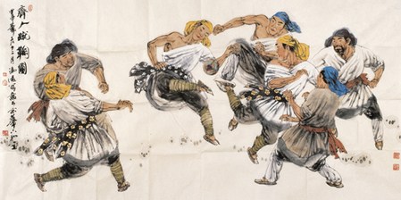
The Rise of the Jin Dynasty and the Fall of the Northern Song
The Jin Dynasty (Jin Chao), also known as Da Jin or the Great Jin (1115–1234 AD), was a significant player in Chinese history, particularly for its role in defeating the Northern Song Dynasty and forcing the Song Imperial Court to retreat to the south.
The dynasty was founded by the Jurchen people, ancestors of the Manchus, who would later establish the Qing Dynasty.
The Jurchens, a nomadic people from the northeast, first defeated the Liao Dynasty and then turned their attention to the Song.
By incorporating Chinese military experts from the cities they had conquered, the Jurchens developed a powerful army capable of laying siege to major Song strongholds.

Slide 10
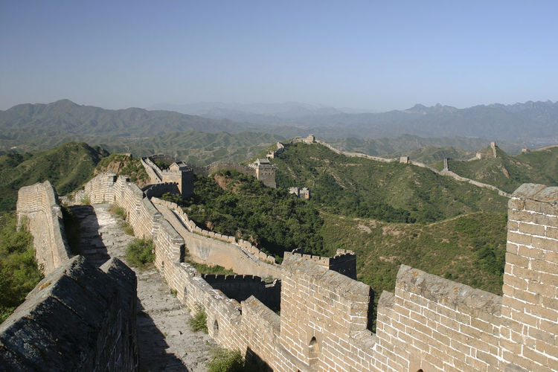
The Rise of the Jin Dynasty and the Fall of the Northern Song Cont.
The Jin Dynasty, after occupying northern China, it came to a confrontation with the Southern Song Dynasty in south China. The two reigns were well-matched in strength, but Jin was harassed by the continuous attacks from the northern tribes, especially the rising Mongols.
The Jin Great Wall ultimately failed in blocking the Mongolian troops led by Genghis Khan, it did repell other small nomadic powers and sustained Jin Dynasty for many years.
However, the huge financial and labor cost on building the wall heavily burdened Jin and later contributed to its collapse.

Slide 11
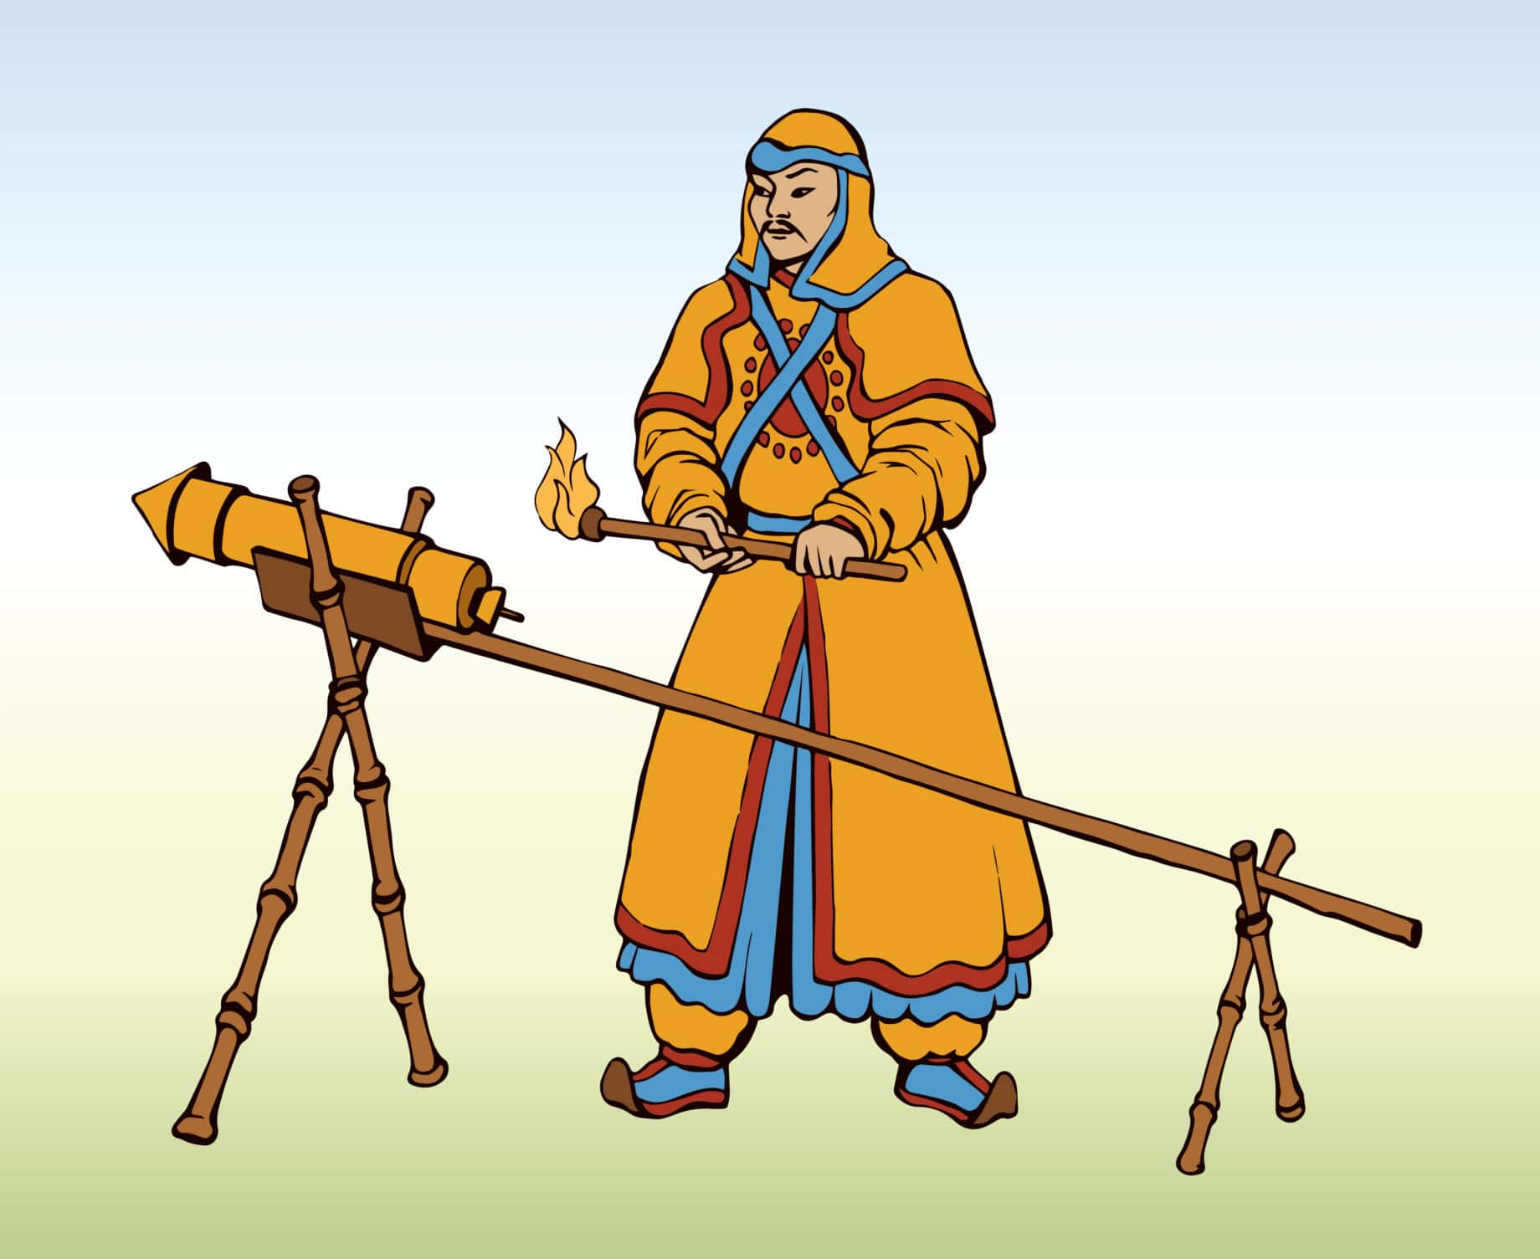
The Rise of the Jin Dynasty and the Fall of the Northern Song Cont.
Kaifeng was defended by 48,000 troops equipped with advanced weapons such as crossbows and flamethrowers. At this time, the Chinese had already discovered gunpowder, referred to as "huoyao" or "fire medicine", although firearms had not yet been developed. The early uses of gunpowder included slow-burning fire arrows and other explosive devices, which later evolved into more sophisticated weaponry.
Despite these defenses, the Jurchens were relentless. They brought 30 catapults, launching massive stones toward the city, and used iron sheeting to bridge Kaifeng's moat.
Additionally, they deployed siege towers taller than the city walls, from which they hurled bombs into the city. Overwhelmed by this onslaught, the city eventually fell, marking a devastating defeat for the Northern Song.

Slide 12
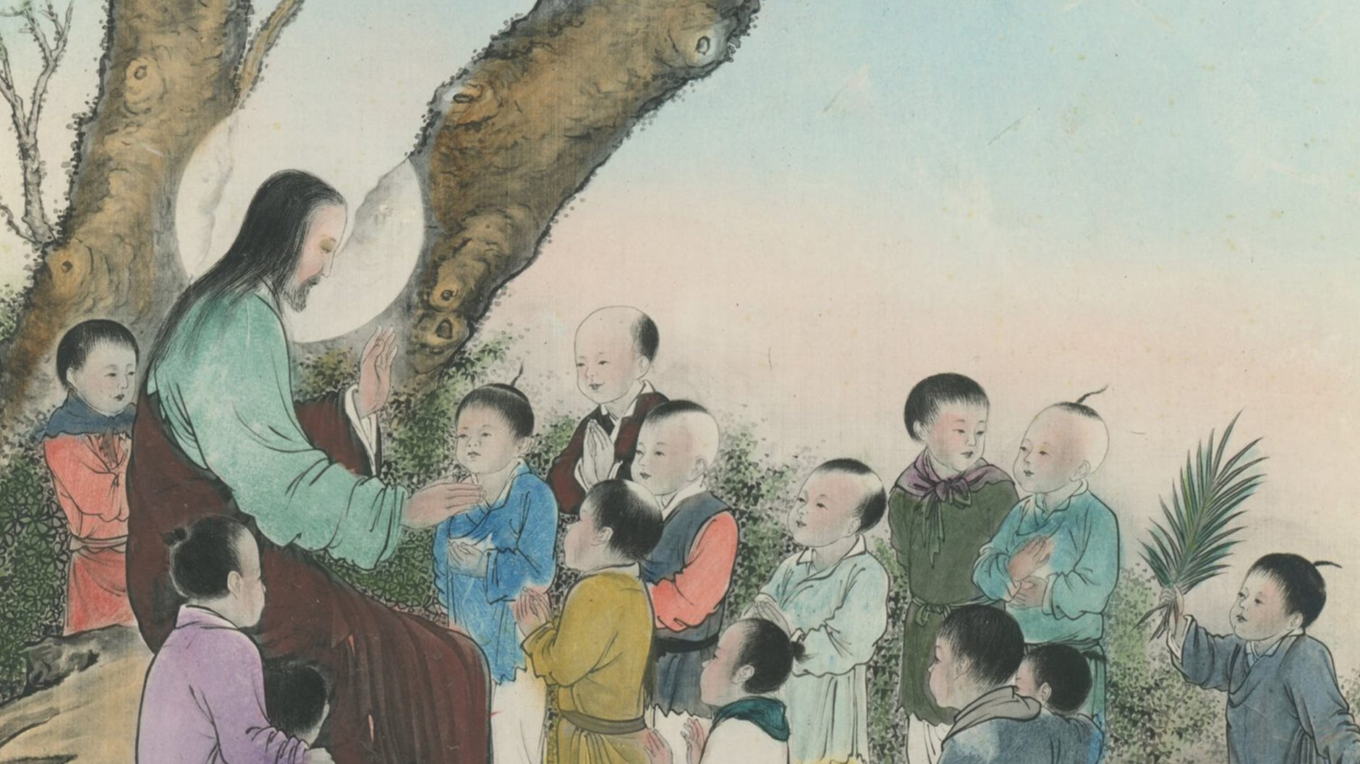
Governance and Assimilation
Once established, the Jin Dynasty ruled over approximately 40 million people in northern China. Although initially foreign rulers, the Jurchens adopted many elements of Chinese governance.
Over time, they began to incorporate Chinese customs into their way of life, a process known as Sinicization. The Jurchens adopted Chinese language, dress, and rituals, integrating themselves into the cultural fabric of the region.
This process, however, was not without resistance.
Some Jurchen officials, concerned about the loss of
their cultural identity, assassinated the emperor as a
form of protest against what they saw as excessive
assimilation.
Despite such efforts, by the end of the dynasty, most
Jurchens spoke Chinese, wore Chinese clothing,
adopted Chinese names, and intermarried with the local Chinese population.

Slide 13
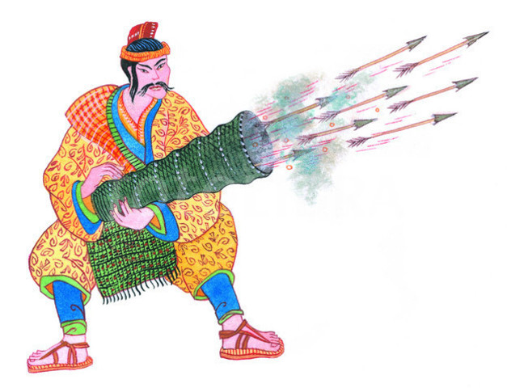
Legacy of the Jin Dynasty
The Jin Dynasty’s significance lies not only in its military conquests but also in its role as a bridge between nomadic rulers and Chinese civilization.
Although it was a foreign dynasty, the Jin contributed to the ongoing process of cultural integration that characterized much of Chinese history during periods of non-Han rule.
The dynasty set the stage for future foreign rulers, such as the Mongols and Manchus, who would also adopt Chinese customs to solidify their rule.
The fall of the Jin Dynasty in 1234 AD came at the hands of the Mongols, who were in the process of building one of the largest empires in history.
The Jin Dynasty’s legacy of cultural assimilation and its impact on the development of Chinese military technology, particularly in the use of gunpowder, remained significant.

Slide 14
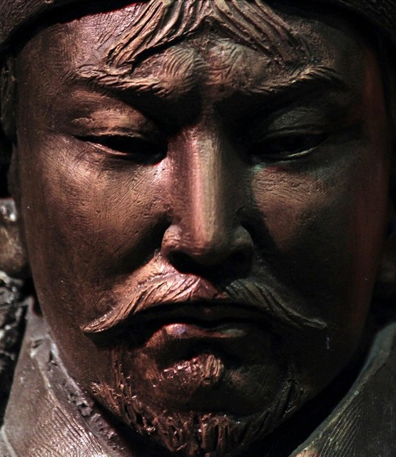
The Rise if the Great Empire
In the late 12th century, a new power emerged to challenge the dominance of the Chinese empires: Genghis Khan and his Mongol Empire.
Though Genghis Khan did not live to see the Mongol Conquest of the Song Dynasty, his establishment of the Mongol Empire laid the foundation for the largest contiguous land empire in history.
The empire stretched from Korea in the east to Eastern Europe in the west, encompassing vast territories and diverse cultures.

Slide 15
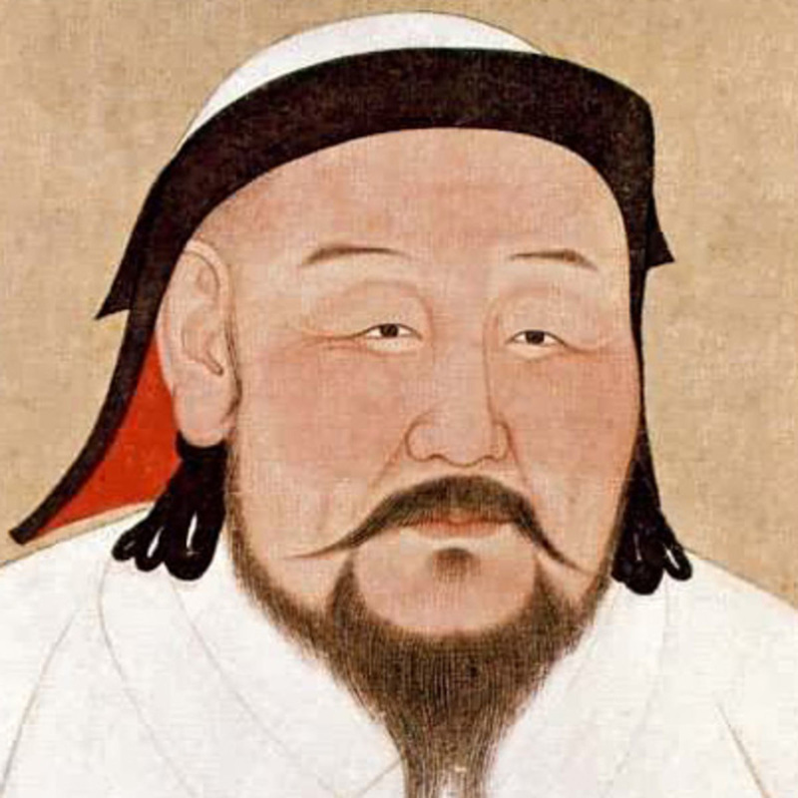
The Rise if the Great Empire
After Genghis Khan's death in 1227, his grandson Kublai Khan continued his legacy. Kublai Khan was instrumental in the Mongol conquest of China, particularly in the southern region where the Song Dynasty still held power.
By 1271, Kublai Khan had established the Yuan Dynasty, marking a new era in Chinese history. He also relocated the capital from Mongolia to Beijing, then known as Da Du, signifying a strategic shift and a deepening commitment to ruling China.

Slide 16
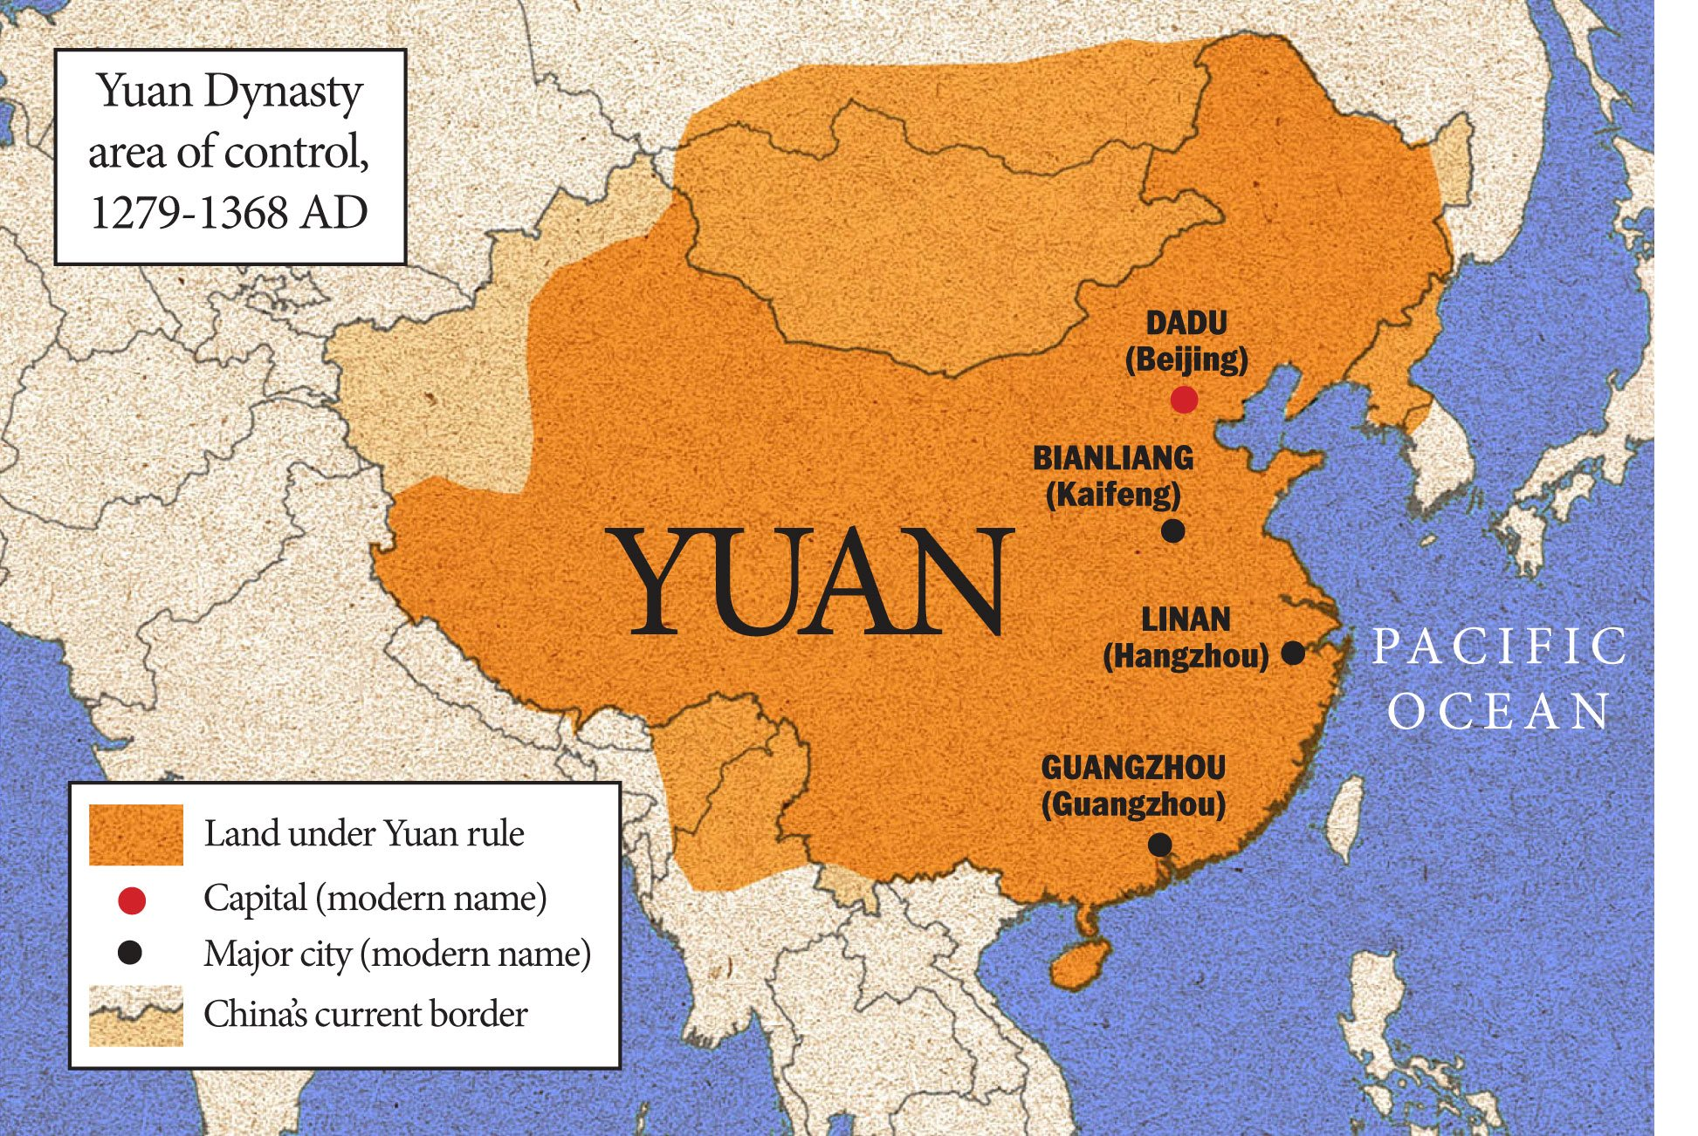
A New China
The Yuan Dynasty, which lasted from 1271 to 1368, represented a significant phase of Mongol rule over China.
The Mongols, much like their predecessors the Liao and Jin Dynasties, adopted a Chinese name for their empire to solidify their legitimacy and integrate into the Chinese cultural and political framework.
The conquest of the southern Song Dynasty was a protracted and challenging endeavor.
The Mongols had to build a formidable fleet to navigate China's rivers and engage in a five-year siege of Xiangyang, a crucial city in the Yangtze Valley.

Slide 17
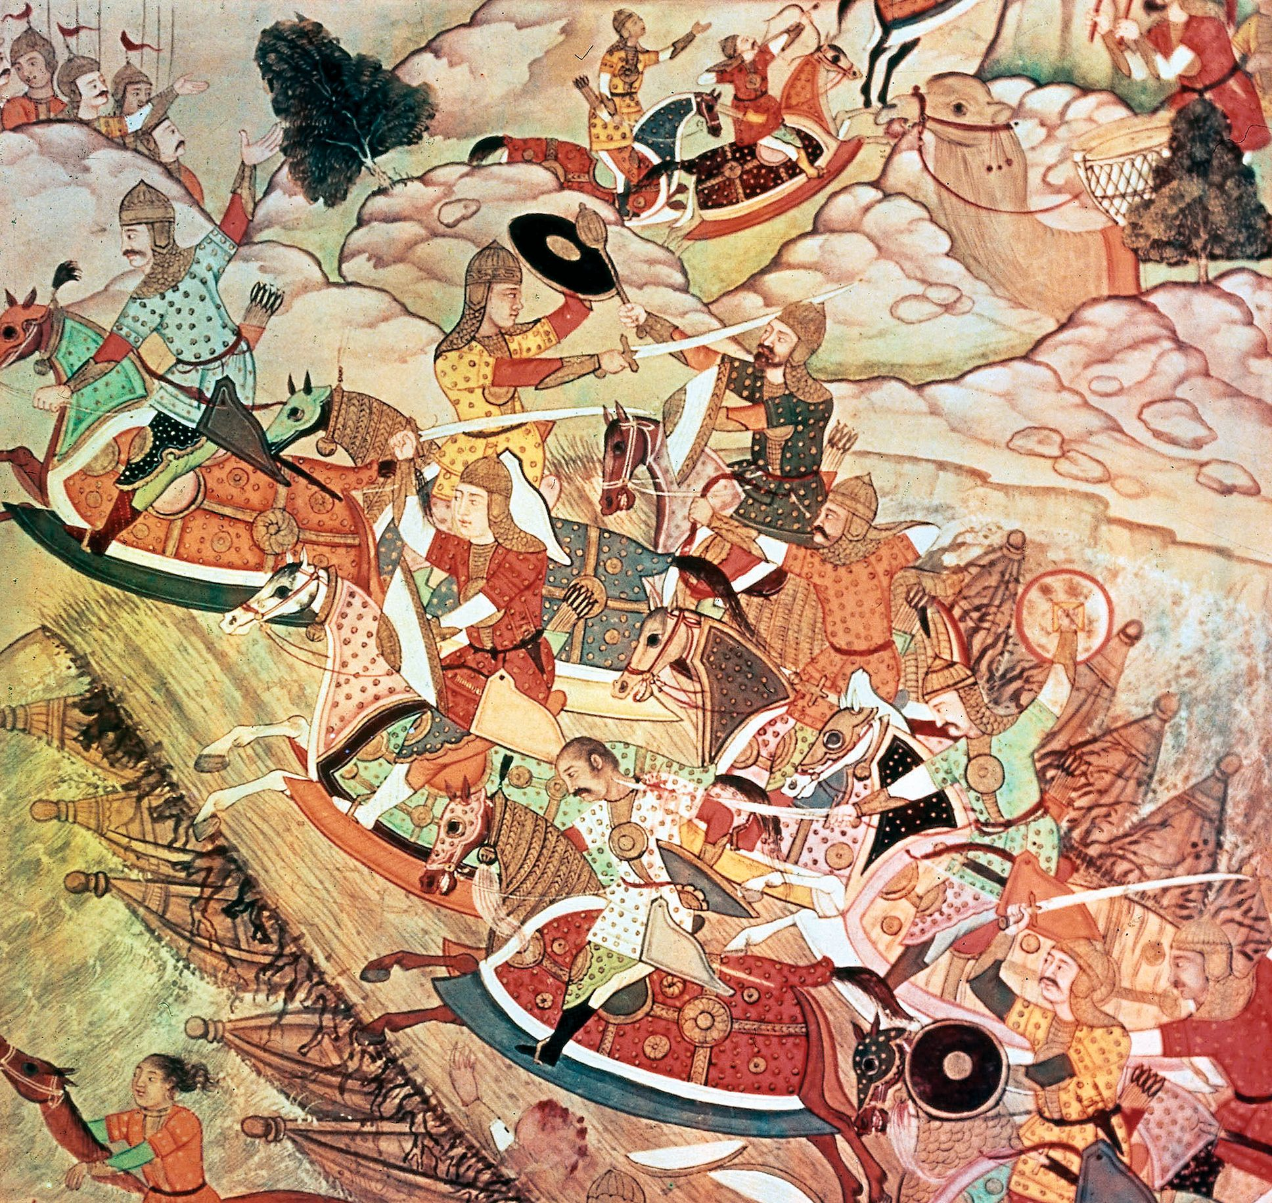
A New China
In 1275, after crossing the Yangtze River, the Mongols faced fierce resistance from the Song forces. The Song Empress Dowager managed to mobilize an army of 200,000 soldiers in defense.
Despite the Song's efforts, the Mongols' military prowess proved overwhelming. Following a brutal massacre in Changzhou, the Empress Dowager ultimately surrendered.
The final blow to the Song Dynasty came in 1279 with a decisive naval battle that ended the last of the Song loyalist resistance.

Slide 18
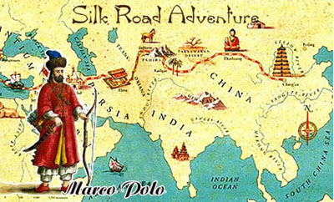
Ethnic Tension
Under Yuan rule, China saw both continuity and change.
The Mongols allowed the Chinese to maintain many of
their customs and religious practices, but the era was also
marked by significant ethnic tension.
The Italian explorer Marco Polo, who visited China during
this time, observed that the Mongol administration imposed
a hierarchical system where different ethnic groups were subjected to different laws and taxes.
Ethnic Chinese faced harsh penalties for resisting Mongol authority, while Mongols enjoyed more lenient treatment. Chinese subjects were also prohibited from owning weapons, reflecting the power imbalance.
During the Yuan Dynasty, China was regarded as the center of the world, and the Chinese Emperor was revered as the "Son of Heaven."

Slide 19
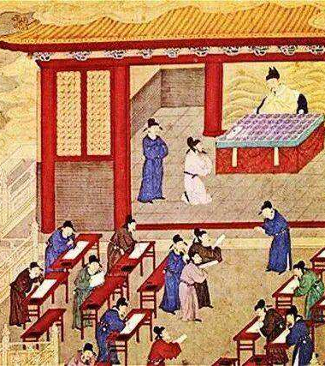
Imperial Examination Reinstated
Despite the Mongols' foreign origins, they retained Chinese advisors and reinstated the imperial examination system in 1315 to ensure a degree of traditional governance.
However, the Yuan administration-imposed quotas to ensure that Mongols and other non-Chinese groups held more positions in government than the ethnic Chinese, especially those from the former Song territories.
The Yuan Dynasty's rule also facilitated increased interaction between China and the broader Eurasian world. This period saw a surge in European interest in China, with more Europeans visiting the region than ever before.

Slide 20
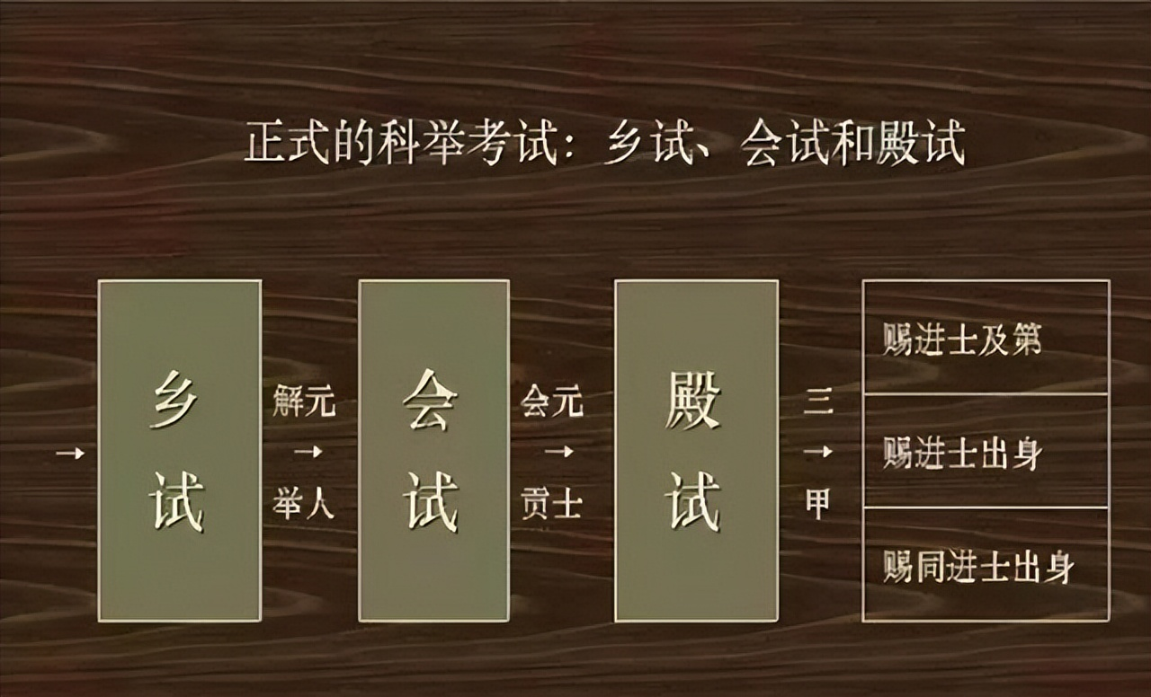
Imperial Examination Reinstated
The exchange of culture and technology, including innovations such as printing and gunpowder, flowed westward from China.
This increased cross-cultural contact contributed to the European Age of Exploration, a period marked by European attempts to explore and colonize distant lands.
This burgeoning era of exploration was met with mixed reactions in China, reflecting a complex dynamic of admiration, apprehension, and eventual resistance to the expanding influence of European powers.

Slide 21
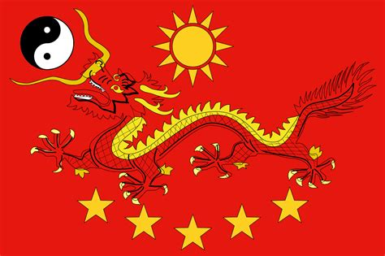
Final Thoughts
This discussion examines the transformative
period between the Song Dynasty (960–1279 CE)
and the fall of the Yuan Dynasty (1271–1368 CE),
marked by significant political, cultural, and
social changes.
The Song Dynasty, a time of stability and intellectual vibrancy, saw major innovations in science, technology, and economics, such as movable-type printing, gunpowder, and shipbuilding.
These advancements boosted maritime dominance and economic growth, with increased urbanization, paper money, and expansive trade networks.
Despite these achievements, the Song faced military threats from the Jurchen-led Jin and later the Mongols, leading to its decline. However, its cultural and technological legacies endured, influencing future dynasties and civilizations.

Slide 22
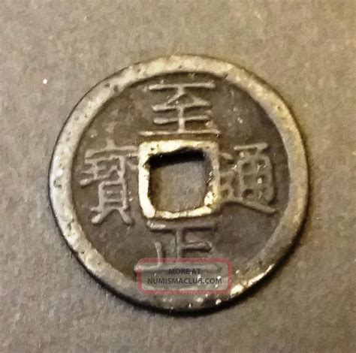
Final Thoughts
The Yuan Dynasty, founded by Kublai Khan after the Mongol conquest, marked China's first foreign rule and connected it more closely with Eurasia.
Kublai Khan encouraged cultural exchange, bringing influences from the Middle East, Europe, and Central Asia.
The Silk Road thrived, facilitating trade and the spread of ideas, with Chinese porcelain, silk, and tea becoming prized in the West.
Despite administrative reforms, Mongol rule introduced challenges like ethnic tensions and social stratification.
However, the Yuan's promotion of trade and diplomacy had a lasting global impact, shaping economic and cultural systems beyond China.

Slide 23
Thankyou for Coming!
I hope you enjoyed my talk!
If you have any more questions, please ask.
I will do my best to answer them for you.
I can be reached by e-mail at
marcs@sonic.net

Slide 24
Acknowledgement
My seminars are the result of many years of experience combined with many hours of research over the internet.
I would like to acknowledge the many source I have accessed.

Slide 25
References
Keightley, D. N. (1978). Sources of Shang History: The Oracle-Bone Inscriptions of Bronze Age China. University of California Press.
Chang, K. C. (1980). Shang Civilization. Yale University Press.
Liu, L. (2004). The Chinese Neolithic: Trajectories to Early States. Cambridge University Press.
Shaughnessy, E. L. (1999). The Cambridge History of Ancient China: From the Origins of Civilization to 221 BC. Cambridge University Press.
Li, F. (2006). Bureaucracy and the State in Early China: Governing the Western Zhou. Cambridge University Press.
Creel, H. G. (1960). Confucius: The Man and the Myth. John Day Company.
Pines, Y. (2002). Foundations of Confucian Thought: Intellectual Life in the Chunqiu Period, 722–453 BCE. University of Hawaii Press.
Loewe, M. (1999). The Cambridge History of Ancient China: From the Origins of Civilization to 221 BC. Cambridge University Press.
Wood, F. (2008). China's First Emperor and His Terracotta Warriors. Macmillan.
Sima Qian. (1993). Records of the Grand Historian: Qin Dynasty. Columbia University Press.
Ch’en, K. (1973). Buddhism in China: A Historical Survey. Princeton University Press.

Slide 26
References
Twitchett, D., & Loewe, M. (1986). The Cambridge History of China: Volume 1, The Ch'in and Han Empires, 221 BC – AD 220. Cambridge University Press.
de Crespigny, R. (2010). Imperial Warlord: A Biography of Cao Cao 155-220 AD. Brill.
Roberts, M. (1991). Three Kingdoms: A Historical Novel. University of California Press
Wright, A. F. (1959). Buddhism in Chinese History. Stanford University Press.
Zürcher, E. (2007). The Buddhist Conquest of China: The Spread and Adaptation of Buddhism in Early Medieval China. Brill.
Benn, C. (2002). China's Golden Age: Everyday Life in the Tang Dynasty. Oxford University Press. Mote, F. W. (1999). Imperial China 900–1800. Harvard University Press.
Ebrey, P. B. (2010). The Cambridge Illustrated History of China. Cambridge University Press.
Mote, F. W. (1999). Imperial China 900–1800. Harvard University Press.
Kuhn, D. (2009). The Age of Confucian Rule: The Song Transformation of China. Harvard University Press.
Andrade, T. (2016). The Gunpowder Age: China, Military Innovation, and the Rise of the West in World History. Princeton University Press.

