Slide 1

Chinese Dynastic History
Part 2
220 CE to 960 CE
Presented by
Marc Silver

Slide 2
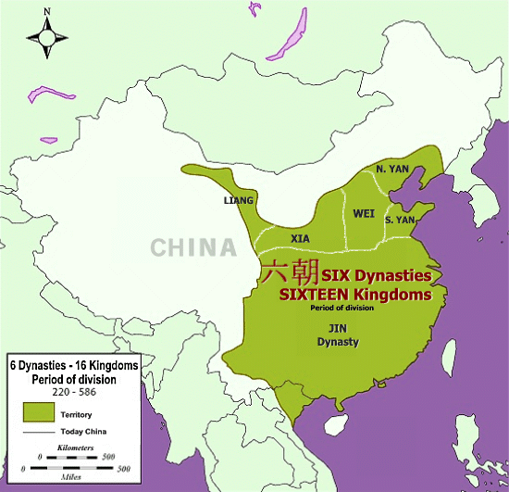
Chinese Dynastic History Part 2
Introduction:
Welcome to Part 2 of an exploration of Chinese Dynastic History, covering the years from 220 CE to 960 CE. During this period, China witnessed the fall of the Han Dynasty and the emergence of new dynasties, as well as eras of political fragmentation, innovation, and cultural development. Our journey today will focus on the following key dynasties and periods:
Six Dynasties Period 220 - 589
The Three Kingdoms Period (220–280 CE): A time of
division, warfare, and heroism, often romanticized in
Chinese literature.
The Jin Dynasty (266–420 CE): Unification and eventual
decline, leading to internal strife and foreign invasions.
The Southern and Northern Dynasties (420–589 CE): A
period of regional division with distinct northern and
southern powers.

Slide 3
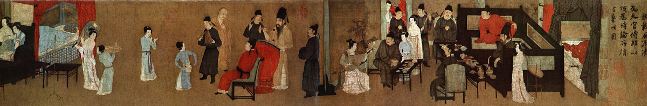
Chinese Dynastic History Part 2
The Sui Dynasty (581–618 CE): A short-lived yet transformative era, credited with reuniting China.
The Tang Dynasty (618–907 CE): One of China’s most prosperous and culturally rich dynasties, marking a golden age of Chinese civilization.
The Five Dynasties and Ten Kingdoms Period (907–960 CE): A chaotic period of fragmentation and regional conflict.
Throughout this presentation, we will examine the political, social, and cultural developments that shaped China during these centuries, highlighting key events, influential leaders, and the enduring legacies of these dynasties.

Slide 4
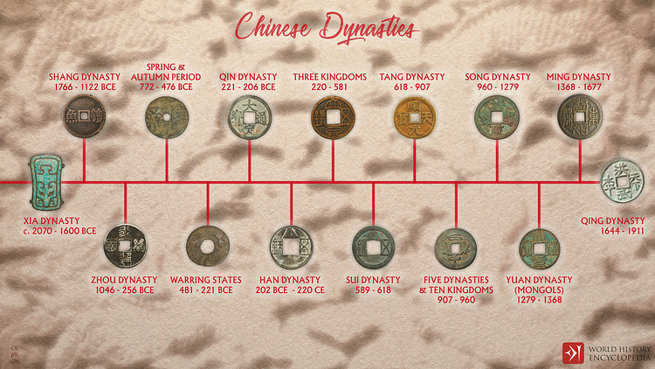

Slide 5
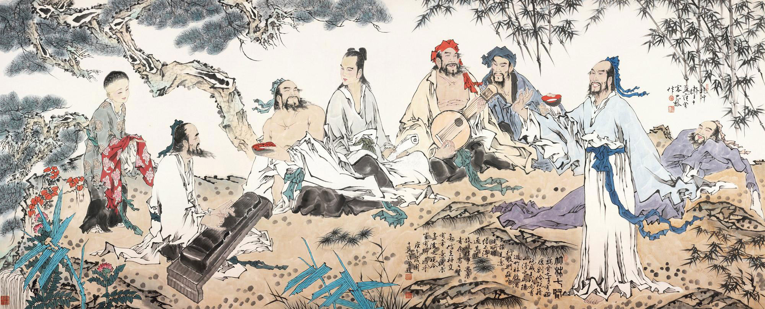
Six Dynasties Period
Three Kingdoms (220-265), Jin Dynasty (265-420), Period of the Northern and Southern Dynasties (386-589).
Six Dynasties is the collective term for the six successive Han-ruled dynasties during this turbulent period. All had their capitals at Jianye, present-day Nanjing.
The Three Kingdoms period has been romanticized repeatedly in Chinese culture – most notably in the novel “Romance of the Three Kingdoms”.

Slide 6
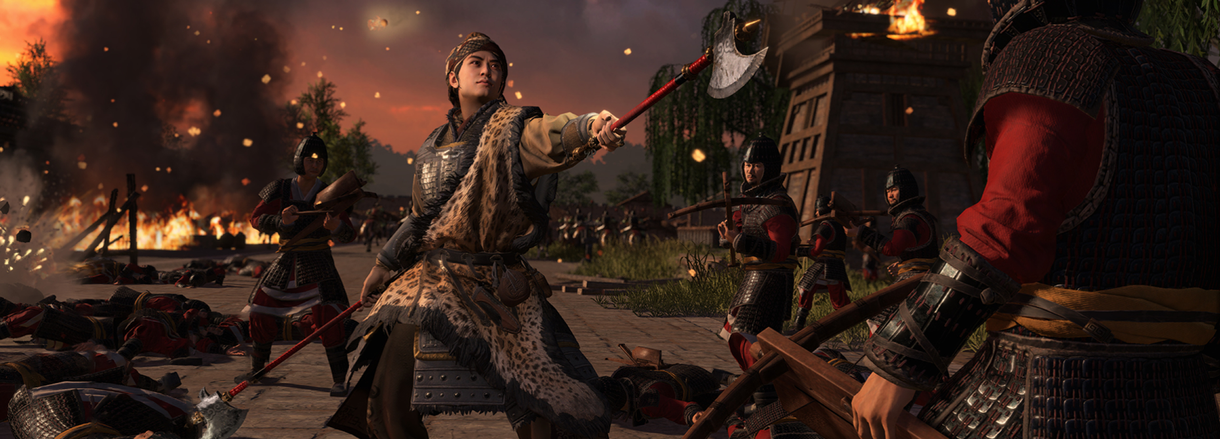
War of the Eight Princes
The most notable conflict during this time was the War of the Eight Princes (291–306 CE), a brutal civil war among rival princes within the Jin royal family. This conflict severely weakened the dynasty and destabilized the central government, leaving the empire vulnerable to external threats.
One of the greatest challenges to Jin rule came from the Xiongnu tribes, nomadic peoples who had long posed a threat to China's northern borders.
The Xiongnu had settled in Northern China during the Jin Dynasty, but tensions between the local populations and the nomadic tribes led to unrest.

Slide 7
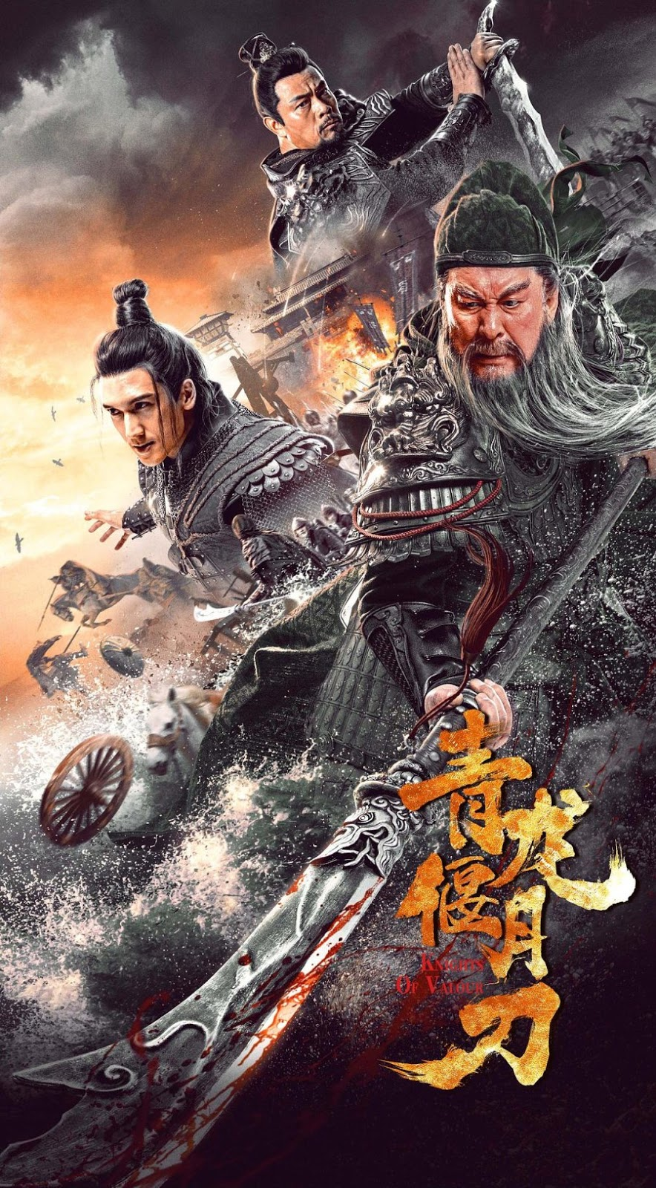
The Fall of the Han
The Rise of Three Kingdoms
The rise and fall of the Han Dynasty left an indelible mark on Chinese history.
Under the Han, China experienced its first Golden Age, marked by territorial expansion, cultural prosperity, and the establishment of Confucianism as the guiding philosophy of state governance.
However, the dynasty’s eventual decline and the ensuing division of the country led to centuries of instability and warfare.
The Three Kingdoms Period and the subsequent Jin Dynasty saw China fragment and struggle under internal and external pressures, particularly from nomadic invasions.
Despite these challenges, this era remains one of the most significant in Chinese cultural memory, immortalized in literature and legend.

Slide 8
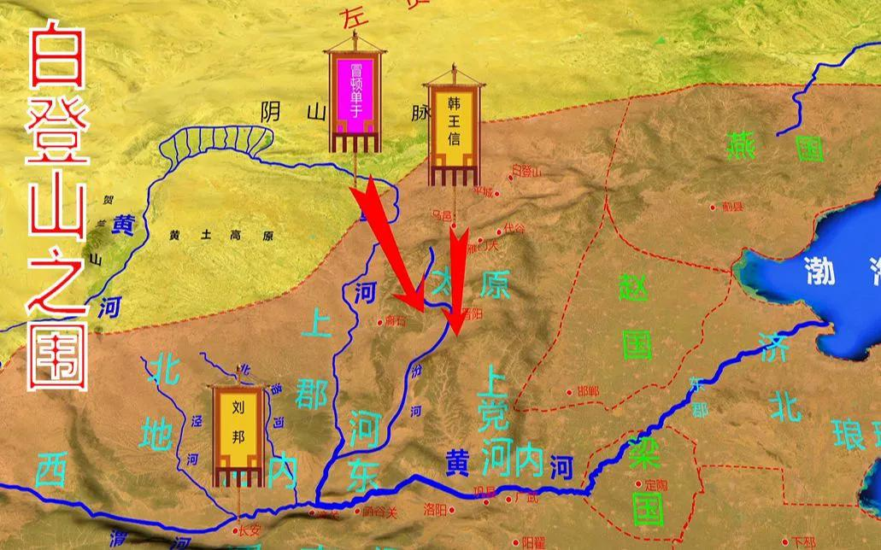
Three Kingdoms
In 311 CE, the Xiongnu tribesmen launched a devastating attack on the Jin capital, Luoyang, and later, in 316 CE, they captured Chang’an (modern-day Xi’an).
This marked the end of the Jin Dynasty’s control over northern China, plunging the region into chaos. Over the next hundred years, Northern China became a battleground, with various nomadic groups and warlords vying for control.
As a result, many Chinese citizens fled southward to the city of Nanjing, where the remnants of the Jin Dynasty established a government in exile, ruling over southern China.

Slide 9

The Northern and Southern Dynasties Period 420–589 CE
A Time of Division and the Rise of Buddhism
The Northern and Southern Dynasties Period (Nan Bei Chao), spanning from 420 to 589 CE, was a time of significant political fragmentation in China, as the country was divided between rival kingdoms in the north and south.
Despite the political instability, this era was also marked by cultural flourishing, particularly the rise of Buddhism as a major religious and philosophical force. The period is noted for the proliferation of Buddhist institutions and the active patronage of Buddhist teachings, which reshaped Chinese society in profound ways.

Slide 10
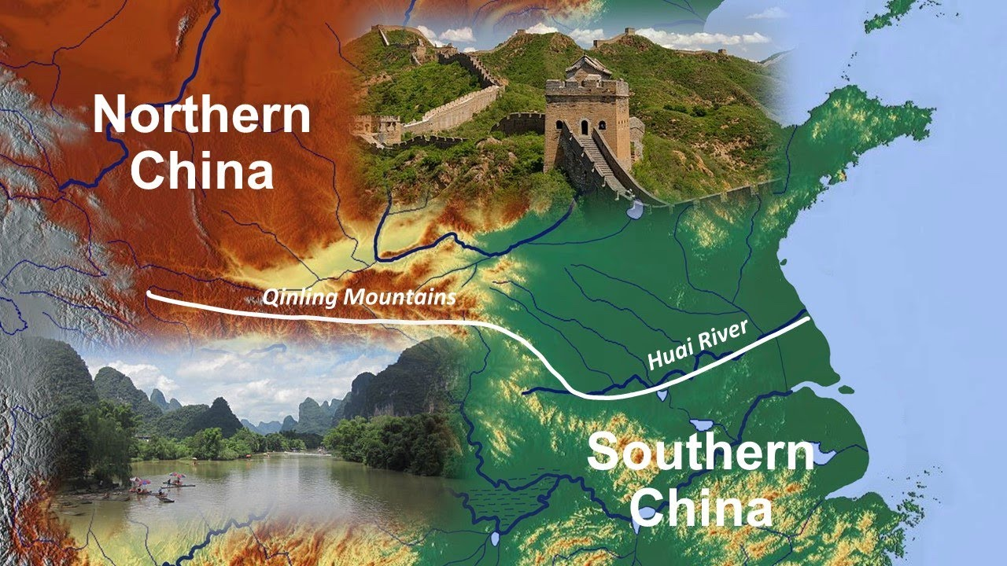
Division of China: North and South
After the fall of the Jin Dynasty, China remained divided between northern and southern regions, each ruled by different dynasties.
The north was primarily controlled by nomadic and non-Han Chinese dynasties, while the south remained under the rule of Han Chinese leaders.
This division lasted for over a century, but during this time, a shared cultural and religious landscape began to develop, particularly through the spread of Buddhism.

Slide 11
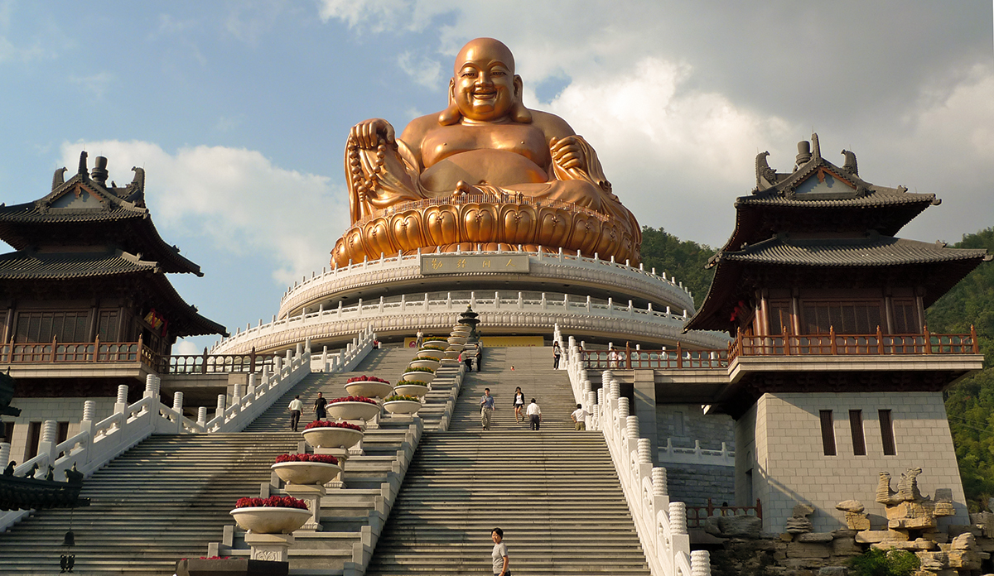
The Spread of Buddhism and Its Role in Society
Buddhism, which had been introduced to China centuries earlier during the Han Dynasty, experienced rapid growth during the Northern and Southern Dynasties.
By 477 CE, the northern part of China
boasted over 6,000 Buddhist temples,
while the south had nearly 3,000.
This increase in religious establishments
highlighted Buddhism’s rise in
popularity among the Chinese populace,
transcending the political division
between the north and south.

Slide 12

The Spread of Buddhism and Its Role in Society
Buddhism appealed to a broad spectrum of society, including the ruling elite, commoners,
and intellectuals.
The religion offered a path to spiritual salvation and addressed existential questions about suffering and the afterlife, which resonated deeply during a time of political turmoil and uncertainty.
Buddhist temples became not only religious centers but also hubs for education, art, and social welfare, contributing to the broader cultural development of China during this period.

Slide 13
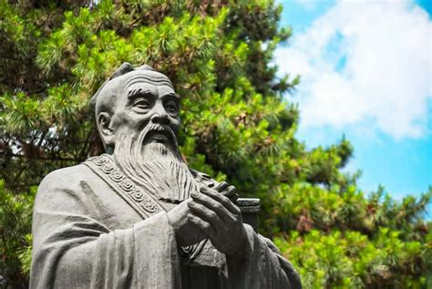
Tension Between Confucianism and Buddhism
Despite its growing influence, Buddhism faced criticism from some Confucian scholars. The main point of contention was the Buddhist monastic lifestyle, which required monks and nuns to remain celibate and childless.
To Confucianists, this went against the core value of filial piety, particularly the duty to produce heirs to carry on the family lineage.
This critique reflected the deep Confucian emphasis on family, societal order, and continuity.

Slide 14
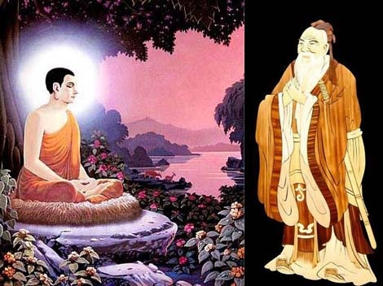
Tension Between Confucianism and Buddhism
Buddhists responded to these critiques by arguing that a family member’s pursuit of enlightenment could bring spiritual blessings to their relatives.
They suggested that by renouncing worldly desires and dedicating oneself to the Buddhist path, an individual was contributing to the spiritual welfare of the entire family.
This counterargument helped to mitigate some of the tension between Confucianism and Buddhism and contributed to the religion’s continued spread among both elites and commoners.

Slide 15
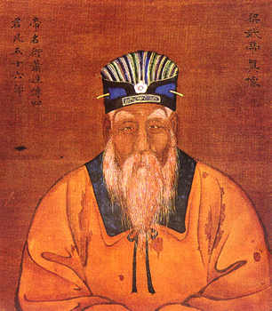
Royal Patronage of Buddhism
Many rulers during the Northern and Southern Dynasties actively supported Buddhism, seeing it as a means to legitimize their rule and unify their people.
These rulers provided financial support for the construction of temples and monasteries, and some even personally engaged in Buddhist practices.
One notable example was Emperor Wudi of Liang (r. 502–549 CE), who was an ardent supporter of Buddhism.
Emperor Wudi’s devotion to Buddhism was so profound that he once allowed himself to be held hostage in a Buddhist monastery until his court raised a substantial sum of money to "ransom" him.

Slide 16
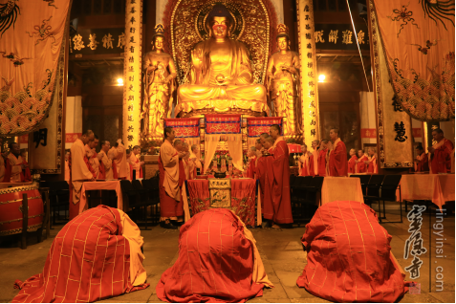
Royal Patronage of Buddhism
This large sum, rather than being used for his personal gain, was directed toward supporting Buddhist establishments.
Under Wudi’s patronage, Buddhism flourished, with significant resources devoted to the construction of new temples, the support of monks, and the promotion of Buddhist teachings.
Wudi's actions underscored the close relationship between state and religion during this period.
By supporting Buddhism, rulers like Wudi aimed to strengthen their moral and spiritual authority, as well as to promote social stability in an era marked by political division.

Slide 17
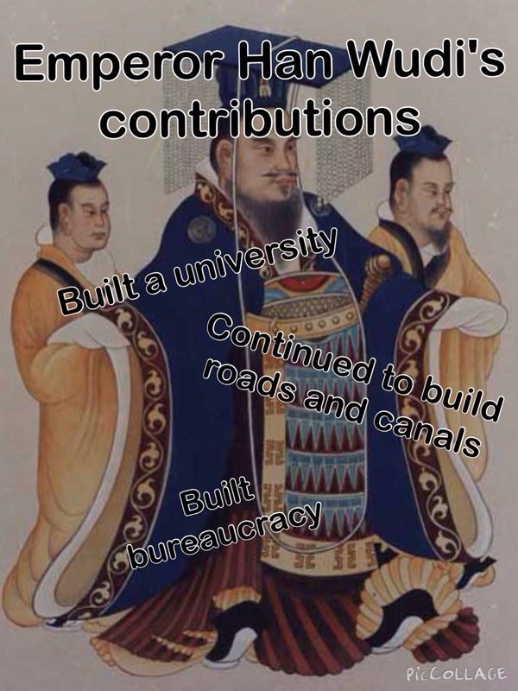
Political Fragmentation and Cultural Integration
The Northern and Southern Dynasties Period was a time of both political fragmentation and cultural integration in China.
While the country remained divided between rival states, the spread of Buddhism bridged many of the gaps between the north and south, providing a common religion and philosophy.
Despite the tension between Confucian and Buddhist values, Buddhism gained widespread acceptance, with royal patronage playing a key role in its expansion.
By the end of this period, Buddhism had firmly established itself as a major force in Chinese religious and cultural life, setting the stage for its continued influence in subsequent centuries.

Slide 18
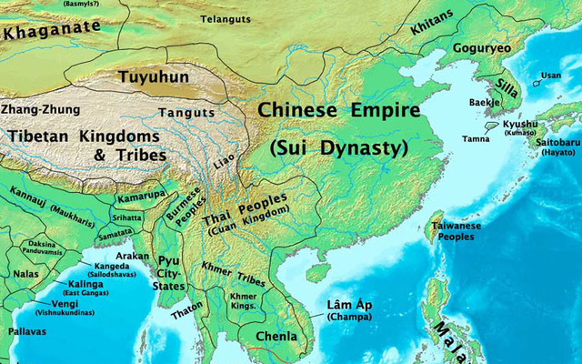
The Sui and Tang Dynasties
Unification, Cultural Flourishing, and China’s Golden Age
In 581 CE, after centuries of division, China was once again unified under the Sui Dynasty 隋朝 Suí (Sui Chao).
The Sui marked the end of the Northern and Southern Dynasties period and set the foundation for one of the most remarkable eras in Chinese history.
While the Sui brought much-needed unity and laid important institutional groundwork, it was the Tang Dynasty (Tang Chao), which followed shortly after, that ushered in China’s Golden Age of cultural, political, and economic development.

Slide 19
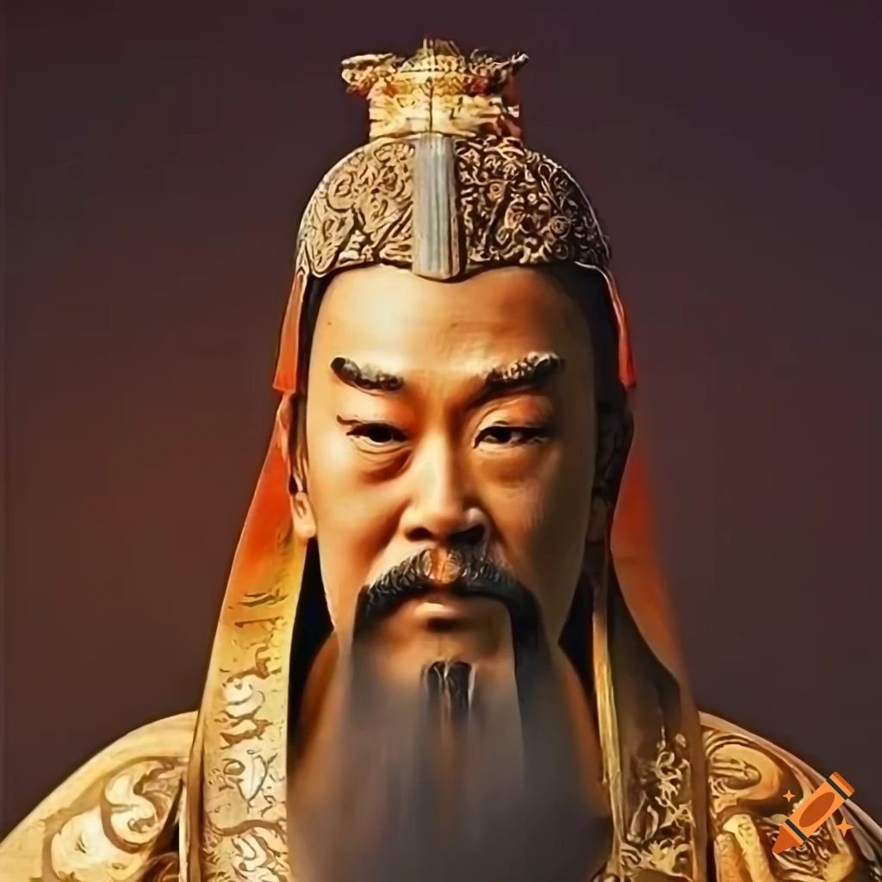
The Sui Dynasty
Unification and Overreach
The Sui Dynasty, founded by Emperor Wendi in 581 CE, was a short-lived but impactful era in Chinese history.
Emperor Wendi, who saw himself as a Buddhist ruler, was committed to both military expansion and the protection of the Buddhist faith.
His rule brought together northern and southern China after centuries of disunity, and his government was focused on rebuilding the nation’s infrastructure and fortifying its political systems.

Slide 20
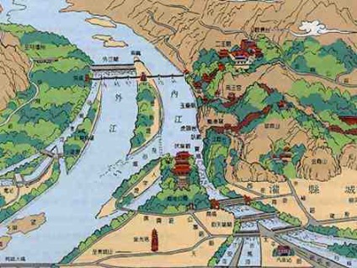
The Sui Dynasty
Unification and Overreach
Wendi and his successor, Emperor Yangdi, were
highly ambitious, embarking on massive public
works projects such as the Grand Canal, which
connected the Yellow and Yangtze Rivers and
facilitated internal trade.
However, their grand projects, alongside costly
military campaigns, such as an invasion of Korea,
which required over 1 million men for military
service, imposed a heavy burden on the populace. This strain led to widespread discontent and rebellion.
The Sui Dynasty collapsed in 618 CE, only 37 years after its founding. The victor of the rebellion, Li Yuan, a cousin of Emperor Yangdi, seized control and established the Tang Dynasty.

Slide 21
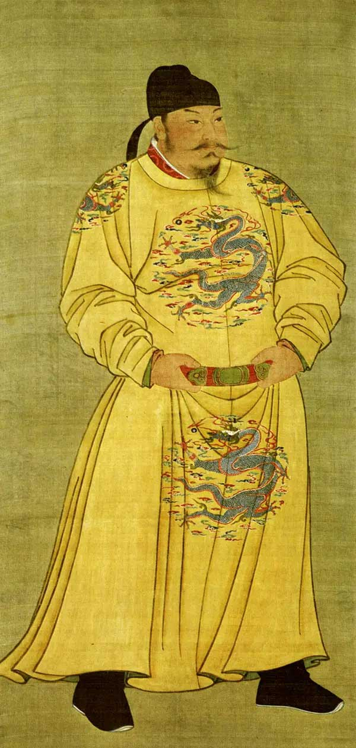
The Tang Dynasty: China’s Golden Age
The Tang Dynasty, founded in 618 CE by Li Yuan, who ruled as Emperor Gaozu, would go on to become one of the most celebrated eras in Chinese history.
Emperor Gaozu, was born with the name, Liu Bang, near the city of Feng, in the region of Peixian (modern Jiangsu province).
He was a smart man who eventually qualified to become the leader of a village along the Si River. Yet, he was still common enough to be selected as an unpaid laborer sent to work in the Qin capital of Xianyang.
Nevertheless, in times of chaos, titles of nobility can also be attained through strength.
When widespread rebellions broke out in 209 BCE, Liu Bang first seized the governorship of Pei, then became the king of Han and, finally, was proclaimed Emperor Gaozu, founder of the Han Dynasty.

Slide 22
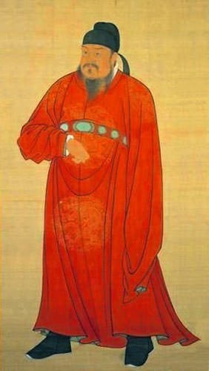
The Tang Dynasty 618 CE
China’s Golden Age
Gaozu eventually abdicated the throne to his son. Li Shimin who ascended the throne as Emperor Taizong after forcing his father to abdicate and murdering his two brothers.
Emperor Taizong, under whom the Tang Dynasty flourished.
This period, often referred to as China's Golden Age, was marked by cultural, political, and economic achievements that influenced not just China but the entire world.
In 630, Chinese efforts against the Eastern Turkic Khaganate over the occupation of Ordos and southwestern Mongolia won Taizong the title of Great Khan and created opportunities for Chinese-Turkish expeditions into the silk route cities between 640 and 650.
With the eastern Turkish threat extinguished, the emperor focused on the westward expansion of China, relying on the military skills of the former Northern Zhou state to make China the dominant power in Asia.

Slide 23
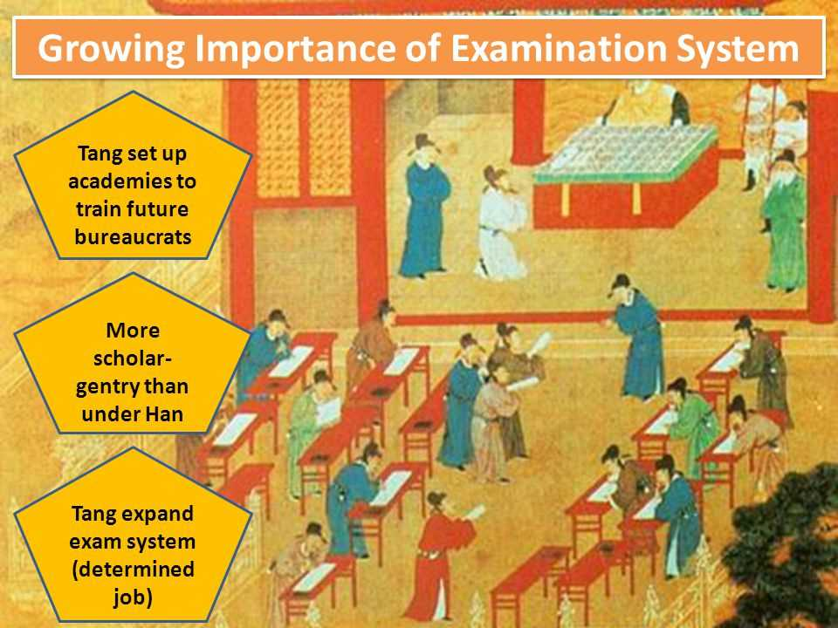
The Tang Dynasty 618 CE
China’s Golden Age
One of the key innovations inherited from the Sui and expanded under the Tang was the civil service examination system.
Based on Confucian Classics, this system allowed individuals to earn government positions through merit rather than hereditary privilege.
By creating schools and issuing official state versions of the Confucian texts, the Tang government ensured that talented individuals could rise through the ranks, reinforcing a more meritocratic bureaucracy.
However, the Emperor's position remained hereditary.

Slide 24
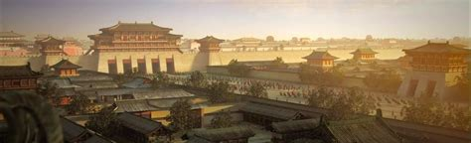
Chang’an
Cosmopolitan Capital
The Tang capital, Chang’an, became a thriving metropolis and a symbol of China’s newfound unity and strength.
By the height of the Tang Dynasty, Chang’an’s population, including its suburbs, reached nearly 2 million people, making it the largest city in the world at the time.
The city was known for its cosmopolitanism, welcoming traders, diplomats, and scholars from as far away as Persia, India, and Central Asia.

Slide 25
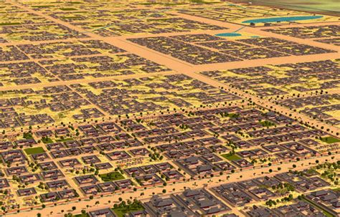
Chang’an: A Cosmopolitan Capital
Chang’an was also a hub of religious diversity. Buddhism, Taoism, and Confucianism all thrived during the Tang era, coexisting peacefully.
The city boasted hundreds of monasteries, temples, and even some foreign churches, reflecting the openness of Tang China to external influences.
This pluralism was supported by the Tang rulers, many of whom actively promoted Buddhism as a stabilizing and moral force.

Slide 26
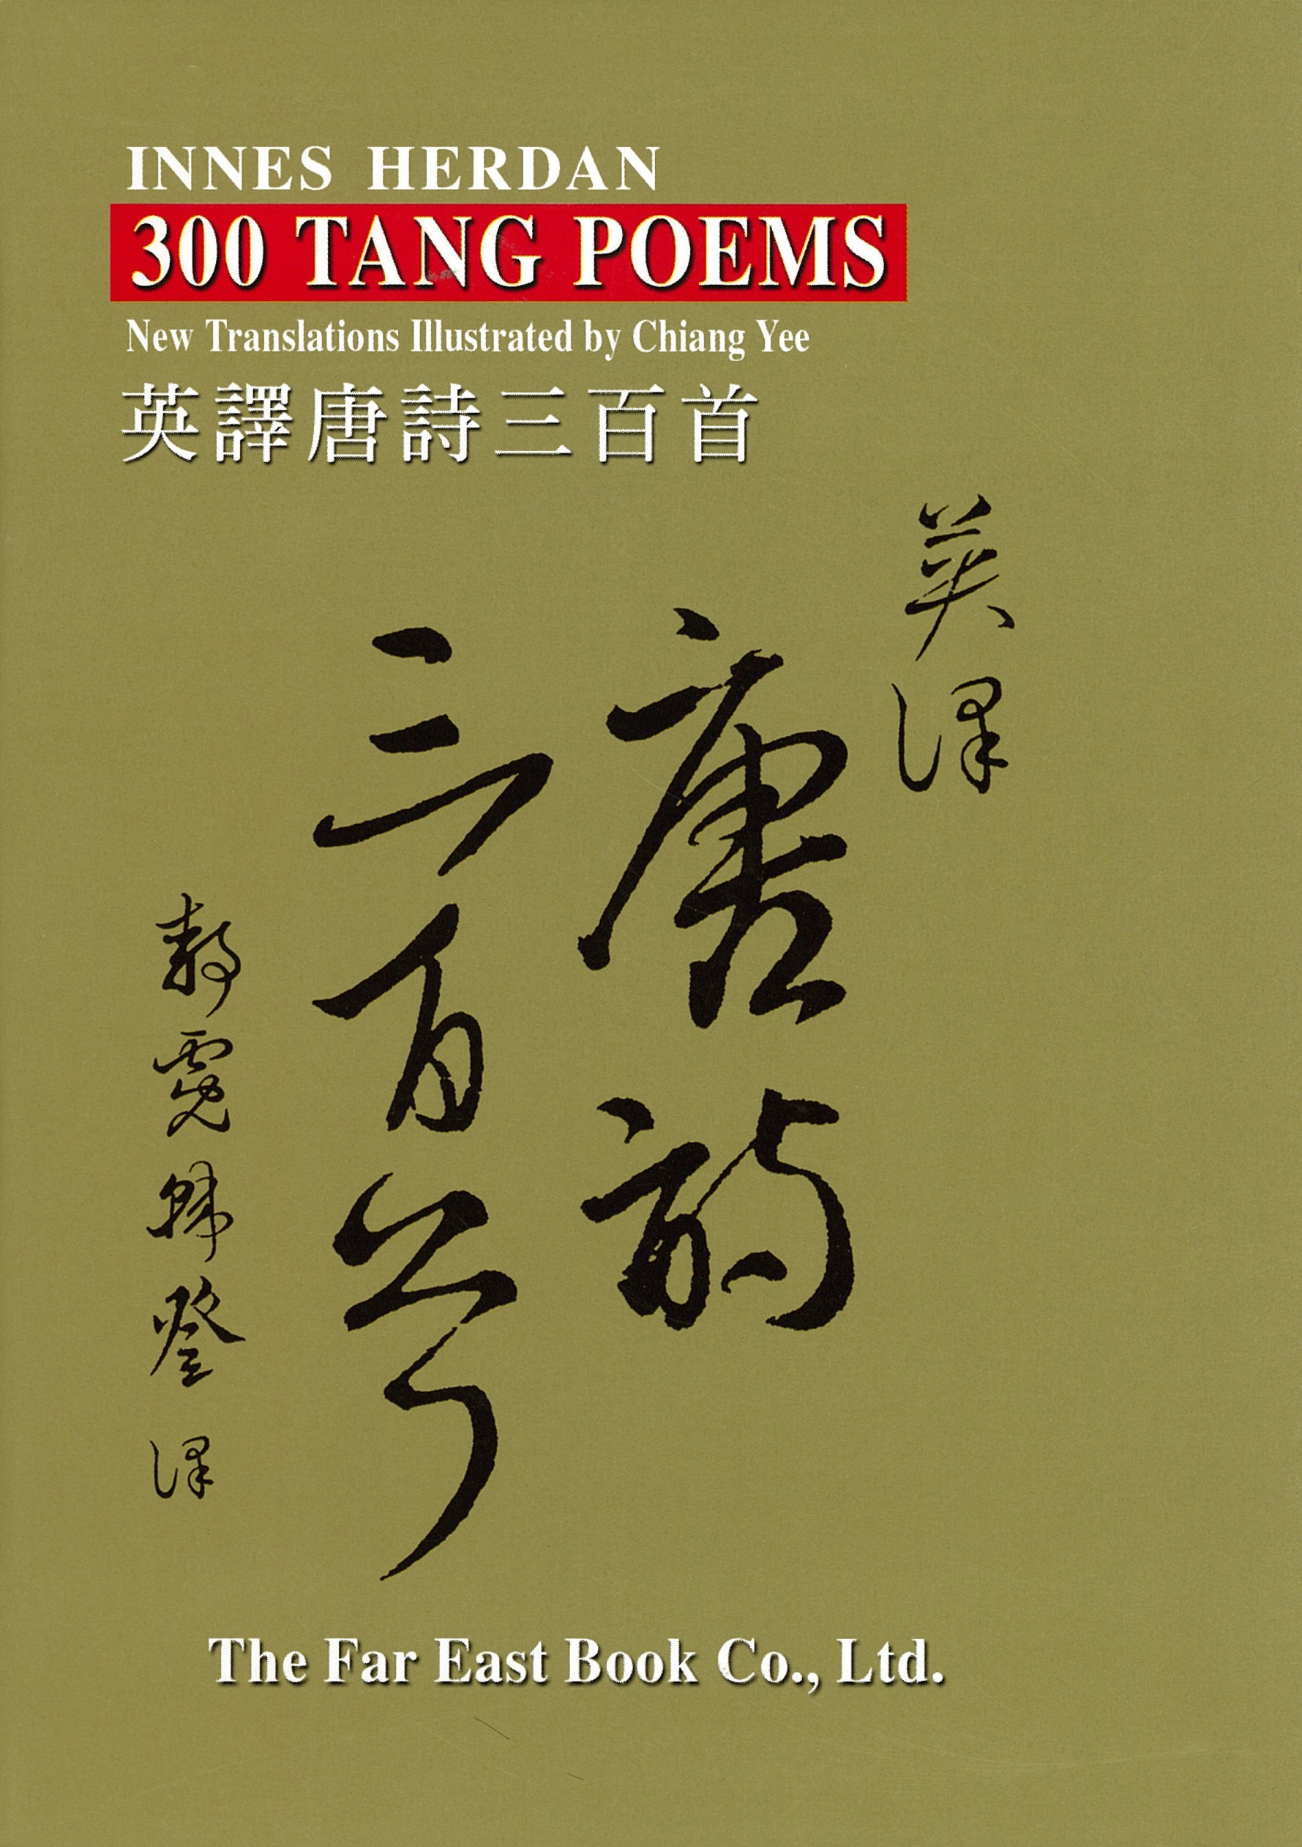
Tang Poetry and Cultural Achievements
One of the most enduring cultural legacies of the Tang Dynasty was its poetry, which reached new heights for the time.
Two of the most famous poets in Chinese history, Li Bai and Du Fu, lived and wrote during the Tang era.
Li Bai, known for his romanticism and love of nature, often celebrated life’s pleasures in vivid imagery. His poetic descriptions of the moon and his drunken reveries have become some of the most iconic in Chinese literature.
Du Fu, on the other hand, was a realist poet, whose works often reflected the harsh realities of his time. His poems described the suffering caused by war and political instability, offering a poignant counterpoint to Li Bai’s more idealistic themes.

Slide 27
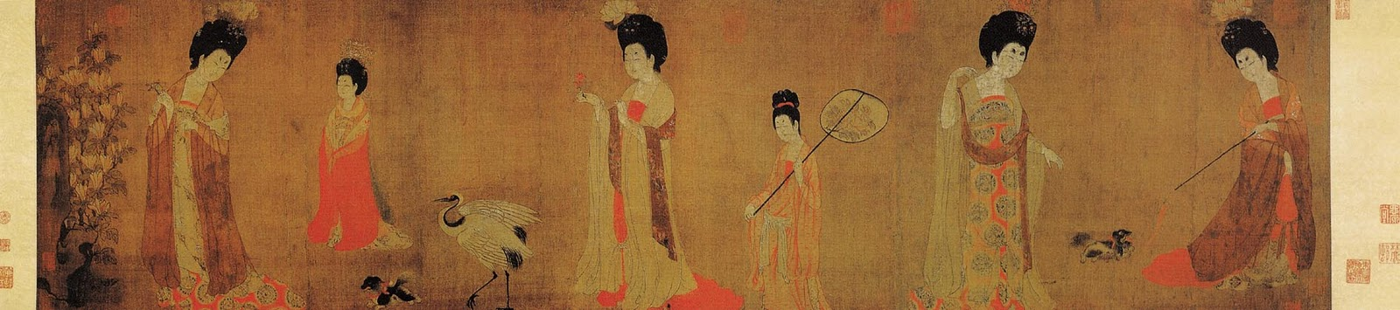
Tang Poetry and Cultural Achievements
In addition to poetry, the Tang period also saw the rise of tea culture.
While tea had been used medicinally for centuries, it was during the Tang era that it became China’s most popular beverage.
This shift was largely due to the efforts of Lu Yu, a scholar and tea master who authored the famous "Cha Jing" (The Classic of Tea).
His work codified the methods of tea preparation and appreciation, and he became known as Cha Sheng (The Sage of Tea) for his contributions to the development of tea culture.

Slide 28
The Legacy of the Sui and Tang Dynasties
Though the Sui Dynasty was brief, its accomplishments, such as the re-unification of China and the initiation of the civil service examination system, set the stage for the Tang Dynasty’s Golden Age.
The Tang expanded these innovations, creating a more merit-based political system and fostering a vibrant cultural and intellectual environment.
Under the Tang, Chang’an became the largest city in the world and a symbol of China's openness to international exchange, both culturally and commercially.
The tolerance for diverse religious practices, the flourishing of literature and poetry, and the rise of tea culture all contributed to making the Tang Dynasty one of the most celebrated periods in Chinese history.
The Tang era’s intellectual vibrancy, cosmopolitanism, and political innovations left an enduring legacy that shaped China for centuries to come.

Slide 29
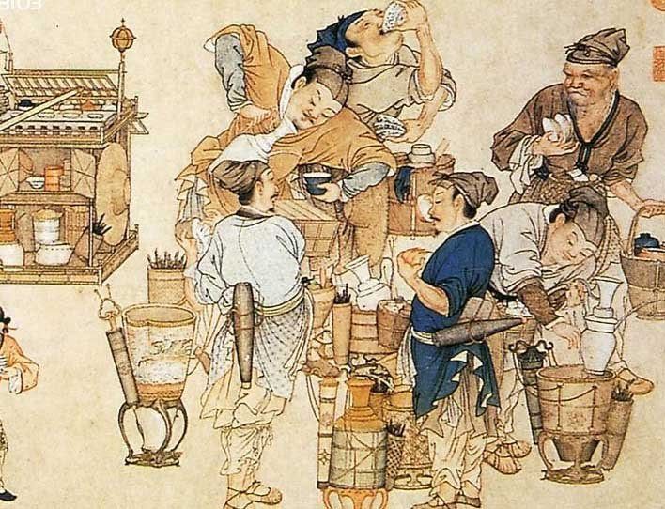
Conclusion
The Spring and Autumn and Warring States periods marked a time of chaos and warfare, but also birthed some of the most influential philosophies that shaped China for millennia.
Confucianism, Daoism, and Legalism emerged as guiding ideologies in response to the instability of these eras, each offering visions for restoring order and harmony.
Despite the tumultuous nature of these times, they
set the stage for the eventual unification under the
Qin Dynasty, followed by the flourishing of Chinese
civilization during the Han, Sui, and Tang dynasties.
The intellectual and cultural legacies of these periods,
particularly the Confucian ideals, continued to
influence Chinese society and governance long after
the wars had ended.

Slide 30
Thankyou for Coming!
I hope you enjoyed my talk!
If you have any more questions, please ask.
I will do my best to answer them for you.
I can be reached by e-mail at
marcs@sonic.net

Slide 31
Acknowledgement
My seminars are the result of many years of experience combined with many hours of research over the internet.
I would like to acknowledge the many source I have accessed.

Slide 32
References
“Mandate of Heaven.” Wikipedia.
“Mandate of Heaven.” World History Encyclopedia.
“What Is China’s Mandate of Heaven?” ThoughtCo.
“The Mandate of Heaven – Early World Civilizations.” Achieving the Dream.
“5.3: The Zhou Dynasty.” Humanities LibreTexts.
Fairbank, J. K., & Goldman, M. (2006). China: A New History. Harvard University Press.
Ebrey, P. B. (2010). The Cambridge Illustrated History of China. Cambridge University Press.
Keay, J. (2009). China: A History. HarperCollins.
“Dynasties of China.” Wikipedia.
“The 13 Dynasties that Ruled China in Order.” History Hit.

Slide 33
References
“Oracle bone script.” Wikipedia.
“Oracle Bones.” World History Encyclopedia.
“What are oracle bones?” BBC Bitesize.
“Chinese Writing from 5000 B.C. to Present.” Rutgers University.
“Jiaguwen | Chinese, Oracle Bones, Shang Dynasty.” Britannica.
Fairbank, J. K., & Goldman, M. (2006). China: A New History. Harvard University Press.
“Shang Dynasty.” World History Encyclopedia.
“Zhou dynasty.” Wikipedia.
“Shang and Zhou Dynasties: The Bronze Age of China.” The Met.
“Mandate of Heaven.” Ancient History Encyclopedia.

