Slide 1

Chinese Dynastic History
Part 1
The first five dynasties
Presented by
Marc Silver

Slide 2
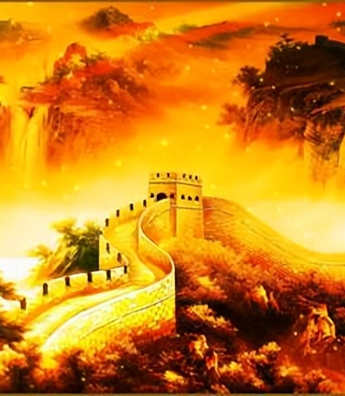
Chinese Dynastic History
China’s history spans over 5,000 years, beginning with a mix of myth, legend, and historical events that have shaped one of the world’s oldest civilizations.
This overview explores Chinese dynasties from around 2000 BCE until the fall of the Imperial System in 1912, shedding light on the rich cultural and political tapestry that has defined China for millennia.

Slide 3
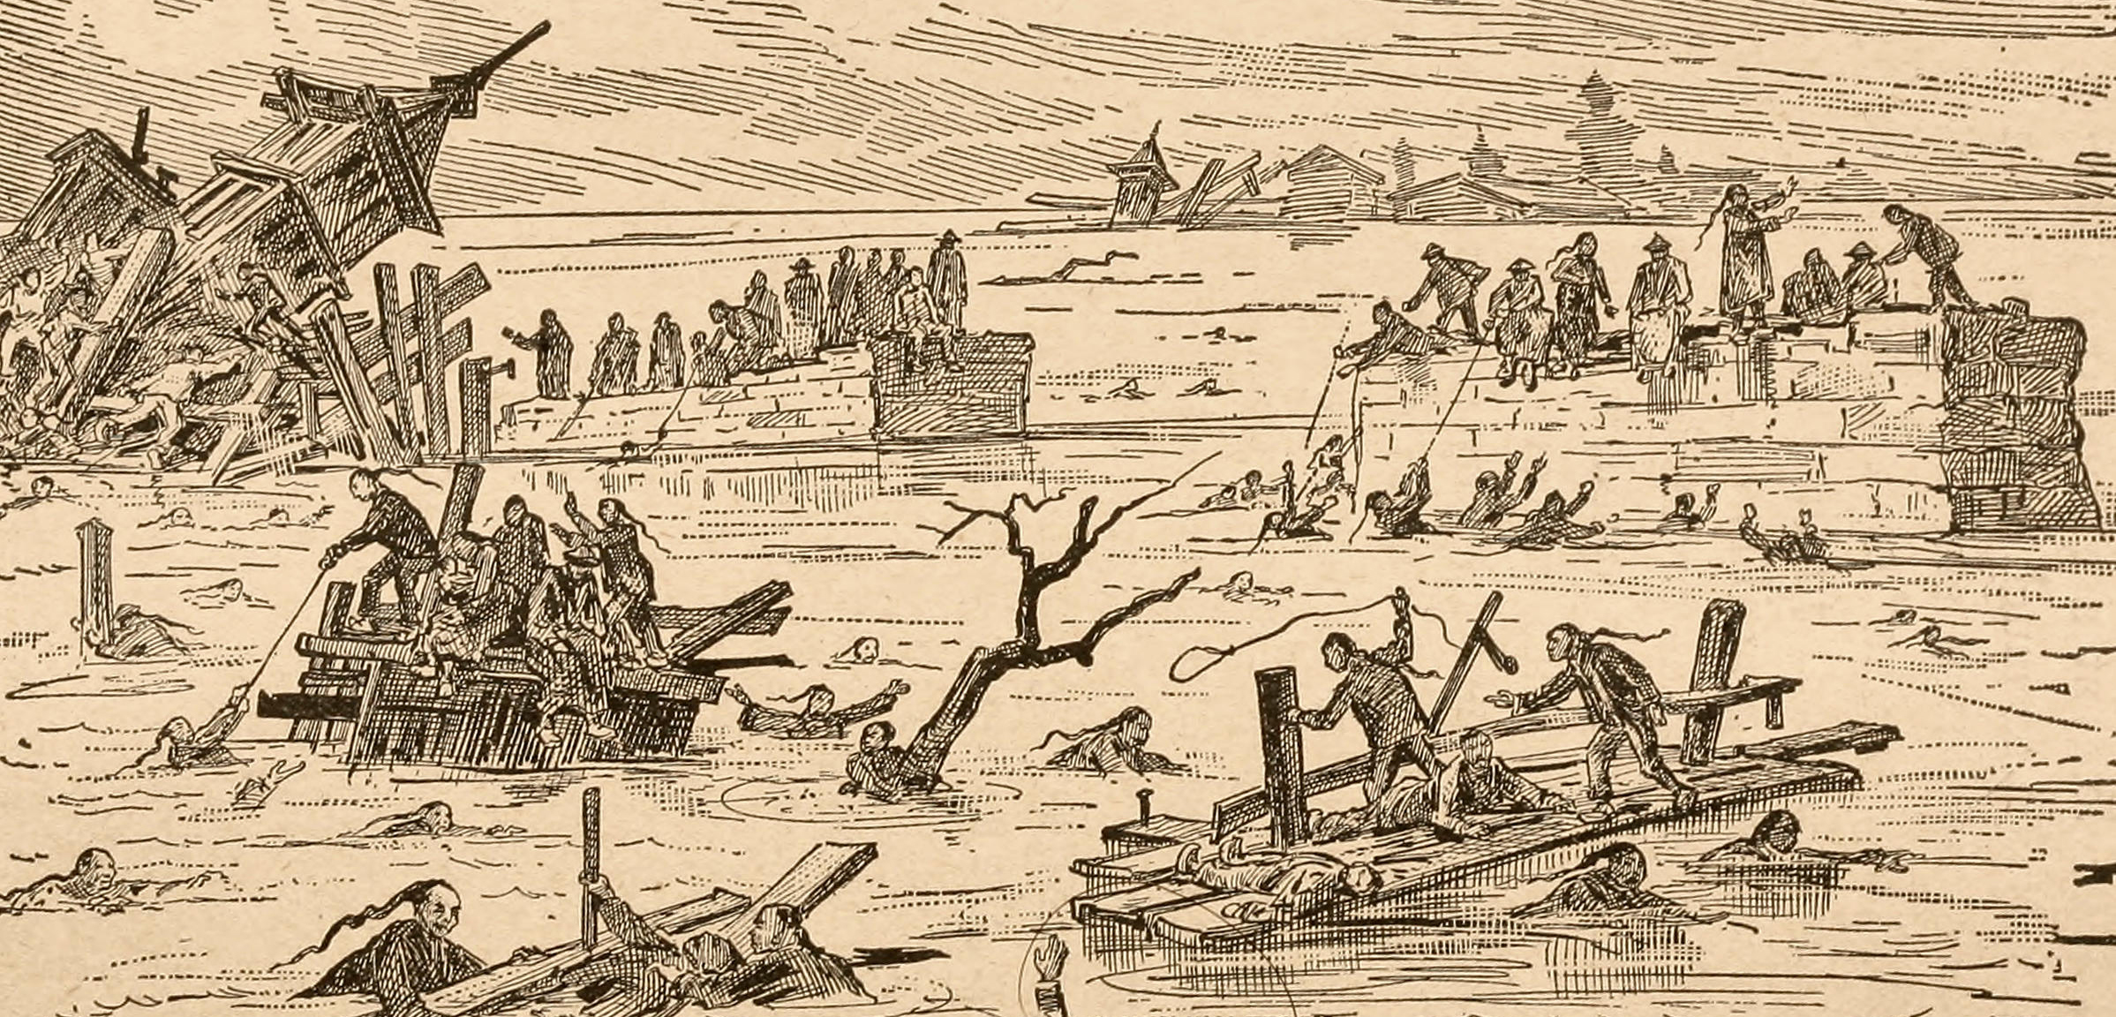
Chinese Dynastic History
The Early Legendary Period
The origins of Chinese civilization are intertwined with ancient myths and legends. Much like the story of the Great Flood found in Western traditions, Chinese history speaks of a catastrophic flood that threatened to destroy everything.
A man named Yu, known for his extraordinary wisdom and engineering skills, was tasked with taming the waters.
Legend states that Emperor Shun, the last of the “sage kings” of ancient China, entrusted Yu with controlling the flood.
Through incredible effort, Yu dug channels to divert the floodwaters to the sea, laying the groundwork for agricultural stability. His success in flood control was so great that he became a celebrated figure, ultimately founding the Xia Dynasty (2070–1600 BCE).

Slide 4
First Five Chinese Dynasties
Chinese Dynasties from 2070 BCE to 200 CE
Xia Dynasty (2070–1600 BCE).
Shang Dynasty (1600–1046 BCE)
Zhou Dynasty (1046–256 BCE)
Qin Dynasty (221–206 BCE
Han Dynasty (206 BCE–220 CE)

Slide 5
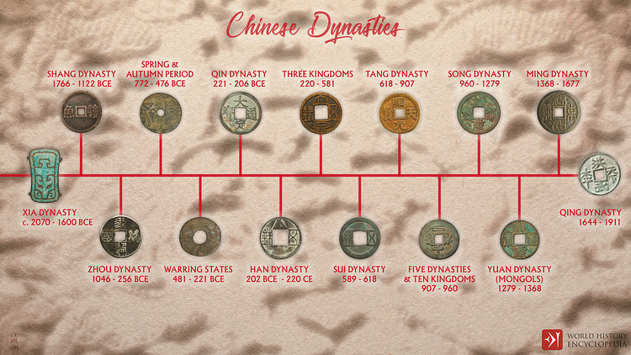

Slide 6
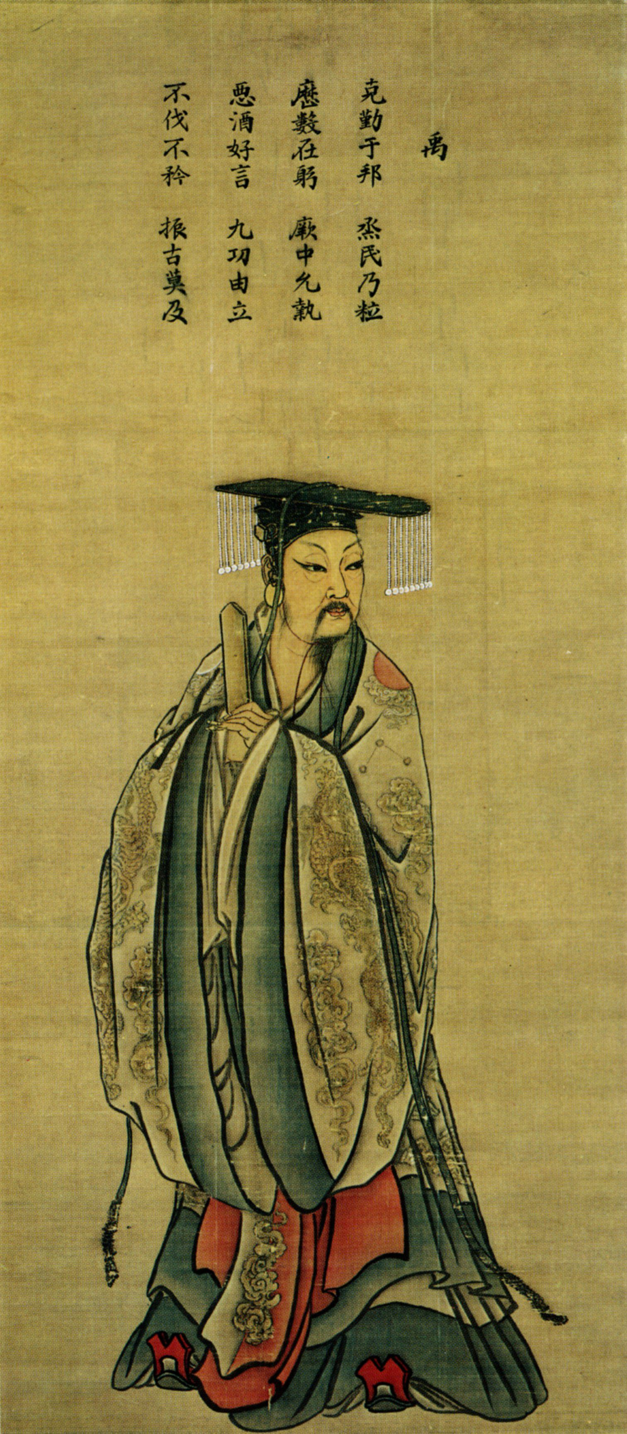
The Xia Dynasty: Myth or Reality?
The Xia Dynasty remains enigmatic. Many historians argue that it occupies a space between legend and fact.
Although traditional Chinese history attributes the start of the dynastic system to Yu and the Xia, no definitive archaeological evidence has been found that can directly confirm the existence of this dynasty.
Many scholars believe the Xia is a symbol of early state formation, rather than a fully established historical dynasty with documented records.

Slide 7
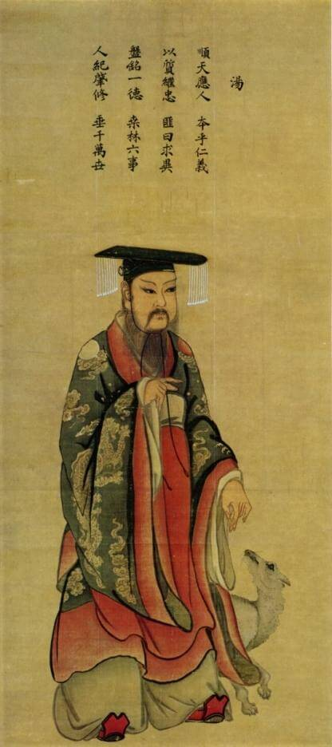
The Shang Dynasty:
The Dawn of Recorded History
After the Xia Dynasty, the Shang Dynasty 商朝 (Shāng cháo, 1600–1046 BCE) emerged, marking a more concrete phase in Chinese history and the start of its recorded history.
While the Xia's existence remains uncertain, archaeological discoveries, such as oracle bones used for divination, provide solid evidence of the Shang's existence and offer insights into their society and culture.
The Shang Dynasty left a lasting legacy on Chinese civilization, not only through its political and military power but also through its advancements in metallurgy, religious practices, and writing.
These innovations laid the foundation for key aspects of Chinese society that persisted for centuries.

Slide 8
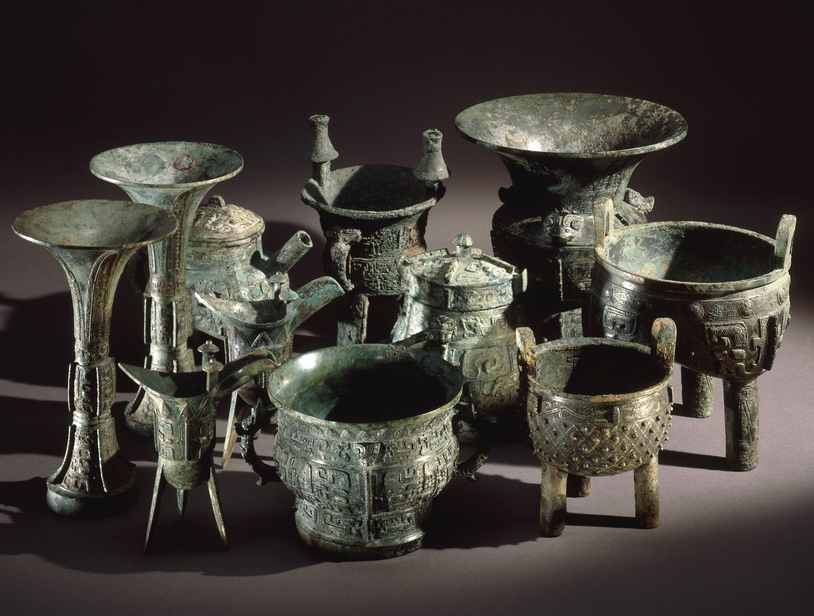
The Shang Dynasty:
Bronze Artifacts and Technological Advancements
One of the most defining features of the Shang Dynasty is its bronze artifacts, which have been uncovered in large quantities by archaeologists.
These items range from ceremonial vessels, cups, and steamers to massive cauldrons, all intricately crafted using sophisticated bronze-casting techniques.
These objects weren’t merely utilitarian; they were believed to be used in sacrificial rituals to honor gods and ancestors.

Slide 9
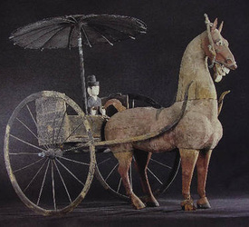
The Shang Dynasty:
Bronze Artifacts and Technological Advancements
As technology advanced throughout the Shang era, the size and complexity of these bronzes grew significantly. By the end of the dynasty, some of the largest bronze items weighed up to 200 pounds, a testament to the dynasty’s increasing technological capabilities and resource control.
Bronze metallurgy was not only an art form but also a symbol of political power and social hierarchy. The elite, particularly the Shang rulers, used these items in rituals that reinforced their divine right to rule, blending governance with religious authority.

Slide 10
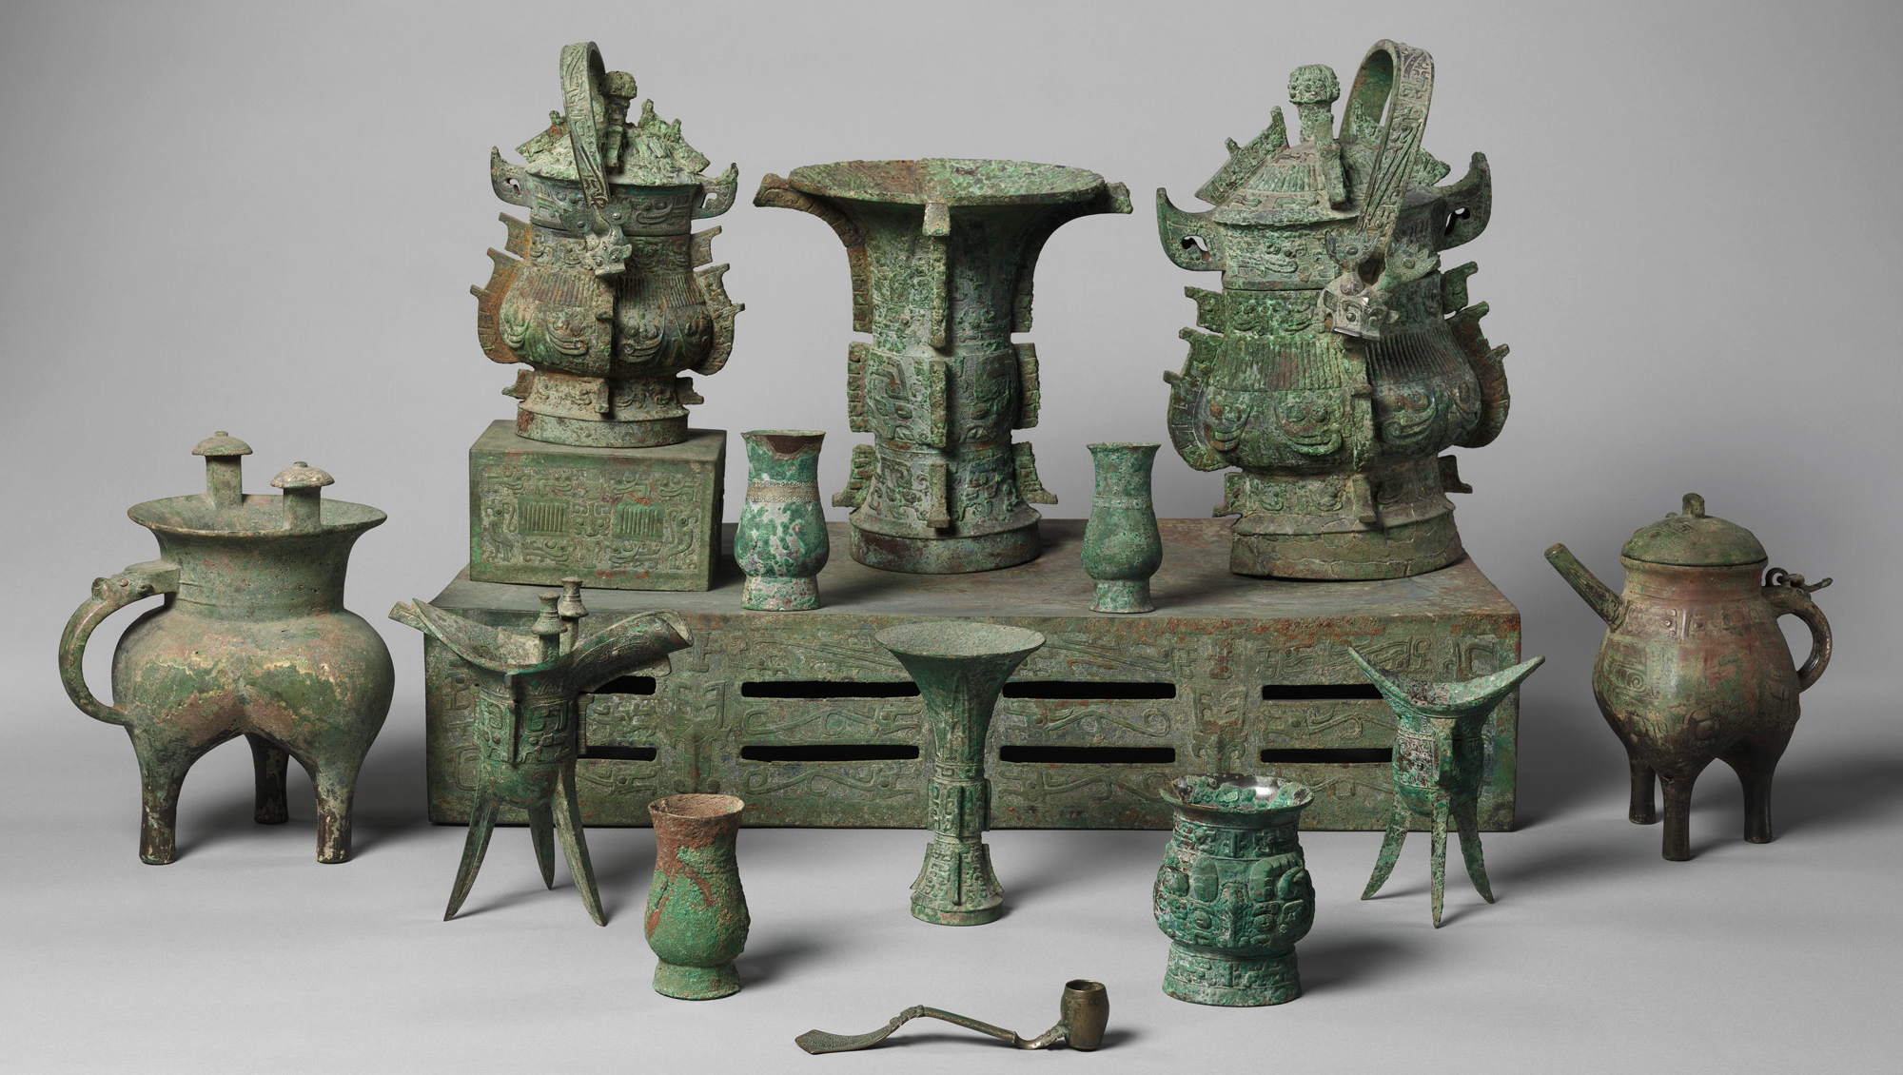
The Shang Dynasty:
Bronze Artifacts and Technological Advancements
Bronze metallurgy during the Shang Dynasty was not only a remarkable art form but also a powerful symbol of political authority and social status.
The Shang elite, particularly the ruling class, commissioned intricately crafted bronze vessels and weapons that served as more than just functional objects.
These items played a critical role in ceremonial rituals, reinforcing the rulers' divine mandate and legitimizing their governance.
Through the use of these bronzes in ancestor worship and state ceremonies, Shang rulers effectively intertwined political power with religious authority, consolidating their control over both the spiritual and temporal realms.
These advancements in metallurgy also demonstrated the dynasty's technological sophistication, setting the Shang apart as leaders in early Chinese civilization.

Slide 11
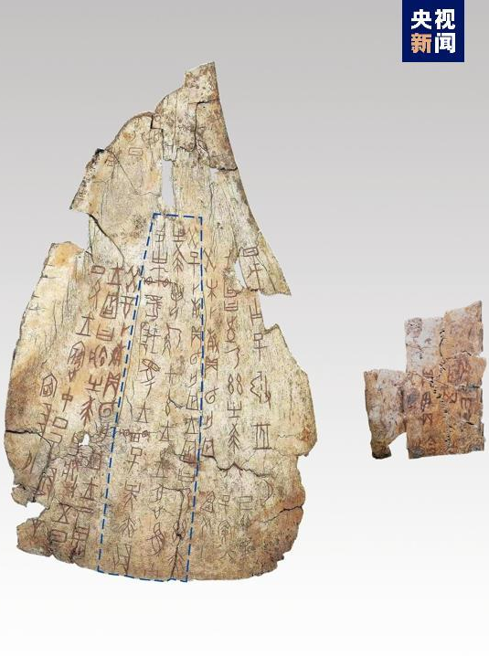
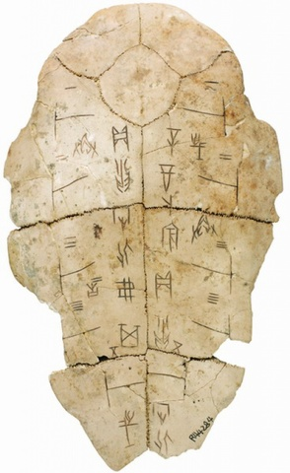
The Shang Dynasty:
Oracle Bone Inscriptions:
The Birth of Chinese Writing
The Shang Dynasty is recognized as the period during which Chinese writing first emerged.
The earliest known examples of Chinese script are found on oracle bones (甲骨文, Jiǎgǔwén) primarily turtle shells and animal bones used by Shang kings for divination.
These bones were inscribed with pictographs, a rudimentary form of writing that would evolve into the complex characters used in later Chinese history.

Slide 12
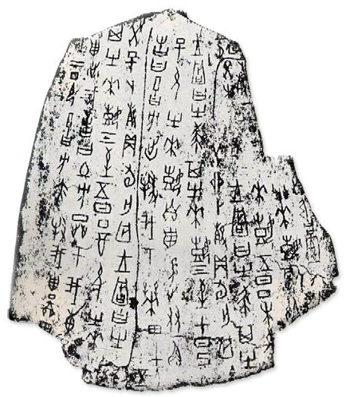
The Shang Dynasty:
The Divination Process
Shang rulers believed they could communicate with deities and ancestors by interpreting the cracks that appeared on the oracle bones after they were heated.
This process, known as scapulimancy or plastromancy, involved carving questions into the bones, applying heat until they cracked, and then interpreting the patterns of the cracks.
The inscriptions on these bones represent the earliest known written records in China, providing valuable insights into Shang politics, religious practices, and even military campaigns.

Slide 13
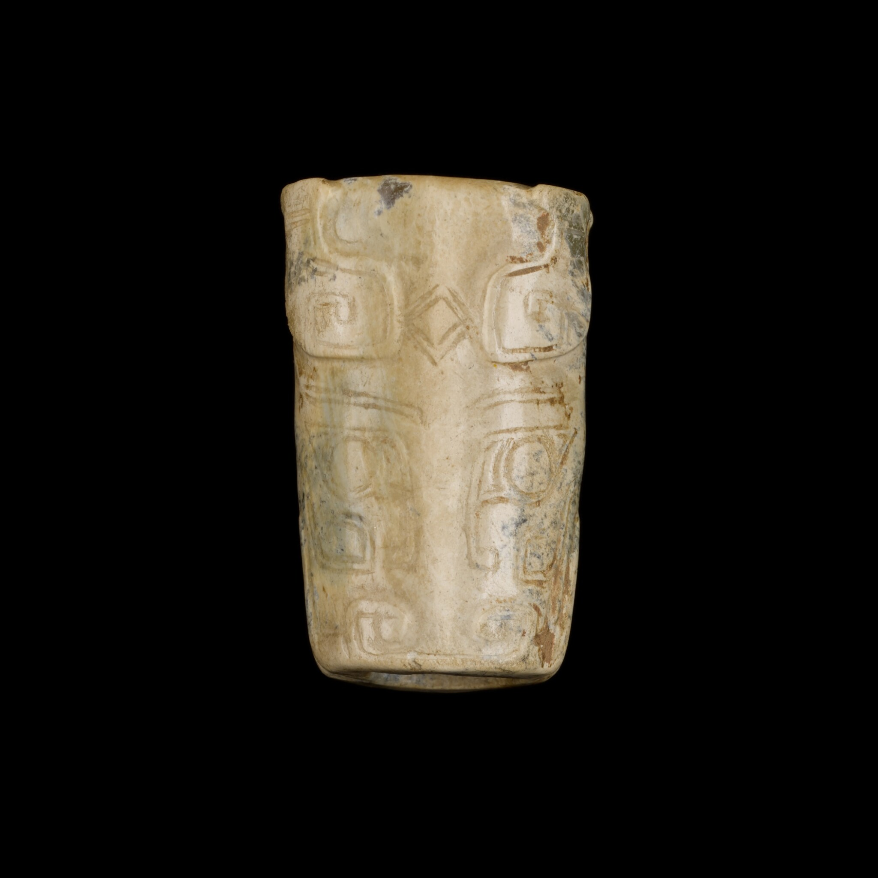
The Shang Dynasty:
Significance of Oracle Bone Inscriptions
The divination process helped the kings make important decisions, from agricultural planning to warfare, cementing the role of spiritual guidance in governance.
These inscriptions are not only significant for their historical content but also for their role in the development of Chinese writing.
The pictographs on the oracle bones are the precursors to the complex
Chinese characters used in later periods.
The Shang Dynasty holds an important place in Chinese history as the first
dynasty to leave behind both material and written records.
Its advancements in bronze metallurgy and the development of Chinese
writing are cornerstones of China’s cultural heritage. Despite its eventual
decline, the Shang laid the groundwork for many aspects of Chinese
civilization that would endure through subsequent dynasties.

Slide 14
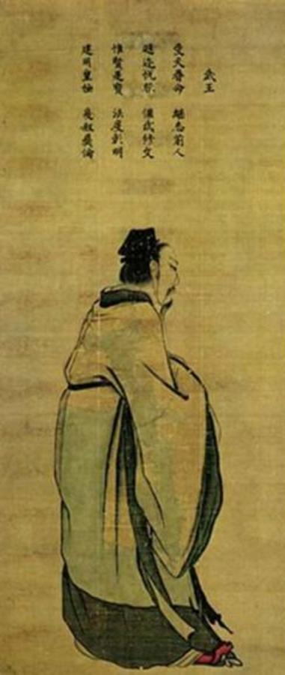
The Zhou Dynasty: Philosophical Flourishing
1046–256 BCE: Following the Shang, the Zhou Dynasty introduced the concept of the Mandate of Heaven, a crucial doctrine stating that the ruler was chosen by divine forces and could be overthrown if they failed to govern justly.
This period saw the flourishing of Chinese philosophy and is notable for its long duration and the philosophical developments that occurred during this period, with Confucianism and Daoism emerging as influential schools of thought.
Confucianism and Daoism, two of China’s most influential philosophical systems, emerged during the Zhou era and had a lasting impact on Chinese culture and governance.

Slide 15
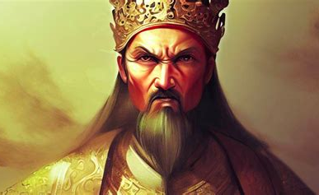
The Zhou Dynasty
The Mandate of Heaven - Stability thru Feudalism
Zhou claimed the Mandate of Heaven, a divine right to rule.
Heaven was a power that controlled human destiny.
The King was the son of Heaven.
Heaven would send signs of displeasure with the ruler like earthquakes and floods.
If the king lost right of Heaven to rule, he could be overthrown.
Increase stability of rule through feudalism.
The King owned all the land.
He would give large pieces of land to loyal supporters to fight for the king if needed.
Lords were the rulers of their own land.
Lords had absolute power over peasant farmers.
Peasants had the lord’s protection but must give a portion of their crops to their lord.

Slide 16
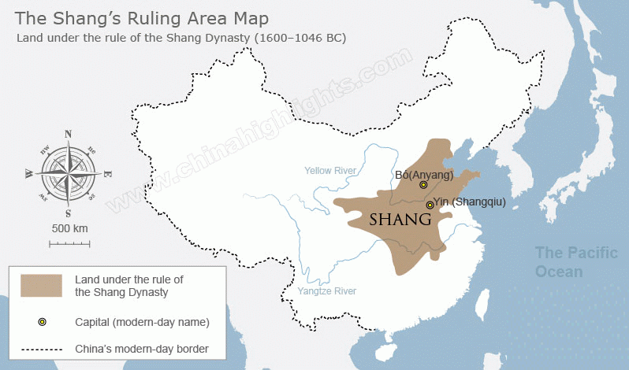
The Zhou Dynasty:
The Fall of the Shang and the Rise of the Zhou
Despite its early achievements, the Shang Dynasty eventually fell into a period characterized by decadence and moral decline.
Historical accounts describe the later Shang kings as corrupt and indulgent, losing the favor of both their people and the heavens.
It was during this period of internal weakness that a frontier state known as Zhou rose to prominence.
The Zhou, seeing an opportunity in the Shang’s
declining moral and political authority, launched a
successful conquest.
In 1046 BCE, the Zhou defeated the Shang at the
Battle of Muye, marking the end of the dynasty.
The Zhou Dynasty would go on to rule for centuries,
but many of its early innovations in governance and
ritual practices can be traced back to the foundations
laid by the Shang.

Slide 17
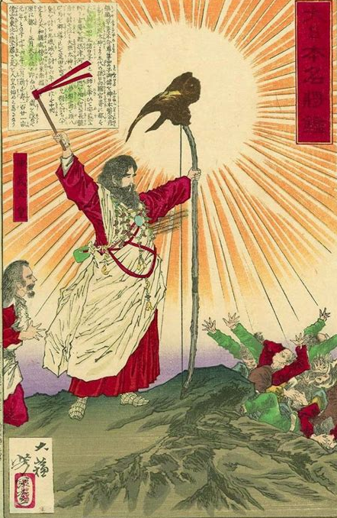
The Zhou Dynasty:
The Mandate of Heaven and Its Legacy
The Zhou Dynasty 周朝 (Zhōu cháo) (1050–256 BCE) is one of the longest-lasting and most influential periods in Chinese history.
During this time, China transitioned from a centralized system of rule to a more decentralized, feudal-like structure.
One of the most significant ideological developments in Chinese governance emerged: the Mandate of Heaven
(天命, Tiān Mìng).

Slide 18
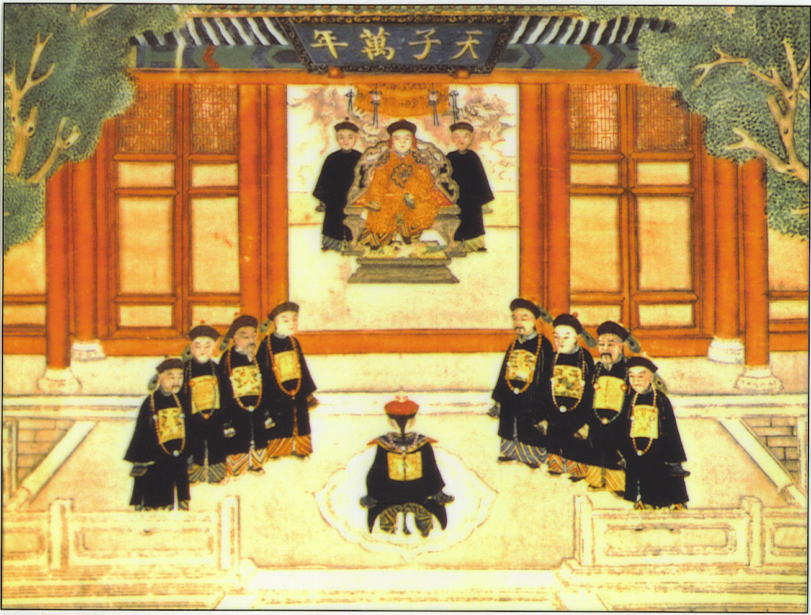
The Mandate of Heaven:
A New Legitimacy for Rule
The concept of the Mandate of Heaven became the central justification for rulership during the Zhou Dynasty.
According to this belief, a ruler’s legitimacy
was granted by divine forces, and a king could
only rule as long as he retained the favor of
Heaven.
Unlike earlier beliefs where kings were seen as
divine or semi-divine figures, the Mandate of
Heaven introduced the idea that heaven’s favor
was conditional, based on the ruler’s ability to
govern with virtue and justice.

Slide 19
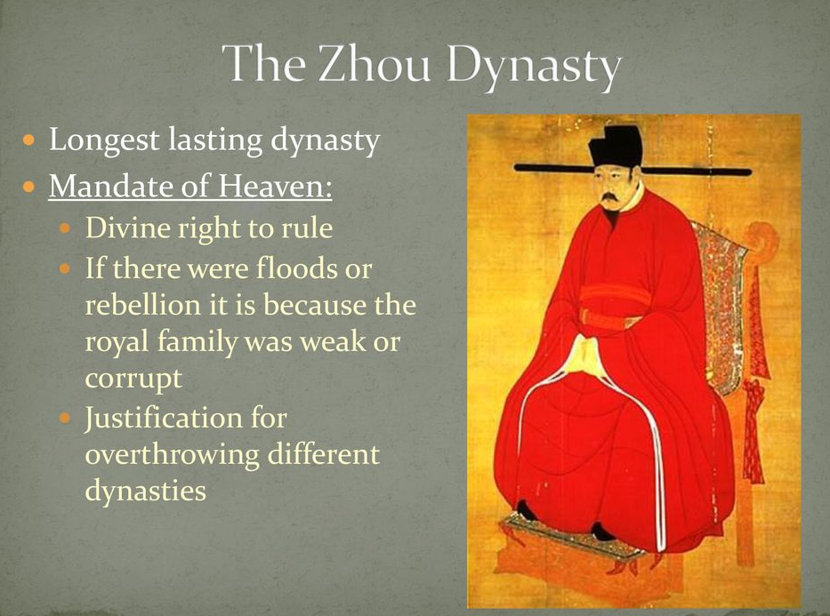
Conditional Divine Favor
If a king ruled tyrannically or unjustly, Heaven would communicate its displeasure through natural disasters such as floods, droughts, or earthquakes.
These disasters were seen as warnings that the ruler was failing in his duties.
If the king ignored these warnings and continued to misrule, it was believed that Heaven would withdraw its mandate, leading to political instability, rebellion, and the eventual downfall of the dynasty.

Slide 20
Revolutionary Concept
This concept was revolutionary because it suggested that no ruler was permanently secure in power.
The right to govern was dependent on good governance and moral authority, making the ruler accountable not only to his subjects but to a higher cosmic order.
Early Zhou Success and Stability
For the first half of the Zhou Dynasty, Heaven appeared to favor the Zhou kings, as they were able to maintain relative peace and stability.
The early Zhou rulers decentralized power by granting lands and titles to noble families, who governed regions on behalf of the king.
This feudal system allowed the Zhou to manage a vast territory while still maintaining central control.

Slide 21
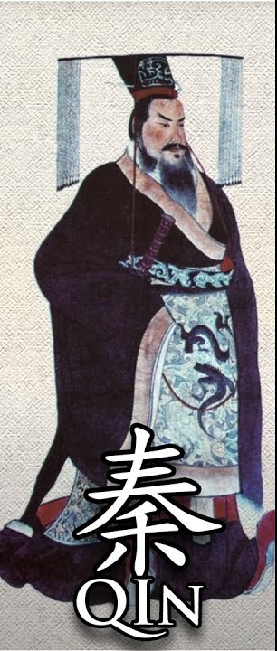
The Qin Dynasty:
Unification and Legalism
The Qin Dynasty 秦朝 (Qín cháo) (221–206 BCE) unified China under Emperor Qin Shi Huang, who is famed for building the Great Wall and commissioning the Terracotta Army. is famous for unifying China under a centralized imperial rule.
Qin Shi Huang, the first emperor, implemented sweeping reforms based on Legalist principles, standardizing weights, measures, and even script.
The construction of the Great Wall also began during this period as a defense against northern invaders.
His reign, though short-lived, was marked by significant reforms, including the standardization of weights, measures, and even the script used throughout China.

Slide 22
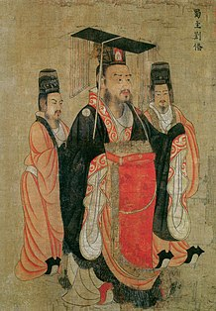
The Han Dynasty: A Golden Age
The Han Dynasty 汉代 朝 Hàndài cháo (206 BCE–220 CE) is often considered a golden age in Chinese history.
It saw significant advancements in science, technology, and culture.
The Han Dynasty expanded China’s territory and influence, making Confucianism the state philosophy.
The Silk Road, a network of trade routes connecting China with the West, was established during the Han period, facilitating cultural and economic exchanges.

Slide 23
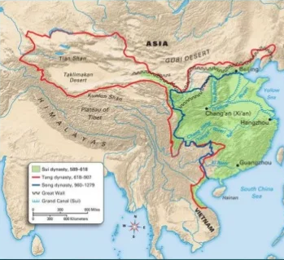
The Tang and Song Dynasties:
Cultural and Economic Prosperity
The Tang (618–907) and Song (960–1279) dynasties are renowned for their cultural and economic prosperity.
The Tang Dynasty is often regarded as a high point in Chinese civilization, with flourishing arts, literature, and trade.
The Song Dynasty continued this trend, making notable advancements in technology, such as the invention of gunpowder and the compass.

Slide 24
Conclusion
Chinese dynastic history was a tapestry of evolving society, culture, and governance, shaped by legendary figures and key events.
Early dynasties like the Xia, though historically elusive, hint at China’s deep cultural roots
The Shang Dynasty is notable for its significant contributions, including advancements in bronze metallurgy and the development of Chinese writing, laying the foundation for future civilizations.
The Zhou Dynasty introduced the Mandate of Heaven, a concept that would profoundly influence Chinese political philosophy, asserting that rulers were accountable to both their people and divine forces.
Although the Zhou eventually fell into disarray, this ideological framework had lasting impact.

Slide 25
Conclusion
The Qin Dynasty, despite its brief existence, was pivotal. Under Qin Shi Huang, China was unified for the first time, establishing the basis for imperial rule through standardized culture, infrastructure, and governance.
However, Qin Shi Huang’s harsh authoritarianism led to the dynasty’s downfall, with his legacy enduring through the Terracotta Army.
The Han Dynasty marked China’s first Golden Age with territorial expansion, cultural flourishing, and the entrenchment of Confucianism.
Its decline, followed by the Three Kingdoms and Jin Dynasties, led to fragmentation and instability, but this era remains significant in Chinese cultural memory.
The Northern and Southern Dynasties Period saw political division yet cultural integration, with Buddhism bridging gaps between regions. By the end of this period, Buddhism had become a major cultural and religious force.
China’s 5,000-year history highlights resilience and transformation, offering valuable lessons and a rich repository of knowledge for contemporary and future challenges.

Slide 26
Thankyou for Coming!
I hope you enjoyed my talk!
If you have any more questions, please ask.
I will do my best to answer them for you.
I can be reached by e-mail at
marcs@sonic.net

Slide 27
Acknowledgement
My seminars are the result of many years of experience combined with many hours of research over the internet.
I would like to acknowledge the many source I have accessed.

Slide 28
References
“Mandate of Heaven.” Wikipedia.
“Mandate of Heaven.” World History Encyclopedia.
“What Is China’s Mandate of Heaven?” ThoughtCo.
“The Mandate of Heaven – Early World Civilizations.” Achieving the Dream.
“5.3: The Zhou Dynasty.” Humanities LibreTexts.
Fairbank, J. K., & Goldman, M. (2006). China: A New History. Harvard University Press.
Ebrey, P. B. (2010). The Cambridge Illustrated History of China. Cambridge University Press.
Keay, J. (2009). China: A History. HarperCollins.
“Dynasties of China.” Wikipedia.
“The 13 Dynasties that Ruled China in Order.” History Hit.

Slide 29
References
“Oracle bone script.” Wikipedia.
“Oracle Bones.” World History Encyclopedia.
“What are oracle bones?” BBC Bitesize.
“Chinese Writing from 5000 B.C. to Present.” Rutgers University.
“Jiaguwen | Chinese, Oracle Bones, Shang Dynasty.” Britannica.
Fairbank, J. K., & Goldman, M. (2006). China: A New History. Harvard University Press.
“Shang Dynasty.” World History Encyclopedia.
“Zhou dynasty.” Wikipedia.
“Shang and Zhou Dynasties: The Bronze Age of China.” The Met.
“Mandate of Heaven.” Ancient History Encyclopedia.

