Slide 1
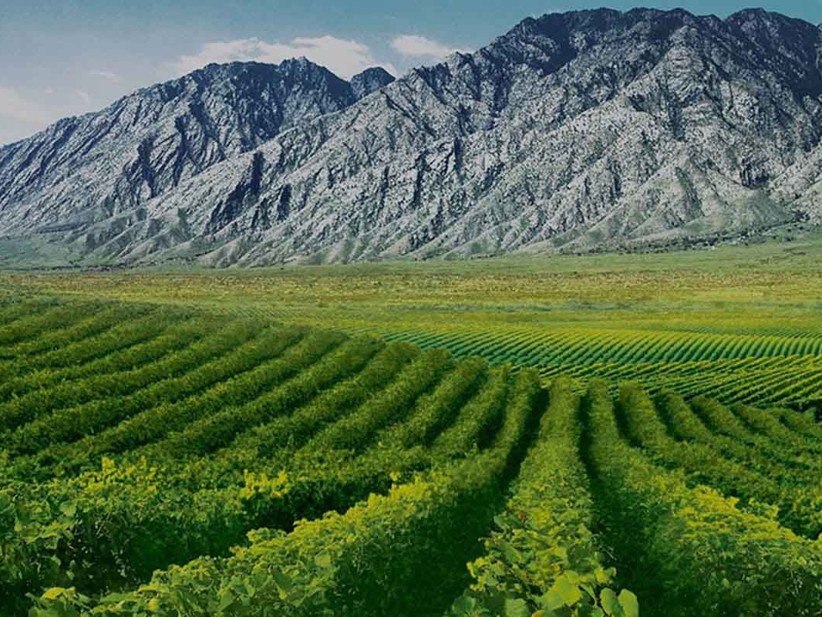
Exploring China’s Wine Landscape
Wine History, Regions, Varietals, and Wineries
Presented by:
Marc Silver

Slide 2
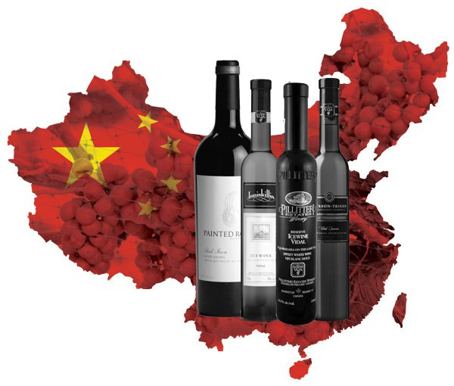
China’s Emergence as a Wine Powerhouse
• China is one of the fastest-growing wine markets in the world.
• Rich yet relatively recent winemaking history.
• Competing with European and New World wines.
Key Stats: China is one of the top 10 wine producers globally with over 750,000 hectares under vine.

Slide 3
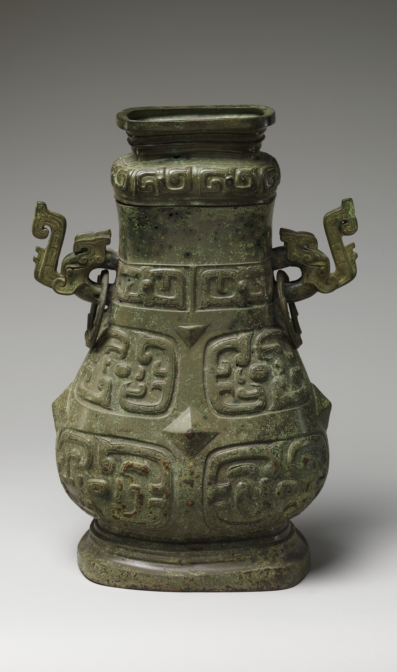
A Brief History of Wine in China
• Ancient Roots: Archaeological finds suggest 4,000+ years of wine production.
• Modern Era: Large-scale grape wine production began in the 1980s.
• Key Milestones:
- 1892: Changyu Winery founded in Shandong.
- 2000s: Rapid industry expansion driven by government support.
Wine container (Hu)
Western Zhou dynasty (1046-771 BCE) The Metropolitan Museum of Art

Slide 4
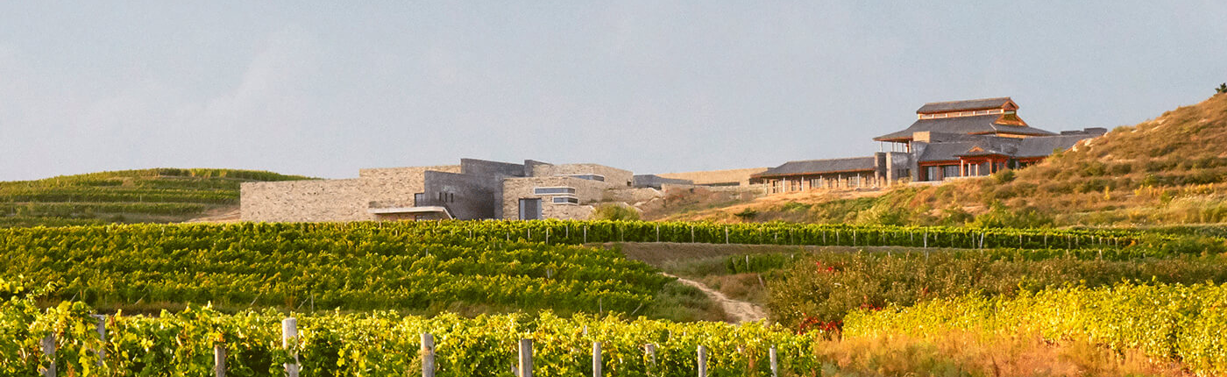
Wine Regions of China
• Shandong Province: Coastal region, known for Cabernet Sauvignon and Merlot.
• Ningxia: Semi-arid, producing Bordeaux-style blends.
• Xinjiang: Hot desert region, famous for Syrah and Cabernet.
• Hebei: Continental climate, produces Chardonnay and Cabernet.
• Yunnan: High-altitude vineyards, producing distinctive wines.
Domaine de Long Dai in Penglai China

Slide 5
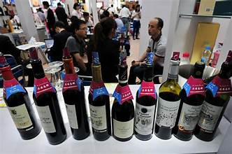
China's Fast-Growing Wine Market
China has emerged as one of the most dynamic wine markets globally. The country has seen a dramatic rise in both the production and consumption of wine.
Wine has become increasingly popular among the growing middle class, who are seeking out new cultural experiences and luxury goods. This fast-paced growth is also driven by the younger generation, which is increasingly influenced by Western lifestyles and trends.
As a result, China has become a major market that competes with established regions like Europe and the New World.

Slide 6
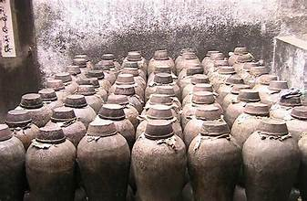
Ancient Winemaking Roots
China's winemaking history is ancient, but it remained relatively underdeveloped until the modern era. Archaeological findings suggest that wine has been made in China for over 4,000 years, particularly from fermented fruits such as hawthorn and wild grapes.
However, this ancient tradition did not evolve into a thriving wine industry until more recently.
The discovery of ancient wine vessels in places like the Yellow River Valley highlights that China's culture of fermentation has deep roots, though it wasn't until the past few decades that wine grape cultivation began in earnest.

Slide 7
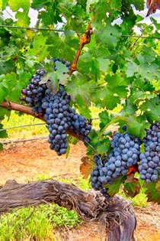
Best-Known Varietals in China
• Cabernet Sauvignon: Dominant red varietal.
• Merlot: Thrives in Shandong and Ningxia.
• Syrah: Popular in Xinjiang.
• Chardonnay: Main white varietal.
• Marselan: Gaining popularity for its adaptability.

Slide 8
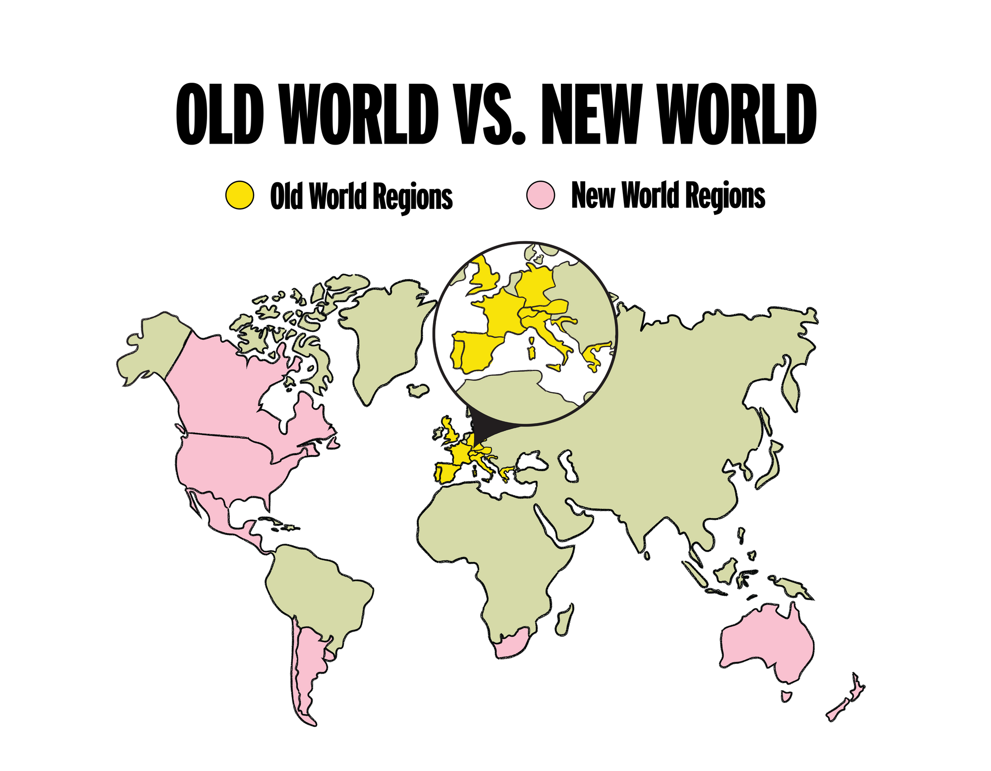
Competing with European and New World Wines
In the modern wine industry, China is competing head-to-head with some of the most famous wine regions in the world, such as France, Italy, and the United States.
Despite its relatively recent development, Chinese wines are gaining recognition on the international stage.
Domestic winemakers have invested in improving wine quality, often with the help of European expertise and advanced viticultural practices.
This competition is both domestic and international, as China has also become a major importer of European wines, fostering an increasingly sophisticated palate among Chinese consumers.

Slide 9
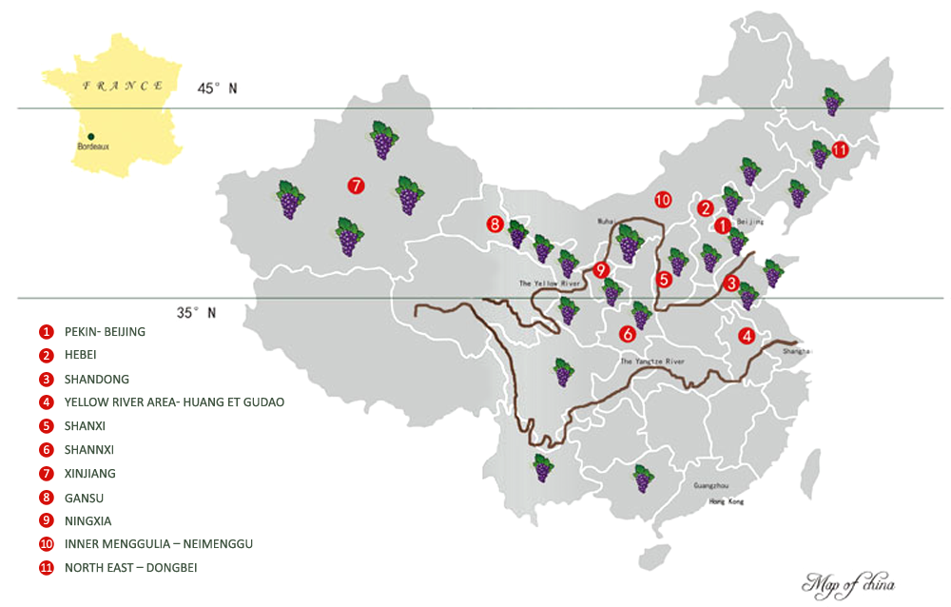
Modern Era and (1980s-Present)
While China’s ancient winemaking roots are significant, its modern era of large-scale grape wine production began in the 1980s.
Before this period, China had little to no commercial wine industry, and the wines produced were of relatively poor quality.
However, starting in the late 20th century, the government began to recognize the economic potential of wine and implemented policies to support vineyard expansion and wine production.
This state-driven focus led to a boom in the wine industry in the 2000s, with massive investments in vineyards, technology, and marketing.

Slide 10

Key Milestones
Changyu Winery (1892): The founding of Changyu Winery in Shandong province was a major milestone in China’s winemaking history.
As the first modern winery in China, Changyu introduced European techniques and grape varietals to the region, laying the groundwork for the future of the Chinese wine industry.
Today, Changyu is still one of the largest and most well-respected wine producers in the country.

Slide 11
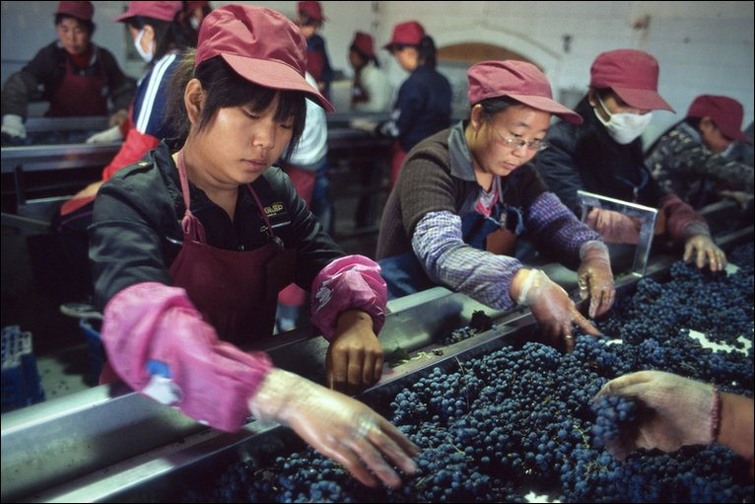
Key Milestones
2000s Industry Expansion: The 21st century saw explosive growth in the Chinese wine industry, primarily driven by the government's initiatives to promote agriculture and tourism through winemaking.
The central government provided support through favorable policies, investments, and infrastructure development, leading to a rapid increase in both wine consumption and domestic production.
This expansion also attracted foreign investment and expertise, further elevating the quality of Chinese wines.

Slide 12
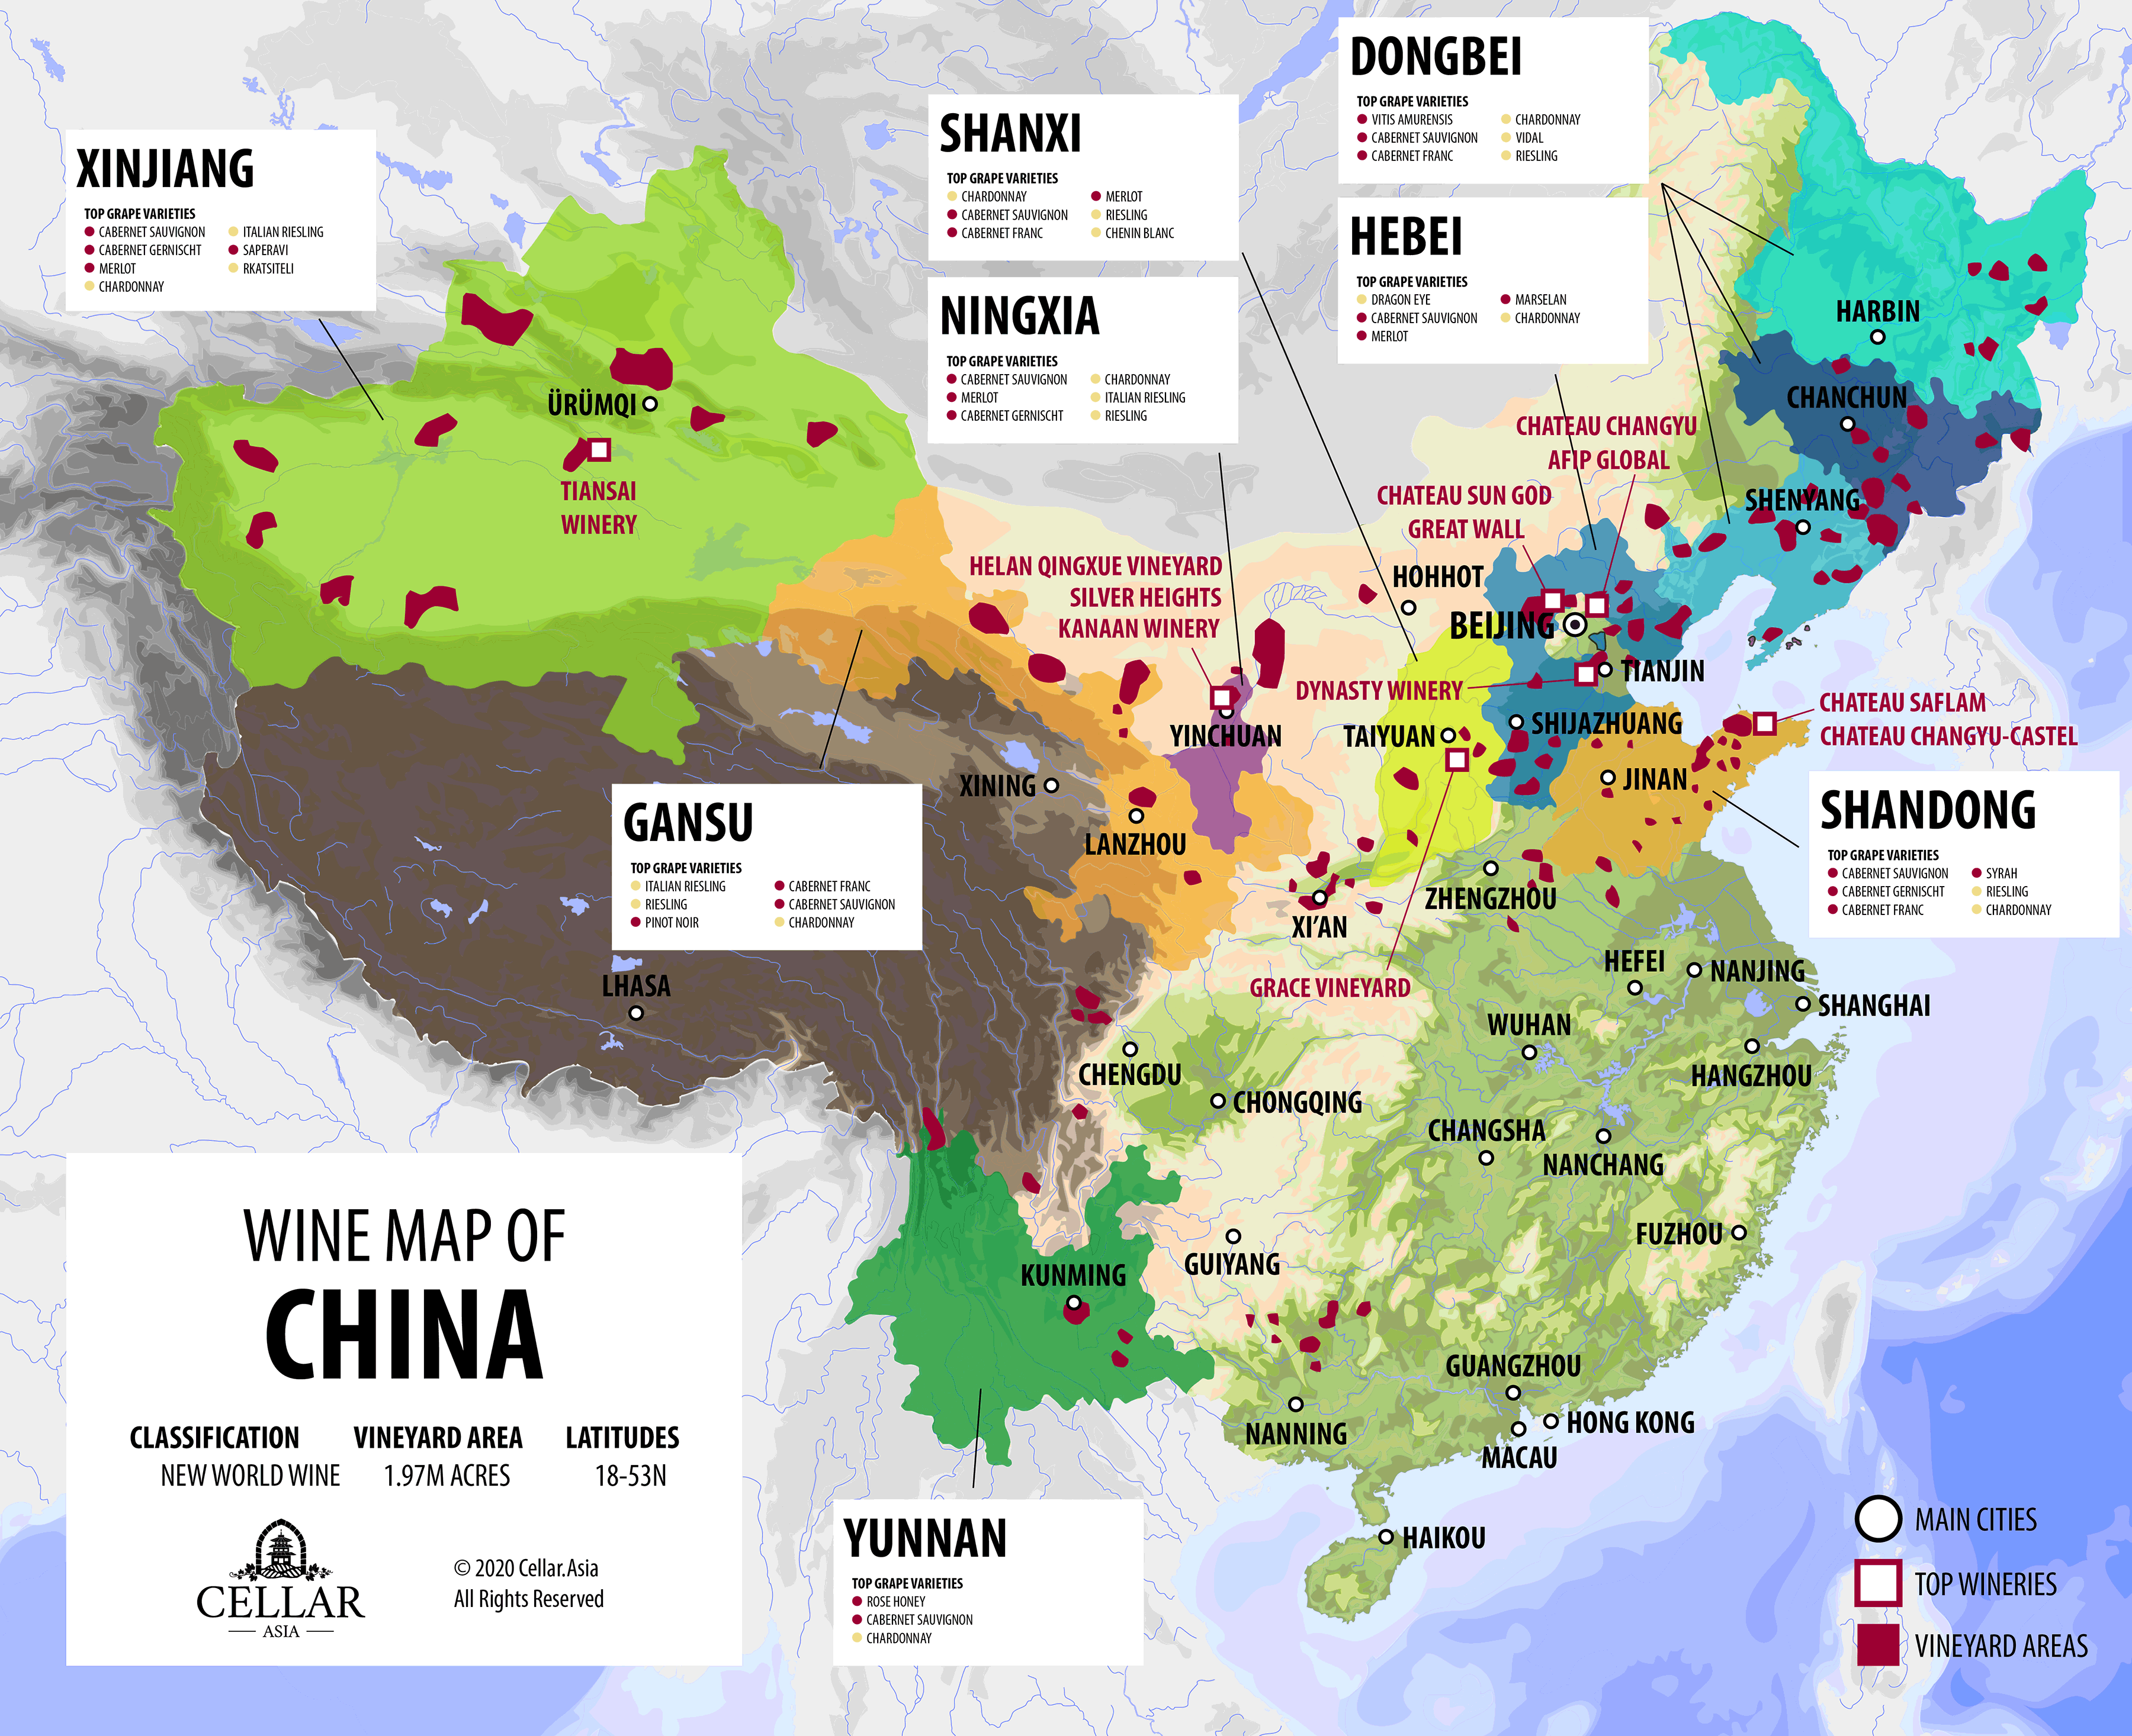
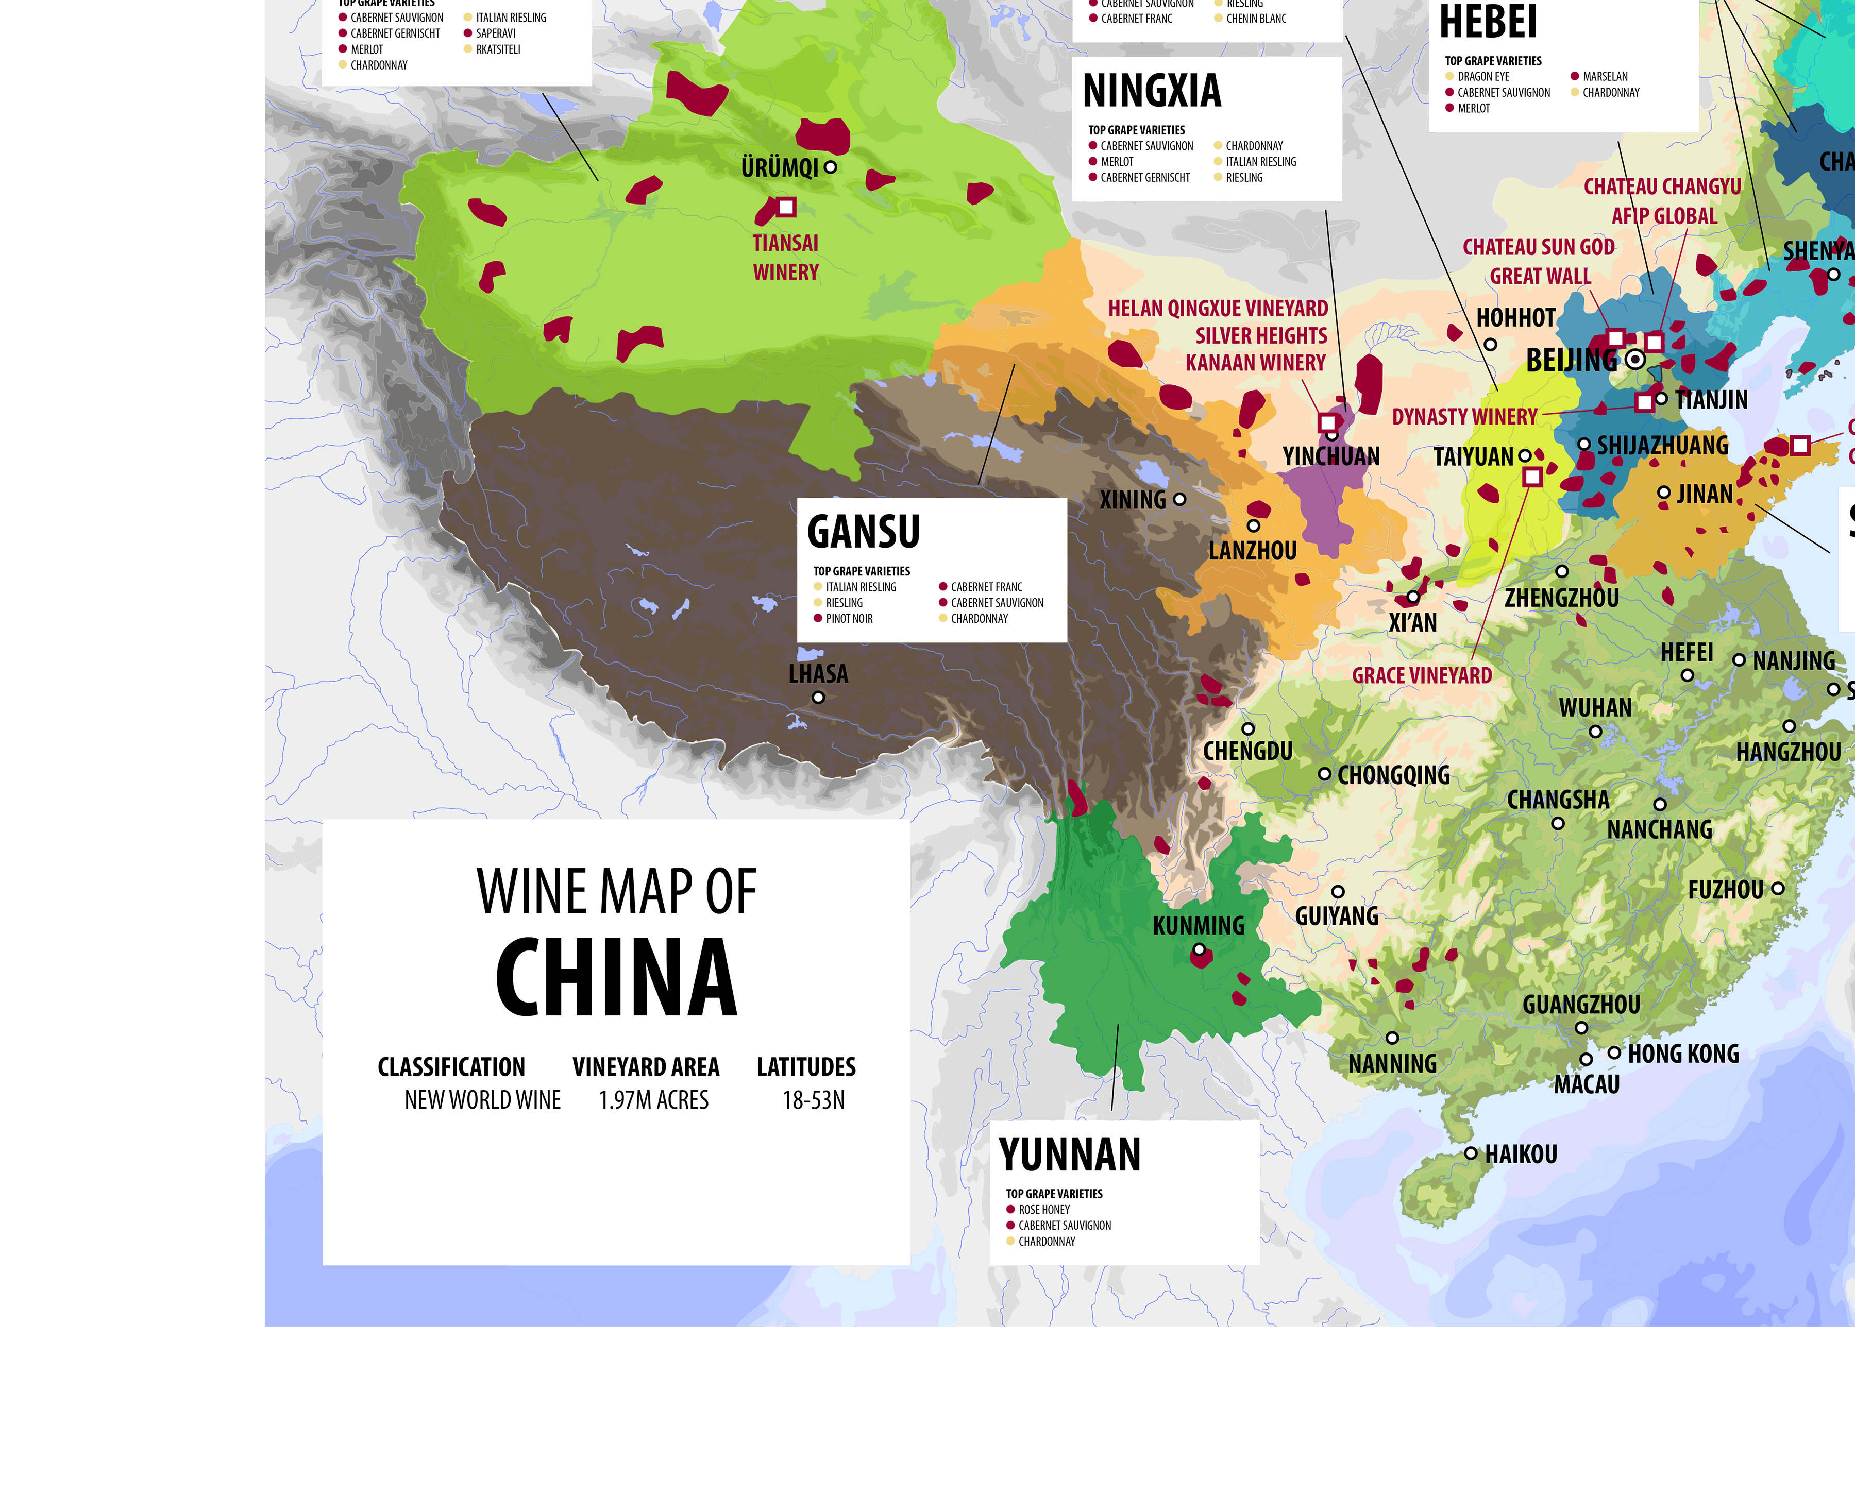

Slide 13
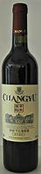
China’s Wine Regions
China's 12 wine regions accommodate more than 450 wineries of the nation.
Ningxia, in northwest China, has quickly risen as a premier wine region, known for its Bordeaux-style blends, including Cabernet Sauvignon, Merlot, and Cabernet Gernischt.
With 30,000 hectares of vineyards, Ningxia gained international acclaim in 2011 after winning four of the top five spots in a “Bordeaux vs. Ningxia” competition. Its wines have since earned prestigious awards, such as Best Bordeaux Blend at the Decanter World Wine Awards.
Ningxia’s success is supported by significant government investment in training and infrastructure, encouraging domestic producers like Changyu to invest heavily, including €70 million in a Bordeaux-style chateau.
The region's dry, high-altitude vineyards, long daylight hours, and irrigation from the Yellow River create ideal growing conditions, though vines must be buried each winter to protect against freezing temperatures.

Slide 14
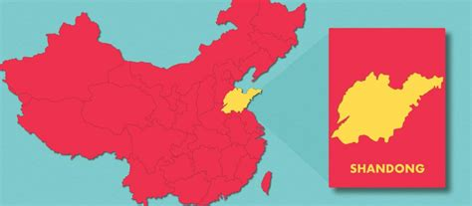
China’s Wine Regions
Shandong Province
Shandong Province produces nearly 40% of the country's domestic wine.
The primary vineyards are located in the Yantai and Qingdao regions on either side of the Shandong Peninsula.
Yantai is especially renowned for its wine quality, home to the Changyu Pioneer Wine Company, China’s oldest winery established in 1892.
Changyu is a top national producer and has invested in international wine destinations, emphasizing the quality of Chinese wines, especially Cabernet Gernischt.
Shandong’s warm, temperate monsoon climate allows vines to remain unprotected during winter, unlike other Chinese regions.
Summer’s rainy weather and reduced sunlight increase the risk of fungal diseases, requiring careful vineyard management. Yantai, with its coastal location and numerous wineries, is often compared to California's Napa Valley and remains China’s most significant wine-producing region.

Slide 15
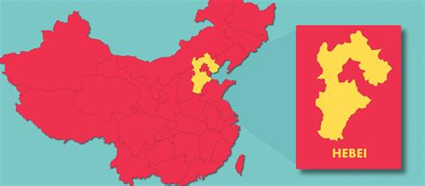
China’s Wine Regions
Hebei
Hebei, located on China’s east coast and surrounding Beijing, is a key wine-producing province. It features two notable sub-regions: Shacheng and Changli. Shacheng, known for its hilly terrain, is home to the Great Wall Wine Company, one of China's top wine producers.
Its proximity to Beijing allows easy promotion to the capital’s residents. The region’s dry climate and summer sunlight make it ideal for grape growing. Changli, near the Bohai Sea, is more humid and often compared to Bordeaux, but requires careful management to prevent grape disease and winter vine protection.
Hebei primarily produces Cabernet Sauvignon, Merlot, Chardonnay, and Marselan, a grape gaining recognition as China’s signature variety.
Hebei ranks second in wine production after Shandong, with the two regions accounting for over 50% of China’s domestic wine production. While Shandong leads in volume, Hebei benefits from its prestigious location near Beijing.

Slide 16
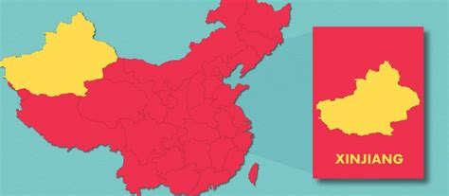
China’s Wine Regions
Xinjiang
Xinjiang, in northwest China, is one of the country's largest wine producers by volume, despite its remote location and high transportation costs.
The region’s best wineries are on the slopes of the Tianshan Mountains, with key sub-regions like the Manas Basin, Yanqi Basin, Turpan Basin, and Ili.
Xinjiang’s climate is harsh, with minimal rainfall and large day-night temperature variations, leading to high-sugar, low-acid grapes suited for sweet wines.
Historically known for raisins, Xinjiang now focuses on large-scale wine production, though logistical challenges mean much of its wine is sent to other provinces for blending rather than bottled locally.

Slide 17
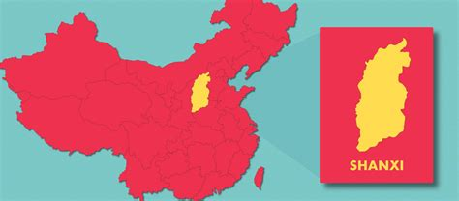
China’s Wine Regions
Shanxi
Shanxi, located near Beijing, is gaining recognition for its high-quality wines, thanks to partnerships with renowned winemakers like Jean Claude Berrouet and wineries such as Rongzi and Grace Vineyard.
The region's plateau and surrounding mountains create a continental climate with low humidity, abundant sunlight, and significant temperature fluctuations between day and night, ideal for grape growing.
Shanxi is noted for wines like Chenin Blanc, Merlot, Cabernet Franc, and Cabernet Sauvignon. While production is relatively small, Shanxi is considered a rising star in the Chinese wine industry.

Slide 18
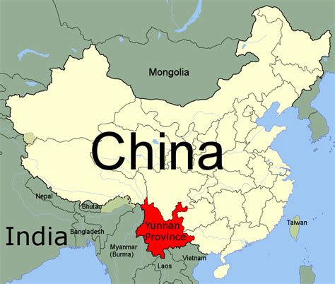
China’s Wine Regions
Yunnan
Yunnan, in southwest China, is known for its small but unique wine production.
The region’s mountainous terrain makes viticulture challenging, but wineries like Yunnan Red Wine Company and Shangri-La Winery, backed by Moet-Hennessy, have gained attention.
Yunnan’s high elevation, particularly near the Tibet border, creates cooler temperatures and longer growing seasons, despite its southern latitude.
This climate, combined with direct sunlight at higher altitudes, allows for the production of distinct wines, often using hybrid grape varieties.

Slide 19

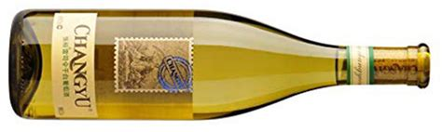
China’s Wine Regions
Liaoning
Liaoning, in northeast China, is renowned for producing ice wines from the Vidal grape.
Notable producers include Changyu Golden Valley and Wunushan Wines.
Changyu Golden Valley, a project of the Changyu Pioneer Wine Company, invested heavily in promoting the prestige of Chinese ice wines, positioning Liaoning as a key region for this specialty.

Slide 20
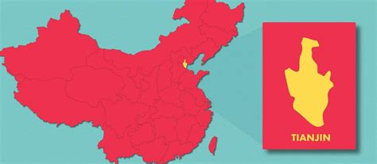
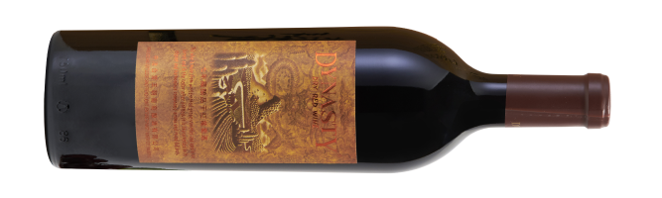
China’s Wine Regions
Tianjin
Tianjin has a long but lesser-known tradition of winemaking, with Muscat Hamburg as its primary grape variety.
The region gained significance in the late 1970s and early 1980s when it became home to China's first-ever Sino-foreign wine joint venture, the Sino-French Tianjin Dynasty Wine Company.
This venture helped establish Muscat Hamburg as a grape with historical and sentimental value to Chinese wine drinkers.

Slide 21
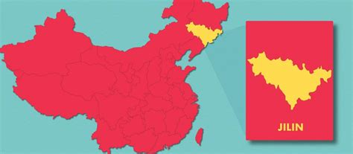
China’s Wine Regions
Jilin
Located in northeast China, bordering North Korea and Russia, Jilin is renowned for its wines made from the Amur (Vitis Amurensis) grape.
This unique, frost-resistant grape thrives in Jilin’s cold climate, producing wines with high color and acidity.
Winemaking in the region has a tradition spanning over 100 years, with the best wineries found near the Changbai Mountain area.
While Jilin is also famous for its ski resorts, its wine industry continues to make a significant mark on the Chinese wine scene.

Slide 22
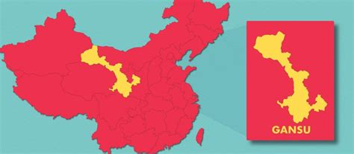
China’s Wine Regions
Gansu Gansu, despite its long winemaking history, is still improving grape growing techniques to enhance the quality and yield of its wines.
The region faces logistical challenges, making it difficult to trade wine with neighboring provinces.
Gansu’s cool climate supports late-ripening grapes, with the best wineries located in the Wuwei sub-region.
While Gansu has potential, its transport issues and ongoing development efforts limit its current reach in the Chinese wine market..

Slide 23
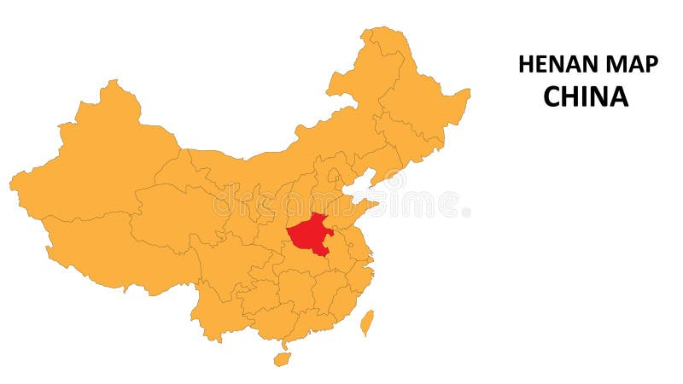
China’s Wine Regions
Henan Henan, a prominent agricultural province in the Yellow River Valley, faces challenges with grape growing due to its excessively hot and damp summers.
The best wineries are located where Henan meets Anhui, Shandong, and Jiangsu provinces.
Although the region is making a comeback, its continental climate makes it difficult to establish a consistent wine industry.
Despite these challenges, Henan is leveraging its advantageous location along the Yellow River to foster development.

Slide 24
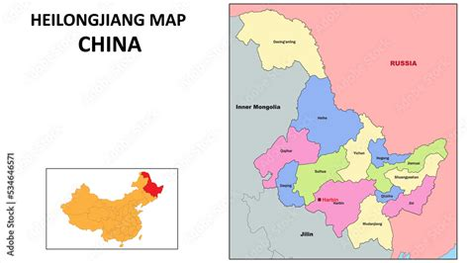
China’s Wine Regions
Heilongjiang
Heilongjiang, bordering Russia in north east China, is emerging as a leading region for ice wines.
The Chinese government has ambitious plans to develop it as a high-altitude ice wine production base.
Already the nation’s largest importer of Canadian ice wines, Heilongjiang’s wineries, including Chateau Fenhe, produce notable ice wines.
Chateau Fenhe has won awards for its high-quality ice wines, positioning the region as a strong contender for the title of China's best ice wine producer.

Slide 25

Major Wineries in China
• Shandong: Changyu Pioneer Wine Co. & Great Wall Wine Company.
• Ningxia: Silver Heights & Kanaan Winery.
• Xinjiang: Tiansai Vineyards.
• Hebei: Domaine de Long Dai.
• Yunnan: Ao Yun.
Chateau Changyu Winery

Slide 26
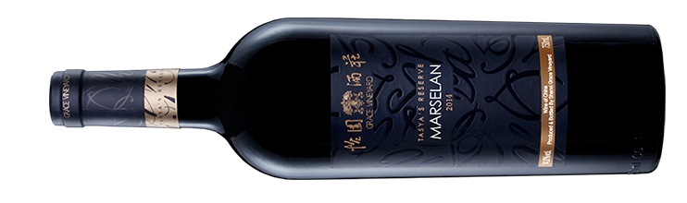
The Rise of Ningxia: China’s Bordeaux
• Ideal climate for grape growing: dry and sunny.
• Signature Varietals: Cabernet Sauvignon, Merlot, Marselan.
• Award-winning wines gaining global recognition.
• Government support through special zones and education programs.

Slide 27
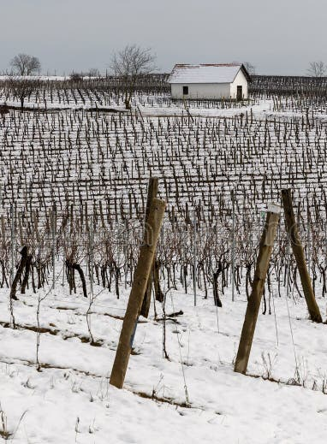
Challenges Facing Chinese Winemakers
Harsh Winters: Requires vine-burying in many regions.
Competition: Imported wines from France, Australia, Chile.
Consumer Education: Still growing in wine knowledge.

Slide 28

The Future of Chinese Wine
Global Recognition: Ningxia and other regions winning awards.
Sustainability: Focus on organic and biodynamic practices.
Expanding Varietals: Marselan and indigenous grapes are being explored.

Slide 29
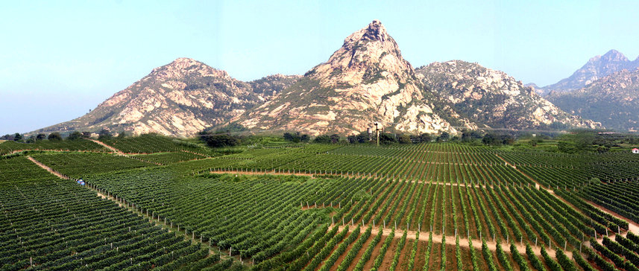
Key Stats and Impact on the Global Market
China’s rapid expansion into the wine market has made it a key player globally. With over 750,000 hectares under vine, China ranks among the top 10 wine-producing countries.
The sheer scale of China’s production and consumption is staggering, and the country continues to increase its exports.
This not only affects the domestic market but also changes the dynamics of global wine trade, as international wine producers are increasingly targeting Chinese consumers.

Slide 30
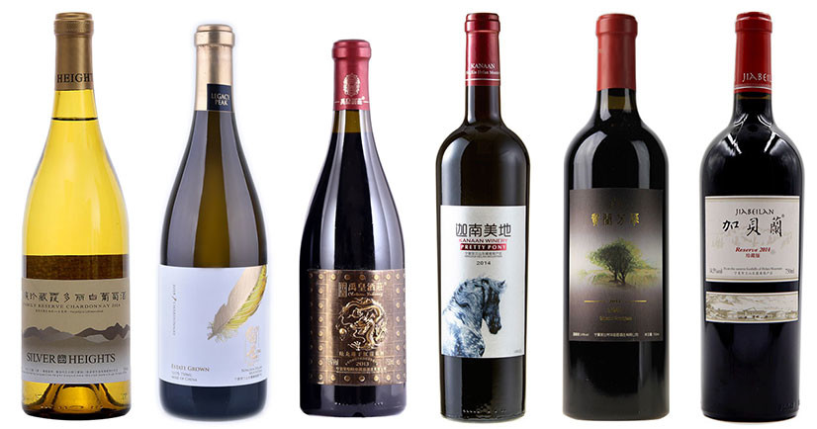

China’s Wine Renaissance
China’s wine industry is diverse and growing rapidly.
The country is becoming a key player in the global wine market.

Slide 31
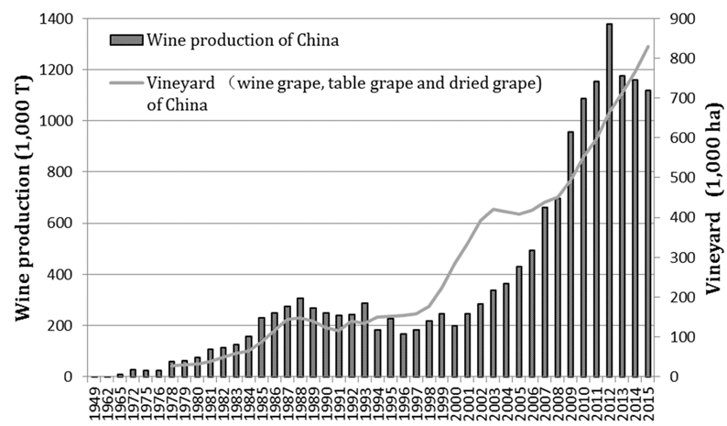
Conclusion:
The trajectory of China's wine industry is remarkable, evolving from ancient fermentation practices to becoming a powerhouse in the global wine market.
With government support, large-scale production, and increasing competition with established wine regions, China is poised to continue growing as both a wine producer and consumer.
The country’s wine culture, though young in comparison to Europe, is quickly gaining sophistication and influence worldwide.

Slide 32
References
McGovern, Patrick E. Uncorking the Past: The Quest for Wine, Beer, and Other Alcoholic Beverages.
Zhang, Jian, and Henderson, David A. 'China’s Emerging Wine Industry: A Global Force in the Making.' Journal of Wine Research, 2021.
Li, Yibin. 'Wine Terroir in China: A Study of Major Wine Regions.' Wine Enthusiast, 2022.
Ningxia: China's Bordeaux?' Decanter, 2023.
Great Wall Wine Company. 'History of Winemaking in China.' Accessed June 2023.

