Slide 1

Wines of Chile
Presented by
Marc Silver

Slide 2
What I will cover
About Chile
Historical Background
Chile’s Major Wine Regions
Micro Wine Regions
Maipo Valley
Rapel Valley Region
Casablanca Valley
Colchagua Valley
Aconcagua Valley
Impact of Climate Change
Conclusion
Acknowledgement

Slide 3
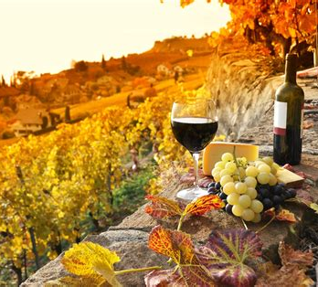
About Chile
Chile, a long, narrow country stretching down the western edge of South America, is renowned for its diverse and vibrant wine industry.
I plan to talk about the nature of Chile's wine industry and its significance in the global wine landscape.
I will touch on the country's unique geography, climate, and soil conditions that contribute to the production of exceptional wines that are gaining global recognition.
We’ll delves into the key aspects of Chilean wine, including its history, major wine regions, varietals, and the impact of climate change.

Slide 4
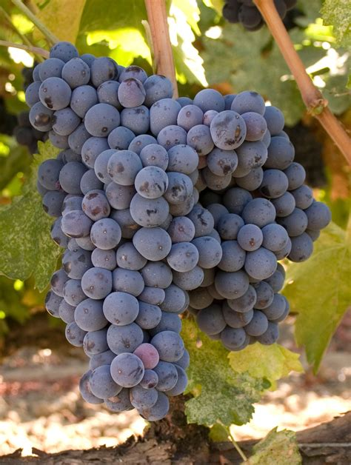
Chile’s Historical Background
The story of Chilean wine begins in the 16th century with the arrival of Spanish colonists.
In 1554, Spanish settlers planted the first grapevines in the region of Santiago, marking the inception of viticulture in Chile.
Early on, the Carignan grape, introduced by French missionaries, became prominent, laying the groundwork for what would become a thriving wine industry (Holliday, 2003).
However, it wasn’t until the late 20th century that Chilean wine gained international acclaim.
The 1990s marked a turning point when Chilean producers began to adopt modern winemaking techniques and invest in new technology. This period saw an influx of international expertise and investment, which played a significant role in elevating the quality of Chilean wines (Parker, 2004).

Slide 5
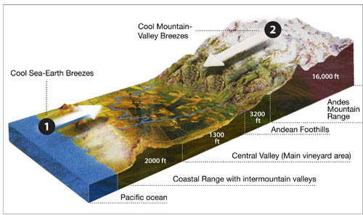
The Effect of Climate
The Andes Mountains play a crucial role in shaping the climate of Chile's wine regions. These towering peaks act as a natural barrier, influencing temperature, precipitation, and overall weather patterns.
Temperature Regulation: The Andes help moderate temperatures by blocking cool, moist air masses from the Pacific Ocean.
This creates a more stable climate with
warm, sunny days and cooler nights,
which is ideal for growing grapes.
The diurnal temperature variation (the
difference between day and night
temperatures) is particularly beneficial
for grapevines, as it helps in the
development of complex flavors and
aromas.

Slide 6
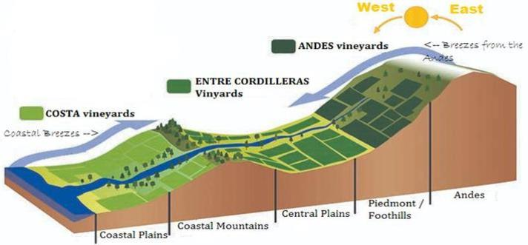
Climate Cont.
Rainfall Patterns: The Andes creates a rain shadow effect; as moist air from the Pacific rises over the mountains, it cools and loses its moisture, leading to significantly drier conditions on the eastern side.
This results in the wine regions on the western slopes and valleys of the Andes, such as the Maipo and Colchagua Valleys, receiving much less rain, which is advantageous for grape cultivation as it reduces the risk of fungal diseases.
Sunshine: The high elevation of the Andes means that the vineyards often enjoy ample sunlight. This increased exposure to sunlight contributes to the accumulation of sugars in the grapes, which is essential for producing high-quality wines.
Overall, the Andes create a favorable
microclimate for Chilean wine regions,
contributing to the distinctiveness and
quality of the wines produced there.

Slide 7
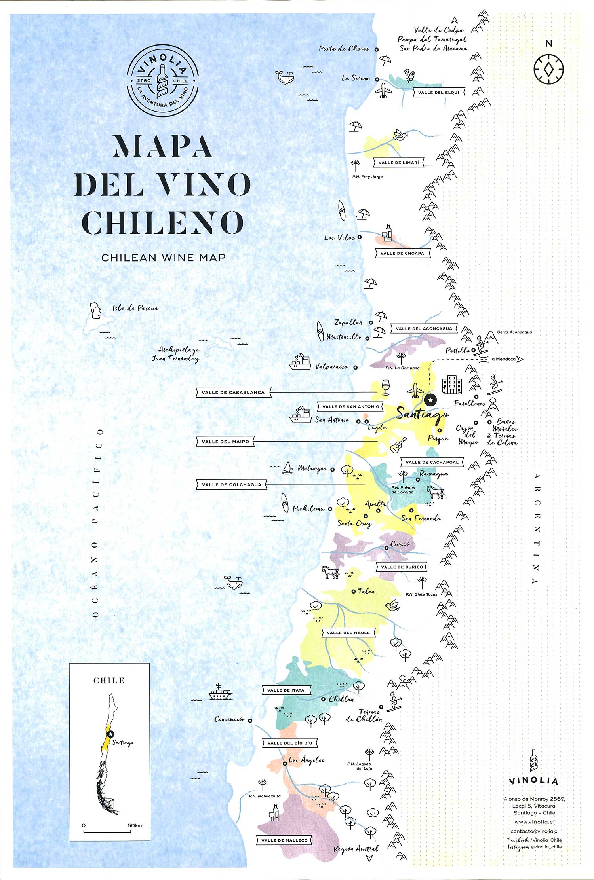
Chile’s Major Wine Regions
Chile’s wine industry is celebrated for its remarkable diversity, with each of its major wine regions offering distinct terroirs that influence the character of its wines.
The country’s varied climates, soils, and topography create ideal conditions for a range of grape varietals.
I will discuss three of Chile’s most prominent wine regions, Maipo Valley, Casablanca Valley, and Colchagua Valley, including their micro-climate regions. I will also highlight the key varietals that define each area.

Slide 8
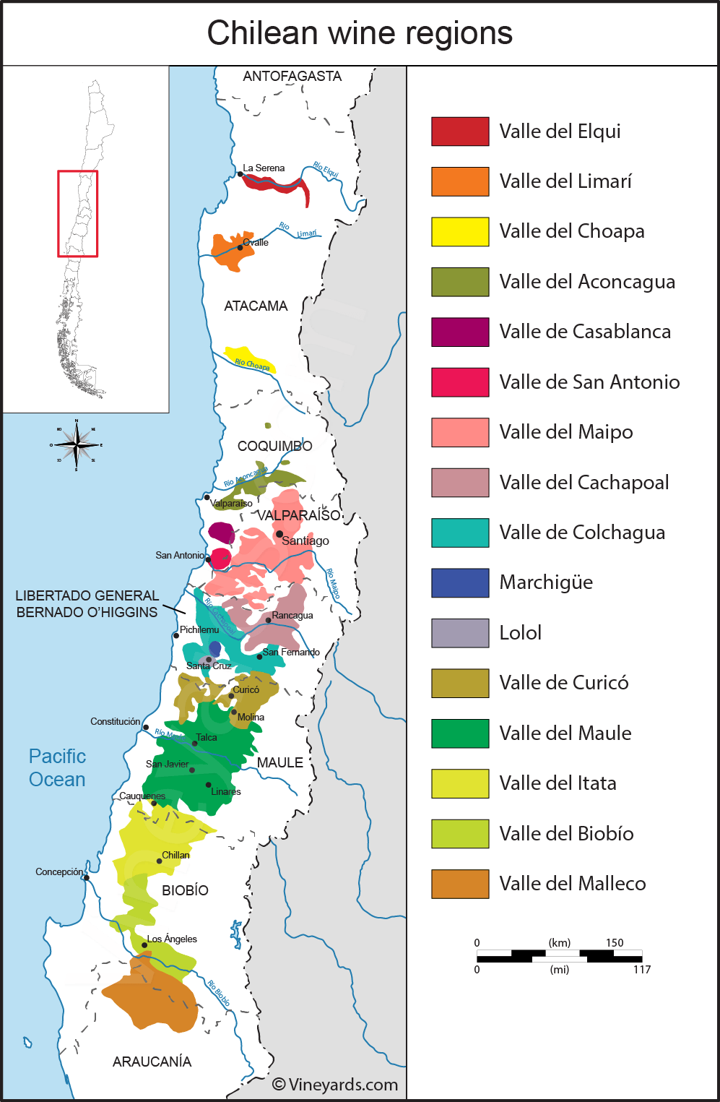
Micro Wine Regions
Key Wine Regions
Chile’s diverse geography features a range of climates and soils, making it an ideal location for various grape varietals. The country’s wine regions are typically divided into five major areas:
Central Valley
The Central Valley is the heart of Chile's wine production. It encompasses several sub-regions, each known for distinct characteristics:

Slide 9
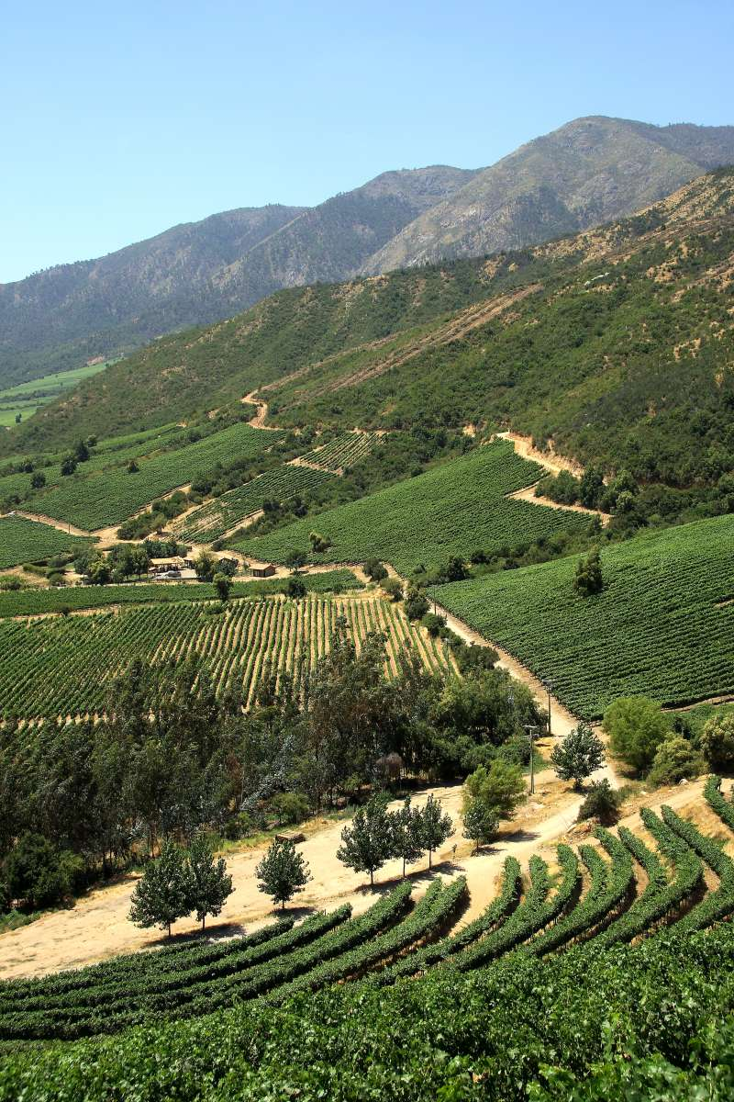
Maipo Valley: The Heart of Chilean Wine
Geography and Climate
Located just south of Santiago, the Maipo Valley is one of Chile’s oldest and most significant wine regions. It benefits from a Mediterranean climate with warm, dry summers and cool, wet winters.
The valley is flanked by the Andes to the east, which helps to regulate temperatures and provides a source of fresh water from melting snow, contributing to the region’s viticultural success.
The Maipo Valley is famous for its Bold red wines, known for their rich flavor and aging potential. The valley’s warm climate and varied soil types contribute to the complexity of its wines (Morrison, 2016).

Slide 10
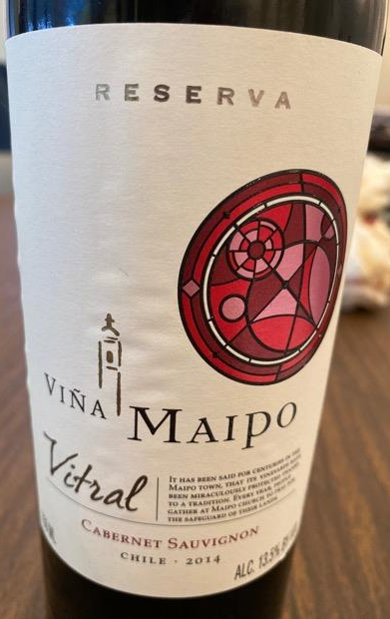
Prominent Varietals
Cabernet Sauvignon: The Maipo Valley is renowned for its Cabernet Sauvignon, which is often considered the region’s flagship varietal. The warm climate allows the grapes to achieve full ripeness, resulting in wines with deep color, rich flavors of black currant, plum, and a characteristic bell pepper note. Maipo Cabernets are typically well-structured with firm tannins and are often aged in oak barrels to enhance their complexity (Gordon, 2018).
Merlot: Merlot from Maipo Valley is another standout, known for its smooth texture and plush fruitiness. The cooler temperatures in the valley’s higher elevations help maintain the grape’s acidity and balance, leading to wines with flavors of ripe cherries, plums, and hints of chocolate (Sánchez, 2019).
Syrah: In recent years, Syrah has gained popularity in Maipo Valley. The varietal thrives in the valley’s diverse soils, producing wines with bold flavors of blackberry, pepper, and a distinctive smokiness. The cool night temperatures contribute to the grape’s aromatic complexity (Williams, 2021).

Slide 11
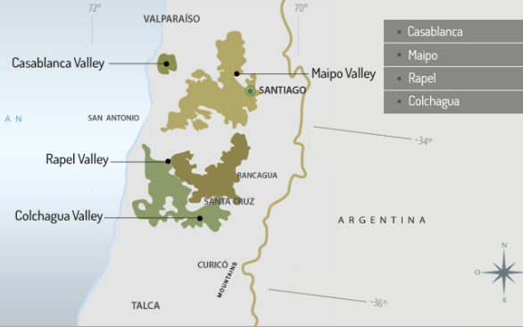
Rapel Valley Region
The Rapel Valley Including the Colchagua and Cachapoal valleys, Rapel is renowned for its robust red wines, particularly Merlot and Carmenère. Colchagua has earned a reputation for its full-bodied reds and award-winning wines (Gordon, 2018).
Curicó Valley: Known for its diverse range of varietals, Curicó produces high-quality wines, including Sauvignon Blanc and Chardonnay.
The valley’s cooler temperatures and proximity to the Andes contribute to the freshness and balance of its wines (Sánchez, 2019).

Slide 12
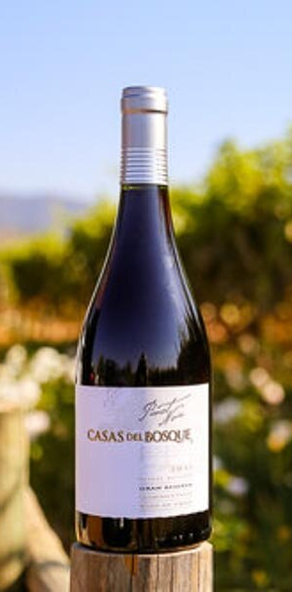
Rapel Valley Region
Located near the coast, the Casablanca Valley benefits from a cooler climate and oceanic breezes, making it ideal for white varietals such as Sauvignon Blanc and Chardonnay.
The region is known for its crisp, aromatic white wines and has become a benchmark for cool-climate viticulture in Chile (Smith, 2017).
Casablanca Valley: Geography and Climate
The Casablanca Valley is situated closer to the coast, benefiting from a cool maritime climate influenced by the Pacific Ocean.
This proximity results in cooler temperatures and morning fog, which help to preserve the acidity and freshness of the grapes. The region’s relatively recent development in the 1980s has quickly established it as a leading area for cool-climate varietals.

Slide 13
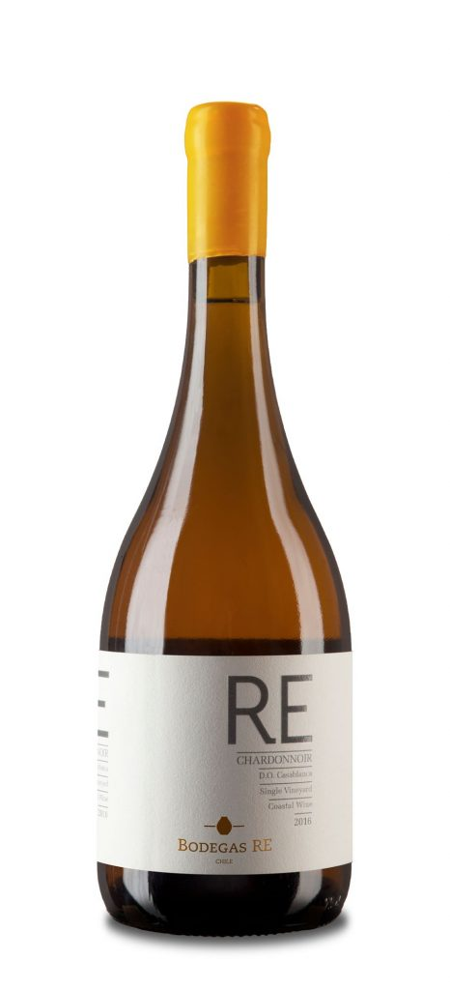
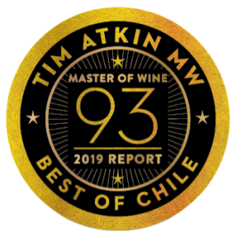
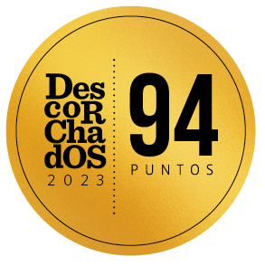
Casablanca Valley Prominent Varietals
Sauvignon Blanc: Casablanca Valley is especially renowned for its Sauvignon Blanc, which thrives in the cool climate. The resulting wines are known for their vibrant acidity and intense flavors of citrus, green apple, and fresh herbs. The region’s maritime influence imparts a distinctive minerality and crispness to the wine (Smith, 2017).
Chardonnay: The region’s Chardonnay is also noteworthy, ranging from lean and mineral-driven styles to richer, more textured expressions. The cooler temperatures help maintain the grape’s natural acidity, while varying winemaking techniques—such as oak aging and lees contact—add complexity and depth. Flavors typically include green apple, pear, and subtle notes of toasted nuts (Parker, 2004).
Pinot Noir: Pinot Noir from Casablanca Valley is gaining acclaim for its elegance and finesse. The cooler conditions slow down ripening, allowing the grape to develop its delicate red fruit flavors and nuanced aromas. Wines from this varietal often feature red cherries, raspberries, and earthy undertones (Ramos, 2015).

Slide 14
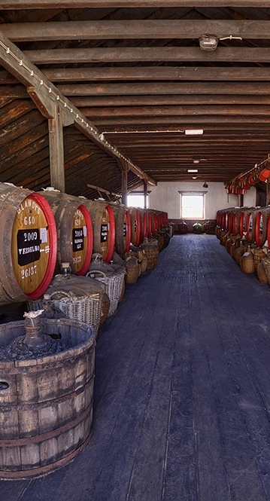

Colchagua Valley: A Robust Red Wine Region
Geography and Climate
Located in the heart of the Central Valley, the Colchagua Valley is known for its warm climate and long growing season.
The region benefits from the cooling influence of the Andes Mountains and the coastal breezes, creating an ideal environment for producing robust and full-bodied red wines.

Slide 15
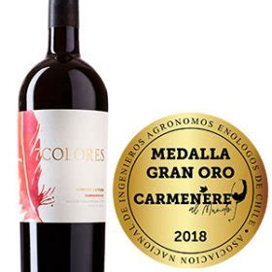
Colchagua Valley Prominent Varietals
Carmenère: Often regarded as Chile’s flagship varietal, Carmenère finds a home in Colchagua Valley.
This grape, which was originally mistaken for Merlot, produces deep red wines with rich flavors of dark berries, green pepper, and a hint of spice.
The warm climate allows Carmenère to fully ripen, resulting in wines with smooth tannins and a velvety texture (Gordon, 2018).

Slide 16

Colchagua Valley Prominent Varietals
Syrah: Colchagua Valley’s Syrah is known for its intense flavors and full body.
This varietal benefits from the region’s warm temperatures and diverse soils, producing wines with flavors of black fruit, pepper, and a touch of smokiness.
The balance of fruit and spice makes Colchagua Syrah a favorite among wine enthusiasts (Sánchez, 2019).
Merlot: Merlot from Colchagua Valley is typically rich and plush, with flavors of ripe plum, chocolate, and vanilla.
The valley’s climate helps the grape achieve a full, rounded character, with soft tannins and a smooth finish (Williams, 2021).

Slide 17
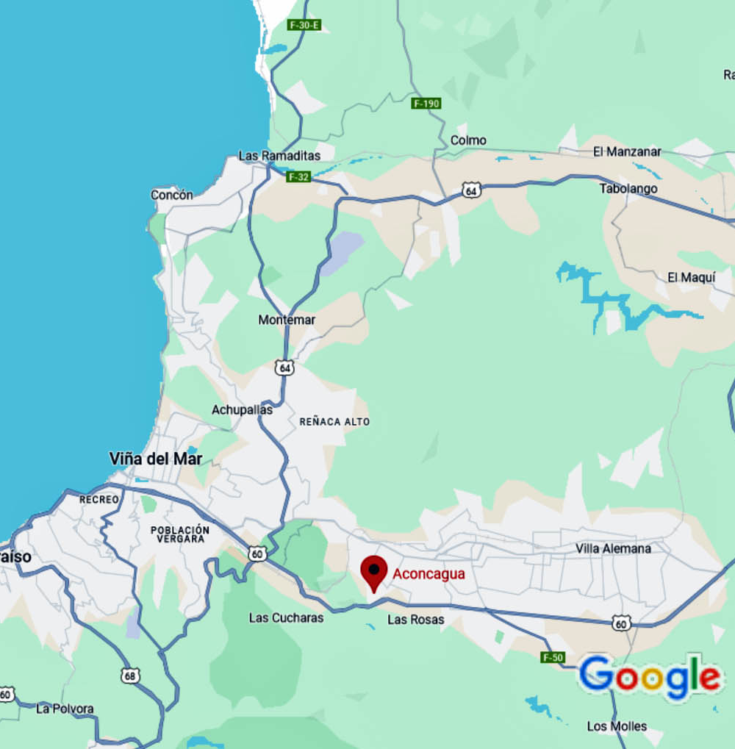
Aconcagua Valley
This region is divided into two main sub-regions: the Aconcagua and the Valle de Casablanca. The Aconcagua Valley is renowned for its high-quality reds, including Syrah and Cabernet Sauvignon. The warm temperatures and well-drained soils contribute to the intensity and depth of its wines.
Elqui Valley
The Elqui Valley, located further north, is known for its unique high-altitude vineyards. The cooler temperatures and intense sunlight help produce distinctive white wines and aromatic reds. The valley is also famous for its Pisco, a South American brandy (Ramos, 2015).
Itata Valley
One of Chile’s oldest wine regions, Itata is gaining recognition for its traditional varietals, including País and Carignan. The region’s old vines and historical winemaking techniques offer a glimpse into Chile’s vinous heritage (Jensen, 2022).

Slide 18
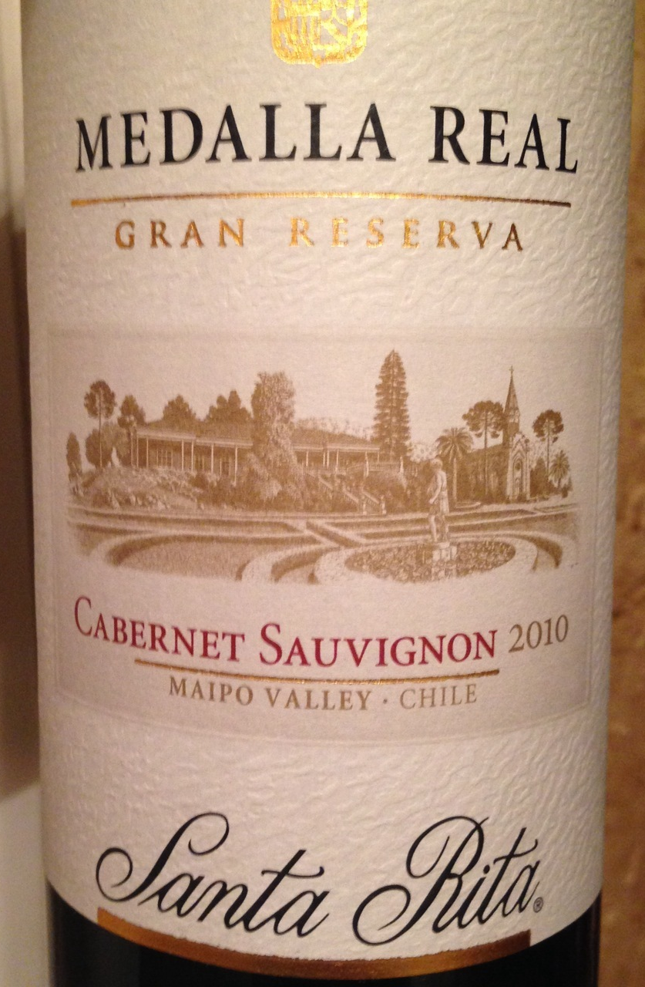
Aconcagua Valley Prominent Varietals
Chile is known for its diverse range of grape varietals. Some of the most notable include:
Cabernet Sauvignon
Chile’s most iconic red varietal, Cabernet Sauvignon, thrives in the warm climates of the Maipo Valley. Chilean Cabernets are characterized by their deep color, rich fruit flavors, and balanced tannins. They are often aged in oak barrels, adding complexity and depth (Parker, 2004).
Carmenère
Often considered Chile’s signature grape, Carmenère was long thought to be Merlot until it was correctly identified in the 1990s. This varietal produces deep red wines with flavors of dark fruit, green pepper, and spicy notes. The warm, dry conditions of the Central Valley are ideal for Carmenère (Gordon, 2018).

Slide 19
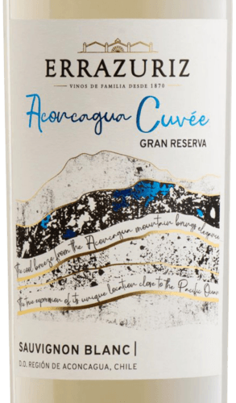
Aconcagua Valley Prominent Varietals
Sauvignon Blanc
Sauvignon Blanc from the Aconcagua Valley is celebrated for its vibrant acidity and crisp, citrusy flavors.
The cooler coastal climate helps preserve the grape’s freshness and aromatic qualities (Smith, 2017).
Chardonnay
Chardonnay from the Casablanca and Curicó valleys displays a range of styles from crisp and unoaked to rich and buttery.
The versatility of this varietal reflects the diverse terroirs within Chile (Sánchez, 2019).

Slide 20
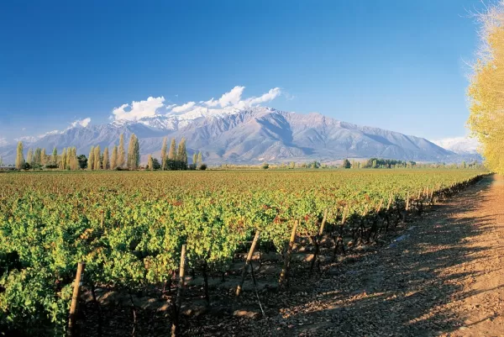
The Impact of Climate Change
Chile’s wine industry faces challenges related to climate change. Rising temperatures and shifting precipitation patterns can affect grape ripening and vineyard management.
In response, Chilean winemakers are adapting by exploring cooler regions, adjusting vineyard practices, and investing in sustainable technologies. (Williams, 2021)
Innovative approaches, such as precision agriculture and the use of drought-resistant rootstocks, are being implemented to mitigate the effects of climate change.
Additionally, there is an increasing focus on organic and biodynamic farming practices to promote environmental sustainability.
(Ramos, 2015)

Slide 21
Conclusion
The wines of Chile offer a remarkable range of flavors and styles, shaped by the country’s unique geography and climate.
From the historic roots of early viticulture to the modern innovations of today, Chilean wines continue to capture the attention of wine enthusiasts worldwide.
As the industry navigates the challenges of climate change, Chile’s commitment to quality and sustainability ensures that its wines will remain at the forefront of the global wine scene.
Chile’s major wine regions—Maipo Valley, Casablanca Valley, and Colchagua Valley—each offer distinct terroirs that shape the character of their wines.
From the classic Cabernet Sauvignon of Maipo to the crisp Sauvignon Blanc of Casablanca and the robust Carmenère of Colchagua, these regions showcase the remarkable diversity and quality of Chilean wine.
Understanding the unique characteristics of each region and its prominent varietals provides a deeper appreciation of the complexity and excellence of Chilean wines.

Slide 22
Acknowledgement
My seminars are the result of many years of travel experience
combined with many hours of research over the internet.
I would like to acknowledge the many sources I have accessed.
These include: Wikipedia.com, Britannica.com, and the
various Museum, Park and Government websites.

Slide 23
References
Gordon, M. (2018). The Wines of Chile. University of California Press.
Holliday, J. (2003). The History of Chilean Wine. Chilean Wine Society.
Jensen, P. (2022). Rediscovering Itata: Old Vines and New Trends. Wine Enthusiast.
Morrison, R. (2016). Maipo Valley: The Heart of Chilean Wine. Wine Spectator.
Parker, R. (2004). The Wine Advocate: Chilean Wines. Wine Advocate Publishing.
Ramos, C. (2015). Pisco and Wine: The Elqui Valley’s Treasures. South American Wine Journal.
Sánchez, J. (2019). The Diversity of Curicó Valley Wines. Global Wine Review.
Smith, L. (2017). Casablanca Valley: A Cool Climate Success Story. Decanter Magazine.
Williams, K. (2021). Climate Change and the Future of Chilean Wine. Wine & Climate Journal.
Parker, R. (2004). The Wine Advocate: Chilean Wines. Wine Advocate Publishing.

