Slide 1
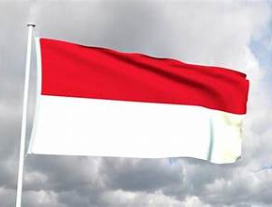
Celukan Bawang (Bali)
Presented by
Marc Silver

Slide 2
What I Will Cover
My Port Philosophy
Don’t Miss the Ship
Balanese Money
About Celukan Bawang
Maps
Getting Around Celukan Bawang
Places to see or at least consider
A few restaurant recommendations
Conclusion

Slide 3
My Port Philosophy
I have been cruising for over 46 years and have taken over 100 cruises.
So, I consider myself an experienced cruiser.
The information I will present is based on those many years of
experience.
When I am on a cruise where the city, I want to visit is not the port city,
I always recommend taking a ship’s tour.
But when I am in a port with multiple attractions nearby and easy to see
on my own -
I will do it on my own.
This presentation is not like that.

Slide 4

Don’t Miss the Ship
How to Avoid Missing Your Ship
Pay attention to the time. - Ship time and local time are often
different.
Put a return-to-ship reminder on your phone.
Choose excursions wisely.
If a ship-sponsored excursion is late returning to port, the ship will
wait for you. If you are on your own???
Be Prepared
Have your Passport, Credit Card, and phone numbers for your ship
port agent.
What to Do If You Miss the Ship
Most cruise lines have port agents stationed in the port area to assist if your ship has left without you. If your are lucky, when cruisers are late returning to the vessel, the ship’s crew will often remove the passengers’ essential items, but it is not guaranteed. – passports, cell phones, and medication -- from the ship to leave with the port agents.
The Port Officials can help you with contacting your ship
and making necessary travel arrangements.

Slide 5
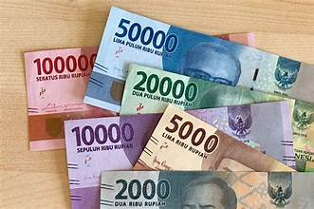
Money
As of January 2026, the exchange rate for USD to IDR is approximately
$1 US dollar = 16,000 to 17,000 IDR.
Don’t be misled, The big numbers don't mean their money is worthless - bali just never 'reset' their
currency.
Think of it like this: their smallest practical bill is
like our $1, it just says 1,000
instead of 1.
bali's inflation is actually
lower than the US right now at
around 3%.
Coins technically exist, but in
practice most transactions use
paper bills.

Slide 6
About Celukan Bawang
A Quiet Harbor and the Inner Life of an Island
Celukan Bawang is not the Bali most people imagine.
There are no grand boulevards here. No iconic skylines. No sense of arrival into spectacle. When ships dock on the northern coast of Bali, they arrive quietly, almost discreetly, at a working harbor that has only recently entered the cruise world.
Celukan Bawang was added to select itineraries in 2017, not because Bali needed another gateway, but because some voyages began looking for something different. Less polish. Less performance.
More texture.
This is Bali without the frame.

Slide 7
A Port Built for Purpose
Celukan Bawang sits on Bali’s north coast, facing the Java Sea. Historically, this side of the island was about trade and practicality. Cargo moved in and out. Fuel was stored. Goods passed through. The harbor served local needs, not visitors.
That history matters.
Unlike southern Bali, which developed around tourism, the north remained quieter, more agricultural, more inward-looking. Fishing villages, plantations, and small towns shaped daily life here, largely untouched by the international gaze.
The port itself reflects that reality. It functions first. It adapts second. It does not perform.

Slide 8
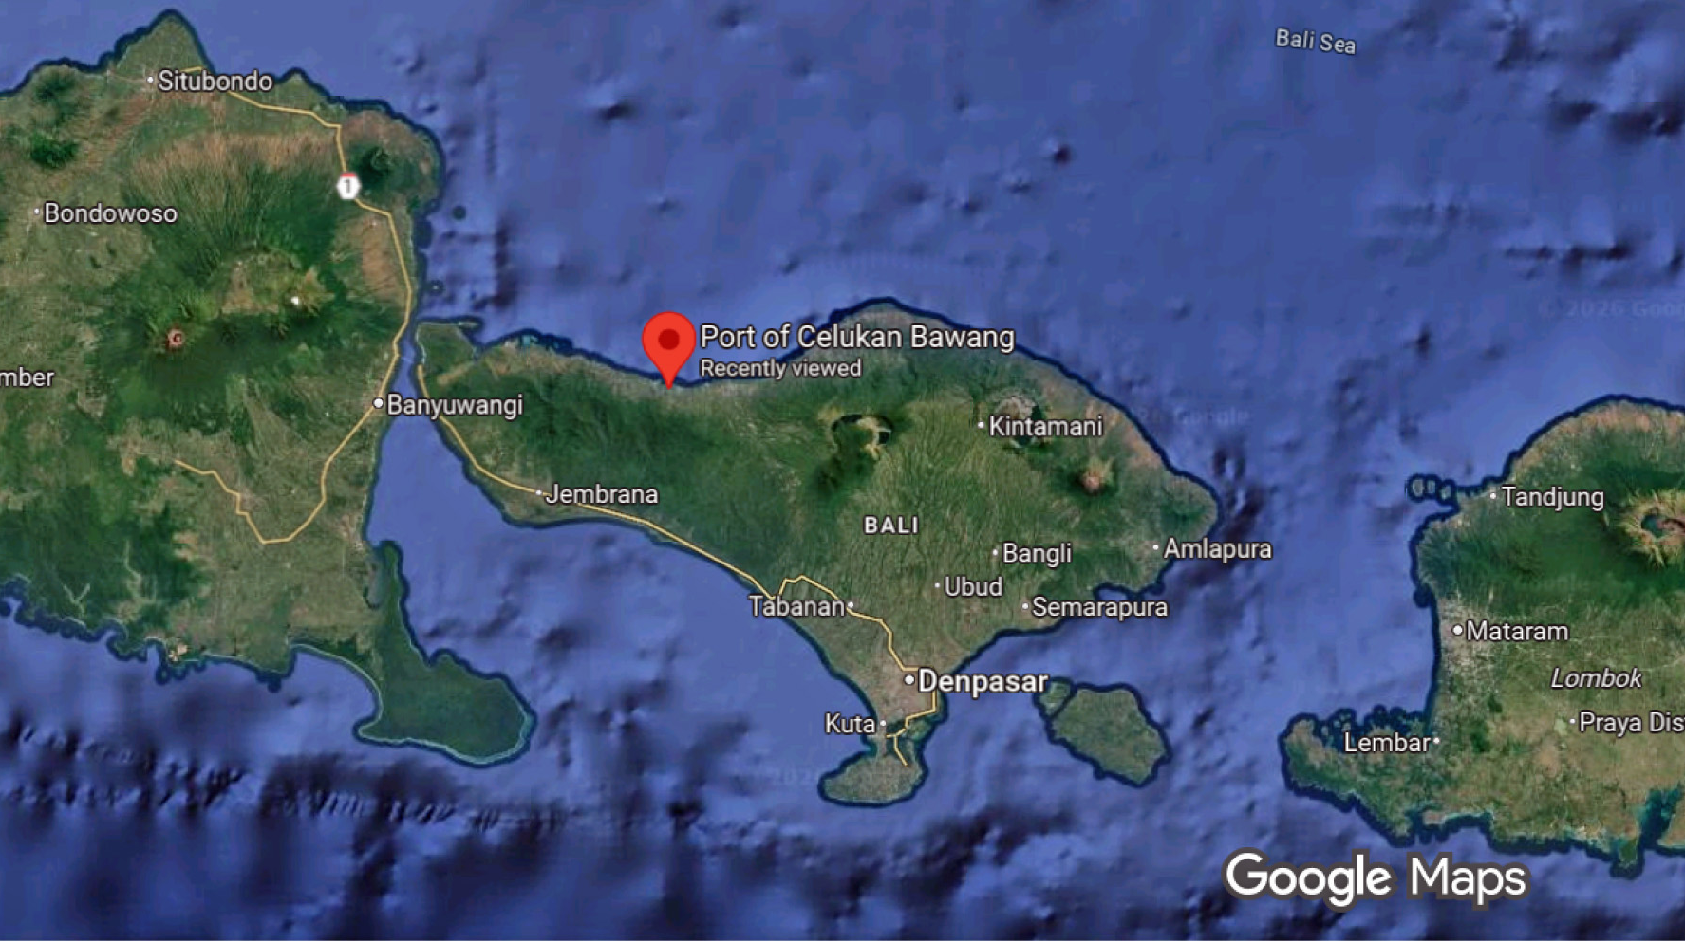

Slide 9
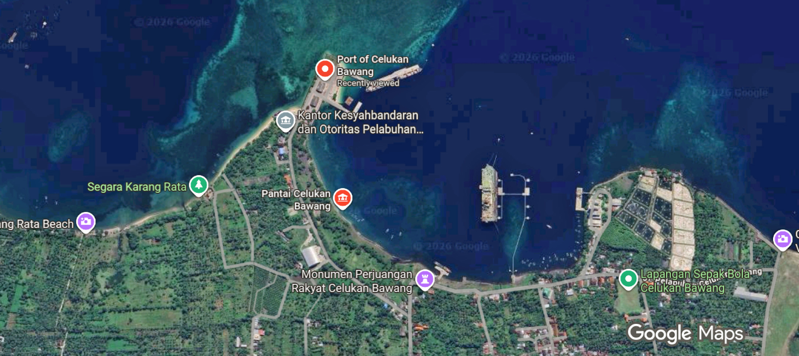
Cruise Port
Celukan Bawang

Slide 10
Bali Beyond the Image
Bali is often reduced to a single image. Temples at sunset. Offerings placed carefully on stone paths. Dancers frozen in perfect poses.
All of that is real. But it is incomplete.
Bali’s culture is not staged for visitors. It is lived, daily, through ritual, obligation, and rhythm. Religion here is not a weekly activity. It is woven into time itself. Calendars are ceremonial. Days are named for gods. Life events are marked by offerings and prayer.
This continuity is easier to sense away from the island’s busier centers.
Northern Bali reveals a slower tempo. Ceremonies are still elaborate, but they are not abbreviated. Community obligations remain central. The island breathes at its own pace.

Slide 11
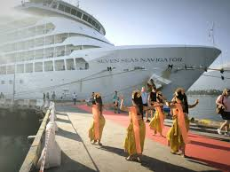
Not the Bali You Expect
Celukan Bawang exists on cruise itineraries because some journeys are designed to slow down.
This is not a highlight port. It is a context port.
It offers a different way to understand Bali, not as a destination, but as a living system. A place where ritual continues without explanation. Where temples serve communities, not cameras. Where daily life has not been reorganized around outside expectations.
For longer voyages, this matters. It provides contrast. It deepens understanding. It reminds travelers that islands, like cultures, cannot be reduced to a single version.

Slide 12
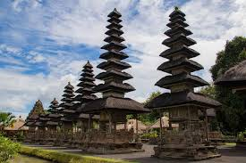
Getting Around
From Celukan Bawang, taxis and organized tours are the best way to explore, as attractions are spread across the island.
Traffic can be heavy, so allow time for travel.
Shore excursions typically cover either cultural Bali (Ubud and temples) or beach resorts in the south.

Slide 13
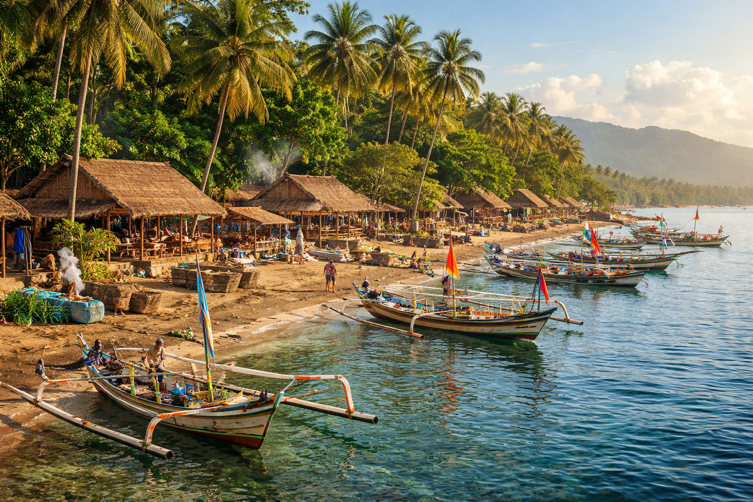
Getting Around
Walking Tour Option
If you'd like to stay nearby, the local area around Celukan Bawang offers a glimpse into authentic Balinese coastal life...
Start by exploring the traditional fishing village atmosphere, where you can observe local daily activities, visit small local eateries, and experience the working harbor.
The area provides an off-the-beaten-path perspective of Bali, away from tourist crowds.
Note that Celukan Bawang is primarily an industrial port, so this is best suited for travelers interested in local culture.

Slide 14
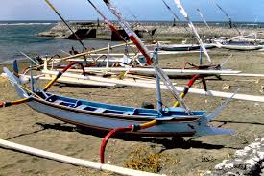
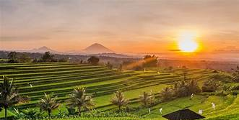
What Celukan Bawangis Famous For
Traditional Fishing Villages
Right outside the port area, you’ll see small coastal villages where life still revolves around fishing.
Colorful jukung boats line the shore. Nets are repaired by hand. Daily rituals happen in the open.
It’s not curated for tourists, which makes it feel authentic. A short walk with a local guide helps turn simple observations into context.

Slide 15
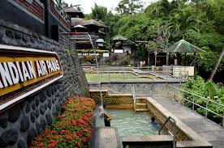
Highlights for Visitors
Banjar Hot Springs
About 30 minutes inland, these sulfur-fed pools date back to the 19th century. Stone spouts shaped like dragon heads feed warm mineral water into tiered bathing pools.
It’s relaxed, scenic, and easy to combine with a monastery visit.

Slide 16
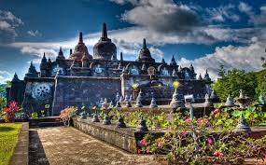
Highlights for Visitors
Brahmavihara Arama
Often paired with Banjar, this is
Bali’s largest Buddhist monastery.
The setting is calm, green, and
elevated, with views toward the
sea.
White stone stupas and a miniature
Borobudur-style structure give it a
very different feel from Bali’s Hindu temples.

Slide 17
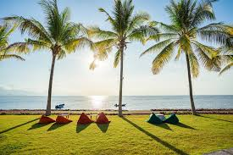
Highlights for Visitors
Lovina Beach
Lovina is known for its black-sand beaches and dolphin sightings.
Early-morning boat trips head offshore to spot pods swimming just beyond the reef.
Even without the dolphins, Lovina offers a slower, less commercial seaside experience than southern Bali.

Slide 18
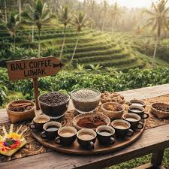
Highlights for Visitors
Coffee and Spice Plantations
Northern Bali is cooler and greener, ideal for small plantations.
Many shore excursions stop at family-run farms where guests see coffee, cacao, vanilla, cloves, and cinnamon growing together.
Yes, kopi luwak is often part of the visit, but the real value is understanding how deeply agriculture shapes Balinese life.

Slide 19

Highlights for Visitors
Waterfalls and Mountain Scenery
If the itinerary allows, inland drives reveal rice terraces, jungle valleys, and waterfalls like Gitgit or Munduk.
These trips are more about scenery than ticking off landmarks, but they give a strong sense of Bali beyond the coast.

Slide 20
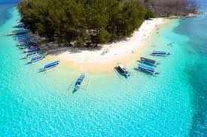
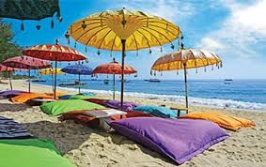
Highlights for Visitors
What Makes Celukan Bawang Different
This port isn’t about shopping districts or headline attractions. It’s about contrast.
Quiet villages instead of beach clubs. Temples tucked into hills instead of Instagram backdrops. Everyday Bali, not resort Bali.
For cruise travelers, that makes Celukan Bawang a pause. A place to slow down, observe, and absorb northern Bali’s rhythm before the ship moves on.

Slide 21
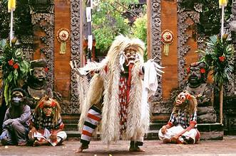
Highlights for Visitors
Barong Dance Performances: Traditional storytelling through dance and costume.

Slide 22
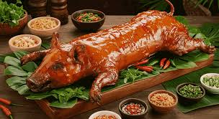
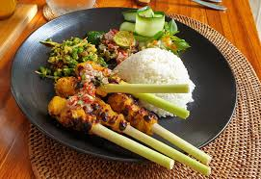
Food and Drink
Balinese cuisine is aromatic and colorful.
Try babi guling (suckling pig), nasi campur (rice with assorted dishes), and satay lilit (minced seafood satay wrapped on sticks).
For dessert, tropical fruits like snake fruit and rambutan abound.
Don’t miss a cup of kopi Bali (Balinese coffee).

Slide 23

Reflection
Bali is more than just a tropical island, it’s a living culture of rituals, temples, and art layered over breathtaking landscapes.
Whether you’re watching dancers in Ubud, walking barefoot on the beach, or standing before a temple at sunset,
Bali leaves an impression of harmony between the spiritual and the natural.

Slide 24
Thanks For Coming
If you have any more questions, please ask.
I will do my best to answer them for you.
Have a great visit in Celukan Bawang!

