Slide 1
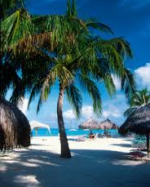
Saint Lucia Presented by Fellow Cruiser Marc Silver

Slide 2
What I Will Cover
My Port Philosophy
Don’t Miss the Ship
Money
About Saint Lucia
Saint Lucia’s History
Saint Lucia’s Today
Map of Saint Lucia
Map of Castries
Castries Transportation
Places to see or at least consider
A few restaurant recommendations
Conclusion

Slide 3
My Port Philosophy
I have been cruising for over 45 years and have taken over 100 cruises. So, I consider myself an experienced cruiser.
The information I will present is based on those many years of experience.
When I am on a cruise where the city, I want to visit is not the port city, I always recommend taking a ship’s tour.
But when I am in a port with multiple attractions nearby and easy to see on my own - I will do it on my own.
This presentation is for that type of port.

Slide 4

Don’t Miss the Ship
How to Avoid Missing Your Ship
Pay attention to the time. - Ship time and local time are often different.
Put a return-to-ship reminder on your phone.
Choose excursions wisely.
If a ship-sponsored excursion is late returning to port, the ship will wait for you. If you are on your own.
Be Prepared
Have your Passport, Credit Card, and phone numbers for your ship port agent.
What to Do If You Miss the Ship Most cruise lines have port agents stationed in the port area to assist if your ship has left without you. If your are lucky, when cruisers are late returning to the vessel, the ship’s crew will often remove the passengers’ essential items – passports, cell phones, and medication -- from the ship to leave with the port agents.
The Port Officials can help you with contacting your ship and making necessary travel arrangements.

Slide 5
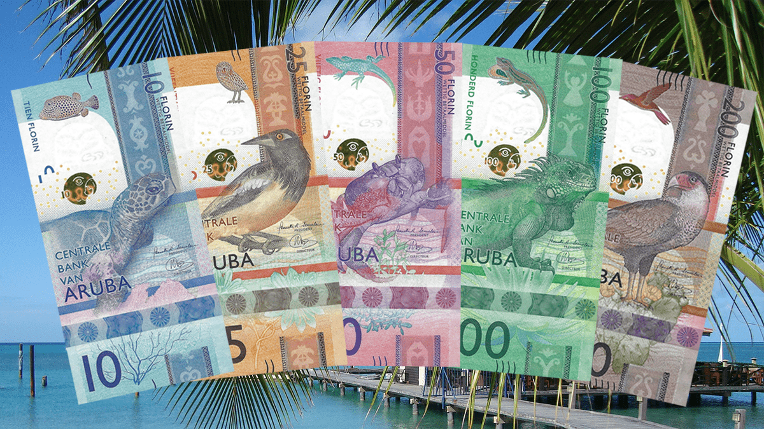
Saint Lucia Money
The currency on the island is the Saint Lucia Florin.
You can exchange U.S. dollars, but it isn’t necessary. Using American money in Saint Lucia is common and widely accepted. You may receive Saint Lucia currency as change.
The Saint Lucia currency exchange rate for U.S. dollars is Afl 1.77 for cash and Afl 1.78 for traveler’s checks.
Most places however use the rate of Afl 1.75, many restaurants and shops use the exchange rate of Afl 1.80.

Slide 6
Saint Lucia
St. Lucia is one of the most breathtakingly beautiful islands in the Caribbean. It’s located on the southeastern side of the Caribbean and bears the most dramatic landscape in the entire West Indies.
Twin Volcanic hills blanketed by lush vegetation rising from the sea create the island’s unique feature and induce awe in anyone who sees them.
The island, an emerald gem sitting on top of blue waters, features thick tropical rainforests, natural wonders, colorful villages, and stunning beaches. These features, coupled with the island’s warm and laid-back nature, provide countless attractions. That makes it easy to fall in love with the place.

Slide 7
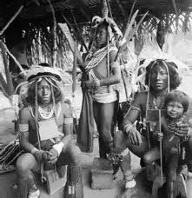
Saint Lucia’s History
The first known inhabitants of the island of Saint Lucia were the Caiquetio Indians of the Arawak tribe from Venezuela.
During the Pre-Ceramic period, 2500 BC - 1000 AD, this seminomadic tribe fished, hunted, and gathered food, depending mostly on the sea for survival.
They created tools out of roughly flaked stones and shells and lived in small family groups in the coastal areas known today as Malmok and Palm Beach.

Slide 8
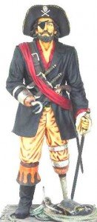
Saint Lucia’s History Cont.
The pirate François Le Clerc is thought to have colonized Saint Lucia and used Pigeon Island to attack Spanish ships in the 1550s. The island is now a National Landmark with historic sites and museums to enthrall those who visit.
The Caribs lived in Saint Lucia until the 1600s when settlers attempted to take control of the island to boost European trade. Even during this period of colonialism, the Caribs continued to fight and stopped multiple attempts by the English and French to settle on the island.
In the 1600s, the French, English, and Dutch all attempted to take Saint Lucia as one of their colonies. The Dutch attempted to build Vieux Fort in but were pushed out by the Caribs. In 1639, the British sent 400 settlers to the island, who were wiped out by the Caribs in less than two years.
In 1651, a member of the French West India Company purchased the land from the Caribs to make it a French colony, and the English immediately sent 1,000 men to take back the island. This fighting continued until 1814 when the French ceded Saint Lucia to the English.

Slide 9
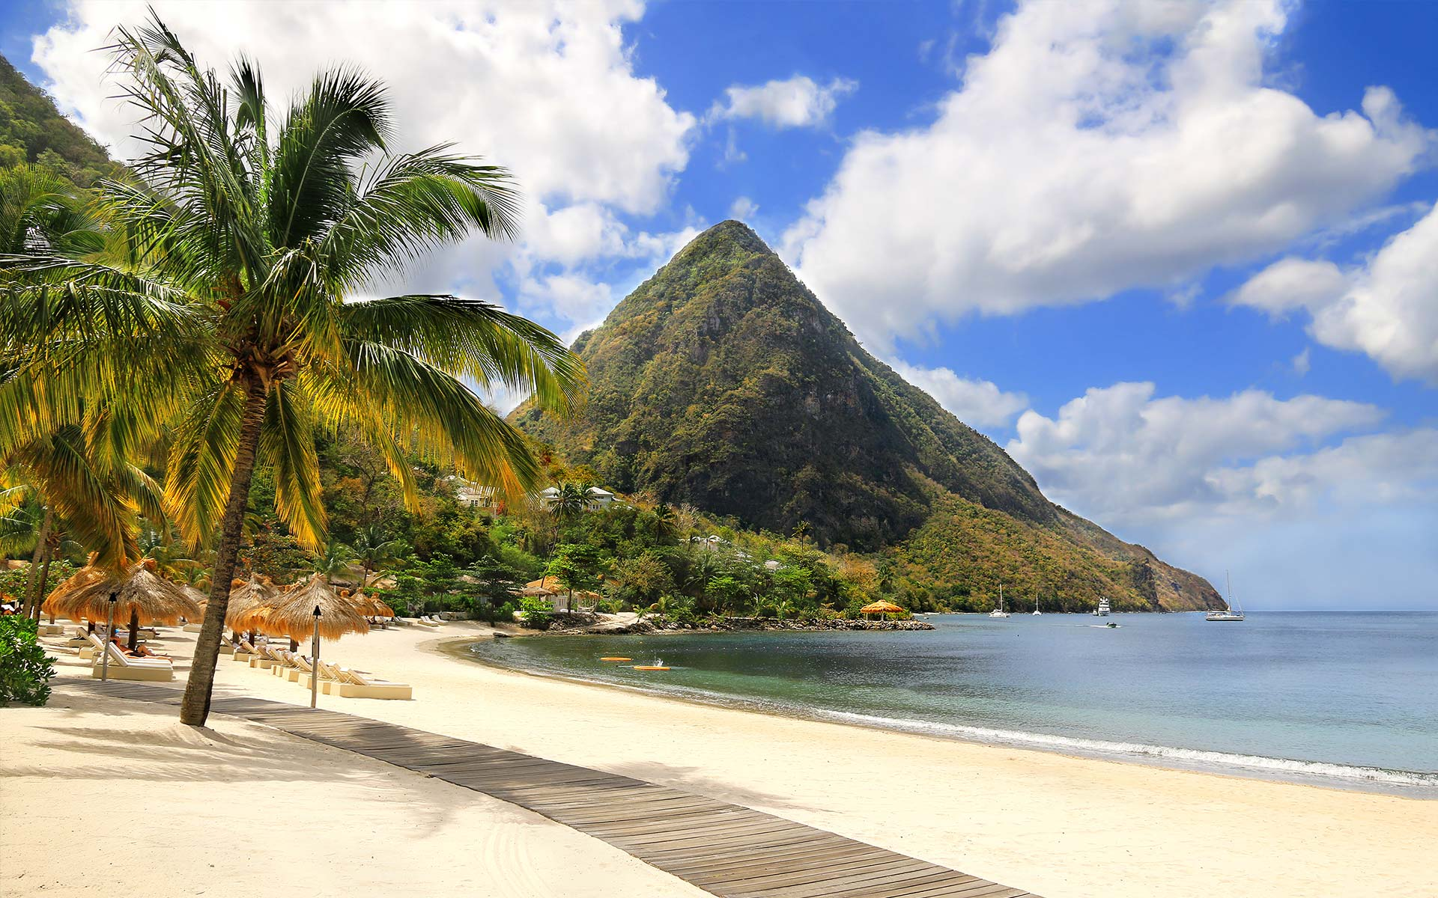
Saint Lucia Today
Saint Lucia was one of the last European colonies to declare independence. The island is now an independent British Commonwealth as of 1979 and finally has a thriving, peaceful economy and sovereign government.
Saint Lucia is a melting pot of various cultures. Carib culture still has a strong influence on the island, even though it is mixed with African cultures brought over during colonial times.
English, French, and Dutch elements also blend with the others on the island, making Saint Lucia’s culture unique to those who visit.

Slide 10
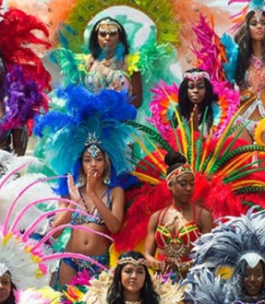
Ethnic Groups and Languages
People of African descent and mixed African-European descent make up more than nine-tenths of the population. A small fraction of the population is of European (mainly British) descent, and there is an even smaller number of inhabitants who originated from the Indian subcontinent.
There are small groups of Syrians, Lebanese, and Chinese. There is also a sizable expatriate community—primarily from the United States and Great Britain—made up of international civil servants, businesspersons, and retirees. English is the official language, and Creole French is also spoken.

Slide 11
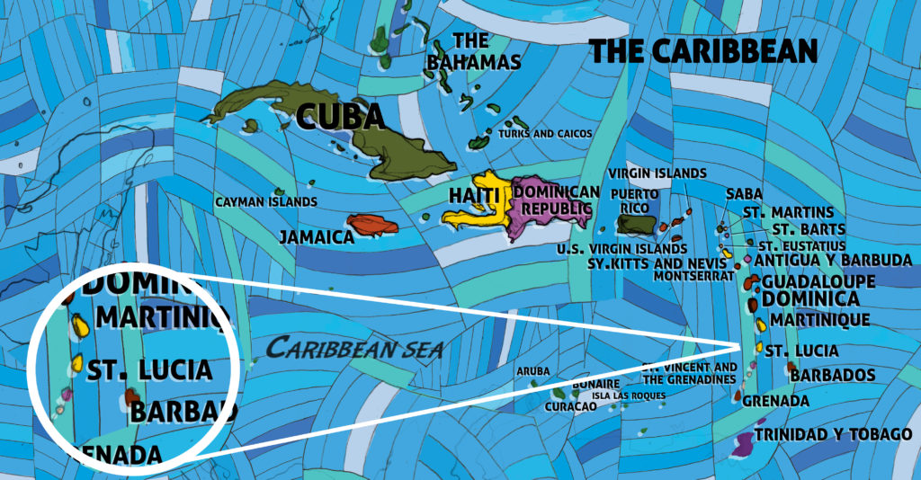
Area Map of Saint Lucia

Slide 12
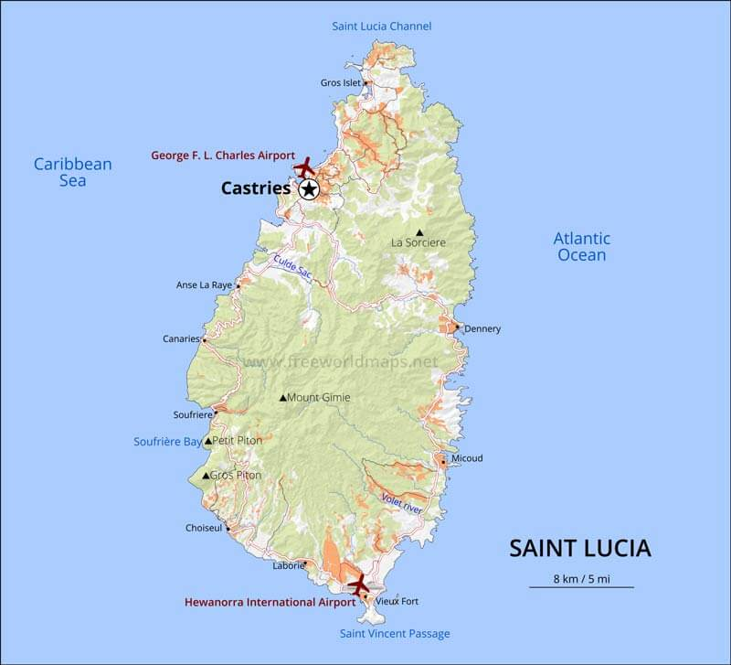
Saint Lucia Map

Slide 13
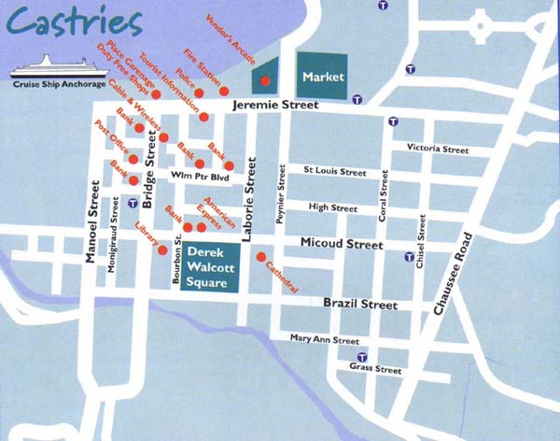
Map of Castries

Slide 14
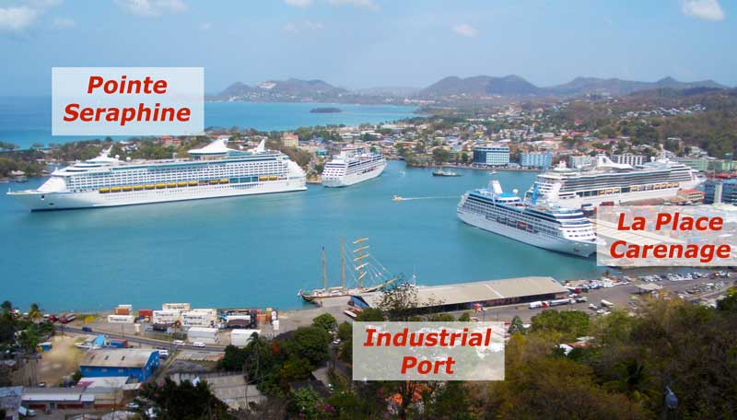
Saint Lucia Port Area

Slide 15
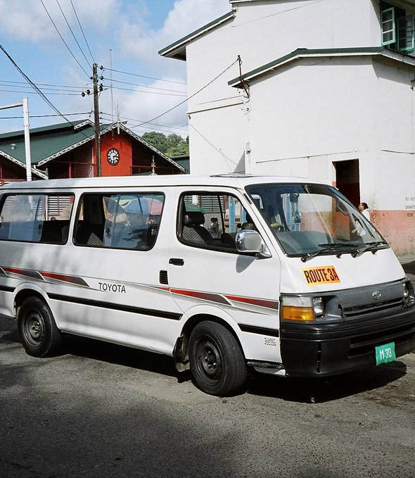
Castries Buses
St Lucia’s minivan buses are a great way to get around the island. To catch a bus in St Lucia, just wait at one of the marked bus stops or you can simply flag one down.
There are several stops in and around Castries, and the buses also travel to Cas en Bas, Dennery, Vieux Fort, Soufriere (home to the Pitons, and Diamond Falls).
Fares for St Lucia buses are quite affordable, with a fare over $5 US being quite uncommon. The average fare from Castries to the south of the island, such as Vieux Fort, is only around $2 US. Most fares are considerably less, with fares around Castries running only about $0.60 US.

Slide 16

Castries Taxis
If you don't mind spending a little extra cash on transportation, taxis serve as a hassle-free way of getting around Saint Lucia.
Taxis are metered, and prices vary by distance.
Even so, before departing, be sure to agree upon a fare with the driver.

Slide 17
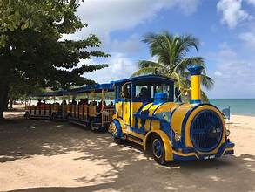
Castries Hibiscus Trolley Train
One of Saint Lucia's transportation options appealing to us cruise ship passengers is the downtown streetcar/trolley.
The trolleys offer free transportation to and from the main street downtown area in a loop.

Slide 18
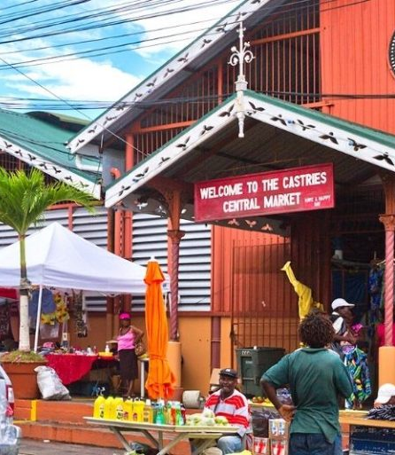
Castries Central Market
Castries Central Market is found in the town center in the Iron Warehouse with bright orange roofing. Here, you can peruse and shop for unfamiliar tropical fruits and familiar ones like bananas.
Or maybe not so familiar as St. Lucia boasts of 127 varieties of bananas; it’s actually the island’s main fruit. You can also shop for Caribbean spices, island-made chocolate, and rum.
Smell the lovely scents of exotic fruits, vegetables, spices, and local St. Lucian food at the food stalls.

Slide 19
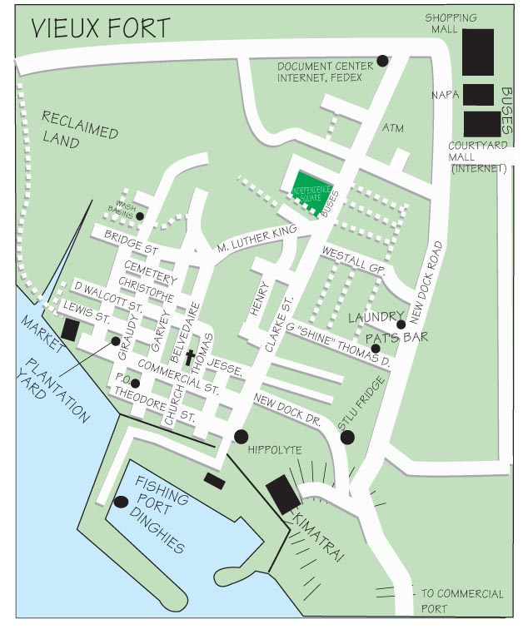
Vieux Fort
Vieux Fort is St Lucia’s main point of entry, but it is also a big industrial area where you can find St Jude’s Hospital and the George Odlum Stadium.
It is a town at the southernmost point of the island. Vieux Fort is home to the Moule-e-Chique Lighthouse, which was built in 1912 and is the second-highest in the world.

Slide 20
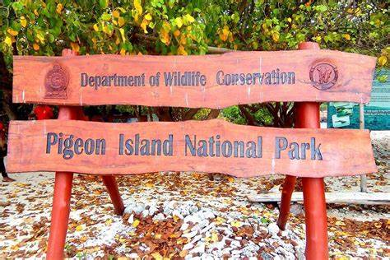
Pigeon Island National Landmark
There is not much to do in Castries, and an hour exploring is enough. However, a point of interest in St. Lucia is at the northernmost point of the island you will find Pigeon Island.
Grab a taxi or bus from town and head to Pigeon Island, which is not really an island but more of a peninsula, with a causeway that connects it to St. Lucia.
The 44-acre Pigeon Island national park has great beaches.
The park is open all day until 5 pm and
There are a couple of places to eat serving local cuisine and drinks, creating a nice and relaxing atmosphere. Whether you’re a thrill-seeker or prefer a more laid-back vibe, Pigeon Island offers a variety of activities to enjoy.

Slide 21
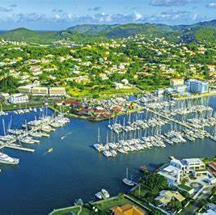
Rodney Bay Marina
Rodney Bay Marina features a street lined with commercial buildings, shops, and restaurants. Streetside eating is popular here. But even more popular are the beach, the beautiful bay, and the party life of the island.
When visiting St Lucia, you can do some duty-free shopping, eat your fill of good food, stroll on the beach or head over to the water park for some thrilling water adventures. If the mention of adrenaline tires you out, try the many hidden spas for a relaxing day at the port. Some of the places to shop include the Bay Walk shopping mall.

Slide 22
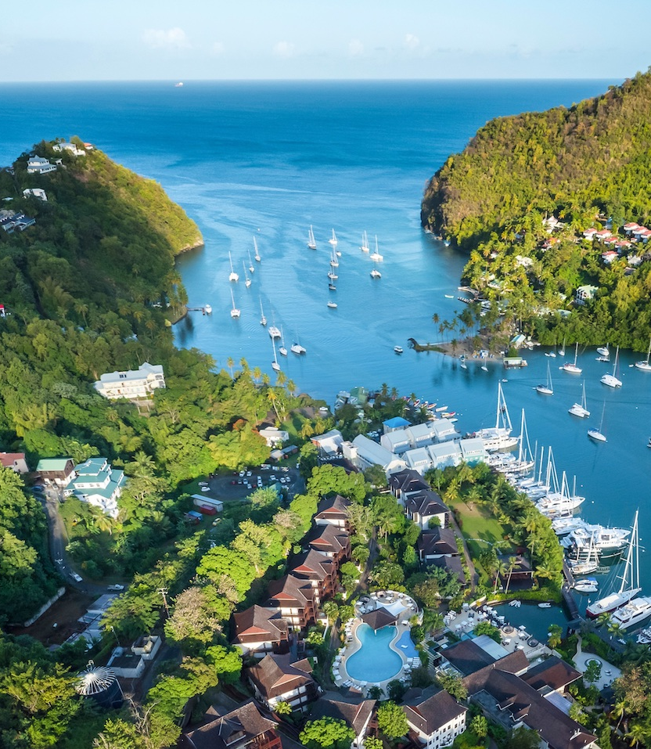
Marigot Bay
From Rodney Bay, take a water taxi over to Marigot Bay. This beautiful and picturesque bay with a deep natural harbor is also known as the Hurricane Hole on account of it being protected from strong winds by the surrounding forested hill peninsulas.
Marigot Bay features big resorts and private residences and bears a laid-back vibe to it that is just perfect for vacation. There is plenty to eat here, and one of the most popular restaurants is the “Hurricane Hole.” It serves delicious St. Lucia cuisine as well as international favorites.

Slide 23
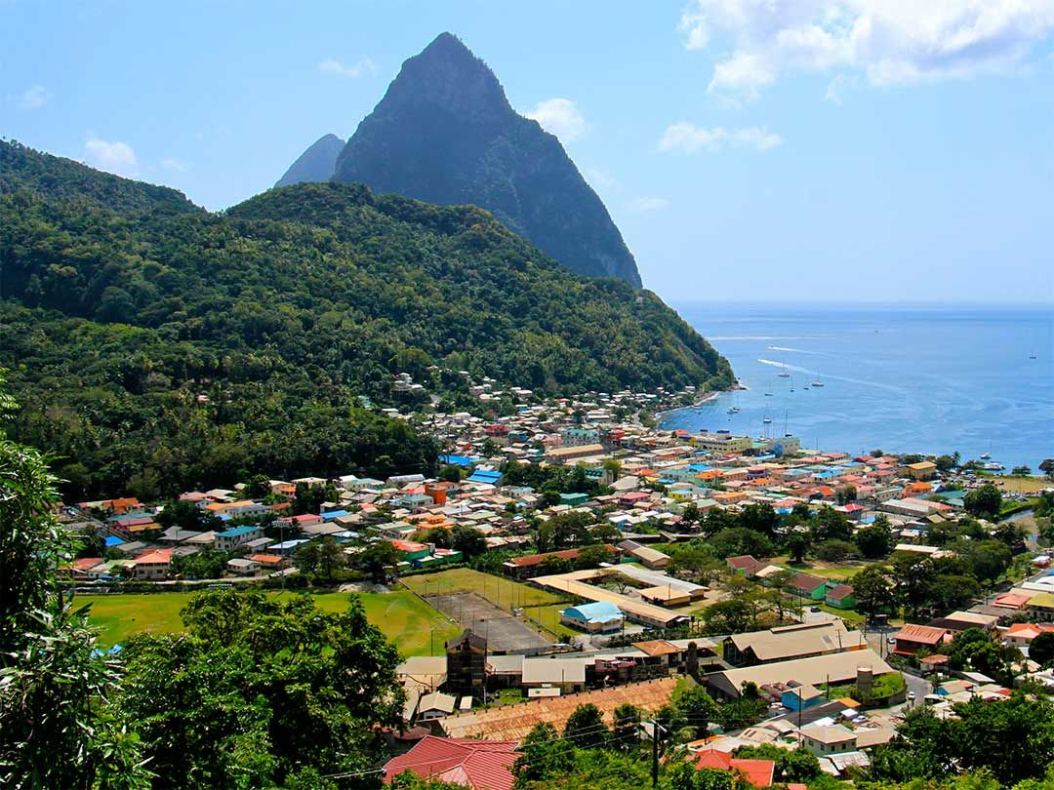
The Town of Soufriere
Soufriere is on the southern coast of the island. Once the capital of St. Lucia when the French were in power. The town features most of the island’s unique and iconic attractions.
It boasts of the world’s only Drive-in Volcano, the award-winning Diamond Botanical Garden, the black beaches of Anse Chastanet, and, the iconic pitons that have become the postcard image of the island.

Slide 24
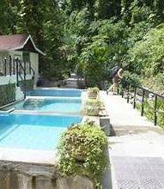
Diamond Botanical Garden & Baths
Diamond Botanical Gardens, Waterfall, and Mineral Baths is a six-acre private park Located in Soufriere, about 27 miles from the cruise port. There is a diverse range of tropical plants, flowers, birds, and insects in the park.
Visit the colorful waterfall for that perfect photo op. Relax in the warm soothing waters of the mineral baths. It sits in a natural gorge that begins up the road at the world’s only drive-through volcano and bubbling Sulphur Springs.
Garden Admission: US$7 Children: $3.50 Private Baths: US$7 Public Baths: US$6

Slide 25
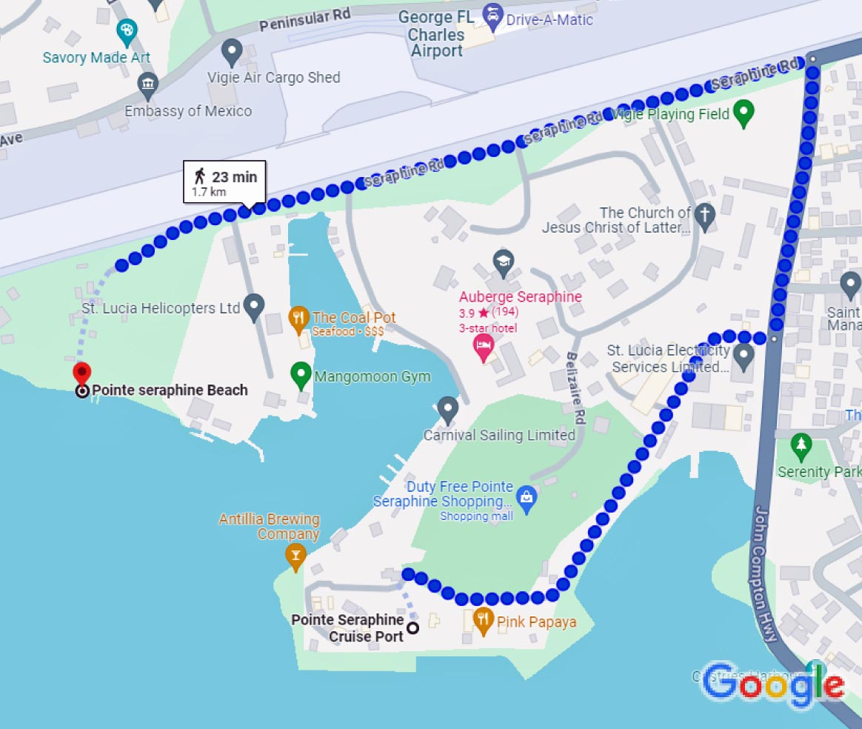
Pointe Seraphine Beach
The beaches are stunning and relatively close to the cruise port in Castries. Pointe Seraphine Beach is only a 20-minute walk from the cruise dock. Just follow the road out of the dock area and then turn left to follow the John Compton Highway around the airport runway. This area has residential housing and sidewalks.
Once at the beach, either turn left to walk on the path through the cemetery to reach a more or less deserted part of the beach, or turn right and walk past the Rendezvous Resort to find a spot. On either side, there is a good stretch of sandy beach with trees for shade or lounge chairs to rent. This is a beach that cruise ships don't have excursions to so it is not crowded, but locals use this beach regularly.
Taxis cost $5 per person one way.

Slide 26
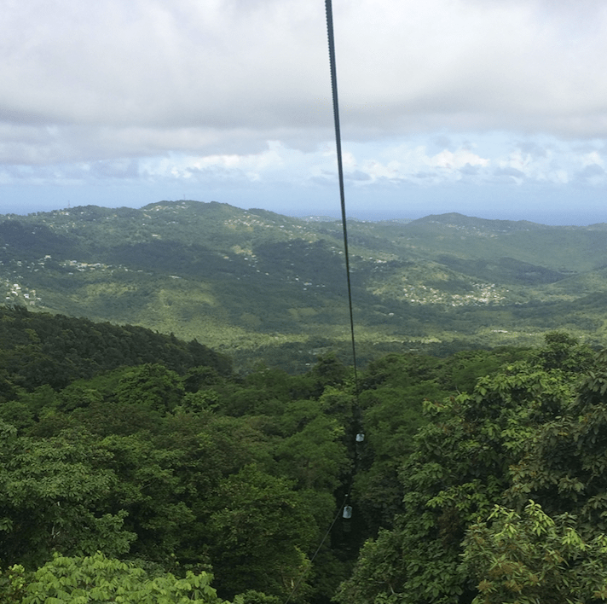
Aerial Tram Ride
Exploring St Lucia’s forest is a popular activity for all tourists on the island, and you will enjoy it, too. Take a gentle aerial tram ride through the island’s northwestern rainforest.
This ride happens on a suspended open-ended gondola that slowly takes you on a tour of the forest’s canopy with a guide who explains the local tropical flora and fauna. Enjoy this activity as you get panoramic views of the rainforest and its inhabitants.

Slide 27
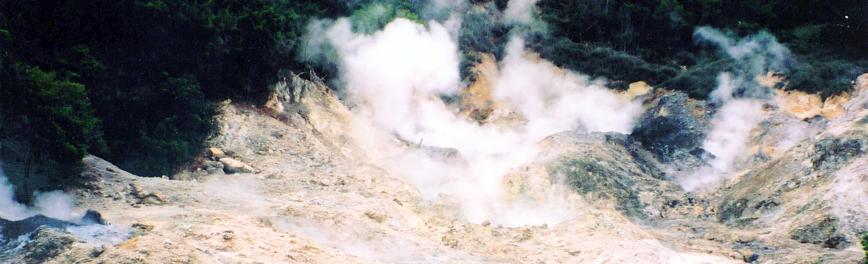
Sulphur Springs Park
One of the most popular attractions in St. Lucia is the mud bath in Sulphur Springs State Park. Located about a mile from Soufriere’s harbor. Just a few steps from the drive-in volcano are the mud baths. The mud is said to heal, restore, tighten, and rejuvenate your skin.
A visit to the bath involves applying the warm gray mud on your body. Then, take a bath in the mineral-rich waters of Sulphur Springs. Afterward, you can cool off at a nearby waterfall.

Slide 28
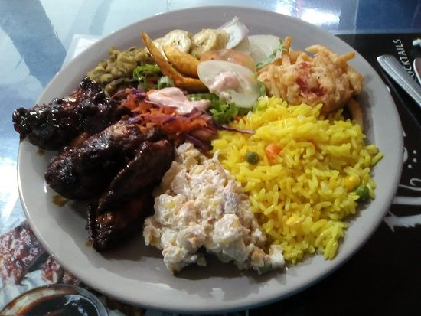
Restaurants
There are a lot of excellent restaurants in St. Lucia. Especially for Caribbean Seafood.
Here are some recommendations:
The Pink Plantation House $$ - $$$ Caribbean, Vegetarian
The Morne Fortune Chef Harry Drive, Castries
The Coal Pot $$$$ Caribbean, Seafood, Fusion
Seraphine Road, Castries
Chef Robby's Caribbean Pirates $$ - $$$ Caribbean, Bar, Seafood
Jeremie Street St. Lucia
Sea Grapes Beach Bar & Restaurant $$ - $$$ Caribbean, Bar, Seafood
Reduit Beach Avenue, Gros Islet
Buzz Seafood and Grill $$ - $$$ Caribbean, Seafood
Reduit Beach Ave Rodney Bay Marina, Rodney Bay
Dream Campari Restaurant $ American, Caribbean
68 Brazil St, Castries St. For those of you who just like good food, I am sure you will enjoy St. Lucia.

Slide 29
Conclusion
Castries is a picturesque City with a rich history and numerous attractions. Regardless of what you're looking for, Castries has something for everyone.
I hope this presentation will help when we visit Castries!

Slide 30
Thanks For Coming
If you have any more questions, please ask.
I will do my best to answer them for you.
Have a great visit to Castries!

