Slide 1
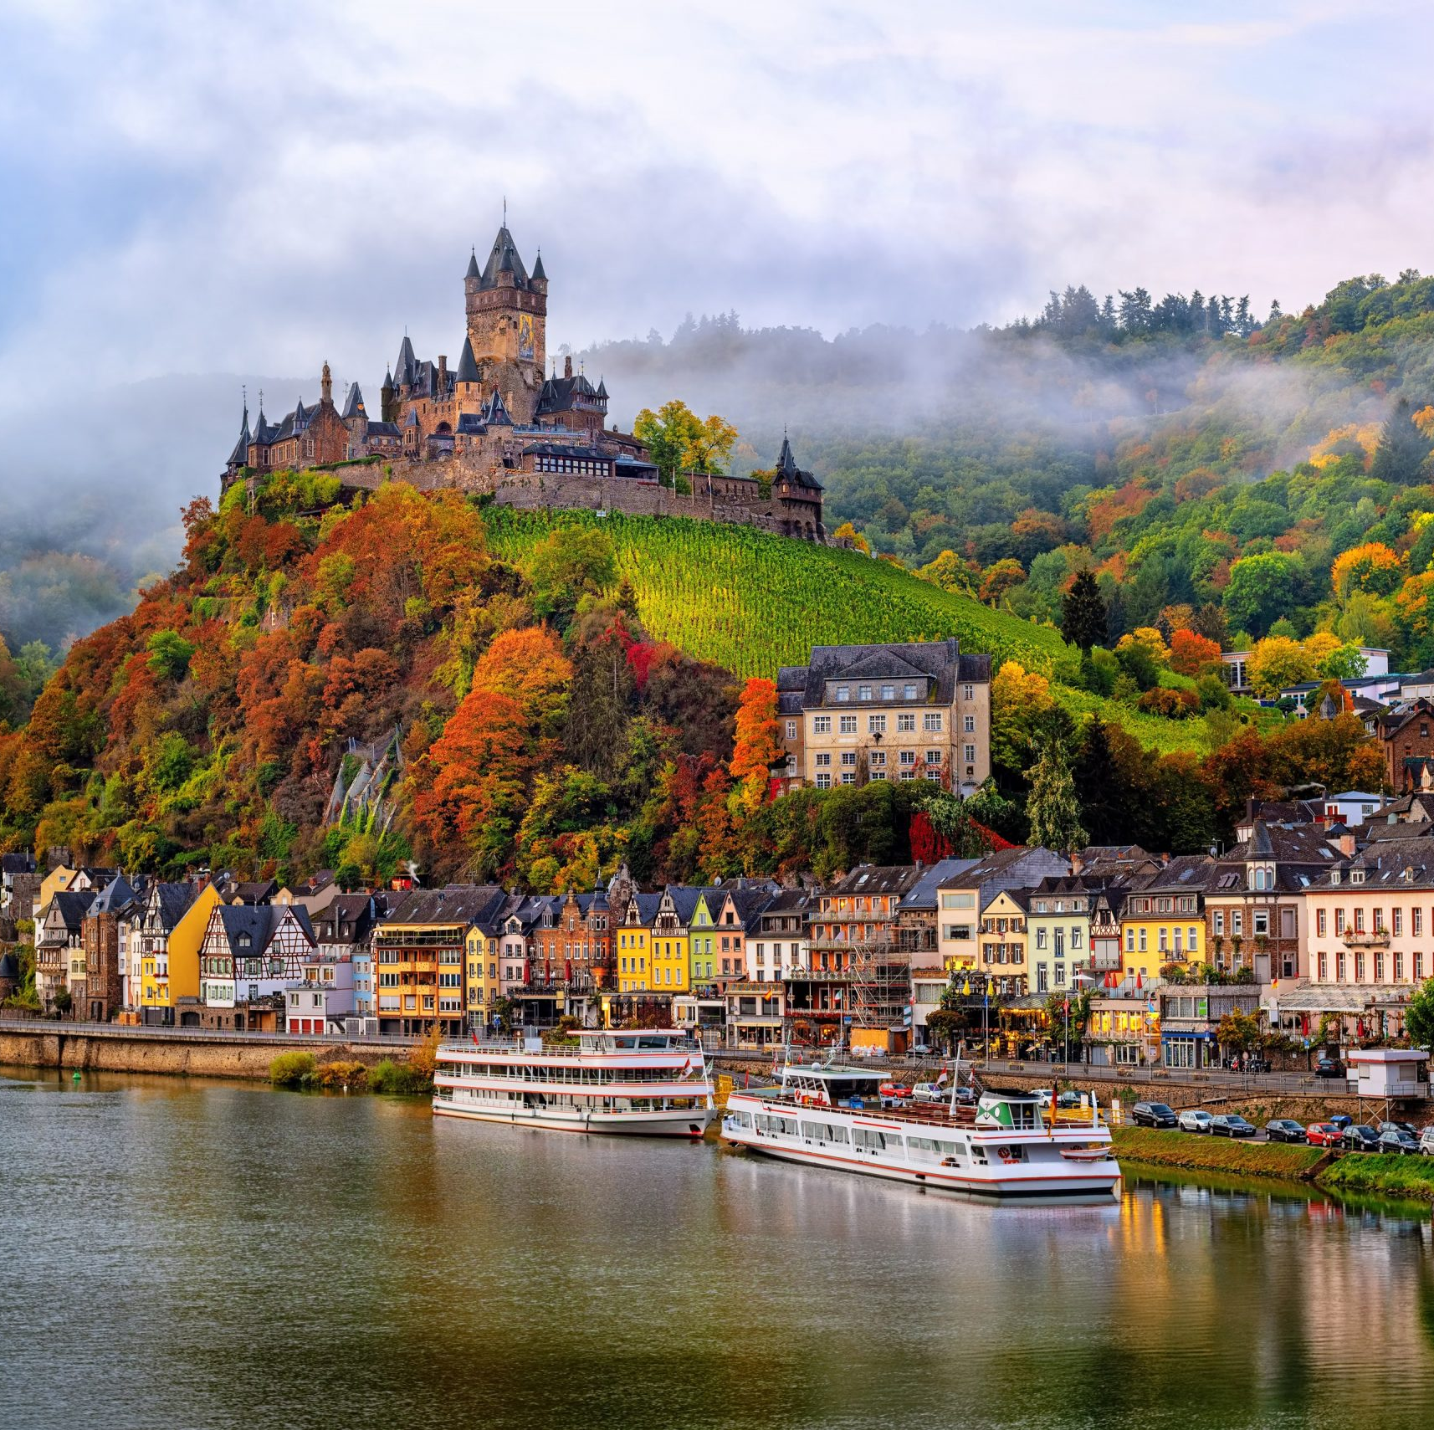
Castles & Cathedrals of the Rhine with Marc Silver
A Journey Through Germany’s Culture

Slide 2
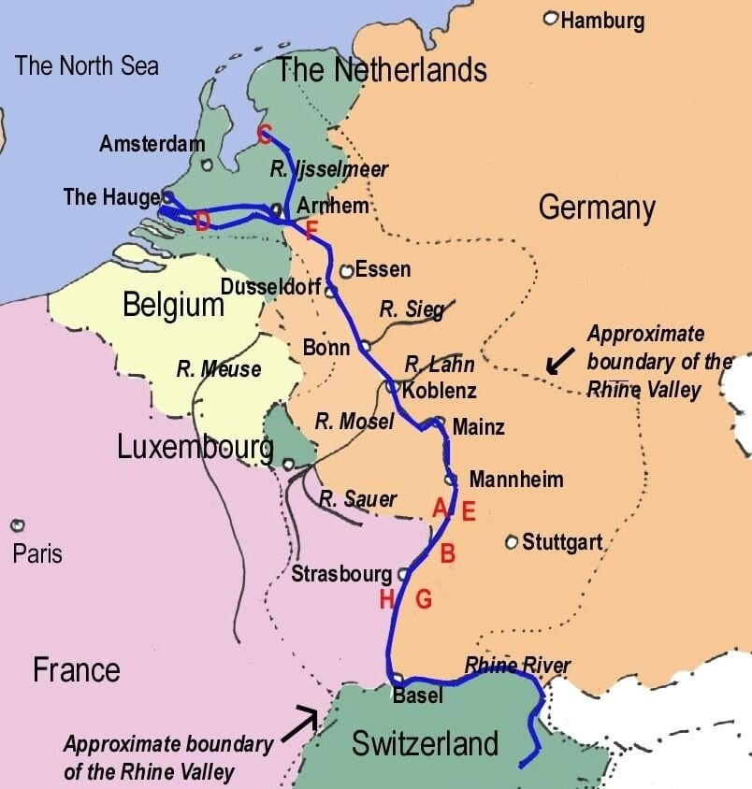
The Romantic Rhine River
Nestled along the serene waters of the Rhine River lies a tapestry of history, where the grandeur of castles and the solemnity of cathedrals stand as testaments to the past.
The Rhine Valley is not just a geographical marvel but a cultural treasure trove, offering a glimpse into the rich heritage of Europe.
During todays talk, I plan to take you on a journey through time, exploring the iconic castles and cathedrals that adorn the banks of the Rhine, each with its own story to tell.

Slide 3
The Romantic Rhine River
The Rhine River, often hailed as the "Romantic Rhine," stretches over 1,200 kilometers, winding its way through Switzerland, Germany, France, and the Netherlands.
Along its course, it passes through the heart of Germany, where the landscape is adorned with imposing castles and majestic cathedrals. These architectural marvels serve as reminders of a bygone era when feudal lords ruled the land and religion held sway over the masses.

Slide 4
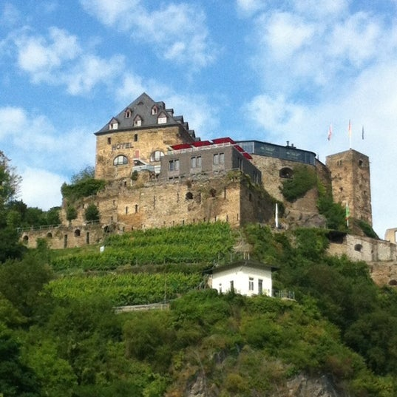
The Castles of the Rhine River
The Rhine Valley boasts an impressive array of castles, each with its own unique charm and history. Among the most renowned is Burg Rheinfel, perched high above the town of St. Goar.
Built in the 13th century, this formidable fortress once serves as a stronghold for the Counts of Katsenelnbogen and later played a key role in the Thirty-year War.

Slide 5
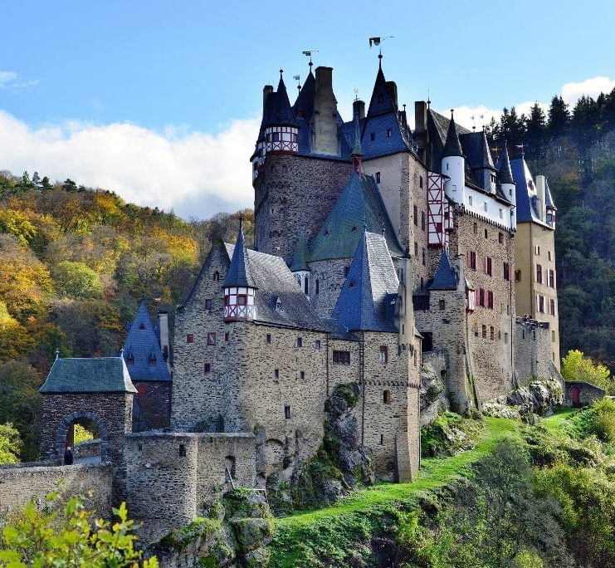
The Castles of the Rhine River
Further downstream lies Burg Pfalzgrafenstein, a solitary castle nestled on a small island in the middle of the Rhine.
Built in the 14th century this picturesque fortress served as a toll station, extracting tolls from passing ships until the early 19th century.
Sailing along the river, we will encounter the magnificent Burg Eltz, often referred to as the "Queen of German Castles." Hidden deep in the forests above the Moselle River, Burg Eltz is a masterpiece of medieval architecture, boasting turrets, towers, and courtyards that seem to have sprung from the pages of a fairy tale.

Slide 6
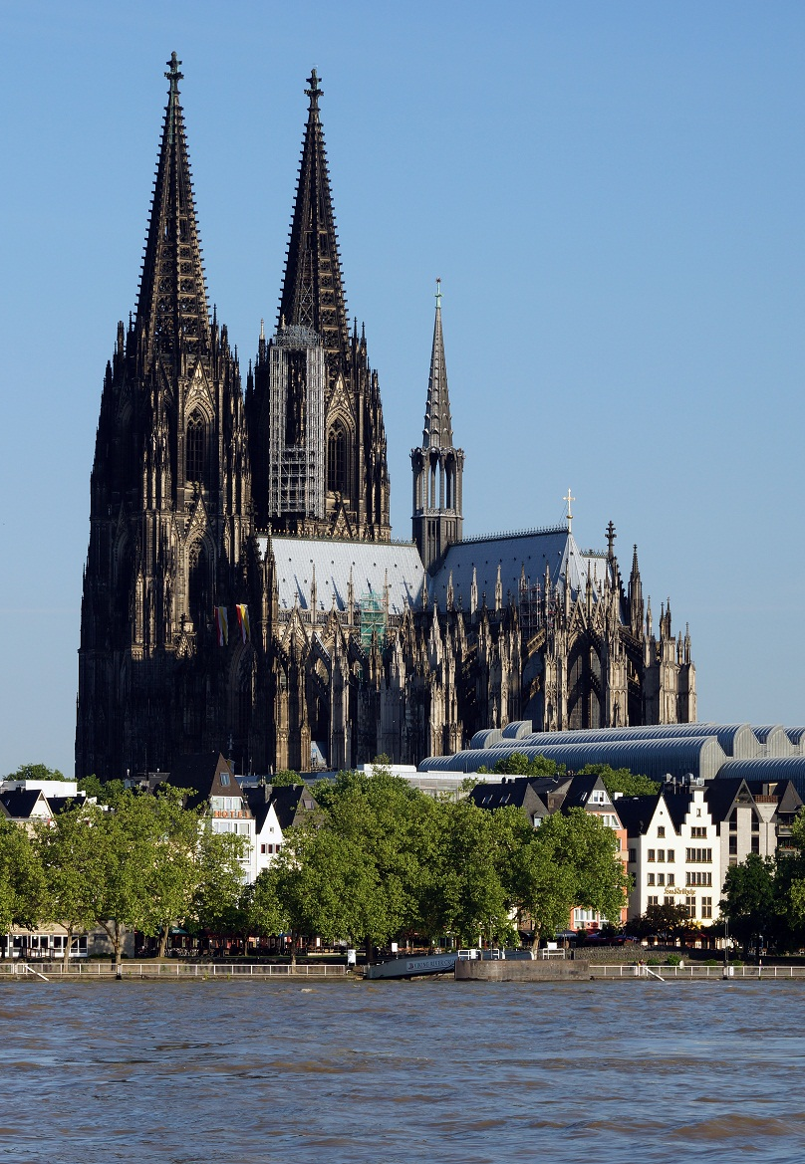
The Cathedrals of the Rhine
In addition to its castles, the Rhine Valley is home to several awe-inspiring cathedrals that bear witness to the region's religious heritage.
One such cathedral is the Cologne Cathedral, a UNESCO World Heritage Site and one of the largest cathedrals in Europe. With its towering spires and intricate Gothic architecture, the Cologne Cathedral is a testament to the skill and devotion of the craftsmen who built it over the course of six centuries.
Another notable cathedral is the Mainz Cathedral, located in the city of Mainz. Dating back to the 10th century, this Romanesque masterpiece features stunning stained glass windows, intricately carved stone reliefs, and a soaring interior that inspires awe and reverence in all who enter.

Slide 7
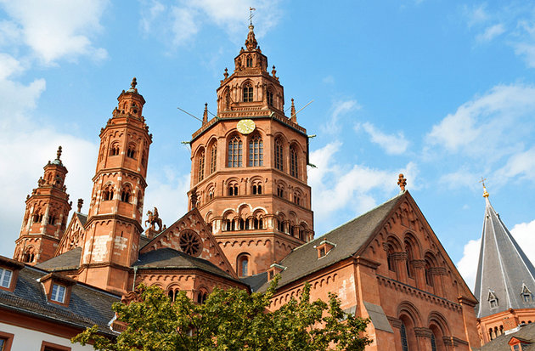
The Cathedrals of the Rhine
Another notable cathedral is the Mainz Cathedral, located in the city of Mainz.
Dating back to the 10th century, this Romanesque masterpiece features stunning stained glass windows, intricately carved stone reliefs, and a soaring interior that inspires awe and reverence in all who enter.

Slide 8
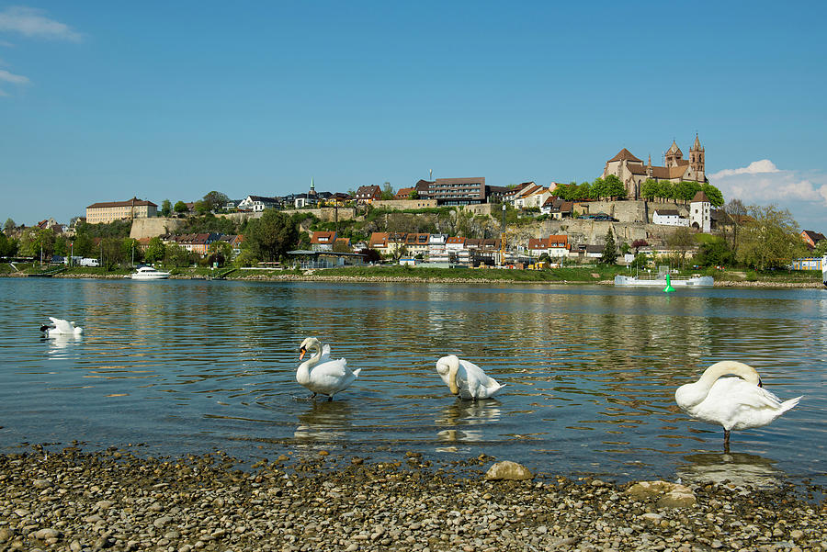
Breisach, Germany
Breisach is a gateway to the fabled Black Forest region, built on a basalt rock outcropping in the Rhine plain.
It is in one of the warmest parts of Germany, across the river from French Alsace, famous for its wine growing.
But Breisach, too, can boast about its wine: it is home to Europe’s largest cellars, with a storage capacity of more than 160 million liters.
The most prominent landmark of Breisach is the Romanesque-Gothic St. Stephen’s Cathedral, built between the 12th and 13th centuries. Its two towers are visible from throughout the city and from the Rhine.

Slide 9
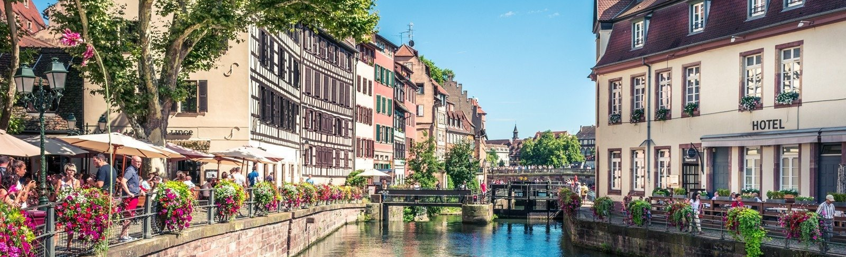
Strasbourg, France
The largest port on the Upper Rhine, Strasbourg is the cultural center of France’s Alsace region. Thanks to its location at the border of France and Germany, it boasts a convivial mix of cultural influences.
The well-preserved Old Town is enclosed on all sides by the little Ill River, with sites so compact that it is easy to explore the “island” on foot. And there is plenty to explore: cobblestone streets lined with wooden houses and intersected by picturesque canals. Indulging in Alsatian café culture is central to any visit here; enjoy coffee and cake amid lovely half-timbered houses.

Slide 10
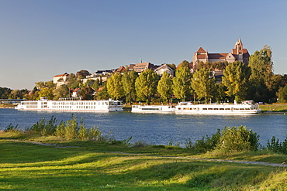
Breisach, Germany One of Germany’s oldest Towns
4000 years ago, the Munsterberg hill was home to a royal residence and later a Roman castle.
In 1664, Vauban improved the city and its fortifications. During the 17th and 18th century, Breisach was dominated by the French and the Habsburgs.
The forifications were destroyed during a bombardmanet in 1793 and again at the end of World War II when 85% of the town was destroyed.
Rising above vineyards and the Rhine, Breisach is where the Black Forest spills into Alsace. Given its geographical and cultural proximity to France, it’s little surprise that the locals share their neighbors' passion for a good bottle of plonk.

Slide 11
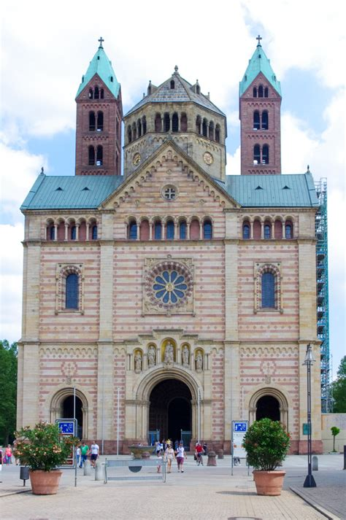
Speyer, Germany
The quiet German town of Speyer lies on the west bank of the Rhine. The city features a Romanesque imperial cathedral, burial place of eight emperors including some of the most famous Holy Roman Emperors.
Speyer was once a major Celtic center that traded hands several times between the Romans and the Huns.
The term Protestant originated here at the Diet of Speyer in 1529, when 14 free cities of Germany and six Lutheran princes protested the Edict of Worms that had banned the writings of Martin Luther and labeled him a heretic and enemy of the state.

Slide 12
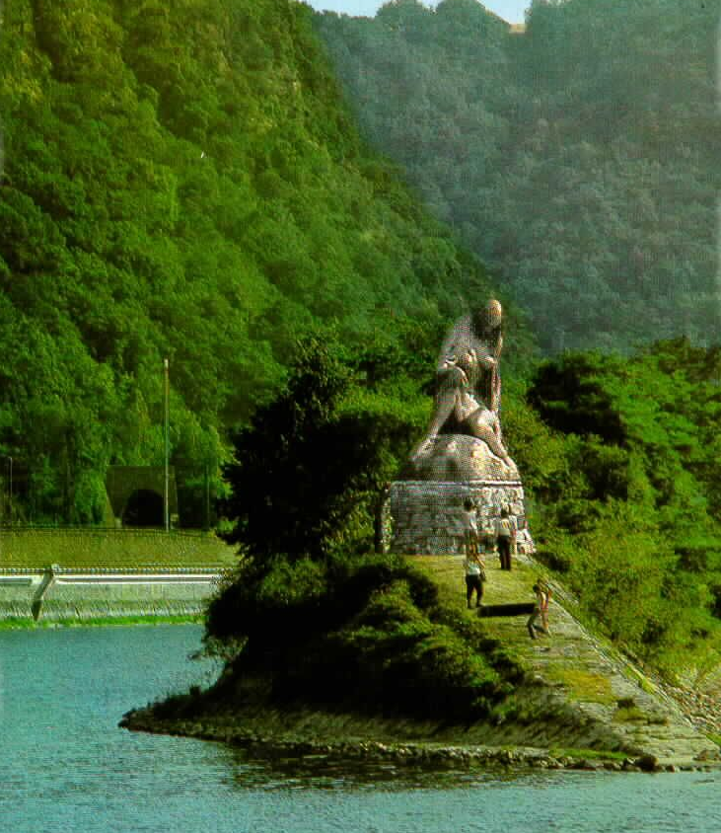
Middle Rhine
The Rhine River flows through one of Germany’s most scenic regions. As you sail its most picturesque stretch, the UNESCO World Heritage Site of the Middle Rhine, you will pass vineyard-blanketed hills whose steep slopes require vintners to pick grapes by hand, keeping a centuries-old tradition alive.
Splendid castles line the banks, all of which have stories to share, and the Lorelei Rock presides at a dramatic curve in the river.
This infamous river maiden mesmerized sailors with her song and lured them to their demise at her feet.

Slide 13
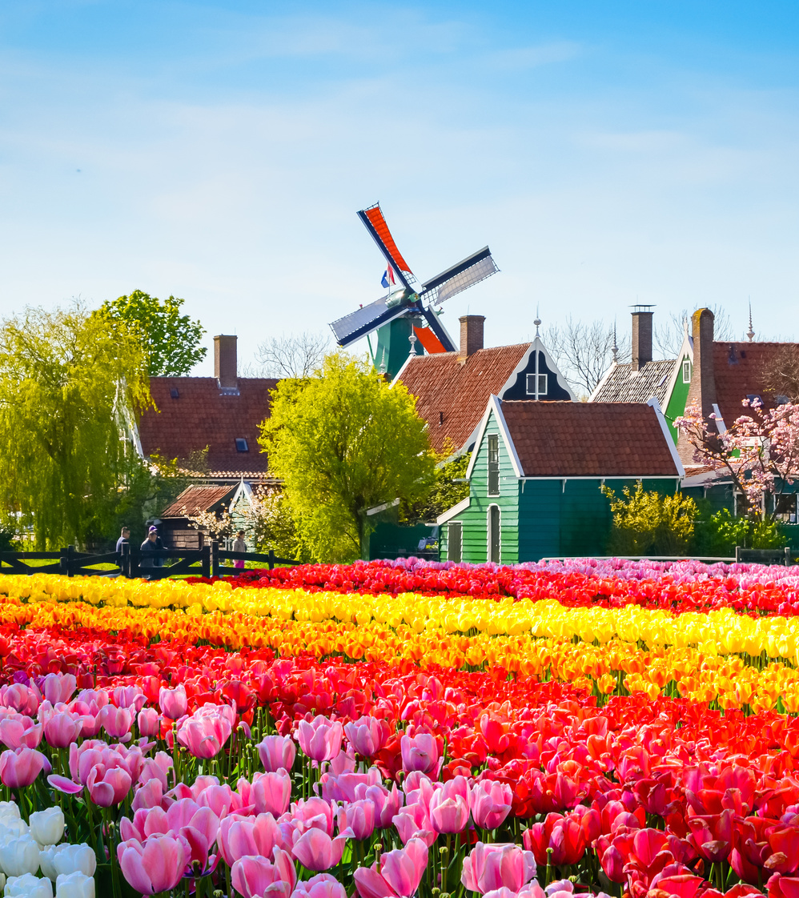
Kinderdijk, The Netherlands
Kinderdijk is a village community in the Alblasserwaard province. This corner of South Holland, part of the scenic Waal and Merwede regions, has long been shaped by Rhine Delta waters.
Kinderdijk is most known for its 19 remarkably preserved 18th-century windmills. The charming hamlet is located amid low-lying polders, tracts of land reclaimed from the sea by the power of the windmills and enclosed by embankments, or dikes.
This legendary place calls to mind the 1865 novel Hans Brinker, in which a heroic boy plugs his finger into a ruptured dike.

Slide 14
What Else Should We Learn
The Rhine has dictated international borders. The river serves as a natural border between several countries, including Germany and Switzerland, Germany and France, and Germany and the Netherlands.
Tipping is common in Germany, though you shouldn’t expect to tip as much as you’re used to in the United States or Canada. When ordering a beer or coffee on a trip to Germany, round up and tip the additional change or tip a few euros. Tips are sometimes included in the bill at restaurants, but it’s common to tip around 5-10% of the total.
Germany has restricted single-use plastics. In many places along the Rhine, you’ll find that single-use plastics like straws and shopping bags are unavailable or come at an additional cost. I recommend carrying a reusable water bottle and shopping bag with you when you join any tour.
Sprechen Sie Deutsch? Although many people in Germany speak English, it helps to learn a few key German phrases before you get off the boat in Germany.

Slide 15
Learn a little German
Guten Tag (pronounced: GOO-tehn tahg) This means “good day” and is a common way to say hello. A more informal way to say hi is simply Hallo.
Entschuldigung (pronounced: ehnt-SHOOL-dig-oong) Say excuse me using this word.
Wie geht es Ihnen? (pronounced: vee gayt ehs EE-nehn) This formal phrase means how are you?, but a simpler way to ask someone how it’s going is wie geht’s? Respond with gut, danke to say you’re fine, thanks.
Sprechen Sie Englisch? (pronounced: SHPREHKH-ehn see EHNG-lish) You can use this question to ask do you speak English? Many Germans do speak some English, so the answer might be ja (yes). If nein (no), then you can ask your Tour Director to help with translating.
Woher kommen Sie? (pronounced: voh-HEHR KOH-mehn zee) Curious locals might use this phrase to ask where are you from? Respond with ich komme aus _______, followed by your home country or city.
Wie komme ich nach ______?** (pronounced: vee KOH-meh ikh nach)_ Use this phrase, which means how do I get to _______, followed by a destination to ask locals how to find a certain place during your free time.
Wo ist hier ein gutes Restaurant? (pronounced: voh ist heer īn GOO-tehs reh-stoh-RAHN) If you get hungry or thirsty while you’re out and about, ask this question to say where is there a good restaurant nearby?
Bitte (pronounced: BIT-teh) This multi-purpose courtesy word means please, but it can also be used to say you’re welcome or to ask may I help you?
Danke (pronounced: DAHN-keh) Use this to say thank you. To add more emphasis say Vielen Dank, or “thank you very much.”
Auf Wiedersehen (pronounced: owf VEE-dehr-zay-ehn) This is one way to say goodbye—a more informal way is to say T_schüss_ or Mach’s gut.

Slide 16
Thankyou for Coming!
I hope you enjoyed my talk!
If you have any more questions, please ask.
I will do my best to answer them for you.
I can be reached by e-mail at
marcs@sonic.net

