Slide 1

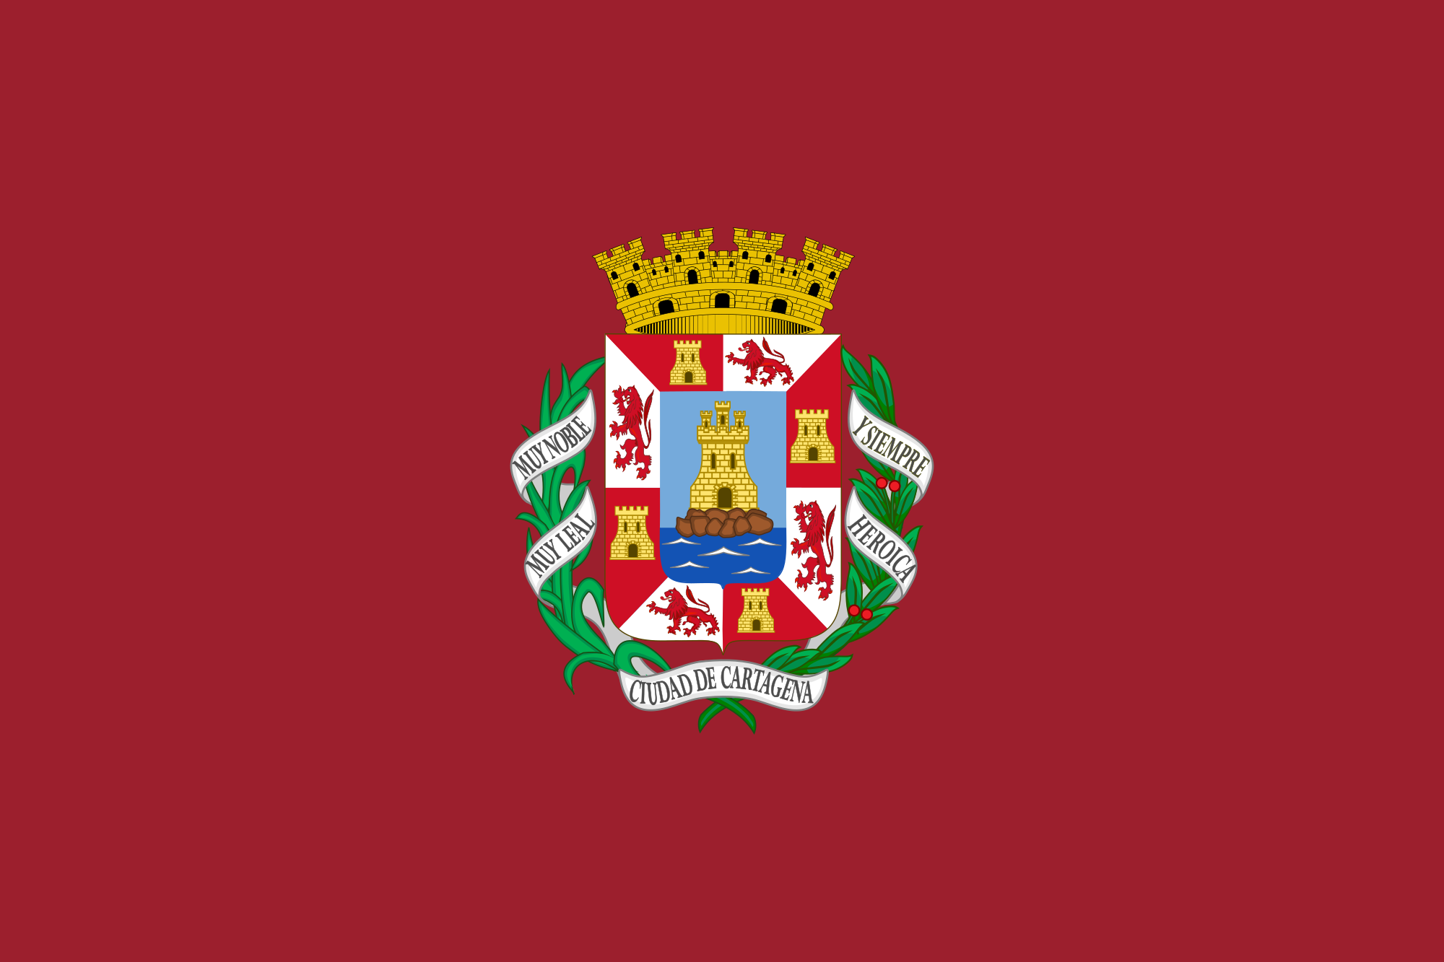
Cartagena, Columbia
Presented by
Marc Silver

Slide 2
What I Will Cover
My Port Philosophy
Don’t Miss the Ship
Money
VAT Refunds
About Cartagena, Columbia
History of Cartagena, Columbia
Transportation
Points of Interest
Places to see or at least consider
A few restaurant recommendations
Conclusion

Slide 3
My Port Philosophy
I have been cruising for over 46 years and have taken over 100 cruises.
So, I consider myself an experienced cruiser.
The information I will present is based on those many years of
experience.
When I am on a cruise where the city, I want to visit is not the port city,
I always recommend taking a ship’s tour.
But when I am in a port with multiple attractions nearby and easy to see
on my own -
I will do it on my own.
This presentation is for that type of port.

Slide 4
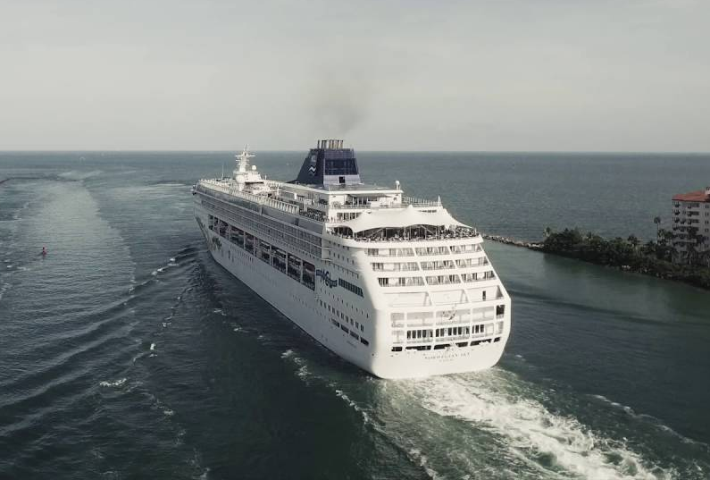
Don’t Miss the Ship
How to Avoid Missing Your Ship
Pay attention to the time. - Ship time and local time are often
different.
Put a return-to-ship reminder on your phone.
Choose excursions wisely.
If a ship-sponsored excursion is late returning to port for, the ship will
wait for you. If you are on your own???
Be Prepared
Have your Passport, Credit Card and phone numbers for your ship port agent.
What to Do If You Miss the Ship
Most cruise lines have port agents stationed in the port area to assist if your ship has left without you. If you’re lucky, when cruisers are late returning to the vessel, the ship's crew will often remove the passengers' essential items -- passports, cell phones and medication -- from the ship to leave with the port agents.
The Port Officials can help you with contacting your ship
and making necessary travel arrangements.

Slide 5
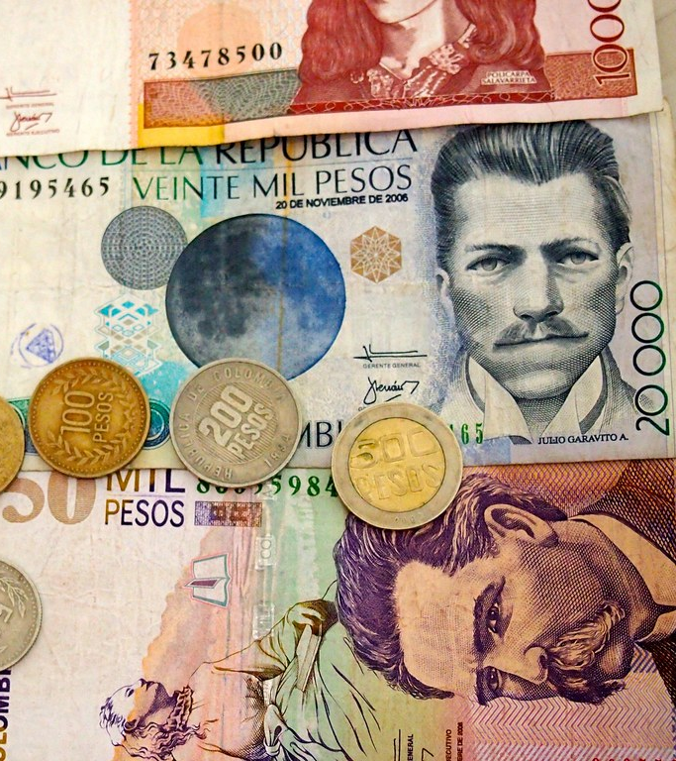
Money
The Colombian peso is the official currency of Colombia
Official Exchange 1000 Pesos COP is about $.25 US
Or 3,935.39 Pesos COP to $1 US

Slide 6
VAT Refunds
If you decide to buy souvenirs, you may want to consider getting a VAT refund.
All foreign tourists are entitled to VAT refunds on products purchased, such as local crafts, toys, linens, household appliances, footwear, leather goods, jewelry, emeralds, etc.
Where can you apply for your refund?
You can apply at the offices of the DIAN (National Tax and Customs Department), located in the international seaports, land, and airports, or at the Special Border Development Unit checkpoint.
What do you need to do?
Come in person with your VAT refund application.
Fill in the necessary forms.
Bring your original passport and a copy thereof or, otherwise, an entry permit proving your migratory status.
A copy of the receipts for your purchases.
For details on the VAT application process, visit the National Tax and Customs Department's site.

Slide 7
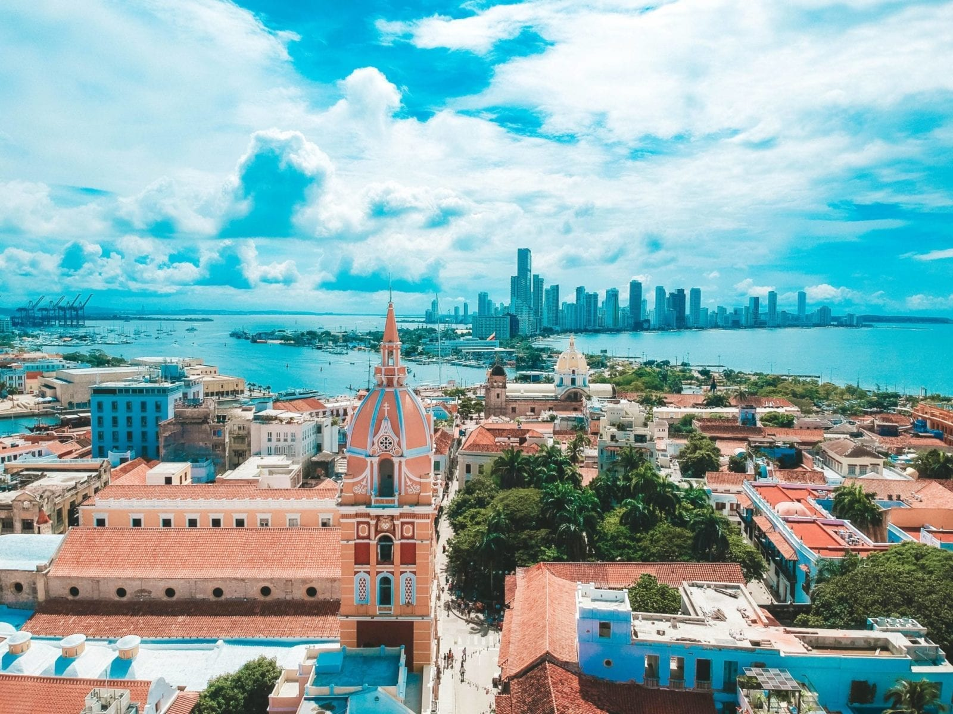
Cartagena, Columbia
Cartagena is one of the major ports on the northern coast of Colombia in the Caribbean Coast Region, bordering the Caribbean Sea. Cartagena’s past role as a link in the route to the West Indies provides it with important historical value for world exploration and preservation of heritage from the great commercial maritime routes. As a former Spanish colony, it was a key port for the export of Bolivian silver to Spain and for the import of enslaved Africans under the Asiento system.
It was defensible against pirate attacks in the Caribbean. The city's strategic location also gave it easy access to the interior of New Granada and made it a main port for trade between Spain and its overseas empire, establishing its importance by the early 1540s.

Slide 8
Historical Cartagena, Columbia
Archaeologists believe humans have lived in the region from around 4,000BCE, the earliest known inhabitants are called the Puerto Hormiga culture. They were later replaced by the Sinú society, who lived along the Colombian Caribbean coast. These tribes survived until the European colonization many centuries later.
The city of Cartagena was founded on 1 June 1533 by Spanish commander Pedro de Heredia, who took over an abandoned Amerindian Caribbean village known as Calamarí and started building a settlement of his own. The first Spanish settlers were sailors who arrived from Cartagena in Spain to start a new life; they established the town as Cartagena de Indias in reference to the Spanish counterpart.
In 1552, a fire flattened all the wooden buildings, after which the governor ordered all the replacements to be made from stone. Treasures were discovered in the tombs of the Sinú tribe, who buried their dead with all their riches; this led the city to prosper.

Slide 9
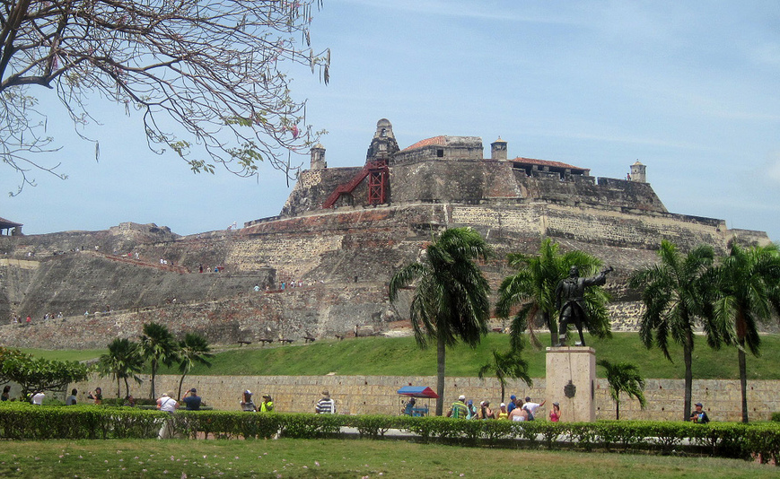
History of Cartagena
Modern Cartagena is the second-largest city in the Caribbean region, after Barranquilla, and the fifth-largest city in Colombia. Economic activities include the maritime and petrochemical industries, as well as tourism.
Today, Cartagena has expanded rapidly and is now home to more than 1m inhabitants. It is still the largest port in Colombia, specializing in petrochemicals. Despite all these changes, the walled Old City remains unchanged, with colonial architecture and historic buildings preserved.

Slide 10
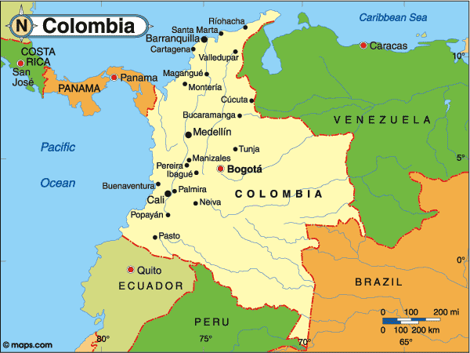

Slide 11
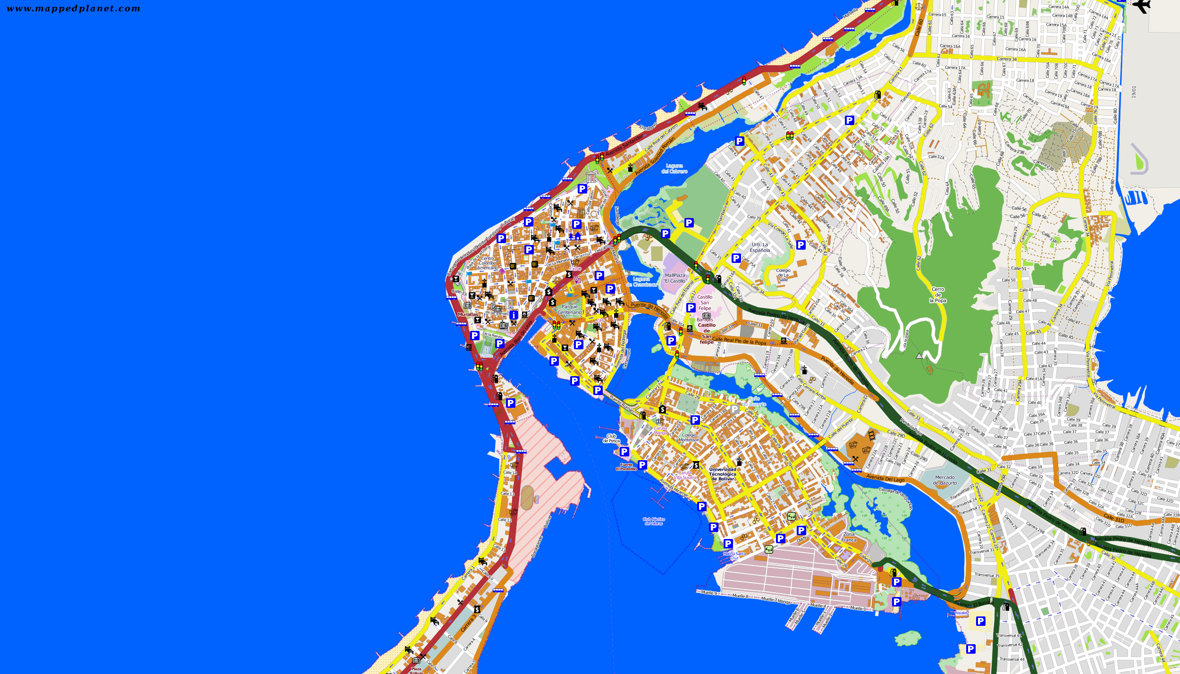
Map of Cartagena, Columbia

Slide 12
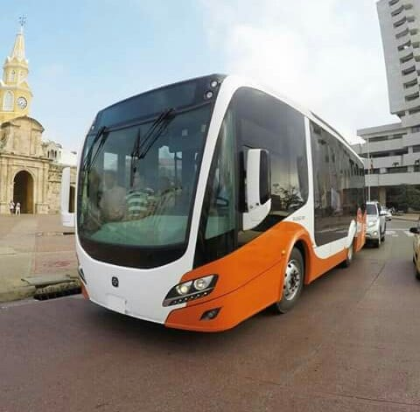
Cartagena City Bus
Transcaribe is a system of public transportation in Cartagena that was opened in 2016. It is meant to function in the vein of a subway with lanes and stations especially for it through Centro and down the main thoroughfares of the city.
It is still working on expanding to serve the entire city, but it is an option for cheap transportation in Cartagena. The buses and stations can get quite full (and you get to see people basically act like cattle getting on and off) at rush hour, but if you aren’t crunched in or can get a seat, the buses are quite comfortable and even have air conditioning.
To access Transcaribe, you must have a card with money
loaded on it (like a MetroCard). The cards can be bought
at the windows at stations and have a cost of 4,000 pesos.
A ride costs 2,300 pesos. If you already have a card, you can add money to it at stations or at places such as Giros Colombia

Slide 13
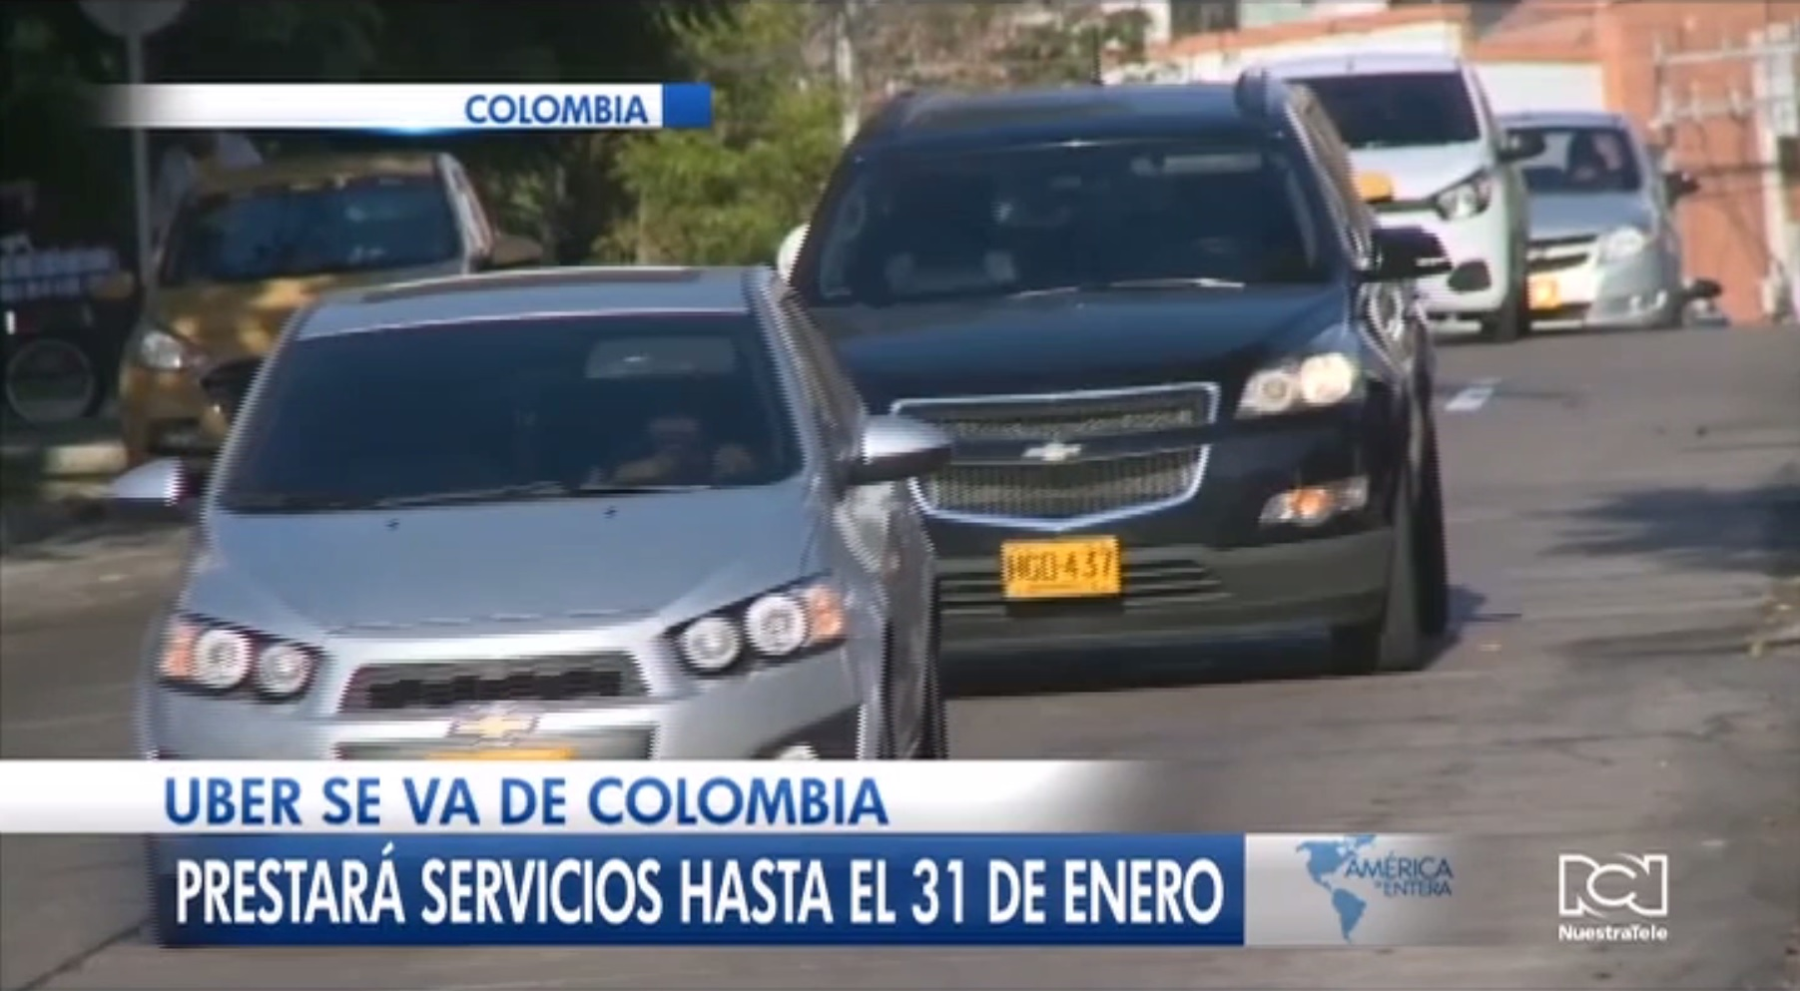
Uber in Cartagena
There is Uber in Colombia in 2023. It’s generally safe to use, available in most major cities, and very inexpensive compared to other transit options.
Uber had always existed in a sort of legal gray area in Colombia. It has caused controversy with taxi companies and unions opposing it. At one point it was banned, however, a mid-2020 court decision overturned that ban.
Given some taxi drivers’ propensity to overcharge, Uber makes for a good and safe alternative. In addition to knowing the price ahead of time, you also can be sure of safety since you can see the driver’s rating as well as the route itself.
Of course, you will need the app on your phone and phone service in Columbia!

Slide 14
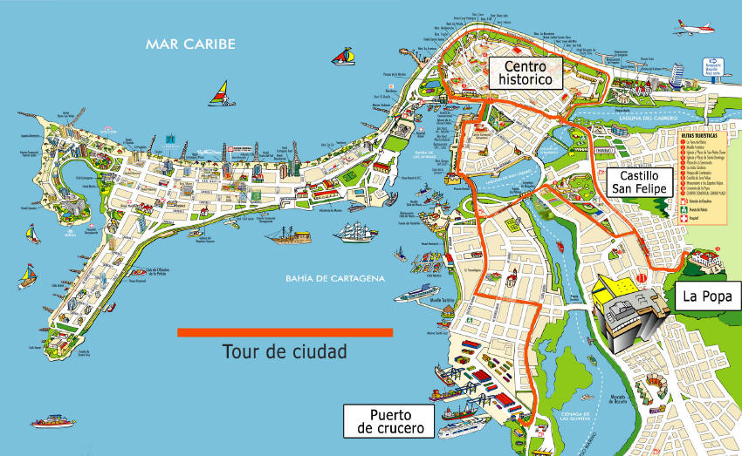
Hop-On Hop-Off Cartagena Bus
The Hop-On Hop-Off Cartagena Bus begins at the beginning of the day at the Muelle de la Bodeguita. It includes a multilingual audio guide service while you enjoy the scenery from the top of the bus, which will take you through the San Felipe Castle, the Clock Tower, Bocagrande, Pastelillo, Casa Rafael Núñez, the monument to India Catalina, and many more popular attractions of the city.
In addition, this tour includes a guided walking
tour of the historic city center to see the
Walled City of Cartagena and its architectural
legacy that has been preserved since colonial
times. This guided tour lasts 90 minutes and
starts at 3:45 p.m., at the Santa Clara Boquetillo
stop. You will visit with a bilingual guide the
most important points of cultural interest such
as the Plaza de San Pedro Claver, the Cathedral
of Cartagena, the Gold Museum, the Palace of
the Inquisition, Las Bóvedas, the Plaza Santo
Domingo, and much more.
Fare $21.00 USD / Person

Slide 15
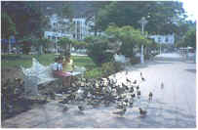
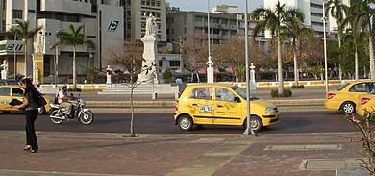
Cartagena Taxis
Taxis are the easiest way of getting around Cartagena, and they are likely to be your most used form of transportation in Cartagena, especially if you’re just visiting.
While Cartagena’s taxis are the most expensive in the country and prices to go longer distances can
be expensive, they’re still considerably cheaper than in the United States or other more developed countries.
Therefore, if you’re just in town on vacation and sticking to the areas near the waterfront, taxis are likely to be your best bet for easy and reliable transportation in Cartagena.
Note that licensed taxis should be yellow and have their license plate number and a “servicio publico” label on them. Taxis can be stopped easily on the street and are for the most part plentiful and easy to flag down except for very late at night or very early in the morning.

Slide 16
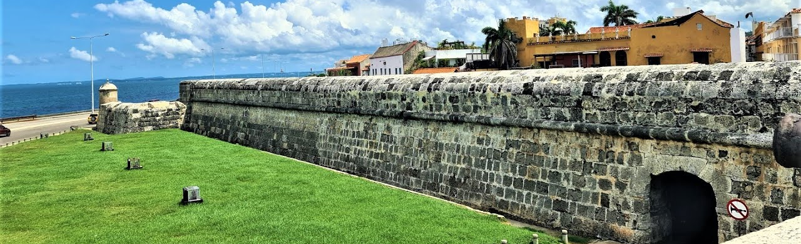
Explore the Walled City
Cartagena's charming walled city is Colombia's shining star. Most of The stunning architecture, meticulously restored, covers an extensive area in the city’s historical center. Narrow streets open onto restaurant-lined squares and inviting open spaces. Music fills the air in the evenings, as small bands set up in restaurants and roaming musicians take to the plazas like a scene from a Gabriel Garcia Marquez novel.

Slide 17


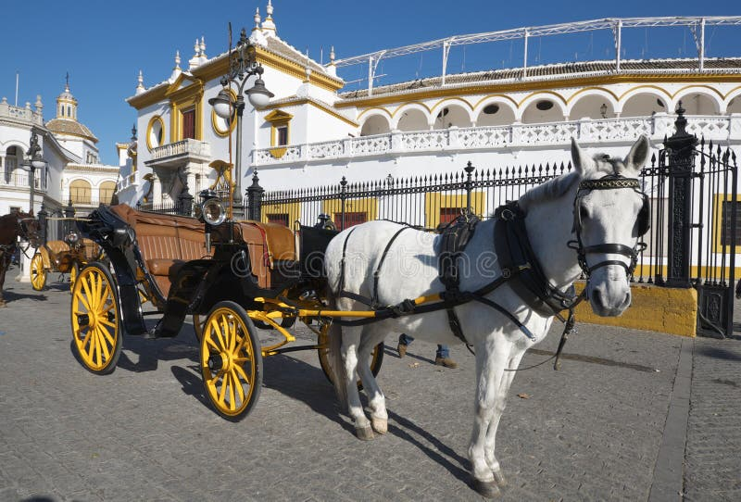
Horse-Drawn Carriage Ride
Although it may seem cliché, a horse-drawn carriage ride through the colonial walled city is one of the most popular things to do in Cartagena. Horses seem to outnumber cars in the old city, and the clip-clock sound of horse hooves can be heard as you walk down almost any street.
Although empty carriages will stop for you anywhere in the city, the best place to start a tour is from Plaza de los Coches in front of the Torre del Reloj, which is the main gate with the iconic yellow clocktower. Horse carriages line up along one side of the square, and touts are quick to sell you a tour.
You can negotiate a price, but your negotiating will generally only save you about 15 to 20 percent off the starting price. Tours operate in the day and late into the evening and run down all the most beautiful streets.

Slide 18
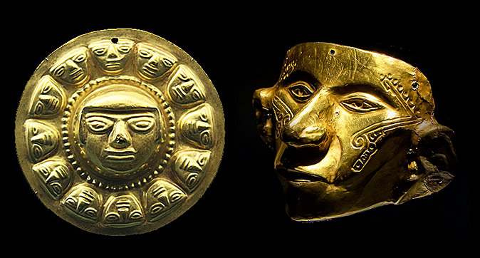
Museo del Oro Zenu
The Museo del Oro Zenu is a free attraction in Cartagena and easy to find, just off the famous Plaza Bolivar. This is more than just a museum dedicated to this lustrous mineral; it also provides a fascinating look into the history of the indigenous Zenu people and the importance of gold in their lives.
Inside, you'll find over 500 gold pieces
carved into fascinating shapes, including
a golden jaguar and a filigree butterfly. Other highlights include displays on body painting and textiles, and an exhibit focusing on the engineering expertise of the Zenu and how they built the vast network of canals over 2,500 years ago.

Slide 19
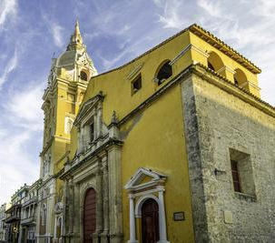
Cathedrals Santa Catalina de Alejandria
The Cathedral Santa Catalina de Alejandria is one of the most photographed buildings in the old town of Cartagena, particularly at night, when the impressive spire is lit up like a scene from a fairy tale. You can see it from throughout the old city as you wander along the streets. The building dates from 1612 and has recently been completely restored. If you are able to sneak a peak inside, you'll find towering archessupported by massive columns.
The cathedral is across the street from the shady Plaza Bolivar. During the day, artists selling their works are often set up in the vicinity of the cathedral.

Slide 20
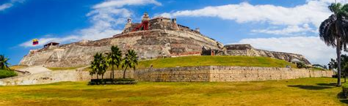
Castillo San Felipe de Barajas
Sitting on a hilltop just a short drive from the walls of the city, Castillo San Felipe de Barajas is regarded as one of the greatest forts the Spanish ever built. It's complex tunnel system and overall design, triangular in shape, make it unique among Spanish forts.
The most impressive feature of the fort is the tunnel system. The design of the tunnels took into consideration acoustics, which allowed the Spanish to hear even the slightest noise created by anyone trying to approach.
They are confusing to navigate, but you can access them at several points.

Slide 21
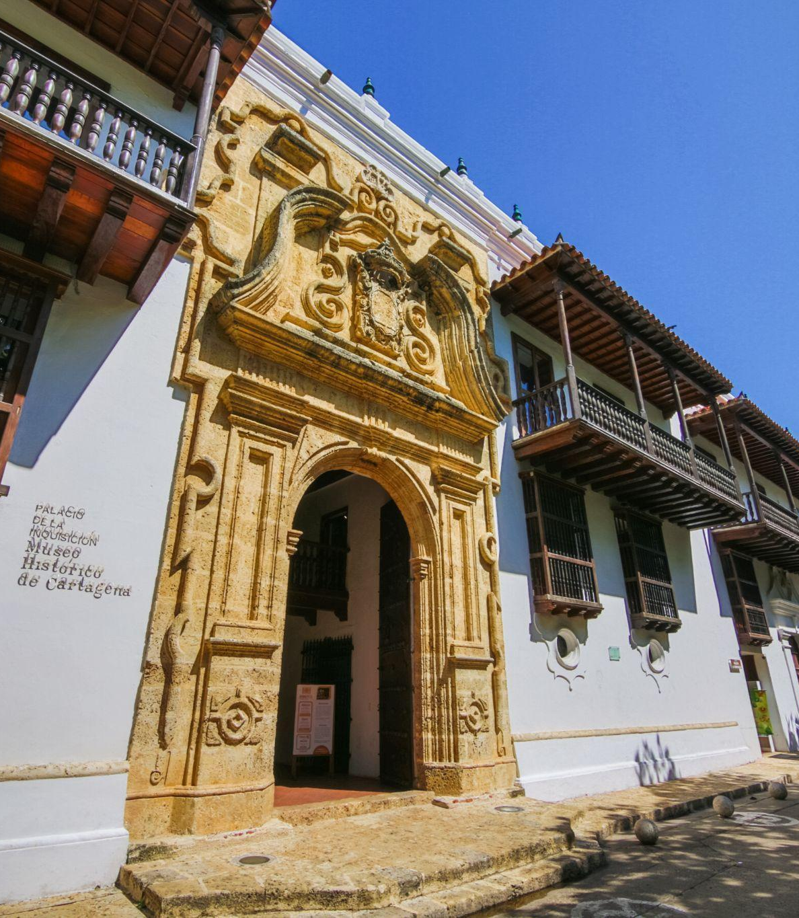
Museo de Historico de Cartagena de Indias
Cartagena was the main headquarters for the Spanish Inquisition in all of South America. Housed in a beautifully restored series of mansions dating from 1770, the Palace of the Inquisition / Museo de Historico de Cartagena de Indias provides a very in-depth overview of the Spanish Inquisition. A numerical system guides you through various rooms and courtyards where the complete story is told in Spanish and English, although not all plaques are translated to English.
Be sure to visit the courtyard to see some of the instruments used during the period, including a guillotine, and various other displays.

Slide 22
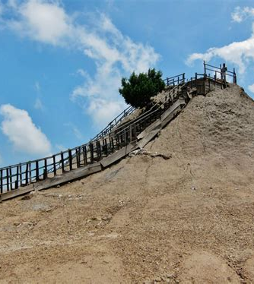
Magic Mud Volcano (El Totumo)
You can visit Colombia's famous mud volcano on a day trip from Cartagena. It's almost a right of passage for travelers to take a dip in the warm mud of this otherwise unassuming little mound.
After walking up a long set of stairs to the top of the so-called volcano, you can then drop into a pool of mud, usually filled wall to wall with other bathers. You will be completely covered head to toe in mud, but once you get out, locals are on hand to help scrub you down with water and towels to try to get the mud off, which is not an easy task! You will need to pay for the clean-up service.

Slide 23
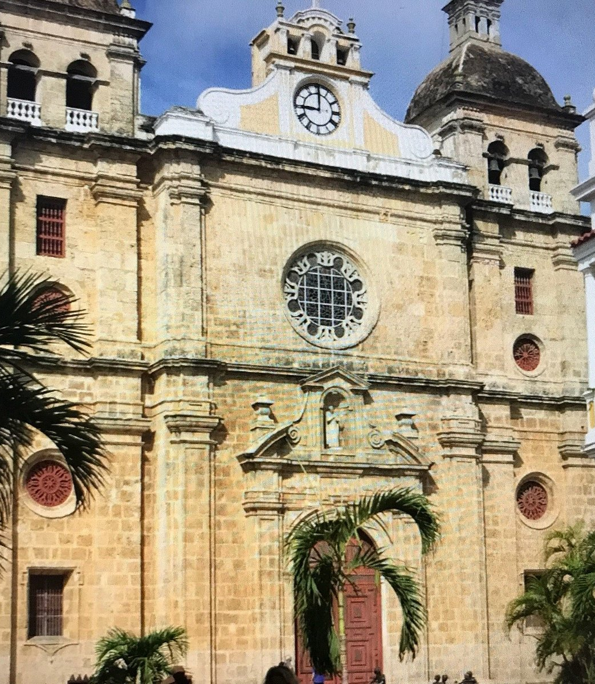
Sanctuary of
St. Peter Claver
The Sanctuary of St. Peter Claver is a wonderfully preserved church dating from 1580, housing the bones of Saint Peter Claver. The church is a cool and quiet escape from the daytime heat of Cartagena. In the evening, the square in front is transformed into a lively spot.
Small metal sculptures are spread around the square, and restaurants set up tables here after sunset. This area also offers a good view of the cathedral spire, and one of the most common photos of the cathedral, which you will frequently see online and in brochures, is taken from the edge of this square.
The church houses a small museum and a shady courtyard and garden. On display inside the church is an impressive collection of religious artwork.

Slide 24
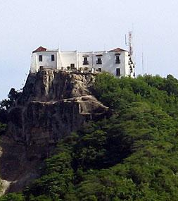
Convento de la Popa
Visible from almost everywhere in Cartagena and lit up at night, Convento de la Popa is perched on a 150-meter hill known as Mt. Popa, high above the city. Built in the early 1600s as a convent, it has been used for several purposes over the years, including army barracks. Simon Bolivar even set up here for a while. Today the Convento de la Popa is a religious museum.
It's worth a visit to see the stunning views out over Cartagena and the Caribbean Sea. Its wonderful patio is filled with colorful plants and several unique statues. Inside the convent is a beautiful rendering of La Virgen de la Candelaria, the patron saint of Cartagena. There is a small fee to enter the building.

Slide 25
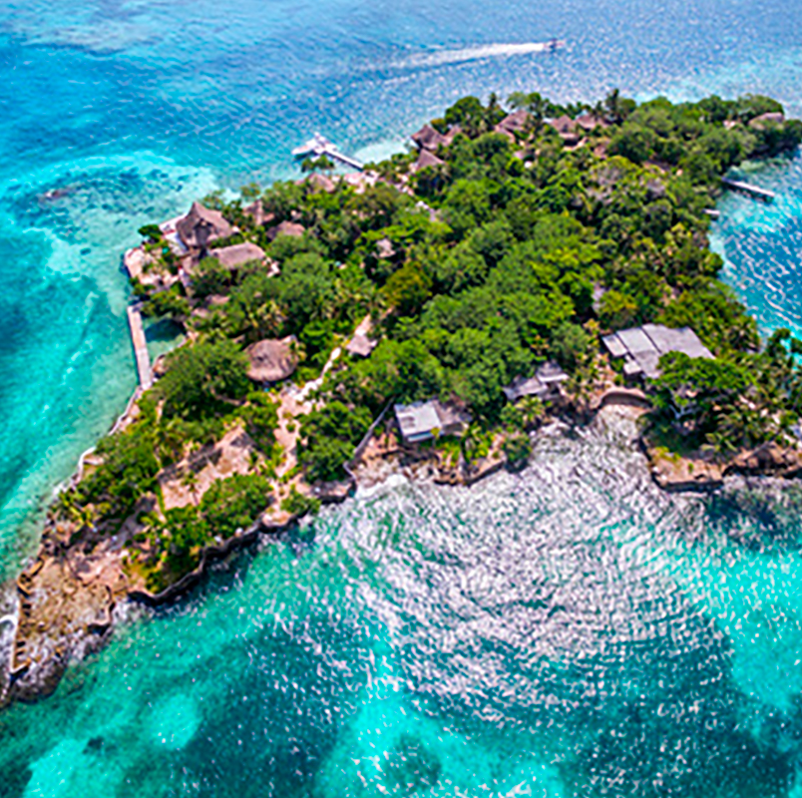
Islas del Rosario
Visiting the nearby islands and beaches is another popular thing to do when visiting Cartagena. The Islas del Rosario is home to beautiful beaches, including the most famous, Playa Blanca. This incredible white-sand beach lapped by the sparkling turquoise waters of the Caribbean Sea is the postcard-perfect beach. A couple of rustic restaurants line the beach.

Slide 26
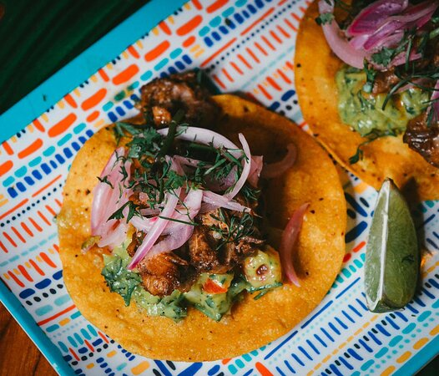
Cartagena Restaurants
Cartagena has many excellent restaurants. Many of us on the ship are
foodies, so naturally, we’re always on the hunt to eat at the most exclusive
spots anytime we travel.
Here are a few of the best restaurants to consider in downtown Cartagena.
Inkanto $$$$ Peruvian, Seafood, International
Carrera 5 #33-55 Portal de Los Dulces, Santa Catalina
Sabine Bistró & Lounge $$$$ French, American Barbecue
Cra. 11 #39-21 La Serrezuela Shopping Center 2nd and 3rd floors, Cartagena
El Arsenal: The Rum Box $$ - $$$ Bar Gastropub, Colombian
Carrera 24 # 8B-19, Cartagena
Inkanto $$$$ Peruvian, Seafood, International
Carrera 5 #33-55 Portal de Los Dulces, Santa Catalina Hotel, Cartagena
Restaurante Kokaú $$ - $$$ Colombian, Vegetarian, Vegan Options
Carrera 1 12 118 Bocagrande, Cartagena
For those of you who just like good food, you can’t go wrong just about anywhere you go in Cartagena.
GOOD EATING

Slide 27
Conclusion
Cartagena is a beautiful City with a rich history and numerous attractions. Whether you're looking for stunning beaches, historic sites, or unique attractions, Cartagena has something for everyone.
I hope this presentation will help when we visit Cartagena!

Slide 28
Thanks For Coming
If you have any more questions, please ask.
I will do my best to answer them for you.
Have a great visit in Cartagena!

