Slide 1
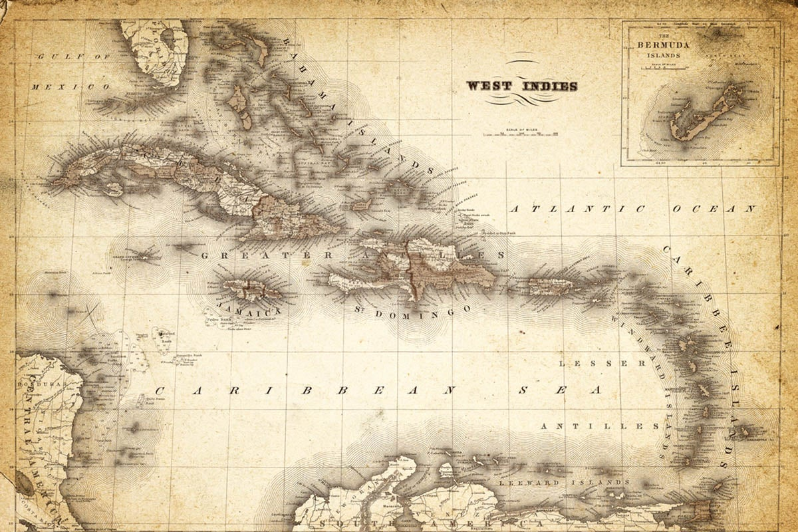
Caribbean Islands Historic View Presented by Marc Silver

Slide 2
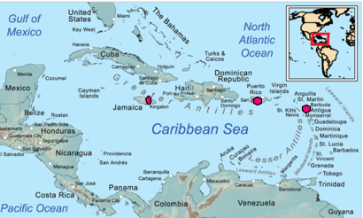
Locating Paradise
This stunning region lies nestled between North and South America, bordered by the Gulf of Mexico, the Atlantic Ocean, and the Caribbean Sea.
Comprising over 7,000 islands, islets, reefs, and cays, the Caribbean stretches from the Bahamas in the north to Trinidad and Tobago near South America.
Understanding its geography is key to appreciating its diverse history and culture. Today, we’ll journey from the days of the indigenous peoples, through colonization and its aftermath, to the thriving societies and economies of modern-day Caribbean islands. This presentation offers a snapshot of life in the Caribbean, blending historical insights with sociological perspectives to illuminate the forces that have shaped these islands.

Slide 3
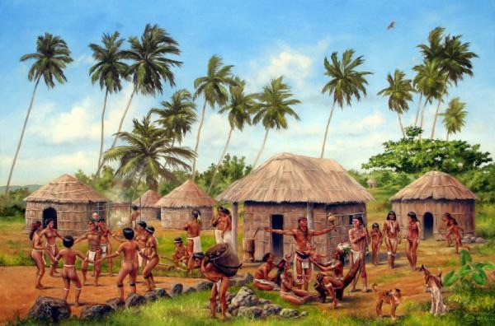
History of the Caribbean
Overview of the Indigenous Peoples
The Caribbean was originally home to indigenous groups like the Taíno, Kalinago (Caribs), and Ciboney peoples.
These communities flourished through fishing, farming, and inter-island trade.
They developed rich cultural traditions, including storytelling and ceremonial practices.
The Taíno crafted intricate petroglyphs and built ceremonial ball courts, while the Kalinago excelled in canoe-building and navigation.

Slide 4
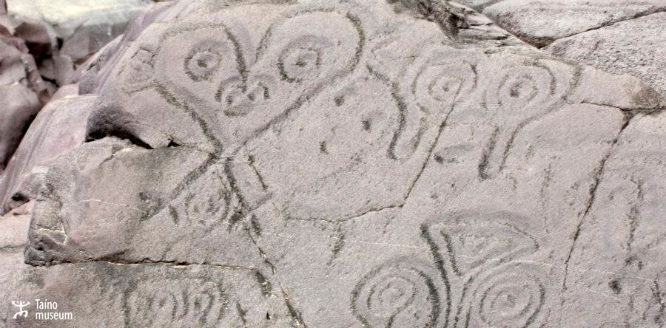
History of the Caribbean
Overview of the Indigenous Peoples
Despite their differences, these groups shared a sustainable way of life, deeply connected to the environment, which shaped their art, beliefs, and daily practices.
Before European arrival, the Caribbean was home to several indigenous groups, including the Taíno, Kalinago (Caribs), and Ciboney peoples.
These societies thrived on fishing, agriculture, and trade, creating vibrant communities with unique languages, spiritual beliefs, and art forms.
For example, the Taíno left a legacy of petroglyphs and ceremonial ball courts, while the Kalinago were known for their navigational skills.

Slide 5
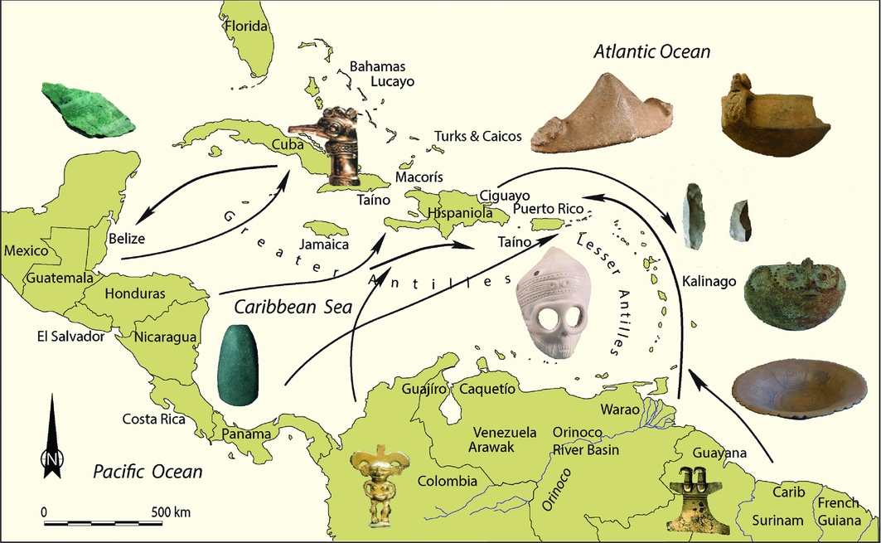
Pre-European Contact
Before European contact, the Caribbean’s indigenous peoples established thriving trade networks across the Greater and Lesser Antilles.
Communities exchanged goods like cassava, tobacco, and pottery, fostering cultural exchanges.
Oral traditions played a vital role in preserving histories and spiritual beliefs.
These societies maintained a deep connection with nature, relying on it for food, shelter, and spiritual guidance.

Slide 6
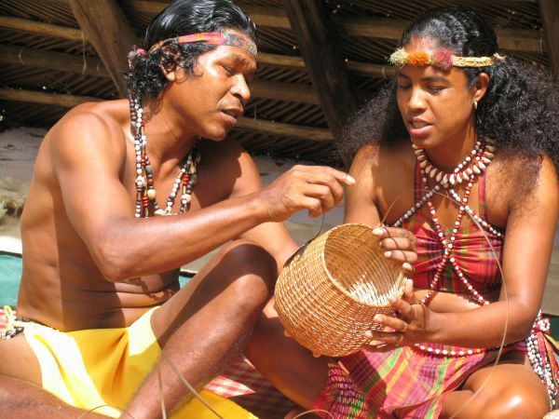
Pre-European Contact
Their harmonious lifestyle laid the foundation for the region’s unique cultural identity, which persists in echoes today.
The islands were part of a vast network of indigenous trade routes, connecting communities across the Greater and Lesser Antilles.
Goods like cassava, tobacco, and ceramics were exchanged, and oral traditions preserved their histories.
Despite their diversity, these groups shared a harmonious relationship with the environment, which profoundly influenced their cultural practices.

Slide 7
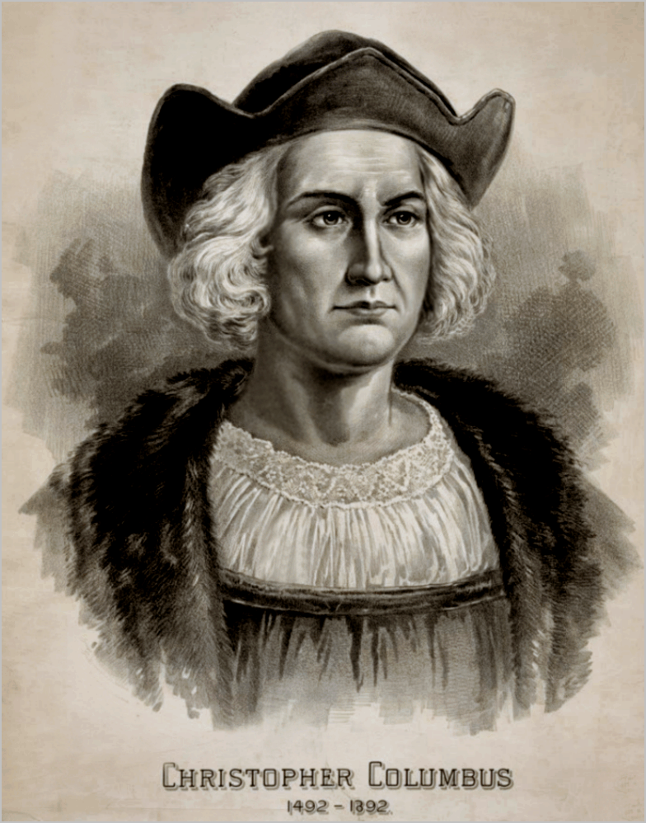
Age of Colonization and the Spanish Empire
The arrival of Christopher Columbus in 1492 ushered in European colonization, with Spain claiming vast territories.
Indigenous populations were rapidly devastated by diseases like smallpox, enslavement, and violence. Spanish settlers extracted resources and converted local peoples to Christianity, establishing the first European settlements in the Americas.
This era marked the beginning of profound cultural and demographic changes, with the Caribbean becoming a focal point for Spain’s imperial ambitions and wealth extraction.
In 1492, Christopher Columbus’ arrival marked the beginning of European colonization. Spain claimed vast territories, exploiting the islands for their resources and converting indigenous populations to Christianity. Disease, slavery, and violence decimated native communities, paving the way for European settlers.

Slide 8
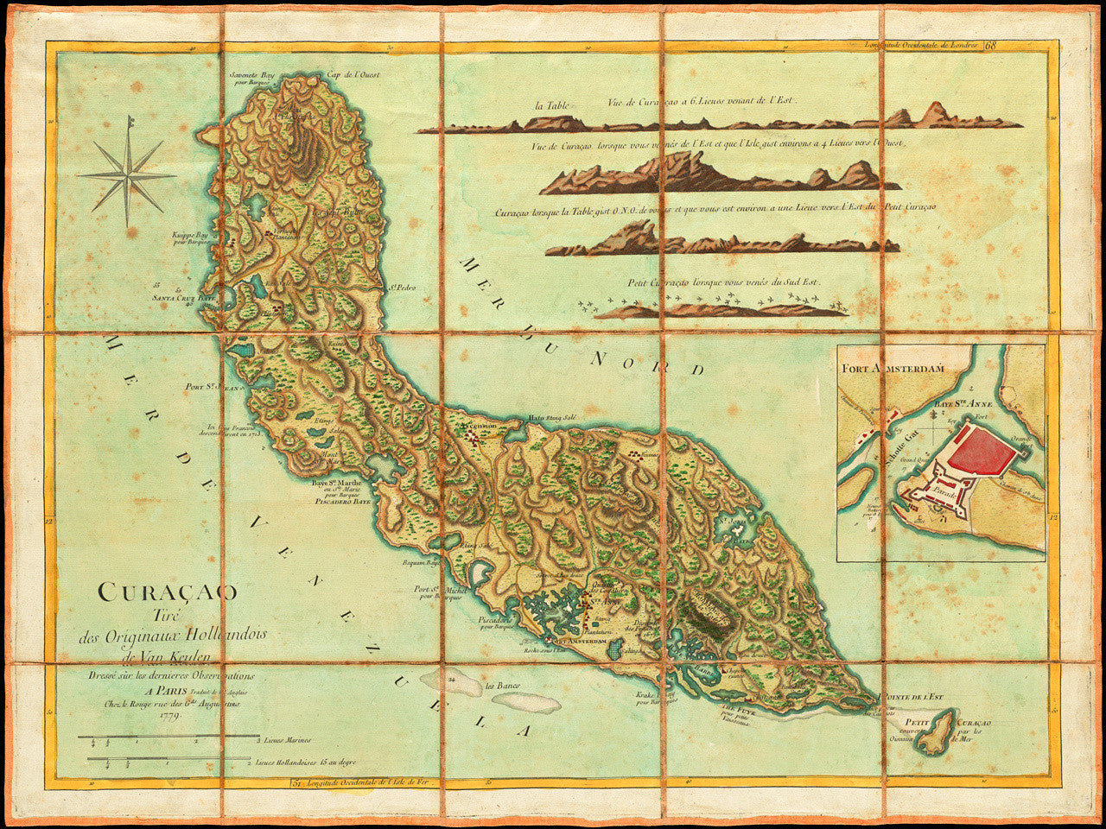
The Dutch, French, and English Conquests
In the 17th century, European powers like the Dutch, French, and English turned their attention to the Caribbean.
England established colonies in Jamaica and Barbados, France took control of Martinique and Guadeloupe, and the Dutch focused on Curaçao and surrounding islands.
These nations fought over territory and resources, transforming the Caribbean into a hub of sugar plantations.

Slide 9
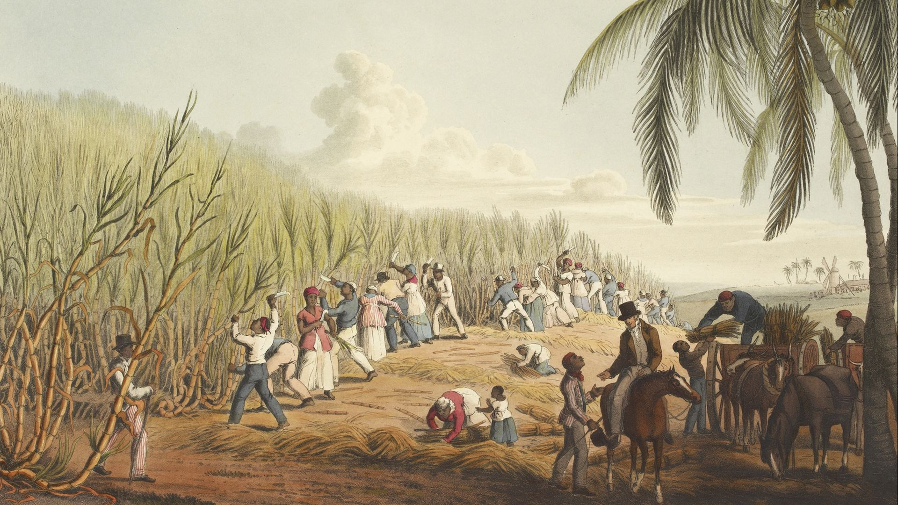
The Dutch, French, and English Conquests
Enslaved labor became central to these economies, permanently altering the social and cultural landscape of the region.
By the 17th century, European powers like the Dutch, French, and English sought Caribbean territories.
The English established colonies in Jamaica and Barbados, the French in Martinique and Guadeloupe, and the Dutch in Curaçao.
These powers competed fiercely for land and resources, shaping the islands into plantations reliant on enslaved labor.

Slide 10
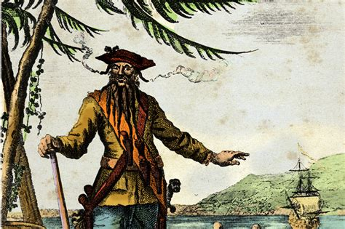
Pirate Period
During the 17th and 18th centuries, the Caribbean’s wealth and trade routes attracted pirates and privateers.
Notorious figures like Blackbeard and Anne Bonny became legends, and places like Port Royal, Jamaica, gained infamy as pirate strongholds.
These marauders targeted Spanish treasure fleets, creating a lawless but fascinating period. The pirate era left an enduring legacy in Caribbean folklore and tourism, contributing to its mystique as a region of adventure and intrigue.
The Caribbean’s lucrative trade routes attracted pirates and privateers during the 17th and 18th centuries. Figures like Blackbeard and Anne Bonny became infamous, while cities like Port Royal in Jamaica became pirate strongholds.
This era added a layer of intrigue to the Caribbean’s history, blending lawlessness with legend.

Slide 11
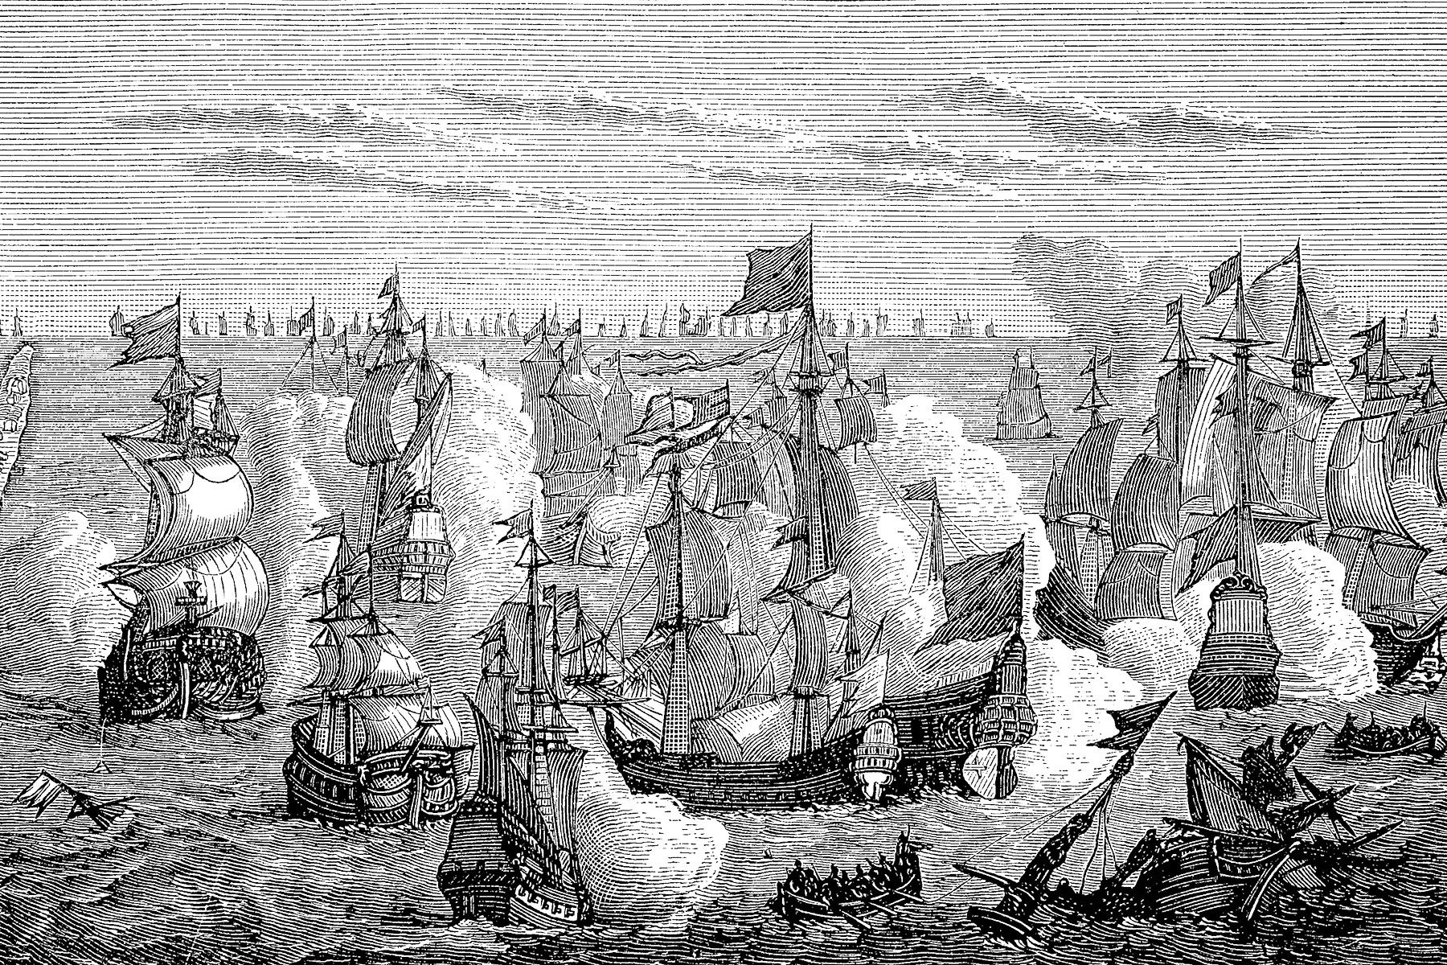
European Rivalries and the Caribbean
European Rivalries and Impact on the Caribbean
The Caribbean became a battleground for European powers during wars like the Seven Years’ War and the Napoleonic Wars.
Colonies shifted hands as England, France, and Spain vied for dominance.
These rivalries fueled the expansion of sugar plantations and slave labor, embedding economic and social inequalities.
The constant conflict and exploitation reshaped the islands’ political and cultural landscapes, laying the groundwork for the struggles and resilience seen in later centuries.

Slide 12
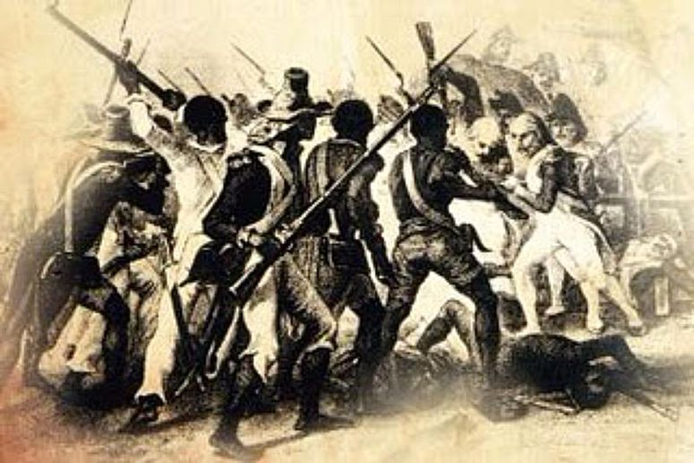
Afro-Caribbean History
Slave Rebellions
Resistance to enslavement was a defining feature of Afro-Caribbean history. Enslaved Africans fought against oppression through acts of defiance and large-scale revolts.
The Haitian Revolution, which led to Haiti’s independence in 1804, was a turning point, inspiring enslaved people across the Caribbean.
Smaller uprisings, such as the Jamaican Maroon Wars, showcased the courage and determination of those seeking freedom.

Slide 13
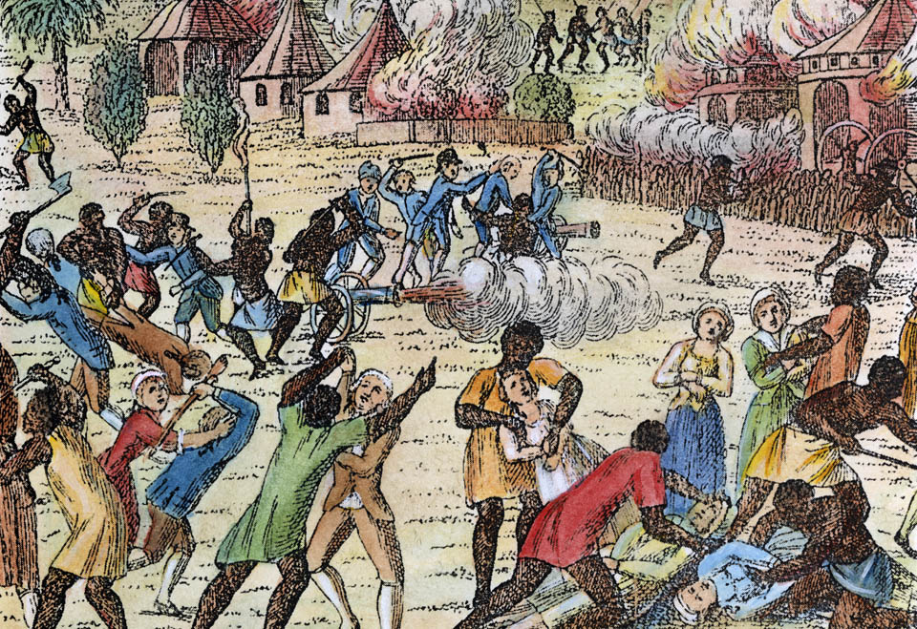
Afro-Caribbean History
Slave Rebellions
These rebellions reshaped the region’s political and social landscape, leaving a legacy of resistance that continues to inspire.
Enslaved Africans, brought to work on sugar plantations, resisted their oppression through rebellions and cultural preservation.
Notable uprisings, like the Haitian Revolution, reshaped the region’s history. Haiti’s independence in 1804 inspired enslaved peoples across the Caribbean.

Slide 14
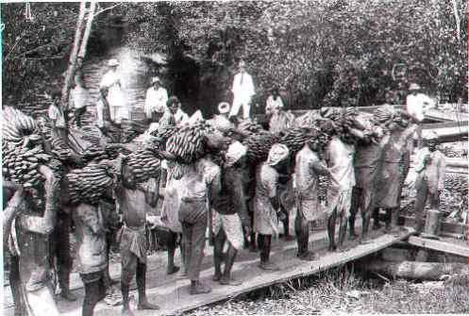
Colonial Dependency
Even after slavery’s abolition, colonial powers maintained control over Caribbean economies.
Former plantations shifted to indentured labor systems, bringing workers from India, China, and other regions.
This influx diversified the cultural landscape but also perpetuated economic inequalities. Many islands relied on exporting raw materials, leaving them vulnerable to global market changes.
The struggles for self-sufficiency and independence emerged from this dependency, shaping the Caribbean’s modern identity and political movements.
Even after the abolition of slavery, many islands remained economically dependent on colonial powers.
Systems of indentured labor replaced slavery, with workers arriving from India, China, and elsewhere, adding to the region’s cultural diversity.

Slide 15
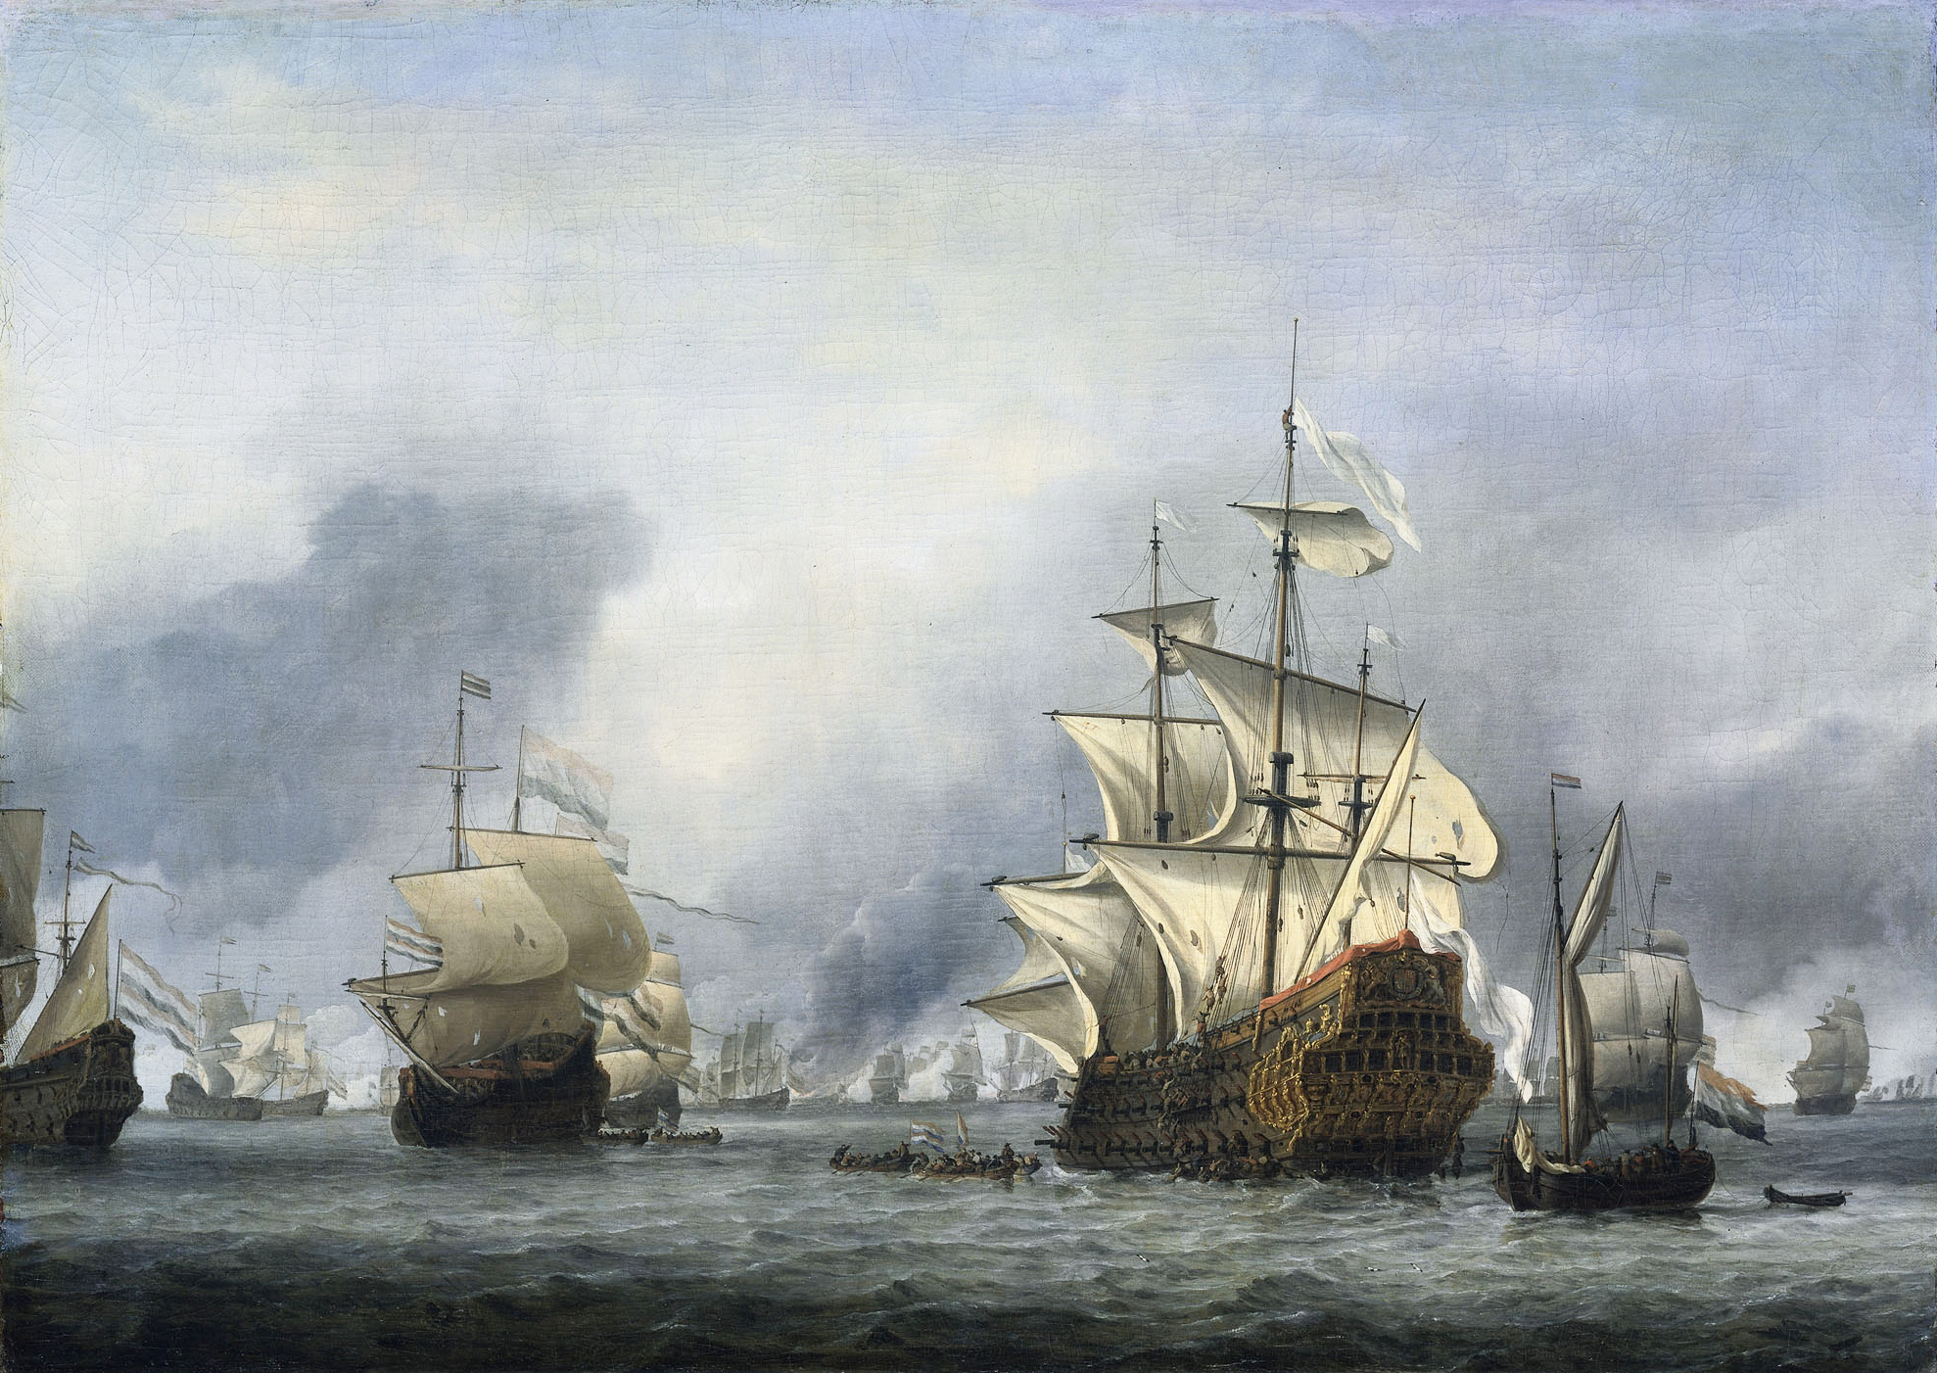
Wars Affecting the Caribbean
The Early Colonial Wars
From the 16th to the 18th century, the Spanish, French, Dutch, and English fought to control the Caribbean’s lucrative territories.
Conflicts like the Anglo-Spanish War and the Franco-Dutch War redrew boundaries repeatedly.
These clashes centered on access to trade routes and resources, leaving lasting impacts on island governance and populations.

Slide 16
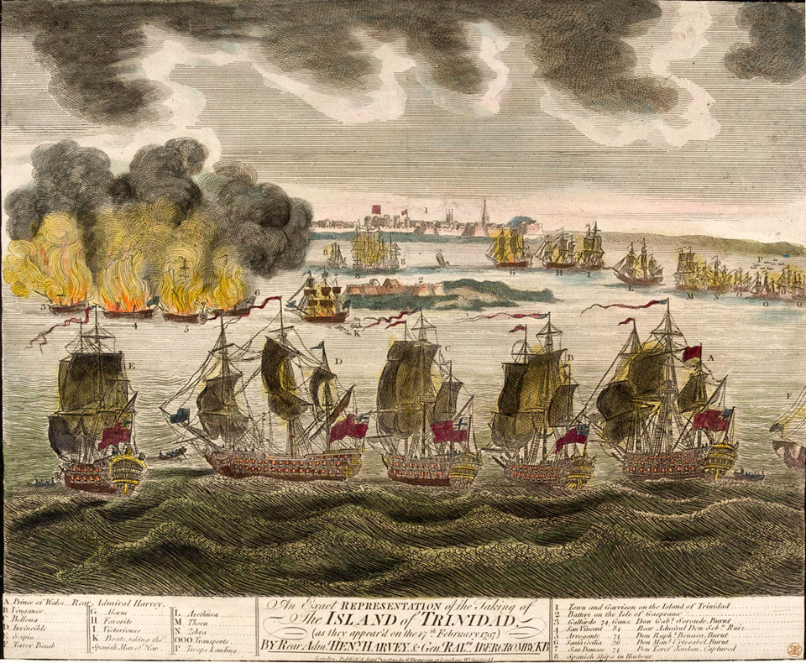
Wars Affecting the Caribbean
The Napoleonic Era
During the Napoleonic Wars (1799-1815), the Caribbean’s sugar-rich islands were highly contested.
England gained dominance, seizing colonies like Trinidad and holding on to Jamaica, while France’s influence waned.
These conflicts shifted economic power and altered colonial hierarchies.

Slide 17
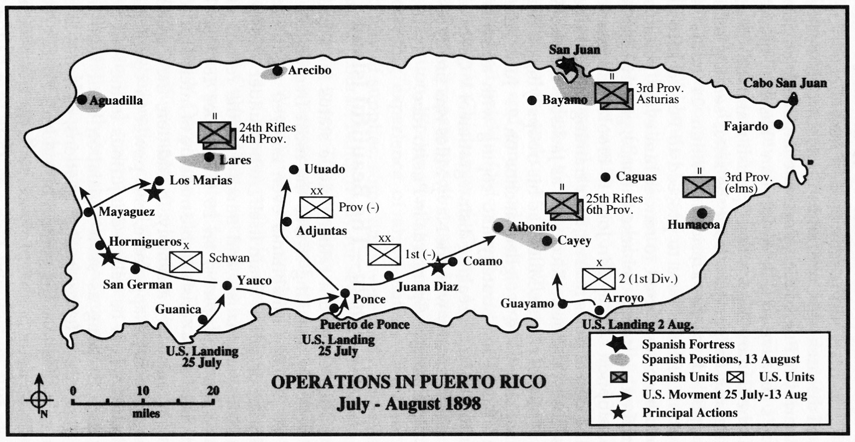
United States Involvement in the Caribbean
The Spanish-American War
The Spanish-American War in 1898 marked a turning point in U.S. involvement in the Caribbean.
The war resulted in the U.S. acquiring Puerto Rico from Spain, establishing it as a territory.
This marked the beginning of an era where the U.S. would exert political and economic influence across the region.
Puerto Rico remains an unincorporated U.S. territory, shaping its governance and economy.

Slide 18
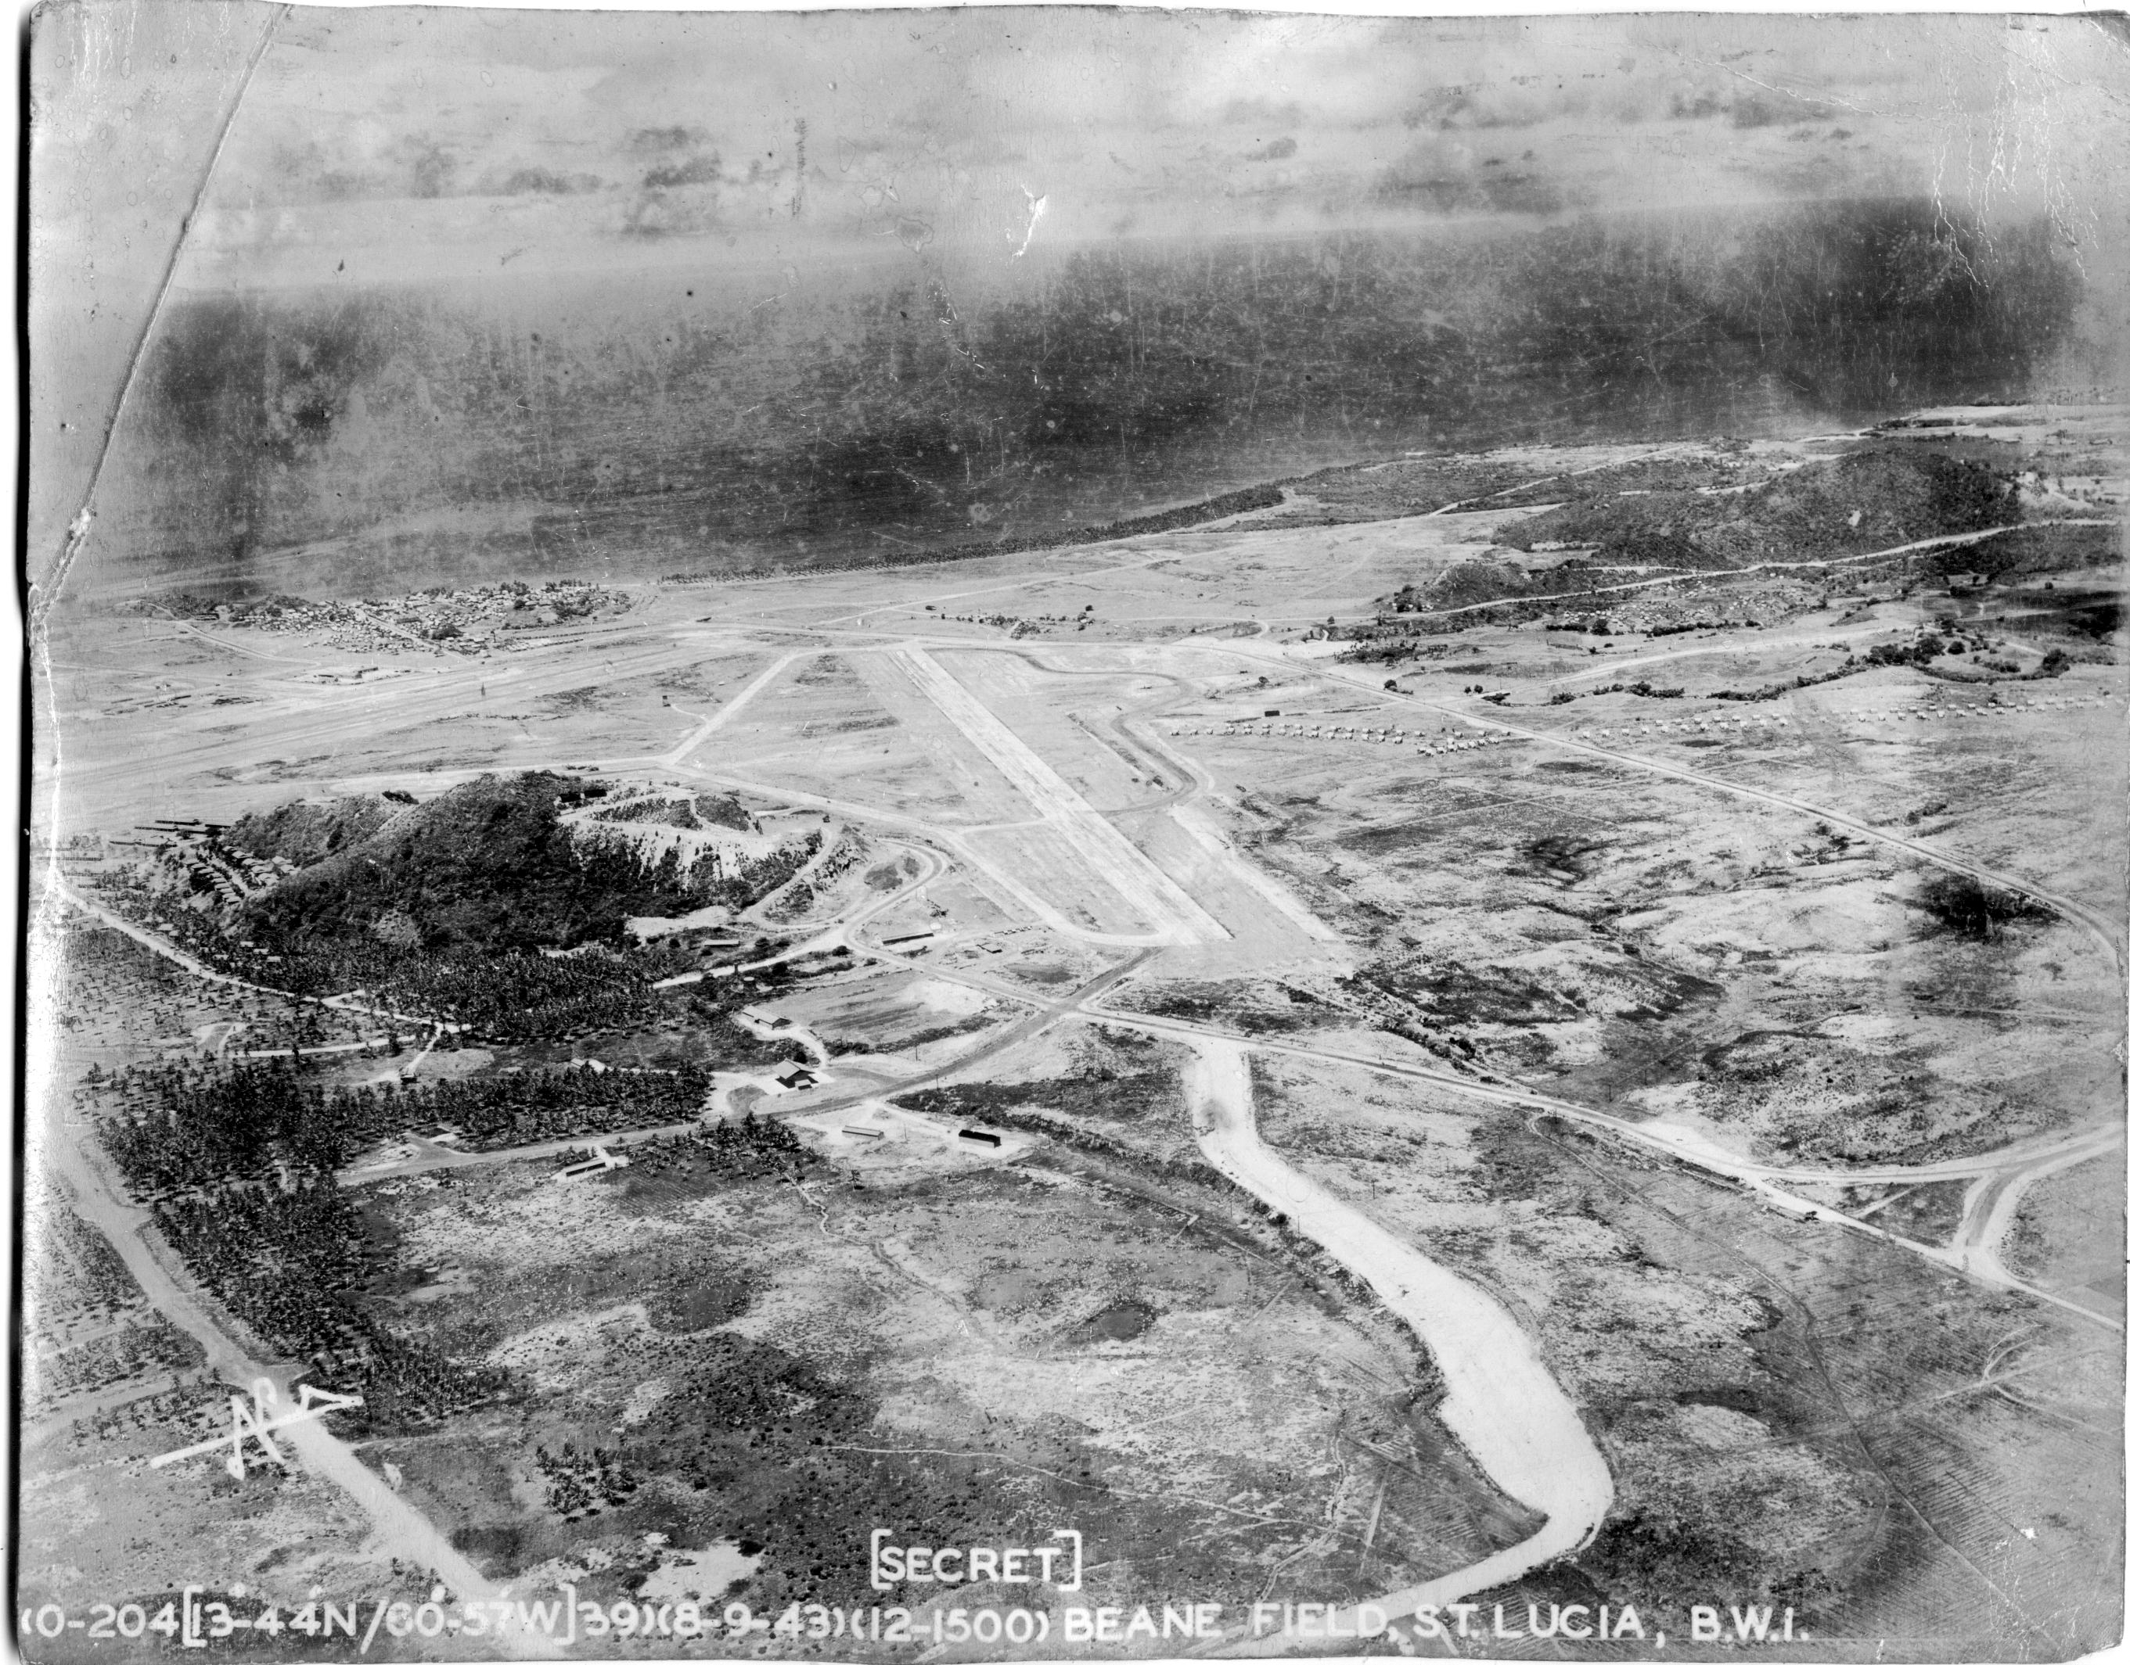
Wars Affecting the Caribbean
The World Wars
In the 20th century, World War I and II had profound effects on the region.
The Caribbean provided crucial resources, manpower, and strategic bases for the Allies. However, war-related disruptions led to economic hardships, spurring migration and decolonization movements.
These experiences reshaped the region’s socio-political landscape. The Caribbean’s strategic location made it pivotal in global conflicts. During both World Wars, the region supplied resources, labor, and soldiers to Allied forces.
The wars also brought economic hardships, as trade disruptions and resource demands strained local economies.

Slide 19
United States Involvement in the Caribbean
The Monroe Doctrine and Roosevelt Corollary
The Monroe Doctrine (1823) signaled U.S. intent to limit European influence in the Caribbean and the Western Hemisphere.
Later, the Roosevelt Corollary (1904) expanded this policy, justifying U.S. intervention in the region to ensure stability and protect American interests.
These doctrines led to military occupations and economic dominance over several Caribbean nations.

Slide 20
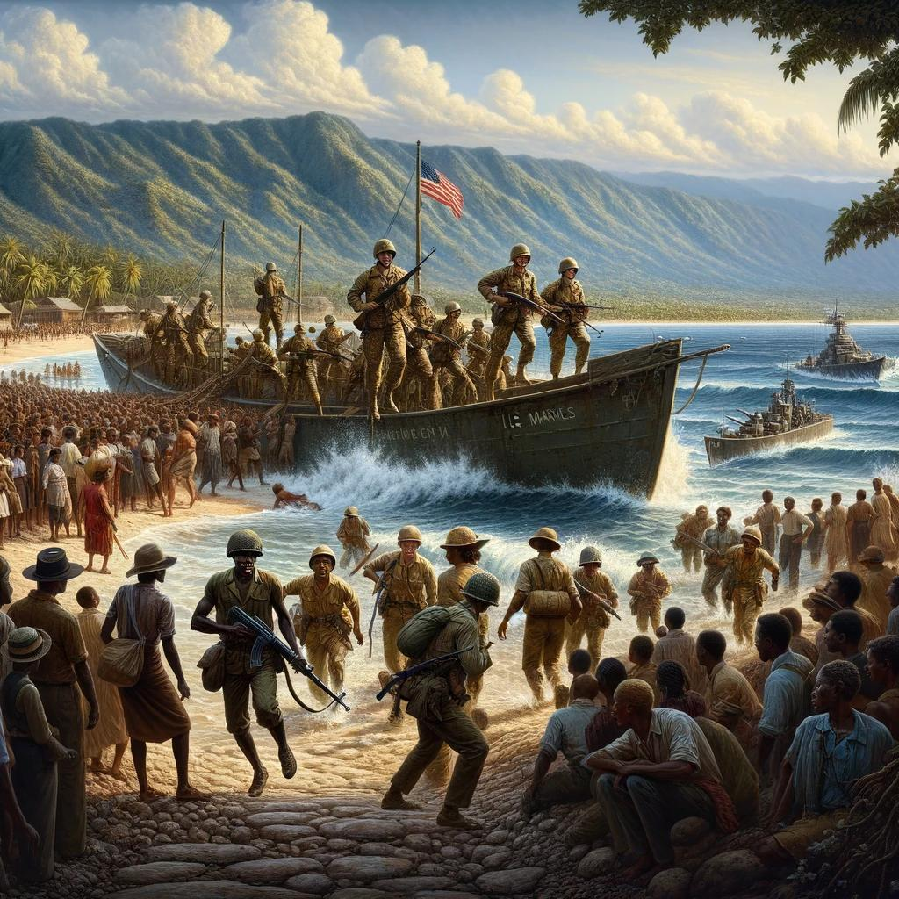
United States Involvement in the Caribbean
Military Occupations and Economic Control
In the early 20th century, the U.S. occupied countries like Haiti (1915-1934) and the Dominican Republic (1916-1924), asserting control under the guise of maintaining order.
The U.S. also dominated industries like sugar and bananas, influencing local economies and politics.
US Seizure of Haiti 1915

Slide 21
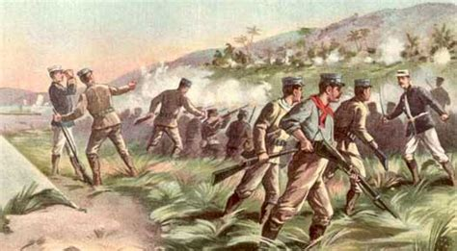
United States Involvement in the Caribbean
Military Occupations and Economic Control
Agreements like the Platt Amendment (1901) allowed the U.S. to maintain influence over Cuba even after its independence.
While many islands gained independence during the 20th century, others, like Puerto Rico and the British Virgin Islands, remain territories of larger nations.
These relationships influence governance, trade, and identity in the modern Caribbean.

Slide 22
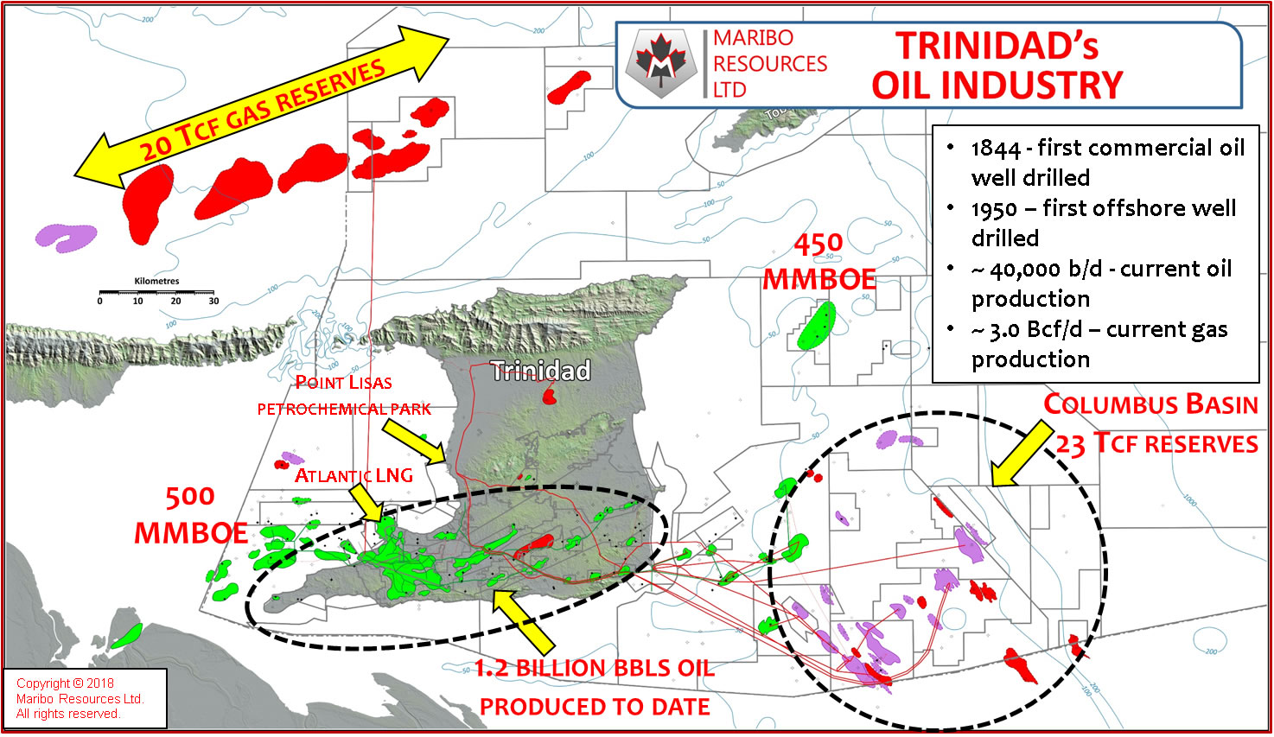
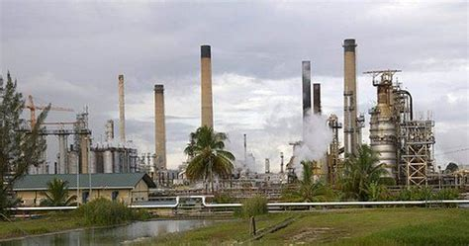
Economic Change in the 20th Century
Oil and Energy Industries
Trinidad and Tobago emerged as a powerhouse in the oil and natural gas sector during the 20th century.
These resources became vital to the nation’s economy, allowing significant investment in infrastructure and social programs.
This shift helped diversify its economic base, making it less reliant on agriculture and boosting its global economic profile.

Slide 23
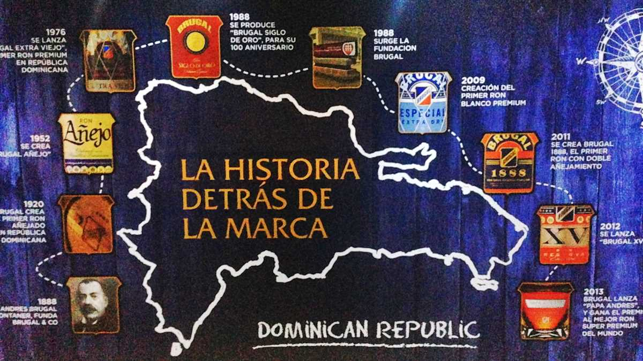
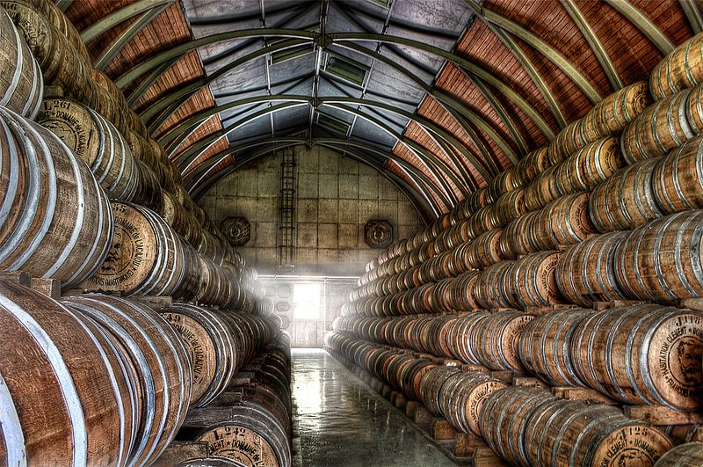
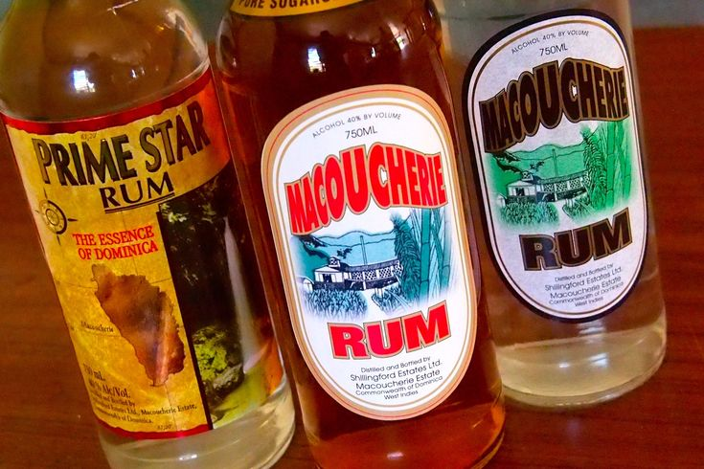
Economic Change in the 20th Century
Manufacturing and Exports
Countries like Barbados and the Dominican Republic developed robust manufacturing industries, producing goods like textiles, electronics, and rum.
Export-driven economies flourished, leveraging proximity to North America and Europe. These industries provided jobs and contributed to economic stability, complementing tourism and agriculture.

Slide 24
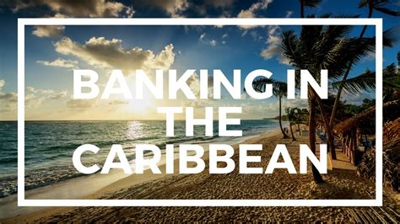
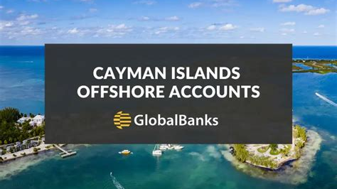
Economic Change in the 20th Century
Financial Services
The Cayman Islands, the Bahamas, and Bermuda became renowned financial hubs.
By offering low taxes and business-friendly regulations, these islands attracted international banking, insurance, and investment firms.
Financial services grew into a cornerstone of these economies, bolstering revenue and employment opportunities.

Slide 25

Economic Change in the 20th Century
Modern Innovations
Contemporary Caribbean economies blend traditional industries with modern innovations.
Agriculture, fisheries, and crafts coexist alongside renewable energy initiatives and tech startups.
Regional cooperation, such as through CARICOM, supports economic stability and growth.
These modern efforts highlight the Caribbean’s adaptability and focus on sustainable development.

Slide 26

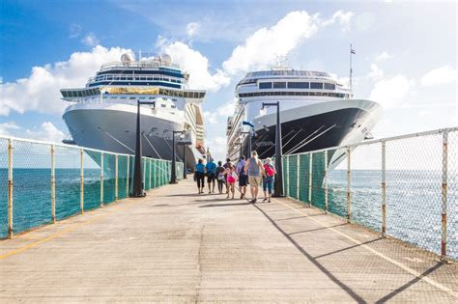

Modern Tourism
Tourism’s Economic Impact
Tourism is the lifeblood of the modern Caribbean economy, with millions of visitors annually contributing to GDP and employment.
Iconic attractions like Jamaica’s beaches, the Bahamas’ coral reefs, and Cuba’s colonial cities draw global attention.
Many islands rely on tourism as a primary source of revenue, investing heavily in resorts, airports, and cruise ports.

Slide 27
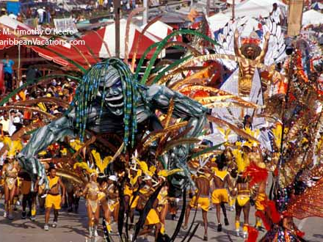
Modern Tourism
Cultural Tourism
Beyond beaches, the Caribbean offers rich cultural experiences.
Festivals like Trinidad’s Carnival and Barbados’ Crop Over celebrate heritage, music, and food.
Visitors explore historic plantations, vibrant markets, and local arts, deepening their connection to the islands’ unique identities.

Slide 28
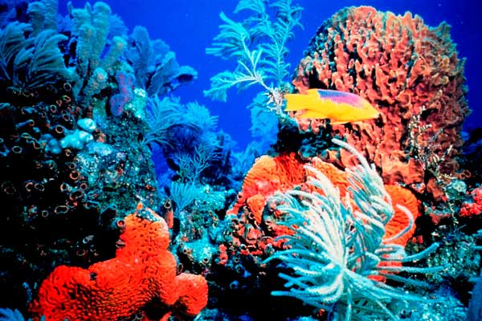
Challenges of Sustainability
Balancing tourism growth with environmental sustainability is a pressing concern. The influx of visitors strains ecosystems, especially in fragile areas like coral reefs.
Efforts like eco-tourism and conservation initiatives aim to mitigate impacts, ensuring long-term viability while preserving the natural beauty that defines the region.
Tourism is the lifeblood of the modern Caribbean economy, with millions of visitors annually. Iconic attractions like Jamaica’s beaches, the Bahamas’ coral reefs, and Cuba’s colonial cities draw global attention.
Yet, balancing tourism with sustainability remains a challenge for many islands.

Slide 29
Final Thoughts
The Caribbean is a region of resilience and reinvention. Its history—from indigenous cultures to modern economies—showcases the enduring spirit of its people.
Contemporary Caribbean economies blend traditional industries with modern innovations, including agriculture, fisheries, crafts, renewable energy initiatives, and tech startups.
Regional cooperation through organizations like CARICOM supports stability and growth, while the islands navigate challenges and opportunities in a globalized world. As you explore these islands, remember the complex forces that have shaped them, enriching your journey with a deeper understanding.
The Caribbean is a region of resilience and reinvention. Its history—from indigenous cultures to modern economies—showcases the enduring spirit of its people.
As you explore these islands, remember the complex forces that have shaped them, enriching your journey with a deeper understanding.

Slide 30
Citations & References
Gómez, M. (2020). The Caribbean: A History of Resilience. Oxford University Press.
National Archives. (2023). Records on Caribbean Colonial Administration.
Caribbean Tourism Organization. (2023). Tourism Statistics and Economic Impact.
Smith, J. (2019). Pirates of the Caribbean: The Real Stories Behind the Legends. Penguin Books.
Online resources: Caribbean History Project (www.caribbean-history.org), UNESCO Heritage Reports.

