Slide 1
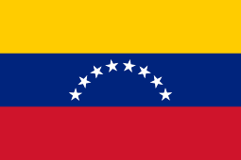
Caracas
Venezuela
Presented by
Marc Silver

Slide 2
What I Will Cover
My Port Philosophy
Don’t Miss the Ship
Money
About Caracas
Area Map of Caracas
Map of Caracas
Caracas Transportation
Places to see or at least consider
A few restaurant recommendations
Conclusion

Slide 3
My Port Philosophy
I have been cruising for over 45 years and have taken over 200 cruises.
So, I consider myself an experienced cruiser.
The information I will present is based on those many years of
experience.
When I am on a cruise where the city, I want to visit is not the port city,
I always recommend taking a ship’s tour.
But when I am in a port with multiple attractions nearby and easy to see
on my own - I will do it on my own.
This presentation is for that type of port.

Slide 4

Don’t Miss the Ship
How to Avoid Missing Your Ship
Pay attention to the time. - Ship time and local time are often
different.
Put a return-to-ship reminder on your phone.
Choose excursions wisely.
If a ship-sponsored excursion is late returning to port, the ship will
wait for you. If you are on your own???
Be Prepared
Have your Passport, Credit Card, and phone numbers for your ship
port agent.
What to Do If You Miss the Ship
Most cruise lines have port agents stationed in the port area to assist if your ship has left without you. If your are lucky, when cruisers are late returning to the vessel, the ship’s crew will often remove the passengers’ essential items – passports, cell phones, and medication -- from the ship to leave with the port agents.
The Port Officials can help you with contacting your ship
and making necessary travel arrangements.

Slide 5
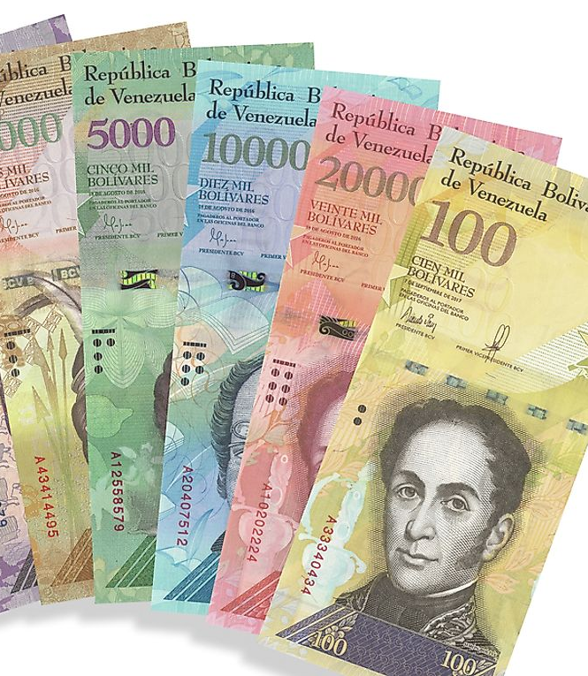
Venezuelan Money
The Venezuelan Bolívares is the official currency of Venezuela
The official Exchange is 10,000,000 Bolívares is $2.93 US
3,394,850 Bolívares to the US Dollar

Slide 6
About Caracas
Caracas officially Santiago de León de Caracas, abbreviated as CCS, is the capital and largest city of Venezuela, and the center of the Metropolitan Region of Caracas Caracas is located along the Guaire River in the northern part of the country, within the Caracas Valley of the Venezuelan coastal mountain range (Cordillera de la Costa). The valley is close to the Caribbean Sea, separated from the coast by a steep 2,200-meter-high (7,200 ft) mountain range, Cerro El Ávila; to the south, there are more hills and mountains. The Metropolitan Region of Caracas has an estimated population of almost 5 million inhabitants.
The center of the city is Catedral, located near Bolívar Square, though some consider the center to be Plaza Venezuela, located in the Los Caobos area

Slide 7
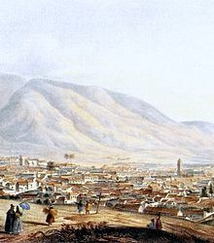
Historical Caracas
Before the city was founded in 1567, the valley of Caracas was populated by indigenous peoples. Francisco Fajardo began establishing settlements in the area of La Guaira and the Caracas Valley between 1555 and 1560. Fajardo attempted to establish a plantation in the valley, but it did not last long, destroyed by natives of the region. Fajardo's 1560 settlement was known as Hato de San Francisco, and another attempt in 1561 by Juan Rodríguez de Suárez was called Villa de San Francisco and was also destroyed by the same native people. The eventual settlers of Caracas came from Coro, the German capital of their Klein-Venedig colony around the present-day coastal Colombia–Venezuela border; from the 1540s, the colony had been controlled by Spaniards. Moving eastward
from Coro, groups of Spanish settlers founded inland towns including Barquisimeto and Valencia before reaching the Caracas valley. n 1728, the Guipuzcoan Company of Caracas was founded by the king, and the cacao business grew in importance.

Slide 8
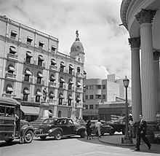
Historical Caracas
In 1812, an earthquake destroyed Caracas, and a quarter of its population migrated in 1814. The Venezuelan War of Independence continued until 24 June 1821, when Simón Bolívar defeated royalists in the Battle of Carabobo. Urban reforms only took place towards the end of the 19th century, under Antonio Guzmán Blanco: some landmarks were built, but the city remained distinctly colonial until the 1930s.
Caracas grew in size, population, and economic importance during Venezuela's oil boom in the early 20th century. In the 1950s, the metropolitan area of Gran Caracas was developed,
and the city began an intensive modernization program, funding public buildings, which continued throughout the 1960s and early 1970s. Cultural landmarks, like the University City of Caracas, were designed by modernist architect Carlos Raúl Villanueva and declared a World Heritage Site by UNESCO in 2000.

Slide 9
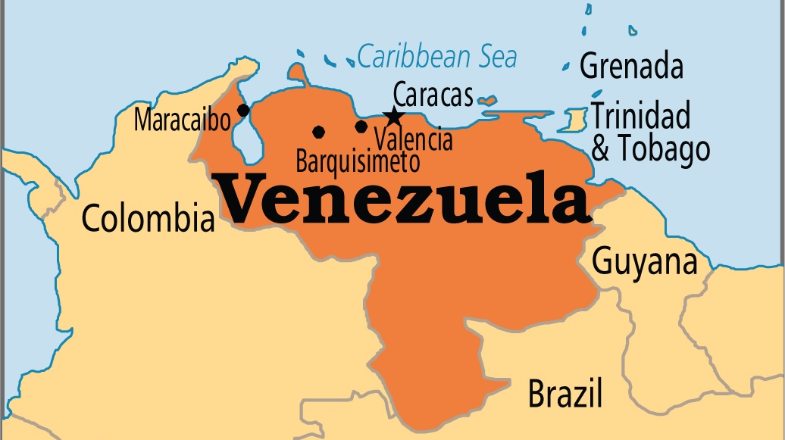
Area Map of Caracas

Slide 10
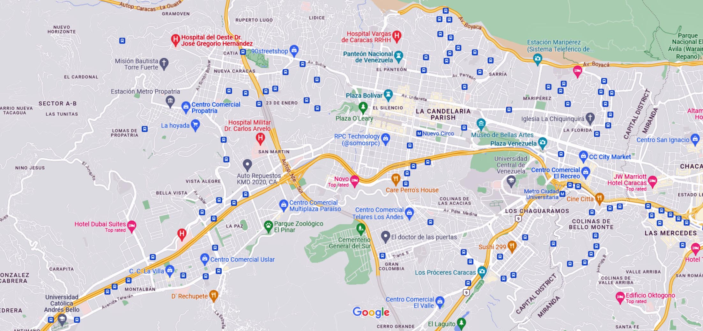
Map of Caracas

Slide 11
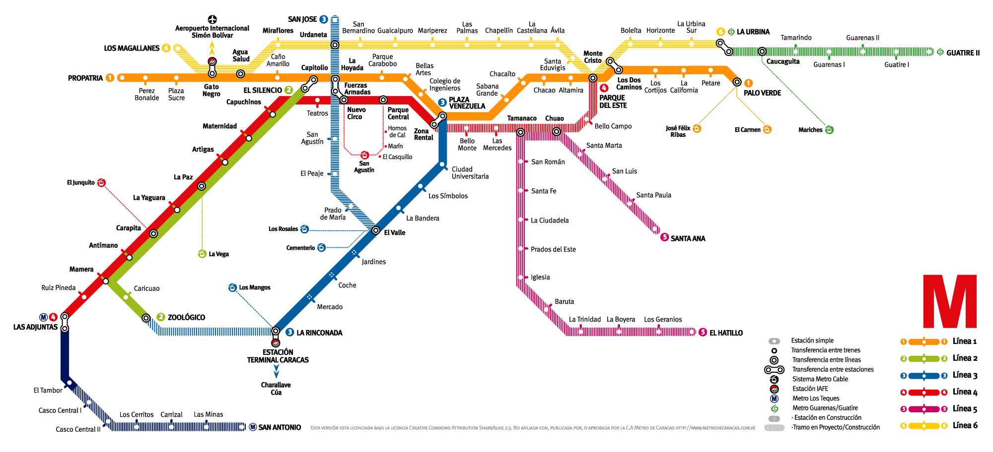
Caracas Metro
Caracas metro is a rapid transit system that serves Caracas, Venezuela. The system began operations on 2nd January 1983 and presently has 4 lines that serve 48 stations. The system is operated by Compañía Anónima Metro de Caracas. As per 2010 statistics, the metro system had a daily ridership of 2,000,000 passengers.
Single: a journey by Metro without a limit of stations. The ticket costs 1.5 Bs
Multipass: ten Metro journeys without limit of stations. The ticket costs 13.5Bs and is orange colored. Definitely your best value if you use the Metro system.

Slide 12
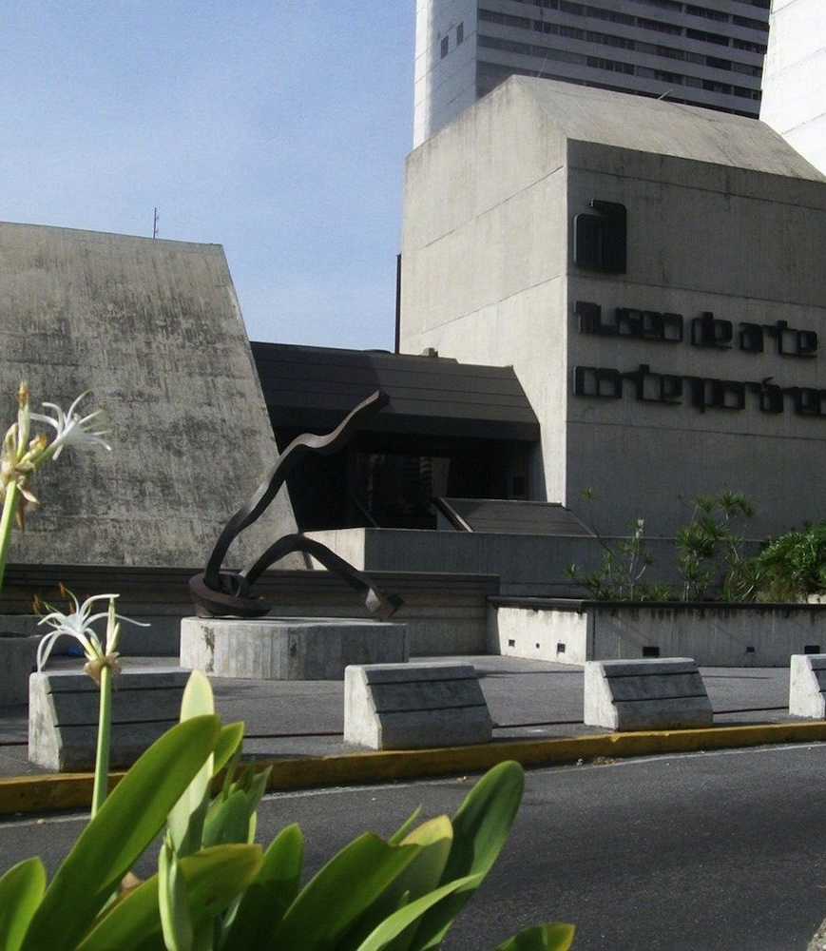
Contemporary Art Museum
The Caracas Museum of Contemporary Art, also known as MACC, is a world-class museum located in Parque Central. It has over 5,000 works of art in its collection, which includes pieces by Picasso, Monet, Warhol, and Bacon.
Admission is free and there are 13 halls in the museum, plus auditoriums, a garden courtyard, and a grand library. The must-see pieces in the museum are the works by Venezuelan artist Jesus Soto, who is famous for his dazzling kinetic sculptures. You can look for one of his most famous pieces found elsewhere in the city: the Caracas Sphere. Made from orange aluminum rods, the sphere is set alongside the Francisco Fajardo Highway.

Slide 13
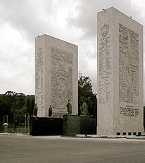
Paseo de Los Proceres
The Paseo de Los Proceres, or the Walkway of Heroes in English, is a promenade with many notable monuments dedicated to the heroes of the Venezuelan War of Independence.
It features numerous statues, squares, steps, and walls and is particularly popular with bikers and joggers, thanks to the many trees that provide shade and greenery in the center of the city.
You'll find references to Greek mythology in the many fountains and other decorative pieces, but the main attraction is the Monument to the Heroes which is formed by four 300-ton marble slabs and statues commemorating important figures like Simón Bolivar.

Slide 14
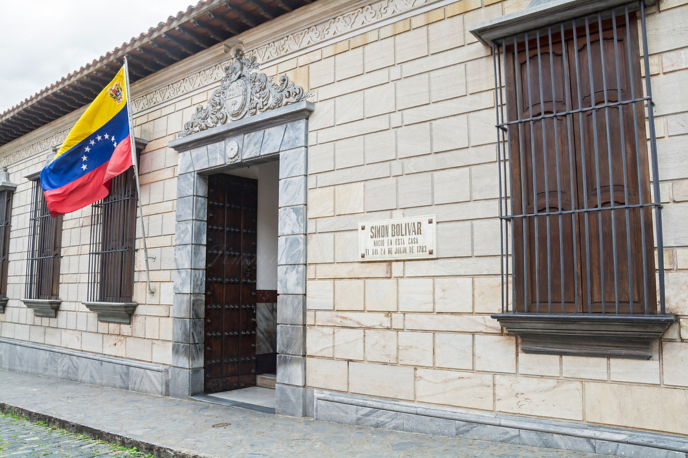
Casa Natal Museo Bolívar
His birthplace and an adjacent museum honor Simon Bolivar, “El Liberator”, who achieved independence from Spain for Venezuela and other South American countries.
Bolívar’s funeral took place just two blocks from the house where, on July 24, 1783, he was born. The interior of Bolívar’s birthplace has been enthusiastically reconstructed.
The walls are splashed with a score of huge paintings by Tito Salas depicting Bolívar’s heroic battles and scenes from his life. All caraqueños take cheesy photos – notebooks in hand – under the backyard tree beneath which Simon Rodriguez was said to have taught Bolívar to read and write.

Slide 15
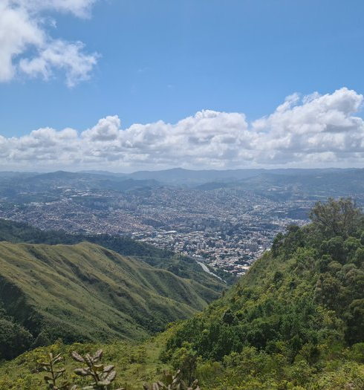
El Ávila
National Park
For spectacular views of the city and the mountains, ride one of the world's longest teleservices (cable cars) to the top of Cerro El Ávila, an approximately 20-minute drive from Caracas. On clear days, you can see the Caribbean Sea from the mountaintop. The park's forests are home to many butterflies, birds, and orchids, including the country's national flower, the Easter orchid.
The cable car reaches a height of about 7,005 feet (2,135 meters).

Slide 16
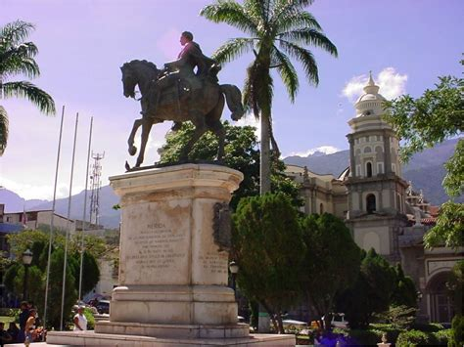
Plaza Bolívar
Bolívar Square is one of the most important and recognized Venezuelan public spaces. It is located in the center of Caracas when it was founded in 1567. It is in the historic center of the city in the Cathedral Parish of the Libertador Municipality.
Surrounded by Caracas Cathedral, Sacred Museum, Archbishop's Palace, City Hall, Chapel of Santa Rosa de Lima, the Yellow House, the Main Theater and the Capital District. The Federal Legislative Palace stands to the Southwest. Buildings.

Slide 17
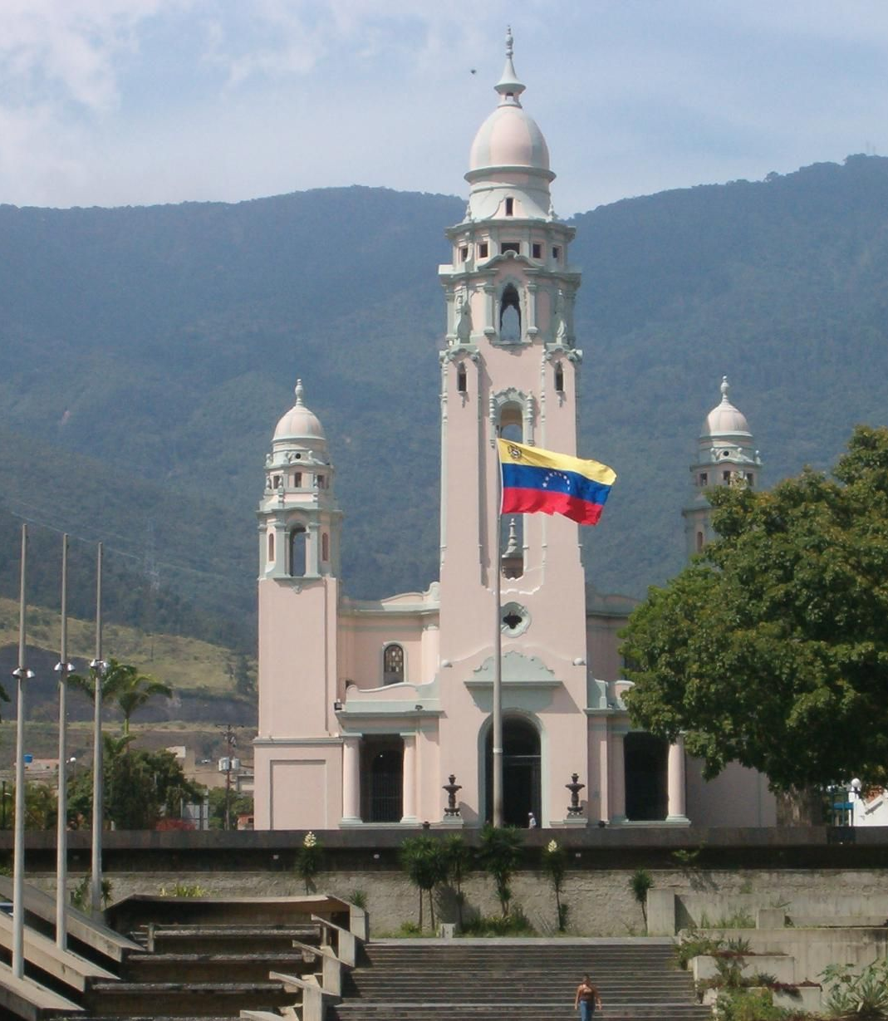
Panteón Nacional
The Panteón Nacional, formerly a church, became the resting place for prominent Venezuelans in the 1870s. Located in the northern part of the old town of Caracas, the site's ceremonial changing of the guard is worth seeing.
The central nave is dedicated to Simón Bolívar, the Venezuelan known as El Libertador (The Liberator), famous for directing the secession of Venezuela, Bolivia, Colombia, Ecuador, Peru, and Panama from the Spanish Empire. You'll see paintings depicting his life and accomplishments.

Slide 18
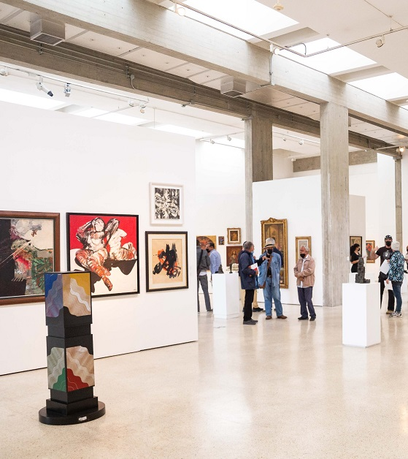
La Galería de Arte Nacional
Known around town as the "GAN," the La Galería de Arte Nacional opened in 1976 and is one of the most interesting things to do in Caracas. Located near the circular Plaza Morelos in front of Puente Brión.
It features works of art by Venezuelan artists and artists such as Camille Pissarro who spent time in Venezuela. The collections span some five centuries from the colonial days featuring colonial Caracas and the period of Simón Bolívar.
The museum has been extolled as a “patriotic celebration of national artists” reminiscent of Venezuelan society
There are more than 4,000 pieces in its eleven rooms (arranged in a circular layout), with international and Venezuelan art. It has paintings of more than 40 Venezuelan artists. The works include pre-Hispanic pieces, colonial-era paintings, sculptures, and Venezuelan works of modern art.

Slide 19
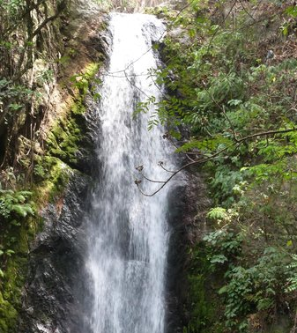
Parque de Recreacion Los Chorros
Located Northeast of the city, at the foot of Caracas' Cerro El Ávila, Parque de Recreacion Los Chorros consists of about 9 acres of stunning scenery, including a natural waterfall to swim in which is a rare find in a capital city park.
The lush landscape spans several levels with tunnels, bridges, large trees, and benches. You might encounter a variety of wildlife, including sloths, vocal guacharaca birds, squirrels, and fish.

Slide 20
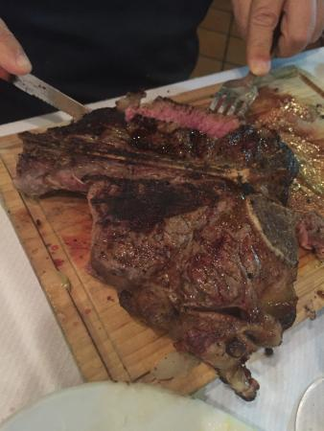
Restaurants
There are a lot of excellent restaurants in Hokkaido. Especially for seafood.
Here are some recommendations:
Moreno $$$$ Latin, Venezuelan, Vegetarian
Av. Luis Roche Centro Commercial Turistico Altamira Village, Caracas
El Alazan de Altamira $$$$ Steakhouse, Barbecue, Venezuelan
Avenida Luis Roche entre 4ta y 5ta transversal, Caracas
La Casa Bistro $$ - $$$ Latin, Venezuelan, Vegetarian Friendly
3ra Avenida Con 4ta Transversal de Los Palos Grandes Chacao, Caracas
Tinajero de los Helechos $$ - $$$ Venezuelan
Av. Rio de Janeiro between Calle Caroni and New York, Caracas
Aranjuez $$$$ Steakhouse, Latin Barbecue
Calle Madrid, Caracas

Slide 21
Conclusion
Caracas is a beautiful City with a rich history and numerous attractions. Regardless of what you're looking for, Caracas has something for everyone.
I hope this presentation will help when we visit Caracas!

Slide 22
Thanks For Coming
If you have any more questions, please ask.
I will do my best to answer them for you.
Have a great visit in Caracas !

