Slide 1

Cannes France
Port Presentation
Presented by
Marc Silver

Slide 2
What I Will Cover
My Port Philosophy
Don’t Miss the Ship
Money
About Cannes
Maps
Best way to get around Cannes
Where is the Tourist Office?
A few interesting facts about Cannes.
Map of Cannes
Places to see or at least consider
A few restaurant recommendations

Slide 3
My Port Philosophy
I have been cruising for over 45 years and have taken over 100 cruises. So, I consider myself an experienced cruiser.
The information I will present is based on those many years of experience.
When I am on a cruise where the city I want to visit is not the port city, I always recommend taking a ship’s tour.
But when I am in a port with multiple attractions nearby and easy to see on my own - I will do it on my own.
This presentation is for that type of port.

Slide 4
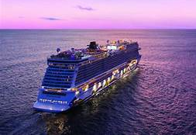
Don’t Miss the Ship
How to Avoid Missing Your Ship:
Pay attention to the time. - Ship time and local time are often different.
Put a return-to-ship reminder on your phone.
Choose excursions wisely:
If a ship-sponsored excursion is late returning to port, the ship will wait, but not for excursions taken on your own.
Be Prepared:
Have your Passport, Credit Card, and phone numbers for the ship port agent.
What to Do If You Miss the Ship: Most cruise lines have port agents stationed in the port area to assist if your ship has left without you. Sometimes, when cruisers are late returning to the vessel, the ship's crew may remove the passengers' essential items -- passports, cell phones, and medication -- from the ship to leave with the port agents.
The Port Officials can help you with contacting your ship and making necessary travel arrangements.

Slide 5
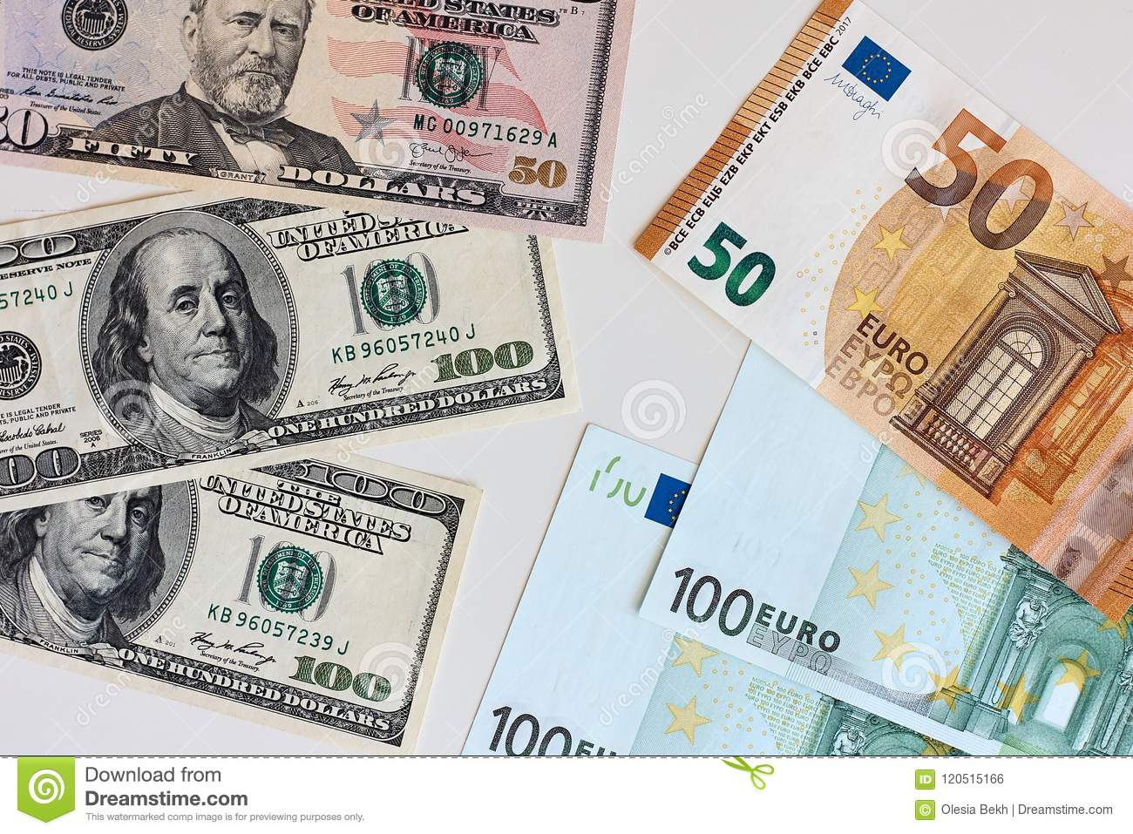
Money
The euro is the official currency of 20 European Union countries which collectively make up the euro area, also known as the eurozone.
Official Exchange is $1.08 US to €1
1.00 US Dollar = 0.92 Euros

Slide 6
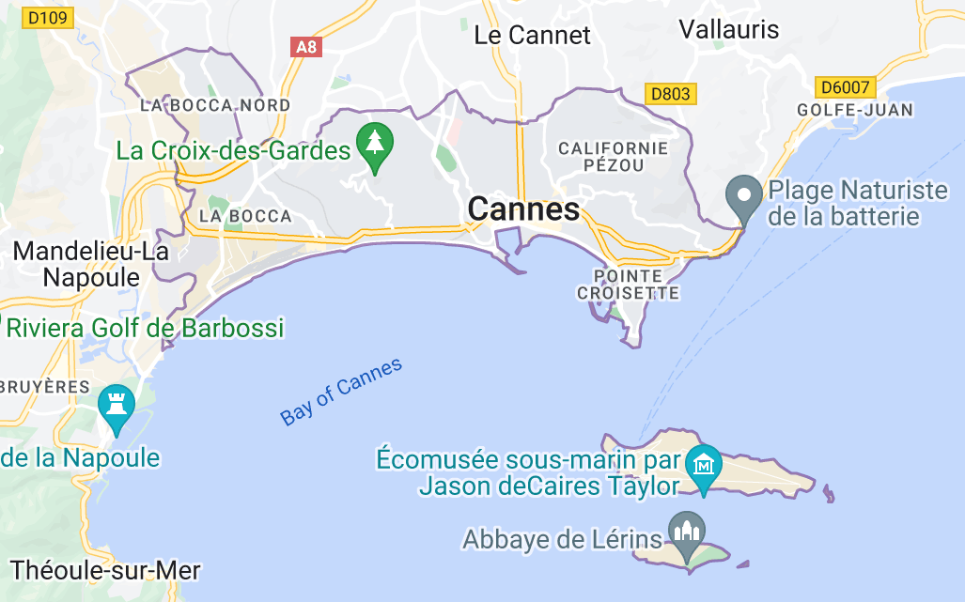
Cannes France
Named for the canes of its once-reedy shore, it was probably settled by Ligurian tribesmen and occupied successively by Phocaeans, Celts (Gauls), and Romans. In the 4th century it came under the protection of the monks of Lérins, whose abbots were lords of Cannes and who in the 10th century built fortifications under Pointe du Chevalier to guard against Muslim sea raiders.
Cannes originated with Lord Brougham, who, prevented by quarantine measures from entering Nice in 1834, stopped at the fishing village of Cannes; he later built a villa and returned every winter for 34 years.

Slide 7
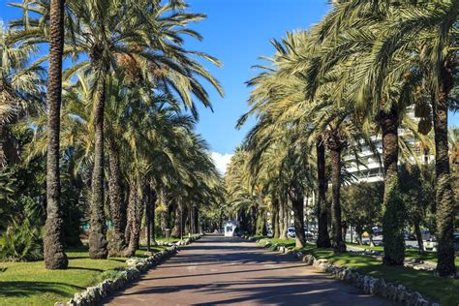
Cannes France
Lying on the crescent of the Gulf of Napoule, Cannes backs against a line of sheltering wooded hills.
Its palm-planted Promenade de la Croisette follows the curve of the sand beach and is fringed with luxury hotels. The harbor is a port of call for yachts and transatlantic liners.
There are several casinos, and the Palais des Festivals is the site of the well-known Cannes film festival.
Tourism is the city’s main source of revenue; of this about a fifth is winter tourism; foreign visitors make up two-fifths of the traffic.
There is an international market for flowers, especially mimosa, which has flourished in the region since its introduction from Santo Domingo in 1835.

Slide 8
Cannes Early History
The first settlement at Cannes was thought to be during the 2nd century BC. For most of its early days it remained a pleasant and quiet fishing village. Cannes fell into the Roman Empire and was populated mainly buy monks who had built and fortified monasteries on both the main land and on the Islands just off the Cannes coast.
Fearing an attack by the Saracens they strengthened their fortifications further and using their vast wealth they constructed a watch tower in the area of Le Suquet. This is how the name Cannes was born; thought to derive from the word kan, meaning summit.

Slide 9
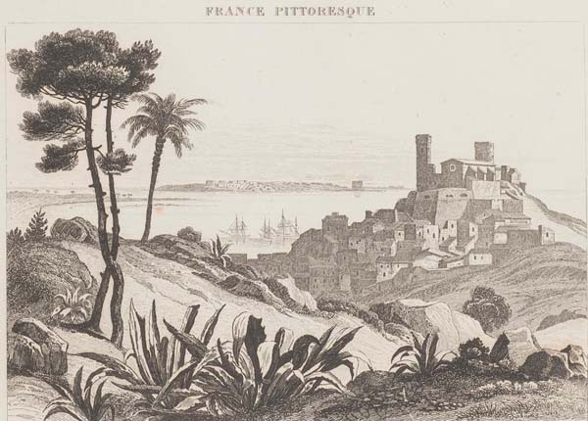
Cannes Became a City in 1530
In 1520 war broke out between French King Francis I and Holy Roman Emperor Charles V. Cannes became a corridor for marching armies, but the worst was yet to come with the great plague of 1579, which wiped out most of the town’s inhabitants.

Slide 10
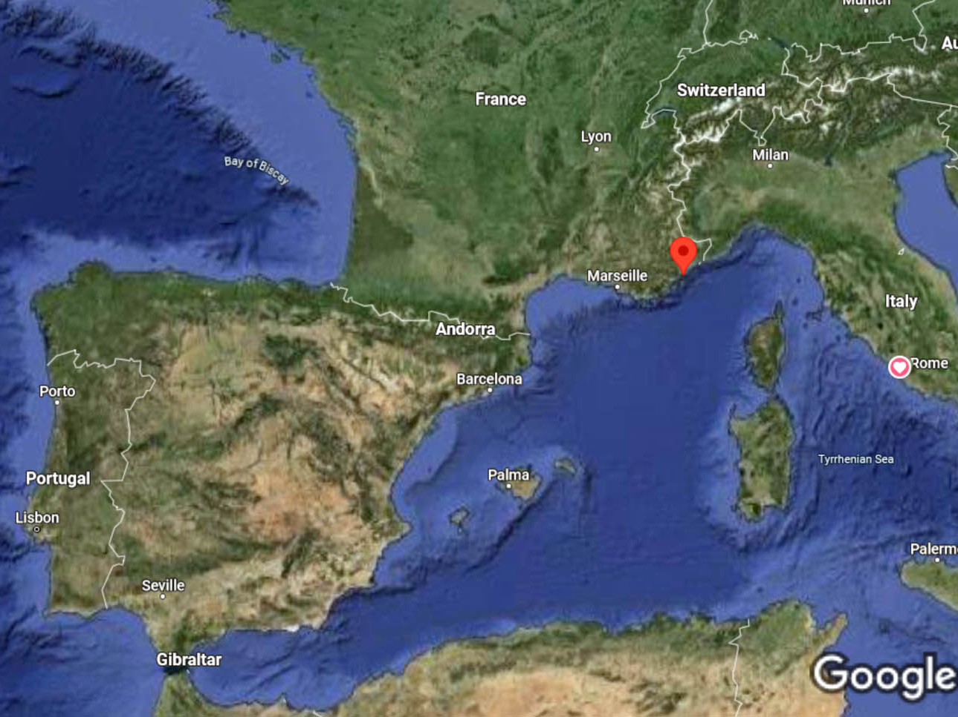
Cannes

Slide 11
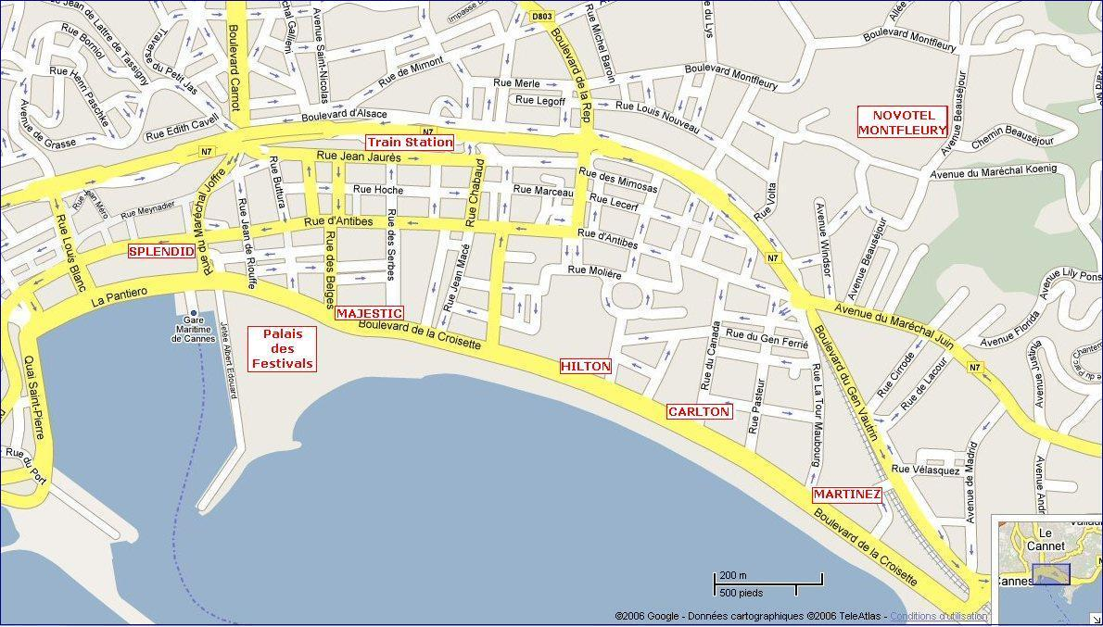
Map Of Cannes

Slide 12
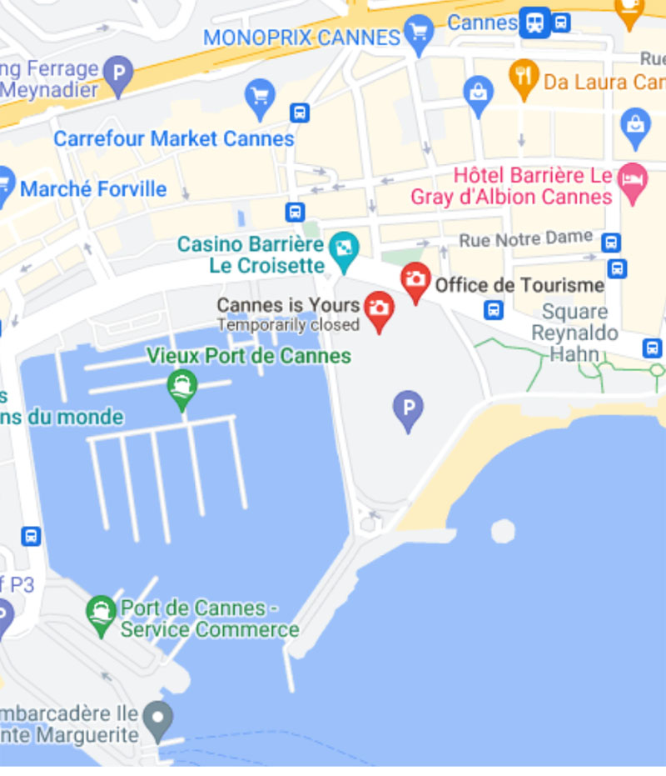
Tourist Office
Tourism Office provides a tourist information service and attention to the city's visitors.
Just walk to the end of the dock to find the Cannes Tourist Center.
1 Bd de la Croisette, 06400 Cannes, France
Phone: +33 49299-8422

Slide 13
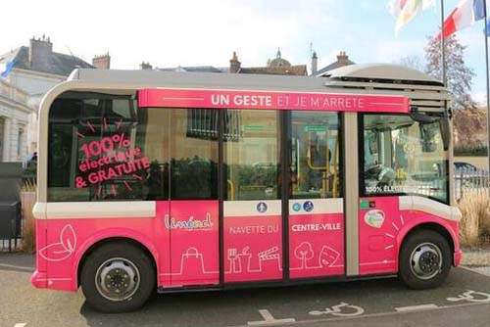
Getting Around Cannes
For the most part Cannes is an easy city to walk, but for those who want to avoid exercise as much as possible, There is an electric minibus operating in and around Le Suquet, the pedestrianized old town.
It runs every 20 minutes, from the bus station. All day tickets cost €1.50.

Slide 14
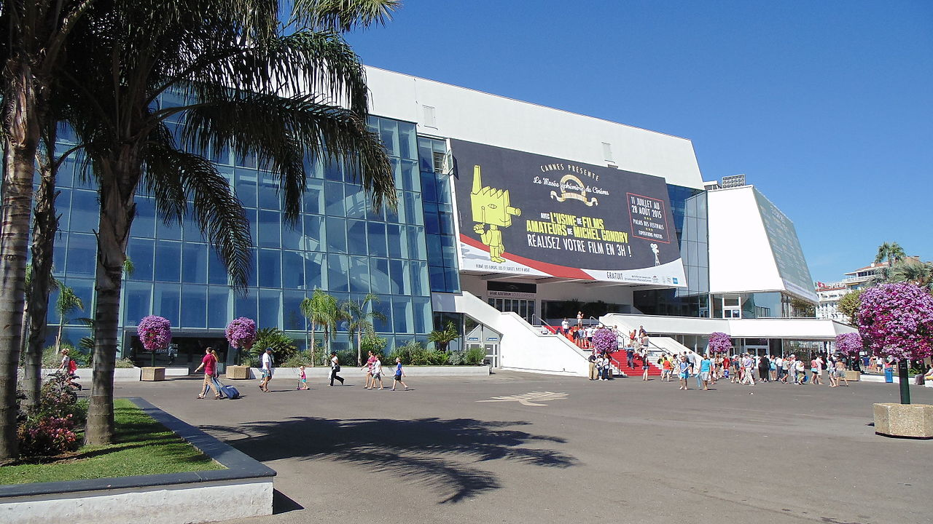
Palais des Festivals et des Congrès de Cannes
VISITOR CENTER
This 25000 square metre exhibition and additional auditorium space was opened in December 1982. It’s why Cannes is famous. It’s where the annual Cannes film festival is held. And when the stars are not actually traipsing through it’s corridors, you can. The managers of the place, the Society of Mixed Economy for the Events of the city of Cannes, organizes guided tours. Make sure you catch the space where the stars have left their imprints on the ground.
Visitor Center is located at the top of blvd. de la Croisette, east of the port. Admission Price: €4

Slide 15
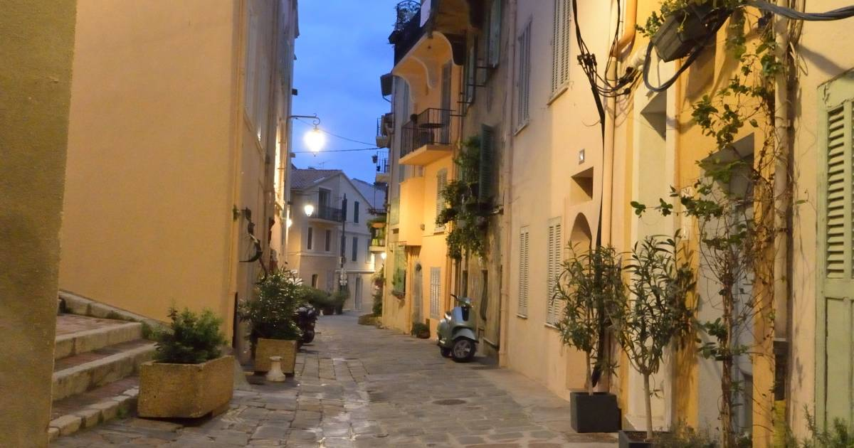
Explore Le Suquet
Most of Cannes is sleek and modern, but Le Suquet is another story. Le Suquet is Cannes’ oldest neighborhood and one of the most beautiful places to visit in Cannes. Looming above the city, you can wander through the streets enjoying the pastel-colored buildings that have stood since the 18th and 19th centuries.
Originally a Roman settlement, Le Suquet is today a maze of narrow, ascending streets, underground bars, and family restaurants, so take
the time to wander and explore
this lovely neighborhood. Here, you will also find a
medieval castle, one of
Cannes’ tourist attractions,
and home to the Musée de la Castre.
Calle Virgen de la Palma
Calle Virgen de la Palma
Plaza de San Juan de Dios

Slide 16
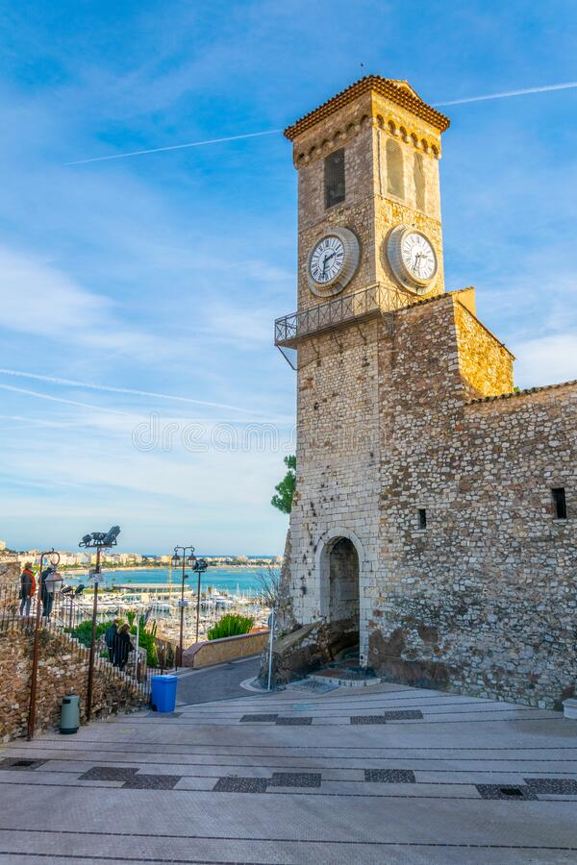
Musée de la Castre
The Musée de la Castre in Cannes sits atop Suquet Hill, offering fantastic city views and a visit to a medieval castle and chapel filled with ancient artifacts. The museum is located within an
ancient castle and connects to a nearby
chapel that dates back nearly 1,000 years.
It's an astounding place to visit, full of the
weight of history and educational exhibits that
will thrill adults and children alike. If you're
looking for great photo ops of the city and
Mediterranean or you want to see ancient
remains from across the continent and beyond,
this is the place to stop.

Slide 17
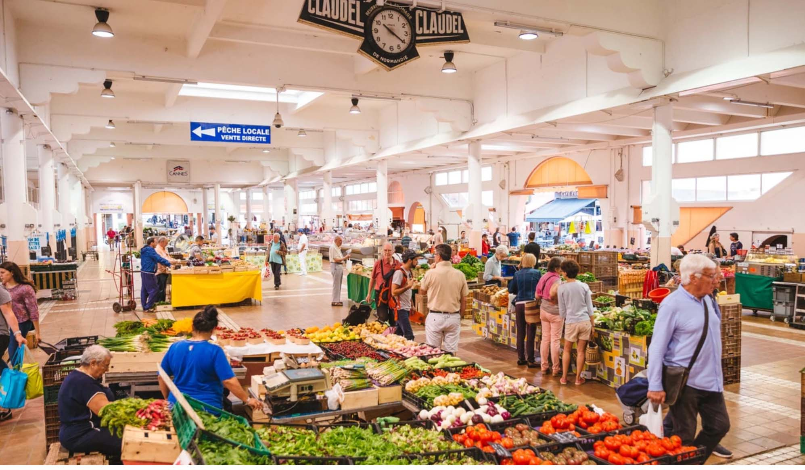
Marché Forville
Forville Market, located near Rue Meynadier, is the oldest market in Cannes. You can purchase everything from fresh vegetables and flowers to Mediterranean fish, and you just may stumble upon one of the area's top chefs also doing his or her weekly shopping.
The food is top quality
and there are a variety
of options to suit any
taste. If you're on the
hunt for unique souvenirs,
such as jarred sauces.
Also the market is a
great place to find
provisions for a picnic. The market is open Tuesday through Sunday from 7:30 a.m. to 1 or 2 p.m.,
Cannes Cathedral

Slide 18
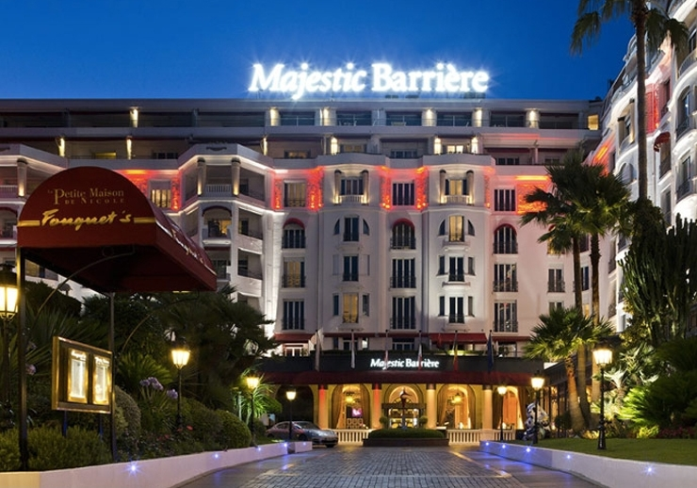
Casinos Abound
For those of you that don’t get enough Casino action on the ship. Along with its annual film festival, Cannes is known for their Casinos. If you're in the mood to test Lady Luck during your trip, consider paying a visit to Casino Barrière Les Princes, Casino De La Pointe Croisette, Petit Casino, or Casino JOA de Cannes Mandelieu.
Some are more formal and some are casual depending upon your comfort level.
Remember these rules:
No shorts, tank tops
or swimsuits are allowed
in any of the casinos.
Torre Tavira

Slide 19
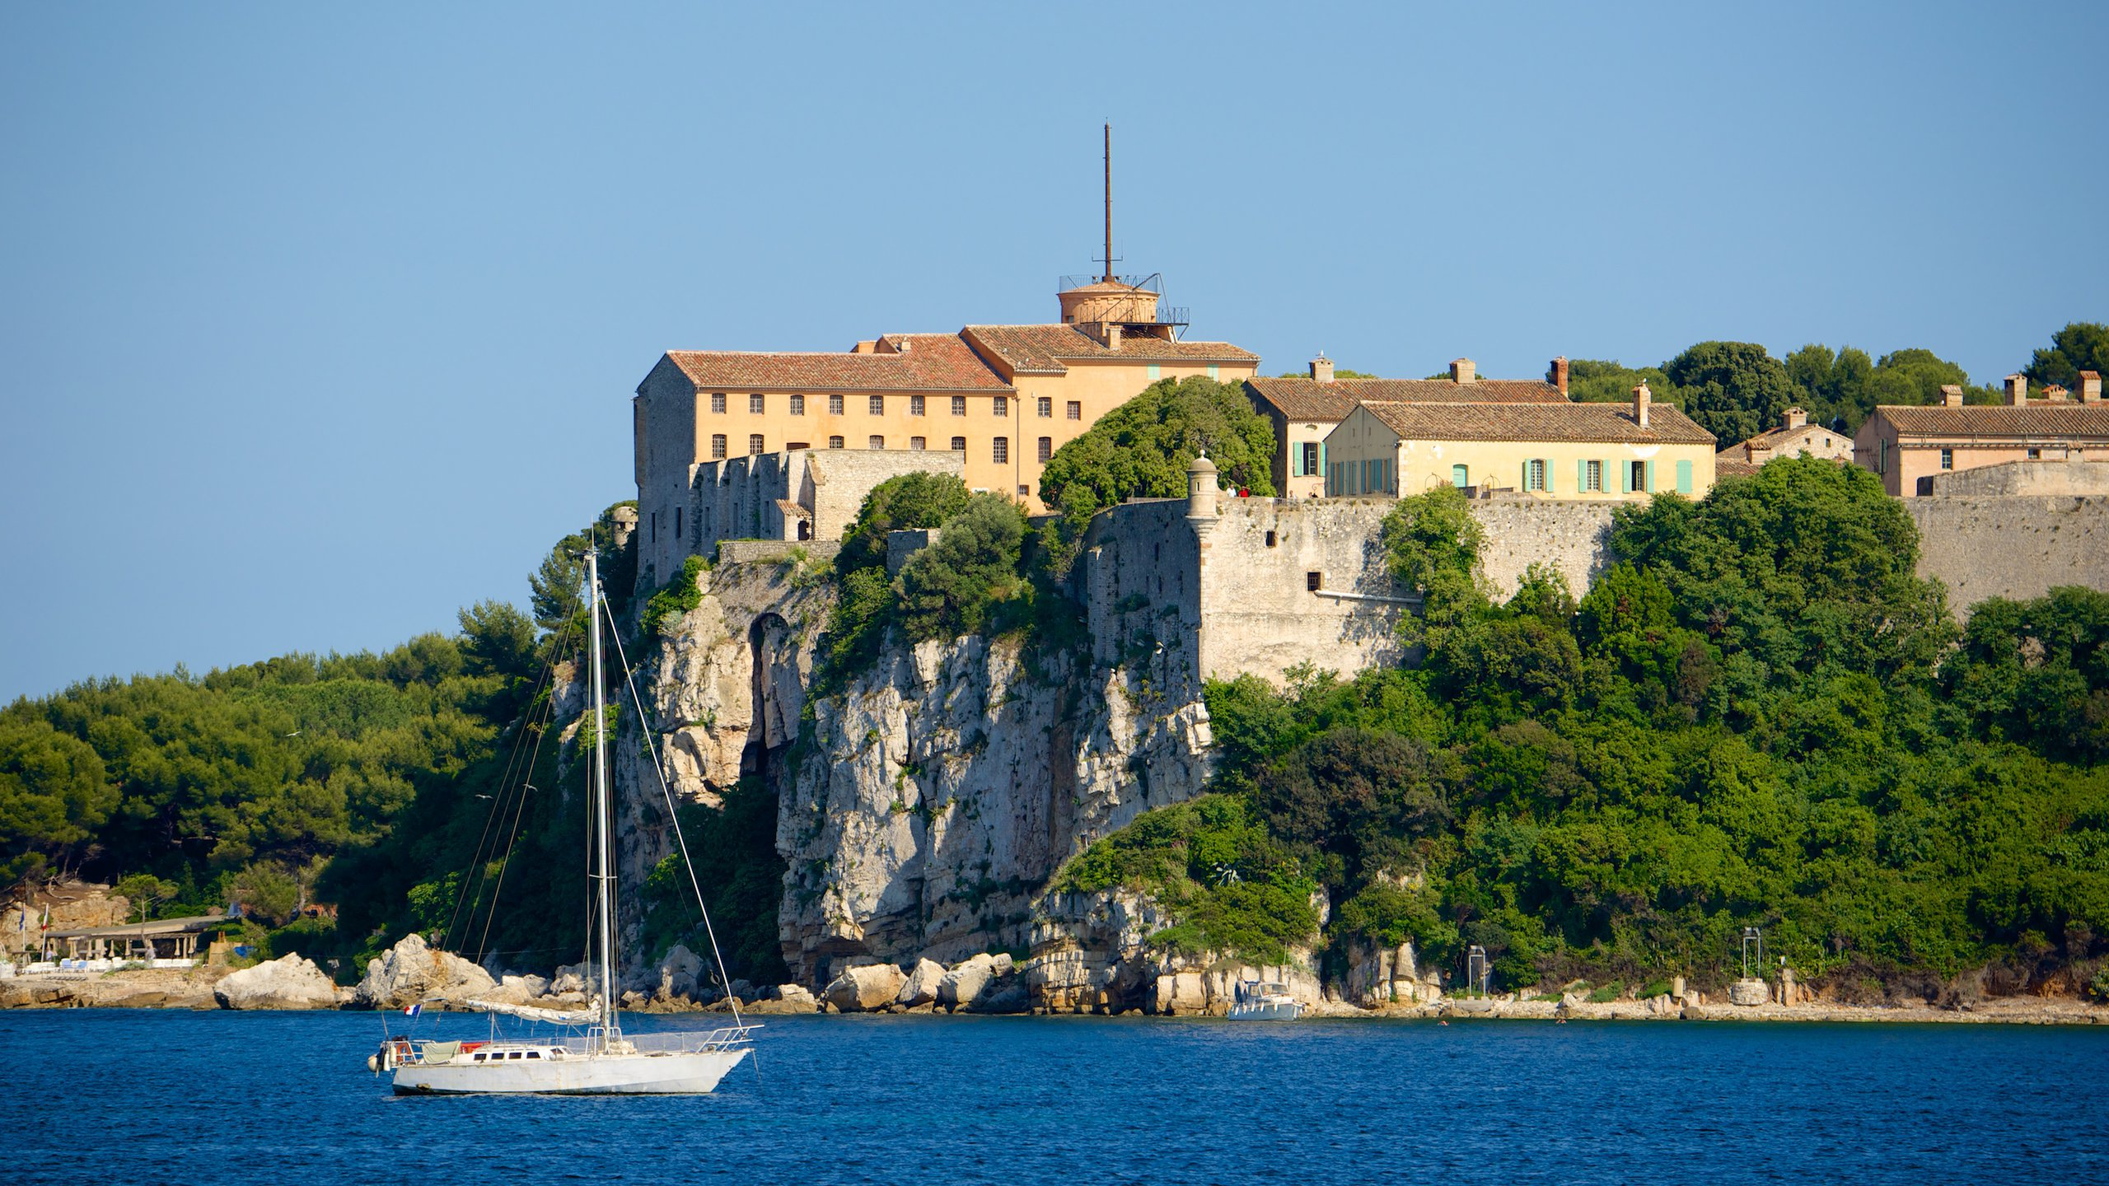
Fort Royal
Cruise over to Fort Royal on Île Sainte-Marguerite (part of the Lérins Islands) to see this historic structure. Built in the early 17th century to defend the entrance to Cannes, the fort later became a state prison in 1685 and housed the mysterious "man in the iron mask“. historians to this day. Today, you can tour some prison cells when you visit the
fort, and several companies offer cruises between Cannes and the island. Tickets cost €6 ($6.60) per person.

Slide 20
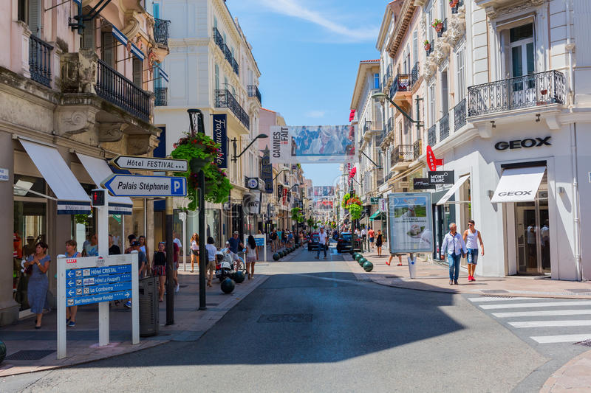
Rue d'Antibes
For retail therapy, you'll want to head to Rue d'Antibes, a road that runs parallel to La Croisette but lies a few blocks inland. Once a road that linked Toulon to Antibes, the Rue d'Antibes is a close competitor to La Croisette. Today, it's
home to stores for moderately priced brands, such as Zara and Mango, as well as the former Cannes theater. Even if you're not interested in shopping, reviewers say Rue d'Antibes is worth a stroll to admire the architecture – many of the buildings date to the 19th century with ironwork and sculptures by Pellegrini.

Slide 21
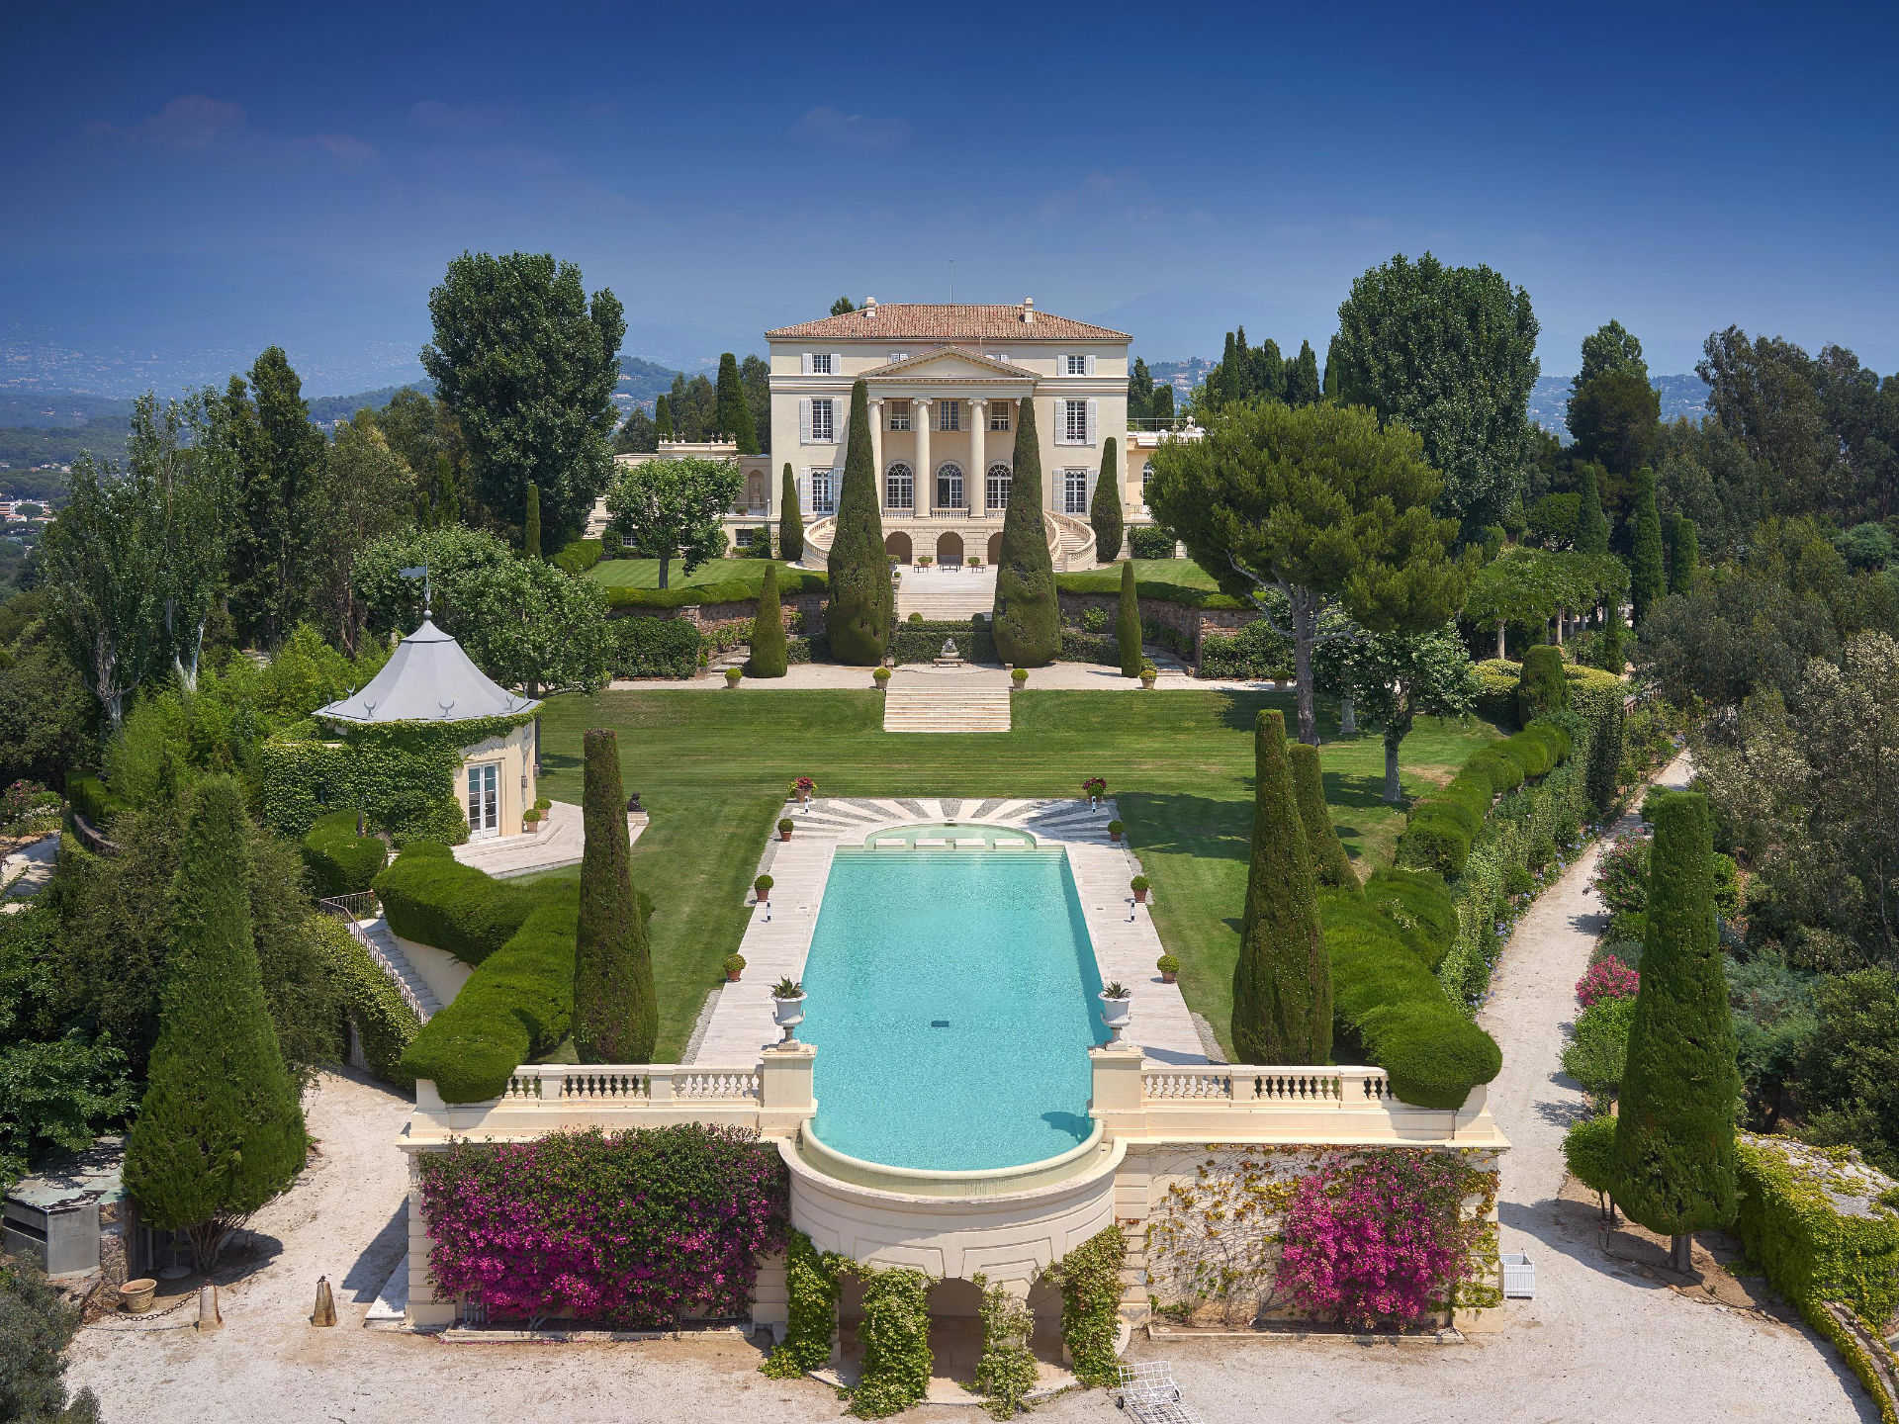
La Croix des Gardes
The avenues of upscale La Croix des Gardes are lined with opulent villas and wend up into forested hills. Hiking trails in the Croix des Gardes nature park have viewpoints looking over the Bay of Cannes and the Estérel Massif mountains. The gardens of
the elegant 19th-century Villa Rothschild are open for strolls on palm-shaded paths. Hip bars and clubs line the Riviera beaches near palm-filled Square Mistral. Located about 3.5km from the port.

Slide 22
Home to Amazing Restaurants
Cannes has five Michelin star restaurants. Many of us on the ship are foodies, so naturally we’re always on the hunt to eat at the most exclusive spots anytime we travel.
Here are a few of the Michelin Star Restaurants in Cannes.
Table 22 par Noël Mantel - 22 rue Saint-Antoine, Cannes - €€€
Aux Bons Enfants - 80 rue Meynadier, Cannes - €€
La Table du Chef - 5 rue Jean-Daumas, Cannes - €€
L'Affable - 5 rue La Fontaine, Cannes - €€€
La Palme d'Or - 73 boulevard de la Croisette, Cannes €€€€
For those of you that just like good food, you can’t go wrong just about anywhere you go in Cannes. After all this is FRANCE!
GOOD EATING

Slide 23
Thanks For Coming
If you have any more questions, please ask.
I will do my best to answer them for you.
Have a great visit in Cannes!

Slide 24
Acknowledgement
My seminars are the result of many years of travel experience combined with many hours of research over the internet.
I would like to acknowledge the many source I have accessed.
These include: Wikipedia.com, Britannica.com, Trip Advisor and the various Museum, Park and Government websites.

