Slide 1
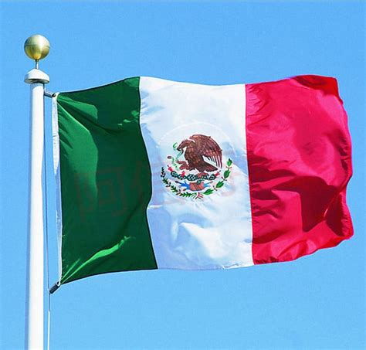
Cancun, Mexico Presented by Marc Silver

Slide 2
What I Will Cover
My Port Philosophy
Don’t Miss the Ship
Money
About Cancun, Mexico
History of Cancun, Mexico
Transportation
Points of Interest
Places to see or at least consider
A few restaurant recommendations
Conclusion

Slide 3
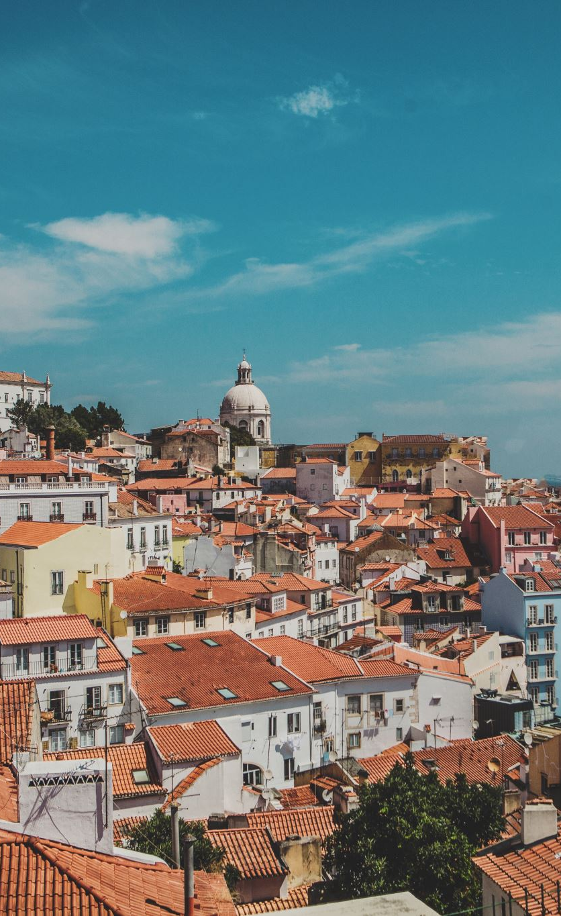
My Port Philosophy
I have been cruising for over 45 years and have taken over 100 cruises. So, I consider myself an experienced cruiser.
The information I will present is based on those many years of experience.
When I am on a cruise where the city, I want to visit is not the port city, I always recommend taking a ship’s tour.
But when I am in a port with multiple attractions nearby and easy to see on my own - I will do it on my own.
This presentation is for that type of port.

Slide 4
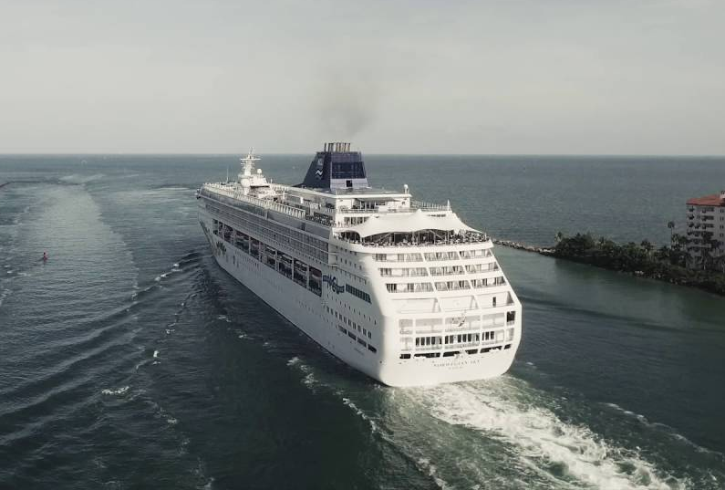
Don’t Miss the Ship
How to Avoid Missing Your Ship
Pay attention to the time. - Ship time and local time are often different.
Put a return-to-ship reminder on your phone.
Choose excursions wisely.
If a ship-sponsored excursion is late returning to port for, the ship will wait for you. If you are on your own???
Be Prepared
Have your Passport, Credit Card and phone numbers for your ship port agent.
What to Do If You Miss the Ship Most cruise lines have port agents stationed in the port area to assist if your ship has left without you. If you’re lucky, when cruisers are late returning to the vessel, the ship's crew will often remove the passengers' essential items -- passports, cell phones and medication -- from the ship to leave with the port agents.
The Port Officials can help you with contacting your ship and making necessary travel arrangements.

Slide 5
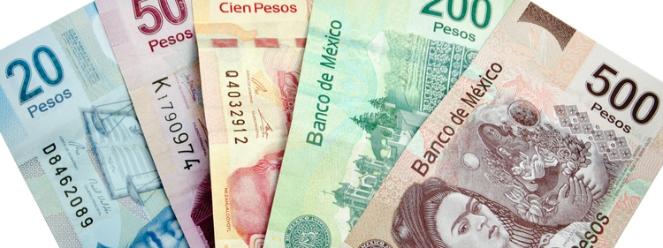
Money
The Peso is the official currency of Mexico
Official Exchange is 100 Pesos is $5.80 US
Or 17.35 Pesos to the US Dollar
Most places in Mexico use 20 pesos to the Dollar

Slide 6
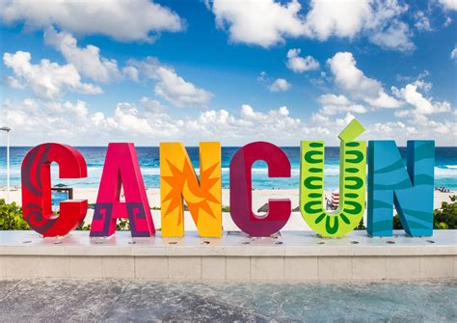
About Cancun
Cancun, with its stunning Caribbean beaches, rich history, and vibrant culture, is one of Mexico’s top destinations for travelers.
Whether you're visiting as part of a cruise or on an extended stay, Cancun offers a diverse array of attractions, from ancient ruins to lively nightlife.
Let’s explore Cancun's highlights, from its historical roots to its top sights, transportation options, and dining recommendations.

Slide 7
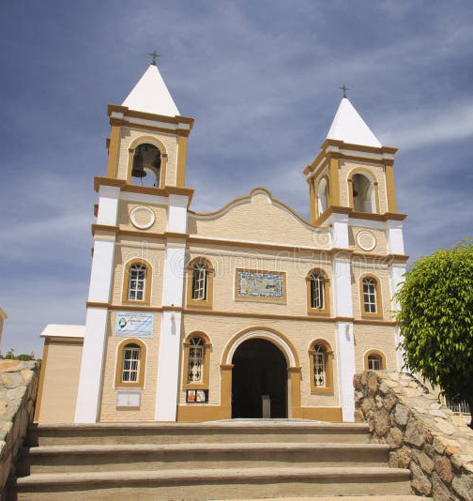
Historical Cancun, Mexico
Cancun's history traces back to the ancient Mayan civilization, which thrived in the region from around 250 AD to 900 AD.
The Mayans built many famous ruins in and around Cancun, including El Rey and the majestic Chichen Itza, a UNESCO World Heritage site.
By the early 16th century, Spanish arrival in the Yucatan Peninsula marked the decline of Mayan dominance. For centuries, Cancun remained sparsely populated and primarily used for fishing.
It wasn't until the 1970s that the Mexican government began developing Cancun into a tourism hub, transforming it into the bustling resort destination it is today, renowned for its beaches, luxurious resorts, and cultural treasures.

Slide 8
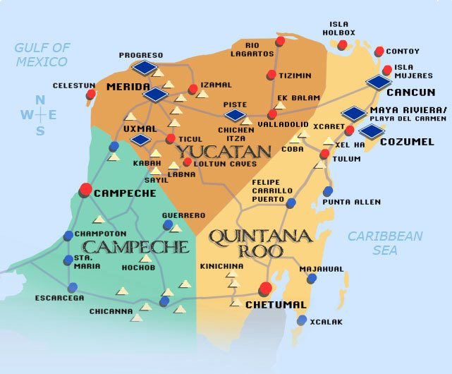
Cancun

Slide 9
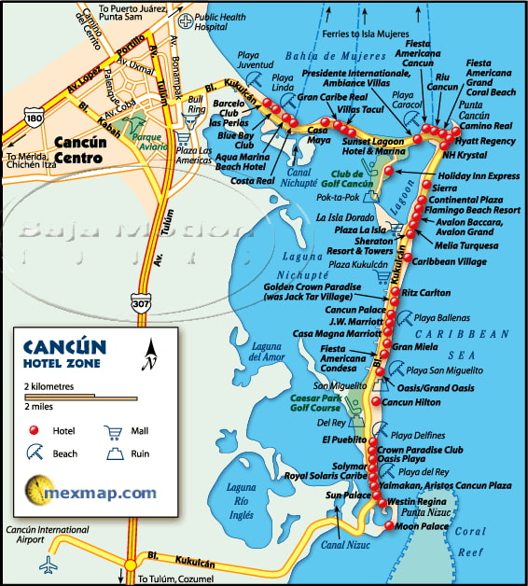
Some Points of Interest:
Isla Mujeres
Playa del Carmen
Chichen Itza
Tulum Ruins
Xel-Ha Park
Underwater Museum
Coba Ruins
Isla Contoy
Xcaret Park

Slide 10
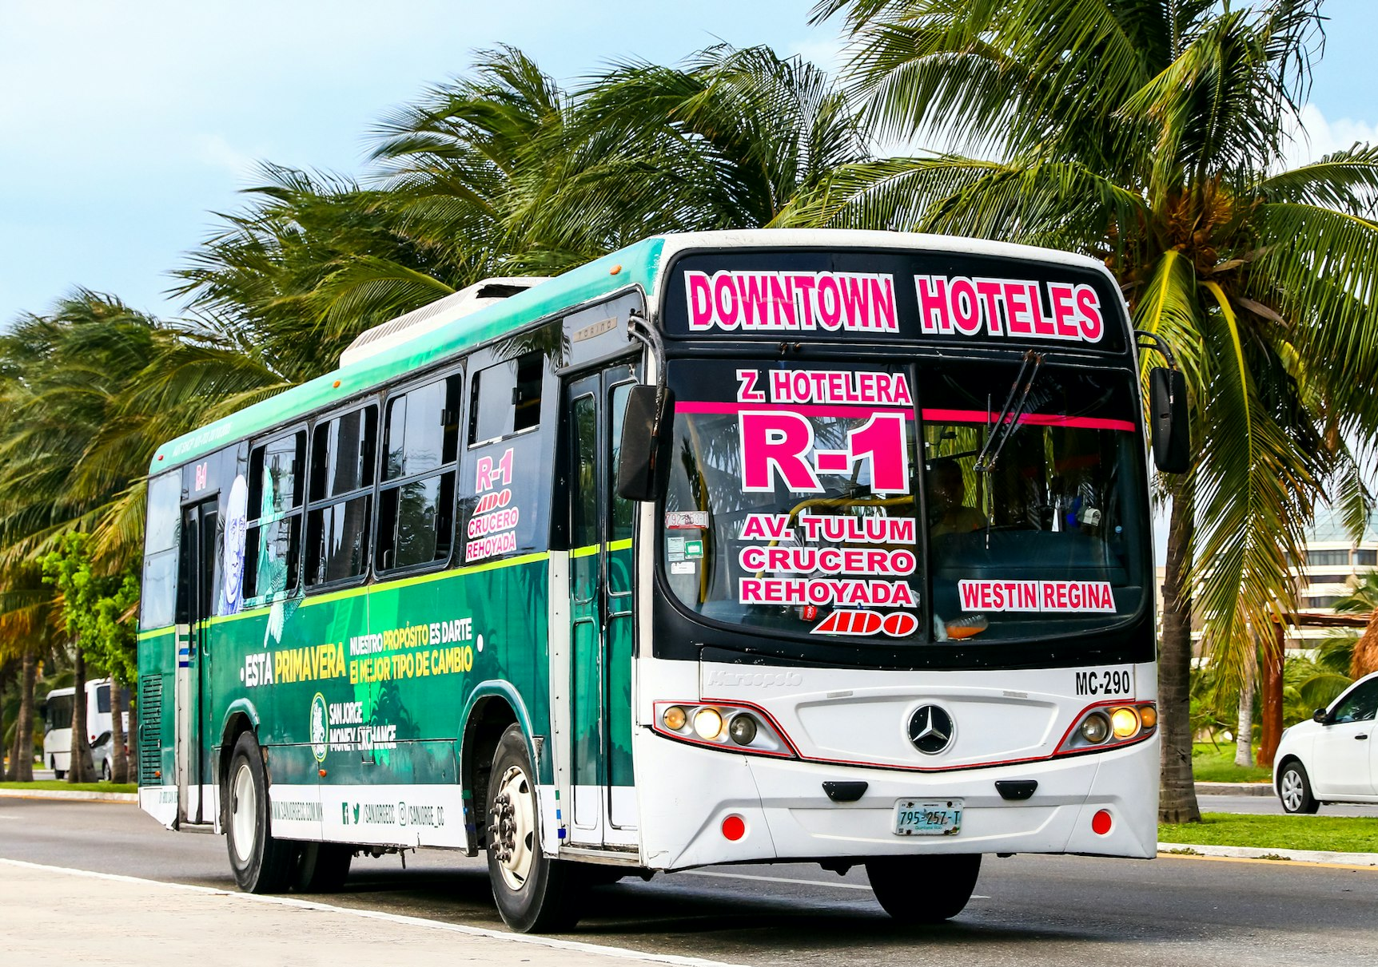
Getting Around Cancun
Buses are the most affordable and popular way to get around, especially in the Hotel Zone. Buses are frequent and cost as little as $0.50 USD. The R1 and R2 buses run between the Hotel Zone and downtown Cancun.
Taxis are abundant and reliable. Fares range from $4-$7 USD within the Hotel Zone and downtown. If you want to use a taxi to see Mayan Ruins negotiate a price first.
Rideshare services such as Uber are available but not as widely used due to taxi regulations. It’s an option for those looking for convenience.
Walking is practical in certain areas like the Hotel Zone and Isla Mujeres. Cancun’s downtown is also pedestrian-friendly with many shops and restaurants within walking distance.

Slide 11
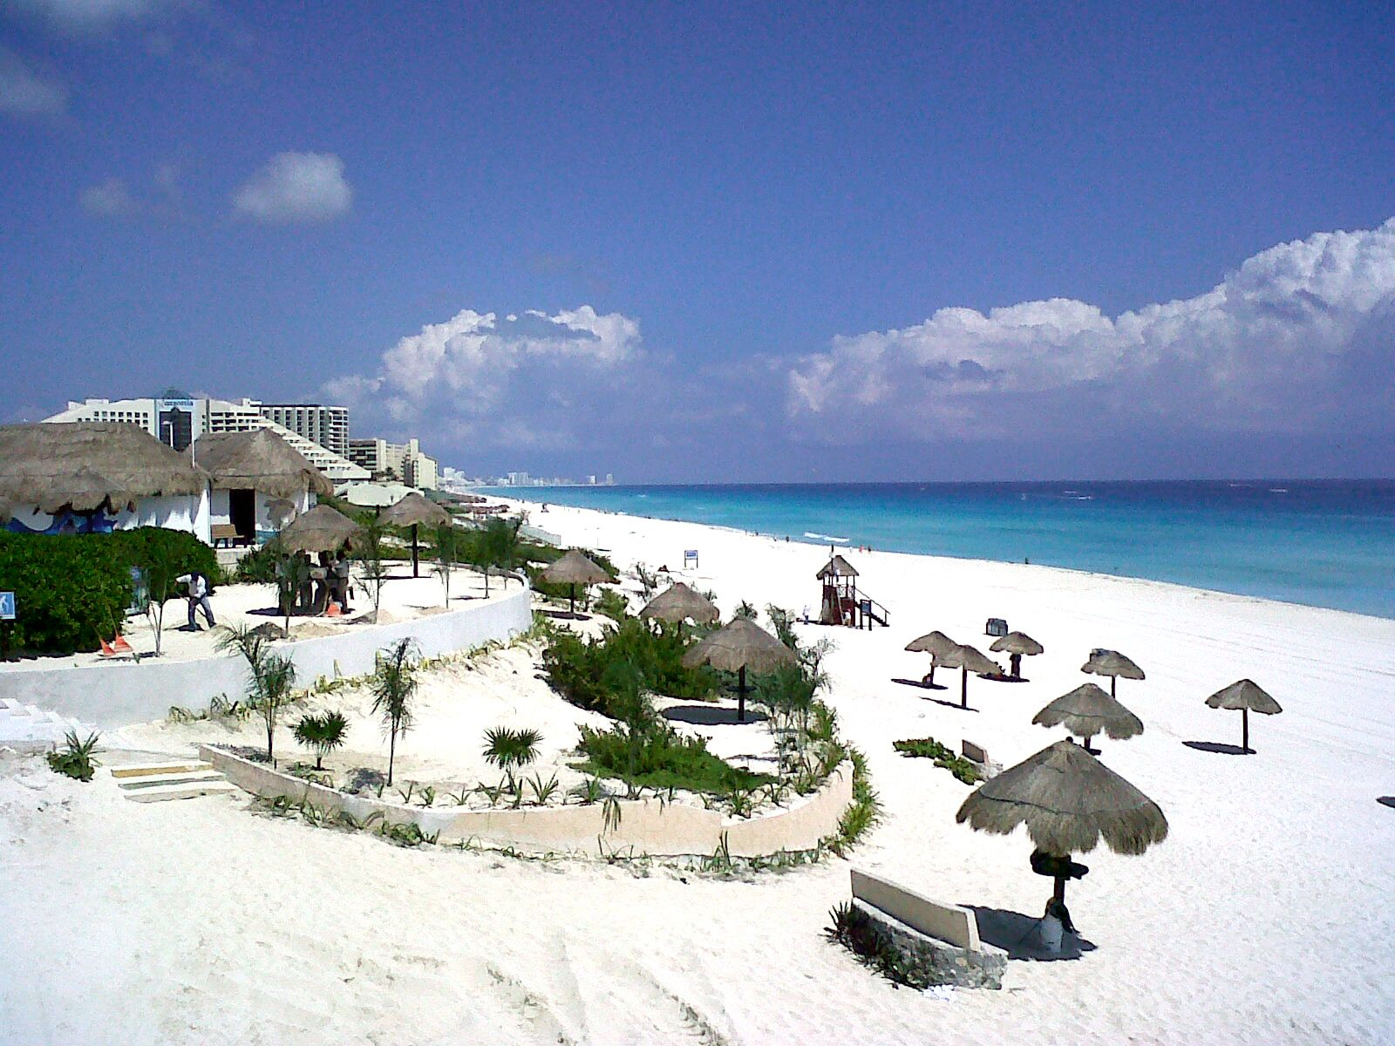
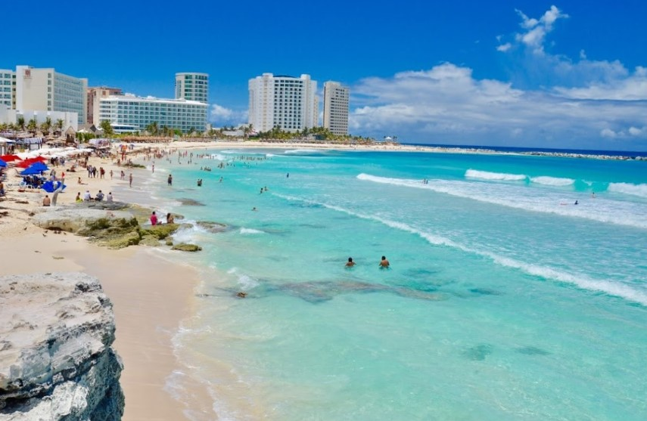
Cancun Beachs
Playa Delfines: One of the most iconic public beaches, known for its tranquil ambiance and the famous “Cancun” sign, perfect for photos. Like every beach in Cancun, they are Free.
Playa Chac Mool: Playa Chac Mool is a hidden gem along the Cancun coastline, offering a quieter and more serene atmosphere compared to some of the busier beaches in the area. This picturesque beach is characterized by its soft, golden sands and gentle waves, making it an ideal spot for swimming and relaxation.

Slide 12
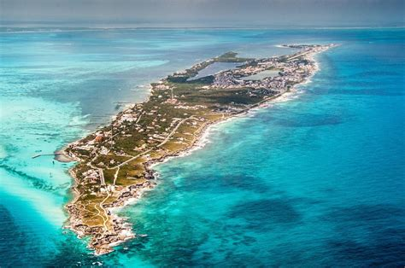
Isla Mujeres
Just a 20-minute ferry ride from Cancun, Isla Mujeres is a charming island known for its pristine beaches and vibrant marine life.
Visitors can enjoy excellent snorkeling opportunities in crystal-clear waters, exploring colorful coral reefs teeming with fish.
A highlight of the island is the Tortugranja Turtle Sanctuary, where guests can learn about sea turtle conservation and even see hatchlings.
Ferry tickets are reasonably priced at around $16 USD for a round trip, making it an accessible getaway for those looking to experience the natural beauty and tranquility of this idyllic destination.

Slide 13
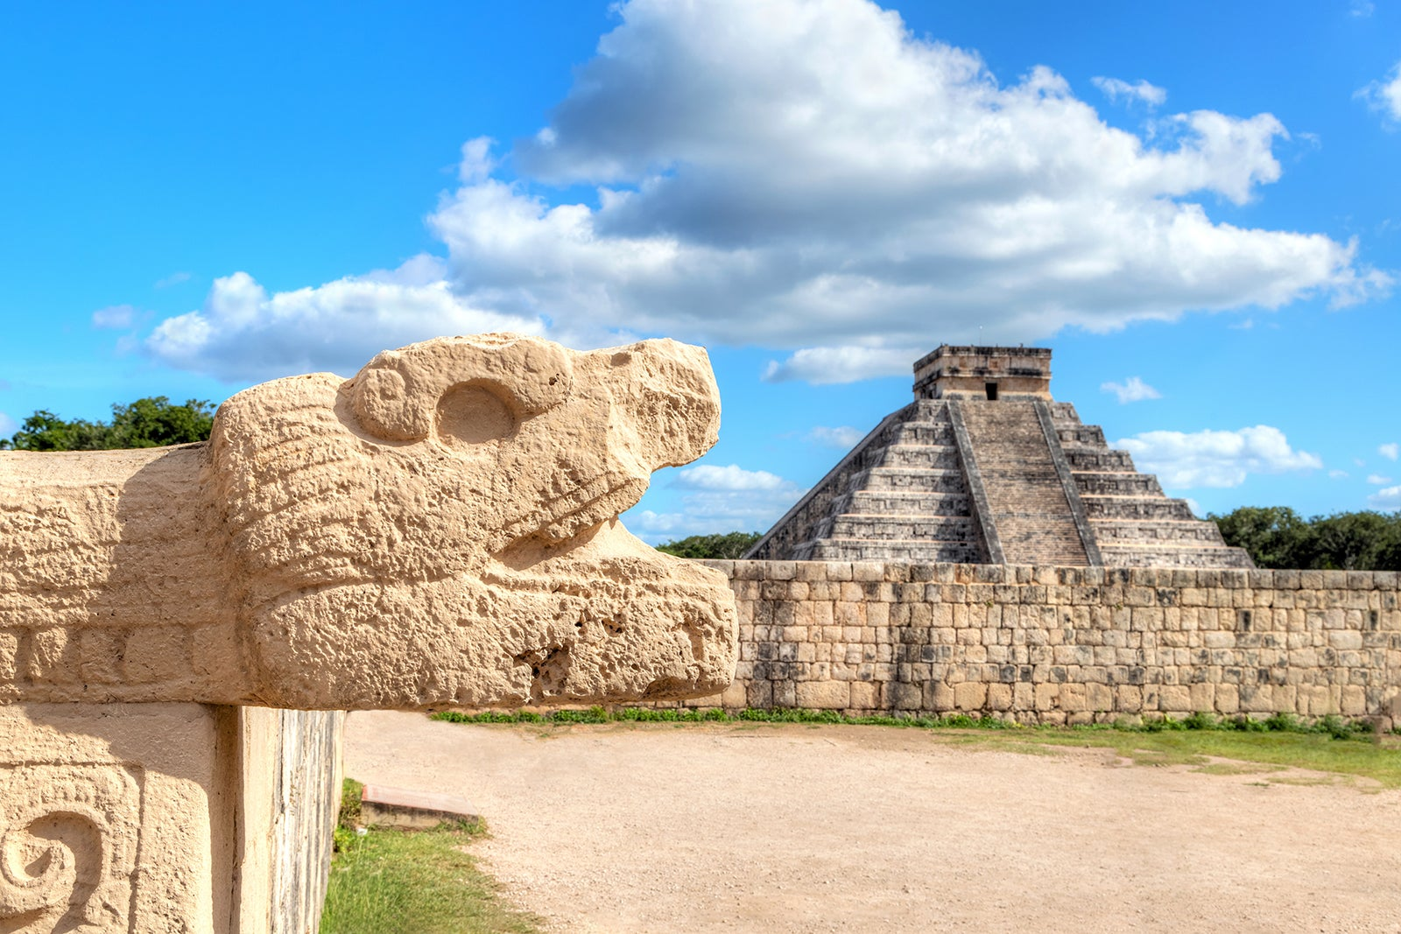
Chichen Itza
Chichen Itza is an essential destination for history enthusiasts, and anyone interested in ancient civilizations.
This massive Mayan archaeological site, located approximately two hours from Cancun, showcases the remarkable achievements of the Mayan culture.
As one of the New Seven Wonders of the World, Chichen Itza features iconic structures such as the Pyramid of Kukulcan, the Great Ball Court, and the Temple of the Warriors, each telling a story of the Mayans' advanced knowledge in astronomy, architecture, and mathematics.
Admission to Chichen Itza costs around $30 USD, granting access to its rich history and stunning architecture.
Guided tours are highly recommended, as knowledgeable guides provide insights into the site's significance, cultural practices, and intricate carvings.

Slide 14
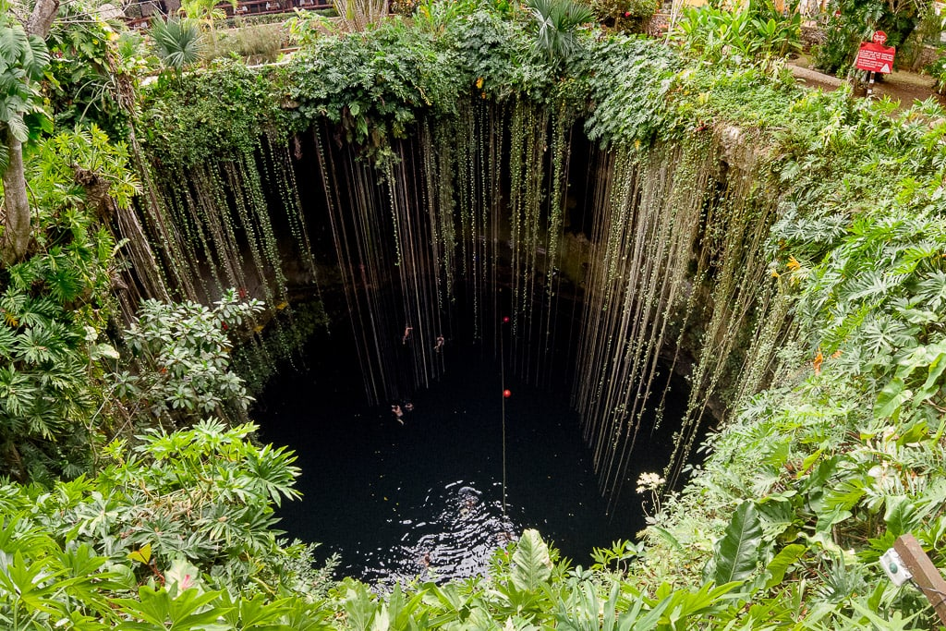
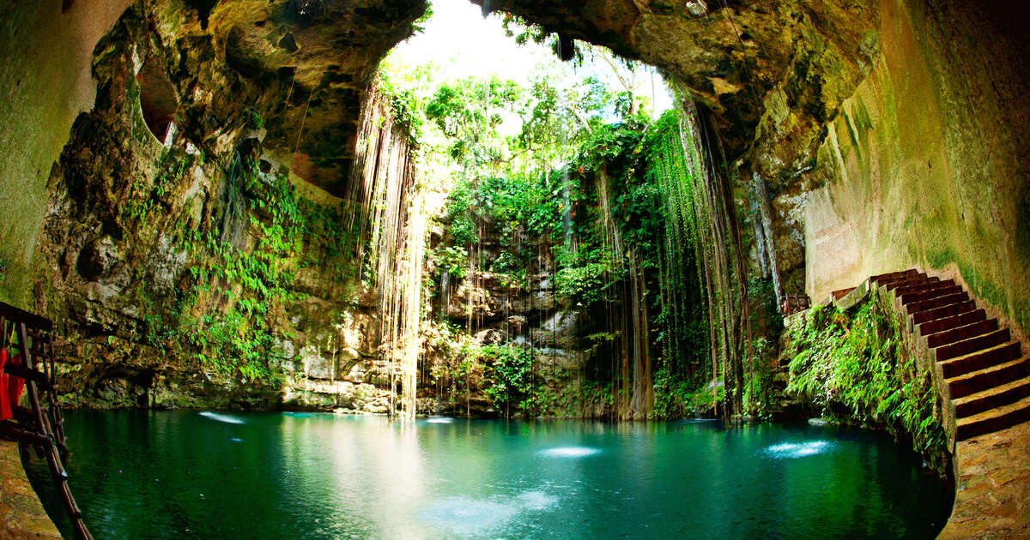
Cenotes
Cenotes are natural freshwater sinkholes unique to the Yucatan Peninsula, formed by the collapse of limestone bedrock, revealing the crystal-clear waters below.
Among the many cenotes, Cenote Dos Ojos stands out for its breathtaking beauty and extensive underwater cave system, making it a popular destination for both swimming and snorkeling.
Admission to Cenote Dos Ojos is reasonably priced at $10-$15 USD, providing access to its stunning turquoise waters and vibrant marine life.
Visitors can explore the enchanting underwater landscapes, swim in the refreshing waters, and enjoy the surrounding lush vegetation, making cenotes a must-visit for nature lovers and adventure seekers alike.

Slide 15
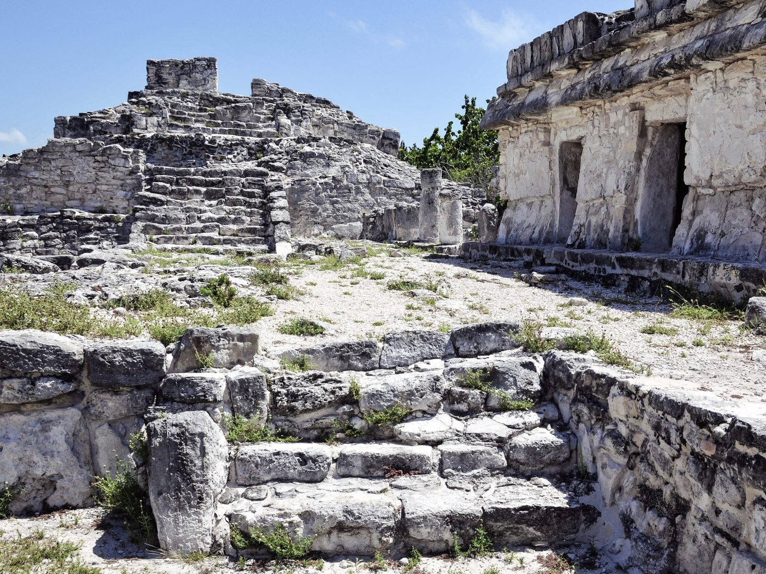
El Rey Ruins
Nestled within Cancun's bustling Hotel Zone, the El Rey Ruins offer a fascinating glimpse into the ancient Mayan civilization without the crowds often found at larger Mayan sites.
This lesser-known gem features well-preserved structures, including temples and plazas, set amidst lush greenery and a tranquil atmosphere.
Admission is a mere $5 USD, making it an affordable option for those looking to explore history.
Visitors can wander through the ruins at their own pace, taking in the intricate stone carvings and learning about the site's significance.
Additionally, the area is home to a population of friendly iguanas that bask in the sun, adding to the charm of this historical site.

Slide 16
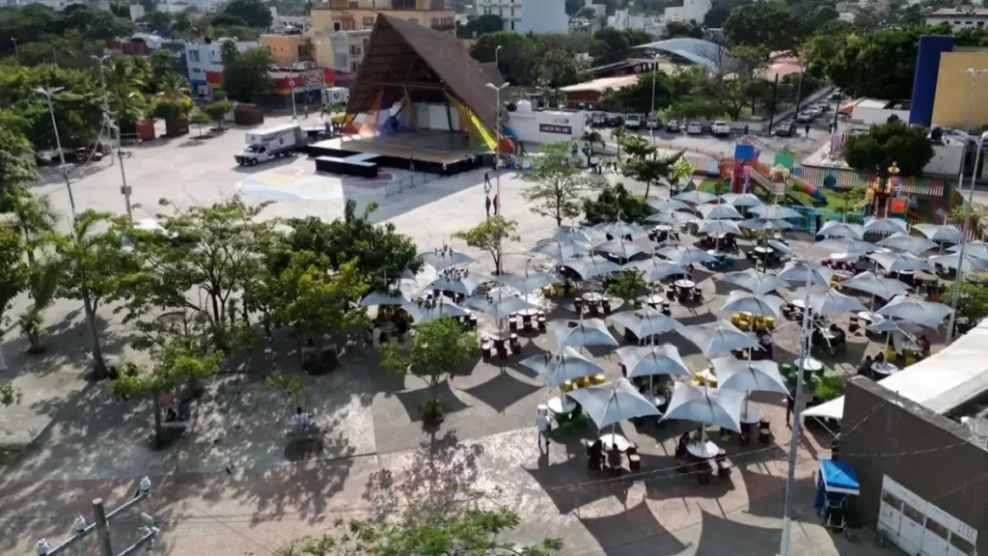
Parque Las Palapas
Parque Las Palapas is a lively and colorful park located in downtown Cancun, beloved by locals and visitors alike.
This vibrant space is a hub of activity, especially in the evenings when families and friends gather to enjoy the lively atmosphere.
The park is renowned for its delicious street food stalls, where you can sample authentic Mexican dishes such as tacos, quesadillas, and elotes, all prepared fresh on-site.
In addition to the culinary delights, Parque Las Palapas often hosts live music performances, cultural events, and traditional dance shows, providing an authentic taste of Mexican culture.
The park's welcoming ambiance and friendly locals make it an ideal spot to relax, socialize, and immerse yourself in the vibrant spirit of Cancun.

Slide 17
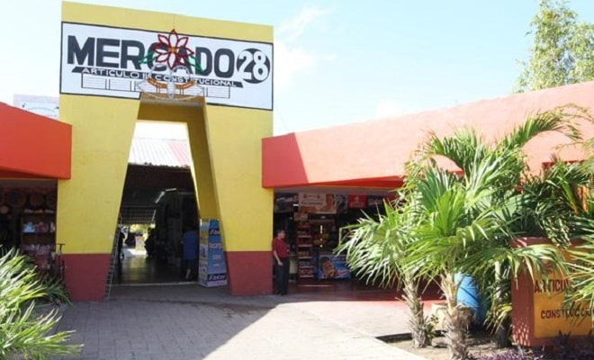
Mercado 28
Mercado 28 is a bustling flea market in downtown Cancun, offering a vibrant shopping experience filled with local flavor.
Visitors can haggle for souvenirs, handicrafts, and traditional Mexican goods, including handmade jewelry and textiles.
The lively atmosphere is enhanced by the enticing aromas of authentic street food, with options like tamales, churros, and fresh ceviche.
More than just a shopping destination, Mercado 28 provides a cultural experience where you can interact with local artisans and immerse yourself in Cancun's vibrant community, making it a must-visit spot for unique gifts and lively ambiance.

Slide 18
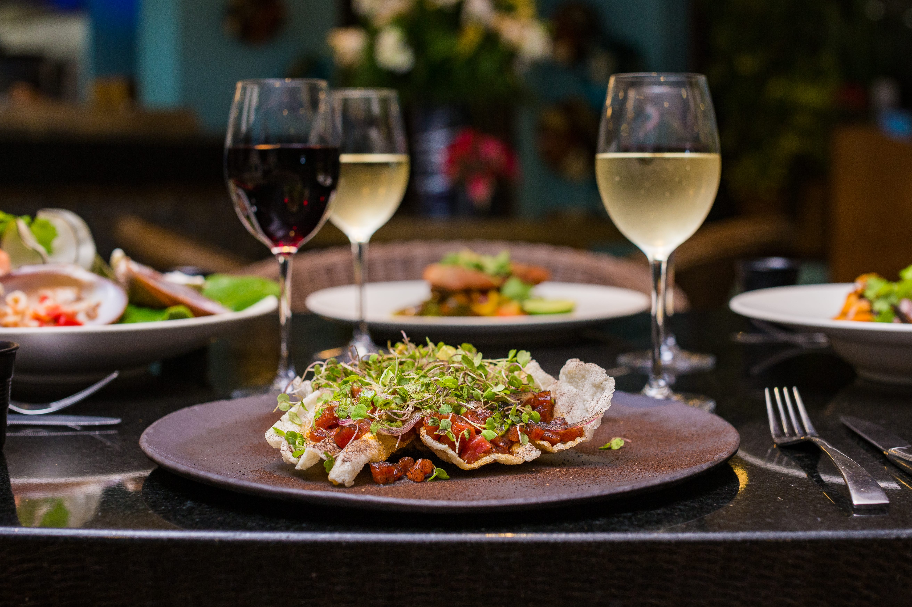
Dining and Food Options
Cancun offers everything from street food to high-end dining:
Street Tacos: Try the famous tacos al pastor in downtown Cancun, near Parque Las Palapas, were street vendors serve delicious and affordable eats.
La Habichuela: This iconic Cancun restaurant offers traditional Mexican and Caribbean dishes. Expect to pay $30-$50 USD each for a full meal.
Hotel Zone Dining: For a more upscale experience, many restaurants in the Hotel Zone offer international cuisine, though they tend to be pricier than downtown options.
For those of you who just like good food, you can’t go wrong just about anywhere you go in Cancun.
GOOD EATING

Slide 19
Final Thoughts
Cancun is a destination where history seamlessly intertwines with modern luxury, creating a unique atmosphere that appeals to a diverse range of travelers.
Whether you're an adventure seeker, a history buff, or someone looking to unwind, Cancun has something for everyone. You can delve into the rich heritage of the ancient Mayan civilization by exploring iconic ruins like Chichen Itza and Tulum, where you can marvel at the architectural wonders and learn about the fascinating culture that once thrived in the region.
For those seeking relaxation, Cancun's world-class beaches provide the perfect backdrop for sunbathing, swimming, and enjoying water sports. The soft, white sands and crystal-clear waters invite visitors to unwind and soak up the sun

Slide 20
Thanks For Coming
If you have any more questions, please ask.
I will do my best to answer them for you.
Have a great visit in Cancun!

