Slide 1
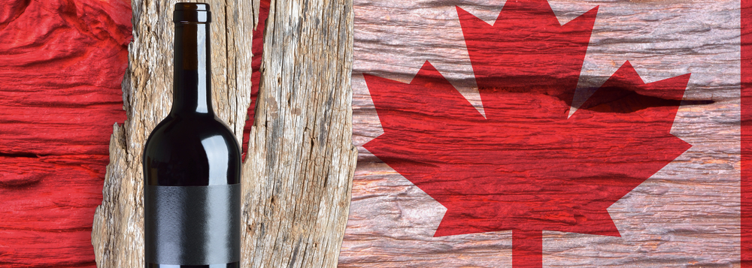
The Evolution of Canadian Wine
Presented by
Marc Silver

Slide 2
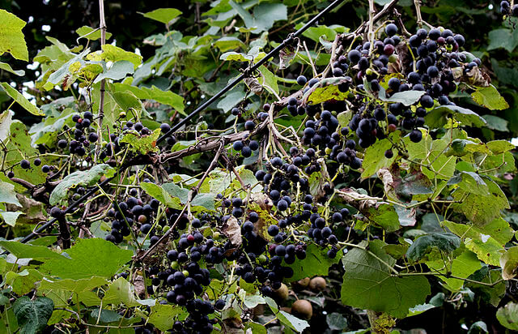
Early European Settlement (Pre-1800s)
The story of wine in Canada begins long before European settlers arrived.
Indigenous peoples across Canada harvested wild grapes like Vitis riparia, known as Riverbank Grapes, for various purposes. While these grapes weren't cultivated for wine, they foreshadowed what would later be a robust viticultural tradition.
European settlers, primarily the French and British, recognized the potential of Canada's cool climate for producing wine. However, the harsh winters and unpredictable growing seasons initially limited their success. The first notable attempts at winemaking came in the 19th century, when European settlers introduced hardy American and hybrid grape varieties that could withstand the cold.

Slide 3
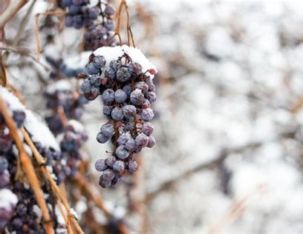
The 1800s to Mid-1900s
The Rise of Hybrid Grapes and Early Winemaking
      By the mid-19th century, the wine industry began taking root in areas like Ontario and British Columbia. Vineyards grew native and hybrid varieties due to their resilience to cold weather.
      However, the wine produced during this time was often sweet and lacking the complexity found in European wines, partly due to the grapes' resistance to disease and pests but not necessarily geared toward premium winemaking.
The Prohibition era (1916–1927 in Canada) disrupted the fledgling wine industry, limiting production to sacramental and medicinal wines.
After Prohibition, wine production grew, especially in regions like Niagara in Ontario, spurred by a greater focus on wine tourism and agriculture.

Slide 4
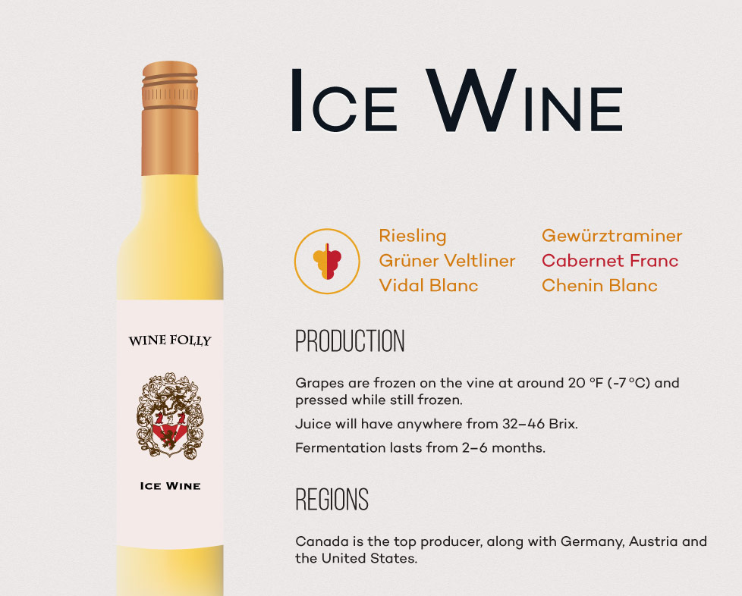
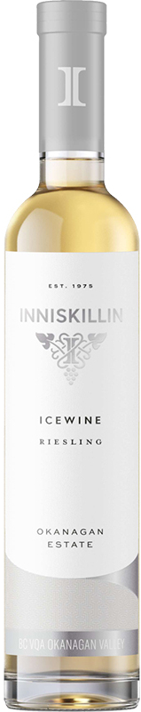
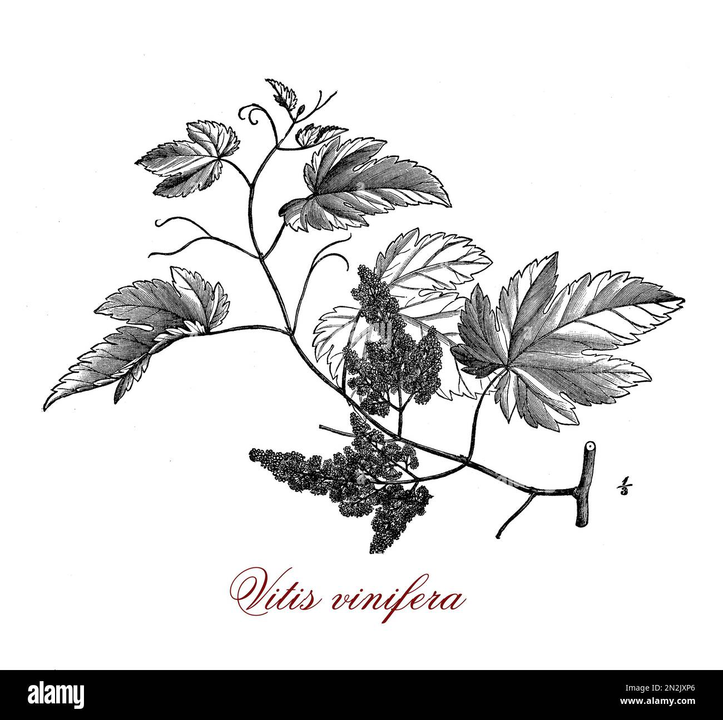
Modern Era
The Vinifera Revolution (1970s to Present)
The true breakthrough came in the 1970s when growers in Canada began experimenting with Vitis vinifera—the same grape species used in traditional European winemaking. These grapes, such as Chardonnay, Cabernet Franc, and Riesling, struggled at first due to the cold, but new viticultural techniques allowed for their success.
Canada's accession to the Free Trade Agreement with the U.S. in 1989 forced local winemakers to modernize, as cheap imports flooded the market. This period saw the introduction of the Vintners Quality Alliance (VQA) in 1988, a regulatory and appellation system that established quality benchmarks, much like France's AOC.
Key Breakthroughs include the introduction of Vitis vinifera in the 1970s.
The establishment of the VQA standard.
The rise of Icewine, positioning Canada as a global leader in this niche market.

Slide 5
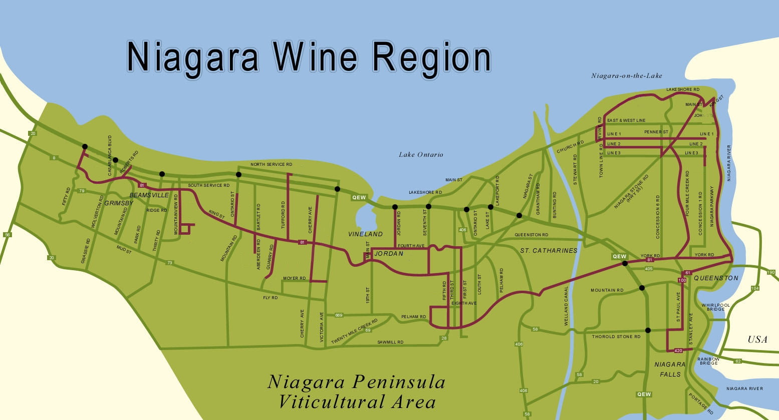
Wine Regions in Canada
Niagara Peninsula (Ontario)
  Production: The largest wine-producing region in Canada, responsible for more than 70% of the country's wine.
  Tourism: Niagara’s proximity to Niagara Falls and Toronto draws millions of visitors annually. Wine trails and boutique hotels enhance the visitor experience.
  Unique Qualities: The Niagara Escarpment and Lake Ontario moderate temperatures, allowing for a longer growing season and high-quality vinifera grapes.
  Why Visit: World-class Icewine festivals, scenic landscapes, and access to over 100 wineries.

Slide 6
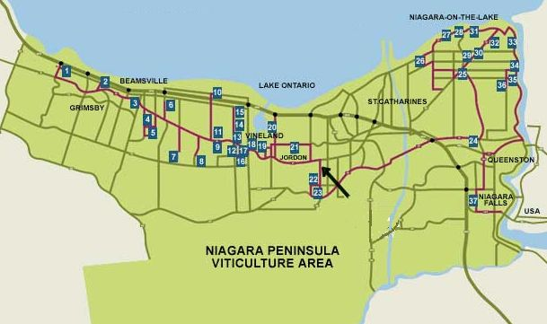
Regional Breakdown
Niagara Peninsula (Ontario)
Location: Southern Ontario, along the
shores of Lake Ontario and the Niagara Escarpment.
Terroir: Limestone-rich soils and a moderate climate
influenced by Lake Ontario.
Climate: Cold winters, warm summers, and a long
growing season.
Predominant Varieties: Icewine (Riesling, Vidal), Chardonnay, Pinot Noir, Cabernet Franc.
Wine Characteristics: High acidity, pronounced fruit flavors, and a mineral-driven finish.

Slide 7
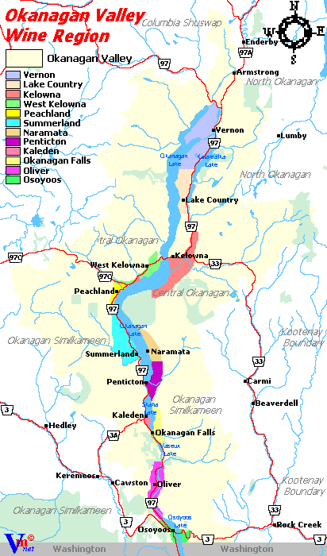
Okanagan Valley
(British Columbia)
  Production: British Columbia’s premier wine region, producing around 85% of the province’s wines.
  Tourism: Known for its lakeside beauty, the Okanagan Valley is a popular destination for wine tourists and nature lovers alike.
  Unique Qualities: The arid, desert-like climate with long daylight hours and cool nights supports the growth of full-bodied reds and aromatic whites.
  Why Visit: Stunning wineries with views of Okanagan Lake, organic winemaking trends, and superb restaurant pairings.

Slide 8
Regional Breakdown
Okanagan Valley (British Columbia)
Location: Interior British Columbia, centered around Okanagan Lake.
Terroir: Desert-like conditions with sandy, well-drained soils.
Climate: Hot, dry summers and cool nights.
Predominant Varieties: Merlot, Syrah, Riesling, Pinot Gris.
Wine Characteristics: Bold reds with ripe fruit flavors, crisp whites with citrus and floral notes.

Slide 9
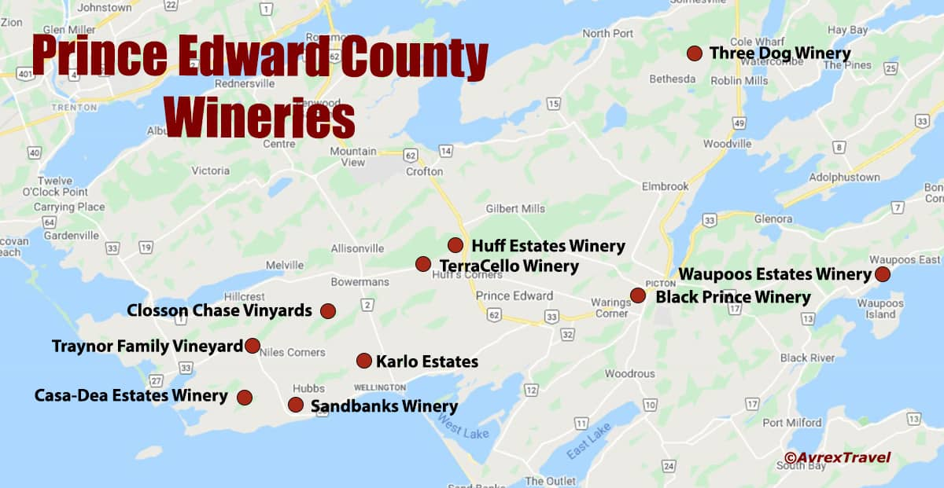
Prince Edward County (Ontario)
  Production: A rising star in Canadian winemaking, producing elegant, cool-climate wines.
  Tourism: Known for its charming countryside, art galleries, and proximity to Toronto and Ottawa.
  Unique Qualities: Its limestone-rich soils and cool climate make for distinctive, mineral-driven wines, especially Chardonnay and Pinot Noir.
  Why Visit: Boutique wineries, farm-to-table dining, and proximity to Sandbanks Provincial Park.

Slide 10
Regional Breakdown
Prince Edward County (Ontario)
Location: Southeast of Toronto, on the northern shore of Lake Ontario.
Terroir: Limestone-rich soils and a cooler, maritime climate.
Climate: Short growing season, but moderated by Lake Ontario.
Predominant Varieties: Chardonnay, Pinot Noir, Gamay.
Wine Characteristics: Crisp acidity, mineral undertones, and elegant structure.

Slide 11
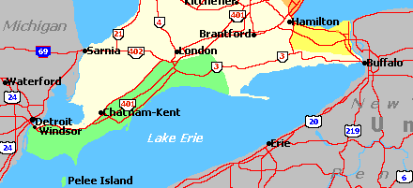
Lake Erie North Shore (Ontario)
  Production: A smaller region but growing in prominence for its rich, full-bodied reds.
  Tourism: Close to Windsor and Detroit, with a quieter wine scene ideal for intimate vineyard experiences.
  Unique Qualities: Warmer than most Canadian wine regions due to its southern latitude, with a long growing season.
  Why Visit: Hidden gems of
  wineries, historic sites, and
  serene vineyards.

Slide 12
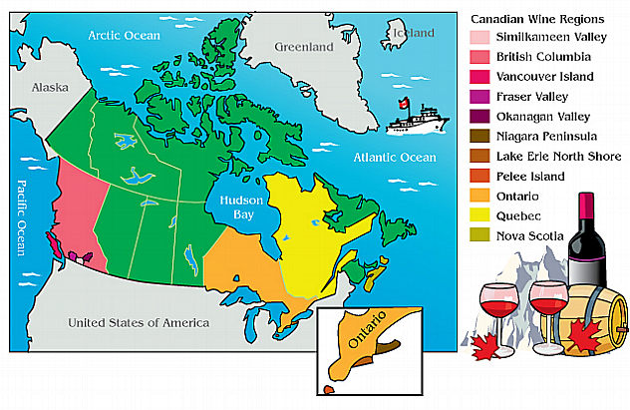
Lesser-Known Regions
  Pelee Island (Ontario): The southernmost point in Canada, known for its long growing season and diverse microclimates.
  Nova Scotia: Specializing in sparkling wines due to its cool, maritime climate.
  Similkameen Valley (British Columbia): A hidden gem for organic and biodynamic wines, with steep vineyards and unique terroir.
  Quebec The grape varieties, both white and red, all have common qualities needed by the harshness of the winter season, including resistance to winter temperatures, resistance to spring freezes and being early ripening.
  Some 40 varieties are grown in Quebec, with the most commonly planted being Maréchal Foch, Frontenac, Sainte-Croix, Vidal and Seyval blanc.

Slide 13
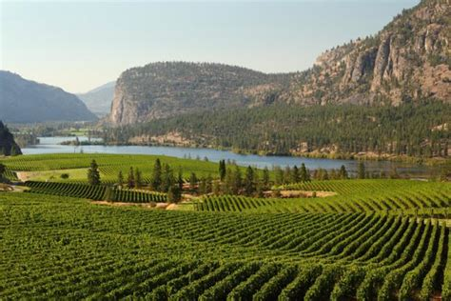
Canada’s Unique Terroir
Canada’s terroir is defined by its cool climate, varied geography, and the interplay of lakes, mountains, and escarpments. The influence of large bodies of water—such as Lake Ontario in Niagara and Okanagan Lake in British Columbia—moderates temperatures, extending the growing season and preventing frost.
Key climatic factors include:
Latitude: Canadian vineyards sit between the 41st and 50th parallels, which puts them at similar latitudes to northern France and Germany.
Continental and Maritime Climates: Regions like Niagara
and Nova Scotia benefit from maritime influences, while
Okanagan and Lake Erie have more continental climates.
Diurnal Temperature Shifts: In regions like Okanagan, hot
days and cool nights enhance grape acidity, critical for balanced
wines.
Soil: Limestone in Prince Edward County and the glacial deposits in
the Okanagan contribute to distinctive mineral notes in wines.

Slide 14

Varietals and Wine Characteristics
Riesling: Known for its high acidity and versatile flavor profile, ranging from bone-dry to sweet. Common tasting notes include green apple, citrus, and honey. Pairs well with spicy dishes like Thai or Indian cuisine.
Chardonnay: A versatile grape that produces wines with flavors of apple, pear, and butter. In cooler regions like Niagara, it shows bright acidity and minerality. Pairs well with roasted chicken or seafood.
Pinot Noir: A challenging grape to grow, but when done right, it delivers complex aromas of cherry, earth, and spice. Best paired with mushroom dishes or grilled salmon.
Cabernet Franc: Often used in blends but also shines solo in Ontario. It has aromas of red fruit, herbs, and bell pepper, with a medium body. Excellent with roasted vegetables or lamb.

Slide 15
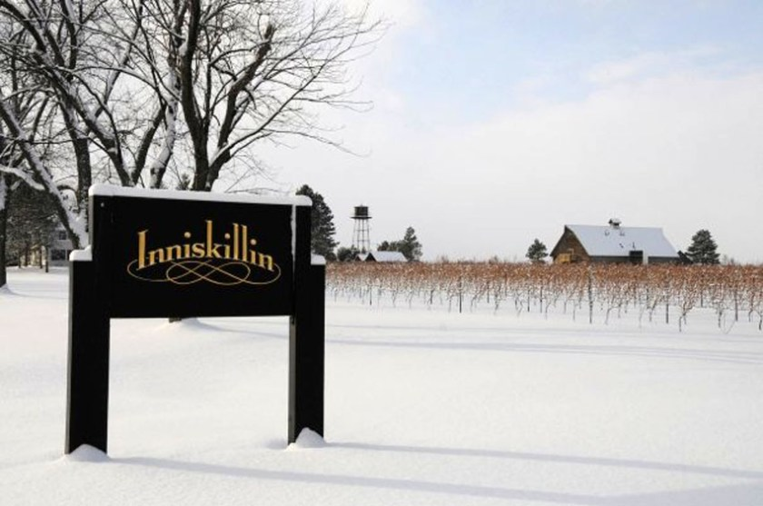
Notable Wineries and Signature Wines
Inniskillin, founded in 1975 in Niagara, is renowned for pioneering Canadian Icewine, particularly its Vidal Icewine.
This dessert wine is crafted from grapes that freeze on the vine, concentrating their sugars and creating a luscious, sweet wine balanced by vibrant acidity.
Inniskillin’s Vidal Icewine offers tropical fruit flavors like mango and pineapple, with a rich, refreshing finish. Ideal pairings include blue cheese, fruit-based desserts, and dark chocolate.
Inniskillin’s Icewine gained international recognition after winning the Grand Prix d’Honneur at Vinexpo in 1991, establishing Canada as a global leader in Icewine production.

Slide 16
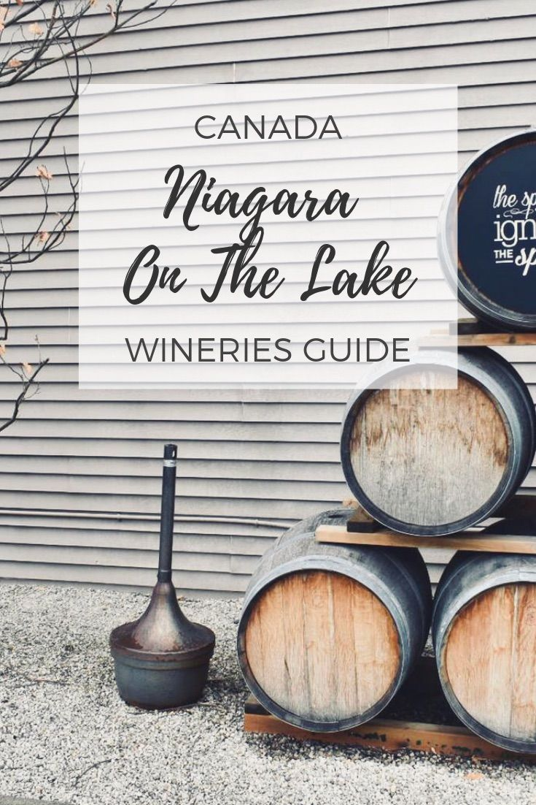
Notable Wineries and Signature Wines
Closson Chase, located in Prince Edward County, is celebrated for its small-lot, terroir-driven Chardonnay and Pinot Noir.
Known for its focus on sustainable practices, the winery capitalizes on the region’s cool climate and limestone-rich soils to produce wines with vibrant acidity and mineral complexity.
Their Chardonnays offer refined, citrus and stone fruit notes, while the Pinot Noirs are elegant with red fruit and earthy tones.
Closson Chase exemplifies the region’s potential for producing world-class wines.

Slide 17
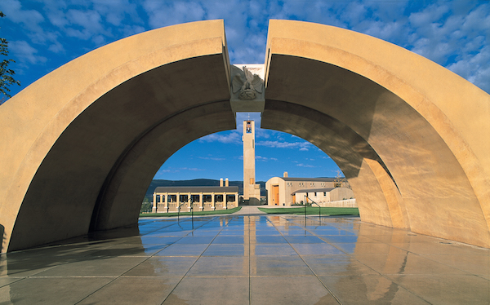
Notable Wineries and Signature Wines
Mission Hill Family Estate, located in British Columbia’s Okanagan Valley, is renowned for producing award-winning Merlot and Chardonnay, reflecting the region’s distinct terroir.
Their Legacy Series represents the pinnacle of their winemaking, crafted from the best vineyard blocks and embodying meticulous viticulture.
These limited-production wines showcase the estate's dedication to quality, with complex flavors and excellent aging potential. Mission Hill's iconic architecture and stunning location also make it a top destination for wine tourism in Canada.

Slide 18
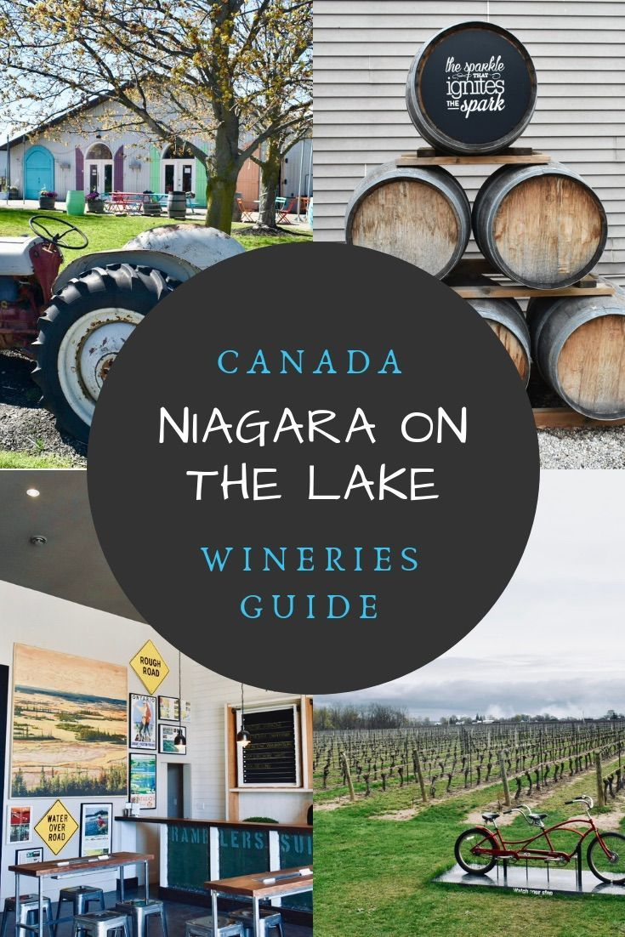
Notable Wineries
Niagara on the Lake Wineries produce an Orange Wine which may qualify as a fourth wine color.
The most unique wines are a Sherry-like Chardonnay called Anniversary and an orange wine.
They fortify (add extra alcohol) the Chardonnay and age it for seven years in small oak barrels, giving it the nutty, caramel character of Sherry.
Orange wine, on the other hand, is an ancient European style that’s seeing a revival in wine regions across the world. Normally, white wine is fermented from freshly run juice while red wine sits on its skins to extract colour and tannins.
The process also helps naturally preserve the wine so it can age.

Slide 19
Conclusion:
Canada’s wine industry continues to evolve, blending tradition with innovation, and crafting wines that stand out in a global market.
Canada’s wine industry is a dynamic blend of tradition and innovation, where winemakers embrace both classic techniques and cutting-edge methods to produce unique, high-quality wines.
With regions like the Okanagan Valley, Niagara Peninsula, and Nova Scotia’s cool-climate vineyards gaining international recognition, there’s never been a better time to explore Canadian wines.
Wine lovers worldwide are discovering the hidden gems of Canadian vineyards, and you could be next. Whether you’re drawn to the rich reds, crisp whites, or the renowned ice wines, Canadian vineyards offer something for every palate.

Slide 20
Acknowledgement
My seminars are the result of many years of experience combined with many hours of research over the internet.
I would like to acknowledge the many source I have accessed.
These include Wine Spectator, Wine Enthusiast, BKWine Magazine, Wine & Spirits Magazine, American Vineyard Magazine, The Grapevine Magazine, Wikipedia.com, Britannica.com, and the
various Government websites.

Slide 21
Citations
"Canadian Vintners Association“, Provides an overview of Canada's wine history, regulations, and VQA standards.
"VQA Ontario"
Offers detailed information about the Vintners Quality Alliance system and wine regions in Ontario.
"Wine Growers British Columbia"
Focuses on British Columbia's wine industry, regions, and viticultural practices.
"Wine Marketing Association of Ontario"
Provides insights into the wine industry, tourism, and the economic impact of winemaking in Ontario.
"Icewine: The Frozen Beauty of Canada’s Vineyards" (Article)
Discusses the history, production, and global significance of Canadian Icewine.
Published by Wine Enthusiast.
"The Oxford Companion to Wine" by Jancis Robinson
A comprehensive resource that covers the global history and key viticultural practices, including Canadian wine developments.
Published by Oxford University Press.
"Decanter Magazine"
Provides expert reviews and insights on Canadian wines, wineries, and trends in the industry.

