Slide 1
Callao/Lima, Peru
Presented by
Marc Silver

Slide 2
What I Will Cover
My Port Philosophy
Don’t Miss the Ship
Money and Currency Tips
A Brief History of Callao & Lima
Transportation
Top Attractions & Points of Interest
Local Cuisine & Dining Options
Important Tips & Practical Advice
Conclusion

Slide 3
My Port Philosophy
I have been cruising for over 46 years and have taken over 100 cruises.
So, I consider myself an experienced cruiser.
The information I will present is based on those many years of experience.
When I am on a cruise where the city, I want to visit is not the port city, I always recommend taking a ship’s tour.
Lima is a fascinating port call — full of history, art, and incredible food. But the port of Callao, where ships dock, is industrial and distant from the city center.
For that reason, I strongly recommend organized ship tours or private, reputable excursions into Lima itself.

Slide 4

Don’t Miss the Ship
How to Avoid Missing Your Ship
Pay attention to the time. - Ship time and local time
are often different.
Put a return-to-ship reminder on your phone.
Choose excursions wisely.
If a ship-sponsored excursion is late returning to port,
the ship will wait for you. If you are on your own.
Be Prepared
Have your Passport, Credit Card, and phone numbers for your ship port agent.
What to Do If You Miss the Ship
Most cruise lines have port agents stationed in the port area to assist if your ship has left without you. If you are lucky, when cruisers are late returning to the vessel, the ship’s crew will often remove the passengers’ essential items – passports, cell phones, and medication -- from the ship to leave with the port agents.
The Port Officials can help you with contacting your ship
and making necessary travel arrangements.

Slide 5
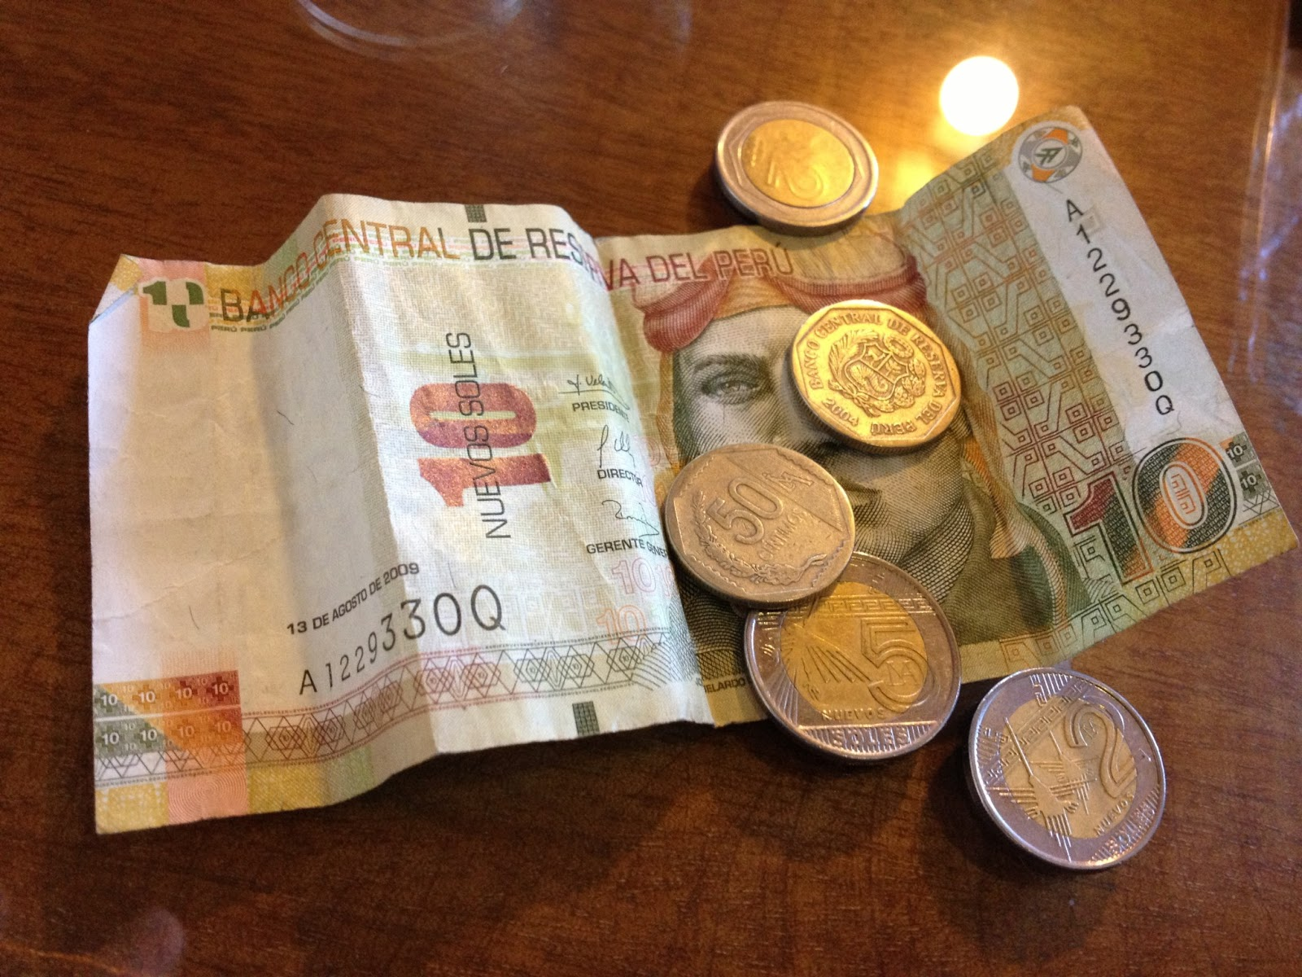
Money
Peru’s official currency is the Sol (PEN). The exchange rate is roughly 1 USD = 3.7 PEN.
U.S. dollars are accepted in some places, but change may be given in soles.
Credit cards are widely accepted, though smaller shops prefer cash.
Avoid money changers near the
port; ATMs in Lima’s city center
are more reliable.
The official exchange rate is:
$1.00 US = 3.43 PEN
1.00 PEN = 0.292 US Dollars

Slide 6
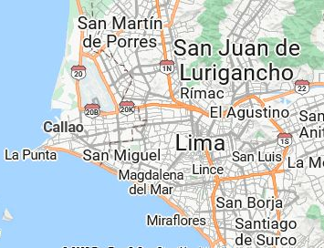

Slide 7
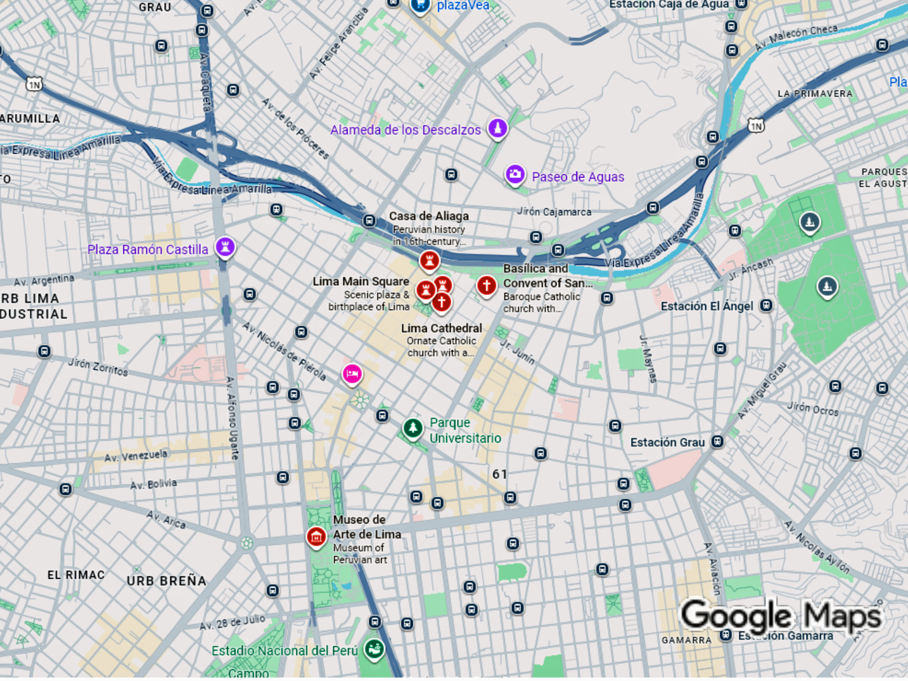

Slide 8
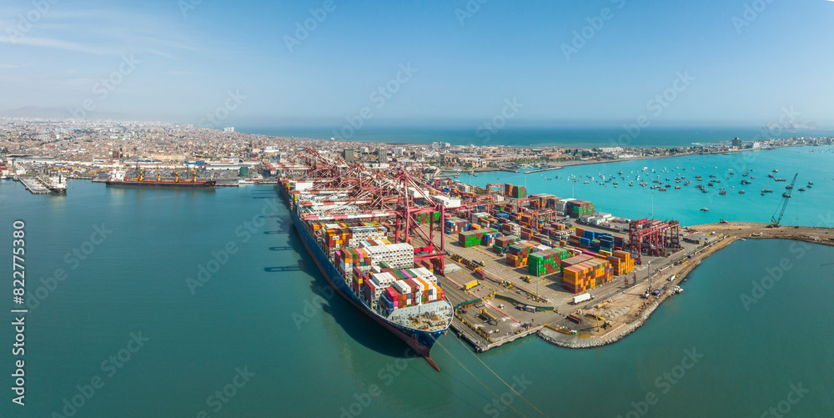
Welcome to Callao & Lima
Callao serves as the main seaport for Lima, Peru’s capital. It’s both historic and bustling, a gateway to one of South America’s most culturally rich cities.
Lima offers colonial architecture, museums, and world-renowned cuisine — a city where Spanish, Indigenous, and African influences blend beautifully.

Slide 9
A Brief History of Lima
Lima was founded by Spanish conquistador Francisco Pizarro on January 18, 1535, becoming the capital of the Viceroyalty of Peru. For nearly three centuries, it served as Spain's most important South American colonial center, accumulating immense wealth from silver mining and trade.
The city's grand colonial architecture reflected its status, with ornate churches, monasteries, and palaces adorning its streets. Lima became known as the "City of Kings" and was a hub of Spanish culture and political power in the New World.
Peru gained independence in 1821, with Lima remaining the national capital. The 20th century brought rapid urbanization and migration from the Andean highlands, transforming Lima into a sprawling metropolis
Despite challenges including political instability and economic struggles, modern Lima has emerged as a cultural and economic powerhouse, famous for its gastronomy and serving as home to nearly one-third of Peru's 33 million inhabitants.

Slide 10
Transportation
The Callao port is about 8 miles (13 km) from Lima’s city center, roughly a 45–60-minute drive depending on traffic.
For safety and convenience, use ship tours or reputable tour operators.
Taxis are available, but always
prearrange the fare or use trusted
companies.
Public buses are not recommended
for visitors due to congestion and
unclear routes.

Slide 11
Top Attractions & Points of Interest
Government Palace (Palacio de Gobierno) - The official residence of Peru's president, featuring daily changing of the guard ceremonies on Plaza Mayor.
The Government Palace, known locally as
the House of Pizarro, stands on the north
side of Plaza Mayor where Francisco
Pizarro built his original residence in 1535.
This neo-baroque masterpiece, constructed
in the 1930s, serves as the official
workplace and residence of Peru's president.
Its ornate facade features wrought-iron balconies typical of Lima's colonial architecture. The palace is most famous for its daily changing of the guard ceremony at noon, where uniformed Hussars of Junín perform an elaborate military ritual. Visitors can tour select rooms showcasing presidential portraits, historical artifacts, and lavish state reception halls that reflect Peru's political heritage spanning nearly five centuries.

Slide 12
Top Attractions & Points of Interest
Convento de Santo Domingo - Colonial monastery where the remains of Santa Rosa de Lima and San Martín de Porres are enshrined.
The Convento de Santo Domingo, founded in 1535, is one of Lima's oldest and most significant religious complexes.
This sprawling monastery showcases stunning colonial
architecture with intricate tile work, carved wooden
ceilings, and peaceful cloisters. It holds profound spiritual
importance as the final resting place of Santa Rosa de Lima,
the Americas' first Catholic saint, and San Martín de Porres,
the patron saint of mixed-race people and social justice.
Their ornate marble tombs attract pilgrims from around the
world.
The monastery also features a remarkable library
containing thousands of antique texts and manuscripts. Its
baroque church, with gilded altars and religious artwork,
remains an active place of worship, embodying Lima's deep Catholic heritage and colonial legacy.

Slide 13
Top Attractions & Points of Interest
Parque de la Reserva -located in central Lima, is home to the Magic Water Circuit (Circuito Mágico del Agua), a Guinness World Record holder as the largest fountain complex in a public park.
This spectacular attraction features 13 interactive fountains that combine water, light, music, and lasers in dazzling evening shows. Visitors can walk through tunnels of water, watch choreographed displays set to Peruvian music, and experience the towering Fuente de la Fantasía, which projects images onto massive water screens.
Opened in 2007, the park has become one of Lima's most popular attractions, drawing families and tourists nightly. The synchronized performances blend technology with artistry, creating a magical atmosphere that showcases modern Lima's creative spirit.

Slide 14
Top Attractions & Points of Interest
Huaca Huallamarca - also known as Pan
de Azúcar (Sugar Loaf), is a pre-Columbian
adobe pyramid built around 200-700 AD by
the Lima Culture.
Located in the upscale San Isidro district,
this ancient ceremonial and administrative
center stands as a striking reminder of Lima's pre-Hispanic past, surrounded by modern high-rise buildings and manicured parks.
The pyramid underwent extensive restoration using its original earthen construction techniques. Its small on-site museum displays artifacts excavated from the site, including ceramics, textiles, and mummies that reveal burial practices of ancient coastal civilizations.
Visitors can climb ramps to view the pyramid's terraced levels and learn how indigenous peoples thrived in this desert region centuries before Spanish arrival, making it an essential stop in Lima.

Slide 15
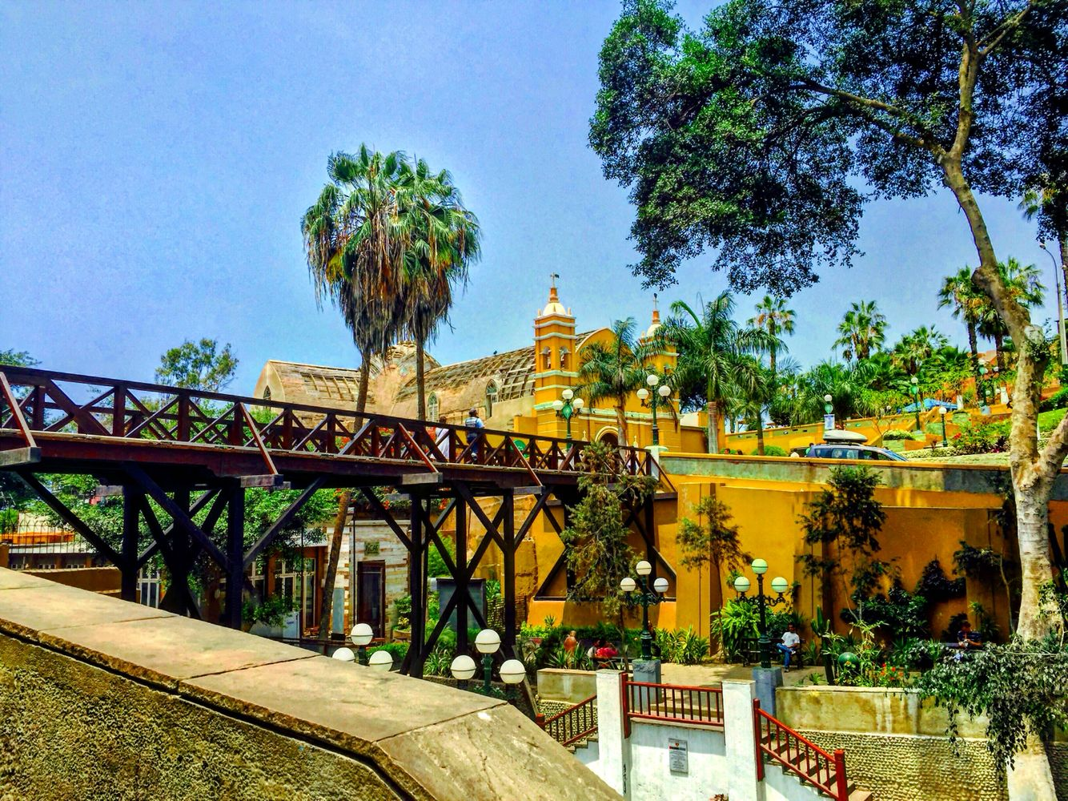
Top Attractions & Points of Interest
The Puente de los Suspiros (Bridge of Sighs) is Barranco's most iconic landmark and a symbol of Lima's romantic soul.
Built in 1876, this charming wooden footbridge spans a steep ravine and connects to the Bajada de Baños, a winding cobblestone pathway descending to the Pacific coast.
Local legend says anyone who crosses the bridge while holding their breath will have their wish granted. The bridge has inspired countless Peruvian songs, poems, and love stories, cementing its place in Lima's cultural identity.
Surrounded by colorful colonial mansions, cafes, and bougainvillea-draped walls, it embodies Barranco's bohemian charm. At sunset, the bridge offers breathtaking ocean views, making it a favorite spot for couples, artists, and anyone seeking Lima's most picturesque and nostalgic corner.

Slide 16
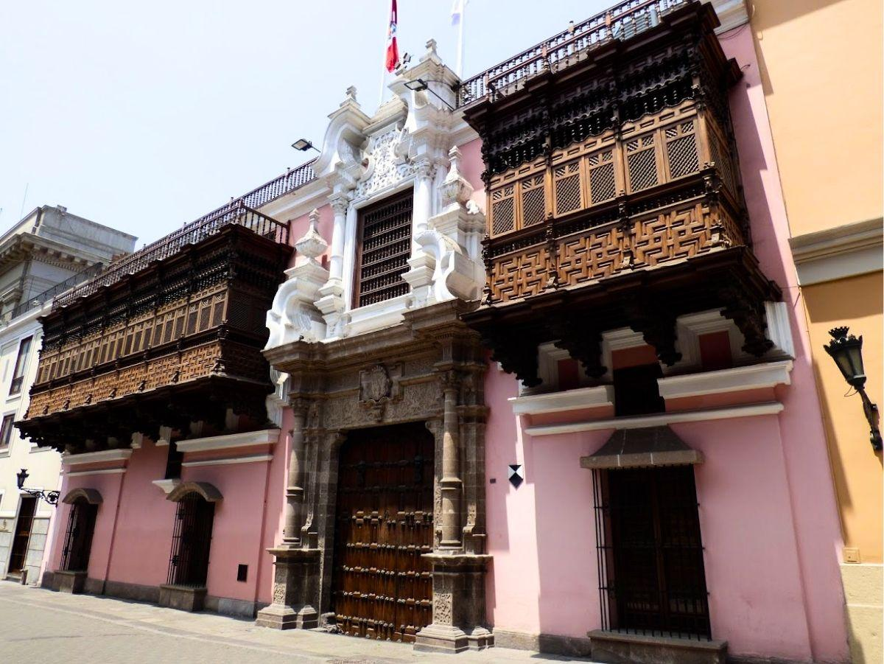
Top Attractions & Points of Interest
Torre Tagle Palace, built in the 1730s, stands as one of Lima's most exquisite examples of Spanish baroque architecture blended with Moorish influences.
Originally constructed as a private mansion for the Marquis of Torre Tagle, a wealthy Spanish nobleman, the palace showcases ornate carved wooden balconies, intricate stone doorways, and beautiful interior courtyards adorned with Sevillian tiles.
Its facade features the distinctive enclosed balconies that became Lima's architectural signature during the colonial era. Since 1918, it has served as the headquarters of Peru's Ministry of Foreign Affairs.
Public access is limited due to its governmental
function, the palace occasionally opens for special cultural events and guided tours, allowing visitors to admire its
gilded salons, antique furnishings, and historical
artifacts that transport guests back to Lima’s
aristocratic colonial past.

Slide 17
Top Attractions & Points of Interest
Pachacamac, located 25 miles southeast of
Lima, is one of Peru's most important
archaeological sites, with ruins dating back
over 1,500 years.
This vast ceremonial complex served as a
major pilgrimage center for multiple pre-Incan civilizations, including the Lima, Wari, Ichma, and later the Inca Empire.
The site features impressive adobe pyramids, temples, plazas, and residential areas sprawling across the desert landscape. The Temple of the Sun, built by the Incas, dominates the site with panoramic views of the Pacific Ocean.
Pachacamac was dedicated to the creator god of the same name, considered an oracle who could predict earthquakes. Today, visitors can explore the restored structures and visit the on-site museum displaying ceramics, textiles, and artifacts that reveal the spiritual significance of this ancient sanctuary.

Slide 18
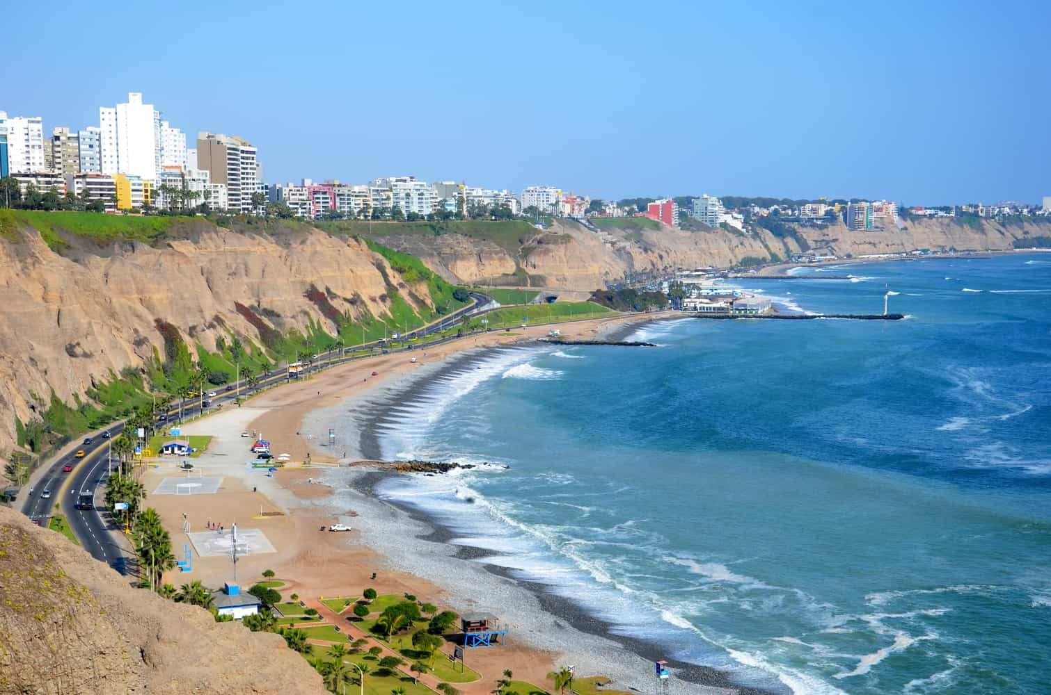
Top Attractions & Points of Interest
Costa Verde is Lima's stunning coastal highway that hugs the Pacific Ocean cliffs, stretching through the districts of Miraflores, Barranco, and Chorrillos. This scenic route offers breathtaking ocean views and connects a series of beaches popular for surfing, paragliding, and seaside recreation.
The highway runs beneath the Malecón, the clifftop boardwalk lined with parks, restaurants, and shopping centers. Costa Verde's beaches, including Playa Waikiki and Playa Makaha, attract water sports enthusiasts year-round despite Lima's cool coastal waters.

Slide 19
Local Cuisine & Dining Options
Peru’s cuisine ranks among the best in the world.
Local specialties:
Ceviche – Fresh fish cured in lime juice,
Peru’s national dish.
Lomo Saltado – Stir-fried beef with onions,
tomatoes, and soy sauce.
Aji de Gallina – Creamy chicken stew with chili peppers.
Recommended restaurants:
La Mar – Lima’s top cevicheria.
Central – Consistently ranked among the world’s best restaurants.
Pescados Capitales – Excellent seafood in Miraflores.
El Mercado – Stylish local favorite.

Slide 20
Important Tips & Practical Advice
Traffic in Lima is heavy — plan travel times carefully.
Stay with organized groups or tour guides; Callao’s port area is not ideal for independent walking.
Carry bottled water and avoid drinking tap water.
Spanish is the primary language, but tourist areas often speak English.
Return to the ship at least one hour before departure.

Slide 21
Conclusion
Lima offers one of the richest cultural and culinary experiences in South America.
From the grandeur of its colonial plazas to the freshness of its ceviche, it’s a city that rewards curiosity and taste.
Enjoy your day exploring — and savor every flavor of Peru!

