Slide 1
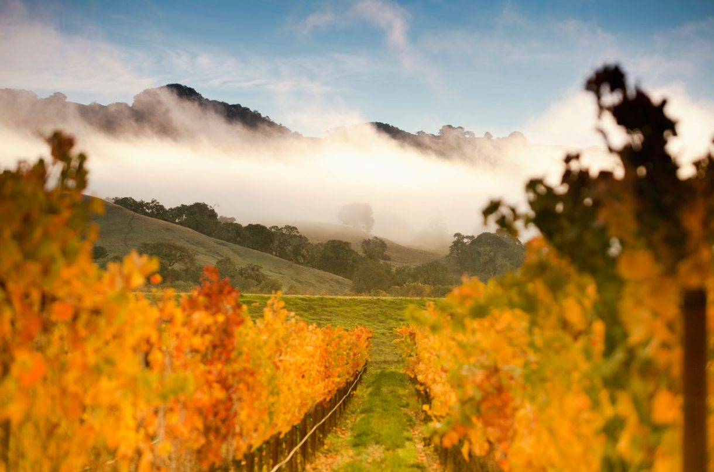
California Wine Presented by Marc Silver
It’s History, Regions, Varietals, and Notable Wineries

Slide 2

California Wine Introduction
California is the beating heart of the American wine industry. With a diverse climate, geography, and wine culture, it has carved out a reputation that rivals some of the world's oldest and most esteemed wine regions.
California’s wine industry accounts for nearly 90% of the wine production in the United States, and it has earned a reputation for producing some of the finest wines globally.
More than 80% of the wine made in the USA is made in California, making it the fourth largest producer of wine in the world, coming in behind Italy, France and Spain.
California wine regions run the length of the state, and wine grapes are grown in 49 of California's 58 counties. Chardonnay is the most widely planted white grape and Cabernet Sauvignon is the most widely planted red grape.
State with the most Wineries

Slide 3
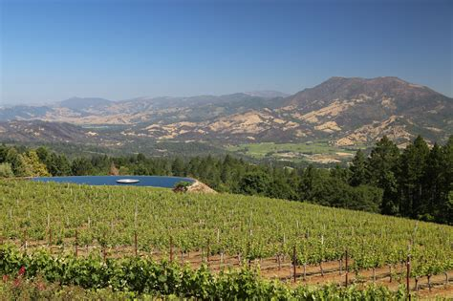
California Wine Introduction Cont.
California’s vast and varied landscape stretches from the rugged coastline of Mendocino County in the north to the southern border with Mexico. This expansive range encompasses a multitude of geographical features, from coastal regions along the Pacific Ocean to the vineyard-laden slopes of the Sierra Nevada foothills.
Each of these regions is distinct, with unique microclimates, soil compositions, and altitudes that play a pivotal role in defining the character of the wines produced.
In the coastal areas, the proximity to the Pacific Ocean influences cooler temperatures, fog, and breezes that create ideal growing conditions for delicate grape varieties like Chardonnay and Pinot Noir. Inland regions, such as those near the Sierra Nevada foothills, benefit from rich, diverse soils, and warmer temperatures which allow for robust varieties like Zinfandel and Cabernet Sauvignon

Slide 4
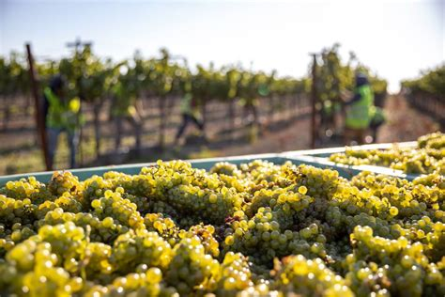
California Wine Introduction Cont.
These distinct local conditions foster an impressive diversity in grape varieties, resulting in wines that range from crisp, refreshing whites to deep, full-bodied reds. Each bottle tells the story of the land it comes from, reflecting the particular terroir, climate, and care that went into its cultivation.
This rich variation across the state positions California as one of the most diverse and celebrated wine regions in the world, where each sub-region contributes its own unique flavor to the broader tapestry of wine production.

Slide 5
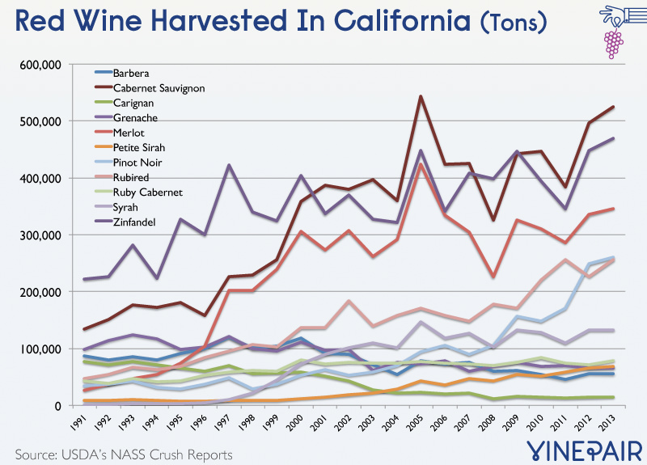
California Wine Statistics
There are 147 AVAs throughout California containing some 4,200 Wineries.
California has over 635,000 Acres of planted vineyards producing 3.92 Million Tons of wine grapes which yields 27,440,000 Liters of juice.
Key Varieties Include:
Cabernet Sauvignon 93K - 14.6%, Chardonnay 92K - 14.5%, Pinot Noir 48K - 7.6%, Zinfandel 40K - 6.3%, Merlot 37K - 5.8% by acres. Top 5-6 varieties (by plantings) and percentages noted.
White Wine Varietals Include:
Chardonnay, Sauvignon Blanc, Pinot Gris, Viognier, Riesling, Chenin Blanc, Muscat, Pinot Blanc, Sémillon, Grenache Blanc, Marsanne, Roussanne, and Gewürztraminer
Red Wine Varietals: Cabernet Sauvignon, Merlot, Pinot Noir, Syrah, Zinfandel, Barbera, Grenache, Malbec, Petite Sirah, Cabernet Franc, Sangiovese, Mourvèdre, Tempranillo
Climate - Mediterranean
I will delve into the rich history of California wine, explores the state’s major wine regions, examines key varietals, and highlights some of the most significant wineries that have shaped California’s wine industry.

Slide 6
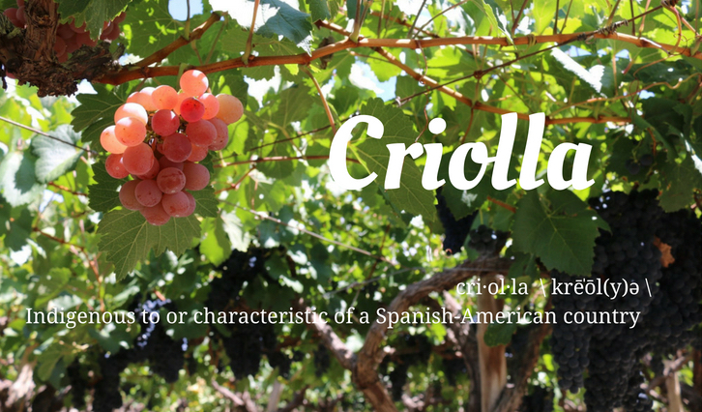
The History of California Wine
The history of California wine dates back to the 18th century when Spanish missionaries planted the first vineyards to produce sacramental wine. The Mission grape, also known as Criolla, was the first varietal cultivated in the region, brought to California by Father Junípero Serra in the late 1700s.
The modern wine industry began to take shape during the Gold Rush of the mid-1800s when immigrants, particularly from Europe, brought their winemaking skills to California.
By the late 19th century, the pioneers, helped to advance California viticulture by importing European vine cuttings and establishing wineries in the Sonoma Valley.

Slide 7
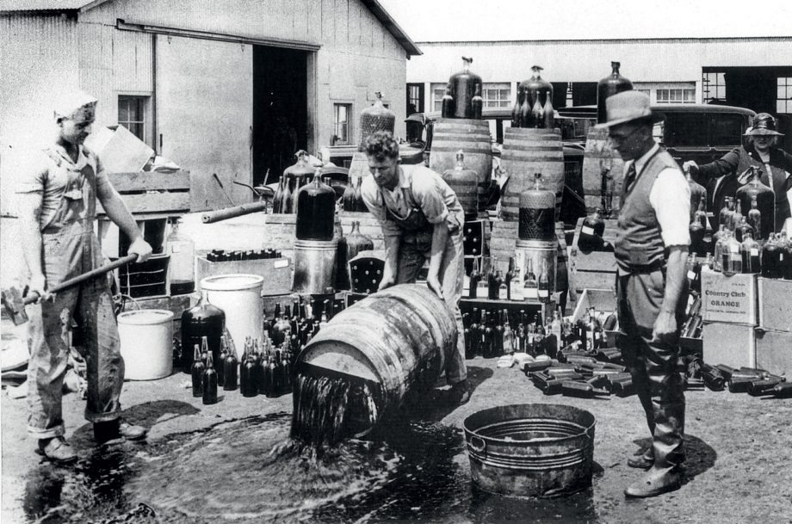
The History of California Wine
The burgeoning wine industry was severely impacted by Prohibition (1920–1933), which nearly wiped-out commercial winemaking.
Only a few wineries survived by producing sacramental and medicinal wine.
The industry slowly recovered after the repeal of Prohibition, but the true renaissance occurred in the 1960s and 1970s when Robert Mondavi helped spearhead the movement toward high-quality, internationally recognized wines.
The 1976 Judgment of Paris, where Napa Valley wines triumphed over top French wines in a blind tasting, further solidified California’s reputation as a world-class wine producer.
A California white and red won the competition. The 1973 chardonnay from Chateau Montelena and the 1973 cabernet sauvignon from Stag's Leap Wine Cellars. (A bottle of each now resides at the Smithsonian's National Museum of American History.)

Slide 8
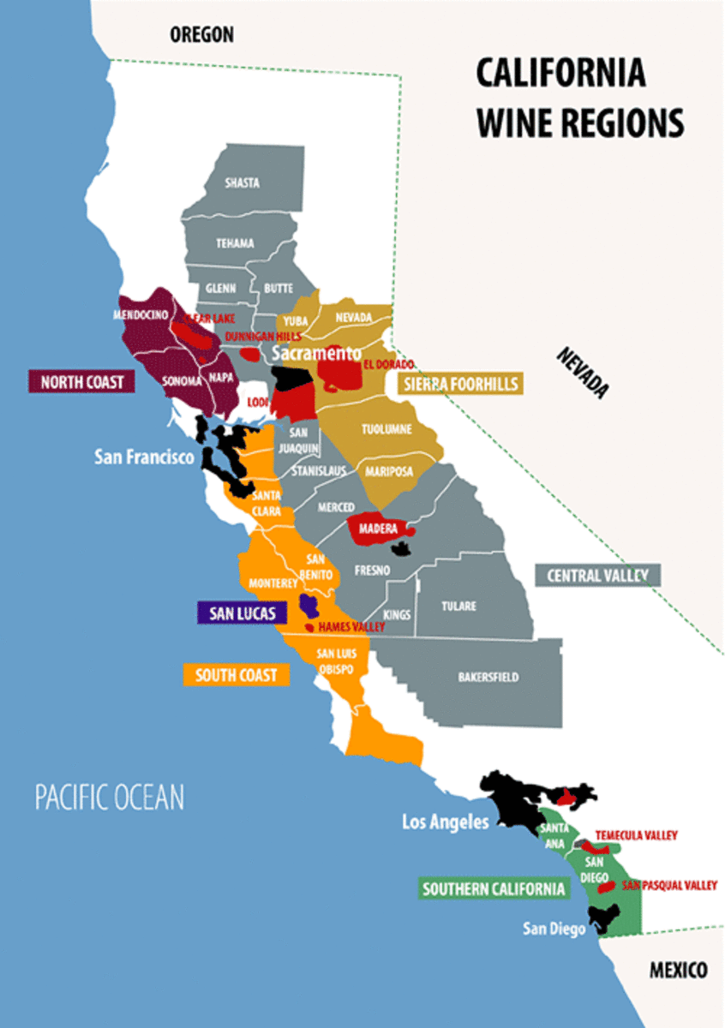
Key Wine Regions
California’s vast and varied geography, from coastal areas to inland valleys and mountainous regions, provides ideal growing conditions for a wide variety of grapes.
When a U.S. winery wants to tell you the geographic pedigree of its wine, it uses a tag on its label called an Appellation of Origin.
Appellations are defined either by political boundaries, such as the name of a county, state or country, or by federally-recognized regions called American Viticultural Areas (AVAs).
The state has over 147 American Viticultural Areas (AVAs), but a few key major regions stand out.
I will discuss the most important of these regions.

Slide 9
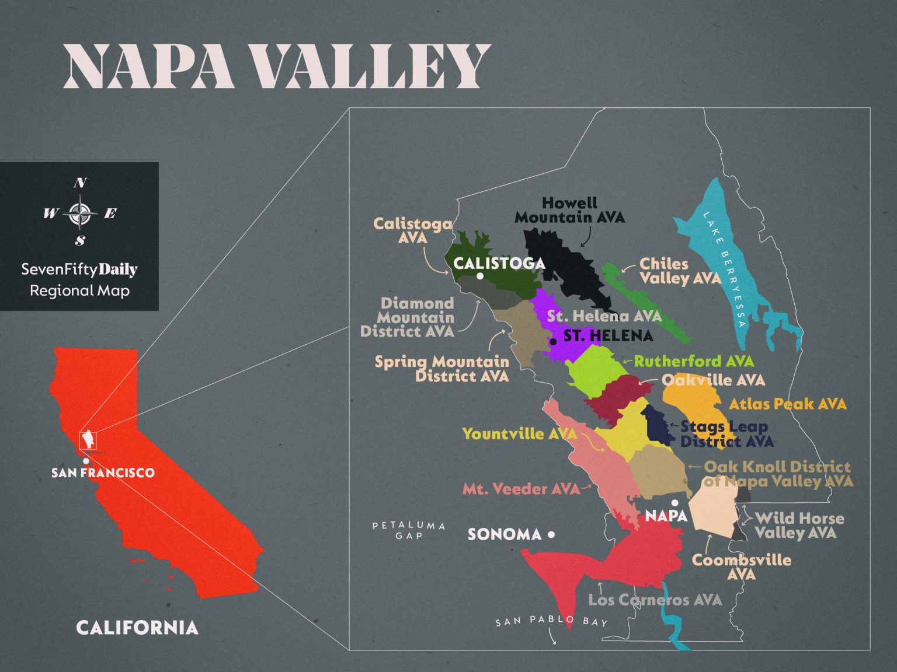
Napa Valley
Napa Valley is not only the most famous and perhaps the most important wine region in California but also a global benchmark for premium winemaking.
Situated about an hour north of San Francisco, Napa’s geographic position makes it an ideal location for growing high-quality grapes.
Its Mediterranean climate, characterized by long, dry summers and mild, wet winters, mirrors the conditions found in many of the world’s top wine regions, such as parts of Italy and southern France.
This stable climate allows for consistent grape ripening, a key factor in producing wines with concentrated flavors and balanced acidity.

Slide 10
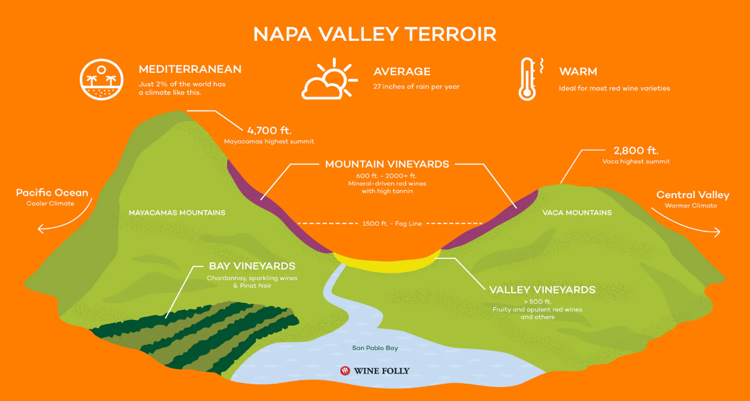
Napa Valley Cont.
One of the most significant factors contributing to Napa’s success is its soils, which are composed primarily of volcanic ash and gravel.
These soils are well-drained, which forces vines to grow deep roots in search of water and nutrients, ultimately producing grapes with more concentrated flavors.
The combination of volcanic soils, a diverse range of microclimates (from the foggy southern end near Carneros to the warmer northern regions around Calistoga), and winemaking expertise has helped Napa Valley build its reputation as a powerhouse for Cabernet Sauvignon, the valley’s signature grape.

Slide 11
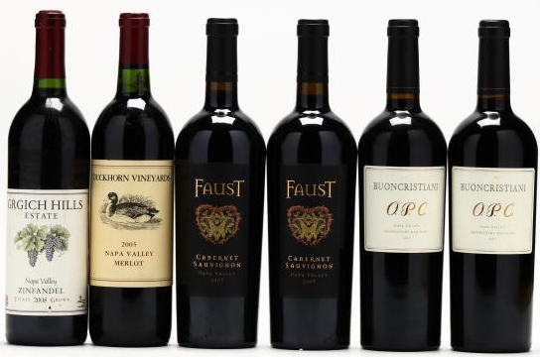
Napa Valley’s Notable Varietals
While Cabernet Sauvignon is the most popular wine, Napa is also known for producing other world-class varietals:
Cabernet Sauvignon: Napa’s most famous grape is prized for its deep flavors of black currant, plum, and hints of tobacco. It’s firm tannins give a capacity to age for decades.
Chardonnay: Grown in both cooler areas like Carneros and warmer regions, Napa Chardonnay ranges from rich and oaky to crisp and refreshing, often showing flavors of apple, pear, and citrus.
Merlot: Often blended with Cabernet Sauvignon, Napa’s Merlot tends to be full-bodied with flavors of dark fruit, chocolate, and sometimes herbs.
Sauvignon Blanc: A versatile white grape that can be made in both oaked and unoaked styles, often showing bright acidity and flavors of citrus, green apple, and tropical fruits.

Slide 12
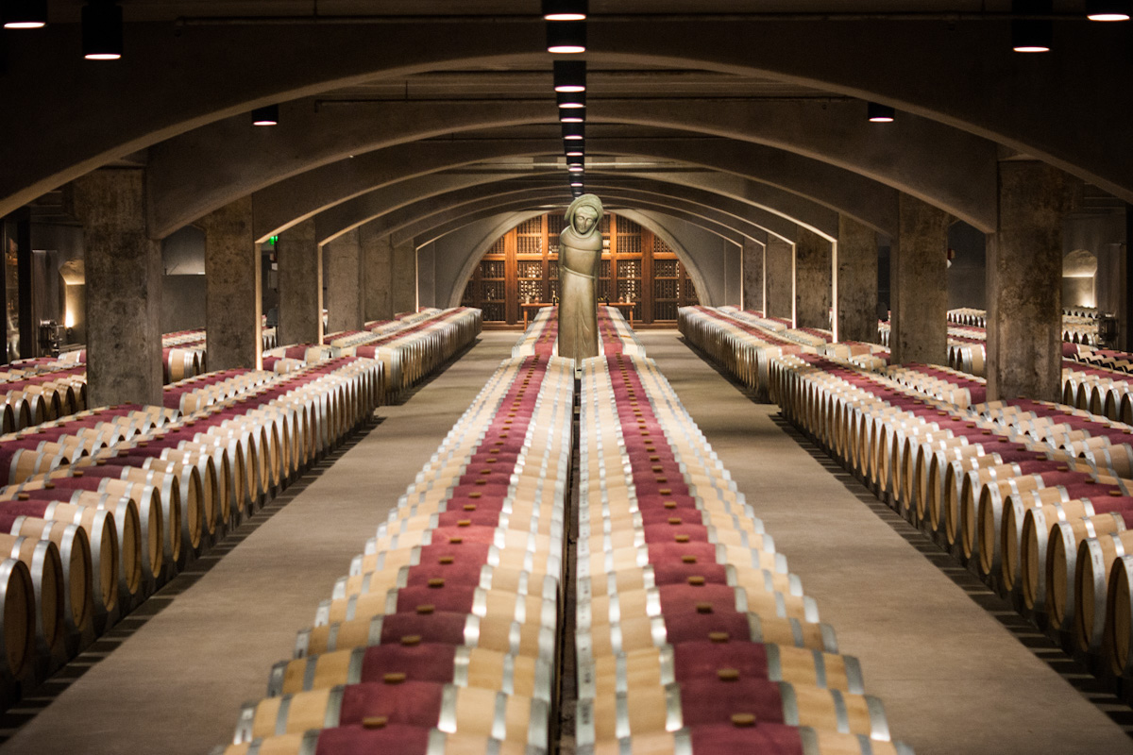
Napa Valley’s Top Wineries
Robert Mondavi Winery: Robert Mondavi is widely regarded as one of the figures responsible for putting Napa on the global wine map.
Founded in 1966, the winery revolutionized winemaking in the region by emphasizing high-quality production and vineyard management.
Mondavi championed the use of French oak barrels and temperature-controlled fermentation, which helped elevate Napa’s winemaking standards.
Today, the winery is still celebrated for its Fumé Blanc (an oaked Sauvignon Blanc) and its Reserve Cabernet Sauvignon, which exemplifies Napa’s mastery of this grape.

Slide 13

Napa Valley’s Top Wineries Cont.
Opus One Winery: Opus One represents one of the most significant partnerships in Napa history. It is a joint venture between Robert Mondavi and Baron Philippe de Rothschild of Bordeaux’s famed Château Mouton Rothschild.
This collaboration brought a Bordeaux-style philosophy to Napa’s winemaking, resulting in Opus One, a Bordeaux blend dominated by Cabernet Sauvignon, with Merlot, Cabernet Franc, and Petit Verdot playing supporting roles.
Opus One consistently ranks among the world’s top wines, known for its elegance, power, and aging potential.

Slide 14
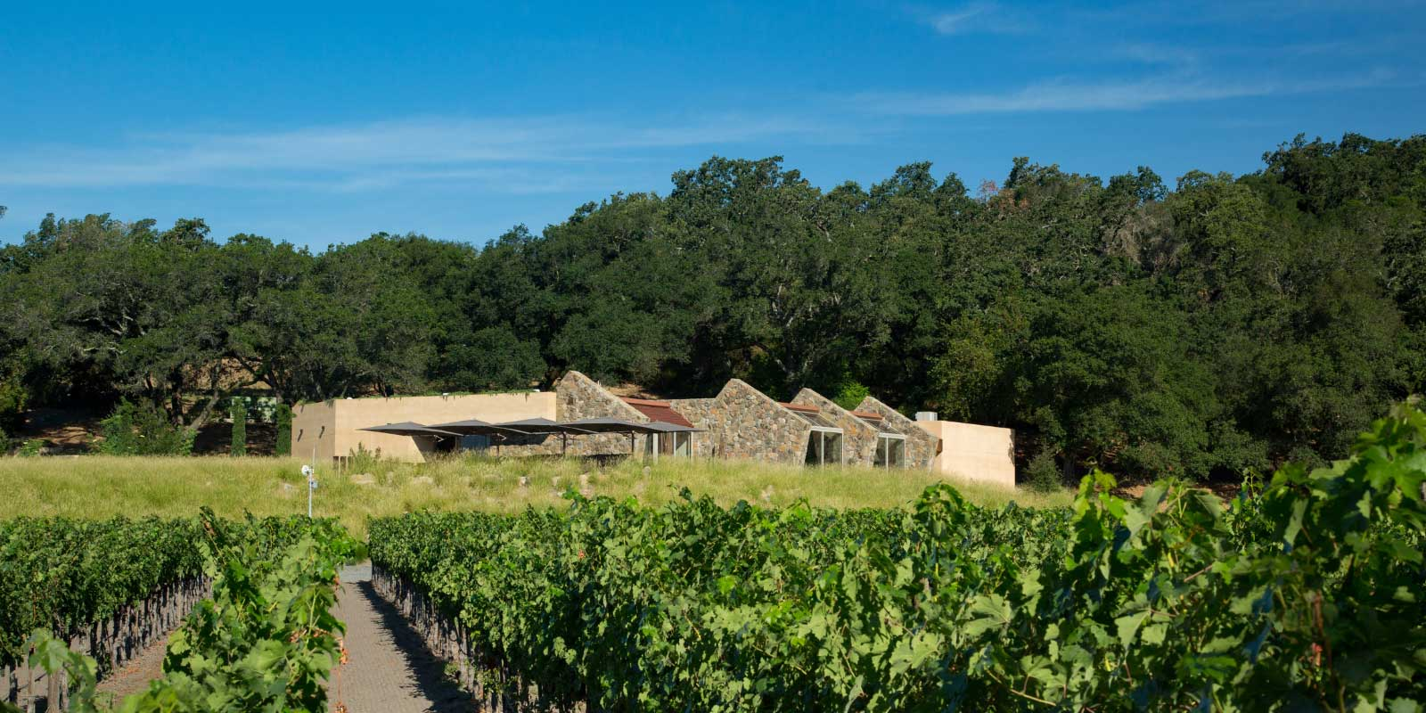
Napa Valley’s Top Wineries Cont.
Stag’s Leap Wine Cellars cemented its place in wine history when its 1973 Cabernet Sauvignon triumphed in the 1976 Judgment of Paris. This landmark event was a blind tasting where California wines, including those from Napa, surprisingly outperformed some of the most revered Bordeaux wines from France.
This unexpected victory was not only a personal achievement for Stag’s Leap but also a pivotal moment for Napa Valley as a whole, signaling to the world that the region was capable of producing wines on par with the best of Europe.
This success propelled Napa Valley onto the global wine stage and transformed perceptions of New World wines, positioning the area as a major player in the global wine industry.

Slide 15
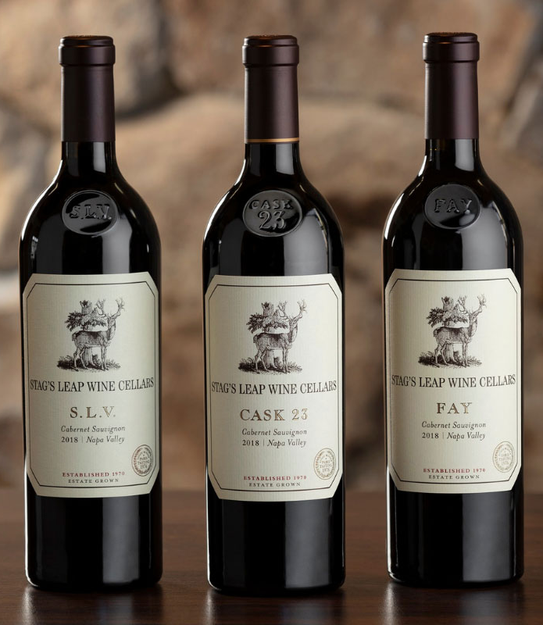
Napa Valley’s Top Wineries Cont.
Stag’s Leap Wine Cellars has since been regarded as a benchmark for high-quality Cabernet Sauvignon.
Their signature style, often described as "an iron fist in a velvet glove," captures the perfect balance of intensity and elegance.
The wine combines rich, bold flavors with a refined structure, appealing to both casual wine enthusiasts and connoisseurs alike.
Stag’s Leap continues to be a reference point for Napa Cabernet, upholding its legacy with wines that exemplify both power and finesse.

Slide 16
Napa Valley's Global Influence
Napa Valley’s rise to fame is not just the result of its natural conditions, but also the ambition and innovation of its winemakers.
In the years following the Judgment of Paris, Napa winemakers refined their techniques, focusing on sustainable farming, precision viticulture, and the use of advanced technologies like optical grape sorting.
As a result, Napa wines have become sought-after collectibles, and the region has influenced winemaking practices worldwide.
While Napa represents only about 4% of California’s total wine production, it generates a significant portion of the state’s revenue due to the high value placed on its wines.

Slide 17
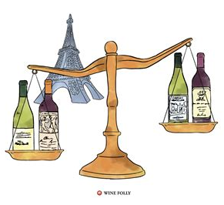
Napa Valley's Global Influence
The valley is also a major destination for wine tourism, attracting more than 3 million visitors annually, who come to experience its picturesque vineyards, world-class wineries, and luxurious tasting rooms.
In conclusion, Napa Valley remains the flagship of the California wine industry, renowned for its terroir-driven wines, innovative winemaking, and a rich history of excellence.
Its top wineries continue to lead the charge in producing wines that stand among the best in the world, while new generations of vintners explore the region’s potential in exciting ways.

Slide 18

Sonoma County
Sonoma County, located adjacent to Napa, offers a remarkable diversity in both climate and geography, making it one of the most varied wine-producing regions in California.
This diversity is reflected in the range of grape varieties that thrive across the county's many distinct microclimates.
The cooler, fog-covered coastal areas are ideal for growing delicate grapes like Pinot Noir and Chardonnay, which benefit from the ocean’s cooling influence.
In contrast, the warmer, sunnier inland valleys provide the perfect conditions for bolder, more robust varieties like Zinfandel and Cabernet Sauvignon.

Slide 19
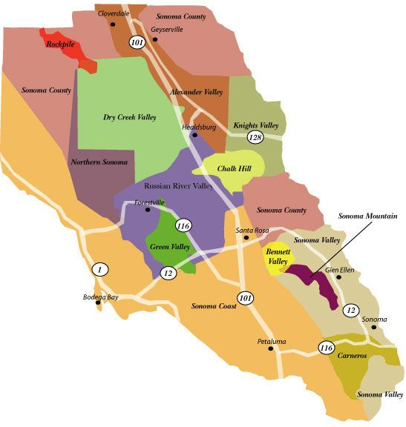
Sonoma County Cont.
Sonoma is home to 18 unique American Viticultural Areas (AVAs), each defined by its specific soil type, climate, and topography.
These AVAs contribute to a wide range of wine styles, from crisp, refreshing whites to rich, full-bodied reds, reflecting the complex interplay of local factors, offering something for every palate.
This level of diversity not only distinguishes Sonoma from its neighboring wine regions but also positions it as a leading producer of some of the most diverse and high-quality wines in the world.
In Sonoma, the combination of varied AVAs, a broad spectrum of microclimates, has solidified the region as a premier wine destination,

Slide 20
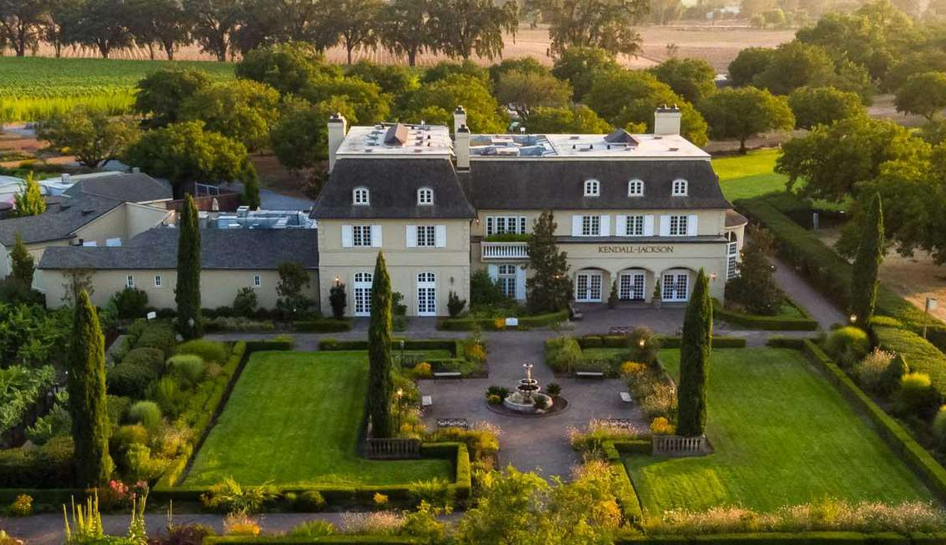
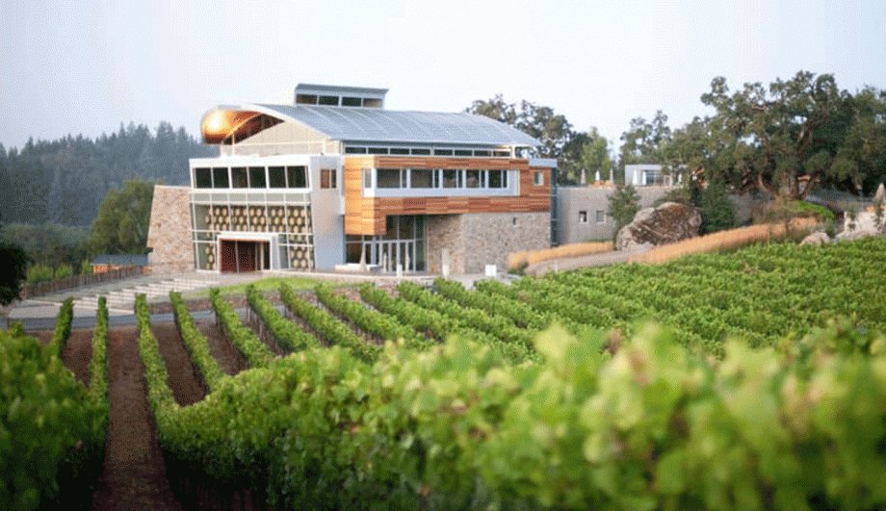
Sonoma County Cont.
Some of the top wineries in Sonoma further highlight this range:
Ridge Vineyards is renowned for its exceptional Zinfandel and Bordeaux-style blends, consistently producing wines that showcase the region’s depth and character.
Kendall-Jackson Winery has become a household name, largely due to its immensely popular Chardonnay, which exemplifies the richness and balance that cool-climate growing conditions can offer.
Williams Selyem Winery, a small yet highly regarded producer, focuses on crafting premium Pinot Noir. Their wines have earned a reputation for excellence, reflecting the careful attention to terroir and winemaking technique.
Kendall-Jackson Winery
Williams Selyem Winery

Slide 21
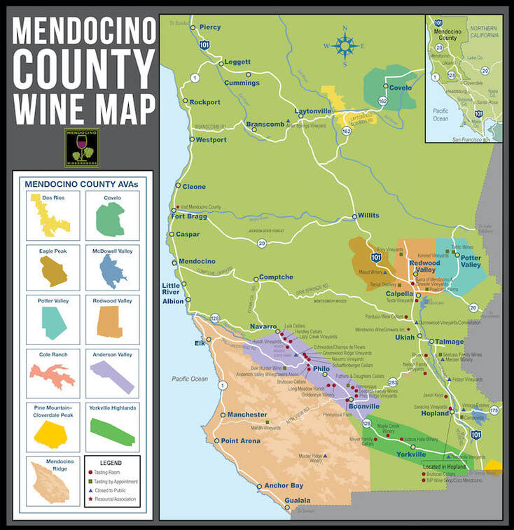
Mendocino County
Mendocino County is one of California’s northernmost wine regions, is renowned not only for its breathtaking natural beauty but also for its commitment to organic and sustainable farming practices.
Mendocino has become a model for responsible wine production, with many vineyards embracing biodynamic methods and organic certification long before it became a trend.
This dedication to sustainability is woven into the fabric of the region, from vineyard management to winemaking techniques.

Slide 22
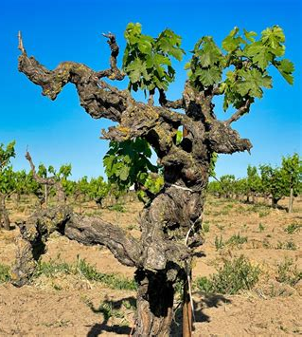
Mendocino County
The region is also home to some of California’s oldest vines, which produce grapes with exceptional depth and concentration, resulting in wines that are rich in character.
Mendocino’s diverse climate, ranging from cooler coastal areas to warmer inland valleys, allows for the cultivation of a wide range of grape varietals.
Pinot Noir and Chardonnay thrive in the cooler, coastal regions, producing wines that are elegant and nuanced.
Inland, Zinfandel and Riesling benefit from warmer temperatures, resulting in robust reds and vibrant, aromatic whites.

Slide 23

Mendocino County
Several notable wineries exemplify Mendocino’s unique contributions to California's wine industry:
Fetzer Vineyards stands out as a pioneer in organic and sustainable winemaking. One of the earliest adopters of eco-friendly practices, Fetzer has played a crucial role in shaping Mendocino's reputation as a leader in environmental stewardship. Their commitment to sustainability is evident in both their farming techniques and their production processes.

Slide 24
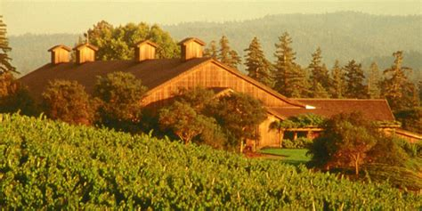
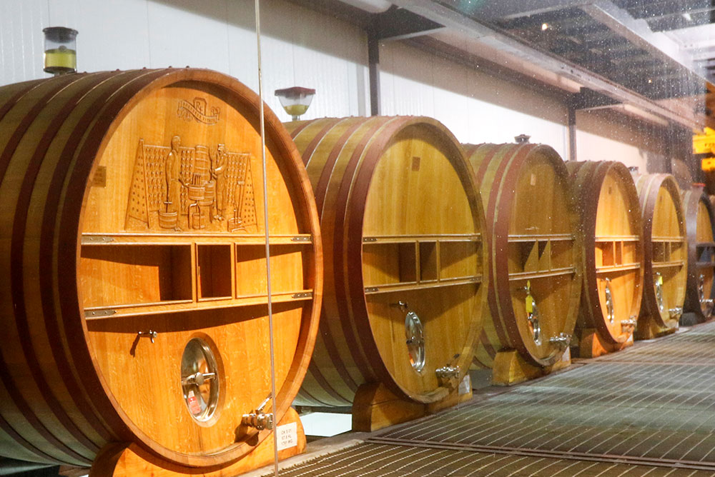

Mendocino County
Roederer Estate, a prestigious winery in the region, is best known for its exceptional sparkling wines.
With a focus on méthode traditionnelle, Roederer produces sparkling wines that rival some of the finest Champagnes, showcasing the region’s capacity to create world-class wines with finesse and complexity.
Mendocino County’s emphasis on sustainability, combined with its ability to grow a diverse array of grape varieties, makes it a distinct and highly respected wine region.
Its wines not only reflect the quality of the grapes and the skill of the winemakers but also the deep respect for the land that nurtures them.

Slide 25
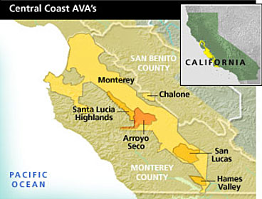
Central Coast
The Central Coast, a vast and dynamic wine region stretching from San Francisco down to Santa Barbara, is one of California's most diverse and exciting areas for wine production.
Spanning such a large geographic area, the region benefits from a variety of climates and landscapes, creating ideal growing conditions for an impressive range of grape varietals.
The cool, coastal breezes and fog that roll in from the Pacific Ocean help to moderate temperatures, making this region particularly well-suited for both cool-climate and warm-climate varieties.
This coastal influence, combined with the region’s varied soils and elevations, gives winemakers the freedom to experiment with an array of styles and techniques.

Slide 26
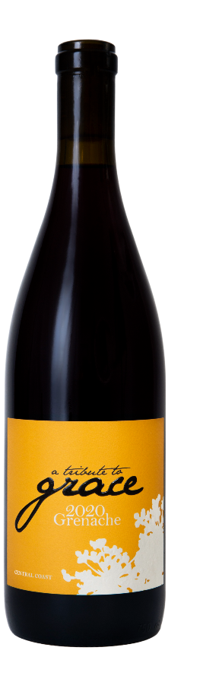
Central Coast
Among the notable varietals produced in the Central Coast are Syrah, Pinot Noir, Chardonnay, and Grenache.
Syrah, in particular, thrives in the warmer areas like Paso Robles, where the grape develops deep, rich flavors with bold structure.
Meanwhile, Pinot Noir and Chardonnay excel in cooler sub-regions like Santa Barbara County, producing wines of elegance and finesse.
Grenache, often used in blends or as a single varietal wine, also shines in this versatile region, reflecting the Rhône influences that have shaped much of the Central Coast's winemaking philosophy.
Grenache 'Central Coast’, A Tribute to Grace - Skurnik Wines

Slide 27
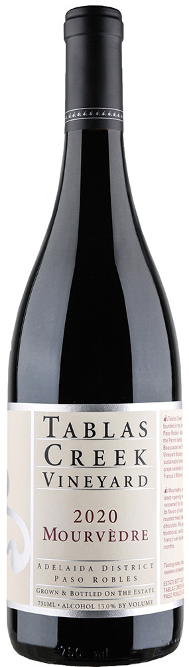
Central Coast
Several standout wineries help define the character of the Central Coast:
Tablas Creek Vineyard, located in Paso Robles, is celebrated for its Rhône-style wines.
With a focus on varietals such as Syrah, Grenache, and Mourvèdre, Tablas Creek has played a key role in introducing Rhône grapes to California, crafting wines that balance complexity with a sense of place.
The winery’s dedication to biodynamic farming practices also underscores the region's commitment to sustainability and quality.

Slide 28
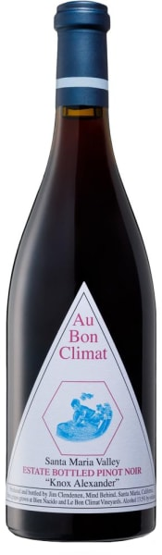
Central Coast
Au Bon Climat Winery, based in Santa Barbara County, has garnered international acclaim for its refined Pinot Noir and Chardonnay.
Winemaker Jim Clendenen’s focus on producing wines with Old World elegance and balance has helped cement the winery's reputation as one of the leading producers of Burgundy-style wines in the region.
Au Bon Climat's wines are known for their subtlety, restraint, and ability to age gracefully over time.
The Central Coast’s vast range of microclimates and terroirs allows for a broad spectrum of wine styles, from bold, full-bodied reds to crisp, nuanced whites. As one of California’s most versatile and innovative wine regions, the Central Coast continues to captivate wine lovers with its diversity, quality, and pioneering spirit.
Au Bon Climat Knox Alexander Pinot Noir 2019
91 Wine Enthusiast

Slide 29
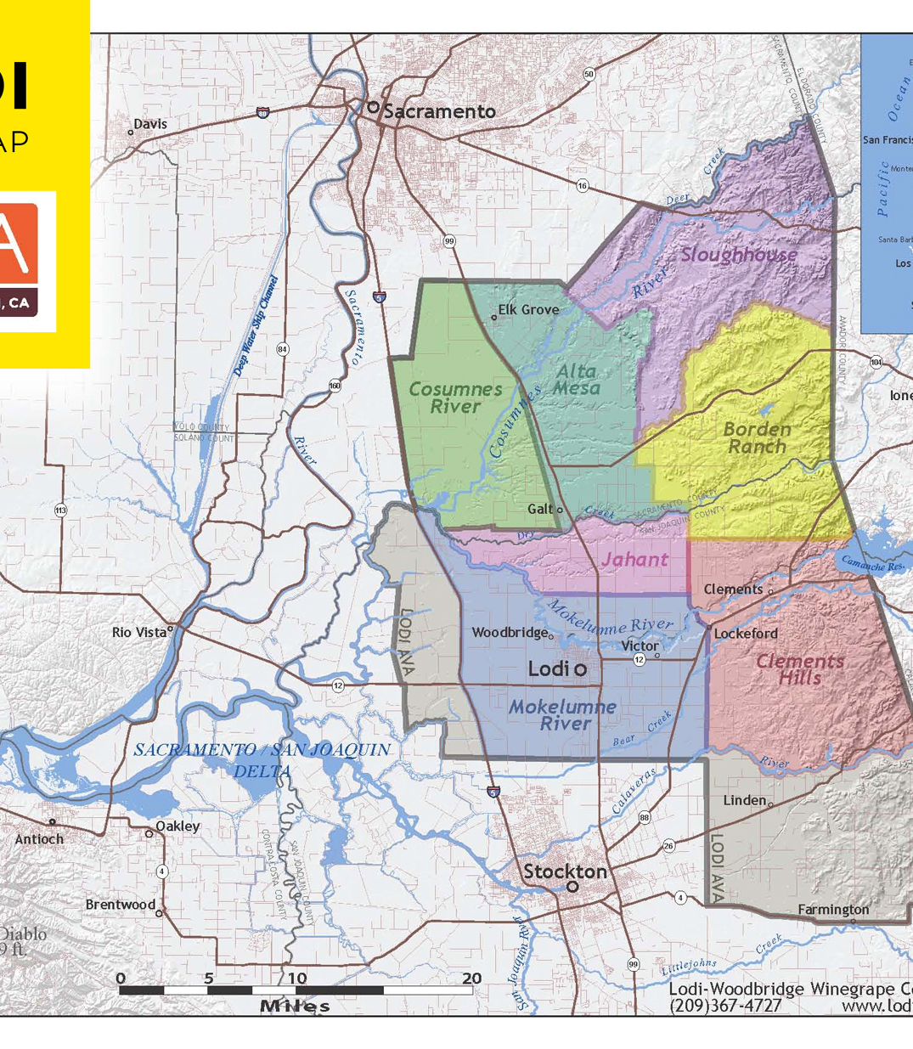
Lodi
Lodi, situated in California's Central Valley, has earned its reputation as the Zinfandel capital of the world.
This region's unique climate, characterized by hot, dry summers and cool evenings, creates the ideal conditions for producing bold, intensely flavored wines.
The warm days allow the grapes to ripen fully, developing rich, concentrated fruit flavors, while the cool nighttime temperatures help to preserve the grapes' natural acidity, resulting in wines that are both vibrant and balanced.
While Lodi is most famous for Zinfandel, it also produces other notable varietals, including Cabernet Sauvignon and Petite Sirah.

Slide 30
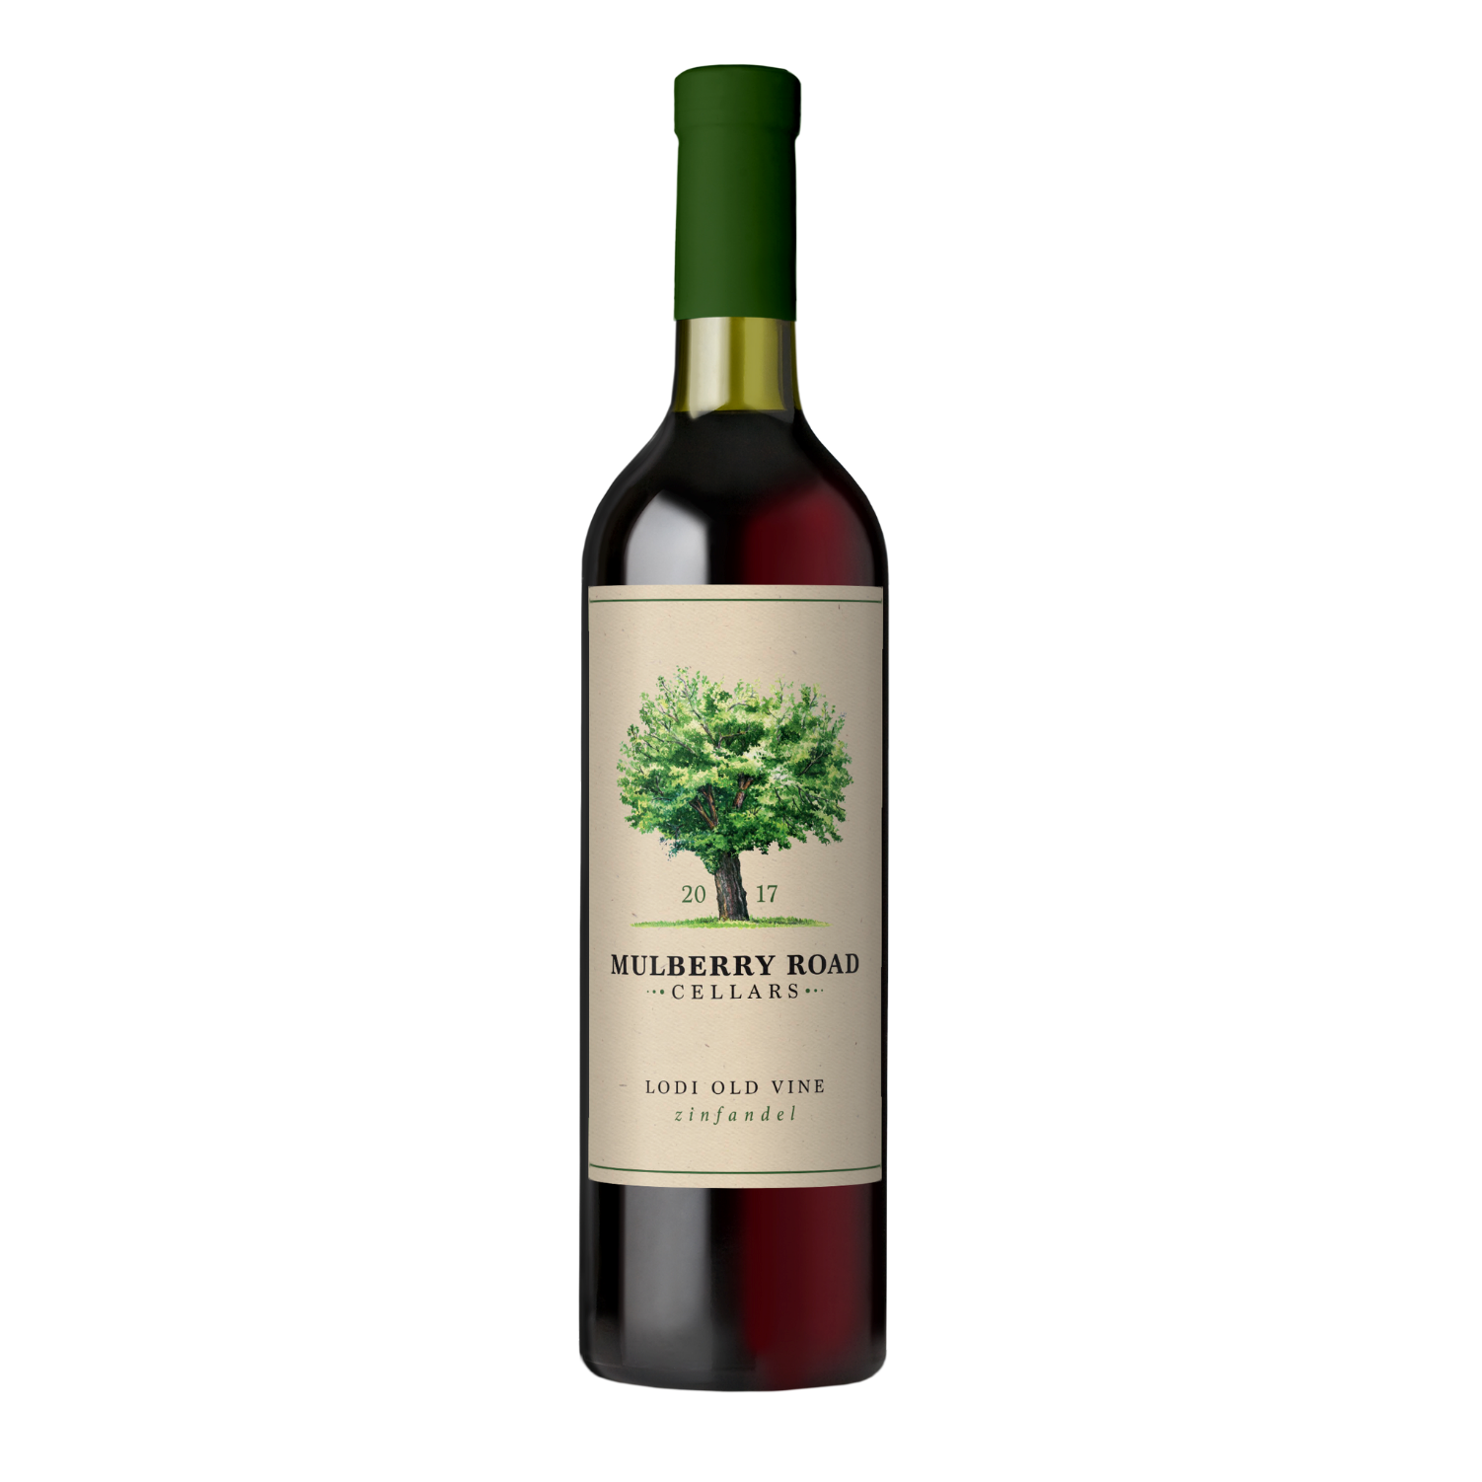
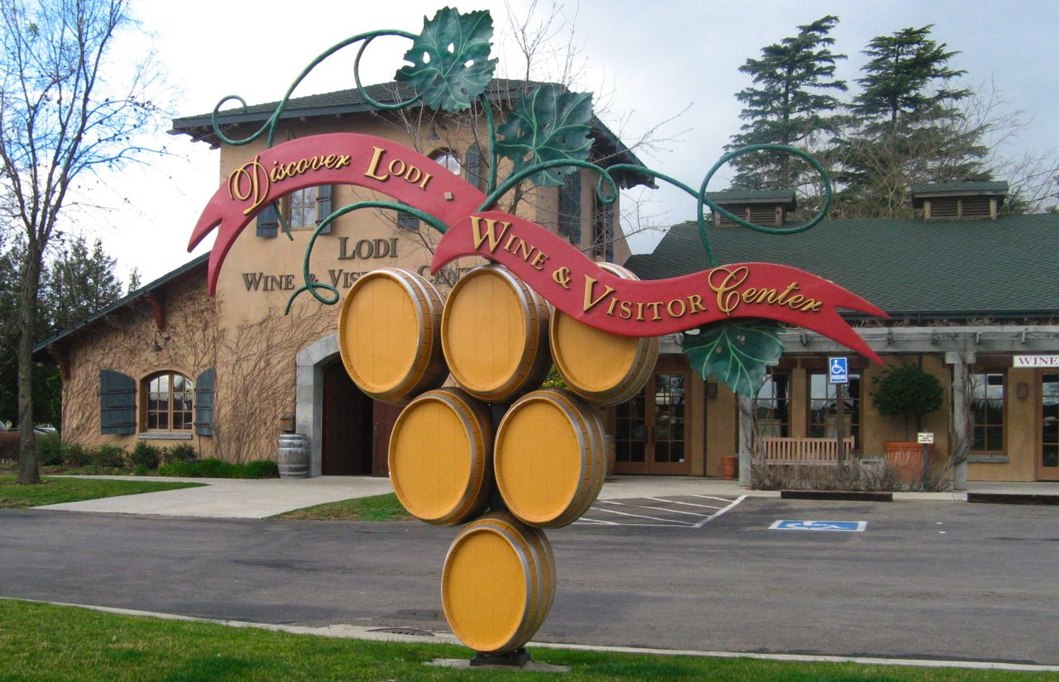
Lodi
The region’s old vines, some of which are over a century old, contribute to the production of wines with remarkable depth, complexity, and structure.
Zinfandel from Lodi tends to be fruit-forward, with lush berry and spice notes, while Cabernet Sauvignon and Petite Sirah showcase the power and richness that this region is capable of producing.
Mulberry Road Cellars Lodi Old Vine Zinfandel

Slide 31
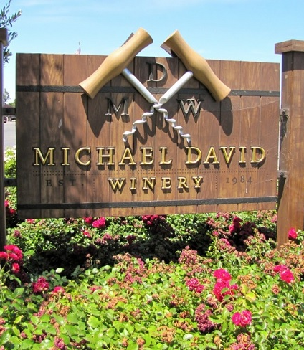
Lodi
Lodi is home to several top-tier wineries that have helped elevate the region's status:
Michael David Winery is renowned for its robust, full-bodied Zinfandels.
Their wines, known for their intense fruit character and bold tannins, have become synonymous with Lodi's reputation for producing powerful, fruit-driven wines.
Michael David Winery has also embraced sustainable farming practices, contributing to the region’s growing focus on environmental stewardship.

Slide 32
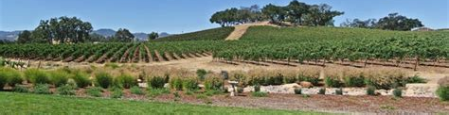
Lodi
Turley Wine Cellars is a leading producer of old-vine Zinfandel, specializing in crafting wines from some of the oldest and most revered vineyards in the region.
Turley’s Zinfandels are celebrated for their balance of concentrated fruit flavors and nuanced complexity, often displaying a sense of history and place that comes from working with vines that have weathered over a century of vintages.
Lodi's climate, combined with its old-vine vineyards and a commitment to sustainable farming, allows the region to produce wines that are both distinctive and world-class. While Zinfandel remains Lodi's flagship varietal, the region continues to gain recognition for its broader range of bold, expressive wines, solidifying its place as one of California’s premier wine-producing areas.

Slide 33
Varietals That Define California
Key Varietals That Define California While California is home to an incredibly diverse range of wine grapes, several key varietals stand out for their exceptional quality and global recognition.
These varietals have not only become synonymous with California wine but have also elevated the state's reputation as a world-class wine-producing region.
The distinct terroirs of California—from the cool coastal regions to the warmer inland valleys—allow for the cultivation of these varietals with remarkable versatility, producing wines that range from elegant and refined to bold and powerful.

Slide 34
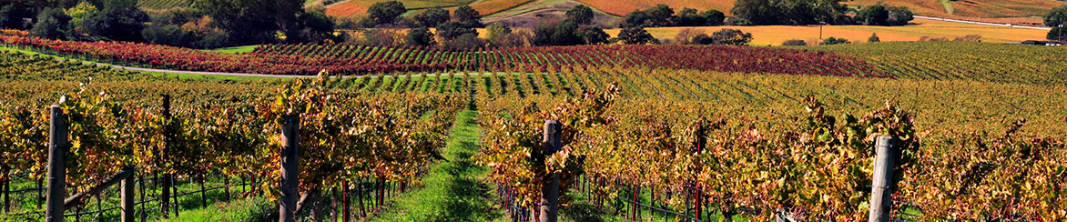
Varietals That Define California
The prominent varietals for California include: Cabernet Sauvignon, Chardonnay, Zinfandel, Pinot Noir, Sauvignon Blanc, and Syrah. But there are There are over 100 grape varieties grown in California
These varietals have become the pillars of California’s wine industry, representing the region’s diversity and innovation. Whether showcasing classic varietals like Cabernet Sauvignon and Chardonnay or embracing California's heritage. with Zinfandel, the state’s winemakers continue to push the boundaries of quality, craftsmanship, and global influence.

Slide 35

Cabernet Sauvignon
Cabernet Sauvignon is a natural cross between Cabernet Franc and Sauvignon Blanc grapes that occurred in the 17th century creating this easy growing, tough-skinned variety in France's Médoc appellation, finding favor with cold hardiness, late bud break, and October harvest.
California Cabernet Sauvignon is prized all over the world.
It is known for sharp tannins and high acidity. They offer an herbal, light floral taste, frequently breathing earthy aromas of tobacco, graphite, licorice, and green pepper. Sauvignon is known for showing deep, opaque red in the glass, often flashed with strikes of blue-violet. Richly textured with an alcohol level around 13.5 to 15 percent. These warmer weather versions deliver mature, dark fruit flavors like blackberry, cassis, and plum, with additional cocoa, black pepper, and tobacco notes.
MacDonald Cabernet Sauvignon Oakville 2018 98 Pts. $185

Slide 36

Chardonnay
Chardonnay The Queen of California Wine
This adaptable and versatile Chardonnay grape is one of the most popular varietals around the world. Chardonnay is an Old World noble grape variety bearing French heritage. It is a cross between Pinot Noir grapes and the now obscure Medieval Gouais Blanc variety
In California, Chardonnay is second only to Cabernet Sauvignon in terms of importance. There are roughly 98,000 acres of farmland dedicated to Chardonnay production in the state. Chardonnay is the most planted varietal in the state.
Grown in cooler regions such as Sonoma and Santa Barbara, California Chardonnay can range from rich and oaky to crisp and minerally.
Spending time in contact with the wood creates pleasing aromas like cloves and cinnamon, while buttery caramel, smoke, and vanilla flavors develop. Some wineries produce a Chardonnay produced in all Steel intended to bring out the fruit and crispness in the wine.
2018 Unoaked Chardonnay Double Gold Winner

Slide 37
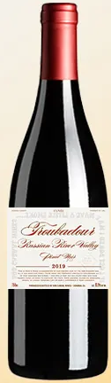
Pinot Noir
Pinot Noir: In 2023, Pinot Noir was the third-most planted grape by acreage in the California, as it has been for years.
But unlike California’s first and second-most planted grapes, Cabernet Sauvignon and Chardonnay, respectively, high-end Pinot Noir is produced in relatively few places.
California’s cooler coastal regions, like Sonoma and Santa Barbara, produce some of the world’s finest Pinot Noir, characterized by its complexity and elegance.
Sonoma boasts a dizzying array of soil types, elevation differences and wind patterns, not to mention the looming presence of the Pacific Ocean as you travel closer to the coast.
Bob Cabral Wines 2018 Troubadour Pinot Noir (Russian River Valley) Cellar Selection. 97 Points
Violets and rose petals in the aroma give an inviting opening to this elegant yet impressively concentrated wine before vivid red cherries and cranberries lift the palate. Fine-grained tannins and tangy acidity lend a mouth-watering texture that will help it age gracefully. Best from 2026–2032.

Slide 38
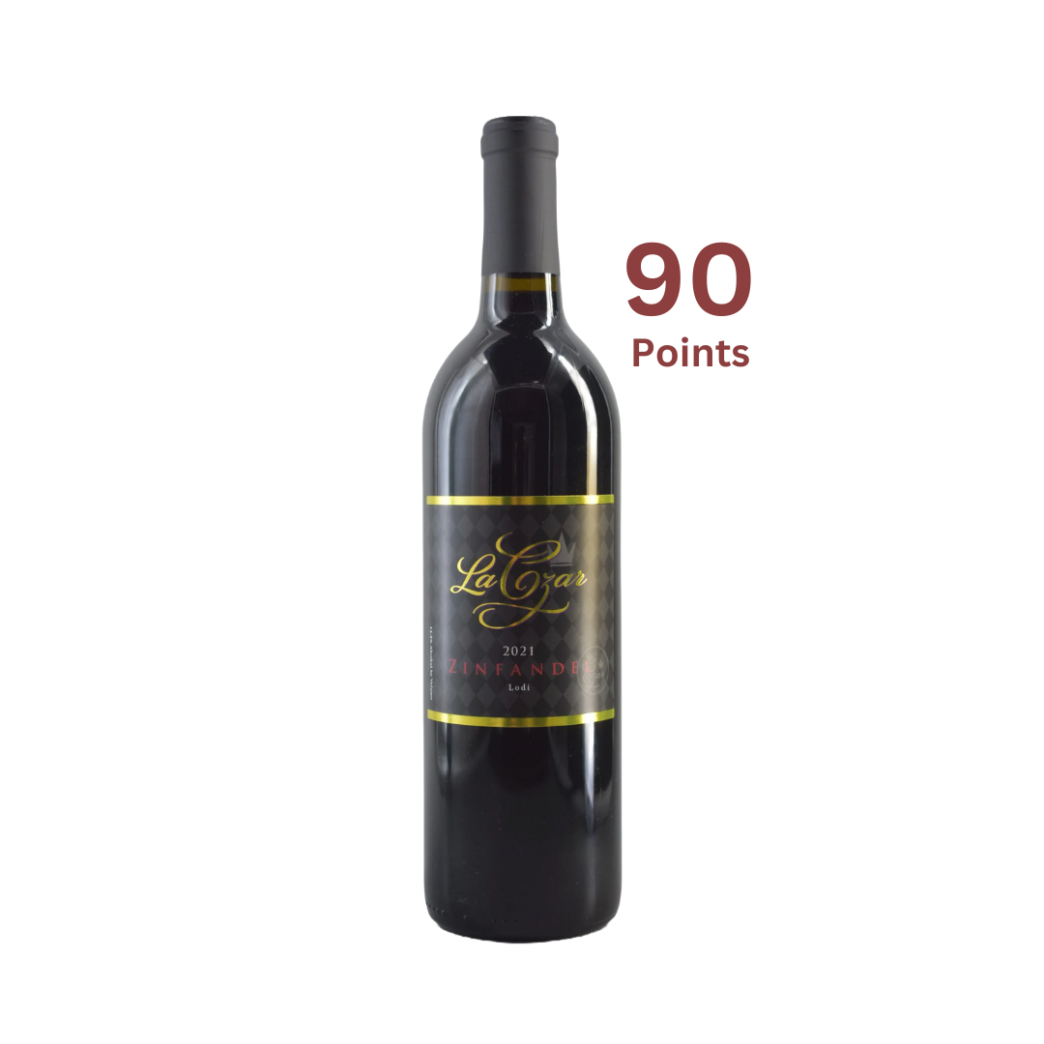
Zinfandel
Zinfandel: Often referred to as America’s heritage grape, Zinfandel is known for its robust, fruity profile, particularly in Lodi.
Zinfandel wine is a bold, fruit forward red that’s loved for its jammy fruit and smoky, exotic spice notes. It’s also made into a sweet rosé called White Zinfandel.
It pairs well with Moroccan and Turkish spices that mirrors the wine’s cinnamon-spice subtleties. Pizza, or calzone stuffed with roasted onions, tomatoes, anchovies, and olives is also a great match.
Taste notes: Zinfandels are Dry, Medium to full Body wine with Medium to high Tannins and Medium to low Acidity. It’s ABV is tipically usually Over 15%.
La Czar Vineyards 2021 Zinfandel Lodi
Regular price $25.00

Slide 39
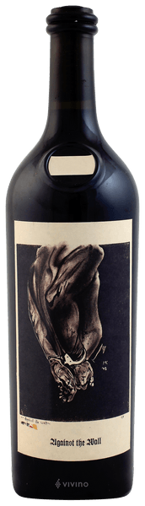
Californian Syrah
Syrah: While not as widely known as Cabernet Sauvignon or Chardonnay, Syrah thrives in regions like Paso Robles and is often used in Rhône-style blends. In fact the original pioneers of Californian Syrah are affectionately known as the Rhone Rangers.
It comes from a historic, dark-skinned, egg-shaped grape. In its best examples, it is every bit as drinkable and cellar able as the finest Burgundy and Bordeaux wines.
High tannins, low acidity, and rich structure make Syrah a global favorite, finding particular favor in the vineyards of Australia where it is known as Shiraz. The wine is fruit-forward with lots of spice. Because of it’s characterizes Syrah is perfect for aging.
Flavors and Aromas include: Pepper, Raspberries, Gooseberries, Blueberries, Blackberries, Boysenberries, Violets, Mignonette, Truffle, Chocolate, Rosemary, and Black Olive.
Sine Qua Non Against the Wall 1996 Syrah/Shiraz from Sta. Rita Hills, Santa Barbara, Central Coast, California. Critics have given the wine 92 to 100 pts $899

Slide 40
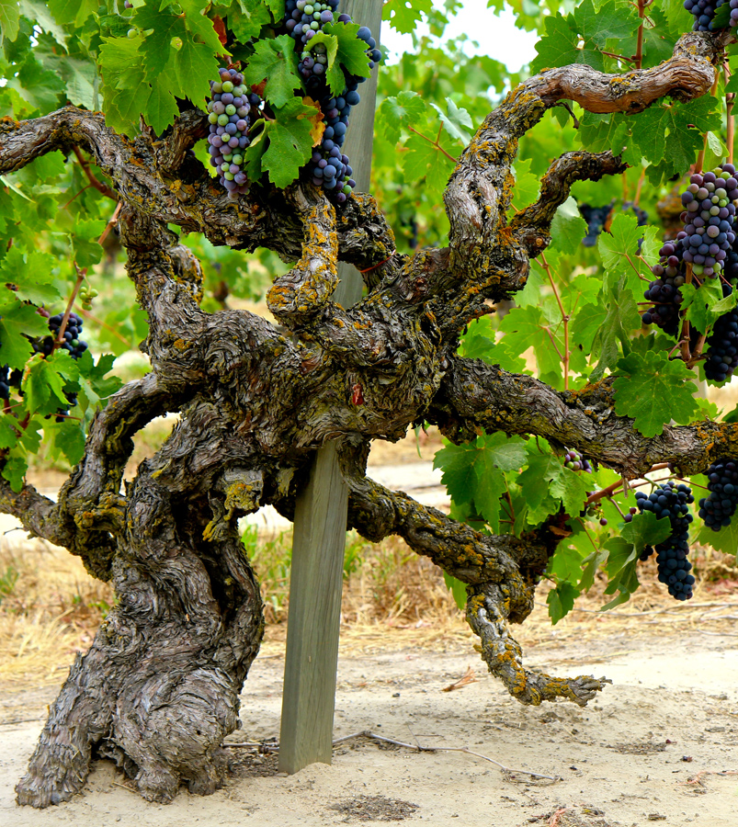
Conclusion
California has grown into one of the world’s most dynamic and diverse wine-producing regions, offering everything from bold, powerful reds to crisp, elegant whites.
The combination of its ideal climate, forward-thinking vintners, and a commitment to quality has made California synonymous with premium wine.
Whether you’re exploring the bold Cabernets of Napa, the cool-climate Pinot Noirs of Sonoma, or the robust Zinfandels of Lodi, California’s wine regions offer something for every palate.

Slide 41
Acknowledgement
My seminars are the result of many years of experience combined with many hours of research over the internet.
I would like to acknowledge the many source I have accessed.
These include Wine Spectator, Wine Enthusiast, BKWine Magazine, Wine & Spirits Magazine, American Vineyard Magazine, The Grapevine Magazine, Wikipedia.com, Britannica.com, and the various Government websites.

Slide 42
References
Sullivan, Charles L. A Companion to California Wine: An Encyclopedia of Wine and Winemaking from the Mission Period to the Present. University of California Press, 1998.
Taber, George M. Judgment of Paris: California vs. France and the Historic 1976 Paris Tasting That Revolutionized Wine. Scribner, 2005.
Robinson, Jancis, and Julia Harding. The Oxford Companion to Wine, 4th ed., Oxford University Press, 2015.
California Wine Institute. “California Wine Facts.” Accessed September 2024. https://www.discovercaliforniawines.com.

