Slide 1

Cairns Australia Presented by Marc Silver

Slide 2
What I Will Cover
My Port Philosophy
Don’t Miss the Ship
Money
About Cairns
Area Map of Cairns
Map of Cairns
Cairns Transportation
Places to see or at least consider
A few restaurant recommendations
Conclusion

Slide 3
My Port Philosophy
I have been cruising for over 45 years and have taken over 200 cruises. So, I consider myself an experienced cruiser.
The information I will present is based on those many years of
experience.
When I am on a cruise where the city, I want to visit is not the port city,
I always recommend taking a ship’s tour.
But when I am in a port with multiple attractions nearby and easy to see
on my own - I will do it on my own.
This presentation is for that type of port.

Slide 4

Don’t Miss the Ship
How to Avoid Missing Your Ship
Pay attention to the time. - Ship time and local time are often different.
Put a return-to-ship reminder on your phone.
Choose excursions wisely.
If a ship-sponsored excursion is late returning to port, the ship will wait for you. If you are on your own???
Be Prepared
Have your Passport, Credit Card, and phone numbers for your ship port agent.
What to Do If You Miss the Ship Most cruise lines have port agents stationed in the port area to assist if your ship has left without you. If your are lucky, when cruisers are late returning to the vessel, the ship’s crew will often remove the passengers’ essential items – passports, cell phones, and medication -- from the ship to leave with the port agents.
The Port Officials can help you with contacting your ship and making necessary travel arrangements.

Slide 5
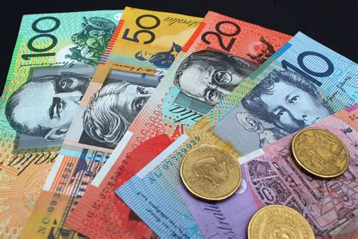
Money
The currency for Cairns is the Australian Dollar.
The conversion at the rate is $1.48 AUD to $1.00 U.S.
Or $1 AUD $.67 U.S.

Slide 6
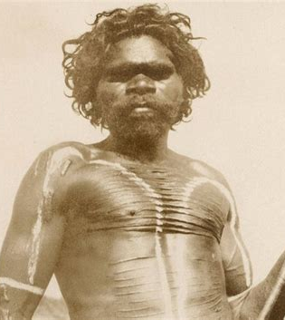
Historical Cairns
The area around Cairns, has a rich history that dates back over 40,000 years when the region was home to several Aboriginal communities.
Traditional local Aboriginal stories recall hunting and fishing on land that once extended past Green Island (10 miles NE of Cairns) during a time of lower sea levels.
Archaeological evidence shows Aboriginal peoples living in rainforest in the Cairns area for at least 5,100 years, and possibly for much of the often suggested 40,000-year period.
Captain James Cook discovered the area in 1770 on his first voyage aboard the HMS Endeavour.

Slide 7
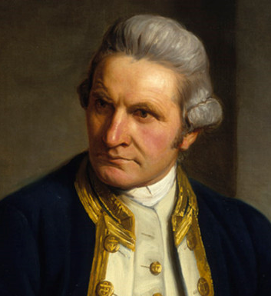
Historical Cairns Cont.
Captain Cook needed all his seamanship skills to navigate the treacherous channels between the Great Barrier Reef and the mainland.
Despite his skill, the tiny 30-metre Endeavor ran aground on the coral reefs. The Crew onboard repaired the boat in a river, later known as the Endeavor. Now the site of present-day Cooktown.
Lieutenant Phillip Parker King, one of the most important early charters of Australia's coast, made three marine surveying expeditions to northern Australia in 1819, 1820, and 1821.
All three expeditions included visits to Fitzroy Island, located about 14 miles from Cairns. On King's first visit, he drew attention to the availability of drinking water and the presence of Aboriginal people in the area.

Slide 8
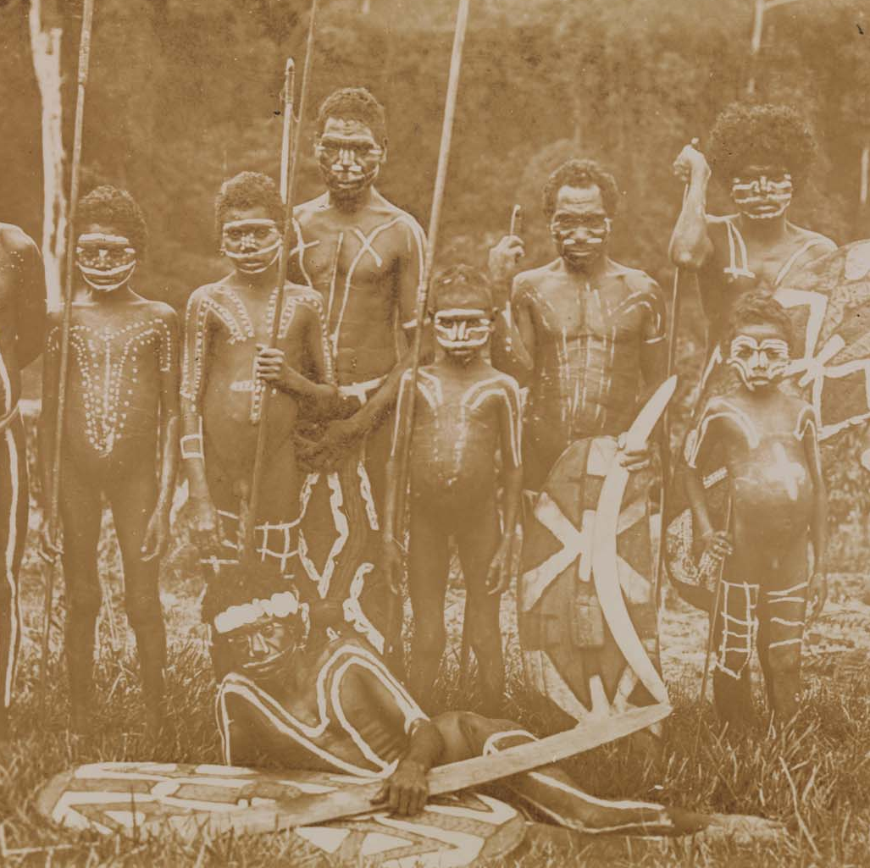
Historical Cairns Cont.
The first historical event of significance leading up to the establishment of Cairns was an essay published in a Sydney newspaper in 1866.
With the arrival of the beche de mer fishermen from the late 1860s came the first semi-permanent British presence in the area.
On the site of the modern-day Cairns foreshore, there was a large native well which was used by these fishermen.
A violent confrontation occurred in 1872 between local Yidinji people and Phillip Garland, a beche de mer fisherman, over the use of this well.
The area from this date was subsequently called Battle Camp.

Slide 9
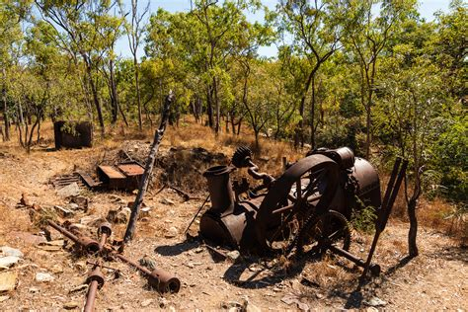
Historical Cairns Cont.
The discovery of payable alluvial gold deposits at the Palmer river in 1873 by James Venture Mulligan, sparked a huge gold rush, drawing prospectors not only from Australia, but also from around the world.
In March 1876, three years after the Palmer River discovery, James Mulligan announced that an even larger and more extensive gold field had been found at the Hodgkinson River on the Atherton Tableland, 76 miles west of Trinity Inlet.
On 7 October 1876, the Governor of Queensland, William Wellington Cairns, proclaimed the new northern port at Trinity Bay which was named Cairns in his honor.

Slide 10
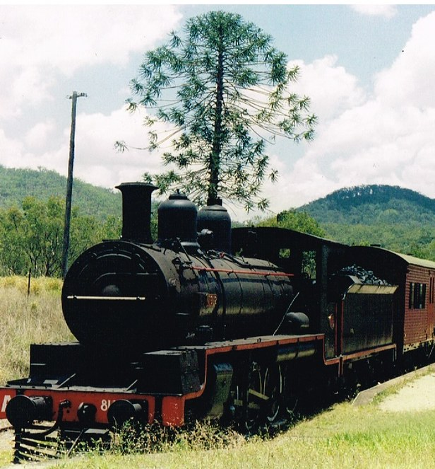
Modern Cairns
Significant events in the history of Cairns were the construction of the Cairns-to-Herberton railway line commencing in 1886.
The establishment of the Cairns Harbor Board in 1906, official recognition 1903, Cairns was officially declared a town, with a registered population of 3,500.

Slide 11
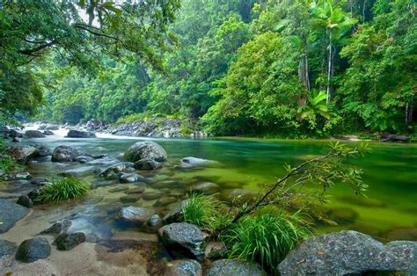
Cairns Milestones
In March 1954 Forty thousand excited locals attended Queen Elizabeth’s visit to Cairns, twice the local population at the time.
The opening of the Cairns International Airport in 1984 helped cement the city as a destination for international tourists.
Cairns is the gateway to exploring Australia’s Great Barrier Reef and the Daintree Rainforest.
Tourism has come a long way and is now a 3.5 billion industry.
The military occupation in 1942 by the World War II defense forces, the construction of concrete high-rise apartments in 1981, the opening of the international airport in 1984, and the establishment of an international-standard convention center in 1996.

Slide 12
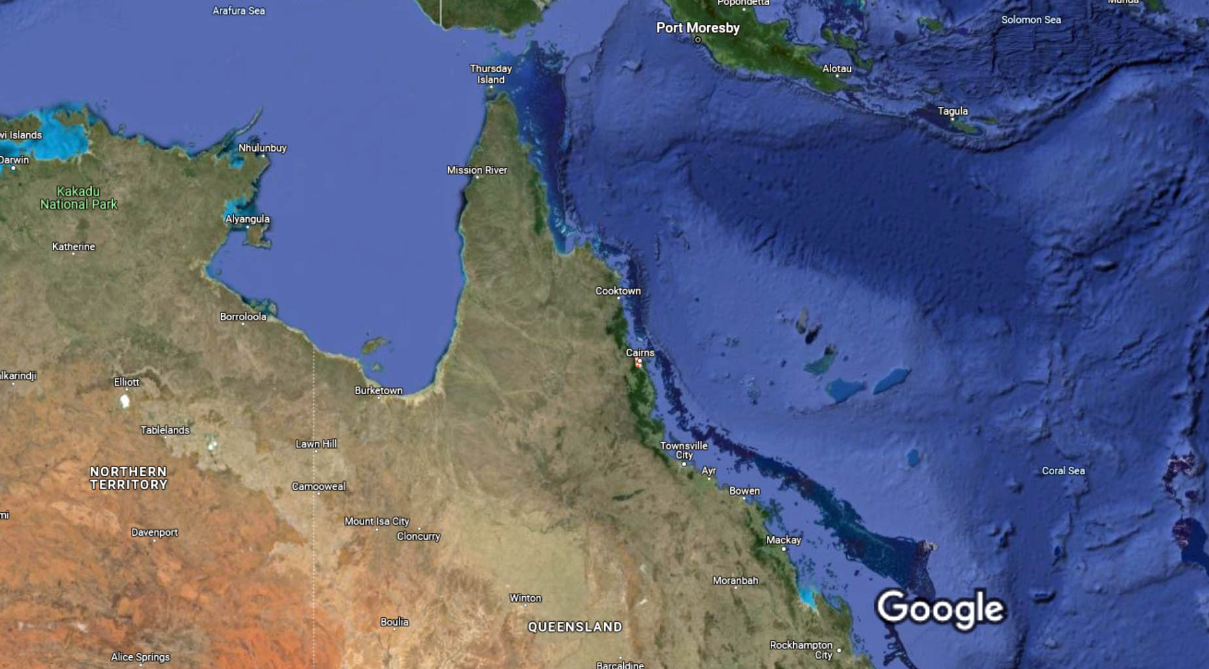
Cairns Area Map
Cairns

Slide 13
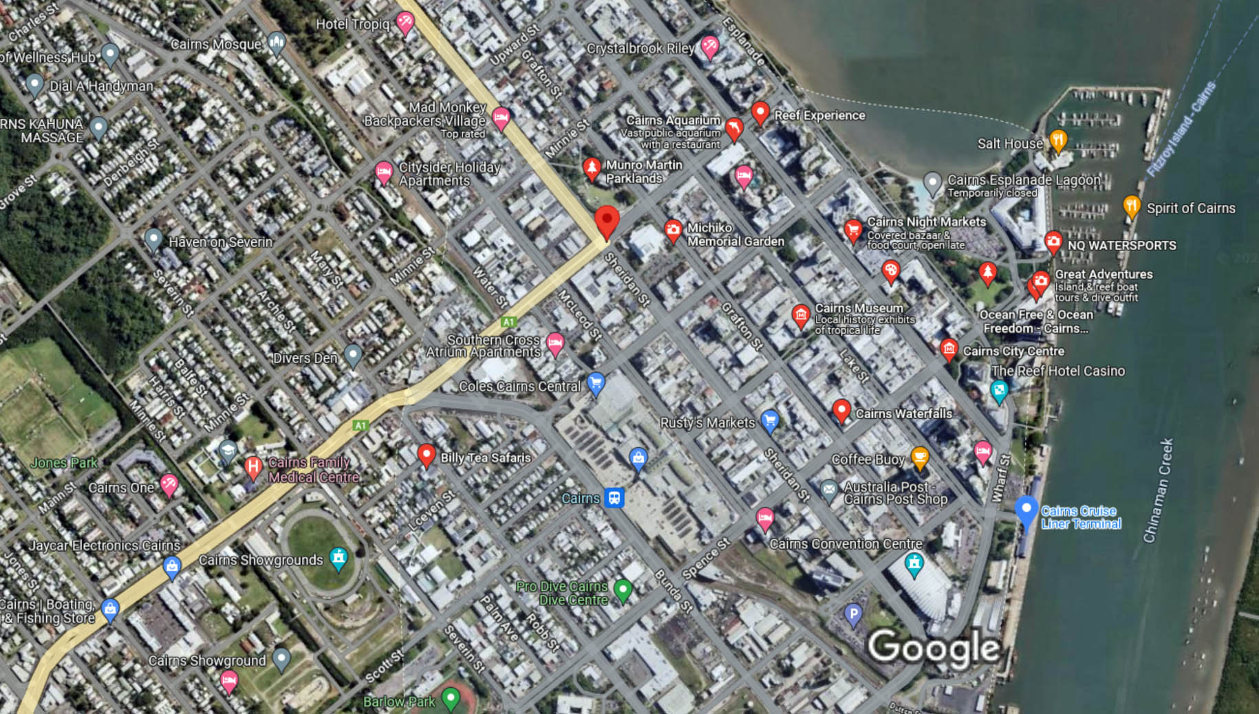
Map of Cairns

Slide 14
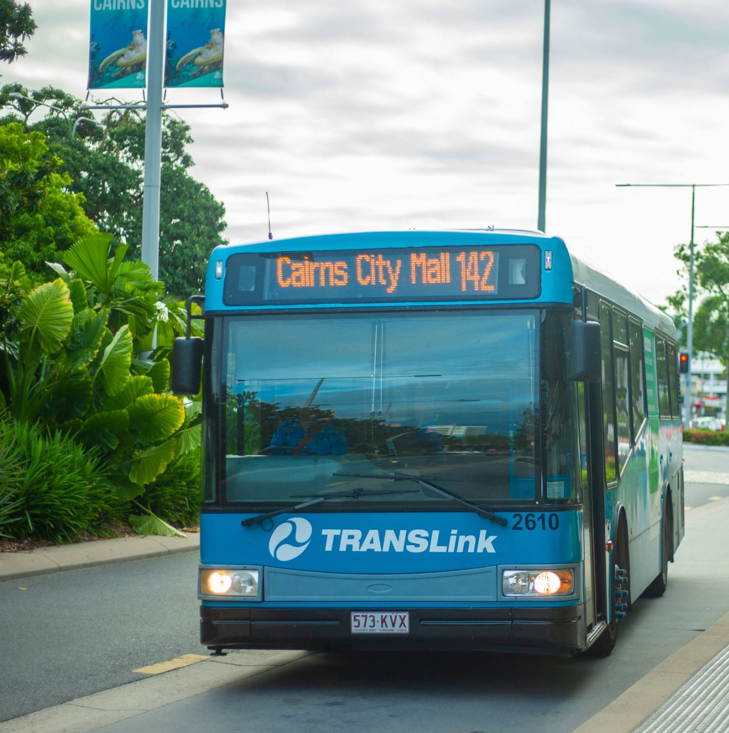

Cairns Transit System
Cairns has one of the most comprehensive and user-friendly public transport.
Bus Fares: Adult $2.40 Child $2.00
I recommend paying with exact change with cash.
The Go Explore Card is only $10 a day for unlimited travel.
No need to carry cash on your journeys.

Slide 15
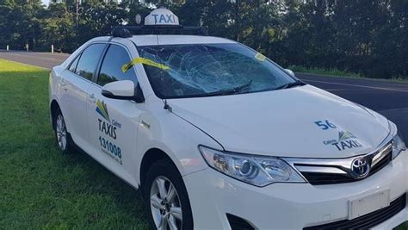
Cairns Taxis
Standard taxis provide a safe and reliable way to explore the city or for transport between the cruise port and various attractions.
Like taxis in most locations the cost is significantly more expensive than other modes of transport.

Slide 16
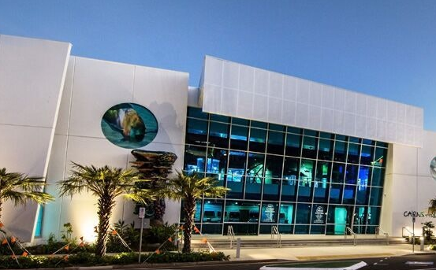
Cairns Aquarium
Cairns Aquarium is home to more than 16,000 Aquatic Animals, in 9 Key Ecosystems, across 11 Zones.
Explore the animals and habitats of Tropical North Queensland and learn about the Wet Tropics Rainforest and the Great Barrier Reef.
Enjoy daily ecosystem talks, animal presentations, and marine touch tank shows.
See Australia’s only 10-meter Deep Reef Tank, 360-degree Oceanarium, 20-meter underwater tunnel, mangrove boardwalk, and Australia’s largest freshwater exhibit.
Plus freshwater fish, pythons, emerald tree monitors, crocodiles, colorful reef
Admission Fee: Adults $58, Children US$33 Children under 5 free

Slide 17
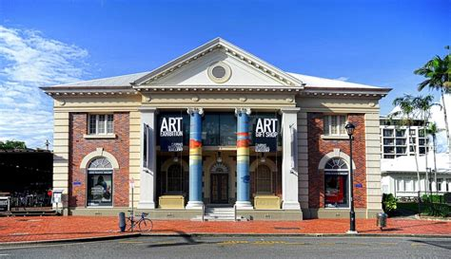
Cairns Art Gallery
The Cairns Art Gallery is one of Australia’s leading public galleries recognized for the excellence of its programs and collections relating to the unique heritage and living culture of North Queensland in the context of the world’s tropic zone and the Asia Pacific region.
Free Entry
The Gallery is committed to bringing great art to the region. Housed in a landmark heritage building the Cairns Art Gallery is the region's premier destination for exhibitions featuring historical and contemporary art by leading regional, national and international artists. The Gallery also presents exhibitions highlighting key works and themes from the Permanent Collection that focus on the unique cultural heritage of Far North Queensland.

Slide 18
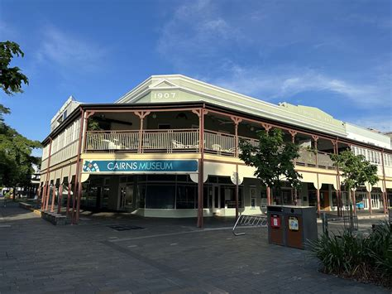
Cairns Museum
The Cairns Museum tells the story of Cairns, right in the heart of the city.
Housed in the award-winning School of Arts building, the Museum contains five galleries that showcase the history of Cairns.
Learn about Aboriginal Traditional Owners, sugar cane history, WW II, tourism development, local architecture and cyclones, as well as the inside story of living in the tropics - amongst crocs, toads, jellyfish and snakes!
Local guides are on hand to assist and give you genuine advice on what to see and do in Cairns.
Admission Fee: Adults $15, Children US$6 Children

Slide 19
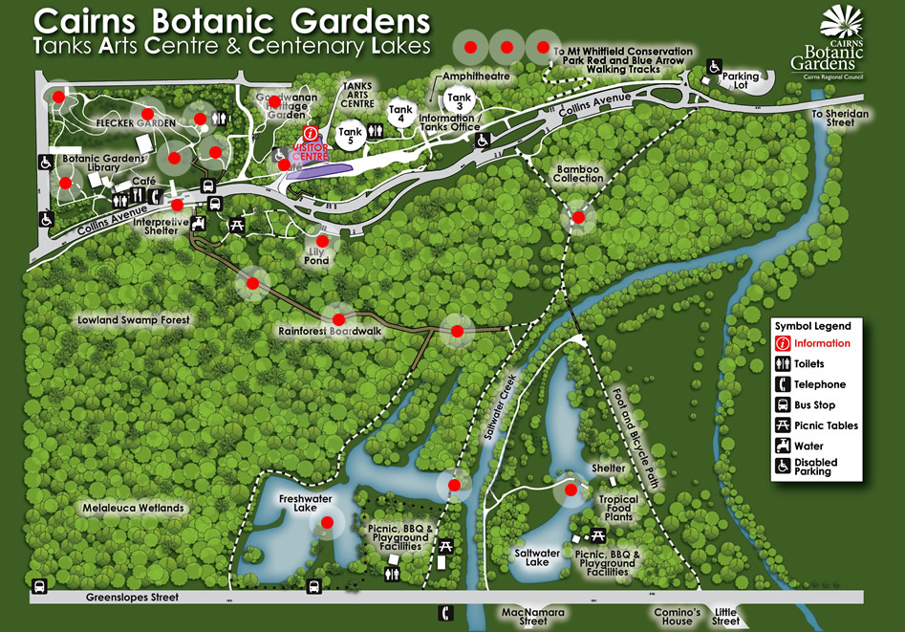
Cairns Botanic Gardens
The Cairns Botanic Gardens is a tropical paradise, renowned as one of the best exhibitions of tropical plants in Australia. Come and explore the beauty of tropical plants, relax in stunning surroundings and learn about tropical flora and horticulture.
The Freshwater and Saltwater Lakes can be easily accessed from Greenslopes Street.
With its stunning reflective exterior, the Visitor Information Centre is a popular focus for visitor photos.
Entry is free.

Slide 20
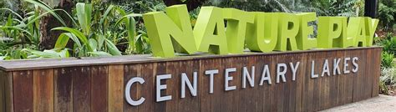
Centenary Lakes Nature Play Space
The Centenary Lakes Nature Playground is a wonderful play environment for young to older children.
Children can explore their surroundings and interact with all the features, which are set in nature and incorporate creative play elements.
Free Entry

Slide 21
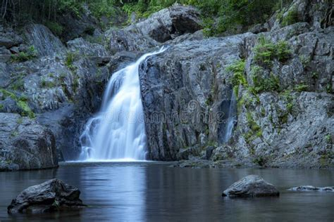
Crystal Cascades
Crystal Cascades is a series of mesmerizing waterfalls and swimming holes located approximately 30 minutes away from Cairns. Nestled within the Barron Gorge National Park, this natural paradise is renowned for its crystal-clear waters and picturesque beauty.
The cascading waterfalls at Crystal Cascades create a soothing and enchanting atmosphere, making it a perfect getaway for those seeking a refreshing retreat.
In addition to the waterfalls, Crystal Cascades is also surrounded by lush rainforest, rich in biodiversity. The dense vegetation offers shade and a cool respite from the tropical Queensland heat.

Slide 22
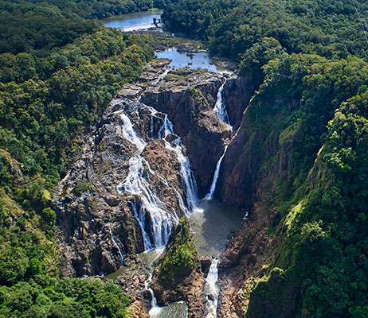
Barron Falls
Rocky, wild, and undeniably dramatic, Barron Falls is incredibly beautiful and worth the visit.
Whether you witness it as a scenic trickle in winter or as a mist-filled force in summer, Barron Falls deserves a spot in your tropical travel itinerary. Get ready to chase the ultimate waterfall with this guide to Barron Falls near Cairns.
Barron Gorge National Park stretches from the coastal lowlands (Lake Placid) to the elevated regions of the Atherton Tablelands near Kuranda. Both Barron Falls and Barron Gorge National Park are within the Wet Tropics World Heritage Area.

Slide 23
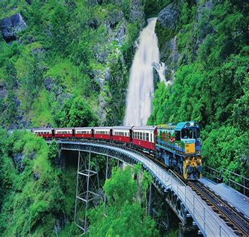
Kuranda Scenic Railway
The Original Kuranda Scenic Railway is a spectacular journey comprising unsurpassed views of dense rainforest, steep ravines and picturesque waterfalls within the World Heritage listed Barron Gorge National Park.
This famous railway winds its way on a journey from Cairns to Kuranda. The journey to Kuranda takes approximately 2 hours, which includes a 10-minute stop at the spectacular Barron Falls Station for a bird’s eye view of the Barron Falls. Passing through 15 hand carved tunnels, 37 bridges, spectacular waterfalls and into the stunning Barron Gorge.
ADULT FARE: $84
CHILDRENS FARE: $42

Slide 24
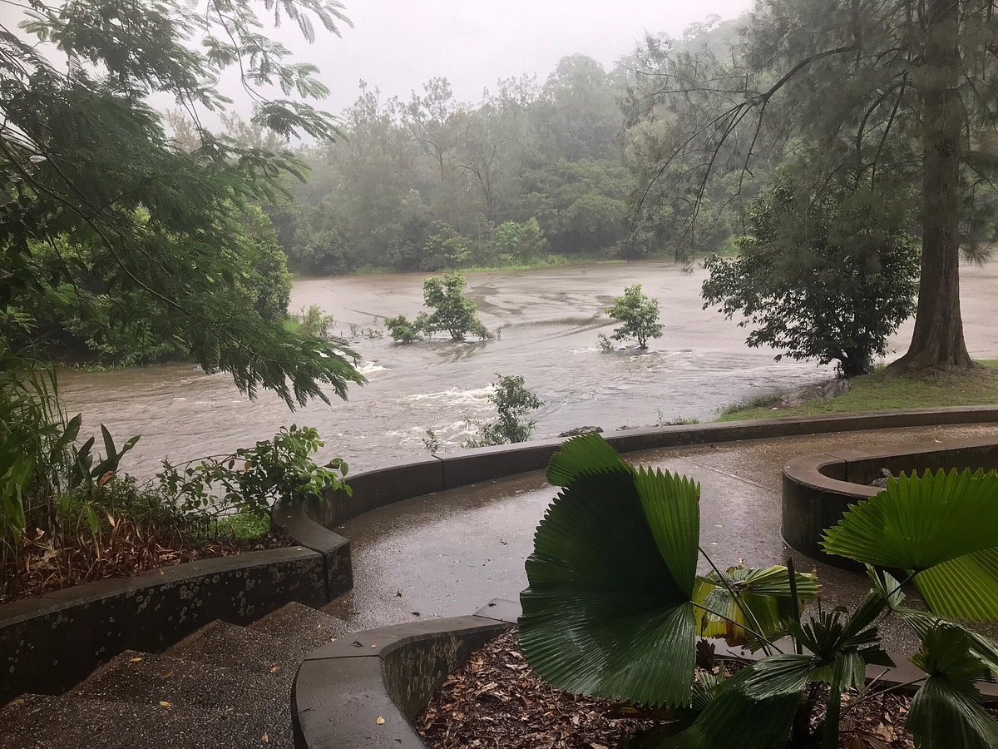
Barron Gorge National Park
Located about 30 minutes Northeast of Cairns is the entrance to the Barron Gorge National Park.
It’s through this area of rapids that the Raging Thunder white water rafting tours operate. To get here is a 10-minute drive up the mountain from Lake Placid.
On the way watch out for cassowaries as there many sighting on the drove up.
You can walk over the gorge to the hydroelectric power station (no longer open to the public) past Surprise Creek Falls and take in a birds eye view of the lower gorge in both directions from the concrete bridge.
The gorge is surrounded by tropical rainforest in both sides.

Slide 25
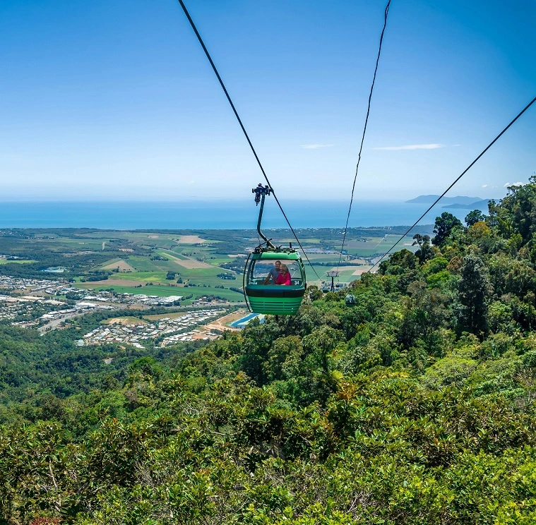
Skyrail Rainforest Cableway
Skyrail Rainforest Cableway takes you on a fascinating journey of discovery over and deep into Australia’s Wet Tropics World Heritage listed rainforest.
Glide mere meters above the pristine rainforest canopy before descending to explore the forest floor at Red Peak and Barron Falls.
Enjoy complimentary ranger guided tours, the Rainforest Discovery Zone, The Edge Lookout, the Historical Precinct and the Rainforest Interpretation Centre to fully immerse yourself in the unique sights, sounds, smells and feel of the rainforest.
Skyrail & Kuranda Scenic Railway with one-way bus transfer
Adults: $135.00 / Children 4 -14: $73.50
Children Under 5 - FREE

Slide 26
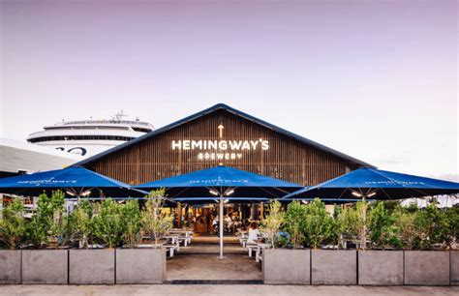
Hemingway's Brewery Cairns Wharf
Hemingway's Brewery Cairns Wharf is a heritage listed venue located at the Cruise Liner Terminal in Cairns with views across Trinity Inlet.
The venue offers various seating options both indoors with views to the brewery, and outdoors, with waterside views.
Hemingway’s Brewery is a local, independent craft brewery operating in Far North Queensland that produces outstanding craft beers. We also have waterfront brewpubs in Port Douglas and Cairns that showcase local provenance in vibrant settings.

Slide 27
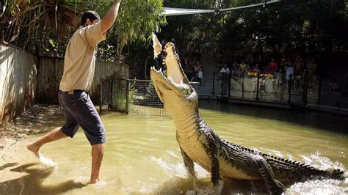
Hartley's Crocodile Adventures
Hartley’s is one of the oldest running tourist attractions in the Cairns region. The business began in 1934 as a tea house for weary motorists, traversing the recently opened road between Cairns and Mossman.
The admission price includes access to the wildlife displays and natural areas, all wildlife presentations, at least one boat ride on Hartley’s Lagoon, various self-guided walks and free wildlife information sheets.
Hartley’s was also the first place in Australia to breed crocs in captivity. Work on crocodile conservation at Hartley’s Creek Zoo attracted worldwide interest.
Ticket Prices
Adults: $45.00
Children*: $22.50
Family (2 Adults, 2 Children): $112.50

Slide 28
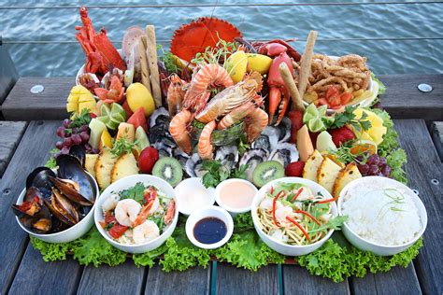
Restaurants in Cairns
There are a lot of excellent restaurants in Cairns. Especially for seafood.
Here are some recommendations: Restaurants in Cairns:
Snoogies $, Cafe, Healthy, Australian
Falafellicious $, Lebanese, Vegetarian, Vegan
Piato $$ - $$$, Seafood, International, Mediterranean
Tha Fish $$ - $$$, Seafood, Contemporary, Healthy
Orient Express Sushi Train $, Sushi, Vegetarian, Vegan
Bombay Kitchen Cairns city $$ - $$$, Indian, Vegetarian, Vegan
Waterbar & Grill Steakhouse $$ - $$$, Steakhouse, Australian, Gluten Free
C'est Bon Restaurant Francais $$$$, French, Vegetarian, Vegan

Slide 29
Conclusion
Cairns is a beautiful City with a rich history and numerous attractions. Regardless of what you're looking for, Cairns has something for everyone.
I hope this presentation will help when we visit Cairns!

Slide 30
Thanks For Coming
If you have any more questions, please ask.
I will do my best to answer them for you.
Have a great visit to Cairns!

Slide 31
Acknowledgement
My seminars are the result of many years of travel experience combined with many hours of research over the internet.
I would like to acknowledge the many source I have accessed.
These include: Wikipedia.com, Britannica.com, and the various Museum, Park and Government websites.

